Slide 2
Evolution of World GDP Per Capita (1800=1)

Slide 3
In 2000, world GDP was about 90 times higher than in 1700.
World population increased by about 10 times during this period (it was about 600 million in 1750), thus world GDP per capita increased by about 9 times (800%) during this period of 300 years.
In contrast, world GDP per capita is estimated to not have increased at all from about 1000 BC to about 1800 – a period of 2800 years.
At the start of the “industrial revolution” (circa 1750), contemporary observers thought that this will probably be a temporary phenomenon – previous growth spurts had not gone much further in the past.

Slide 4
Per capita industrialization levels (UK in 1990=100)
1750 1800 1900
France 9 9 39
Germany 8 8 52
Italy 8 8 17
Russia 6 6 15
UK 10 16 100
US 4 9 69
Japan 7 7 12
China 8 6 3
India 7 6 1

Slide 5
Index of global value of useful human knowledge and global population
YEAR | KNOWLEDGE INDEX | POPULATION (MNS)
8000 BC | 1 | 3
1 | 4 | 170
1500 | 5 | 500
1870 | 16 | 1300
2018 | 420 | 7600

Slide 7
Shares in World GDP (PPP)
Year | France | Germany | Italy | UK | USA | F. USSR | China | India | Japan
1 | 2,2 | 1,2 | 6,1 | 0,3 | 0,3 | 1,5 | 25,4 | 32,0 | 1,1
1000 | 2,3 | 1,2 | 1,9 | 0,7 | 0,4 | 2,3 | 22,7 | 27,8 | 2,6
1500 | 4,4 | 3,3 | 4,7 | 1,1 | 0,3 | 3,4 | 24,9 | 24,4 | 3,1
1600 | 4,7 | 3,8 | 4,3 | 1,8 | 0,2 | 3,4 | 29,0 | 22,4 | 2,9
1700 | 5,3 | 3,7 | 3,9 | 2,9 | 0,1 | 4,4 | 22,3 | 24,5 | 4,1
1820 | 5,1 | 3,9 | 3,2 | 5,2 | 1,8 | 5,4 | 33,0 | 16,1 | 3,0
1870 | 6,5 | 6,5 | 3,8 | 9,0 | 8,9 | 7,5 | 17,1 | 12,2 | 2,3
1913 | 5,3 | 8,7 | 3,5 | 8,2 | 18,9 | 8,5 | 8,8 | 7,5 | 2,6
1950 | 4,1 | 5,0 | 3,1 | 6,5 | 27,3 | 9,6 | 4,6 | 4,2 | 3,0
1960 | 4,1 | 6,6 | 3,5 | 5,4 | 24,3 | 10,0 | 5,2 | 3,9 | 4,4
1970 | 4,3 | 6,1 | 3,8 | 4,4 | 22,4 | 9,8 | 4,6 | 3,4 | 7,4
1980 | 4,1 | 5,5 | 3,7 | 3,6 | 21,1 | 8,5 | 5,2 | 3,2 | 7,8
1990 | 3,8 | 4,7 | 3,4 | 3,5 | 21,4 | 7,3 | 7,8 | 4,0 | 8,6
2000 | 3,4 | 4,2 | 3,0 | 3,3 | 21,9 | 3,5 | 11,8 | 5,2 | 7,2
2008 | 2,8 | 3,4 | 2,3 | 2,8 | 18,6 | 4,4 | 17,5 | 6,7 | 5,7

Slide 8
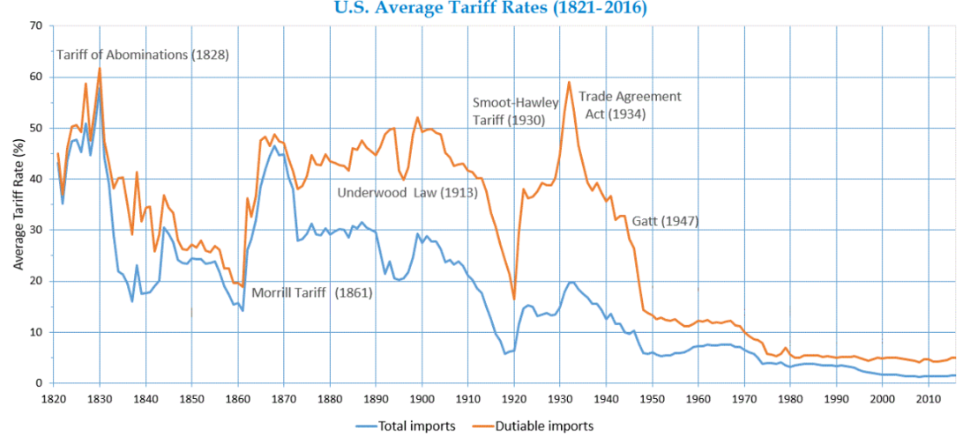

Slide 9
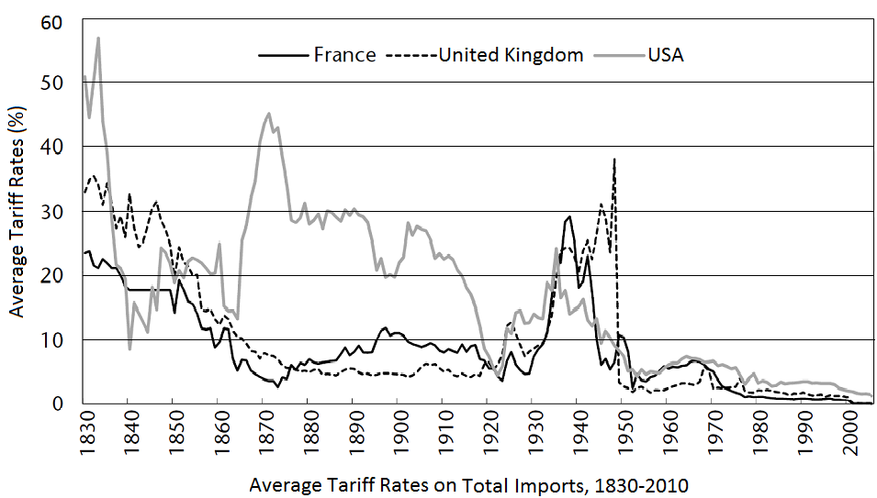

Slide 12
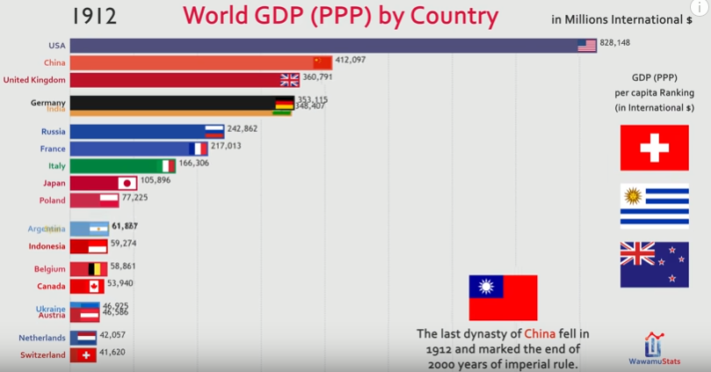

Slide 26
Wealth Data

Slide 27
Figures are per adult in USD for 2018 (median wealth in parentheses)
GDP Wealth GDP Wealth
Argentina 21,137 11,530 (3,176) Brazil 14,236 16,664 (4,263)
Australia 77,007 411,060 (191,453) Bulgaria 10,603 23,984 (11,013)
China 12,147 47,810 (16,333) Cyprus* 34,836 100,308 (10,384)
France 55,668 280,580 (106,827) Germany 57,955 214,893 (35,169)
Greece 24,524 108,127 (40,789) India 3,247 7,024 (1,289)
Ireland 104,336 232,952 (72,473) Israel 63,841 174,129 ( 54,966) Italy 41,418 217,787 (79,239 ) Japan 47,980 227,235 (103,861)
Kazakhstan 14,069 5,122 (152) Korea 38,534 171,739 (65,463)
Mexico 14,679 20,620 (5,784) Nigeria 4,488 1,572 (208)
Portugal 27,830 109,362 (31,313) Qatar 77,703 121,638 (59,978) Russia 14,500 19,997 (2,739) Spain 37,672 191,177 (87,188)
Sweden 72,188 249,765 (39,709) Switzerland 104,515 530,244 (183,339)
Turkey 16,100 18,555 (2,677) Ukraine 3,381 1,563 (40)
UK 54,621 279,048 (97,169) USA 81,425 403,974 (61,667)
World Median Wealth : 4,209

Slide 29
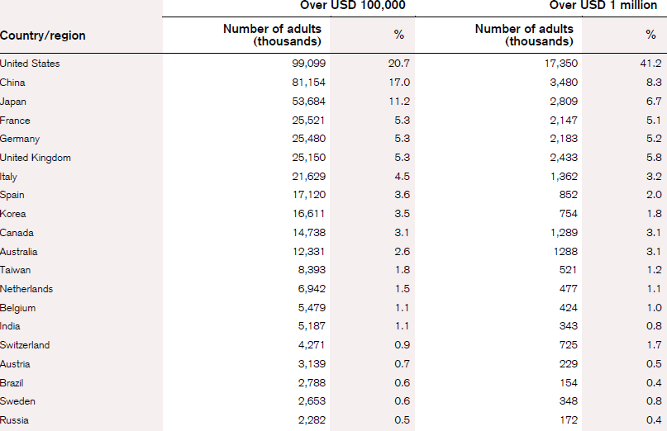
% of Global Wealth Holders

Slide 30
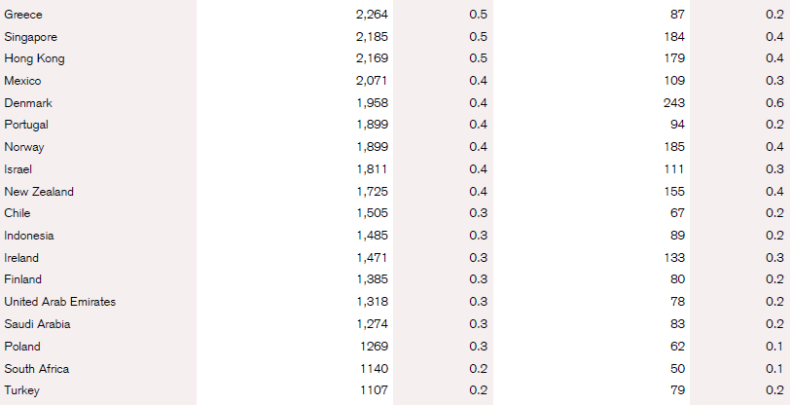

Slide 36
World Trade Data

Slide 38
Appendix Table 1: Leading exporters and importers in world merchandise trade, 2023
(Billion dollars and percentage)
Rank | Exporters | Value | Share | Annual percentage change | Rank | Importers | Value | Share | Annual percentage change
1 | China | 3380 | 14,2 | -5 | 1 | United States of America | 3173 | 13,1 | -6
2 | United States of America | 2020 | 8,5 | -2 | 2 | China | 2557 | 10,6 | -6
3 | Germany | 1688 | 7,1 | 1 | 3 | Germany | 1463 | 6,0 | -8
4 | Netherlands | 935 | 3,9 | -3 | 4 | Netherlands | 842 | 3,5 | -6
5 | Japan | 717 | 3,0 | -4 | 5 | United Kingdom | 791 | 3,3 | -4
6 | Italy | 677 | 2,8 | 3 | 6 | France | 786 | 3,2 | -5
7 | France | 648 | 2,7 | 5 | 7 | Japan | 786 | 3,2 | -12
8 | Korea, Republic of | 632 | 2,7 | -8 | 8 | India | 673 | 2,8 | -7
9 | Mexico | 593 | 2,5 | 3 | 9 | Hong Kong, China | 654 | 2,7 | -2
 |  |  |  |  |  | Retained imports ¹ | 184 | 0,8 | 12
10 | Hong Kong, China | 574 | 2,4 | -6 | 10 | Korea, Republic of | 643 | 2,7 | -12
 | Domestic exports | 21 | 0,1 | 30
 | Re-exports | 553 | 2,3 | -7
11 | Canada | 569 | 2,4 | -5 | 11 | Italy | 640 | 2,6 | -8
12 | Belgium | 562 | 2,4 | -12 | 12 | Mexico | 621 | 2,6 | -1
13 | United Kingdom | 521 | 2,2 | -2 | 13 | Canada | 570 | 2,4 | -2
14 | United Arab Emirates ¹ | 488 | 2,1 | -5 | 14 | Belgium | 547 | 2,3 | -12
15 | Singapore | 476 | 2,0 | -8 | 15 | Spain | 470 | 1,9 | -5
 | Domestic exports | 213 | 0,9 | -11
 | Re-exports | 263 | 1,1 | -5
16 | Chinese Taipei | 432 | 1,8 | -10 | 16 | United Arab Emirates ¹ | 449 | 1,9 | 7
17 | India | 432 | 1,8 | -5 | 17 | Singapore | 423 | 1,7 | -11
 |  |  |  |  |  | Retained imports ¹ | 160 | 0,7 | -20
18 | Russian Federation | 424 | 1,8 | -28 | 18 | Poland | 370 | 1,5 | -3
19 | Spain | 423 | 1,8 | 2 | 19 | Switzerland | 364 | 1,5 | 2
20 | Switzerland | 420 | 1,8 | 5 | 20 | Türkiye | 362 | 1,5 | -1

Slide 39
Appendix Table 3: Leading exporters and importers of commercial services, 2023
(Billion dollars and percentage)
Rank | Exporters | Value | Share | Annual percentage change | Rank | Importers | Value | Share | Annual percentage change
1 | United States of America | 966 | 12,3 | 7 | 1 | United States of America | 694 | 9,6 | 3
2 | United Kingdom | 581 | 7,4 | 16 | 2 | China | 549 | 7,6 | 19
3 | Germany | 435 | 5,5 | 2 | 3 | Germany | 506 | 7,0 | 9
4 | Ireland | 397 | 5,1 | 11 | 4 | United Kingdom | 389 | 5,4 | 23
5 | China | 380 | 4,8 | -10 | 5 | Ireland | 389 | 5,4 | 9
6 | France | 355 | 4,5 | 4 | 6 | France | 323 | 4,5 | 12
7 | India | 344 | 4,4 | 11 | 7 | Netherlands | 297 | 4,1 | 10
8 | Singapore | 328 | 4,2 | -3 | 8 | Singapore | 295 | 4,1 | 0
9 | Netherlands | 314 | 4,0 | 10 | 9 | India | 247 | 3,4 | 0
10 | Japan | 201 | 2,6 | 21 | 10 | Japan | 225 | 3,1 | 8
11 | Spain | 197 | 2,5 | 20 | 11 | Switzerland | 191 | 2,6 | 19
12 | Switzerland | 168 | 2,1 | 12 | 12 | Italy | 157 | 2,2 | 13
13 | United Arab Emirates ¹ | 165 | 2,1 | 8 | 13 | Belgium | 156 | 2,1 | 12
14 | Luxembourg | 148 | 1,9 | 3 | 14 | Canada | 154 | 2,1 | 7
15 | Canada | 147 | 1,9 | 12 | 15 | Korea, Republic of | 149 | 2,1 | 8
16 | Belgium | 146 | 1,9 | 8 | 16 | Luxembourg | 120 | 1,7 | 5
17 | Italy | 145 | 1,8 | 15 | 17 | Sweden | 113 | 1,6 | 8
18 | Korea, Republic of | 124 | 1,6 | -6 | 18 | United Arab Emirates ¹ | 108 | 1,5 | 13
19 | Denmark | 113 | 1,4 | -14 | 19 | Denmark | 107 | 1,5 | 7
20 | Poland | 106 | 1,4 | 12 | 20 | Spain | 97 | 1,3 | 13
21 | Sweden | 104 | 1,3 | 10 | 21 | Saudi Arabia, Kingdom of | 87 | 1,2 | 24
22 | Türkiye | 101 | 1,3 | 12 | 22 | Brazil | 81 | 1,1 | 3
23 | Hong Kong, China | 99 | 1,3 | 19 | 23 | Austria | 80 | 1,1 | 9
24 | Austria | 89 | 1,1 | 9 | 24 | Hong Kong, China | 79 | 1,1 | 25
25 | Israel | 84 | 1,1 | -3 | 25 | Russian Federation | 75 | 1,0 | 7
26 | Australia | 75 | 1,0 | 45 | 26 | Australia | 73 | 1,0 | 13
27 | Thailand | 62 | 0,8 | 62 | 27 | Mexico | 69 | 0,9 | 10
28 | Portugal | 56 | 0,7 | 20 | 28 | Poland | 65 | 0,9 | 15
29 | Chinese Taipei | 54 | 0,7 | -5 | 29 | Thailand | 65 | 0,9 | 4
30 | Greece | 53 | 0,7 | 7 | 30 | Chinese Taipei | 64 | 0,9 | 45

Slide 40
Appendix Table 5: Leading exporters of digitally delivered services, 2023
(Billion dollars and percentage)
 |  | Value |  |  |  |  | Share in world exports |  | Annual percentage change
Rank | Exporters | 2019 | 2020 | 2021 | 2022 | 2023 | 2019 | 2023 | 2021 | 2022 | 2023
1 | United States of America | 471 | 534 | 602 | 631 | 649 | 16,7 | 15,3 | 13 | 5 | 3
2 | United Kingdom | 274 | 318 | 380 | 377 | 438 | 9,7 | 10,3 | 20 | -1 | 16
3 | Ireland | 169 | 242 | 295 | 295 | 328 | 6,0 | 7,7 | 22 | 0 | 11
4 | India | 124 | 144 | 173 | 219 | 257 | 4,4 | 6,0 | 20 | 27 | 17
5 | Germany | 183 | 203 | 246 | 238 | 248 | 6,5 | 5,8 | 21 | -3 | 4
6 | China | 114 | 147 | 185 | 198 | 207 | 4,0 | 4,9 | 26 | 7 | 4
7 | Netherlands | 164 | 147 | 160 | 171 | 194 | 5,8 | 4,6 | 10 | 7 | 13
8 | Singapore | 107 | 130 | 156 | 171 | 182 | 3,8 | 4,3 | 21 | 10 | 6
9 | France | 128 | 131 | 151 | 151 | 170 | 4,6 | 4,0 | 15 | 0 | 13
10 | Luxembourg | 100 | 104 | 128 | 117 | 122 | 3,5 | 2,9 | 23 | -9 | 4
11 | Japan | 104 | 110 | 117 | 110 | 116 | 3,7 | 2,7 | 6 | -6 | 6
12 | Switzerland | 86 | 86 | 99 | 101 | 111 | 3,0 | 2,6 | 16 | 1 | 10
13 | Belgium | 63 | 73 | 84 | 82 | 89 | 2,2 | 2,1 | 14 | -2 | 9
14 | Canada | 56 | 69 | 78 | 77 | 80 | 2,0 | 1,9 | 13 | -1 | 5
15 | Sweden | 45 | 51 | 65 | 65 | 69 | 1,6 | 1,6 | 27 | 0 | 7
16 | Spain | 45 | 46 | 52 | 57 | 67 | 1,6 | 1,6 | 14 | 9 | 19
17 | Israel | 34 | 43 | 55 | 59 | 63 | 1,2 | 1,5 | 27 | 9 | 6
18 | Korea, Republic of | 36 | 42 | 54 | 55 | 62 | 1,3 | 1,5 | 28 | 2 | 13
19 | Italy | 42 | 46 | 55 | 55 | 61 | 1,5 | 1,4 | 19 | 0 | 12
20 | United Arab Emirates | 29 | 33 | 37 | 46 | 48 | 1,0 | 1,1 | 14 | 22 | 5
21 | Poland | 22 | 29 | 35 | 39 | 46 | 0,8 | 1,1 | 21 | 10 | 20
22 | Hong Kong, China | 38 | 39 | 43 | 46 | 46 | 1,4 | 1,1 | 9 | 8 | 0
23 | Austria | 25 | 29 | 33 | 34 | 36 | 0,9 | 0,8 | 16 | 1 | 6
24 | Denmark | 18 | 22 | 24 | 26 | 34 | 0,7 | 0,8 | 8 | 9 | 29
25 | Philippines | 19 | 23 | 25 | 27 | 29 | 0,7 | 0,7 | 9 | 9 | 8
26 | Chinese Taipei | 18 | 22 | 24 | 26 | 27 | 0,6 | 0,6 | 13 | 9 | 4
27 | Finland | 20 | 22 | 25 | 24 | 23 | 0,7 | 0,5 | 14 | -6 | -1
28 | Brazil | 13 | 14 | 17 | 21 | 23 | 0,5 | 0,5 | 19 | 23 | 10
29 | Romania | 11 | 13 | 16 | 18 | 20 | 0,4 | 0,5 | 19 | 13 | 14
30 | Australia | 15 | 16 | 19 | 19 | 19 | 0,5 | 0,5 | 17 | 1 | 2

Slide 41
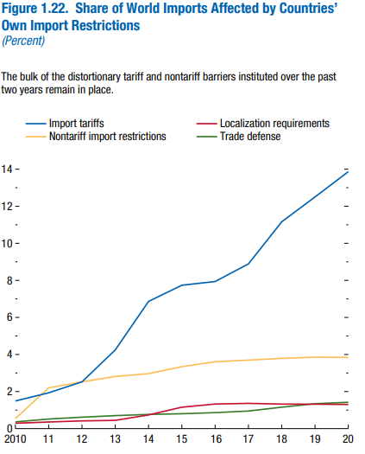

Slide 42
World FDI Inflows as % of World GDP (Globalization at Risk?)

Slide 43
2010 ( Blue: Deficit; Green: Surplus; Grey: No Data )

Slide 46
2018 ( Blue: Deficit; Green: Surplus; Grey: No Data )

Slide 48
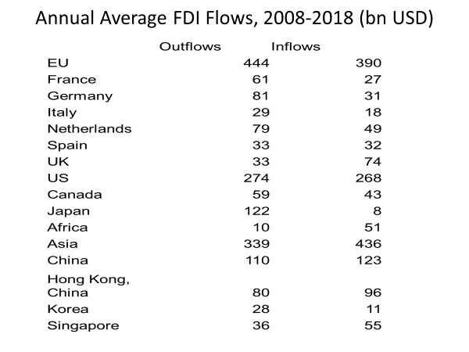

Slide 50
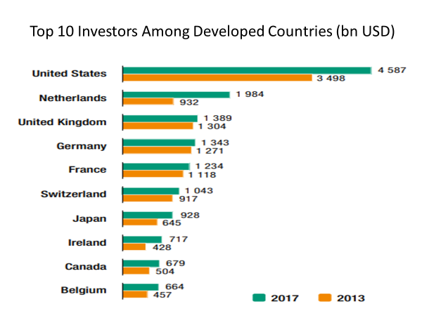

Slide 52
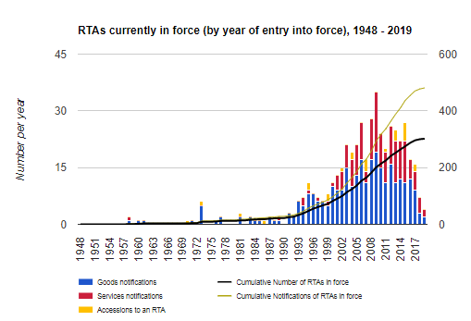
The Proliferation of Regional Trade Agreements

