Slide 1
Δίκτυα Επικοινωνιών
Ενότητα # 8: Riverbed Modeler Διδάσκων: Θεόδωρος Αποστολόπουλος
Τμήμα: Πληροφορικής

Slide 2
Δίκτυα Επικοινωνιών
Riverbed Modeler (a Discrete Event Simulation Tool)
Επιμέλεια – Παρουσίαση Άννα Κεφάλα

Slide 3
About SIMULATION

Slide 4
Simulation
Two ways to evaluate system performance
Analyze real system
Inject real input and measure results
System operates normally
Observer is an outsider
Simulate system
Inject pseudo-random input
Software simulates system behaviour
Simulation proceeds according to a set of rules
Notes:
Grammi paragogis lamptirwn
Software testing me px Microsoft bombing the server (fuzzing)
Kapoios tritos empistos giati xreiazetai allo mindset apo autou pou to eftiaxe
Modelopoiisi tou hardware kai software se kapoio perivallon gia test prin to prototyping
Pseudo giati stin pliroforiki den mporoume na exoume pragmatiki tuxaiotita
Montelopoiountai statistika ola ta components kai rules: cpus, routers, klp

Slide 5
Real life experiments…

Slide 6
Why simulation?
Real life system is
Unavailable or too complex
Cannot experiment with real system
Too costly
Too dangerous
Simulation offers
Easy modification of parameters
Constant availability
Proactive testing (test non-implemented design)
Good analysis capabilities (detailed simulation)
Notes:
Security/ safety by design
Oso pio realistiki I parametropoiisi tis prosomoiwsis, toso pio konta se pragmatiko peirama

Slide 7
Why to avoid simulation?
Modelled system may not reflect reality
System may be too complex to simulate
Detailed simulation may be resource exhausting and time consuming
Results could turn out to be misleading

Slide 8
Real life engine testing

Slide 9
Systems
Static: static behavior during time
Predictable behavior
Study with analytic methods
Bridge oscillation (mathematical formulas)
Dynamic: variable behavior during time
Unpredictable behavior
Stude with experimental methods → simulation
Network simulations (non mathematical)

Slide 10
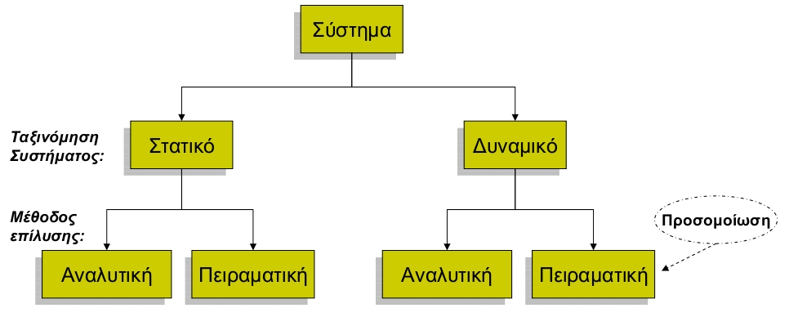
Systems (2)
Simulation: imitation of the operation of a real-world process or system over time
Notes:
(algorithmoi pliroforikis)
Analystiki = formal analysis gia kathe pithani timi eisodou
Peiramatiki=fuzzing
(Networks)
Den boithane oi pithanotites na apotupwsoun tinpragmatikotita
Opote pas se peiramatiki → simoulation

Slide 11
Traffic Simulation

Slide 12
Network Simulation
What is a network simulator?
Virtual Network Environment
Models behaviour of entire network utilizing complex statistical models
Routers, switches, protocols, servers, applications
Customizable by users
Supports most popular protocols (UDP, TCP, WLAN, etc.)
Examples: NS-2, NS-3, OmNET++, Riverbed Modeler
Notes:
Router sto spiti:
Skype, youtube, browse, torrent apo tous enoikous
Skype thelei ligo bandwidth alla amesis antapokrisis
Torrent anapodo
Me simulation vrika kai ftiaxame routers mporoun na ta xirizontai kai ta duo

Slide 13
Simulation workflow
Topology definition (nodes and links)
Protocol configuration (UDP, IPv4)
Node and link configuration (link speed)
Execution: generation of events
Analysis: time stamped trace of events
Repetition with many different seeds
Statistical analysis of different experiments

Slide 14
Discrete-event simulation (DES)
System represented as sequence of events
Event:
Occurs at an instant in time
Primary (certain time) or Conditional (triggered)
Marks a change of state in the system
In a queue sorted by time (at t event e will occur)
Time evolves based on the next event
No relation between simulation time and real time
Simulator processes event queue

Slide 15
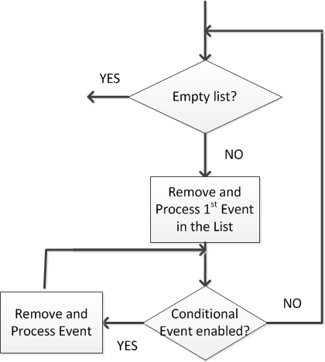
Simulation algorithm of DES
Remove and process 1st primary event*:
Remove 1st primary event from event list
Advance simulation time
Update state variable
Enter new future events into event list
Compute statistics
*Source: Graham Horton

Slide 16
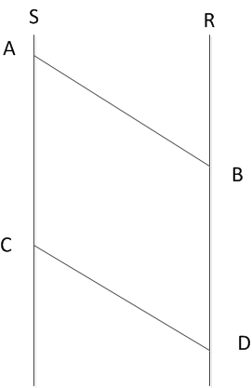
DES Example
 | Time | Event
A | 1.000 | S starts sending pkt to R
B | 1.002 | R starts receiving pkt from S
C | 1.010 | S finishes sending pkt to R
D | 1.012 | R finishes receiving pkt from S
Propagation time | Transmission Time
0.002 | 0.01

Slide 17
RIVERBED MODELER

Slide 18
Riverbed Modeler academic
Modeling, scalable simulation and detailed analysis environment of wired and wireless networks.
Better understanding of design trade-offs (accelerates time-to-market)
Improve product performance and quality
Helps hardware prototyping (less time-intensive, expensive)
Develop proprietary protocols and technologies

Slide 19
Riverbed Modeler academic (2)
Evaluate enhancements to standards-based protocols
Test and demonstrate technology designs in realistic scenarios

Slide 20
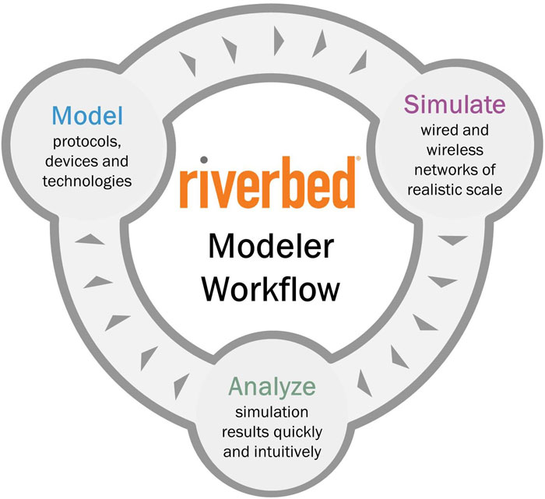
Riverbed Modeler academic (3)
more than 400 out-of-the-box protocol and vendor device models from Modeler’s library
correlate graphical results with network behavior by replaying simulations
Interpret simulation results using intuitive charts, tables, graphs

Slide 21
Information
Project site: http://www.opnet.com/university_program/itguru_academic_edition/
Documentation & Examples, Help:
https://splash.riverbed.com/community/product-lines/steelcentral/university-support-center/
https://splash.riverbed.com/community/product-lines/steelcentral/university-support-center/academic-edition-tutorials
Need to sign up (for free)

Slide 22
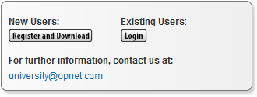
Installation
Sign up
Fill in the form with valid email and mentioning University, lesson and Professor
An email will be sent to you with the link to download the software (https://enterprise37.opnet.com/4dcgi/DOWNLOAD_HOME)
Simple installation
Double confirmation of the license once you open the tool
Regional settings!!! (Force POSIX Locale: false)

Slide 23
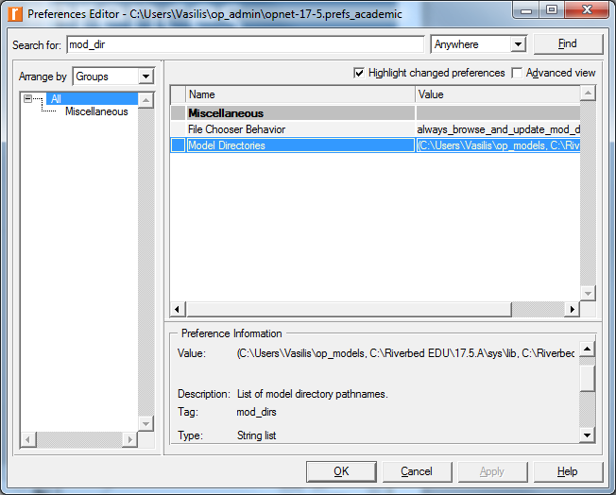
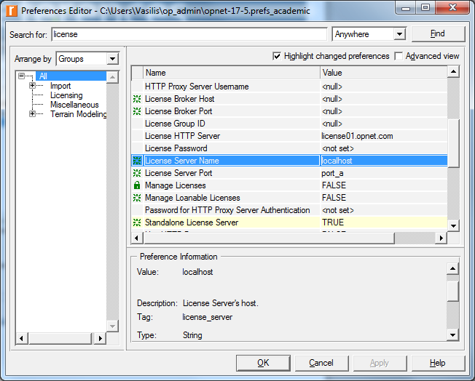
Check Preferences
Edit-> Preferences
License server name -> localhost
License_server_standalone-> TRUE
Model Directories-> (where to put OPNET model files)

Slide 24
Creation of New Project
Depends on the magnitude of the scenario
File ⇒ New ⇒ Project ⇒ Ok
Name the project and the scenario
A project may contain multiple scenarios
Run them all & compare results
Create empty scenario ⇒ Next ⇒ office ⇒Next ⇒ 200 to X Span and 100 Y Span ⇒ Next twice ⇒ OK
Step 3 changes depending on what we need
The size of our canvas to be created

Slide 25
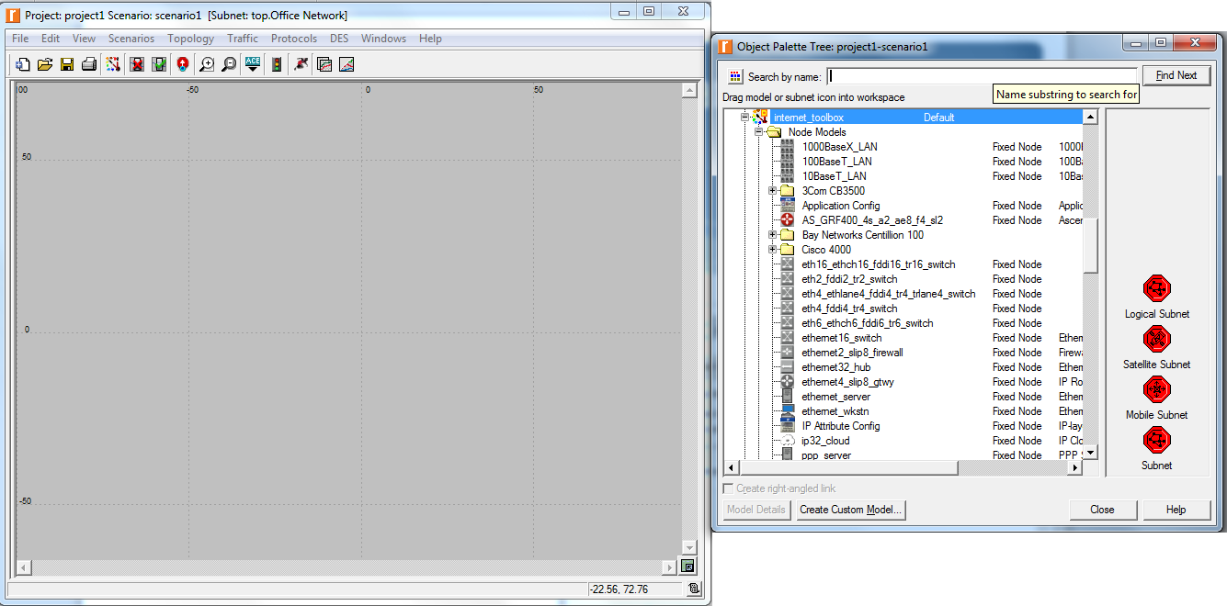
Introduction to the workspace (1/4)
Canvas
All available nodes to add in our network

Slide 26
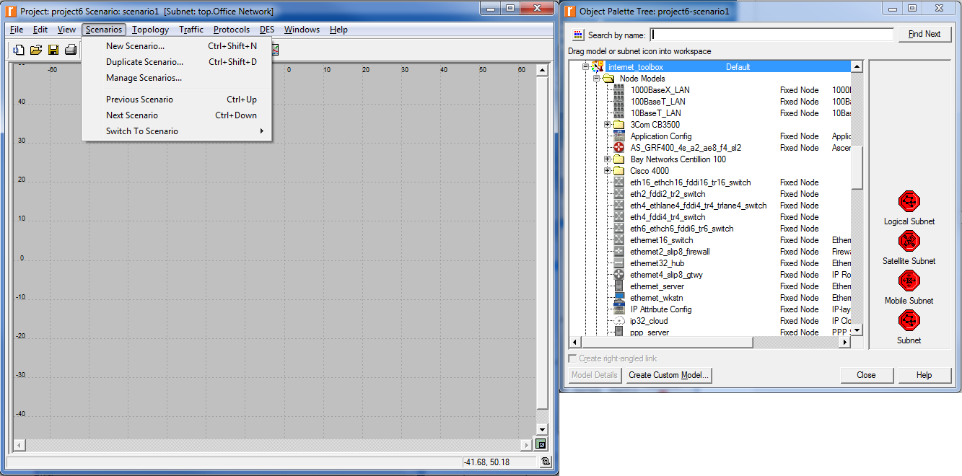
Introduction to the workspace (2/4)
Options for project scenarios

Slide 27
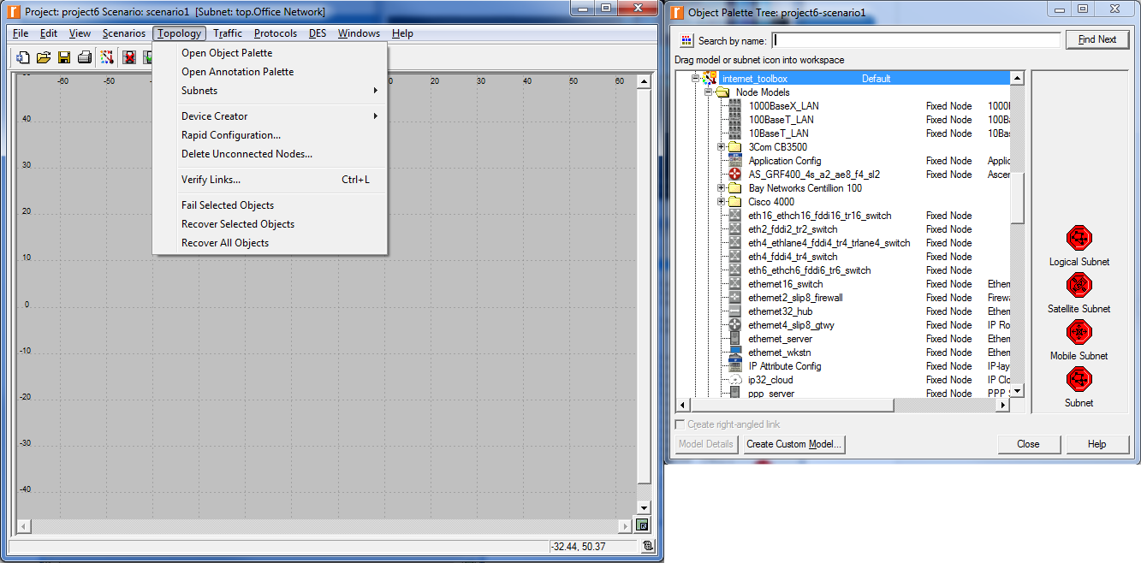
Introduction to the workspace (3/4)
Options for our network topology (helpful for quick configuration)

Slide 28
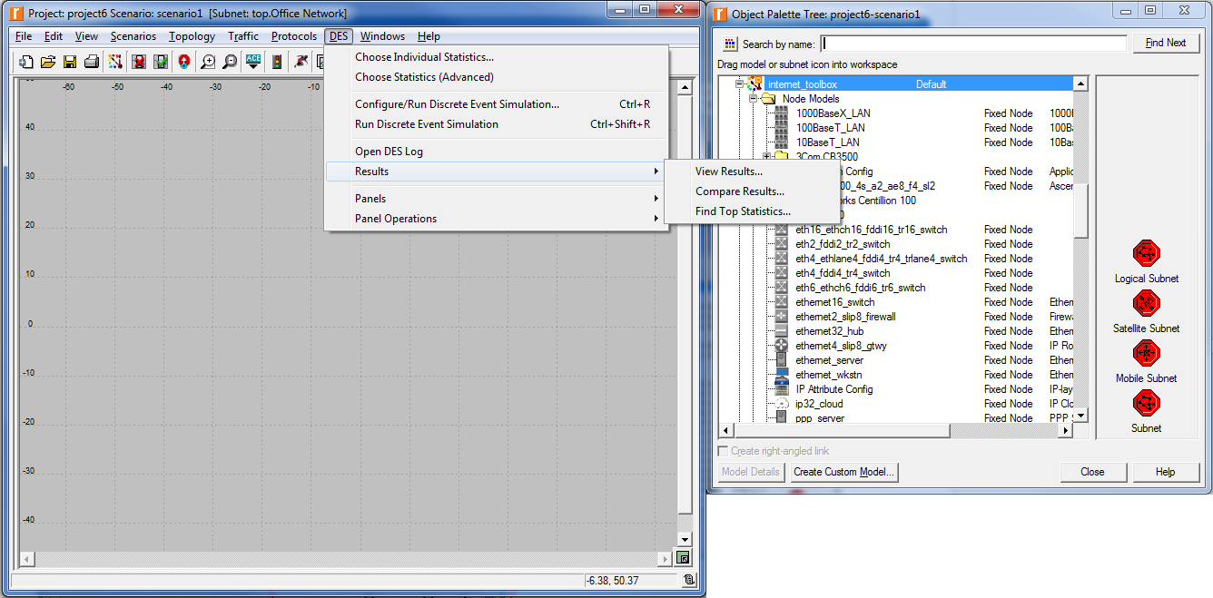
Introduction to the workspace (4/4)
Options for our network simulation, including run

Slide 29
Statistics
Select Statistics to collect during simulation run (→DES/Choose Individual Statistics)
Global Statistics (for all network nodes)
Node Statistics (per node)
Link Statistics (per link)

Slide 30
Troubleshooting Tips
Numerous configuration options → peculiar results
Simulations results. eg. Looking at TCP retransmissions: Incorrect bandwidth link, results in high response time
DES log: warnings, errors (DES/Open DES log)
Error log: warnings and errors from the kernel/operation system (Help/Error log/Open)

Slide 31
A direct link network with media access control demo

Slide 32
0. Problem Statement
Ethernet: multiple access network
CSMA/CD: nodes can distinguish between an idle and a busy link
Collision Detection: node listens as it transmits and can detect when a frame has collided with a frame transmitted by other node
Ethernet with 15 nodes connected via coaxial link in a bus topology
Coaxial link at 10Mbps
How network throughput is affected by network load

Slide 33
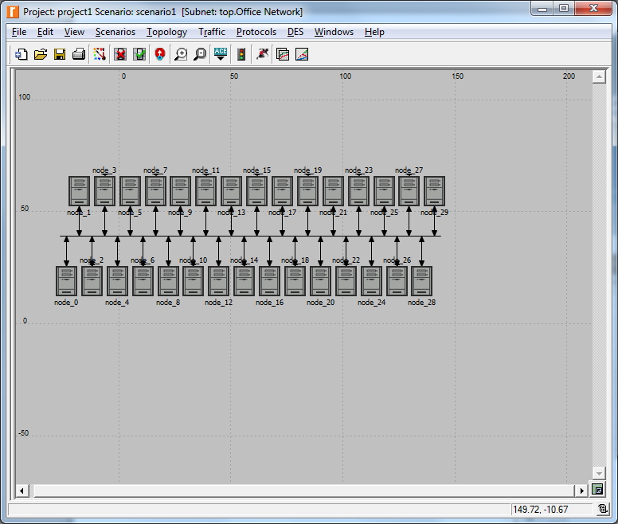
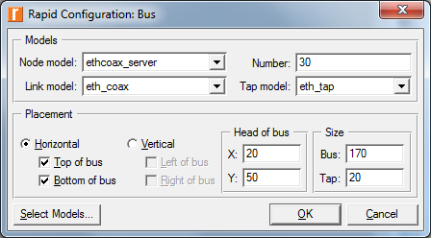
1. Create the network topology
Topology → Rapid Configuration → Bus → Next
Select Models → ethcoax → OK
Node model, link model, tap model (nodes, link and connector)

Slide 34
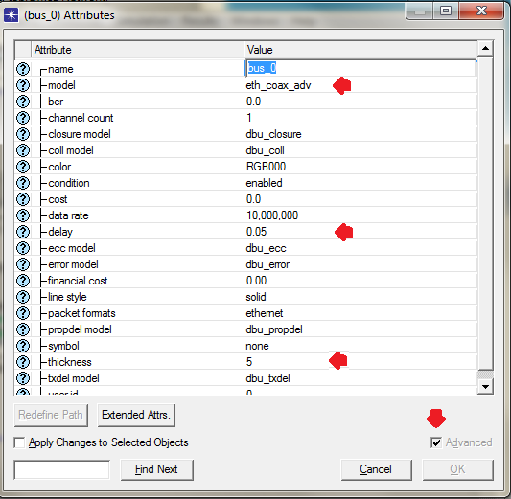
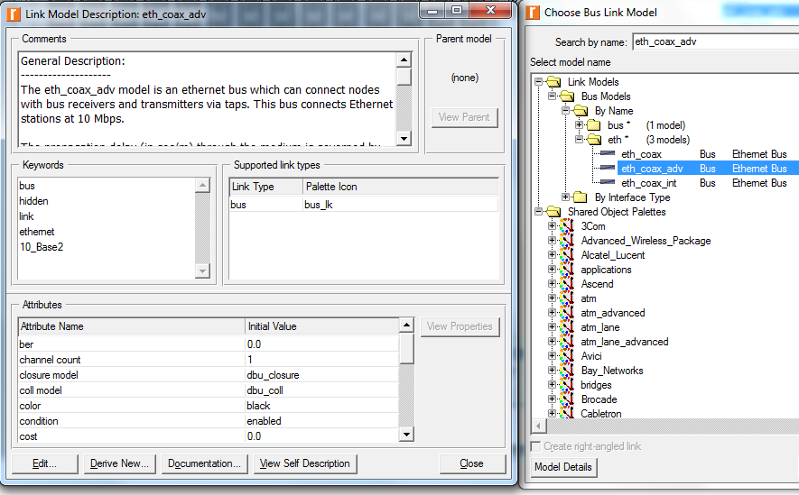
2. Configure the link
Select bus from canvas → Right click on the bus → Attributes
Higher delay generates higher traffic
Thickness specifies the thickness of the line used to “draw” the bus link

Slide 35
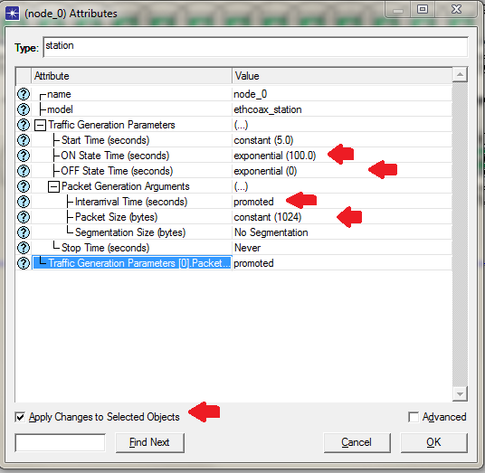
3. Configure the nodes
Right click on any of 14 nodes→ select similar nodes
Right click on any of 14 nodes→ edit attributes
Apply changes to selected objects
Traffic generation parameters:ON State time: exponential(100) and OFF State time: constant(0)
Packet generation arguments: Packet size: constant(1024), Right-click on InterarrivalTime and choose PromoteAttribute to Higher lever

Slide 36
Comments
Distribution: for generating random outcomes
ON State Time: application generates traffic when ON, stops sending traffic when OFF. It alternates between ON and OFF state.
Interarrival Time: time between successive packet generations in the ON state.
Promoted: assign multiple values to attribute and hence test the network performance under different circumstances

Slide 37
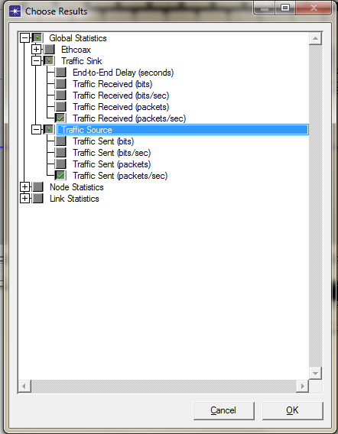
4. Choose Individual Statistics
DES → Choose Individual Statistics→ Global Statistics
Traffic Sink→ Traffic Received (packets/sec)
Traffic Source→ Traffic Sent(packets/sec)

Slide 38
Comments
Traffic received: amount of traffic received by all sinks across all nodes in the network. A sink is where packet terminates, on termination, any associated statistics are updated
Traffic sent: amount of traffic sent by traffic sources (in this case, all packet generating nodes of the scenario, i.e. all ethernet workstation nodes)

Slide 39
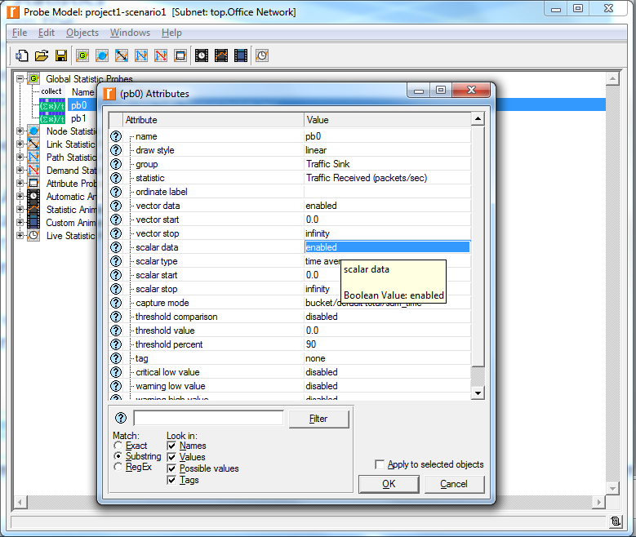
5. Choose Statistics (advanced)
We now need to configure the statistics that will be captured!
Traffic Sent and Traffic Received probes should appear under Global Stat Probes
Right-click on Traffic Received → Edit attributes. Set scalar data: enabled, Set scalar type attribute: time average
Repeat for Traffic Sent

Slide 40
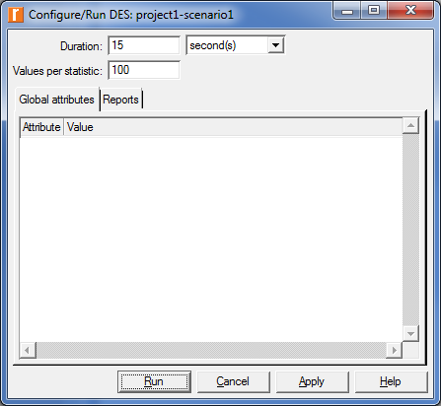
6. Run the simulation
Run the simulation multiple times under different circumstances (i.e. load)
Click on Configure/Run Simulation
Common → 15 sec Duration

Slide 41
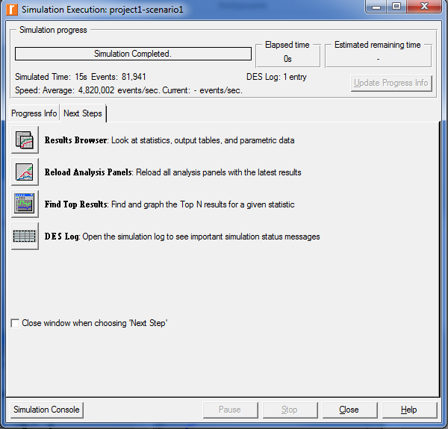
7. View the results
DES → Results → View results
(it pops up when simulation ends)

Slide 42
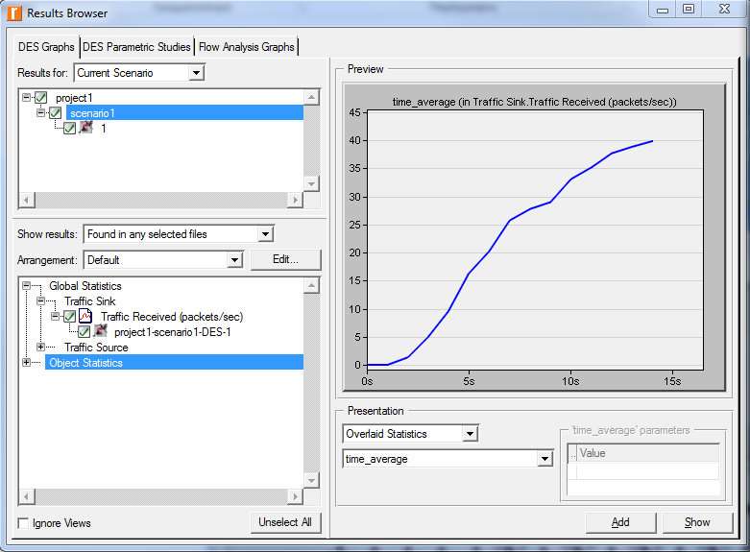
7. View the results (2)
DES Graph tab
Select scenario
Expand Global Stats, check Traffic Sink
Select time_average (Presentation)

Slide 43
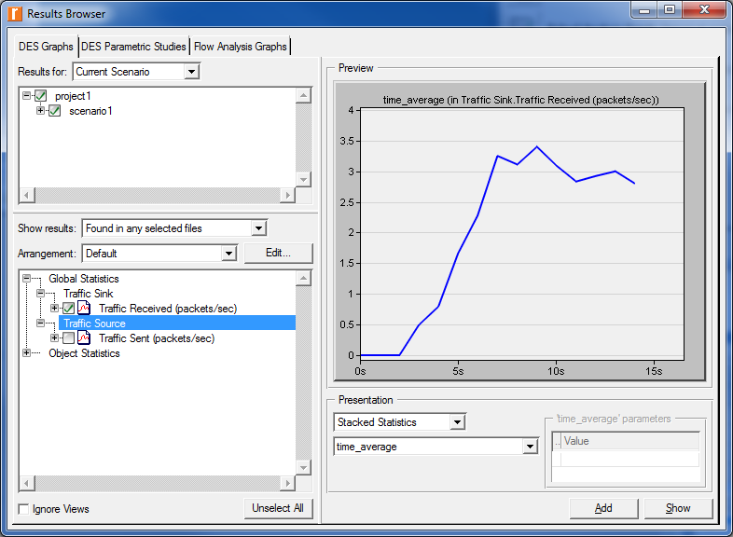
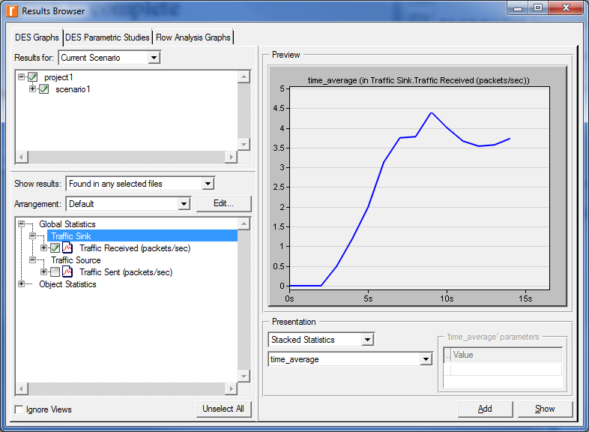
Comments
If we run multiple times the scenario with various load (packet size, interval, etc.)
Different results, calibrate our network performance

Slide 44
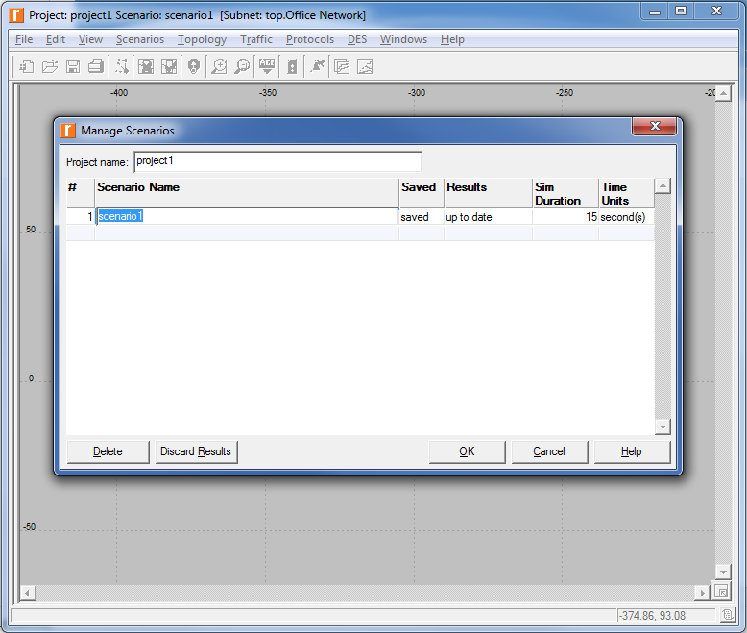
Hint
In order to run simulation again, discard previous results, to analyse fresh data!
Manage scenarios → Select scenario → Discard Results

Slide 45
Switched lans demo

Slide 46
0. Problem Statement
Switching device
Enables communication between hosts
Takes packets that arrive on an input and forwards (or switches) them to the right output
Uses queues, or buffers, if more packets arrive to a port, discards packets if it runs out of buffer space
Hub forwards packet that arrives on any of its inputs to all outputs
Switch forwards incoming packets to one or more outputs depending on packet destination(s)
How throughput and packet collision in a switched network are affected by the configuration of the network and the types of switching devices that are used?

Slide 47
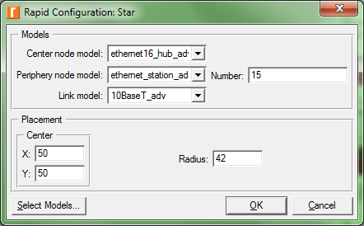
1. Create the network topology
Topology -> Rapid Configuration…
Choose “Star” then next
Click Select Models… button. From the Model List drop down menu choose ethernet_adv and click OK
Center Node Model = ethernet16_hub_adv
Periphery Node Model = ethernet_station_adv
Link Model = 10BaseT
Number = 15
X = 50, Y = 50
Radius = 42
The 10BaseT_adv link represents an Ethernet connection operating at 10Mbps

Slide 48
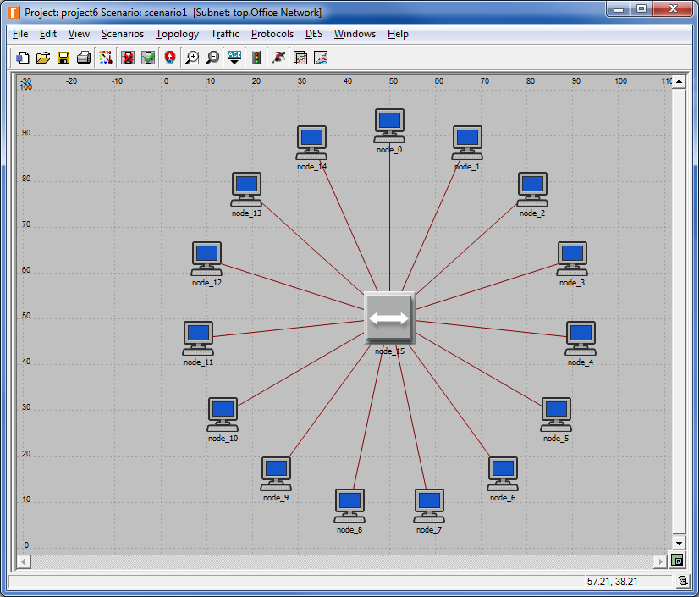
2. Configure the nodes
Right-click on node_15, which is the hub -> Edit Attributes and change the name attribute to “Hub1” and click OK

Slide 49
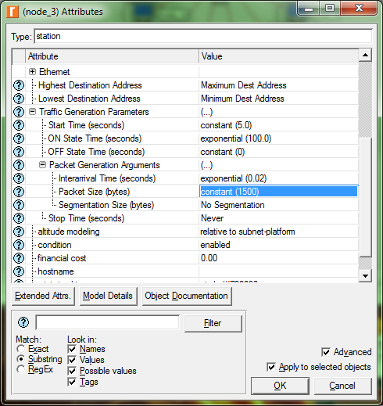
2. Configure the workstations
Right click on any of the 15 stations-> Select Similar Nodes.
Right click on any of the 15 stations -> Edit Attributes
Expand the Traffic Generation Parameters and Packet Generation Arguments
ON State Time: (exponential) 100
OFF State Time: (constant) 0.0
Interarrival Time (seconds): (exponential) 0.02
Packet Size (bytes): (constant) 1500

Slide 50
Comments
Start time: when packets start appearing
The application generates traffic when ON, and stops sending traffic when OFF
The ON and OFF states alternate
Interarrival time: time between successive packets in the ON state
Packet size (bytes): size of generated packets
Time distribution with parameters for each
Constant (fixed), exponential, etc.

Slide 51
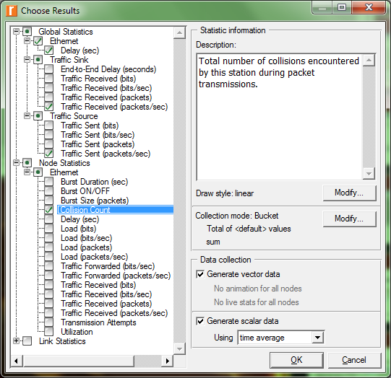
3. Choose Individual Statistics
Right click the workspace (canvas) -> Choose DES Individual Statistics
Global Statistics->Ethernet->Delay (sec)
Global Statistics->Traffic Sink->Traffic Received (packets/sec)
Global Statistics->Traffic Source->Traffic Sent (packets/sec)
Node Statistics->Ethernet->Collision Count
OK
Collision Count: total number of collisions encountered by the hub (or hubs) during packet transmissions within the scenario. Collisions occur when Ethernet resolves simultaneous attempts to access the shared channel. On a busy Ethernet with fast machines you can expect to see many

Slide 52
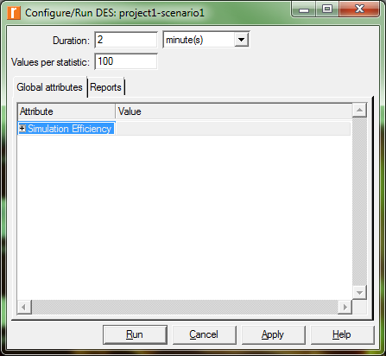
4. Configure the simulation
DES->Configure/Run Discrete Event Simulation
Set the duration to be 2.0 minutes ⇒OK
Click Apply

Slide 53
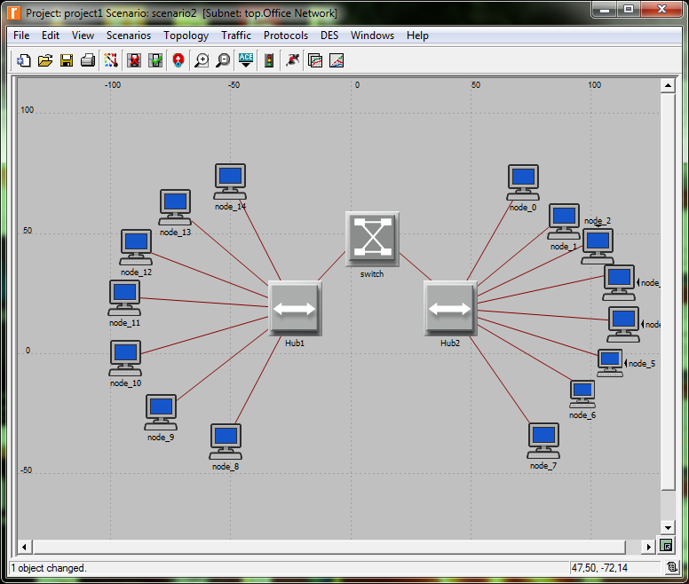
5. Duplicate the scenario (I)
We need to create another network that utilizes a switch and see how this will affect the performance of the network
Scenarios ⇒ Duplicate Scenario ⇒ name ⇒ OK
Object Palette ⇒ place a hub and a switch in the new scenario

Slide 54
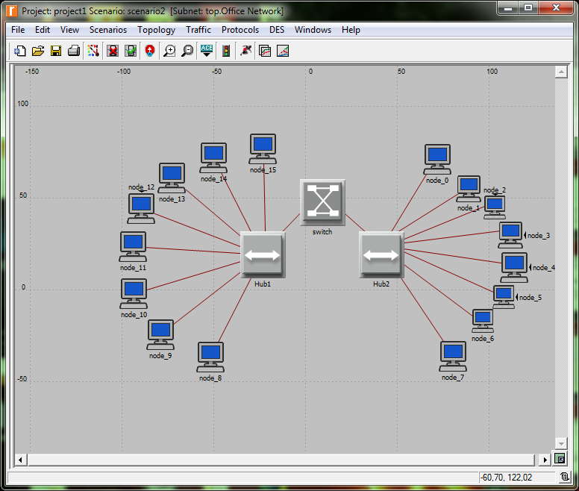
5. Duplicate the scenario (II)
Choose ethernet16_hub_adv from palette and add
Right click to stop adding
Rename to Hub2
Choose ethernet16_switch_adv from palette and add
Right click to stop adding
Rename to Switch

Slide 55
5. Duplicate the scenario (III)
Delete half of the node links
Choose 10BaseT from palette
Link nodes to second hub
Link both hubs to switch
Click Topology
Select Verify links
Shows dangling links!

Slide 56
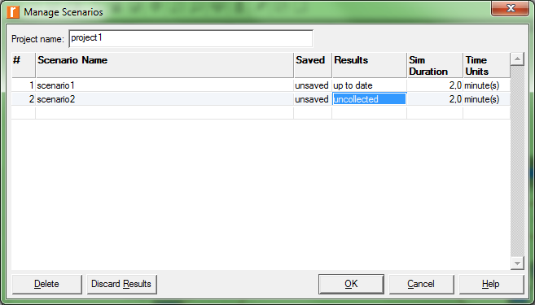
6. Run the simulation
Scenarios ⇒ Manage Scenarios
Be sure to have the second scenario selected
DES -> Run Discrete Event Simulation

Slide 57
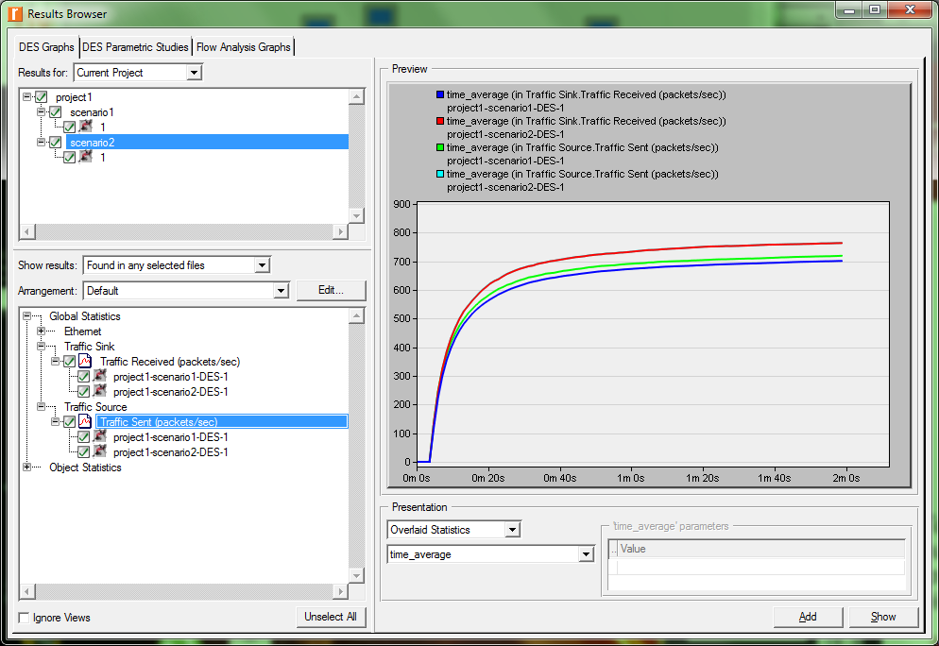
7. View the results (I)
DES ⇒ Results ⇒ Compare Results
As Is ⇒ time_average
Select the Traffic Sink / Source (packets/sec) statistic
The traffic in both scenarios is almost identical on average in the preview panel.
(To display the results as a graph you must click the Show button at the bottom right of the Compare Results window)

Slide 58
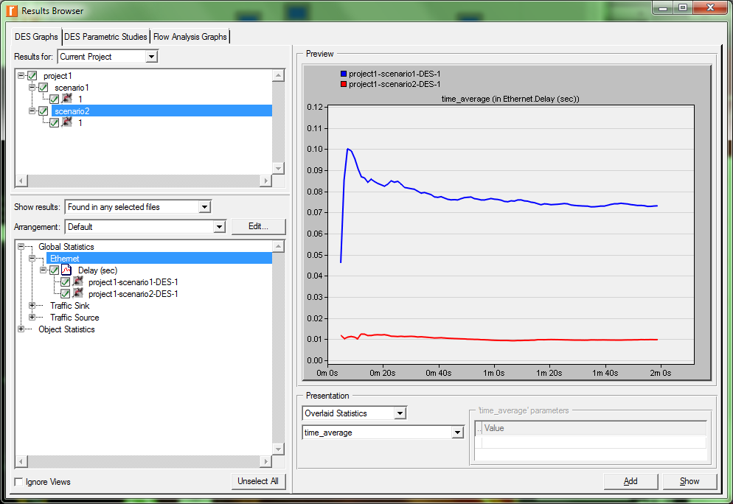
7. View the results (II)
Deselect all
Ethernet ⇒ Delay (both scenarios)
As Is ⇒ time_average
Why?

Slide 59
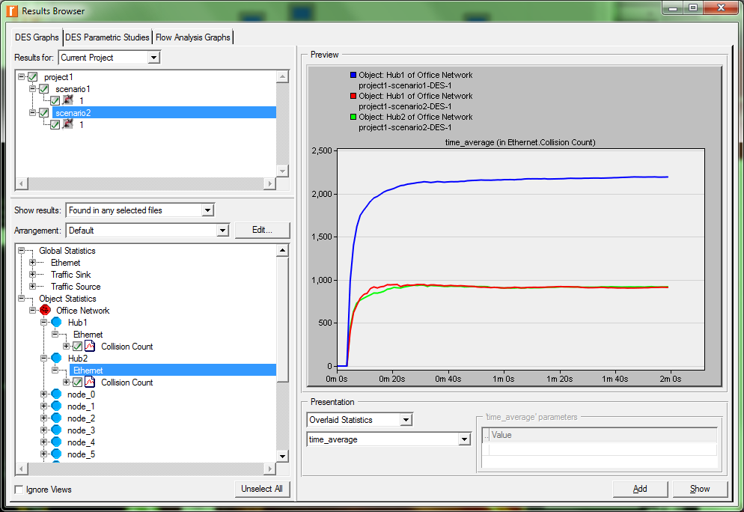
7. View the results (III)
Deselect all
Object Statistics ⇒ Office Network ⇒ Hub 1, Hub2 ⇒ Ethernet ⇒ Collision Count
As Is ⇒ time_average
Why?

Slide 60
Questions?

Slide 61
Τέλος Ενότητας # 8
Μάθημα: Δίκτυα Επικοινωνιών
Ενότητα # 8: Riverbed Modeler
Διδάσκων: Θεόδωρος Αποστολόπουλος
Τμήμα: Πληροφορικής

