Slide 1
Ασύρματες και Κινητές Επικοινωνίες
Ενότητα # 13: Mobility Support in Information Centric Networking (ICN)
Διδάσκων: Βασίλειος Σύρης
Τμήμα: Πληροφορικής

Slide 2
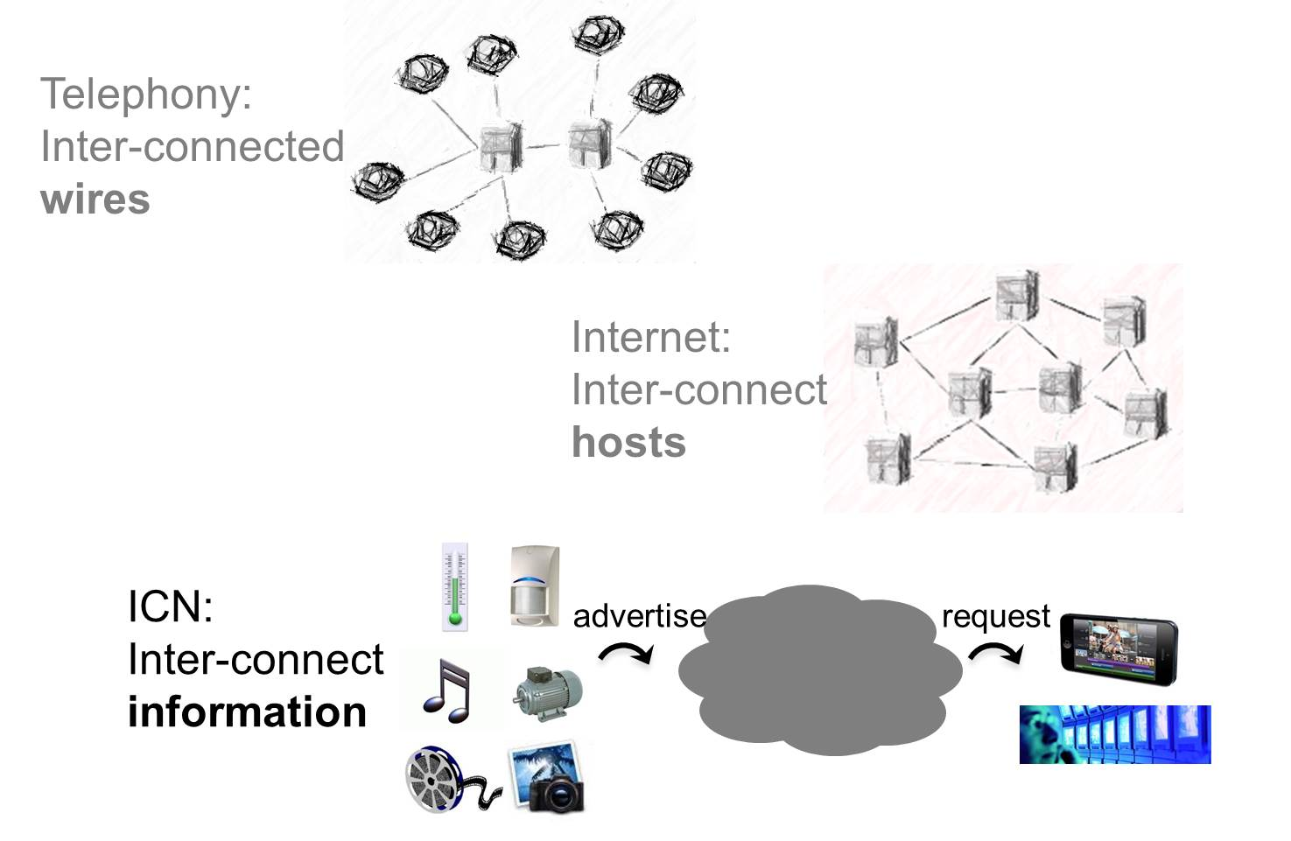
Three network generations

Slide 3
Problems with Current Internet
End-to-end semantics is not the prevailing usage paradigm
Information-centricity: focus on information itself not where it resides
Overlay content delivery structures (CDNs, P2P): ignore network topology and requester/data location
Firewalls, NATs, proxy servers
ISPs: costly (Deep Packet Inspection-DPI) to find type of information
Mobility support not seamless
IP addresses used both as host and location identifiers

Slide 4
Problems with Current Internet (cont.)
Security and trust
Sender controlled transport facilitates DoS attacks
Focus on communication security, but information security can be more important
Run-time tussles between various players
Imbalance of power – functions not separated when they should be (e.g. well-known port numbers and applications)
Ossification of architecture with point solutions/patches
Congestion control
End-to-end semantics not appropriate when links have different and variable network conditions
flash crowds

Slide 5
Principles of Information-Centric Networking (ICN)
Naming of content rather than hosts/interfaces
Departs from host-to-host communication model
Content independent of devices that store it
Names are location independent
Receivers (subscribers) request content
Receiver control
Sources (publishers) advertise content
Need to match requests to advertised content
Receivers and senders
do not have to be aware of each other, and
are decoupled in time

Slide 6
Basic Functions of ICN
Different degree of coupling between resolution & data transfer
Resolution Network
Data Transfer = Routing + Forwarding
Forwarding Node
Receiver
Source
Name resolution: Match requests to content advertisements
Routing (topology formation): Determine path from source (publisher) to receiver (subscriber)
Forwarding: Transfer content from source to receiver

Slide 7
… but isn’t previous picture an IP network ?
ICN principles make the difference:
Naming of content rather than hosts/interfaces
DNS: location-dependent names
IP: location-dependent addresses used as both host & location identifiers
Receivers (subscribers) request content
IP: sender has all power
Sources (publishers) advertise content and network matches requests to content advertisements
IP: user needs to know or find out where to get content
Receivers & senders don’t have to be aware of each other
IP: both sides of a connection know other side’s location-dependent address

Slide 8
Key Advantages & Features of ICN
Receiver mobility support
In-network caching
Content-aware traffic management
Hop-by-hop transport & congestion control
One-to-many/any and many/any-to-one communication modes
ICN architecture proposals differ in degree of coupling between
name resolution & data transfer
data routing & forwarding

Slide 9
Name Resolution and Data Transfer
Resolution Network
Data Transfer = Routing + Forwarding
Forwarding Node
Receiver
Source
Different degree of coupling between resolution & data transfer
Decoupled: different nodes perform resolution & data transfer (similar to DNS)
Coupled: nodes perform resolution and data transfer

Slide 10
Decoupled Resolution & Data Transfer
Examples: PSIRP/PURSUIT, NetInf/SAIL
Resolution Network
Information request
name
Forwarding Node
data
Receiver
Data Transfer
Source or Cache
Resolution function matches requests to sources or caches (in-network caches)
Data path independent of request (control) path

Slide 11
Coupled Resolution & Data Transfer
Examples: CCN/NDN, DONA, COMET, Convergence
Information Request
name
Forwarding Node
Receiver
data
Data Transfer
Source or Cache
Nodes route information requests to source or cache (in-network caching)
Data path inverse of request (control) path

Slide 12
Tradeoffs from different coupling of Name Resolution & Data Transfer
Coupled
Data path reverse of request (control) path
In-network caching simpler through local mechanisms for routing requests
Decoupled
Support for advanced policies (e.g. QoS, interconnection agreements)
Implemented by one function without affecting the other
Exploitation of different paths for control & data (e.g. low-delay path for control and high bandwidth path for data)
Separation of functions addresses tussles & allows competition
More choices for supporting source mobility

Slide 13
Receiver mobility
Source
Receiver mobility supported by design:
Receiver-driven content request model
No end-to-end session establishment such as TCP
Individual chunks/packets are named hence can be requested individually
Information Request
Receiver
old location
Receiver
new location

Slide 14
Receiver mobility and caching
Source
In-network caching can assist receiver mobility
Caches along path followed by request can provide data
Possible with naming of content chunks/packets
Further optimization: use caches proactively
Data Transfer
Receiver
old location
Receiver
new location

Slide 15
Receiver mobility & proactive caching
Source
Transfer content requests to one-hop neighbors
Prefetch content at neighbors when mobile disconnects
Wasted resources if we prefetch content to all neighbors
Select subset of neighbors based on transition probability ⇒ Selective Neighbor Caching (SNC)
Receiver

Slide 16
Receiver mobility & proactive caching
Source
Transfer content requests to one-hop neighbors
Prefetch content at neighbors when mobile disconnects
Wasted resources if we prefetch content to all neighbors
Select subset of neighbors based on transition probability ⇒ Selective Neighbor Caching (SNC)
Receiver
Higher prob to move to green PoA than to red

Slide 17
Source mobility
Not as straightforward as receiver mobility
Receiver-driven (pull) model helps receiver mobility
Requests need to be “matched” to sources
Requests contain location-independent names
Two problems need to be addressed
Find source’s new location: to forward content requests
Achieve session continuity: reduce or avoid service disruption and data loss/delay

Slide 18
Source mobility approaches
Routing-based approach
Routing tables updated when source moves
Only solution if no location-dependent addresses
Indirection approach
Agents at home and visited network
Need location-dependent addresses
Resolution approach
Requires separate resolution function

Slide 19
Source mobility: routing-based
Source
old location
Source
new location
Requests forwarded using routing tables
Routing tables populated based on content advertisements
Source mobility would trigger new content advertisements. Issues:
Convergence time
Routing table scalability
Smaller problem in case of micro-mobility
Optimization: Proactive content advertisements
How data is forwarded from source to receiver depends on specific architecture
n1
n1
n1
Receiver

Slide 20
Source mobility: indirection approach
Source
old location
Source
new location
Home agent forwards requests to new source location
Requires location-dependent identifiers
Similarities with Mobile IP
Agents in visited network can help transparency
Automatically add location prefixes
Disadvantages:
Communication goes through home agent
n1
n1
Home
agent
PoA
n1
Receiver

Slide 21
Source mobility: indirection approach
Source
old location
Source
new location
Home agent forwards requests to new source location
Requires location-dependent identifiers
Similarities with Mobile IP
Agents in visited network can help transparency
Automatically add location prefixes
Disadvantages:
Communication goes through home agent
n1
n1
PoA/n1
Home
agent
PoA
n1
Receiver

Slide 22
Source mobility: resolution approach
Source
old location
Source
new location
Resolution function already exists when resolution and data transfer decoupled
Resolution table updated with current location ⇒ need location-dependent ids
Separation of identity-locator not new: Host Identity Protocol (HIP), Identifier-Locator Network Protocol (ILNP)
n1
n1
PoA
Resolution function
Receiver

Slide 23
Source mobility: resolution approach (2)
Source
old location
Source
new location
Resolution function can be provided by
Independent resolution network
Home agent
Issue: Resolution overhead, only for first communication
How data is forwarded from source to receiver depends on specific architecture
n1
n1
PoA
Resolution function
Receiver

Slide 24
Source mobility: resolution approach based on home agent
Source
old location
Source
new location
Home agent: binding between name and location
Location id: PoA prefix+name
Updated when source moves
Request for content n1 routed to home agent
Home agent responds with PoA/n1
Receiver requests PoA/n1
PoA
Home
agent
Receiver

Slide 25
Source mobility: resolution approach based on home agent
Source
old location
Source
new location
Home agent: binding between name and location
Location id: PoA prefix+name
Updated when source moves
Request for content n1 routed to home agent
Home agent responds with PoA/n1
Receiver requests PoA/n1
PoA
Home
agent
n1
Receiver

Slide 26
Source mobility: resolution approach based on home agent
Source
old location
Source
new location
Home agent: binding between name and location
Location id: PoA prefix+name
Updated when source moves
Request for content n1 routed to home agent
Home agent responds with PoA/n1
Receiver requests PoA/n1
PoA
Home
agent
PoA/n1
n1
Receiver

Slide 27
Source mobility: resolution approach based on home agent
Source
old location
Source
new location
Home agent: binding between name and location
Location id: PoA prefix+name
Updated when source moves
Request for content n1 routed to home agent
Home agent responds with PoA/n1
Receiver requests PoA/n1
PoA
Home
agent
PoA/n1
Receiver

Slide 28
Source mobility: session continuity
Mechanisms at mobile nodes help
Moving node informs other side that it will move and possibly where it will move
Home/visited agents can help achieve transparency
Automatically add PoA prefix
No changes to mobile nodes

Slide 29
Conclusions
Receiver mobility supported by design in ICN
Optimizations are possible by exploiting caches
Source mobility is more difficult in ICN
With location-independent names only routing-based approach is possible
Convergence time and routing table scalability issues
Location-dependent identifiers necessary to support efficient source mobility in the general case
Both location-independent names and location-dependent addresses have a role in future networks
Flexible/dynamic mapping and usage of names and addresses to find & transfer information is key

Slide 30
Τέλος Ενότητας # 13
Μάθημα: Ασύρματες και Κινητές Επικοινωνίες
Ενότητα # 14: Mobility Support in Information Centric Networking (ICN)
Διδάσκων: Βασίλειος Σύρης
Τμήμα: Πληροφορικής

