Slide 1
Ασύρματα Δίκτυα και Κινητές Επικοινωνίες
Ενότητα # 8: Σύστημα 2.5 Γενιάς GPRS
Διδάσκων: Βασίλειος Σύρης
Τμήμα: Πληροφορικής

Slide 2
GPRS (General Packet Radio Service)
The major GSM Phase 2+ enhancement and an important step to 3G
considered 2.5G
Aims at providing data services to mobile users with high bandwidth efficiency and “always on” connectivity
Address shortcomings of GSM
Low data rates (up to 9.6 kbps)
Long connection setup
Expensive
Circuit-switched

Slide 3
GPRS features
Data rates up to 172 kbps
Fast call setup times
“Always on” connectivity
Integrates IP infrastructure into the GSM network
Uses packet-switched mechanisms
more efficient for bursty traffic
allow volume-based charging

Slide 4
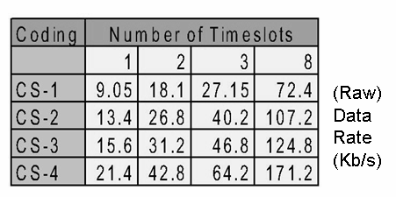
Channel coding & transmission rate
Coding used in every digital communication system to
increase channel capacity
protect against errors
GPRS uses 4 different coding schemes, depending on channel conditions
Up to 8 slots can be
combined
physical layer

Slide 5
QoS
GPRS Release 99 specified 4 traffic classes

Slide 6
High-level view

Slide 7
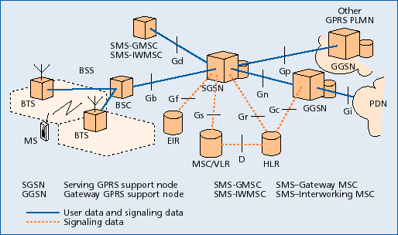
GPRS architecture
2 new nodes .
Serving GPRS Support Node (SGSN)
Gateway GPRS Support Node (GGSN)

Slide 8
Serving GPRS Support Node (SGSN)
Serving GPRS Support Node (SGSN) is responsible for:
Admission control
Routing, mobility management, location management, authentication, charging
Receiving and delivering data packets
Address translation and mapping
Encapsulation

Slide 9
Gateway GPRS Support Node (GGSN)
Gateway GPRS Support Node (GGSN)
acts as interface between GPRS backbone and external Packet Data Networks (PDN) or other Public Mobile Land Networks
converts GPRS packets coming from SGSN into the appropriate packet data protocol (PDP) format (e.g. IP)
converts the PDP addresses of incoming data packets to the GSM address of the destination user, and sends the readdressed packet sto the responsible SGSN

Slide 10
Additional enhancements
Base Station System (BSS): enhanced to recognize and send user data to the SGSN that is serving the area
Home Location Register (HLR): enhanced to register GPRS user profiles and respond to queries originating from SGSNs

Slide 11
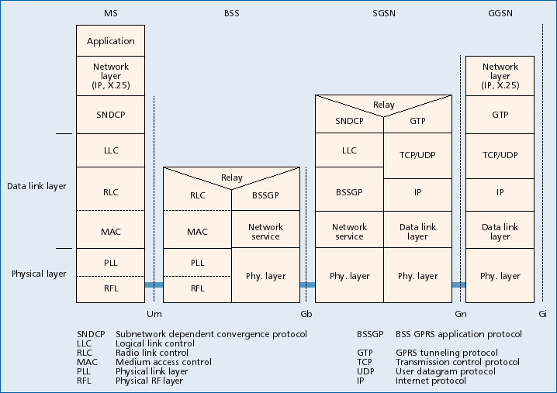
Protocol architecture

Slide 12
Routing Scenarios
Scenario 1: A GPRS mobile station located in PLMN 1 sends packets to a host connected to the IP network
The SGSN that the MS is registered with encapsulates the IP packets, examines the PDP context, and routes them through the intra-PLMN GPRS backbone to the appropriate GGSN
The GGSN decapsulates the packets and sends them out on the IP network
IP routing mechanisms are used to transfer the packets to the access router of the destination network. The latter delivers the IP packets to the host
Scenario 2: Assume the home-PLMN of the MS is PLMN2. The host is now sending IP packets to the MS, which are sent out onto the IP network and are routed to the GGSN of PLMN2
The GGSN of PLMN2 queries the HLR and obtains the current location of the MS (PLMN1). It encapsulates the incoming IP packets and tunnels them to the appropriate SGSN in PLMN1
The SGSN decapsulates the packets and delivers them to the MS

Slide 13
Scenario 1: A GPRS mobile station located in PLMN 1 sends packets to a host connected to the IP network
The SGSN that the MS is registered with encapsulates the IP packets, examines the PDP context, and routes them through the intra-PLMN GPRS backbone to the appropriate GGSN
The GGSN decapsulates the packets and sends them out on the IP network
IP routing mechanisms are used to transfer the packets to the access router of the destination network. The latter delivers the IP packets to the host
Scenario 2: Assume the home-PLMN of the MS is PLMN2. The host is now sending IP packets to the MS, which are sent out onto the IP network and are routed to the GGSN of PLMN2
The GGSN of PLMN2 queries the HLR and obtains the current location of the MS (PLMN1). It encapsulates the incoming IP packets and tunnels them to the appropriate SGSN in PLMN1
The SGSN decapsulates the packets and delivers them to the MS

Slide 14
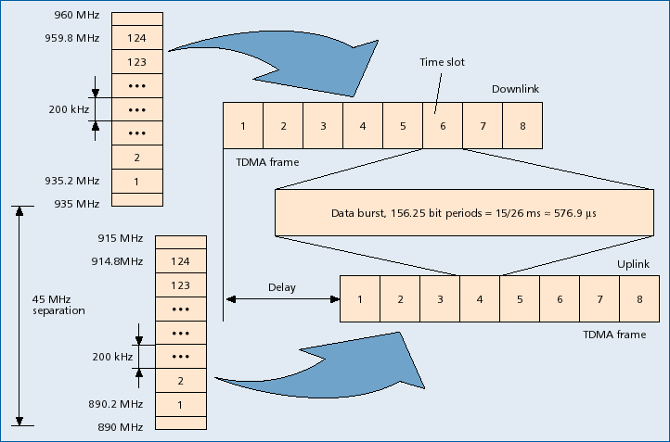
Air interface – physical layer

Slide 15
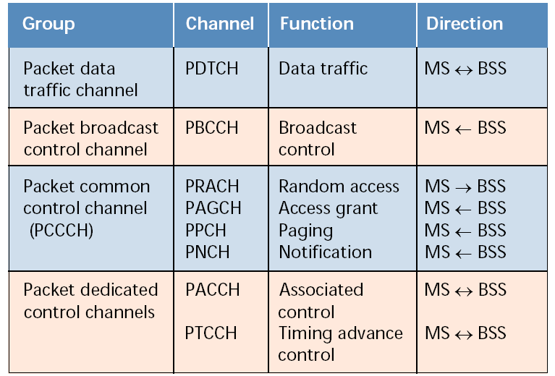
Logical channels

Slide 16
Radio block format
Radio block for data transfer
RLC/MAC block
MAC Header
RLC Header
RLC Data Unit
spare
RLC data block
Radio block for control message
RLC/MAC block
MAC Header
Ctrl Header
RLC/MAC signalling
RLC/MAC control block

Slide 17
GPRS processes
Attach process
Authentication process
PDP activation process
Detach process

Slide 18
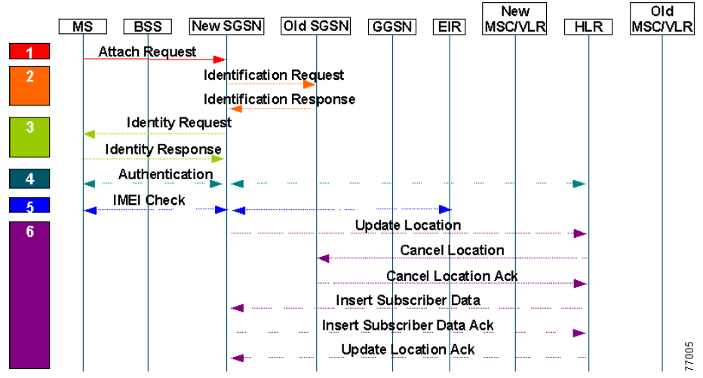
Attach process

Slide 19
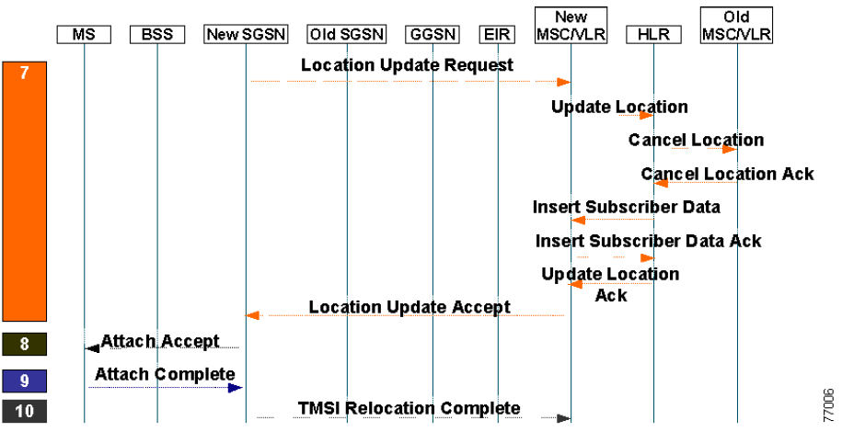
Attach process (cont)

Slide 20
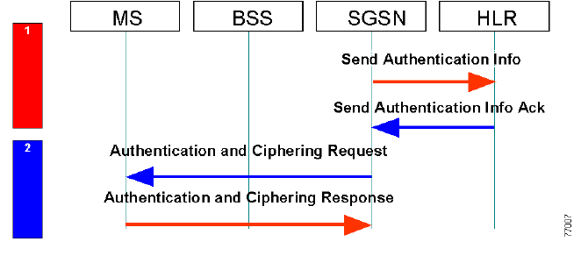
Authentication process

Slide 21
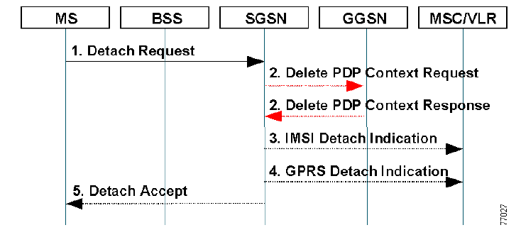
Detach process

Slide 22
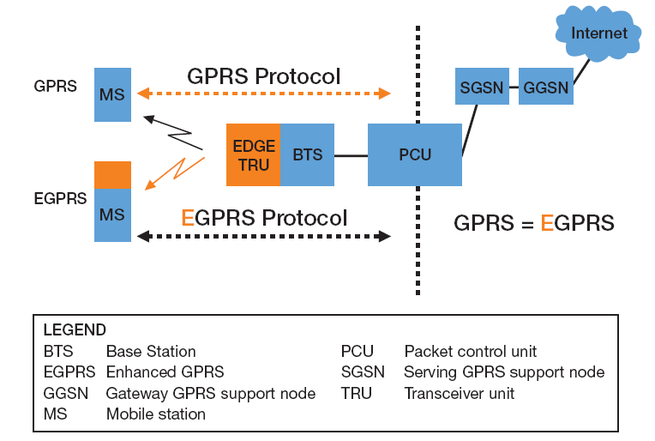
Enhanced Data for GSM Evolution (EDGE)
Higher data rates using 8PSK modulation
user rate 384 kbps (GPRS: 115 kbps)
Software-only update (Release 99)
EGPRS: EDGE enhancements to GPRS

Slide 23
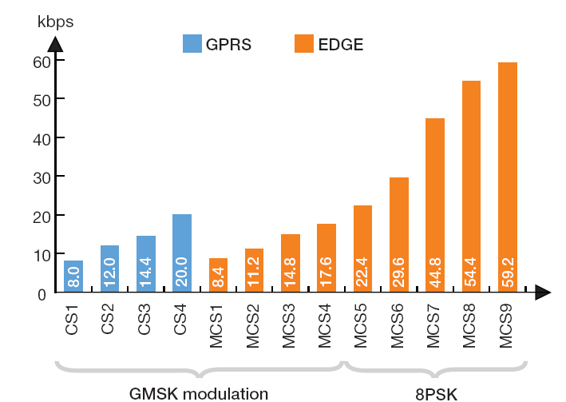
EDGE higher rates
RLC data rate

Slide 24
Τέλος Ενότητας # 8
Μάθημα: Ασύρματα Δίκτυα και Κινητές Επικοινωνίες
Ενότητα # 8: Σύστημα 2.5 Γενιάς GPRS
Διδάσκων: Βασίλειος Σύρης
Τμήμα: Πληροφορικής

