Slide 1
Ασύρματες και Κινητές Επικοινωνίες
Ενότητα # 8: 3G UMTS, HSPA, LTE/4G, 5G Διδάσκων: Βασίλειος Σύρης
Τμήμα: Πληροφορικής

Slide 2
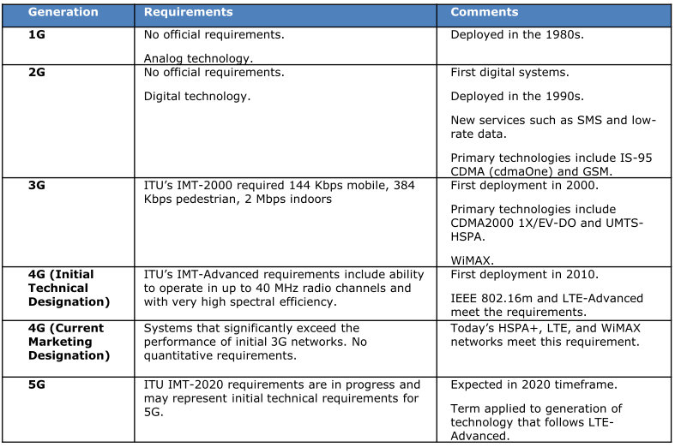
1G to 5G

Slide 3
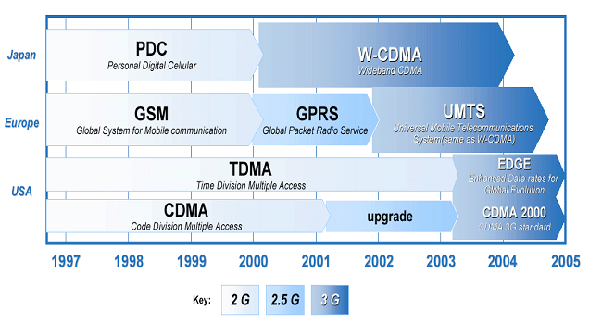
From 2G to 3G

Slide 4
Standardization
3rd Generation Partnership Project (3GPP)
collaboration between telecommunication associations: ETSI, ARIB/TTC (Japan), CCSA (China), ATIS (North America), TTA (South Korea)
develop 3G mobile system specification within scope of IMT-2000 (ITU)
focus on radio, core network, service architecture
GSM, UMTS 3G, HSDPA/HSUPA/HSPA,3G LTE
Different from 3GPP2
focus on IS-95 (CDMA2000)

Slide 5
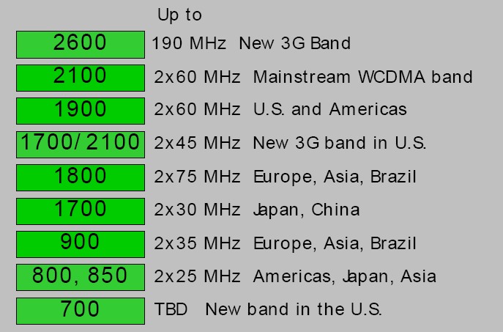
UMTS bands

Slide 6
UMTS architecture

Slide 7
UMTS architecture
UTRAN is composed of several Radio Network Subsystems (RNSs) connected to the Core Network through the lu interface.
Every Radio Network Subsystem is composed of a
Radio Network Controller (RNC).
RNSs can be directly interconnected through the lur interface (interconnection of the RNCs).
RNC is responsible for the local handover process and the combining/multicasting functions related to macro-diversity between different Node-Bs.
RNC also handles radio resource management (RRM) operations.
one or more “Node Bs”.
A Node-B may contain a single BTS or more than one (typically 3) controlled by a site controller.
Above entities are responsible for the radio resource control of the assigned cells

Slide 8
UTRAN: Node B
Node B (commonly called Base Station)
comparable to Base Transceiver Station in GSM
responsible for air interface layer
Key Node B functions
modulation and spreading
RF processing
inner loop power control
macro diversity

Slide 9
UTRAN: RNC
RNC (Radio Network Controller) controls multiple base stations
comparable to Base Station Controller in GSM
layer 2 processing
Radio Resource Management
Key functions
outer-loop power control
handover
admission control
code allocation
packet scheduling
macro diversity across base stations

Slide 10
Core network
SGSN (Serving GPRS Support Node)
The SGSN is mainly responsible for Mobility Management related issues like Routing Area update, location registration, packet paging and controlling and security mechanisms related to the packet communication
GGSN
The GGSN node maintains the connections towards other packet switch networks such as the internet. The Session Management responsibility is also located on the GGSN.

Slide 11
Radio Resource Management (RRM)
Handles QoS provisioning over the wireless interface
Controls cell capacity and interference in order to provide an optimal utilization of the wireless interface resources.
Includes Algorithms for Power Control, Handover, Packet Scheduling, Call Admission Control and Load Control

Slide 12
RRM (cont)
Power Control
Ensures that transmission powers are kept at a minimum level and that there is adequate signal quality and level at the receiving end
Packet Scheduling
Controls the UMTS packet access
Call Admission Control
Decides whether or not a call is allowed to generate traffic in the network
Load Control
Ensures system stability and that the network does not enter an overload state
Handover
guarantees user mobility in a mobile communications network

Slide 13
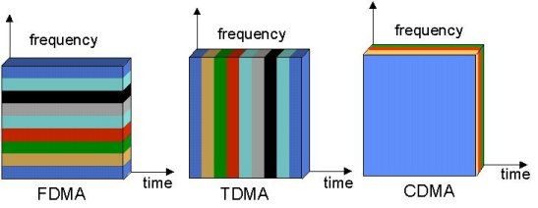
Multi-Access Radio Techniques
Courtesy of Petri Possi, UMTS World

Slide 14
Wideband CDMA
Bandwidth >= 5MHz
Multirate: variable spreading and multicode
Power control:
open power control
fast closed-loop power control
Frame length: 10ms/20ms (optional)

Slide 15
WCDMA and rate
Signals from different mobiles separated based on unique codes
Transmission rate can change between frames
received
power
different codes
rate can be different in different frames
frequency
5 MHz
10 msec
time

Slide 16
Power control in WCDMA
fast closed-loop power control
outer-loop power control (uplink)
BS
RNC
Fast closed-loop power control: between MS and BS
Adjusts transmission power to achieve target signal quality (Signal-to-Interference Ratio, SIR)
Both uplink & downlink, frequency: 1500 Hz
Uplink outer-loop power control: between BS and RNC
Adjusts target SIR to achieve given frame error rate (data: 10-20%, voice: 1%), frequency < 100 Hz
Increase power when interference increases
Diverge when signal qualities are infeasible

Slide 17
Power and rate control
WCDMA: rates fixed within single frame (10ms)
Fast closed-loop power control (Mobile-BS) operates at 1500 Hz (0.67ms)
Outer loop power control (BS-RNC) adjusts target E_{b}/N₀ to achieve specific frame or block error rate
rate
power
time

Slide 18
Quality of Service
Traffic Class | Conversational Class | Streaming Class | Interactive Class | Background Class
Fundamental Characteristics | Preserve time relation of (variation) between information entities of the stream Conversational pattern (stringent and low delay) | Preserve time relation of (variation) between information entities of the stream | Request response pattern Preserve payload content | Destination is not expecting the data within a certain time Preserve payload content
Example of application | voice | streaming video | web browsing | background download of emails

Slide 19
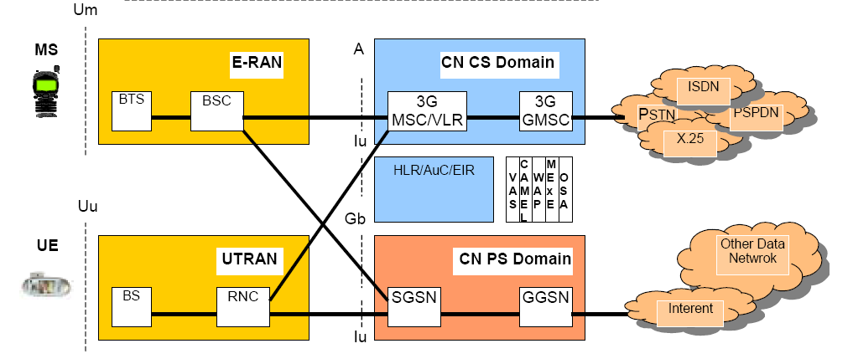
UMTS architecture (rel99)

Slide 20
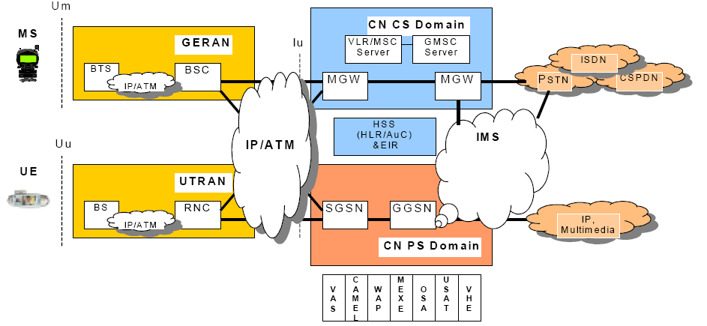
UMTS architecture (3GPP Rel.5)

Slide 21
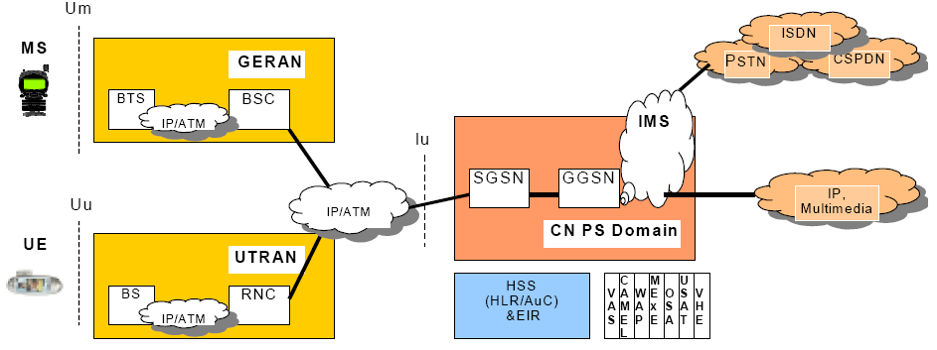
UMTS all-IP

Slide 22
3GPP releases
Rel-99 (3/2000)
first deployable version of UMTS
GSM/GPRS/EDGE/WCDMA radio access
Rel.4 (3/2001)
multimedia messaging
efficient IP-based interconnection of core network
Rel.5 (3/2002)
HSDPA (up to 14.4 Mbps, 1.8,3.6,7.2Mbps avail. up to 2008)
first phase IMS
IP UTRAN
Rel.6 (3/2005)
HSUPA (up to 5.76 Mbps)
enhanced MBMS
second phase IMS
Rel. 7
HDPA+
flat radio access network

Slide 23
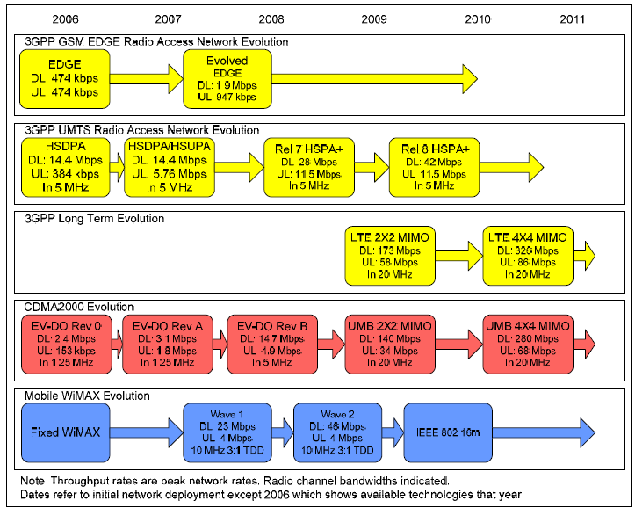
Evolution of cellular technologies

Slide 24
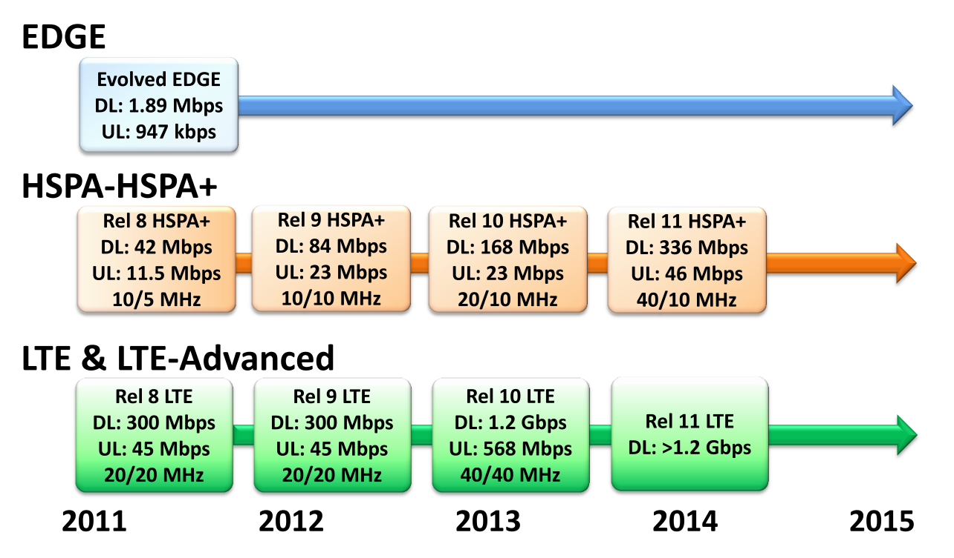
Evolution of cellular technologies
Source: 4G Americas

Slide 25
HSDPA
High speed shared channels (15@5MHz)
sharing in both code and time domains
Fast scheduling and user diversity
shorter TTI (Transmission Time Interval): 2ms
Adaptive Modulation and Coding (AMC)
Higher order modulation: QPSK and 16-QAM
Fast link adaptation: different FEC (channel coding)
Fast hybrid ARQ
fast combined with scheduling/link adaptation
hybrid: combine repeated data transmissions with prior transmissions to improve successful decoding

Slide 26
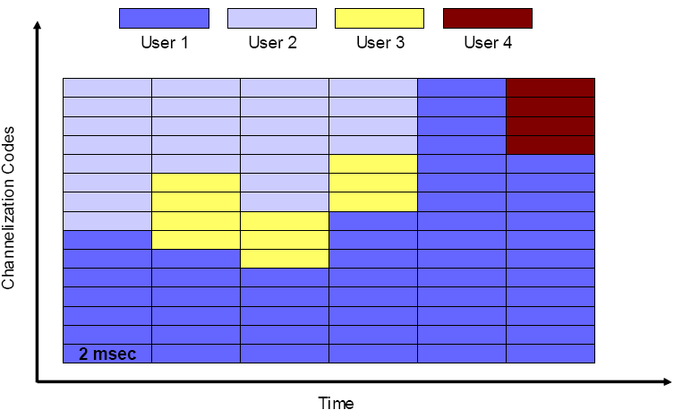
Fast scheduling and user diversity

Slide 27
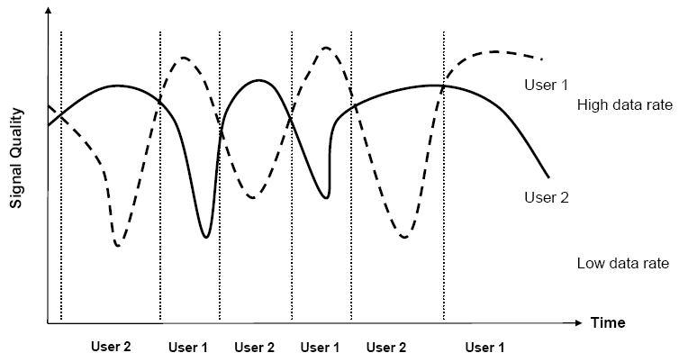
User diversity

Slide 28
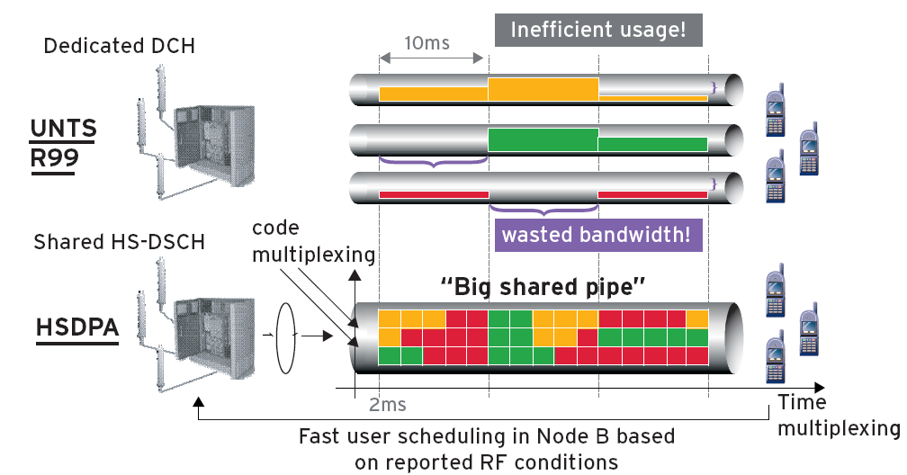
HSDPA vs. WCDMA
WCDMA
HSDPA

Slide 29
HSUPA
Enhanced dedicated physical channel
Fast scheduling with short TTI (2ms)
Fast hybrid ARQ

Slide 30
HSPA and HSPA+
HSPA (Rel. 6)
DL: 14.4 Mbps, UL: 5.76 Mbps
HSPA+ goals
exploit full potential of CDMA before moving to OFDMA (3G LTE)
operation of packet-only mode for voice and data
HSPA+: many versions
Rel.7 HSPA+ (DL 64 QAM, UL 16 QAM): DL: 21Mbps, UL: 11.5Mbps
Rel.7 HSPA+ (2X2 MIMO, DL 16 QAM, UL 16 QAM): DL: 28Mbps, UL: 11.5Mbps
Rel. 8 HSPA+ (2X2 MIMO, DL 64 QAM, UL 16 QAM): DL: 42.2Mbps, UL: 11.5Mbps

Slide 31
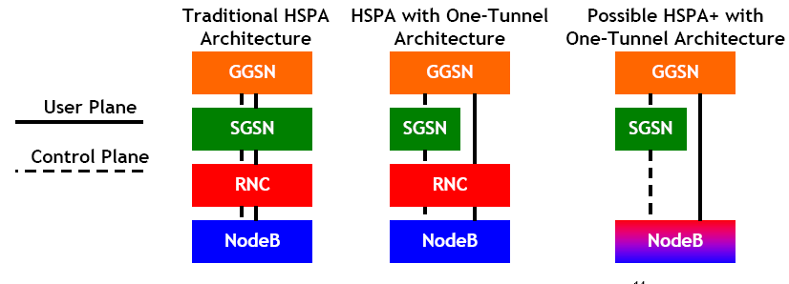
Towards a simpler architecture

Slide 32
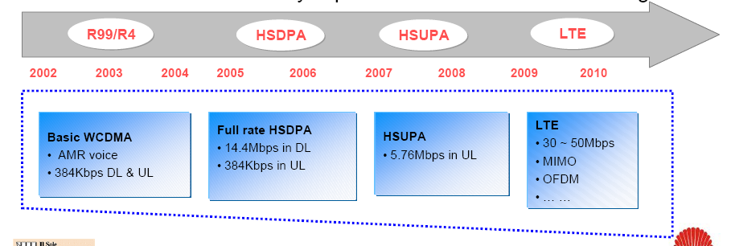
UMTS evolution towards LTE
3G LTE: next step in evolution of 3GPP radio interfaces to deliver Global Mobile Broadband
Not 4G, but beyond 3G: 3.9G

Slide 33
LTE targets
Increased data rates
Peak data rate: above 100 Mbps (downlink) and 50 Mbps (uplink)
Increase “cell edge bitrate” whilst maintaining same site locations as deployed today
Improved spectrum efficiency
2-4X Rel 6 HSPA
Reduced latencies:
network latency < 10 ms
inactive-to-active latency < 100 ms
Designed for IP traffic
Efficient support packet services (e.g. Voice over IP, Presence)
Enhanced IMS and core network
Enhanced MBMS (broadcasting)

Slide 34
LTE targets (cont)
Spectrum and deployment flexibility
Scaleable bandwidth: 1.25,2.5,5,10,15,20 MHz
Both TDD and FDD modes
High mobility
optimized for speeds 0-15 Km/h
support high performance for 15-120 Km/h
support mobility for 120-350 Km/h
Cost effective introduction
Cost effective migration from Rel-6 UTRAN
inter-working with existing 3G and non-3GPP systems (WiMAX, WLAN)
simplified Radio Access Network (RAN)

Slide 35
LTE features
Downlink based on OFDMA
Uplink based on SC-FDMA
only packet switched
no circuit switched connectivity
MIMO: use more than one TX/RX antennas

Slide 36
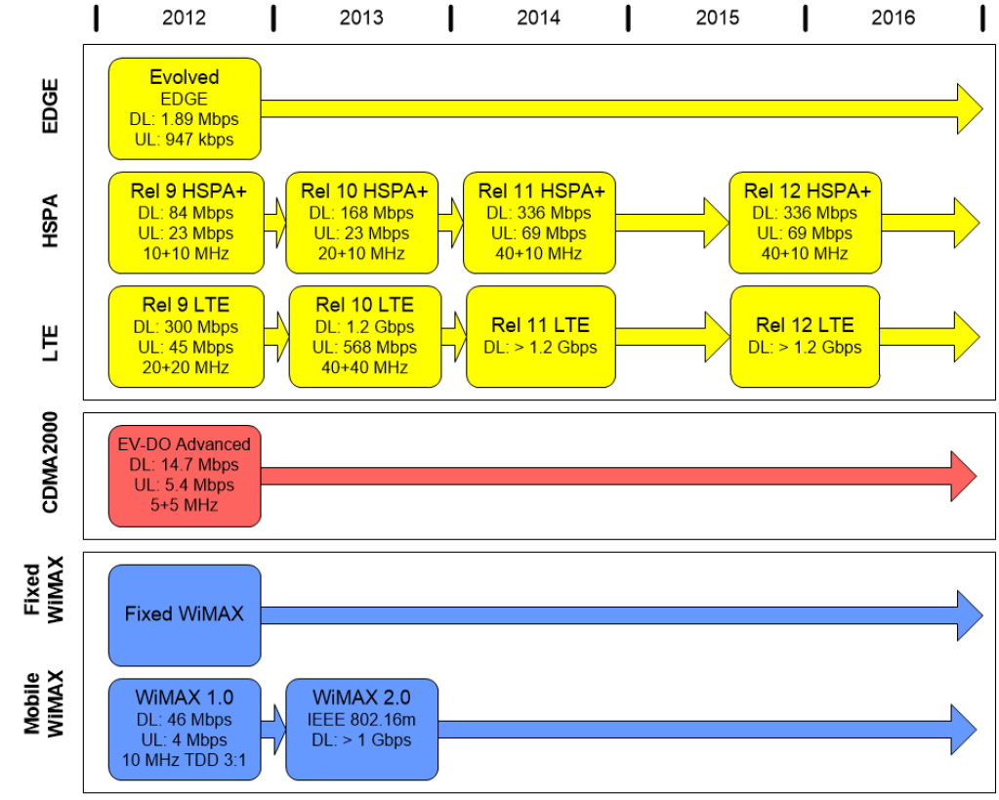
Evolution > 2012

Slide 37
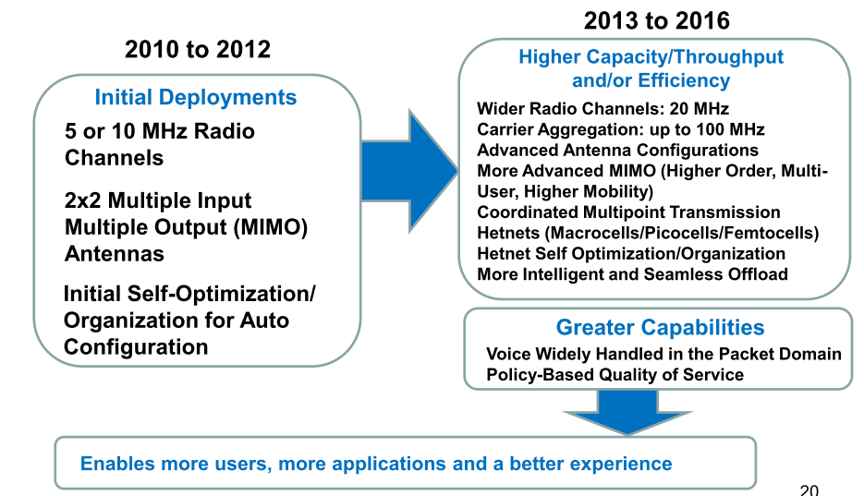
LTE Advanced (Rel. 12)
Source: 4G Americas, 2015

Slide 38
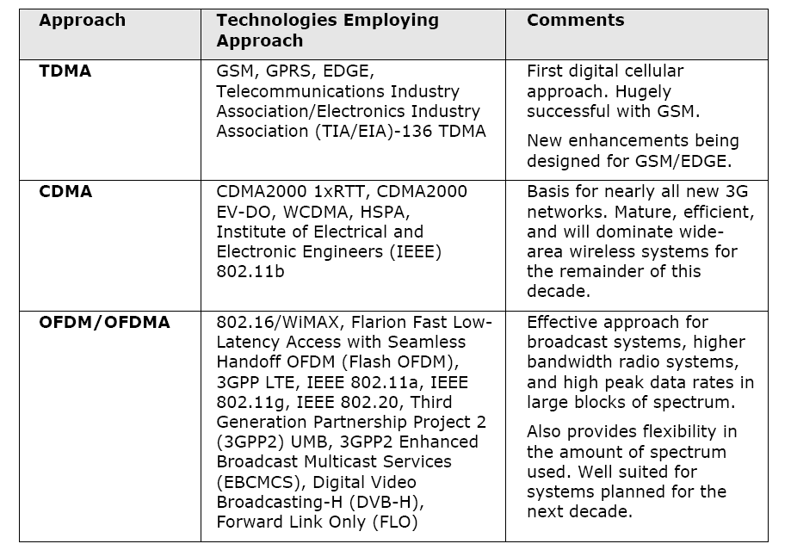
Air interface technologies

Slide 39
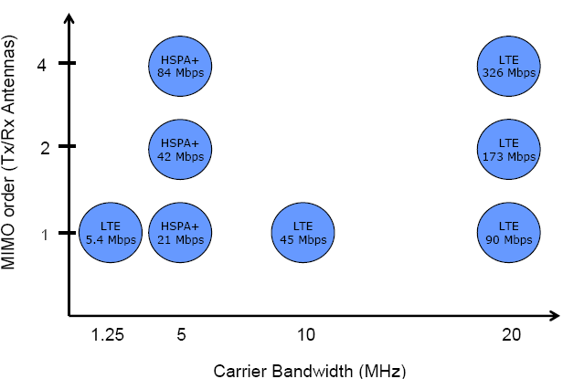
MIMO and carrier bandwidth

Slide 40
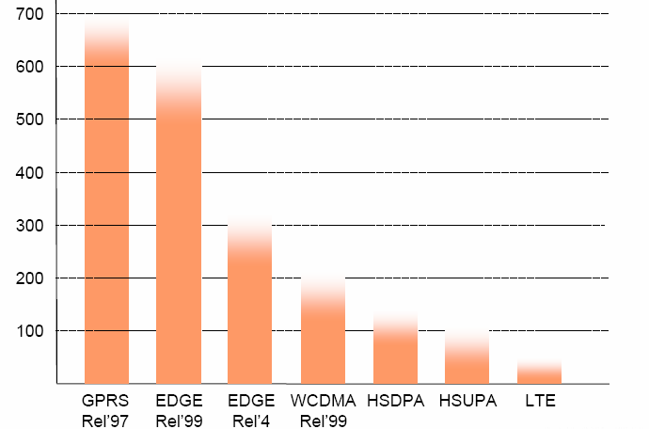
Latency comparison

Slide 41
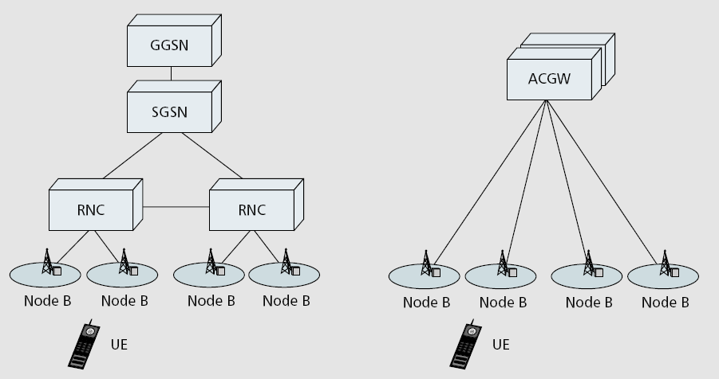
LTE Radio Access Network
UMTS:
LTE:
Evolved-UTRAN

Slide 42
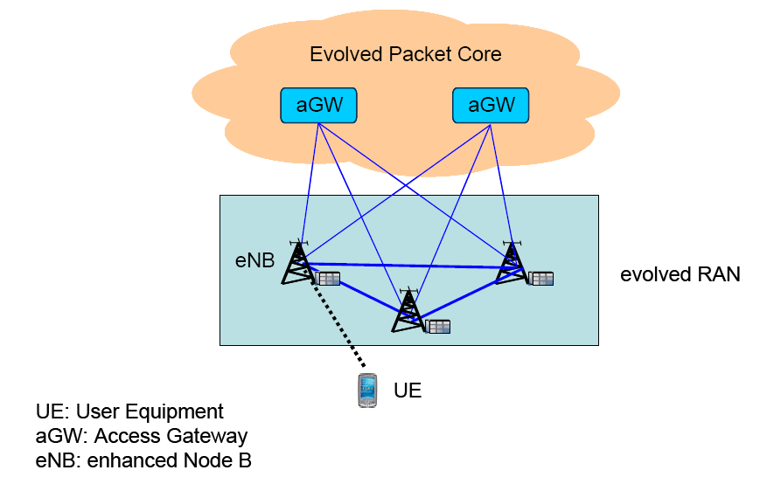
3G LTE Evolved-UTRAN

Slide 43
LTE simplified architecture
Evolved UTRAN (EUTRAN):
Most RNC functionalities moved to eNodeB
RNC removed
eNodeB connects to evolved packet core

Slide 44
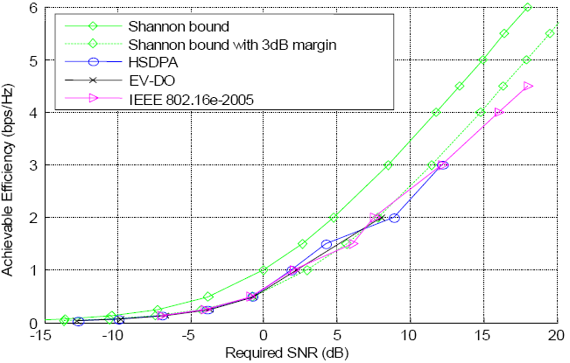
Spectral efficiency
Source: 4G Americas, 2015

Slide 45
Proximity Services (LTE Rel. 12)
Direct discovery: identifies UE that are in direct proximity of each other
Direct communication: device-to-device communication between UEs
both in presence and in absence of LTE network

Slide 46
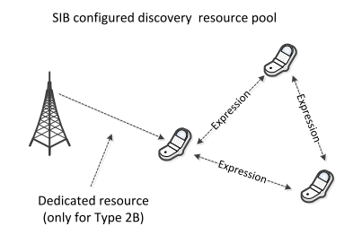
Direct Discovery
Type 1: UE selects resource from resource pool
Type 2B: LTE network allocates resources

Slide 47
Direct Communication
Mode 1: LTE network explicitly assigns resources
Mode 2: UEs select resources for control & data from resource pool

Slide 48
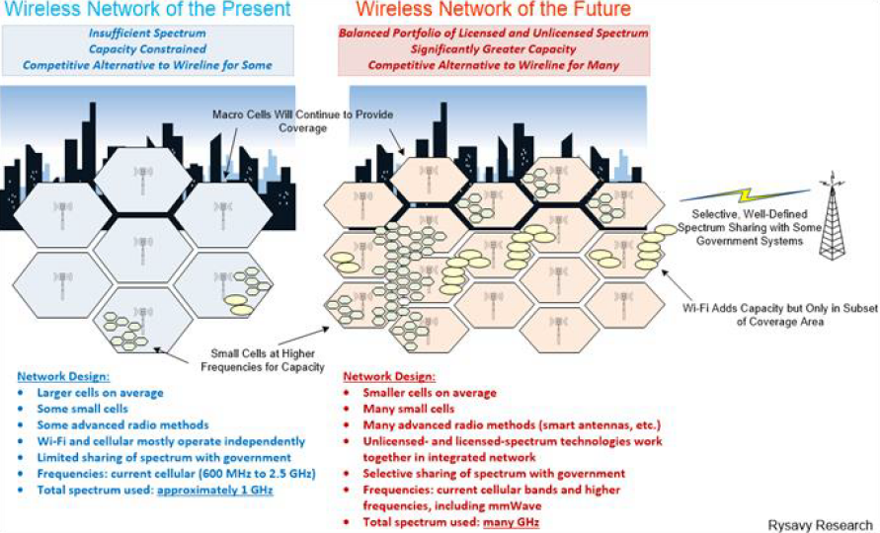
Small cells

Slide 49
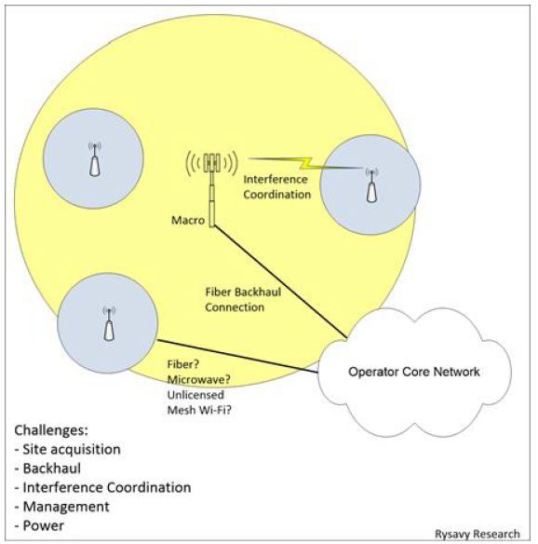
Small cell challenges

Slide 50
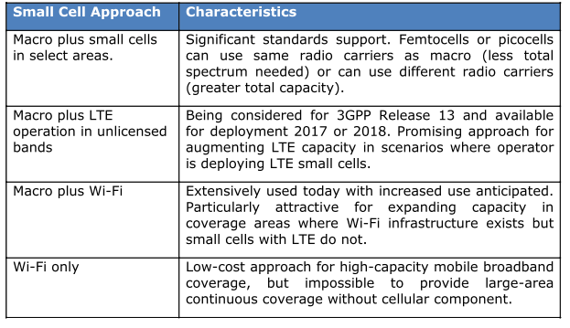
Small cell approaches

Slide 51
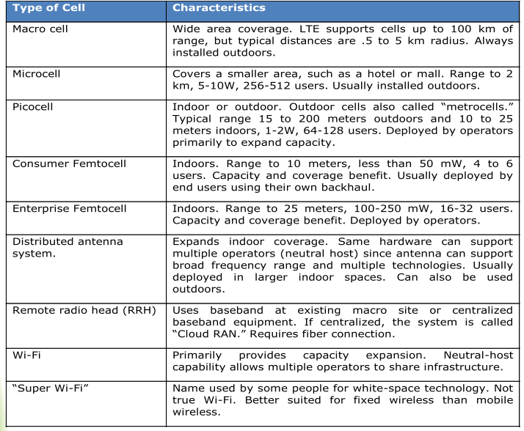
Types of cells

Slide 52
Partnerships and Forums
ITU IMT-2000 http://www.itu.int/imt2000
Mobile Partnership Projects
3GPP: http://www.3gpp.org
3GPP2: http://www.3gpp2.org
Mobile Technical Forums
3G All IP Forum: http://www.3gip.org
IPv6 Forum: http://www.ipv6forum.com
Mobile Marketing Forums
Mobile Wireless Internet Forum: http://www.mwif.org
UMTS Forum: http://www.umts-forum.org
GSM Forum: http://www.gsmworld.org
Universal Wireless Communication: http://www.uwcc.org
3G Americas: http://www.3gamericas.org
Global Mobile Supplier: http://www.gsacom.com

Slide 53
Τέλος Ενότητας # 8
Μάθημα: Ασύρματες και Κινητές Επικοινωνίες
Ενότητα # 8: 3G UMTS, HSPA, LTE/4G, 5G
Διδάσκων: Βασίλειος Σύρης
Τμήμα: Πληροφορικής

