Slide 1
Ασύρματα Δίκτυα και Κινητές Επικοινωνίες
Ενότητα # 4: Πρωτόκολλα Πολλαπλής Προσπέλασης
Διδάσκων: Βασίλειος Σύρης
Τμήμα: Πληροφορικής

Slide 2
Multiple access
Goal: share a common communication medium among multiple transmitting nodes
Objectives/issues:
High resource utilization
Avoid starvation (fairness)
Simplicity

Slide 3
Switching
Circuit switched-based
Packet-based
Datagram switching
Virtual circuit switching

Slide 4
Multiple access
Contention-less
Contention-based
Fixed assignment
Polling
Token passing
Random access
Random access with reservation
FDM,
TDM,
CDM,
centralized
Aloha, CSMA,
CSMA/CA
Cellular, satellite

Slide 5
Multiple Access Systems
…
Nodes use common transmission channel
Collisions when two or more hosts send simultaneously
Access Control design problem: limit inefficiencies due to collisions and idle periods

Slide 6
Multiple Access Control
TDM: inefficient
Ethernet: based on CSMA/CD (Carrier Sense Multiple Access/ Collision Detect
Wait for idle channel, then send packet
Stop if collision detected
Wait for random delay after collision
ALOHA: less polite than Ethernet
Transmit whenever packet is ready
Stop if collision detected
Wait for random delay after collision

Slide 7
Multiple Access Control (cont)
Token passing
Token passed from one node to another
Node transmits if it has token
Need to make sure token not lost, and no one node exhibits unfair behavior
Token ring: nodes connected in ring topology

Slide 8
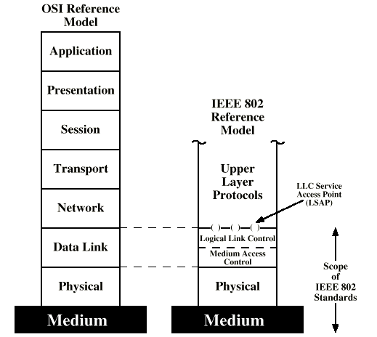
OSI and IEEE 802

Slide 9
IEEE 802 Layers - Physical
Encoding/decoding
Preamble generation/removal
Bit transmission/reception
Transmission medium and topology

Slide 10
IEEE 802 Layers - Logical Link Control (LLC)
Interface to higher levels
Multiplexing
Flow and error control

Slide 11
IEEE 802 Layers - Media Access Control (MAC)
Assembly of data into frame with address and error detection fields
Disassembly of frame
Address recognition
Error detection
Govern access to transmission medium
Not found in traditional layer 2 data link control
For the same LLC, several MAC options may be available
Examples:
802.3 (Ethernet)
802.4 (Token Bus)
802.5 (Token Ring)
802.11 (Wireless LAN, Wi-Fi, or wireless Ethernet)
802.15 (Bluetooth)
802.16 (Wireless Local Loop – WLL)

Slide 12
Media Access Control (MAC)
Goal: share a communication medium among multiple hosts connected to it
Objectives/issues:
High resource utilization
Avoid starvation (fairness)
Simplicity
Solutions:
Centralized
+ Greater control, simple access logic and co-ordination
- Single point of failure, potential bottleneck
Distributed: random access, taking turns
On demand or synchronous

Slide 13
MAC Protocol: A Taxonomy
Channel partitioning
Divide channel into smaller “pieces” (time slots, frequency)
Allocate piece to node for exclusive use
Random access
Allow collisions
“recover” from collisions
“Taking-turns”
Tightly coordinate shared access to avoid collisions
Token ring, toke bus

Slide 14
Random Access MAC Protocols
Stations access medium randomly
Collisions when two or more hosts send simultaneously
Random access MAC protocol specifies:
how to detect collisions
how to recover from collisions
Access Control design problem: limit inefficiencies due to collisions and idle periods
Examples:
ALOHA (Slotted, Pure)
CSMA and CSMA/CD (Ethernet)
CSMA/CA (Wireless LAN/ IEEE 802.11)

Slide 15
Random Access MAC Protocols: Performance
Efficiency=maximum fraction of time nodes transmit packets successfully
Throughput=maximum rate of successful bit transmission = (Efficiency) × (Transmission rate)

Slide 16
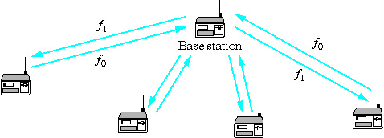
ALOHA Protocol
ALOHA: packet-switched radio communication network
University of Hawaii, 1970s
Can also run over wired media (coaxial cable, twisted pair)
Father of multiple access protocols
Transmission rate of original ALOHA network : 9600 bps
Two versions: Slotted and Pure

Slide 17
Slotted ALOHA
Time is divided into equal size slots (= packet transmission time)
Node with new pkt: transmit at beginning of next slot
If collision: retransmit pkt in future slots after random delay (why random?)
Success (S), Collision (C), Empty (E) slots

Slide 18
Slotted ALOHA
Time in uniform slots equal to frame transmission time
All frame (packets) have fixed size
Need central clock (or other sync mechanism)
Transmission begins at slot boundary
Sender (wireless stations):
Waits for ACK after packet transmission
Retransmits frame after Timeout
Receiver (base station):
Error detection using Frame Check Sequence (similar to CRC)
Send ACK if frame OK
Max utilization 36%

Slide 19
Slotted ALOHA Transmissions
Frames either miss or overlap totally
Wasted time:
Slots with collisions
Unused slots

Slide 20
Slotted ALOHA: Efficiency
G: total rate of transmission attempts (pkts/timeslots)
S: rate of successful transmissions (pkts/timeslots)
p: probability of successful packet transmission
Assumptions:
Infinite number of stations
Number of packet arrivals is Poisson distributed
From above

Slide 21
Slotted ALOHA: Efficiency (cont)
Hence
S ≤ 1/e ≈ 36%
What if there are only two stations?

Slide 22
Slotted ALOHA: Finite Station Population
Finite number of stations N
Each transmits in slot with probability q
Probability of successful transmission
Above is maximized for q=1/N
A node does not know number N of other stations that have packet to transmit
Single station:
N stations:

Slide 23
Slotted ALOHA: Finite Station Population (cont)
Maximum efficiency for finite population ALOHA

Slide 24
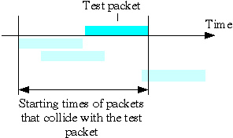
Pure ALOHA
No slotted time as in pure ALOHA
When station has frame, it sends
Any overlap of frames causes collision

Slide 25
Pure ALOHA: Performance
Probability of successful packet transmission
Hence

Slide 26
Reservation ALOHA
Two phases:
Reservation phase
Transmission phase
Reservation phase: Slotted ALOHA
Transmission phase:
Divided into time slots
Station to transmit in each time slot determined by reservations
Duration of transmission phase depends on # of successful reservations
…
Reservation
phase
Transmission
phase
Reservation
phase
Transmission
phase

Slide 27
Reservation ALOHA: Efficiency
Reservation phase is slotted ALOHA: 36% efficiency
Transmission phase: 100% efficiency
TRES: size of reservation slot
TRANSP: size of transmission slot
Average duration of reservation: TRES/0.36
Example: TRES/TRANSP=1/20

Slide 28
Carrier Sense Multiple Access (CSMA)
Carrier Sense: “Listen before talking”
Sender:
Listen for clear medium (carrier sense)
If medium idle
Transmit whole frame
Start Timeout and wait for ACK
If medium busy
Defer transmission -> Three alternatives
Receiver:
Send ACK if packet received correctly

Slide 29
Why ALOHA doesn’t listen…
ALOHA targeted for wide area and satellite systems
These have long propagation delays
“Send and pray” is about the best you can do for random access
ALOHA not a good choice for local area networks
These have short propagation delays

Slide 30
CSMA: What happens if channel is busy?
1-persistent CSMA:
Continue listening for idle channel
When channel becomes idle transmit whole packet immediately
p-persistent CSMA:
Continue listening for idle channel
When channel becomes idle transmit packet with probability p
Assumes slotted time (like slotted ALOHA)
Non-persistent CSMA:
When channel busy, wait for random time, then check channel again

Slide 31
CSMA persistence schemes
Constant or variable delay
Non-persistent
Channel busy
Sense channel
1-persistent
p-persistent
1-persistent:
If two or more stations waiting to transmit, collision is guaranteed
Non-persistent:
Reduces probability of collisions
Wasted idle time before transmissions
p-persistent:
How is p selected ? Must be Np<1
Np>1 instability, Np<<1 unnecessarily long delays

Slide 32
CSMA: efficiency
efficiency
non-persistent CSMA
1-p CSMA
S.ALOHA
P.ALOHA
G, offered traffic
PROP/TRANSP=0.1

Slide 33
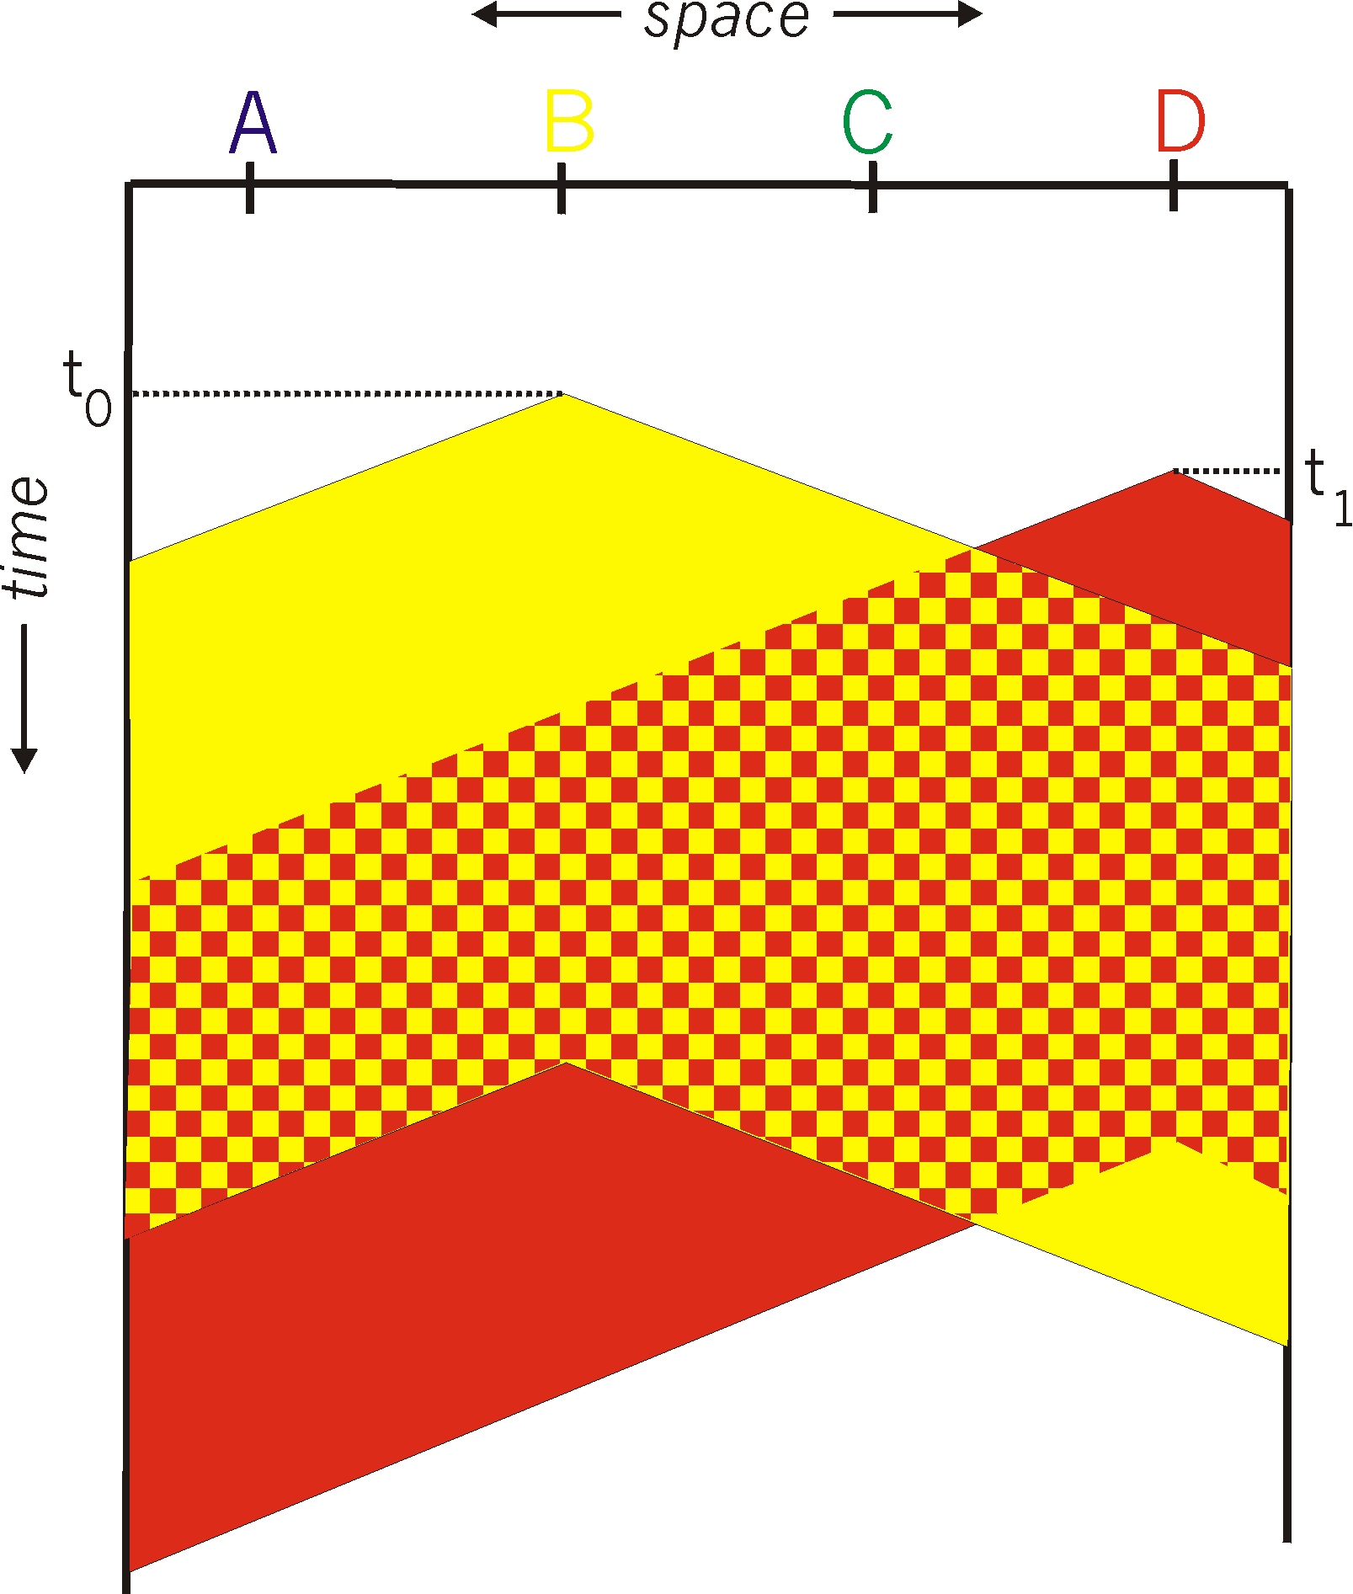
CSMA Collisions
spatial layout of nodes along ethernet
Collisions can occur:
propagation delay means
two nodes may not
hear each other’s transmission
Collision:
entire packet transmission
time wasted

Slide 34
CSMA/CD (Collision Detect)
Collision Detect: listen while transmitting
CSMA/CD steps
If medium idle, transmit
If busy, listen for idle, then transmit (1-persistent)
If collision detected, jam then cease transmission
After jam, wait random time then start again
Binary exponential back off

Slide 35
Collision Detection
Easy in wired LANs: measure signal strengths, compare transmitted, received signals
Difficult in wireless LANs
receiver shut off while transmitting
one station cannot hear all other stations

Slide 36
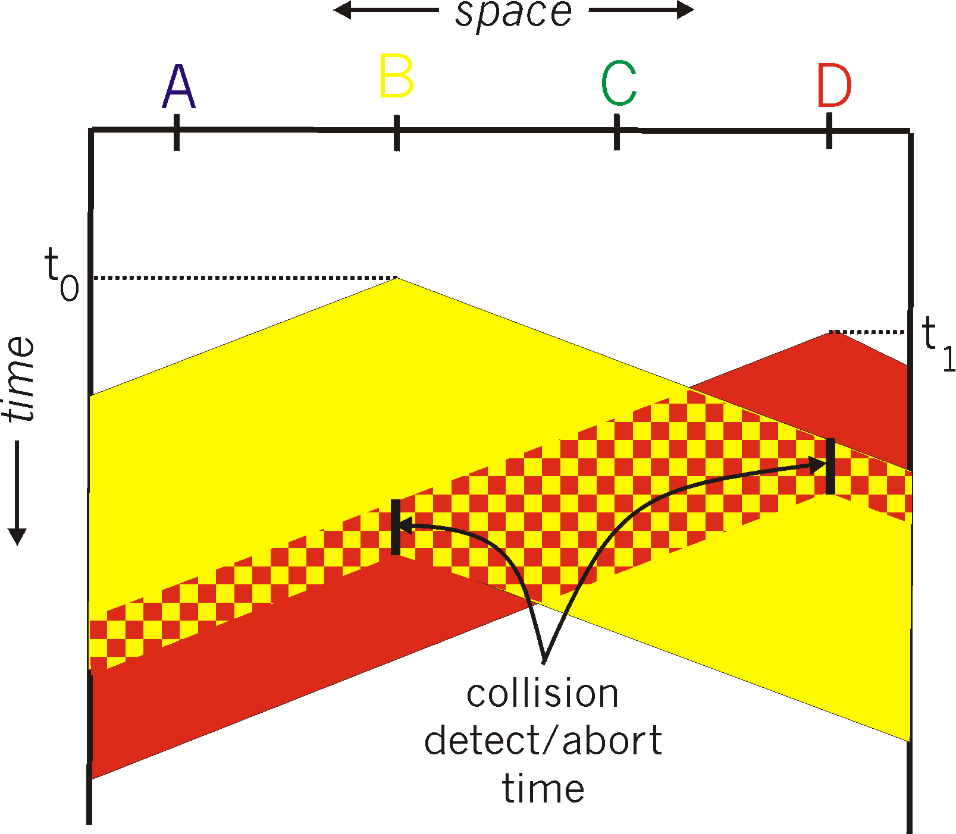
Gains of Collision Detect

Slide 37
Maximum Time to Detect Collision
A
B
Time T1
A transmission
Bus signal
Time T2
A transmission
B starts transmission just prior
to signal A reaching it
Bus signal
Time T3
A transmission
B senses collision, stops transmitting and sends jam signal
Bus signal
collision
Time T4
A transmission
Bus signal
collision
T2-T1=T4-T3=PROP
Minimum time to detect collision: T4-T1=2×PROP
Minimum frame length: TRANSP > 2×PROP

Slide 38
CSMA/CD Efficiency
CSMA/CD
efficiency
non-persistent CSMA
1-p CSMA
S.ALOHA
P.ALOHA
G, offered traffic
PROP/TRANSP=0.1

Slide 39
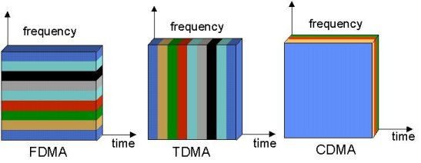
Multi-Access Radio Techniques
Courtesy of Petri Possi, UMTS World

Slide 40
Courtesy of Suresh Goyal & Rich Howard

Slide 41
Courtesy of Suresh Goyal & Rich Howard

Slide 42
Courtesy of Suresh Goyal & Rich Howard

Slide 43
Courtesy of Suresh Goyal & Rich Howard

Slide 44
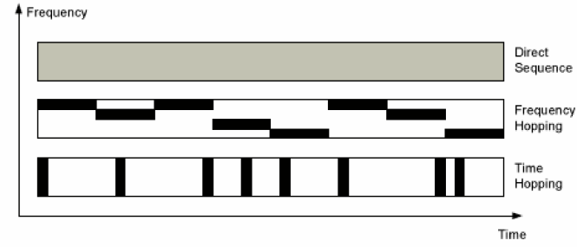
CDMA

Slide 45
Frequency hopping
Frequency hopping based on pseudorandom numbers
Spreads power over wide spectrum: spread spectrum
Narrowband interference not effective
Initially developed for military

Slide 46
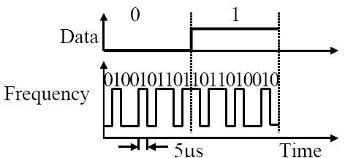
Direct sequence
Spreading factor: code bit rate/data bit rate
10-100 typically for commercial systems
Signal bandwidth = Spreading factor X Data rate
Code sequence synchronization necessary
Correlation between codes => interference

Slide 47
OFDMA
Orthogonal Frequency Division Multiple Access
Multicarrier modulation similar to DMT
Available frequency band divided into many (256 or more) sub-bands
Orthogonal: peak of one band at null of others
Each carrier modulated with BPSK, QPSK, 16/64-QAM, etc

Slide 48
Wideband CDMA
Bandwidth >= 5MHz
Multirate: variable spreading and multicode
Power control:
open power control
fast closed-loop power control
Frame length: 10ms/20ms (optional)

Slide 49
Τέλος Ενότητας # 4
Μάθημα: Ασύρματα Δίκτυα και Κινητές Επικοινωνίες
Ενότητα # 4: Πρωτόκολλα Πολλαπλής Προσπέλασης
Διδάσκων: Βασίλειος Σύρης
Τμήμα: Πληροφορικής

