Slide 1
Εξόρυξη γνώσης από Βάσεις Δεδομένων και τον Παγκόσμιο Ιστό
Ενότητα # 6: Web Mining
Διδάσκων: Μιχάλης Βαζιργιάννης
Τμήμα: Προπτυχιακό Πρόγραμμα Σπουδών “Πληροφορικής”

Slide 2
Χρηματοδότηση
Το παρόν εκπαιδευτικό υλικό έχει αναπτυχθεί στα πλαίσια του εκπαιδευτικού έργου του διδάσκοντα.
Το έργο «Ανοικτά Ακαδημαϊκά Μαθήματα στο Οικονομικό Πανεπιστήμιο Αθηνών» έχει χρηματοδοτήσει μόνο τη αναδιαμόρφωση του εκπαιδευτικού υλικού.
Το έργο υλοποιείται στο πλαίσιο του Επιχειρησιακού Προγράμματος «Εκπαίδευση και Δια Βίου Μάθηση» και συγχρηματοδοτείται από την Ευρωπαϊκή Ένωση (Ευρωπαϊκό Κοινωνικό Ταμείο) και από εθνικούς πόρους.

Slide 3
Άδειες Χρήσης
Το παρόν εκπαιδευτικό υλικό υπόκειται σε άδειες χρήσης Creative Commons.
Οι εικόνες προέρχονται … .

Slide 4
Σκοποί ενότητας
Εισαγωγή και εξοικείωση με τις μεθόδους Web personalization and recommendations (collaborative filtering), Web Advertising.

Slide 5
Περιεχόμενα ενότητας
Web personalization and recommendations (collaborative filtering)
Web Advertising

Slide 6
Web personalization and recommendations (collaborative filtering)
Μάθημα: Εξόρυξη γνώσης από Βάσεις Δεδομένων και τον Παγκόσμιο Ιστό
Ενότητα # 6: Web Mining
Διδάσκων: Μιχάλης Βαζιργιάννης
Τμήμα: Προπτυχιακό Πρόγραμμα Σπουδών “Πληροφορικής”

Slide 7
Web personalization and recommendations
~25% of Internet users reading online reviews prior to paying for an offline service,
80% claimed reviews had significant influence on their purchasing habits.
Users pay a mark-up of 20% to 100% for services/products with excellent peer ratings on review sites.
Humans are notoriously bad at choosing between too many choices,
rely on external recommendations and reviews to narrow the set of possible choices.

Slide 8
Personalization
Personalized reviews tend to dominate
Netflix: personalized video-recommendation system based on ratings and reviews by its customers.
In 2006, offered a $1,000,000 prize to the first developer of a video-recommendation algorithm that could beat its existing algorithm

Slide 9
Recommender Data Model
Set U={u₁, …, u_{n}} of users
Set I={i₁, …, i_{m}} of items (e.g. products)
Elements from U and I can be described by a vector respectively
(a₁, …, a_{s}) → attributes of user profile
(b₁, …, b_{t}) → description of items (meta data, features, …)
Goal of recommendation process: recommend new items for an active user u
Overview of process
User modeling (explicit or implicit, e.g. user rates items)
Personalization, generate list of recommended items

Slide 10
User-Item Ranking
Recommendation often based on ratings of an item ij by a user u_{k}:
Rating r_{j,k}: I → [0,1] ⋃ ø
Other range of values possible, e.g. {*, **, ***, ****, *****}
ø := no rating for Item (or “0”)
Example user-item matrix of ratings
 | V for Vendetta | La Vita e Bella | Lion King | Wall-e
Alice | 4 | 3 | 2 | 4
Bob | ∅ | 4 | 5 | 5
Cindy | 2 | 2 | 4 | ∅
David | 3 | ∅ | 5 | 2

Slide 11
Types of Recommender Systems
Collaborative filtering (CF)
Content-based filtering (CB)
Individual recommender algorithms
Also utility- or knowledge-based approaches
Case-based recommendation
Hybrid recommender systems
Combination of several other recommenders
Additional important variants
Context-aware and multi-dimensional recommenders
Decentralized recommender systems
Recommending for groups

Slide 12
Example: Product Page on Amazon

Slide 13
Issues of Recommender Systems
Cold start and latency problems
Sparseness of user-item matrix
Diversity of recommendations
Scalability
Privacy and trust
Robustness
Utilization of domain knowledge
Changing user interests (dynamics)
Evaluation of recommender systems

Slide 14
Cold Start Problems
“New user” and “new item” problem
Systems cannot recommend items to new users with no profile or no interaction history
Same for new items
Also “latency problem”: items need some time until they can be recommended
Chicken-and-egg problem
Users will not use system without good recommendations
No incentive to rate items etc.
System cannot generate good recommendations
Possible solutions
include explicit user profiling methods to start interaction

Slide 15
Data Sparseness
Common situation
Lots of users and items
But only few ratings
Sparseness of user-item matrix
Recommender algorithms will not work very well
In addition, new items are continuously added
Users should also rate these items
Number of ratings has to keep up with new users and items
Possible solution
Include the automatic generation of ratings
Implicit user profiling, use of transaction history of users, e.g. click on a video constitutes a positive rating

Slide 16
Diversity of Recommendations
Focus usually on generating recommendations as “good” as possible
But also important: new, unexpected items
Do not recommend items that are already known
Do not recommend items that are too similar to already known items
E.g. user likes “Lord of the Rings 1” → user possibly also likes “Lord of the Rings 2”, but is this really a useful recommendation?
Possible solutions
Use content-based approaches to easier integrate new items in recommendation process
Use collaborative filtering to allow “cross-domain” recommendations

Slide 17
Scalability
Algorithms are based on matching users and items
The more items and users, the higher the computational effort to analyze the data
Storage/memory and runtime complexity
Alternatively, the quality of recommendations suffer
Scalability of recommender systems is an issue in practice
Problem in particular with memory-based approaches
Possible solutions include
Use model-based approach
Limit the number of items and/or users
E.g. only consider items that received at least k ratings
Pre-compute recommendations for users
Will reduce runtime

Slide 18
Privacy and Trust
Collecting and interpreting personal data, e.g. ratings
For example, bought items or visited product Web pages on Amazon
Control for users?
Bought product may have been gift for other person
Privacy problem!
Tradeoff with recommender quality
The more information about the user the system is able to collect, the higher the recommendation quality is in general
Also trust, how can user trust the quality of a recommended item?
Possible solutions include
Consider social relationships (“social recommender”, “Web of Trust”)
Let user control their profile information
Explanations of recommendations
Why was an item recommended?

Slide 19
Robustness
Quality of (collaborative) recommenders depends on quality of ratings
Manipulation by users possible
E.g. by automatic registration of a large number of “users” and ratings
Also called “shilling”, “profile injection”
Attacks in principle
“push”: Aim is to push item(s) by inserting a large number of good ratings
“nuke”: Same with negative ratings
Possible solutions include
Make registration for service harder, e.g. request and check personal information
Detect attacks and remove corresponding users and ratings
Adjust algorithms, some algorithms have proven to be more robust

Slide 20
Utilization of Domain Knowledge
Systems often regard items in isolation
No relationships between items
No domain knowledge
Example: searching for (books or other products on) “baseball”
Too many hits → restriction to “baseball technique”, or “baseball player”, for example
Based on user model and domain ontology
Too few hits → broading to “sport”, for example
Some approaches in current research literature utilize Semantic Web technologies
Build and maintain item ontologies
Also for users
E.g. „GUMO“ (General User Modeling Ontology)

Slide 21
Changing User Interests (Dynamics)
User model is often relatively static
But dynamic evolution over user interests
Changes over time, older ratings may not be valid any more
Also the context of recommendations
Example: Mobile restaurant guide
Restaurant may be too far away from current position (location)
Restaurant may be closed today (time)
A good rating for a restaurant after a dinner on a weekend may not be relevant for recommending a restaurant for a quick lunch on a workday
Solutions in research literature include
E.g. explicit distinction between short- and long-term interests
Context-aware recommender systems

Slide 22
Evaluation of Recommender Systems
Goal of personalization is to improve the interaction of users with the system
May be subjective, hard to evaluate
General method for recommender systems
Let users rate recommended items and compare actual user ratings with predicted rating
Most important metrics
“precision”: probability rate that users did like recommended items
“recall”: probability rate that preferred items by users are recommended
In addition user studies
User evaluate system in questionnaire etc.

Slide 23
Collaborative Filtering (CF)
Basic idea: System recommends items which were preferred by similar users in the past
Based on ratings
Expressed preferences of the active user
And also other users → Collaborative approach
Works on user-item matrix
Memory-based or model-based
No item meta data etc.!
Assumption: Similar taste in the past implies similar taste in future
CF is formalization of “word of mouth“ among buddies

Slide 24
General Process
Users rate items
Find set S of users which have rated similar to the active user u in the past (→ neighborhood)
Similarity calculation
Select the k nearest users to the active user
Generate candidate items for recommendation
Items which were rated in neighborhood of u,
but were not rated by u yet
Predict rating of u for candidate items
Select and display n best items

Slide 25
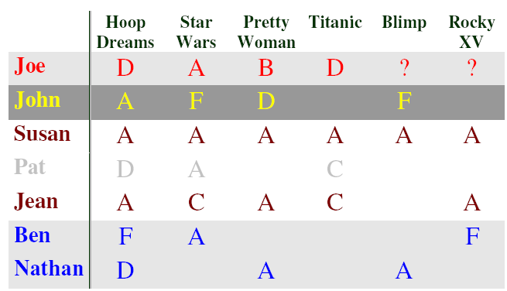
Example (I)
Source: http://www.dfki.de/~jameson/ijcai03-tutorial/

Slide 26
Example (II)

Slide 27
Example (III)

Slide 28
Required Metrics
Metric for user-user similarity
Mean-squared difference
Cosine
Pearson/Spearman correlation
Select set S of most similar users (to active user u)
Similarity threshold
Aggregate neighborhood
Center-based
Metric to predict the rating of u for an item i

Slide 29
Required Metrics
Metric for user-user similarity
Mean-squared difference
Cosine similarity
Pearson/Spearman correlation
Select set S of most similar users (to active user u)
Similarity threshold
Aggregate neighborhood
Center-based
Metric to predict the rating of u for an item i

Slide 30
User-User Similarity
Item set I
Users U,V with u[i] denoting rating of item i by user u
the rating vector of user u is denoted by
the vector norm is denoted by
n is the number of items rated by both U and V
Mean squared difference:
Small values show similar users
Cosine similarity:
Large values show similar users

Slide 31
Pearson/Spearman Correlation
Average rating is taken into account
The vector of average ratings is denoted by
Not suitable for unary ratings
Unary: Item is marked (or not)
e.g. “Product was purchased“
Binary: good/bad, +/- etc.
Scalar: Numerical rating (e.g. 1-5) etc.
Consider only items which were rated by both users
Values near 1 show similar users

Slide 32
Example Calculation
User/item | a | b | c | d | e | f
U | 5 |  | 3 |  | 4
A | 1 | 1 |  | 1
B | 1 |  | 3 | 1
C | 5 | 2 | 2 |  | 5 | 4
D |  | 3 |  | 2
Sim₁(U,V) | Sim₂(U,V) | Sim₃(U,V)
- | - | -
16 | 1 | 0
8 | 0.76 | -1
2/3 | 0.98 | 0.833
∞ | ∞ | ∞

Slide 33
Required Metrics
Metric for user-user similarity
Mean-squared difference
Cosine
Pearson/Spearman correlation
Select set S of most similar users (to active user u)
Similarity threshold
Aggregate neighborhood
Center-based
Metric to predict the rating of u for an item i

Slide 34
Neighborhood of Similar Users
Goal: Determine set S of users which are most similar to the active user u
Center-based
S contains k most similar users
Problem: maybe some of the users are not really that similar, if k was chosen too large, deviators possible
Similarity threshold
S contains all users with a similarity bigger than a threshold t
Problem: maybe too few users in S
Aggregate neighborhood
Follow similarity threshold method first
If S is too small (less than k users)
Determine “centroid” of set S and add users which are most similar to centroid (→ less deviators than center-based method)

Slide 35
Required Metrics
Metric for user-user similarity
Mean-squared difference
Cosine
Pearson/Spearman correlation
Select set S of most similar users (to active user u)
Similarity threshold
Aggregate neighborhood
Center-based
Metric to predict the rating of u for an item i

Slide 36
CF Recommender (I)
Given
Set S with most similar users to u
s[i] rating of a user (from S) from an item i
Goal: Predict the rating of u for i
Easiest option: Arithmetic mean
Problems
Similarity of u with members of S is not taken into account
Solution: Weighting based on similarity

Slide 37
CF Recommender (II)
Different users utilize rating scale differently
Solution: Consider deviation from average rating (for user)
Note
Many variations of algorithms in research literature
For various application domains, with different properties

Slide 38
Collaborative Filtering
Amazon and other commercial service use some form of collaborative filtering
Exact method usually not published
Non-commercial example with published algorithms: http://www.movielens.umn.edu
Exercise ☺
Comprehend calculation for introductory example
Substitute 1:=A, 2:=B etc.
Calculate predicted rating of user “Joe“ for movies “Blimp“ and “Rocky XV”

Slide 39
Advantages Collaborative Filtering
Works well in practice
Quality of recommendations improves with density of ratings
Only ratings as input data required
In particular, no information (meta data, description) about items needed
CF is able to generate cross-domain (“cross genre”) recommendations → high diversity
Because item categories etc. are not considered
Has proven useful in practice
Implicit user feedback often adequate (CTR)
Unary ratings, e.g. rating = “Click on product Web page”

Slide 40
Disadvantages Collaborative Filtering
New user and new item problem
Serious issue in practice
Often sparseness in user-item matrix
Algorithms generate worse results with too few ratings
“Grey sheep” problem
Does not work very well for users with “extraordinary” taste
Because similar users are not available
Also “black sheep”, users that intentionally make incorrect ratings
CF is prone to manipulation
Trust and robustness are issues

Slide 41
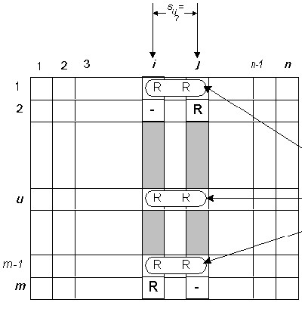
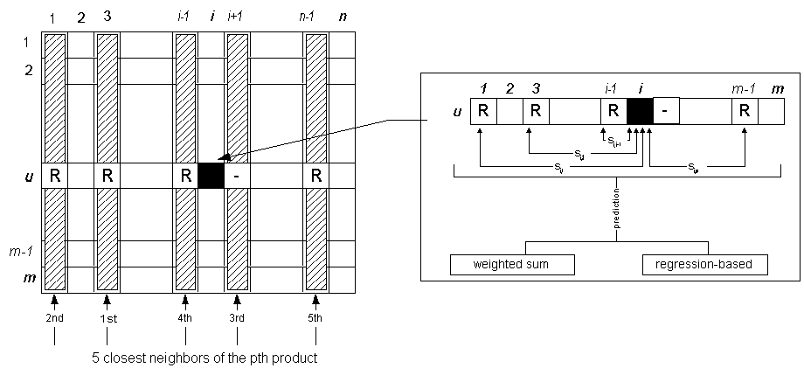
Item-to-Item Collaborative filtering (Amazon)
Item representation through a N-dimensional vector.
Each dimension corresponds to a user’s action on this item.
Rather than matching the user to similar customers, build a similar-items table by finding that customers tend to purchase together.
Recommend items with high-ranking based on similarity

Slide 42
References
- presentation inspired by slides of Wolfgang Wörndl for “User Modeling, Personalization and Recommender Systems” course in Technical University Munich
http://www11.in.tum.de/Veranstaltungen/CSCW2:UserModeling,PersonalizationandRecommenderSystems%28IN2119%29
D. Billsus and M. J. Pazzani, “Learning collaborative information filters”, In Proceedings of the Fifteenth International Conference on Machine Learning, pages 46{54, 1998
“A Comparative Study of Collaborative Filtering Algorithms”, Joonseok Lee, Mingxuan Sun, Guy Lebanon, http://arxiv.org/pdf/1205.3193.pdf
A. Paterek. Improving regularized singular value decomposition for collaborative filtering, Statistics, 2007:2{5, 2007.

Slide 43
Web Advertising
Μάθημα: Εξόρυξη γνώσης από Βάσεις Δεδομένων και τον Παγκόσμιο Ιστό
Ενότητα # 6: Web Mining
Διδάσκων: Μιχάλης Βαζιργιάννης
Τμήμα: Προπτυχιακό Πρόγραμμα Σπουδών “Πληροφορικής”

Slide 44
Advertising
Why is the advertising important?
“Advertising is a form of communication that typically attempts to persuade potential customers to purchase or to consume more of a particular brand of product or service. ”
---- Wikipedia

Slide 45
The advertising market
According to <<The Economics>>, the global advertising industry was worth $428 billion in revenues in 2006.
The global advertising market grew to just over $600 billion in 2007, according to The Kelsey Group.
The United States is the world’s largest advertising market who worth $172 billion in 2008, increased by 53% in last ten years.
The world’s second largest advertising market is China who worth $50 billion, increased by 1200% in the last ten years.
Followed by Japan who worth $34 billion, UK and German.

Slide 46
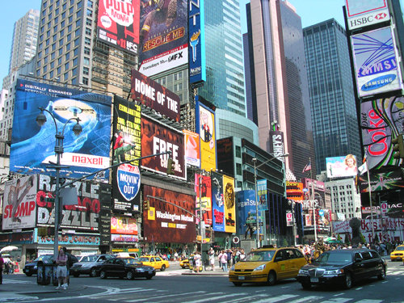
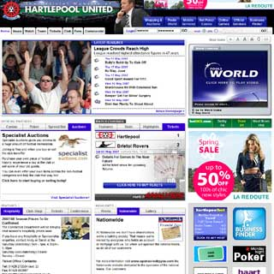
Categories of the advertising
The traditional one:
Based on the traditional media: television, radio, newspapers, billboard.
The new one:
Based on the internet: Web (online) advertising.

Slide 47
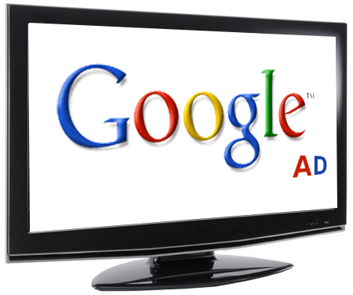
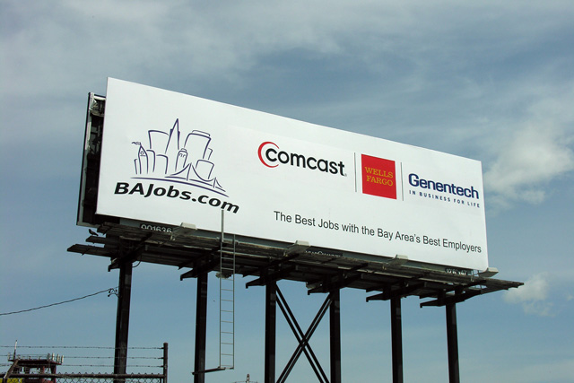
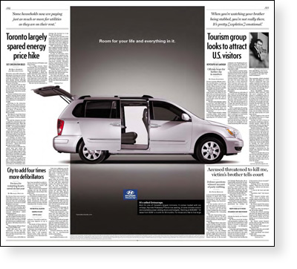
Traditional advertising
Forms:
Television, Radio, Newspaper, Magazine, Billboard, Outdoor, etc.

Slide 48
Traditional advertising
Advantages:
Huge coverage
Big spread range
Example: there are more than 1 billion audiences watched the Beijing Olympic Games Opening Ceremony all over the world!
Defects:
High investment
The cost of the advertisement in the Opening Ceremony is about $49,000 per second!
The ROI (return on investment) is low
“Half the money I spend on advertising is wasted, the trouble is, I don’t know which half.”
---- John Nelson Wanamaker
Notes:
The Interactive Advertising Bureau estimates that advertisers waste — that is, they send messages that reach the wrong audience or none at all — $112 billion a year in America and $220 billion worldwide, or just over half of their total spending.

Slide 49
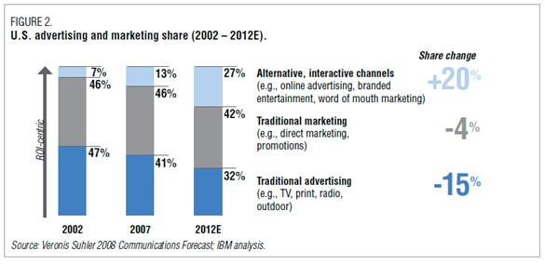
The traditional advertising is still a major component of the advertising market, however, it is challenged by Online advertising…
Notes:
Source from the IBM analysis.

Slide 50
Online advertising
Forms:
Online advertising is a form of promotion that uses the Internet and World Wide Web for the expressed purpose of delivering marketing messages to attract customers.
------ Wikipedia
Categories:
CPI
CPC
CPA

Slide 51
Online advertising
CPI (CPM)
Cost Per Impression, often abbreviated to CPI, is a phrase often used in online advertising and marketing related to web traffic. It is used for measuring the worth and cost of a specific e-marketing campaign. It is also called CPM, Cost Per Mille. “Per mille" means per thousand impressions.

Slide 52
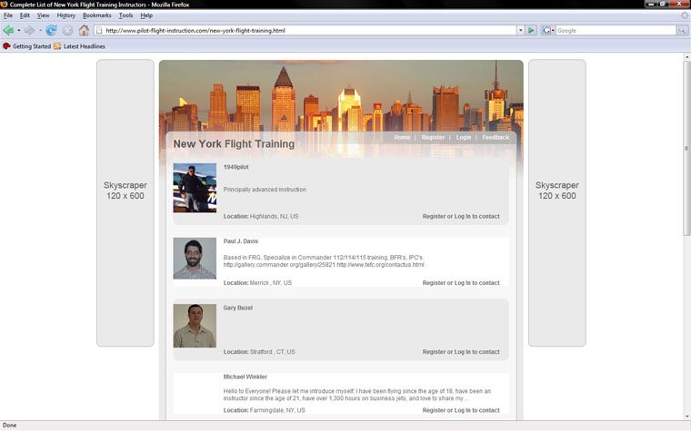
Online advertising
Example

Slide 53
Online advertising
CPC
Cost Per Click (CPC) is the amount an advertiser pays search engines and other Internet publishers for a single click on its advertisement that brings one visitor to its website.

Slide 54
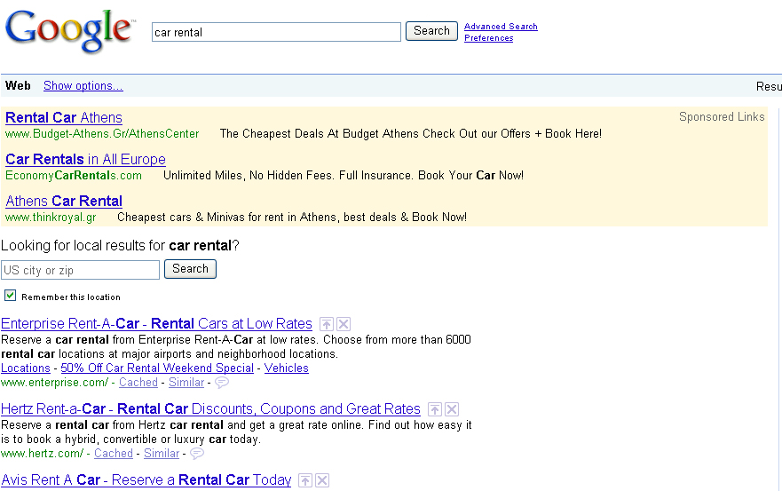
Online advertising

Slide 55
Online advertising
CPA
Cost Per Action or CPA (sometimes known as Pay Per Action or PPA) is an online advertising pricing model, where the advertiser pays for each specified action (a purchase, a form submission, and so on) linked to the advertisement.

Slide 56
Online advertising
Online advertising is targeted.
Ensure that ad viewers are the ones most likely to buy.
Online advertising enables good conversion tracking.
Tracking the reach of newspaper and television advertisements is difficult. However, internet advertising allows advertiser to track:
number of impressions (how many people see it),
# visits their business web site gets from particular ads,
conversion rates internet advertisements are getting.
y.

Slide 57
Online advertising
Online advertising can be much cheaper.
Because of the targeted nature of internet advertising and the ability to track the effectiveness of ads, conversion rates from internet advertising is typically much better than traditional mediums.
So the ROI can be much higher.

Slide 58
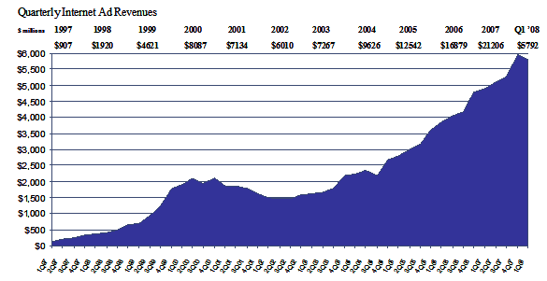
Online advertising market
Notes:
According to the Interactive Advertising Bureau (IAB):
In USA, online advertising revenues reached $5.8 billion for the first quarter of 2008 which represents a 18.2 percent increase over the same period in 2007.

Slide 59
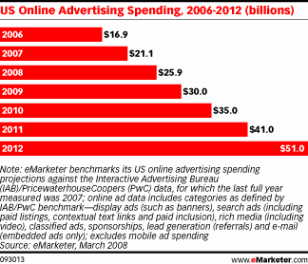
Online advertising market
Notes:
According to the eMarketer.com:
In 2008, the US online advertising spending was $25.9 billion!
And this spending will be $30 in 2009 and will reach $51 billion by the end of 2012!

Slide 60
Conclusion
Online advertising spreads fast.
its efficiency is much higher than the traditional way.
Online advertising can track advertising effectiveness.
Online advertising has a high ROI ( return on investment)

Slide 61
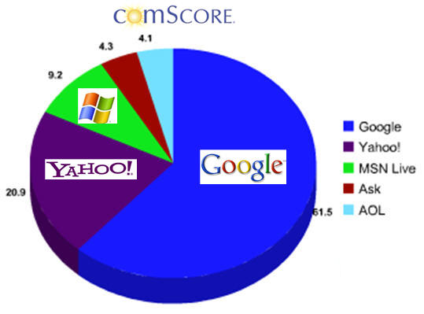
Search engine market share
2008
Notes:
Source from Nielsen.

Slide 62
Search engine market share
The search engine giant ---- Google.
Google is the most widely used search engine on the internet today. More than 60% of internet searches done online is via Google in the world. It’s market share has increased by 15% in the last 3 years!
In UK, Google has gained 79% of the search engine market!
In USA, Google maintained 72% of the search engine market, increased by nearly 30% since last three years!

Slide 63
Web Advertising
Google ---- the most powerful search engine in the world.
More than 60% of internet searches done online is via Google in the world. Which means, there are more than 200 million queries searched on Google everyday!
Google is a platform which collect a great popularity, based on this, it’s an ideal intermediate for the dissemination of information, included the advertisements.

Slide 64
Web Advertising
The three most common ways of web advertising:
Cost Per Impression (CPI)
Cost Per Action / Acquisition (CPA)
Cost Per Click (CPC) / Pay Per Click (PPC)

Slide 65
Google AdWords
What is Google AdWords?
---- Google's flagship advertising product.
In 2003 Google introduced site-targeted advertising ---- Google AdWords.
AdWords offers CPC advertising, and site-targeted advertising for both text and banner ads.
AdWords also offers CPI advertising.
This advertising product became the main source revenue of Google, which brought a revenue of $50.6 BN$ in 2013

Slide 66
Google AdWords
How does it work?
Using the AdWords control panel, advertisers can enter keywords, domain names, topics, and demographic targeting preferences, and Google places the ads on what they see as relevant sites within their content network.
If domain names are targeted, Google also provides a list of related sites for placement.
Once the somebody searches a keyword on Google, besides the natural results, Google will display the relevant advertisements on the other side.
Example:

Slide 67
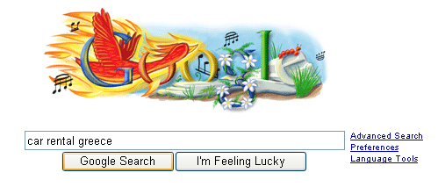
Google AdWords
When somebody searches on Google for a particular product or service…

Slide 68
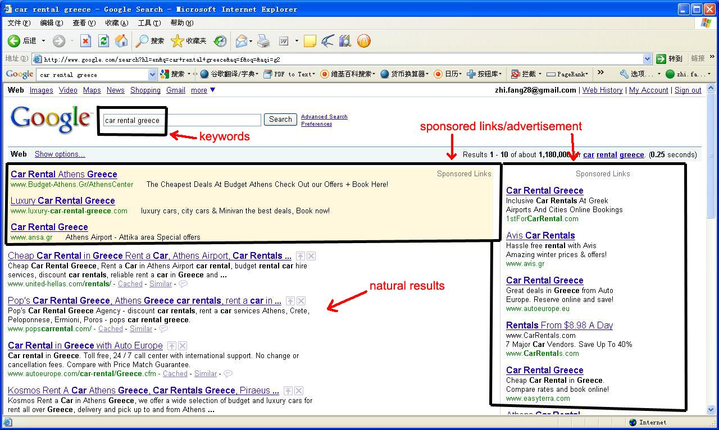
Google AdWords
The results given by Google…
Notes:
He sees the result pages. Your advertisements will appear in the sponsor’s link section.
If he clicks on your advertisement, he will come to your website…

Slide 69
Google AdWords
Once a clicks on advertisement…

Slide 70
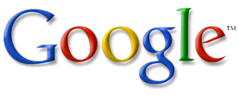
Google AdWords
What are the benefits of using Google AdWords?
High popularity, huge number of potential customer.
Google is the most powerful search engine in the world, more than 60% search engine market share.
High ROI.
Search engines drive extremely targeted traffic. He who finds your site through a search engine is already actively looking for exactly what you provide.

Slide 71
Google AdWords
What are the benefits of using Google AdWords?
Board range, variety in forms, easy to implement.
The AdWords program includes local, national, and international distribution. Google's text advertisements are short, consisting of one title line and two content text lines. Image ads can be one of several different Interactive Advertising Bureau (IAB) standard sizes.
Advertisers also have the option of enabling their ads to show on Google's partner networks. The "search network" includes AOL search, Ask.com, youtube.com, etc.

Slide 72
Google AdWords
How to use Google AdWords?
Create your own account.
Getting start with Organization, Keywords, Placements and Ad Text.
Set the maximum CPC bid ---- the bid cost.
Improve your quality ---- quality score.
Improve the rank of your ad ---- ad rank.
Pay the actual cost.

Slide 73
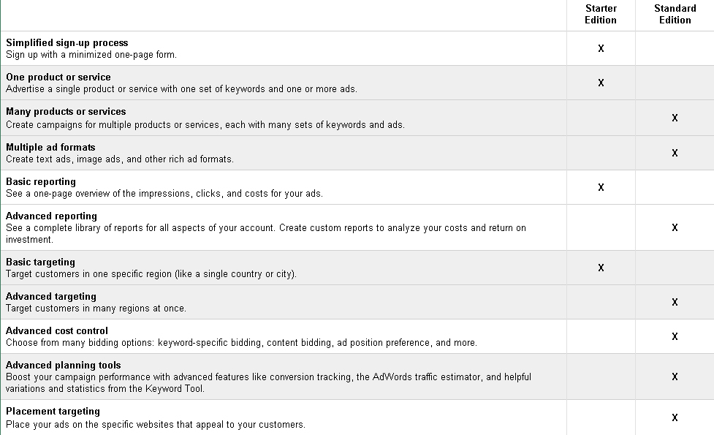
Google AdWords
Notes:
The difference between the two accounts.

Slide 74
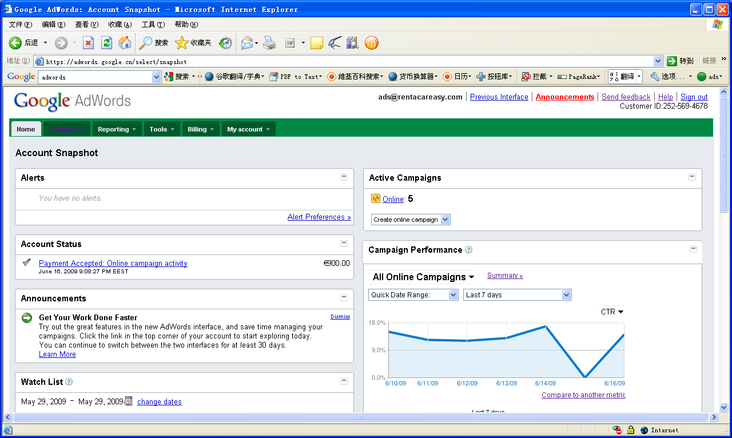
Google AdWords
Getting start with Organization, Keywords, Placements and Ad Text.

Slide 75
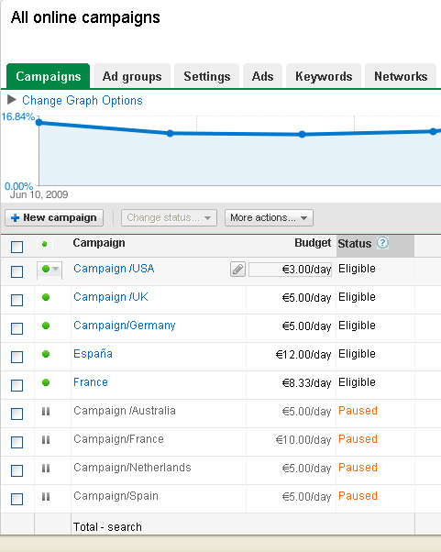
Google AdWords
Getting start with Organization, Keywords, Placements and Ad Text.
Campaign Strategy
Every account starts with a single campaign. Each campaign — whether you have one or multiple — should reflect a single, goal.
- target a certain audience,
- sell more products,
- increase signups,
Notes:
Google AdWords gives you a basic structure to work within. From here, it's essentially up to you to organize your own campaigns, ad groups, keywords and placements in a way that makes the most sense. Organization is a key component to starting off strong and to helping you determine what works and what doesn't.

Slide 76
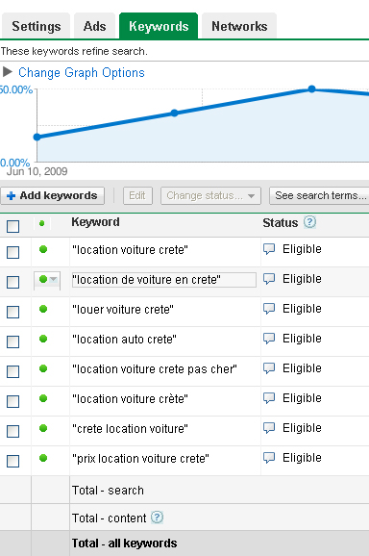
Google AdWords
Getting start with Organization, Keywords, Placements and Ad Text.
Ad Group Strategy
Just like your campaigns, your ad groups should be organized by common theme, product, or goal. Often, picking keywords and placements can lay the groundwork for your ad group strategy.
Notes:
Think hard about your keywords and placements. When choosing keywords, think of what words someone would use to search for on Google when seeking your product. Try writing down every keyword that comes to mind. You can refine them later.

Slide 77
Google AdWords
Getting start with Organization, Keywords, Placements and Ad Text.
Ad Text

Slide 78
Google AdWords
The bid cost ---- you usually pay less than this amount.
With Google AdWords, you set a cost-per-click (CPC) bid or cost-per-1000-impressions (CPM) bid. However, the AdWords Discounter works so you usually end up paying less than this amount.
AdWords Discounter calculates actual CPC or CPM. This is the actual amount you pay to maintain your ad's position above the next lower ad. Your actual CPC or CPM is never more than the maximum CPC or CPM bid you specify.

Slide 79
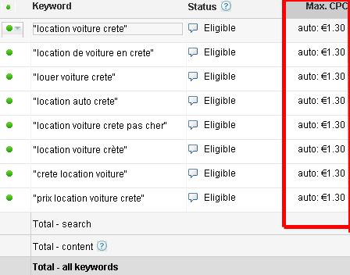
Google AdWords
The bid cost ---- Maximum CPC
Your maximum cost-per-click (CPC) is the highest amount that you are willing to pay for a click on your ad. You can set a maximum CPC at the keyword- or ad group-level. The AdWords Discounter automatically reduces this amount so that the actual CPC you are charged is just one cent more than the minimum necessary to keep your position on the page.

Slide 80
Google AdWords
Quality Score ---- the higher, the better
The AdWords system calculates a 'Quality Score' for each of your keywords. It looks at a variety of factors to measure how relevant your keyword is to your ad text and to a user's search query. A keyword's Quality Score updates frequently and is closely related to its performance. In general, a high Quality Score means that your keyword will trigger ads in a higher position and at a lower cost-per-click (CPC).

Slide 81
Google AdWords
Quality Score ---- the higher, the better
A Quality Score is calculated every time your keyword matches a search query -- that is, every time your keyword has the potential to trigger an ad.
If the campaign uses cost-per-thousand-impression (CPM) bidding, Quality Score is based on:
The quality of your landing page
If the campaign uses cost-per-click (CPC) bidding, Quality Score is based on:
The historical CTR of the ad on this and similar sites
The quality of your landing page
The best way to improve your keywords' Quality Scores is by optimizing your account.

Slide 82
Google AdWords
Ad Rank.
Ads are positioned on search and content pages based on their Ad Rank. The ad with the highest Ad Rank appears in the first position, and so on down the page.
Up to three AdWords ads are eligible to appear above the search results (as opposed to on the side). Only ads that exceed a certain Quality Score and CPC bid threshold may appear in these positions. If the three highest-ranked ads all surpass these thresholds, then they'll appear in order above the search results. If one or more of these ads don't meet the thresholds, then the next highest-ranked ad that does will be allowed to show above the search results.

Slide 83
Google AdWords
Ad Rank.
Ad Rank formulas
A keyword-targeted ad is ranked on a search result page based on the matched keyword's maximun CPC bid and Quality Score.
Ad Rank = CPC bid × Quality Score

Slide 84
Google AdWords
Ad Rank.
Improving your ranking
- Having relevant keywords and ad text,
- a strong CTR on Google,
- a high CPC bid will result in a higher position for your ad.
Because this ranking system rewards well-targeted, you can't be locked out of the top position as you would be in a ranking system based solely on price.
- AdWords Discounter monitors competition and automatically reduces actual CPC so you pay the lowest price possible for your ad's position on the page.

Slide 85
Google AdWords
The actual cost
- never pay more for a click on your ad than the matched keyword's maximum CPC bid (for search pages) or the ad group's content bid (for content pages).
- quality-based pricing system ensures that you'll often pay less than that amount.

Slide 86
Google AdWords
The actual cost
Formula
For search pages, Ad Rank is calculated by multiplying the matched keyword's CPC bid by its Quality Score. For content pages, Ad Rank is calculated by multiplying the ad group's content bid by its Quality Score.
Actual CPC = (Ad Rank to beat / Quality Score) + $0.01

Slide 87
Google AdWords
Example:
Assuming you bid $4/CPC for the keyword “car rental Greece”, with a quality score of 5.
And your competitor bids $5/CPC with his quality score equals 3.
So your pagerank will be:
4*5=20
And your competitor’s will be:
3*5=15

Slide 88
Google AdWords
As you have a higher pagerank, your ad will be displayed in front of your competitor’s.
But the actual CPC is:
15 (the pagerank of advertiser behind you) / 5 (your quality score) + 0.01euros = $3.01
So the actual price you pay for each click is lower than your bid!

Slide 89
Τέλος Ενότητας # 6
Μάθημα: Εξόρυξη γνώσης από Βάσεις Δεδομένων και τον Παγκόσμιο Ιστό, Ενότητα # 6: Web Mining
Διδάσκων: Μιχάλης Βαζιργιάννης, Τμήμα: Προπτυχιακό Πρόγραμμα Σπουδών “Πληροφορικής”

