Slide 1
Ασύρματες και Κινητές Επικοινωνίες
Ενότητα # 6: Κυτταρική Δομή Κινητών Επικοινωνιών και Συστήματα Κινητής Τηλεφωνίας 1ης & 2ης Γενιάς
Διδάσκων: Βασίλειος Σύρης
Τμήμα: Πληροφορικής

Slide 2
Κυτταρική Δομή Κινητών Επικοινωνιών
Mobile Communications Principles
Early Mobile Telephone System Architecture
Co-channel Interference and Frequency Reuse
The Cellular Concept
Cellular System Architecture
Frequency Reuse
Cell Splitting
Handoff
Handoff Initiation
Cellular System Components
Digital Cellular
Time Division Multiple Access (TDMA)

Slide 3
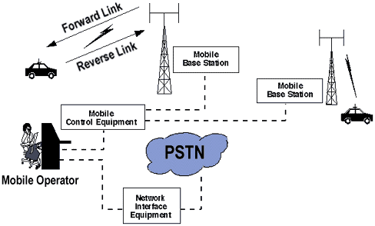
Mobile Communications Principles
each mobile (station)
uses a separate, temporary radio channel to talk to the cell site
the cell site (base station)
talks to many mobiles at once, using one channel per mobile
a pair of frequencies are used for communication
one (the forward link) for transmitting from the cell site
another frequency (the reverse link) for the cell site to receive calls from the users
mobiles must stay near the base station
to maintain communications
radio energy dissipates over distance
mobile (voice) networks include
mobile radio service
operates in a closed network
no access to the telephone system
mobile telephone service
interconnection to the telephone
network

Slide 4
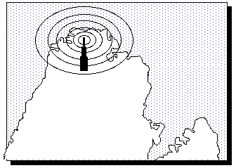
Early Mobile Telephone System Architecture
Traditional mobile service
structured in a fashion similar to TV broadcasting
one powerful transmitter in a (e.g., metropolitan) area
could broadcast in a radius of up to 50 km
The cellular concept
different!
many low-power transmitters placed throughout an area
×
×
•
•
×
×
×
×
×
×
•
•
×
×
×
•
×
×
•
×
×
×
×
•
×
×
•
×
×
•
×

Slide 5
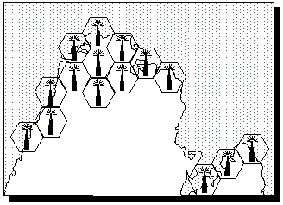
Co-channel Interference and Frequency Reuse
co-channel interference
caused by mobile units using the same channel in adjacent areas
all channels cannot be (re-)used in every cell
areas have to be skipped before the same channel is reused
frequency reuse is still a key technique for mobile communications systems
interference
is not proportional to the distance between areas, but to the ratio of the distance between areas to the transmitter power (radius) of the areas
reducing the radius of an area by 50%, increases the number of potential customers in an area 4x
systems with a 1 Km radius can have 100 times more channels than systems with areas 10 Km in radius

Slide 6
The Cellular Concept
variable low-power transmission levels
allow cells to be sized according to
subscriber density
traffic demands
as the population or traffic grows
cells can be added to accommodate that growth
frequencies used in one cell cluster can be re-used in other clusters
conversations can be handed-off from cell to cell
to maintain continuous service as the user moves between cells
the base station can communicate with mobiles as long as they are within range
×
×
•
•
×
×
×
×
×
×
•
•
×
×
×
•
×
×
•
×
×
×
×
•
×
×
•
×
×
•
×

Slide 7
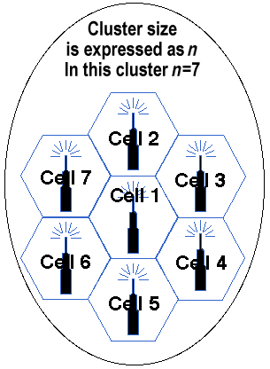
Cellular System Architecture
engineering plan
clusters
frequency reuse
handovers
cells
basic geographic unit of a cellular system
base stations transmit over small geographic areas
often represented as hexagons
true shape of cells is not a perfect hexagon
because of constraints imposed by
natural terrain
man-made structures
cell size varies depending on the landscape
clusters
a group of cells
no channels are reused within a cluster

Slide 8
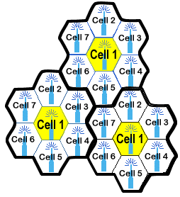
Frequency Reuse
no channels are reused within a cluster
cells with same number have same group of frequencies
they are far enough so that there is no interference
number of available frequency groups is 7
frequency reuse factor=7
each cell is using 1/7 of available channels
Hexagon cell pattern, values of N=1,3,7,9,12,13,16,19,21

Slide 9
Reuse patterns
A
A
B
B
N = 3
C
C
C
A
A
A
B
B
B
C
C
B
G
C
B
A
G
C
N = 7
F
D
A
E
F
D
E

Slide 10
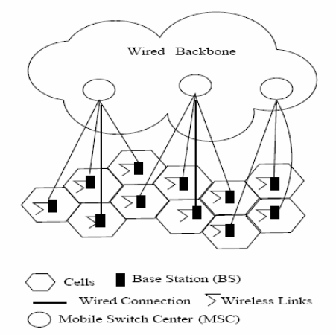
Cellular architecture
Cellular backhaul or Radio Access Network: interconnect base stations to backbone
Can be wired or wireless (point-to-point)

Slide 11
Increasing cellular capacity
Cell splitting
smaller cells in high demand areas
smaller cells => more base stations & more frequent handoffs
smaller cells (micro cells) => reduced transmission power
Frequency borrowing
congested cells borrow frequencies from less congested cells
dynamic allocation of frequencies
Sectorization
cell divided into sectors (typically 2-6)
use directional (sector) antennas
3-sector cell

Slide 12
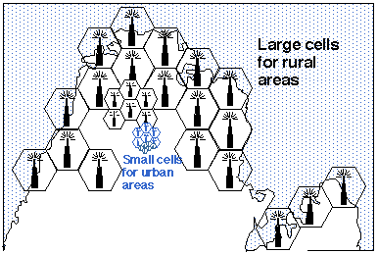
Cell Splitting
creating full systems with many small areas impractical
cell splitting
as a service area becomes full of users
split a single area into smaller ones
urban centers
can be split into as many areas as necessary
to provide acceptable service levels in heavy-traffic regions
rural regions
larger, less expensive cells

Slide 13
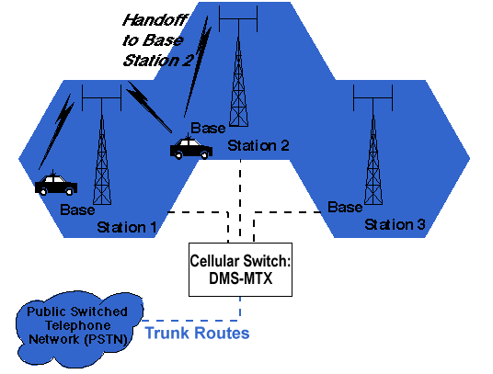
Handoff
mobile subscriber travels from one cell to another during a call
adjacent cells do not use the same radio channels
call must either
be dropped or
transferred
from one radio channel to another when a user crosses cells
dropping the call is unacceptable
hand-off (US, hand-over in UK)
mobile telephone network automatically transfers a call
from radio channel to radio channel, as a mobile crosses adjacent cells

Slide 14
Handoff Initiation
when MS moves out of the coverage area of a given cell site
the reception becomes weak
the cell site (in use) or the MS requests a handoff
system switches the call to
a new site (and channel) with
a stronger signal
without interrupting the call or alerting the user
call continues as long as the user is talking, and the user does not notice the handoff at all

Slide 15
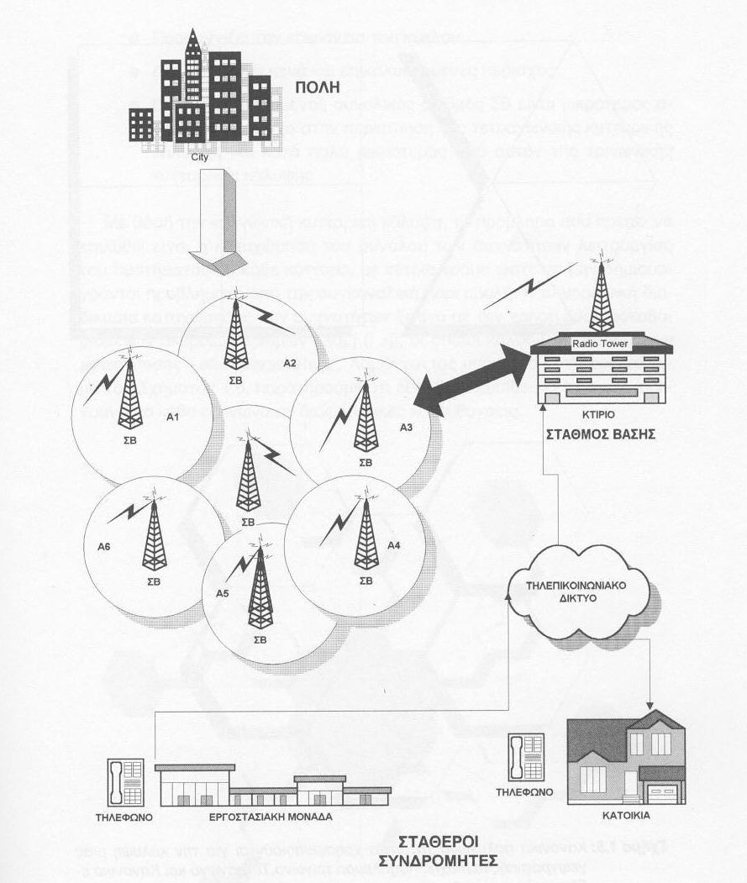
Cellular System Components
public switched telephone network (PSTN)
mobile telephone switching office (MTSO)
cell site with antenna system
mobile subscriber unit (MSU)

Slide 16
Cellular System Component Definitions
PSTN (public switched telephone network)
made up of:
local networks
the exchange area networks, and
the long-haul network (on a worldwide basis)
Mobile Telephone Switching Office (MTSO)
the central office for mobile switching
houses the mobile switching center (MSC), field monitoring, and relay stations for switching calls from cell sites to wireline central offices (PSTN)
in analog cellular networks, the MSC controls the system operation:
controls calls, tracks billing information, and locates cellular subscribers
the Cell Site
refers to the physical location of radio equipment (providing coverage within a cell)
includes:
power sources
interface equipment
radio frequency transmitters and receivers, and
antenna systems

Slide 17
Συστήματα Κινητής Τηλεφωνίας 1ης & 2ης Γενιάς
1st generation
AMPS
2nd generation
GSM
DAPMS, IS-54, IS-136 (TDMA)
CDPD (Packet Data extension)
IS-95 (CDMA)

Slide 18
North American Analog Cellular Systems
originally devised in the late 1970s to early 1980s
operate in the 800-MHz range
system development takes into consideration many different, and often opposing, requirements
often a compromise between conflicting requirements results
cellular development involves the following basic topics:
frequency and channel assignments
type of radio modulation and modulation parameters
maximum power levels
messaging protocols
call-processing sequences

Slide 19
AMPS: Advanced Mobile Phone Service
U.S. (’80s)
Analog
cell size: 1km² … 100km²
indoor coverage: problematic
×
×
•
•
×
×
×
×
×
×
•
•
×
×
×
•
×
×
•
×
×
×
×
•
×
×
•
×
×
•
×

Slide 20
Advanced Mobile Phone Service (AMPS)
released in 1983
a fully automated mobile telephone service
the first standardized cellular service in the world
used throughout the world
United States
South America
China
Australia
designed for use in cities, later expanded to rural areas
maximized the cellular concept of frequency reuse
by reducing radio power output
AMPS telephones (or handsets)
have the familiar telephone-style user interface
are compatible with any AMPS base station
mobility between service providers (roaming) possible

Slide 21
AMPS (cont.)
using the 800-MHz to 900-MHz frequency band
30-kHz bandwidth for each channel
frequency modulation (FM) for radio transmission
in the US, Frequency Division Duplex (FDD):
separate frequencies for
transmissions from mobile to base station
transmissions from the base station to the mobile subscriber
(alternative to FDD is Time Division Duplex--TDD)

Slide 22
AMPS Limitations
low calling capacity
limited spectrum
no room for spectrum growth
poor data communications
minimal privacy
inadequate fraud protection

Slide 23
Narrowband Analog Mobile Phone Service (NAMPS)
introduced as an interim solution to AMPS capacity problems
operational in 35 U.S. and overseas markets
combines
existing voice processing
with digital signaling
tripling the capacity of today's AMPS systems
3 channels from a single AMPS 30-kHz channel
FDM
provides 3 users in an AMPS channel
increased probability of interference
thus lower voice quality
because channel bandwidth is reduced for a call (compared to AMPS)

Slide 24
Συστήματα Κινητής Τηλεφωνίας 2ης Γενιάς
GSM (discussed extensively later)
TDMA (IS-54, then IS-136)
CDMA (IS-95)
“marketing name” PCS (IS-95 based)
smaller cells, higher speeds

Slide 25
AMPS/DAMPS Comparison

Slide 26
CDPD: Cellular Digital Packet Data
CDPD: data (IP) on AMPS (extended)
AMPS: U.S. (’80s)
Analog
cell size: 1km² … 100km²
modems for data (error control)
20-30 s set-up
up to 4.8 Kb/s
CDPD
exploiting 30+% idle time on AMPS circuit-switching channels
40 ms delay for voice to recapture channel
channel hopping
up to 19.2 Kb/s
IP

Slide 27
GSM - Global System Mobile
European, introduced in 1992
digital cellular, TDMA based
extended for data traffic at 9.6 Kb/s
short messages (160 Bytes)
frequencies
900 Mhz, 1800 Mhz (DCS), in Europe
1900 Mhz in the U.S.
×
×
•
•
×
×
×
×
×
×
•
•
×
×
×
•
×
×
•
×
×
×
×
•
×
×
•
×
×
•
×

Slide 28
Ασύρματες και Κινητές Επικοινωνίες
Ενότητα # 6: Κυτταρική Δομή Κινητών Επικοινωνιών και Συστήματα Κινητής Τηλεφωνίας 1ης & 2ης Γενιάς
Διδάσκων: Βασίλειος Σύρης
Τμήμα: Πληροφορικής

