Slide 1
The Global Investment Fund Industry

Slide 2
Institutional Investors
Financial institutions that collect savings and other deposits and invest long-term in financial markets
Institutional investors have grown rapidly in the recent decades: e.g. in the UK collectively own more that 80% of UK ordinary shares, compared to private investors.
Banks
Insurance Companies
Depository institutions (e.g. commercial banks, savings and loan associations, etc.)
Pension Funds, Mutual funds, Hedge Funds
Investment companies
Endowment funds (e.g. universities, nonprofit organizations, churches, hospitals, etc.)

Slide 3
Who are the most important Institutional Investors in Europe ? (by share of assets under management, 2015, by type of investor)

Slide 4
Investment Management – 4 Key Issues
International Investment Funds Association (IIFA)
Investment funds (IFs) should be operated at all times in the interests of investors.
Investors in investment funds should be provided with the information needed for informed investment decisions.
The process by which investment funds are sold by intermediaries should be transparent and have as its goal the purchase by investors of suitable products and services.
Investment funds should be able to compete in the marketplace on a level playing field with other savings and investment products.

Slide 5
The Global IF Industry (IIFA)

Slide 6
Where do these funds invest ?
Asset classes
Cash (or equivalently, short term Treasury bills).
Equities (shares of stock, either individual or a fund).
Bonds (long term government or corporate bonds)—often called “fixed income”.
Additional asset classes “Alternative Investments”
Hedge funds
Commodities
Derivatives
Real estate (usually commercial)
Private equity (e.g. a fund that directly invests in private (not listed) companies)

Slide 7
What is the distribution of investments in Asset Classes? (source: The Global IF Industry (IIFA))

Slide 8
What is the distribution of investments in Asset Classes? (source: The Global IF Industry (IIFA))

Slide 9
Closed end Funds – Open end Funds
Collective Investments
Mutual Funds Investment Trusts
Sell Units the quantity of which Sell shares the quantity
fluctuates with Supply & Demand of which remains fixed
(Open-end funds) (Closed-end funds)

Slide 10
Mutual Funds (MFs) vs Exchange Traded Funds (ETFs)
MFs are actively managed, i.e. the fund manager makes decisions about how to allocate assets in the fund according to a stated set of objectives.
MF shares are issued and redeemed on demand at a specific Net Asset Value (NAV) that is determined at the end of each trading day (based on the total market value of the fund's holdings).
In MFs there's no fixed number of shares; if many people want to buy in, the fund company will issue more shares.
ETFs can be traded like stocks, they are usually passively managed and based more simply on a particular market index.

Slide 11
Mutual Funds vs Investment Trusts (ITs)
An Investment Trust (IT) invests in a relatively fixed portfolio of investments.
ITs are closed-end funds.
Investors pool their money and employ a fund manager (who tends to charge a lower fee than a mutual fund manager).
IT managers can use gearing.
Investors who want to trade shares of an IT do so on the secondary market.
Unlike a MF, IT share prices in the secondary market may be priced above or below the net asset value of the trust's actual holdings.

Slide 12
Trading Systems & Orders

Slide 13
Basic Trading Systems
Order-driven market, in which interested buyers and sellers submit bid-and-ask prices (buy and sell orders) for a given stock to a central location where the orders are matched by a broker who does not own the stock but acts as a facilitating agent.
Participants also refer to this system as price-driven because shares of stock are sold to the investor with the highest bid price and bought from the seller with the lowest offering price.

Slide 14
Basic Trading Systems
Dealer market (quote-driven market) where individual dealers provide liquidity for investors by buying and selling the shares of stock for themselves.
Ideally, with this system there will be numerous dealers who will compete against each other to provide the highest bid prices when you are selling and the lowest asking price when you are buying stock.
Clearly, this is a very decentralized system that derives its benefit from the competition among the dealers who are connected by technology to provide the best price for the buyer and seller.

Slide 15
Orders
Market Orders
The most frequent type of order, an order to buy or sell a stock at the best current price indicting a willingness to buy/sell immediately at the time the order reaches the exchange; provides immediate liquidity
E.g. for General Electric (GE) the prevailing price is 30 bid–30.05 ask:
If you placed a market buy order for 100 shares, you would buy 100 shares at $30.05 a share (the lowest ask price) for a total cost of $3,005 plus commission.

Slide 16
Orders
Limit Orders
The limit order specifies the buy or sell price.
You might submit a limit order bid to purchase 100 shares of Coca-Cola (KO) stock at $60 a share when the current market is 65 bid–65.10 ask, with the expectation that the stock will decline to $60 in the near future.
You must also indicate how long the limit order will be outstanding.
A limit order can be instantaneous (“fill or kill”) i.e. fill the order instantly or cancel it.
It can also be good for part of a day, a full day, several days, a week, or a month.
It can also be open ended, or “good until cancelled” (GTC)

Slide 17
Orders
A stop loss order is a conditional market order whereby the investor directs the sale of a stock if it drops to a given price.
You buy a stock at $50 and expect it to go up.
If you are wrong, you want to limit your losses.
To protect yourself, you could put in a stop loss order at $45.
In this case, if the stock dropped to $45, your stop loss order would become a market sell order, and the stock would be sold at the prevailing market price.

Slide 18
Short sales
Most investors purchase stock (“go long”) expecting to derive their return from an increase in value.
If you believe that a stock is overpriced, however, and want to take advantage of an expected decline in the price, you can sell the stock short.
A short sale is the sale of stock that you do not own with the intent of purchasing it back later at a lower price.
Specifically, you would borrow the stock from another investor through your broker and sell it in the market.
Subsequently you would replace it by buying at a price lower (you hope) than the price at which you sold it (this is referred to as covering your short position).

Slide 20
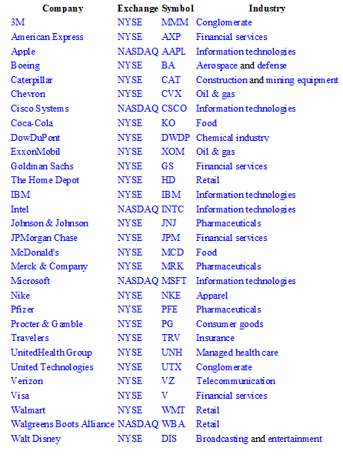
Indexes
A stock index is a compilation (portfolio) of stocks constructed in such a way as to track a particular market, sector, commodity, currency, bond, or other asset.
The Dow Jones Industrial Average (Dow, DJIA, see side) indicates the value of 30 large US, publicly owned companies
Index-weighting is how the shares in an index basket are allocated; how the index is designed.
For example, weighting may be based on market capitalization. The shares of each stock in a cap-weighted index are based on the market value of the outstanding shares.

Slide 21
Indexes
A primary application is to use the index values to compute total returns and risk measures for an aggregate market or some component of a market
Many investors use the computed return-risk results as a benchmark to judge the performance of individual portfolios.
A basic assumption when evaluating portfolio performance is that any investor should be able to experience a risk-adjusted rate of return comparable to the market; hence, a superior portfolio manager should consistently do better than the market.
Therefore, an aggregate stock or bond-market index can be used as a benchmark to judge the performance of professional money managers.

Slide 22
Indexes
An obvious use of indexes is to develop an index portfolio.
It is difficult for most money managers to consistently outperform specified market indexes on a risk adjusted basis over time.
Creation of index funds and exchange traded funds (ETFs), whose purpose is to track the performance of the specified market series (index) over time.
The development of comprehensive, well specified bond-market indexes and the inability of most bond-portfolio managers to outperform these indexes have led to a similar phenomenon in the fixed-income area (bond-index funds)

Slide 23
Example: Major Indexes (11/2/2019)

Slide 24
Example: Major Indexes (11/2/2019)

Slide 25
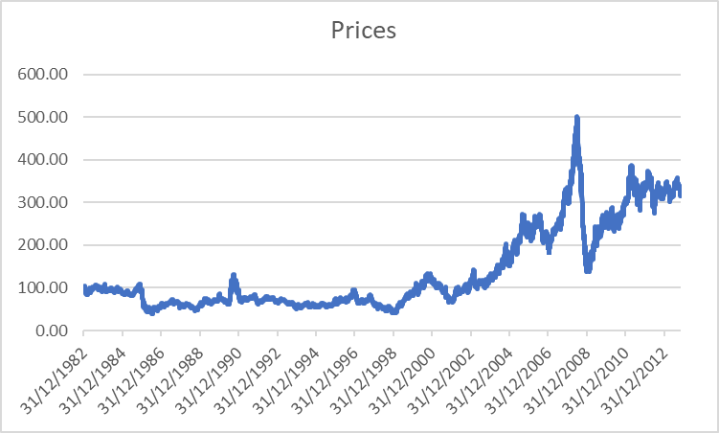
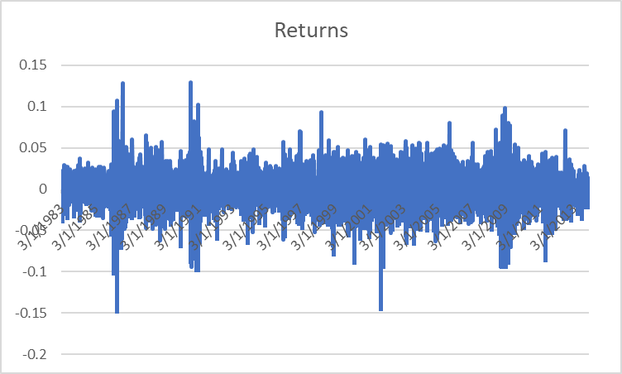
The Dow Jones-UBS Commodity Index (renamed the Bloomberg Commodity Index in 2014) is composed of futures contracts on physical commodities and is also a broadly diversified index that allows investors to track commodity futures

Slide 26
Indexes
Gain exposure to certain markets or sectors without having to buy all the index constituents
Lower transaction costs
E.g. the total capitalization of the Russell 3000 Index, which includes more than 98% of the market's current capitalization, has recently reached $30 trillion.
Exchange Traded Funds (ETFs)
Are constructed to mimic an index, the “basket” is pre-packaged and ready for trade, tax advantages, ease of trade

Slide 27
Indexes
Indexes are often used as benchmarks by investment managers and measure the performance of the manager who is managing the portfolio.
Items to consider when looking at a stock index:
Boundaries: if the universe is the FTSE 100, then the boundaries are large capitalisation firms listed on the London Stock Exchange.
Criteria for including a stock in the universe: including stocks ranked by market capitalisation and then selecting the highest 100.
Weighting: How stocks are weighted within the index: price, value, equal

Slide 28
Indexes
A price-weighted index is biased towards the shares with the highest price. A share with a price of $400 will be weighted four times more heavily than a share of $100. However, it is very simple to construct and easily understood
A value-weighted index is biased towards companies with larger market capitalisations. For instance, an increase in share price of a very large company in the index will have a bigger impact on the index than the increase in share price of a smaller company.
An equally-weighted index will capture characteristics of smaller companies in the index (or at least since they have the same weighting as the larger companies they are not crowded out in the same way as a value weighted index).

Slide 29
Example: Index composition value-weighted
An index divisor is calculated to make reporting of the index level easier and more manageable.

Slide 30
The Portfolio Management Process
Key Issues

Slide 31
Key Steps - STEP 1: Planning
Identify and specify the investor’s objectives and constraints
Objectives are the preferences about risk and return
Constrains are, among others liquidity requirements,
investment horizon,
tax issues,
regulation
Design Investment Strategy (passive, active, semi-active)
Investment Policy Statement (see below)

Slide 32
Key Steps - STEP 2: Execution
The manager selects the specific assets for the portfolio in accordance to the investment strategy (see step 1) using information from financial analysts and expectations about future capital market conditions.
Poor execution may increase costs to the portfolio, this reducing portfolio performance.
Costs include transaction costs: commissions; fees to exchanges; missed trade opportunity costs
The portfolio is created as outlined in Stage 1.

Slide 33
Key Steps - STEP 3: Feedback
Monitoring: changes in the investor’s circumstances and changes in economic capital market conditions.
Rebalancing: if there are significant changes a revision to the portfolio must take place

Slide 34
Investment Policy Statement (IPS) (see examples)
A document drafted between a portfolio manager and a client that outlines general rules for the manager.
This statement provides the general investment goals and objectives of a client and describes the strategies that the manager should employ to meet these objectives.
Specific information on matters such as asset allocation, risk tolerance, and liquidity requirements are included in an investment policy statement.
The investment policy statement is crucial for portfolio management.
Investor Attitude to risk: different methodologies but generally six questions provide an understanding (CFA)

Slide 35
Investment Policy Statement (IPS) (see examples)
The major components of an IPS (see CFA) generally include:
An introduction, which characterises the client.
A statement of purpose.
A statement of duties and responsibilities.
Procedures that explain how to keep the investment policy statement current and what to do in response to specific conditions.
Investment objectives: this is a key component for the portfolio manager.
Investment constraints: this is also a key component for the portfolio manager.
Investment guidelines: this includes information on leverage, derivatives, hedge funds and alternative investments, or possibly ethical investing or exclusion of investment in specific assets
Evaluation and review.
Appendices: information on strategic asset allocation and the rebalancing policy.

Slide 36
Investment Policy Statement (IPS) (see examples)
Risk Objectives
Reflect the risk tolerance of the client.
E.g. an absolute risk objective would be not to have a loss greater than x% in any 12 month period.
A relative risk objective would relate risk to a benchmark which is expected to reflect a measure of systematic risk in the economy. For example, a client may wish a return which is within 2% of the benchmark approximately 95% of the time.
Risk tolerance of a client can be measured as above average or below average. Much may depend upon the time horizon.
A longer time horizon, say thirty years, offers the opportunity to have an above average risk tolerance (since there is more time to receive compounded returns and to make adjustments to the portfolio).
A short time horizon, say two years, suggests it would be appropriate to have a lower risk tolerance. Of course, other information such as current wealth, future expenditure, liabilities, would also be taken into consideration.

Slide 37
Investment Policy Statement (IPS) (see examples)
Return Objectives
An absolute return objective would be to achieve a particular x% return in any 12 month period.
A relative return objective would be to achieve a return relative to a benchmark. For example, to outperform the benchmark by 2% approximately 95% of the time.
It is also quite usual to state return objectives before fees and after fees (or taxes, etc).

Slide 38
Investor Attitude to risk
1) How is risk understood and measured? Variance, standard deviation, VaR. e.g. the probability of a decline in value of, say 3%, during a specified holding period.
2) How willing is the investor to take on risk? (see discussion later, on ESMA guidelines)
3) What is the investor’s ability to take risk? What are the investor’s liabilities or obligations? What is the investor’s financial strength?
4) How much risk is the investor both willing and able to bear? That is, what is the investor’s risk tolerance (capacity to accept risk). This term can also be captured by risk aversion.
5) What are the specific risk objectives?
6) How should the investor allocate risk? I.e. allocate the risk budget to assets that result in a maximisation of the overall risk-adjusted return.

Slide 39
Thank you for your attention !

