Slide 1
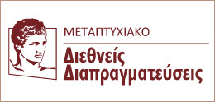
International Organizations (IOs) and Negotiations
Dimitris Bourantonis (bouranto@aueb.gr)
Professor
Department of International and European Economic Studies
Athens University of Economics and Business

Slide 2
Three Types of Negotiations Involving IOs
Intra-IO Negotiations
Among stakeholders (i.e. member-states) about the functioning of the IO
IO with one stakeholder (i.e. member-state)
Inter-organizational Negotiations (IO-IO)
Negotiations between ‘nested’ organizations (e.g. Regional Organizations in IOs)
Negotiations between independent or interdependent IOs (i.e. without an overarching authority: EU-NATO on security issues)
IO with Third Actors (most probably states or other entities)

Slide 3
Key IO Features that Affect Negotiations (1/5)
In other words, what is different when IOs come into play in negotiations?
Negotiations involve by default multilateral orders
Free riding and collective action problems
Multiple principals (states) at least from one side (maybe both), entailing negotiating agents (IOs’ bureaucracy)
‘Principal-agent’ issues: significance of mandate, control and monitoring to avoid the pursuit of autonomy
(In)voluntary defection (with significant costs)
Multi-level Games (three levels of negotiations: national-IO-international negotiation)

Slide 4
Key IO Features that Affect Negotiations (2/5)
Size and scope of an IO
Existence of mini-lateral or sublateral groupings within an IO that create additional complexity (contra: these groupings actually simplify the work of an IO!)
Multi-thematic IOs entail opportunities for ‘package deals’ (contra: more issues, more chaos!)
Intra-IO process of preference aggregation is more protracted and often cumbersome
Flexibility ↓↓↓ → agreement more difficult
Clear demarcation of IO’s contract zone → overall, less uncertainty; but, for IO, less chances for information concealing, bluffing etc.

Slide 5
Key IO Features that Affect Negotiations (3/5)
Available Resources: Magnitude and mobilization capacity
Tangible resources
‘Power of the Purse’ (e.g. EU contributes more than 50% of global Aid and Development funds)
Political-military-diplomatic resources (e.g. NATO and any military alliance)
Intangible resources
Bestowing legitimacy (e.g. UNSC for the use of force, globally; LAS for the fall of the Gaddafi regime in Libya)
Norm setter (e.g. IMO for migration flows; ILO for basic labour regulatory standards )
Cultural/ideological influence (e.g. IMF promoting the neo-liberal economic paradigm)
→ Critical Question: Does the IO have own resources or is it dependant upon the stakeholders?

Slide 6
Key IO Features that Affect Negotiations (4/5)
Institutional Organization and Modus Operandi of IOs
Role of Chair/Presidency/Secretary General/Secretariats: mandate, functions and control
Intra-IO decision-making rules: they affect policy-making and the negotiating mandate
Multiple veto points and unanimity → narrow national interests of member-states prevail → narrow negotiating mandate for the IO
Majority voting → member-states more willing to compromise → broader negotiating mandate
Ratification process of an agreement
Overturning any mandate overshooting (by the IO bureaucratic machinery)
Ultimate control by the principals - stakeholders
→ May lead to unpleasant reverberations

Slide 7
Key IO Features that Affect Negotiations (5/5)
Level of Homogeneity
Preference homogeneity: IO as a solid bloc in negotiations
Cultural/ideological homogeneity: Affinity may help overcome preference divergence → coherence of IO ↑
→ Homogeneity facilitates stakeholders’ mobilization (contra: may also increase chances of free riding)

Slide 8
1. Intra-organizational Negotiations

Slide 9
Among stakeholders (i.e. member-states)
Size, Scope and Modus Operandi
Number of constituent members
Depth and extent of interactions
Repetitive games (how often?)
Sovereignty sharing (e.g. EU)
Consensus seeking norm: negotiating advantage for members whose agreement is needed
Availability of national resources
Scarce resources → ill-equipped diplomatic teams
E.g. WTO’s biennial ministerial meetings held away from Geneva, powerful states dispatch large delegations

Slide 10
Opportunities for extensive outreach activity at low cost
bi-, mini- or polylateral diplomacy;
reaching out to friends and adversaries on any kind of issue;
UN General Assembly meeting every September
Who Negotiates?
Often, civil servants other than MFA staff
economic affairs negotiations: WTO, IMF, World Bank;
ministries of agriculture in the infamous WTO negotiations about farm subsidies;
in ILO, government officials in the labour sector take the lead
MFAs: managerial role – ‘inter-civil-servant-negotiations’
E.g. Role of National Permanent Representations to the EU
‘de facto’ and ‘de jure’ diplomats
Former group: consultative position in the formulation of a negotiation strategy
Latter group: formally in charge of national delegations at multilateral negotiations in IOs

Slide 11
Negotiations and deliberations (may) bring about socialization and generate learning processes (for both member-states and the respective IO)
OECD’s data-based authenticity → ideational authority
Changes to the conflictual style of a new member-state (e.g. Greece in the EU in the 1980s)
Engrenage effect of states’ officials
IO: process of organizational learning
E.g. International Maritime Organization, 1995 Convention;
EU Commission and the Codex Alimentarius

Slide 12
IO with one/many stakeholder(s)
IOs not unitary actors
(intra-IO) bureaucratic turf battles
normative and content-based preference heterogeneity
e.g. UN High Commission for Refugees (UNHCR) on Internally Displaced Persons (IDPs): division between regional operational bureaus and legal ones
Technicality of issues blurs distinction between the IO’s bureaucracy of experts and national representatives
not technical first, political next but rather simultaneously
e.g. WTO, World Meteorological Organization

Slide 13
IOs Bureaucracies as agenda-setters and negotiation facilitators
Bureaucrats of the World Meteorological Organization and the UN Environmental Programme (UNEP) initiated and organized the Intergovernmental Panel on Climate Change (knowledge production and dissemination);
UNEP bureaucrats key role in calling and directing the first conferences on negotiating an international Treaty on ozone-depleting chemicals, in the 1980s;
Key role in negotiations under the biodiversity convention, ozone treaties, and the climate conventions, even against the intention of member-states as in the case of the desertification secretariat (‘activist bureaucracies’)

Slide 14
Capacity of imposing sanctions to a stakeholder
Enforcement of decisions critical to negotiations with recalcitrant member-states
Economic and political sanctions (penalties, fines, etc)/Expulsion → Increased negotiating leverage for the IO

Slide 15
2. Inter-organizational Negotiations

Slide 16
Inter-Secting Multilateralisms
IO-IO relationships: inter-secting multilateralism
IO performance is a key parameter of its continuing existence and survival (e.g. Food and Agricultural Organization –FAO- felt threatened by the ascendance of the World Food Program – WFP)
IOs operate in a context of environmental interconnectedness: one IO’s performance is more often than not linked with other IOs
Theoretical perspective of Inter-Organizationalism (Biermann, R. and Koops, J.A., eds., 2017. Palgrave Handbook of inter-organizational relations in world politics, London: Palgrave Macmillan)

Slide 17
Inter-Organizationalism
In general, IOs cherish their organizational autonomy
So, why do they relate with other IOs? What determines their ‘win sets’ (as autonomous actors, not as the sum of their constituent member-states but on top of them)?
Three Reasons (organizational studies, US, 1960s):
Resource scarcity:
Lack of resources leads to poor performance, so IOs often seek economies of scale to save assets and avoid becoming irrelevant/obsolete for their members
Normative congruence:
Ideological belief in synergistic linkages (emphasis on multilateralism and cooperation as the basic modus operandi of the international system) (e.g. EU)
Extra-organizational force:
Presence of a powerful third actor (state or other IO) outside the IO that induces or imposes collaboration between IOs (e.g UN and African regional schemes)

Slide 18
Inter-Organizational Relations
‘Nested’ Inter-Organizational Relations
Interaction of IOs within a broader framework
Regional Organizations in the UN system
African inter-regionalism under the aegis of the African Union
Negotiations conditioned by the features of the overarching framework
‘Non-Nested’ Inter-Organizational Relations
Interactions in the absence of a broader framework
Inter-regionalism
On the same continent (e.g. MERCOSUR – Andean Community (CAN)
Cross-continental (e.g. EU and the world, South-South, MERCOSUR-GCC/Gulf Countries Council, or MERCOSUR-SACU/Southern African Customs Union)
Negotiations affected by the features of the IOs per se

Slide 19
‘Nested’ inter-organizational negotiations: Regional organizations in the un and beyond

Slide 20
‘Nested’ Organizations
Elaboration of the concept:
Regional or thematic organizations that are members of a broader institutional framework
This framework may be an encompassing IO or an international regime (trade regime, security regime, etc)
Thematic differentiation and number of member-states distinguish ‘encompassed’ and ‘encompassing’ organizations
‘Nestedness’ entails some kind of hierarchical relationship
Operating rules at both levels are convergent
Clear in the UN system, less clear in other regimes (e.g. EU competition and Single Market rules as opposed to WTO ones)

Slide 21
Two critical questions
Are ‘nested organizations’ doomed in any negotiations with their overarching IO? IO-RO dimension
How do regional groupings (inter)act in multilateral negotiations within such settings? RO-RO dimension

Slide 22
Regional Organizations (ROs) in the UN
Already at the UN founding conference (1945), strong pressures for the accommodation of ROs within the UN universal framework
Five rules of engagement:
activities of ROs regarding international peace and security should be consistent with the purposes and principles of the UN
states are encouraged to work through ROs before going to the UNSC
the UNSC may use ROs for the settlement of regional disputes and/or conflicts.
ROs can take no enforcement action without the UNSC authorization.
the UNSC should be kept fully informed for the activities undertaken or contemplated by ROs for the maintenance of peace and security.

Slide 23
In practice, rhetoric universalism undermined by regionalism
UNSC hesitant to exercise its right of intervention in a crisis already under consideration by a RO;
‘enforcement’ systematically narrowed down to comprise only military sanctions (non-military –especially economic- sanctions have been imposed often without such authorization by UNSC);
ROs inclined to submit post-activity reports documenting only the results of their actions

Slide 24
ROs mentioned explicitly in all UN reform documents
1992, Agenda for Peace (Boutros Boutros Ghali)
1995, Supplement to the Agenda for Peace
2000, the Brahimi Report: coalitions of the willing
2005, In Larger Freedom (Kofi Annan): clearer division of labour
2012, Report (Ban Ki-moon)
At the UNSC level: Resolution 1631 (determination for enhanced cooperation with the ROs) (2005)
At the UNGA level: Resolution 49/57 (1995)

Slide 25
UN-RO Dimension: Resource Scarcity
LEGITIMACY : ROs pursue some form of recognition (from the UN) as autonomous political actors
UN sole international agent of collective legitimation
ROs seek the UN endorsement in pursuit of legitimacy, moral authority and an international status of actorness

Slide 26
ROs bestow legitimacy to the UN …
ROs validate UN actions and increase their likelihood of success
actions with little support from ROs face severe legitimacy problems (e.g. UN peacekeeping in Lebanon and Iraq)
‘new regionalism’ literature: regional multilateral arrangements that get their mandate and legitimacy ‘from below and within’
… but also subtract legitimacy from the UN
delegation of tasks to an RO hides the veiled hegemony of a powerful regional actor (biased IO taking sides in regional power games);
ROs’ direct criticism to the UN for task delegation to inappropriate partners

Slide 27
UN-RO Dimension: Resource Scarcity
ROs offer human and financial resources BUT ascendance of ROs can also drag resources
demise of the Standby High Readiness Brigade for United Nations Operations (SHIRBRIG) to the EU’s own crisis management tools
‘crowding out’ effect vis-à-vis resource availability to the encompassing organization
UN: delegation of tasks under the premise of greater effectiveness
ROs better understanding of the political and cultural underpinnings of regional disputes
Faster mobilisation capacity avoiding the escalation of a conflict
Point of Caution: encompassed organizations not only current partners but also potential rivals and competitors for limited resources and members’ loyalty.

Slide 28
UN-RO Dimension: Normative Congruence
association of an RO with the UN obviously entails the RO adherence to the universal UN norms and principles
EU in pursuit of ‘effective multilateralism’ rejects in principle unilateral action
Example: Break down of negotiations with Iran (2005), the EU did not impose economic sanctions unilaterally but took the issue to the UN to legitimize enforcement action in concordance with its own normative adherence to multilateralism

Slide 29
ROs take the general UN normative frame further, adding specificity to the global regime
African Union (AU) expands the existing UN-agreed framework of human rights protection to better reflect African conceptualization and understanding of human rights
Potential problem: adjustments consistent with global norms but also development of contradictory norms in conflict with the universal ones → undermines the normative base of the IO;
Two options: expulsion of the encompassed organization or gradual transformation of the IOs normative base.

Slide 30
UN-RO Dimension: Effect
For the ROs:
UN actions may cause intra-RO turbulence in the form of internal inter-institutional conflict (example: EU and the counter-terrorism funding Resolution – Res. 1373)
UN actions may lead to vague diplomatic parlance in order to leave technical details to the skilled bureaucratic personnel of both organizations → increase of the autonomy potential of the agent-RO at the expense of the multiple constituent principals.
For the UN:
regional arrangements evolve to become policy gatekeepers (Role of LAS in the Libyan crisis, 2011, and the fate of Res. 1973)
‘forum-shopping’ opportunities for member-states: ROs offer a more distinct and clearer voice for countries lost in the UN plethora; alternative and more effective way to be heard

Slide 31
RO-RO Dimension: Effect
‘Nestedness’ generates positive and negative interactions with other RΟs:
Positive: synergistic linkages and a symbiotic relationship: delegation of tasks by the IO leads to a functional or operational differentiation; establishment of ROs’ policy niche
Example: peacekeeping operations;
AU willing to intervene at a very early stage after or even prior to conflict settlement in contrast to the EU;
hence, the UN can call on the recourse of alternative ROs to address the situation in hand, contributing to their further differentiation.

Slide 32
Negative: exacerbating underlying antagonisms between ROs
competition with the prize of political supremacy and enhanced political status
Examples: LAS more relevant for Northern Africa, marginalization of AU; LAS gatekeeping role;
the UN gave the ‘kiss of life’ to OSCE in the Kosovo crisis
institutional isomorphism in regional integration
EU as a blueprint of regionalism (vs. ASEAN, MERCOSUR etc)

Slide 33
NON-NESTED inter-organizational negotiations: Inter-regionalism

Slide 34
Why Inter-Regionalism?
Different theoretical accounts:
Realism
Need to balance third parties (states), other regional schemes in the same or other continents, or bandwagoning (fear of exclusion from beneficial arrangements)
Power of numbers (‘the more, the merrier’) but at the expense of homogeneity and cohesion
Liberal Institutionalism
Complex inter-dependence (market-driven globalism and political aspirations of regionalism)
Increase trust and reduce uncertainty
Emphasis on economic liberalism: domestic business interests push forward for regional market-opening policies
Constructivism
Collective identity formation (identifying the ‘Other’)
Inter-regionalism help forge a common identity (‘Self’: ‘European’)

Slide 35
Features of Non-Nested Inter-Organizational Negotiations
Institutionalization and depth of intra-regional/intra-organizational cooperation
Resources of the IOs:
Absence of strong and well-staffed secretariats
EU’s predominance in Africa (but often seen patronizing and accused for ‘soft imperialism’)
Capacity to articulate a single position and speak with a single voice (political reluctance to cede sovereignty)

Slide 36
Cohesion of the IOs: ‘divide and rule’
EU and the Southern African Development Community (SADC): SADC critical to EU sanctions at the Mugabe regime in Zimbabwe, EU-South Africa relations ↑↑ (negotiations for a bilateral Free Trade Agreement) → to undermine regional cohesion
EU’s heterogeneity often targeted in such negotiations
Intra-IO political dynamics: existence (and role) of the ‘regional hegemon’ (country or axis) or a ‘League of equals’?

Slide 37
Driving force and underlying motivation of pursued relations and negotiations:
‘soft balancing’ acts
For MERCOSUR, close relations with the EU seen as a strategy to balance US hegemony in South America;
Same for Central American Common Market (CACM) and Central American Integration System (SICA);
Cooperation among African regional schemes of integration to forge a common position in view of upcoming negotiations with the EU

Slide 38
Overlapping membership
NATO-OSCE negotiations on crisis management
EU-CARICOM-CARIFORUM (states in the Carribean) negotiations
US concluded a Trade Agreement with CACM (2004) upsetting the EU-SICA trade relations
Negotiations among African regional schemes of cooperation hampered by extensive overlap (AMU, COMESA, CEN-SAD, EAC, ECCAS, ECOWAS, IGAD, SADC)

Slide 39
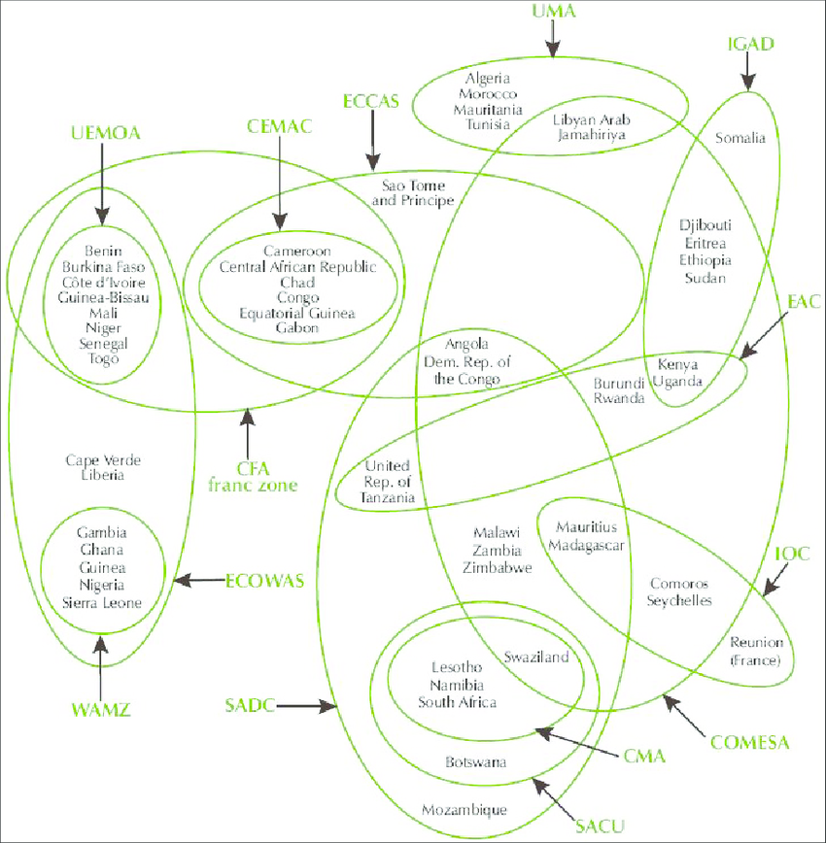
Overlapping Membership in African Regional Schemes

Slide 40
3. Negotiations of international organizations with third actors (STATES – NGO)

Slide 41
Types of Negotiations
Third states seeking membership or enhanced relational status
Asymmetric relationship: for membership, assent power of current IO members
Veto power of existing members (Greek veto to N. Macedonia’s membership in NATO – 2008)
European Parliament: assent procedure for EU enlargement
Symmetric relationship
Special trade agreement (EU-S. Korea/ EU-Canada/etc)

Slide 42
IO as a mediator in inter-partisan conflicts (inter- or intra-state conflicts)
Deployment of IO negotiators on ad hoc field assignments
Assumptions of neutrality and impartiality – IOs seen as ‘honest brokers’
Violation of key assumptions heavily undermines mediation function

Slide 43
Special Representatives of the UN Secretary General used to be a rare occurrence; currently much more in fashion
‘Part diplomat, part manager’: effective diplomats, efficient managers (to run the diplomatic mission) [and capable communicators]
Mandate stems from both the UN Charter and specific texts related to the crisis
Preparing an international conference (Great Lakes Region, 1997)
Implementation of Resolutions (Lebanon, 2007)
Leading a transitional administration (Kosovo, 1999)
Full range of peace-promoting endeavours (Haiti, Sudan, Burundi, 2006)
Selection and appointment
No specific and formal criteria
Interpersonal networks
Consent of key stakeholders

Slide 44
IOs - NGOs
IO-NGOs: acquisition by NGOs of a (formal or informal) consultative status (which limits the autonomy of the IO and its constituent members)
Why? Resource scarcity
Knowledge and legitimacy
NGOs have increased their leverage over IOs
Technical expertise
Power-based explanations: only ‘friendly’ NGOs are granted a role in IOs
Norm diffusion: civil society participation a ‘must’ of the new era of international politics; credibility and countering the ‘democratic deficit’ of IOs
NGOs as monitoring and enforcement agents

