Slide 1
Change Management
Managing Change
Professor Maria Vakola
Director of the MSc in Human Resources Management
Athens University of Economics and Business

Slide 2
What is change?
What is organizational change?

Slide 3
Change brings turbulence

Slide 4
Bad news?
Good news?

Slide 5
70% failure rate in change projects

Slide 7
Lack of vision and strategy/ Top management commitment
Arrogance
Lack of effective communication
Lack of Resources
Lack of change management skills
Organizational Culture
Resistance to change
HR issues/ e.g. compensation systems, structure and training

Slide 8
TOP MANAGEMENT COMMITMENT
Notes:
Δέσμευση Ηγεσίας

Slide 9
The role of middle management
The sandwich effect

Slide 10
ARROGANCE
‘The only thing in life that is constant is change ’
The superiority syndrome
When a successful brand cannot ensure a successful future

Slide 11
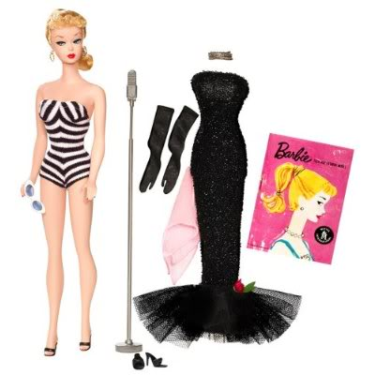
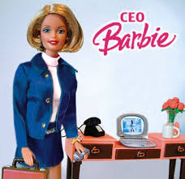
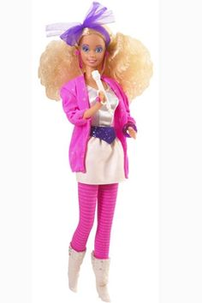

Slide 12
How does a change
START?
Notes:
Πώς ξεκινάει μια αλλαγή?

Slide 13
Digital Transformation is not (only)about technology…is about people and culture

Slide 14
Obstacles to digital transformation
Organizational Culture
Resistance to change
Infrastructure
Lack of digital skills

Slide 15
LEWIN’S MODEL
Unfreezing
Moving
Refreezing

Slide 16
Force-Field Analysis
Forces for Change
GREATER THAN
Forces against Change
Forces for
Change
Forces Against
Change
Forces for Change
LESS THAN
Forces against Change
Forces for
Change
Forces Against
Change
Forces for Change
EQUAL TO
Forces against Change
Forces for
Change
Forces Against
Change

Slide 17
Force field analysis
Case Study: Implementing a Remote Work Policy
Background: Vexus Corporation, a mid-sized digital marketing company, has traditionally operated with all employees working onsite. However, following the COVID-19 pandemic, the management has observed increased employee satisfaction and productivity among those who worked remotely during the lockdown. As a result, the leadership is considering implementing a permanent remote work policy.
Current Situation: The company’s leadership is divided. Some executives believe that remote work will improve employee morale and reduce overhead costs. Others fear that remote work may lead to decreased collaboration, lower team cohesion, and challenges in monitoring employee performance.

Slide 18
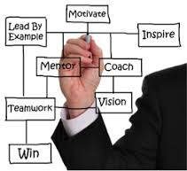
CHANGE AGENTS

Slide 19
Choosing a Change Agent
Internal Change Agents
External Change Agents
Possess better knowledge of the organization
Are more quickly available
Require lower out-of-pocket costs
Have more control and authority
Have more objective views of the organization
Have more experience in dealing with more diverse problems
Can call on more individuals with diverse expertise
Have more technical knowledge, competence, and skills available
Advantages

Slide 20
Choosing a Change Agent (Cont.)
Internal Change Agents
External Change Agents
May be too close to the problem
May hold biased views
May create additional resistance if views as part of the problem
Must be reassigned; not available for other work
Disadvantages
Have less knowledge of the organization
Require higher out-of-pocket costs
Have longer start-up time
Reflect unfavorably on the image of management

Slide 21
EXERCISE
Selecting change agents

Slide 22
People can make or break organizational change

Slide 23
Why some people embrace change, and some other people resist change?

Slide 24
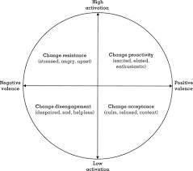
Valence and Activation
Responses to change

Slide 25
Explaining reactions (Oreg, Vakola & Armenakis, 2011)
Individual Differences
Context Variables
The impact of change
The process of change

Slide 26
Individual Differences
Locus of control
Self efficacy
Positive Affectivity
Tolerance to ambiguity
Problem focused coping style

Slide 27
Personality
Personality factors (Big 5)
Extraversion
Neuroticism
Agreeableness
Openness to new ideas
Conscientiousness

Slide 28
COST
BENEFIT

Slide 29
More specifically......
Perceived benefit
Low
High
Low Cost + Low Benefit
=
Indifference
Low Cost + High Benefit
=
Favorable
Low
Perceived cost
High Cost + Low Benefit
=
Resistance
High Cost + High Benefit
=
Conflict
High

Slide 30
Pre-change conditions
Trust
Leadership
Support
Communication
Justice
Culture

Slide 31
Process of change
Participation & Involvement
Communication and Information
Justice
Support during change
Management change competence

Slide 32
Case study
Characters:
Alex – Head of Digital Innovation
Susan – Senior Operations Manager
Tom – Customer Service Supervisor
Scene: The three are having coffee in the break room, discussing the bank’s ongoing digital transformation.

Slide 33
Alex: Exciting news! The AI-powered loan approval system rolls out next month. It’s going to speed things up.
Susan: I don’t know, Alex. Do we really need this? We’ve been fine without all this tech. It just feels like unnecessary change.
Tom: Yeah, and our customers value personal service. I’m not sure these systems will help
with that. Plus, I’m not exactly tech-savvy.
Alex: You won’t need to be a tech expert, Tom. It’s about simplifying processes. Susan,
wouldn’t it be better to automate paperwork so you can focus on more important
tasks?
Susan: Maybe, but I’m worried about costs and system failures. When tech breaks, we’re the ones who have to fix it.
Tom: And what if customers hate it? I trust my team’s judgment more than an algorithm.

Slide 34
Alex
I get it. But customers expect faster service. If we don’t adapt, other banks will take our place. And Tom, these systems will handle routine tasks, freeing you to focus on more complex customer issues. You’ll have more time for real connection.
Susan: And if we don’t embrace it?
Alex: Honestly, you’ll fall behind. The bank is moving forward with or without us. Those who adapt will thrive—and get the promotions. If you lean into this, you’ll be more valuable than ever.
Tom: (Sighs) I don’t know. I’m just not confident with this tech stuff.
Alex: That’s why we have training, Tom. Trust me, it’s not as hard as it sounds. We’re talking about making things easier, not harder. You’ve got this.
Susan: (Laughs) We’ll see. I’m still skeptical, but I’ll keep an open mind—for now.

Slide 35
Dealing with resistance
TRAINING AND
COMMUNICATION
IMPOSE
PARTICIPATION
AND
INVOLVEMENT
NEGOTIATION

Slide 36
Practical
Dealing with responses to change in a public sector
Dealing with responses in the retailing

Slide 37
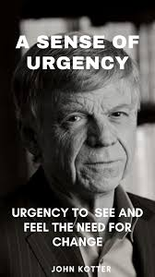
Kotter’ s 8 stage model

Slide 38
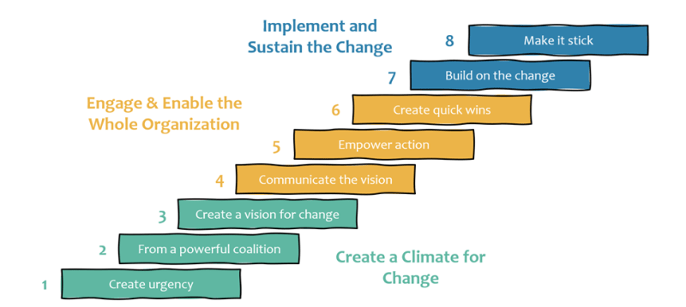

Slide 39
Kotter’s model
Create
Create a Sense of Urgency
Communicate the need for change and create awareness about the urgency of the situation.
Help individuals understand the consequences of not changing.
Build
Build a Guiding Coalition:
Assemble a group of influential and committed leaders to lead the change effort.
Ensure diverse representation to bring different perspectives and expertise to the coalition.
Form
Form a Strategic Vision and Initiatives:
Develop a clear vision that outlines the desired future state of the organization after the change.
Identify specific initiatives and strategies that will help achieve the vision.
Communicate
Communicate the Vision:
Mobilise employees and stakeholders who are willing to actively support and contribute to the change.
Foster a sense of ownership and engagement throughout the organization.
Empower
Empower Action:
Identify and eliminate obstacles or barriers that could impede the progress of the change initiative.
Empower employees by providing the necessary resources and support.

Slide 40
6. Create Quick Wins:
Create and celebrate small, visible victories early in the change process.
These wins build momentum, boost morale, and demonstrate progress.
7. Build on the Change:
Reinforce the change by continually building on the momentum gained from the initial successes.
Institutionalise new practices and behaviours to prevent a return to the old ways.
8. Make it Stick:
Embed the changes into the organization’s culture and processes.
Ensure that the new behaviours and practices become the new norm.

Slide 41
ORGANIZATIONAL CULTURE
How do we define it & why is it important?
Notes:
Πώς την ορίζουμε & ποιά η σημασία της;

Slide 42
Organizational Culture (the way we do things in our organization) is deep rooted and hard to change
So?

Slide 43
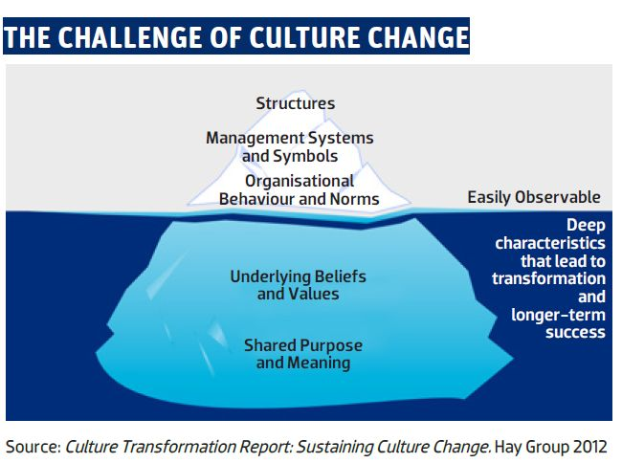

Slide 44
Organizational Culture
‘Culture is the set of shared, taken-for-granted implicit assumptions that a group holds and that determines how it perceives, thinks about, and reacts to its various environments’ (Schein, 1996: pp236)
‘The way we do things around here’

Slide 45
Culture can eat change for breakfast
Organizational Silence
Syndrom of burnout- Change fatigue

Slide 46
Flexibility
THE CLAN
THE ADHOCRACY
Internal Focus
External Focus
THE HIERARCHY
THE MARKET
Control

Slide 47
Public and private sector
FLEXIBILITY
THE CLAN
THE ADHOCRACY
PRIVATE
Management
INTERNAL
FOCUS
EXTERNAL
FOCUS
PUBLIC
Management
THE HIERARCHY
THE MARKET
CONTROL
Notes:
Εδώ δείτε τις μεταφράσεις του δημόσιου και ιδιωτικού
Δείτε και τα σημεία του οριζόντιου άξονα, σε σχέση με την προηγούμενη διαφάνεια (εσωτερική εστίαση vs εστίαση στο εσωτερικό περιβάλλον)

Slide 48
Problem: As the financial services industry underwent rapid digital transformation, this institution found itself lagging behind competitors who were embracing fintech innovations, AI-driven solutions, and streamlined customer experiences. Senior leadership recognized the need to move towards a more digital-first strategy, but the bureaucratic culture made this transition incredibly difficult.
Background: A large, well-established financial institution, known for its conservative approach and rigid hierarchy, had maintained a bureaucratic culture for decades. The organization followed strict procedures, with multiple layers of approval for every decision, creating a slow-moving and risk-averse environment. Employees were accustomed to adhering to traditional methods of operation, including paper-based processes and in-person approvals. Decision-making was highly centralized, with little room for innovation or rapid response to market changes.

Slide 49
Challenge 1
Identify the barriers

Slide 50
Suggestions
Rigid Hierarchy: Decisions required multiple layers of approval, slowing down the implementation of digital projects.
Siloed Departments: Collaboration between departments was minimal, causing delays in integrating new technologies across functions.
Risk Aversion: Employees were resistant to adopting digital tools due to fear of failure or deviation from established norms.
Lack of Innovation: The focus was on maintaining the status quo rather than experimenting with new digital initiatives that could enhance customer experience or operational efficiency.

Slide 51
Challenge 2
Key steps

Slide 52
Solutions
Decentralizing Decision-Making: Empowering middle managers and teams to make decisions related to digital projects without needing approval from top executives. This shift allowed for faster experimentation and implementation of digital solutions.
Fostering Cross-Department Collaboration: Creating digital task forces composed of employees from various departments (IT, marketing, finance) to collaborate on technology-driven initiatives. This helped break down silos and encouraged knowledge-sharing.
Encouraging Innovation and Risk-Taking: Establishing an innovation lab where employees were incentivized to pilot new technologies without fear of failure. This lab created a safe space for experimentation and the testing of digital solutions in a controlled environment.
Training and Digital Upskilling: Providing comprehensive digital training programs to upskill employees, enabling them to feel more confident using new technologies and contributing to the digital transformation efforts.
Revising Performance Metrics: Shifting performance evaluations to reward agility, innovation, and collaboration rather than adherence to rigid processes. This encouraged employees to prioritize digital initiatives and think creatively about their work.

Slide 53
Challenge 3 Align our organizational culture with the digital vision
How?

Slide 54
ORGANIZATIONAL CULTURE ASSESSMENT
https://limesurvey.aueb.gr/limesurvey/index.php/359371

Slide 55
CULTURE GAP - EXERCISE
The clan
Adhocracy
50
40
30
20
10
10
20
30
40
Bureaucratic
50
Market
THE DESIRED SITUATION -----------
THE CURRENT SITUATION

Slide 56
Is it possible to change?
Leadership
Communication
Selection
Performance management
Training and development

Slide 57
CASE STUDY

