Slide 1
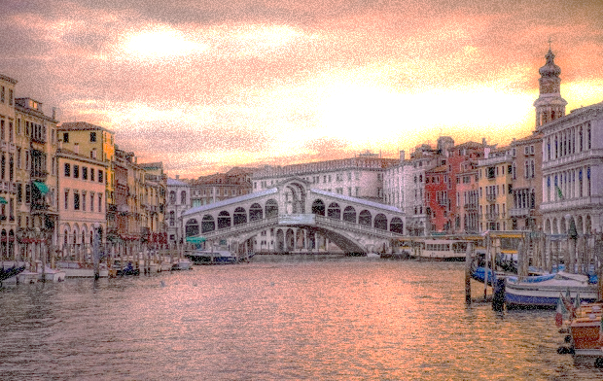
Ιταλία στον Μεσοπόλεμο
Εργασία στο μάθημα: Οικονομική ιστορία Ελλάδος
Οι φοιτήτριες Δουληγέρη Μαρία Αντωνία
Κόκα Οριόνα
Tσαουσάι Μπεσάρντα

Slide 2
Μεσοπόλεμος : διάστημα που μεσολαβεί ανάμεσα στο τέλος του Α΄ Παγκόσμιου (1918) και στην έναρξη του Β΄ Παγκόσμιου πολέμου (1939).
Notes:
Half-circle picture with accent arcs
(Basic)
To reproduce the shape effects on this slide, do the following:
On the Home tab, in the Slides group, click Layout, and then click Blank.
On the Home tab, in the Drawing group, click Shapes, and then under Basic Shapes, click Arc (third row, 12th option from the left). On the slide, drag to draw an arc.
Select the arc. Under Drawing Tools, on the Format tab, in the Size group, do the following:
In the Shape Height box, enter 7.5”.
In the Shape Width box, enter 7.5”.
Drag the right yellow diamond adjustment handle to the bottom of the slide to create a half-circle.
Under Drawing Tools, on the Format tab, in the bottom right corner of the Shape Styles group, click the Format Shape dialog box launcher. In the Format Shape dialog box, click Fill in the left pane. In the Fill pane, select Picture or texture fill, and then under Insert from, click File.
In the Insert Picture dialog box, select a picture, and then click Insert.
Also in the Format Shape dialog box, in the Fill pane, under Insert from, select Tile picture as texture.
Also in the Format Shape dialog box, click Line Color in the left pane, and then select No line in the Line Color pane.
Also in the Format Shape dialog box, click Shadow in the left pane, and then do the following in the Shadow pane:
Click the button next to Presets, and then under Inner click Inside Diagonal Top Right (first row, third option from the left).
In the Transparency box, enter 70%.
In the Blur box, enter 20 pt.
In the Distance box, enter 20 pt.
Drag the half-circle to the left until the two middle yellow adjustment diamonds are lined up with the left edge of the slide. On the Home tab, in the Drawing group, click Arrange, point to Align, and then do the following:
Click Align to Slide.
Click Align Middle.
Select the arc. On the Home tab, in the Clipboard group, click the arrow under Copy, and then click Duplicate.
Select the second arc. Under Drawing Tools, on the Format tab, in the Size group, do the following:
In the Shape Height box, enter 6.79”.
In the Shape Width box, enter 10.03”.
On the Home tab, in the bottom right corner of the Drawing group, click the Format Shape dialog box launcher. In the Format Picture dialog box, click Fill in the left pane, and then in the Fill pane, select No fill.
Also in the Format Shape dialog box, click Line Color in the left pane. In the Line Color pane, select Solid line and then do the following:
Click the button next to Color, and then under Theme Colors click White, Background 1 (first row, first option from the left).
In the Transparency box, enter 50%.
Also in the Format Shape dialog box, click Line Style in the left pane. In the Line Style pane, in the Width box, enter 1.5 pt.
Drag the second arc left on the slide until the two middle yellow adjustment diamonds are lined up with the left edge of the slide. On the Home tab, in the Drawing group, click Arrange, point to Align, and then do the following:
Click Align to Slide.
Click Align Middle.
Select the second arc. On the Home tab, in the Clipboard group, click the arrow under Copy, and then click Duplicate.
Select the third arc. Under Drawing Tools, on the Format tab, in the Size group, do the following:
In the Shape Height box, enter 6.86”.
In the Shape Width box, enter 9.98”.
On the Home tab, in the bottom right corner of the Drawing group, click the Format Shape dialog box launcher. In the Format Shape dialog box, click Line Color in the left pane, select Gradient line in the Line Color pane, and then do the following:
In the Type list, select Linear.
Click the button next to Direction, and then click Linear Down (first row, second option from the left).
Under Gradient stops, click Add gradient stop or Remove gradient stop until two stops appear in the slider.
Also under Gradient stops, customize the gradient stops that you added as follows:
Select the first stop in the slider, and then do the following:
In the Position box, enter 0%.
Click the button next to Color, and then under Theme Colors click Blue, Accent 1, Lighter 40% (fourth row, fifth option from the left).
In the Transparency box, enter 77%.
Select the second stop in the slider, and then do the following:
In the Position box, enter 100%.
Click the button next to Color, click More Colors, and then in the Colors dialog box, on the Custom tab, enter values for Red: 208, Green: 215, Blue: 222.
In the Format Shape dialog box, in the Line Style pane, in the Transparency box, enter 90%.
Also in the Format Shape dialog box, click Line Style in the left pane. In the Line Style pane, in the Width box, enter 4.25 pt.
On the Home tab, in the Drawing group, click Arrange, point to Align, and then do the following:
Click Align to Slide.
Click Align Left.
Drag the third arc left on the slide until the two middle yellow adjustment diamonds are lined up with the left edge of the slide. Drag the third arc vertically as needed to position it slightly above the second arc on the slide.
To reproduce the background on this slide, do the following:
Right-click the slide background area, and then click Format Background. In the Format Background dialog box, click Fill in the left pane, select Gradient fill in the Fill pane, and then do the following:
In the Type list, select Linear.
Click the button next to Direction, and then click Linear Up (second row, second option from the left).
In the Angle box, enter 270⁰.
Under Gradient stops, click Add gradient stop or Remove gradient stop until four stops appear in the slider
Also under Gradient stops, customize the gradient stops that you added as follows:
Select the first stop in the slider, and then do the following:
In the Position box, enter 0%.
Click the button next to Color, click More Colors, and then in the Colors dialog box, on the Custom tab, enter values for Red: 167, Green: 185, Blue: 197.
Select the second stop in the slider, and then do the following:
In the Position box, enter 30%.
Click the button next to Color, and then under Theme Colors click White, Background 1 (first row, first option from the left).
Select the third stop in the slider, and then do the following:
In the Position box, enter 70%.
Click the button next to Color, and then under Theme Colors click White, Background 1 (first row, first option from the left).
Select the fourth stop in the slider, and then do the following:
In the Position box, enter 100%.
Click the button next to Color, click More Colors, and then in the Colors dialog box, on the Custom tab, enter values for Red: 167, Green: 185, Blue: 197.

Slide 3
Οι άνθρωποι δεν έχουν χρήματα
Προιόντα μένουν απούλητα
Βιομηχανίες κλείνουν
ΑΝΕΡΓΙΑ
Μεγάλη οικονομική κρίση το 1929
Οι πολίτες αντιδρούν με πορείες και απεργίες

Slide 4
Πολλά δημοκρατικά πολιτεύματα, κάτω από αυτήν την πίεση, σταδιακά καταρρέουν. Τα διαδέχονται δικτατορίες.

Slide 7
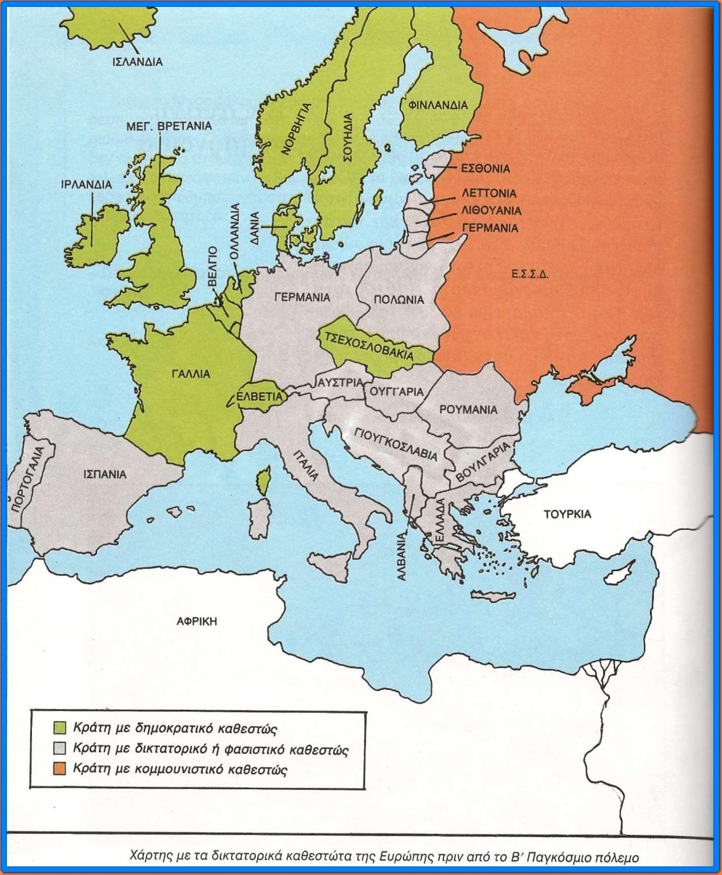
YOUR TOPIC GOES HERE
Your Subtopics Go Here

Slide 8
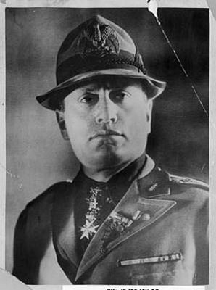
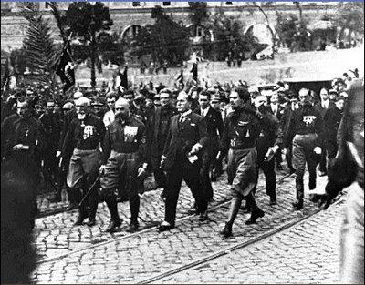
Μπενίτο Μουσολίνι
-
Ντούτσε
Η πορεία προς τη Ρώμη (1922) ,η υποχώρηση του βασιλιά και η κατάκτηση του θρόνου από το Εθνικό Φασιστικό Κόμμα (PNF)

Slide 9
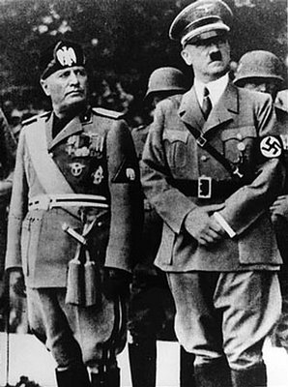
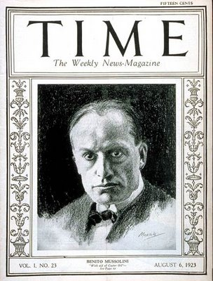
Η ΦΑΣΙΣΤΙΚΗ ΔΙΑΚΥΒΕΡΝΗΣΗ
Διαλύει το Κοινοβούλιο
Κρατικός μηχανισμός = μέσο προπαγάνδας
Εξοντώνει κάθε αντιπολιτευόμενη φωνή
Επιθετική εξωτερική πολιτική
Μυστικές συμφωνίες με Α. Χίτλερ
Επεκτατική πολιτική
Αντικομουνιστής
Επιδιώκει αύξηση βιομηχανικής παραγωγής
Επενδύει στο στρατό
Συμμετέχει στο Β’ παγκόσμιο πόλεμο στο πλευρό της Γερμανίας

Slide 10
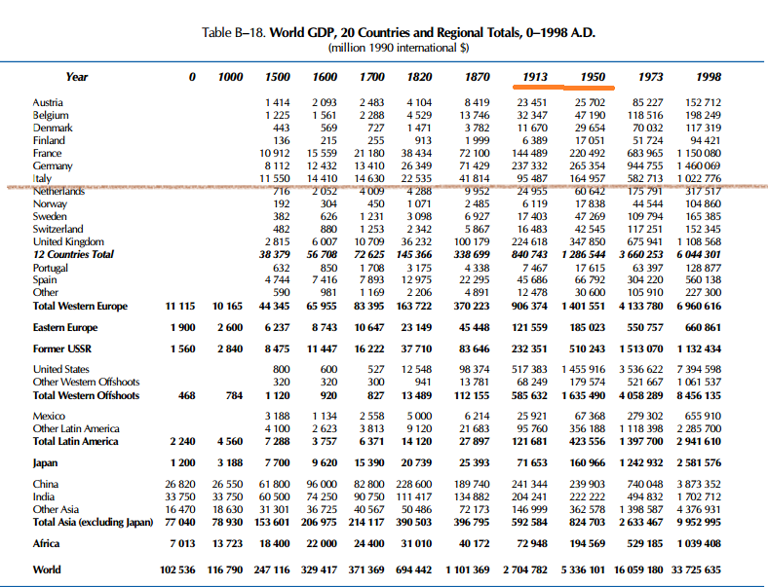

Slide 11
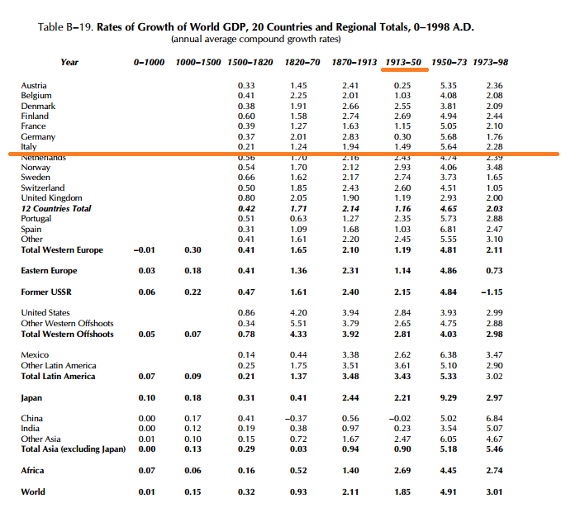

Slide 12
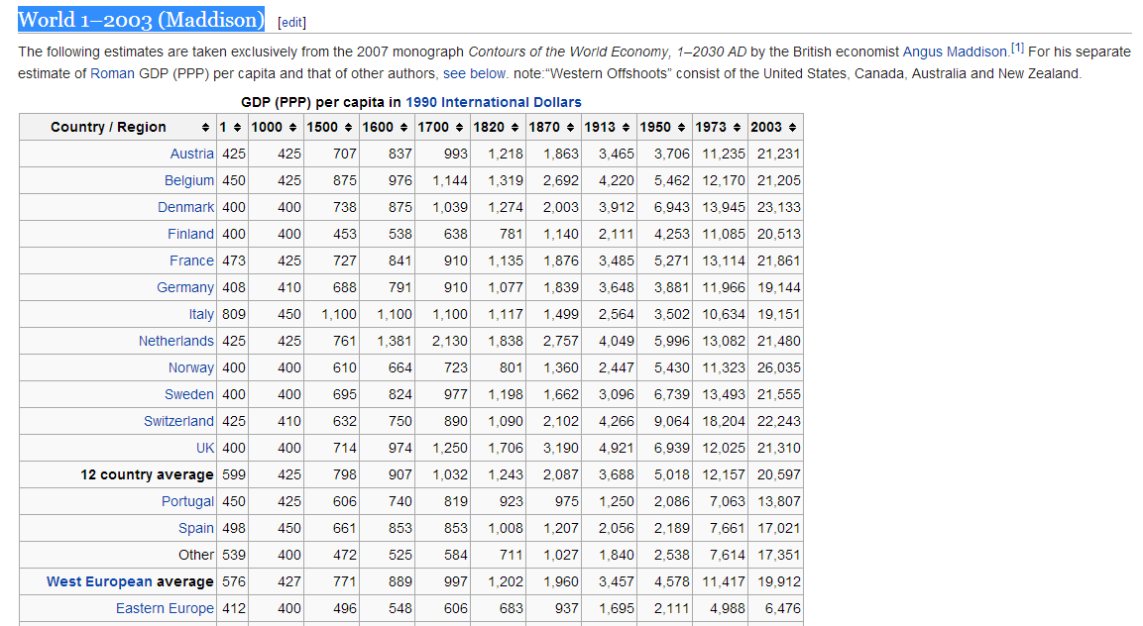

Slide 13
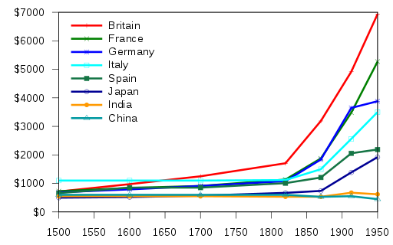
Gross domestic product (at purchasing power parity) per capita between 1500 and 1950 in 1990 International Dollars for selected nations, depicting data excerpted from Contours of the World Economy, 1–2030 AD. Essays in Macro-Economic History by Angus Maddison, Oxford University Press, 2007

Slide 15
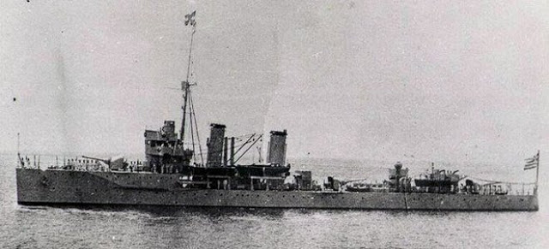
H ραγδαία πτώση του ξεκινά όταν στρέφεται εναντίον της Ελλάδας όπου εξοντώνεται ο στρατός του και εξωθείται στην Αλβανία.
Μετά από συνεχόμενες λάθος κινήσεις χάνει τη δύναμη και τη δημοτικότητά του.
Την εξουσία παίρνει ο βασιλιάς
Ο Μουσολίνι εξορίζεται και η εκτέλεση του δεν αργεί
Η πρώτη εχθρική πράξη γίνεται στις 15 Αυγούστου 1940, όταν ιταλικό υποβρύχιο τορπιλίζει το ελληνικό καταδρομικό Έλλη στην Τήνο

Slide 16
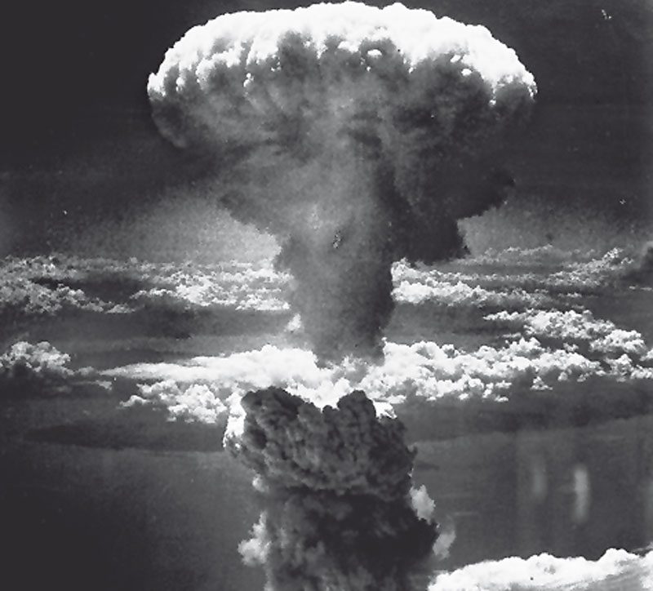
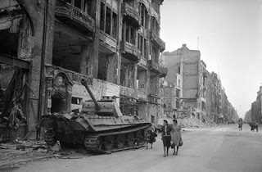
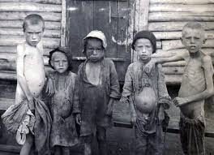
Αποτελέσματα Β’ παγκοσμίου πολέμου 1937-1945
55 εκατομμύρια νεκροί
35 εκατομμύρια τραυματίες
2 εκατομμύρια αγνοούμενοι
Το κόστος του πολέμου ανήλθε σε 1.154 δις. δολάρια
Οι ζημιές που προκλήθηκαν σε 230δις. Δολάρια
Μετακινήσεις περίπου 30 εκ. ανθρώπων
Η κατάρρευση του βιοτικού επιπέδου
Η ηθική καταρράκωση
Η εξασθένιση του διεθνούς ρόλου της Ευρώπης
Βιολογικές επιπτώσεις λόγω πυρηνικής ακτινοβολίας , ραδιενέργειας για πολλές ακόμα δεκαετίες

Slide 17
Τέλος
Σας ευχαριστούμε !!!

