Slide 1
Natural Capital in Sustainability Transition:
A European Perspective
SDGs, European Green Deal, EU MFF,
Recovery & Resilience Plan
Job Creation and Just Transition
Prof. Phoebe Koundouri
pkoundouri@aueb.gr
Professor and Director ReSEES Research Laboratory, School of Economics, ATHENS UNIVERSITY OF ECONOMIC AND BUSINESS
President-Elect, European Association of Environmental and Resource Economist
Director, Cluster on Sustainability Transition
Co-Chair, UN Sustainable Development Solutions Network (SDSN) – Greece
Director, EIT Climate KIC Hub – Greece, ATHENA RC
Chair SAB, European Forest Institute
Member of Greek Prime-Ministerial Committee on Recovery and Development Plan
Member of the Greek Ministerial Climate Change Committee, Ministry of Environment and Energy
Notes:
1

Slide 2
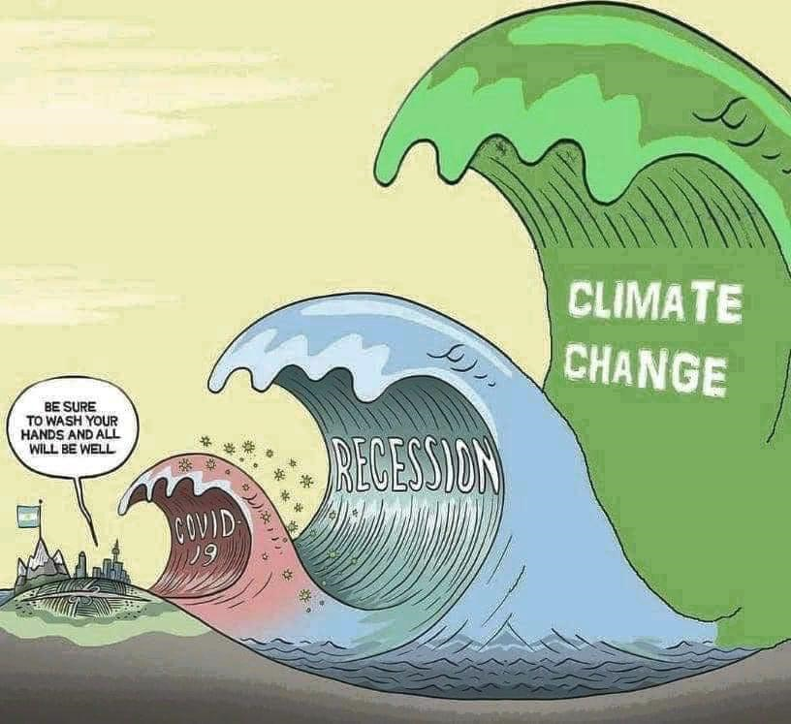
Control Epidemic
Measures
Biomedical Research

Slide 3
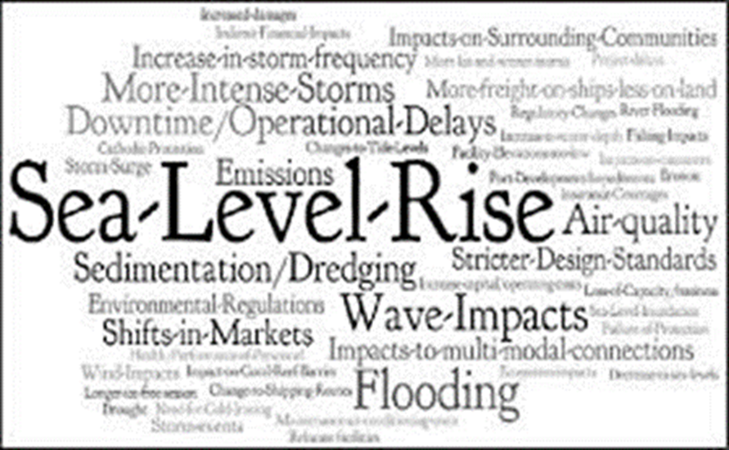
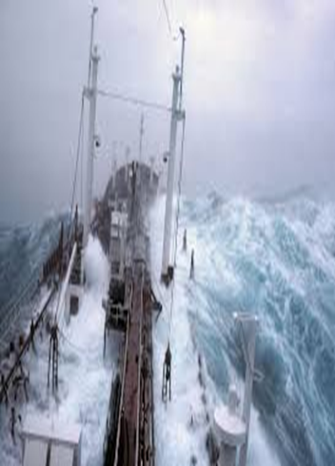
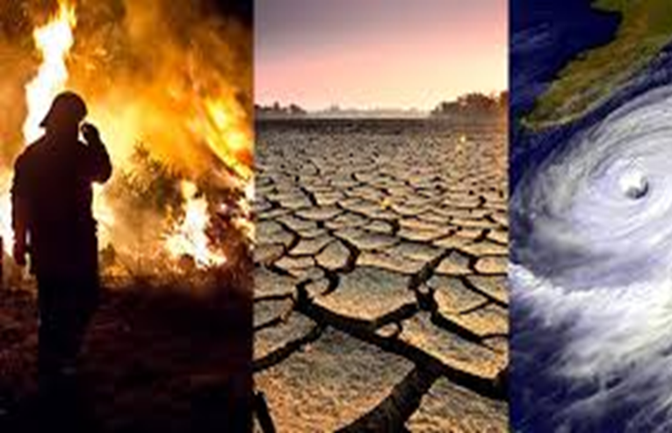
THE CLIMATE EMERGENCY
Urgency of limiting global warming to +1.5C, beyond which the risk of extreme weather events and poverty for hundreds of millions of people, will significantly increase. There is no country that is not experiencing the drastic effects of climate change.
The annual average economic losses from climate-related disasters are in the hundreds of billions of dollars.
The human impact of geo-physical disasters, which are 91 percent climate-related, and which between 1998 and 2017 killed 1.3 million people, and left 4.4 billion injured.
CARBON NEUTRALITY-2050.
UNEP Emissions Gap Report 2019 indicates that global emissions need to be cut by 7.6% per year. Calculated, this means a global reduction target of at least 68% by 2030.
17.09.2020 European Commission President proposed to increase the 2030 goal for emissions reduction from 40% of 1990 levels to ‘at least 55%.’

Slide 4
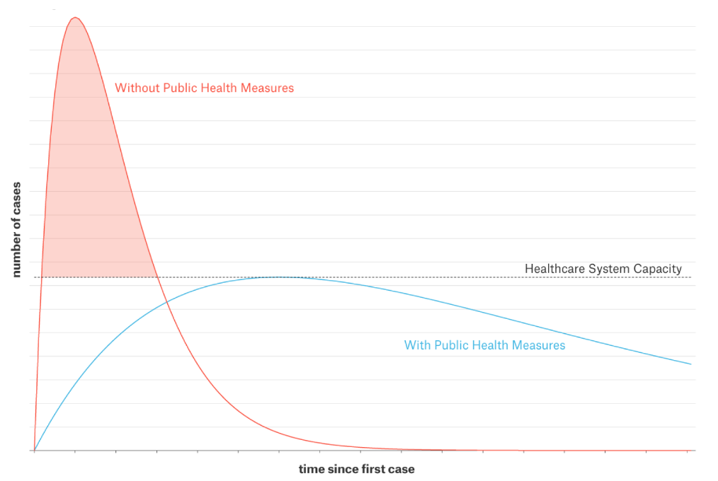
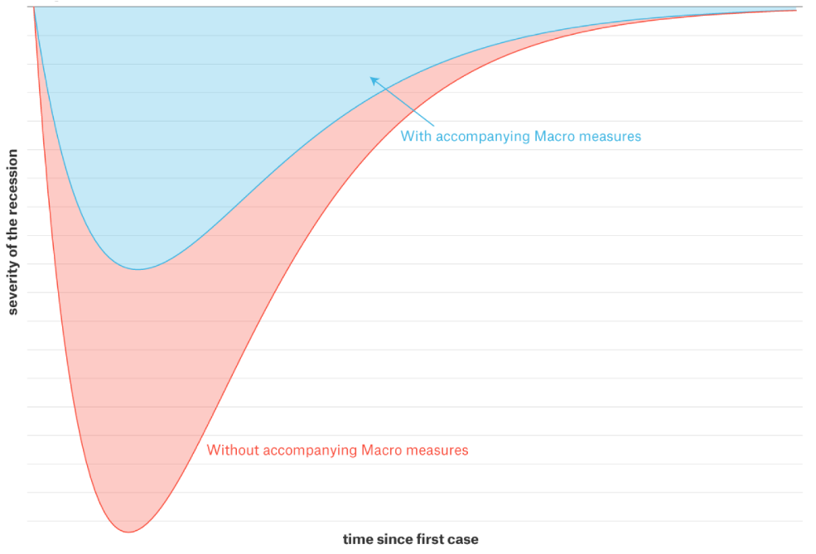
Flattening the infection curve Steepens the macroeconomic recession curve
Health-related measures aim to spread the pandemic out over time and buy time for drastically raising the capacity of the health-care sector.
Strict isolation measures lead to the shutdown of the complex web of economic supply chains and socio-economic networks.
How can we avoid the pandemic turn into a major economic and financial crisis that will long outlast the health crisis?
Work force remains employed even if quarantined.
Governments channel financial support to public and private institutions that support vulnerable citizen groups.
SMEs be safeguarded against bankruptcy.
Policies to support the financial system as nonperforming loans mount.
Fiscal packages, comparable to the crisis related loss of GDP, will have to be financed by national debt.
Should we worry about the level of the debt? Yes, to the extent that is possible we want to avoid another debt crisis, but most importantly, we want to avoid an unsustainable recovery.

Slide 5
What kind of Growth
do we need?
Sustainable Growth:
Organizing principle for meeting human development goals, while
sustaining the ability of natural systems to provide the natural resources and ecosystem services , upon which
the economy and society depend.
Environmental Sustainability
Economic Sustainability
Social Sustainability
Sustainable development meets the needs of the present, without compromising the ability of future generations to do the same.

Slide 7
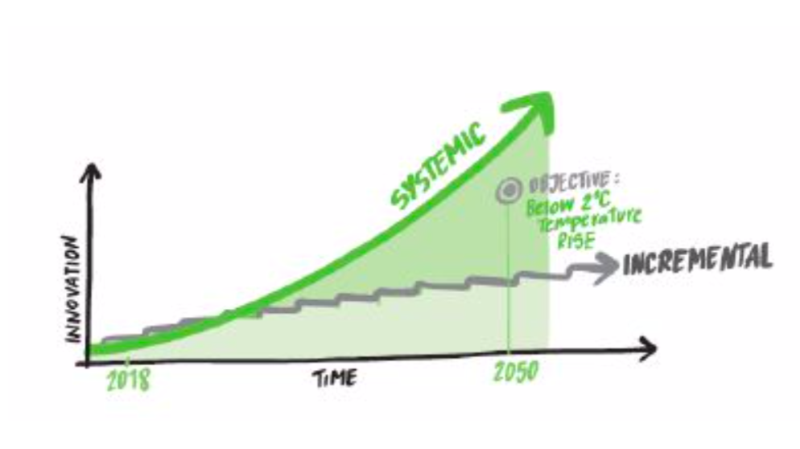
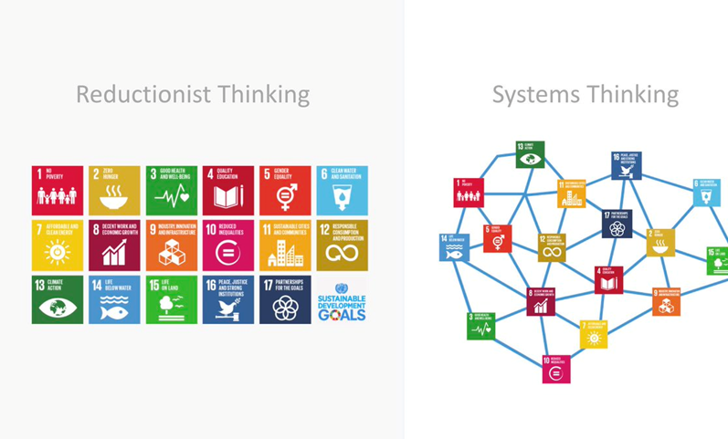
Why Systems Innovation?
Integrated & Coordinated Interventions in economic, financial, political and social systems and along whole value chains. In systems, by means of the relations, elements are arranged in such a fashion that gives rise to a new structure functioning.
Working through gradual, incremental changes is not enough!
What is needed now is a fundamental transformation of economic, social and financial systems that will trigger exponential change in decarbonisation rates and strengthen climate resilience – IPCC report: “rapid, far- reaching and unprecedented changes in all aspects of society”.

Slide 8
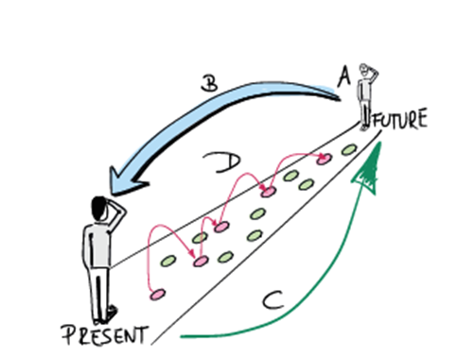
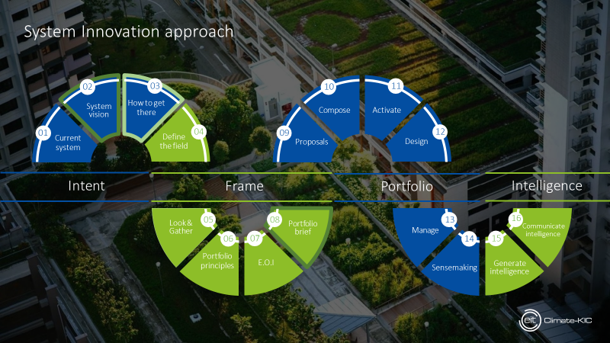
Bottom Up Mobilization: THE CLIMAE PACT Systems Innovation Approach Co-Design with Stakeholders
Notes:
8

Slide 9
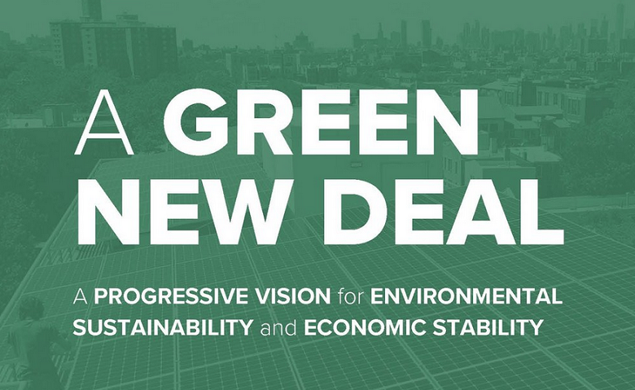
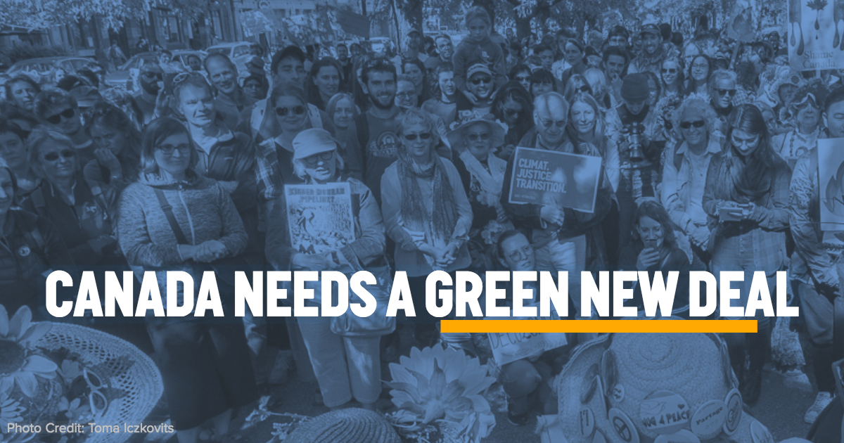
Top-Down Mobilization Green New Deals around the World
Canada
The Pact for a Green New Deal
Proposed on May 2019
USA
Green New
Deal
Proposed on March 2019
South Korea
Green
New Deal
Agreed on 14 July, 2020
$94.5 billion
China
Carbon neutral before 2060
Announced on 22 September, 2020
Israel
Green recovery plan
June 2020
Notes:
Green bonds
Measures https://www.enelfoundation.org/content/dam/enel-found/e-quality/E-quality%20study%20-%20final%20report.pdf
9

Slide 10
Top-Down Mobilization THE CLIMATE LAW – PROPOSAL Critic
Does not include an ambitious goal with regards to Green House Gas (GHG) emissions by 2030
Does not address the other legislative interventions and revisions that will be required to achieve climate neutrality by 2050
Does not allow the European Commission (EC) to impose sanctions on Member States (MS)
Does not allow the EC to take additional measures and change policies that will correct possible deviations from the path to achieving the emission goals.
There is no clear reference to an assessment mechanism between today and 2050
No reference to financial mechanisms that will be required to achieve the goal of climate neutrality.
No reference to comprehensive framework that will recognize the relationship between water, energy, food security and biodiversity (WEF Nexus)

Slide 11
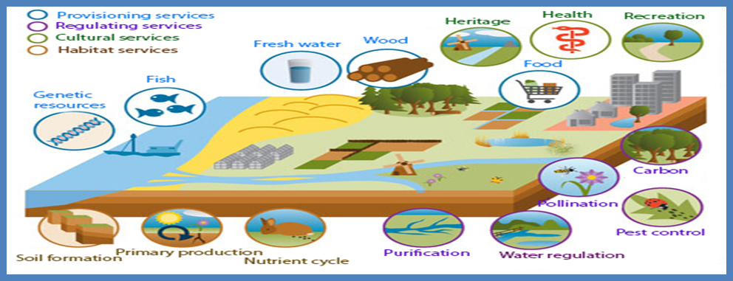
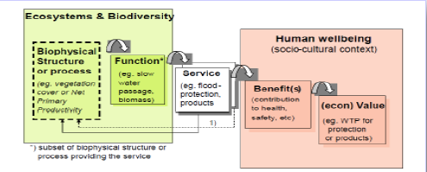
Integrated and Interdisciplinary Methodology
Aim: Allocation of scarce natural, human, accounting capital across people, over time & space, while Environmental-Economic-Social Sustainability is achieved.
EMPIRICAL APPLICATION of MODELS
Estimation of Economic Value
OPTIMAL ALLOCATION based on Value
MODELS ON INTERACTION
Dynamic, Spatial, Uncertainty
Nature
Society
Economy
How?
Socio-Economic, Legal Instruments
Technological Innovations
Social and Institutional Innovations
Nature Based Solutions
Infrastructural Solutions
FRAMEWORK CHARACTERIZATION & Co-Design of Future Vision with Stakeholders
Natural Capital
Socio-Economic-Institutional Framework
Stakeholders: Research&Innovation, Business, Financial System, NGOs, Civil Society
STRATEGIC MANAGEMENT PLANS Co-Developed with Stakeholders:
Technological & Policy Pathways Supported by Funding Portfolios
Notes:
RESEARCH FOCUS:
Achieving Natural Resources, Economic, Social Sustainability by developing structured and methodologically sound approaches to recognizing, demonstrating and capturing the Total Economic Value of natural resources and other public goods important for social welfare, integrating them in sustainable management tools and policy making, while recognizing the interdisciplinary nature of the challenge
STAGES OF ANALYSIS:
Natural Resources, Socio-Economic, Institutional Characterization
Mathematical Model of People’s Behaviour, NR stocks & flows
Empirical/Econometric Modelling
Data Collection (revealed/stated preference data)
Empirical Models Application & Estimation
Analysis of Results
Decision Support Tools
Policy Recommendations

Slide 12
Total Economic Value per ES
Use Value
Non-Use Value
Actual Use Value
Option Value
Existence Value
For Others
Warm Glow
Direct Use Value
Indirect Use Value
Bequest Value
Altruistic Value

Slide 13
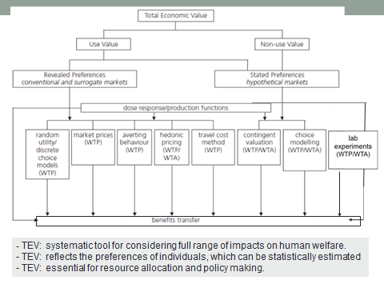

Slide 14
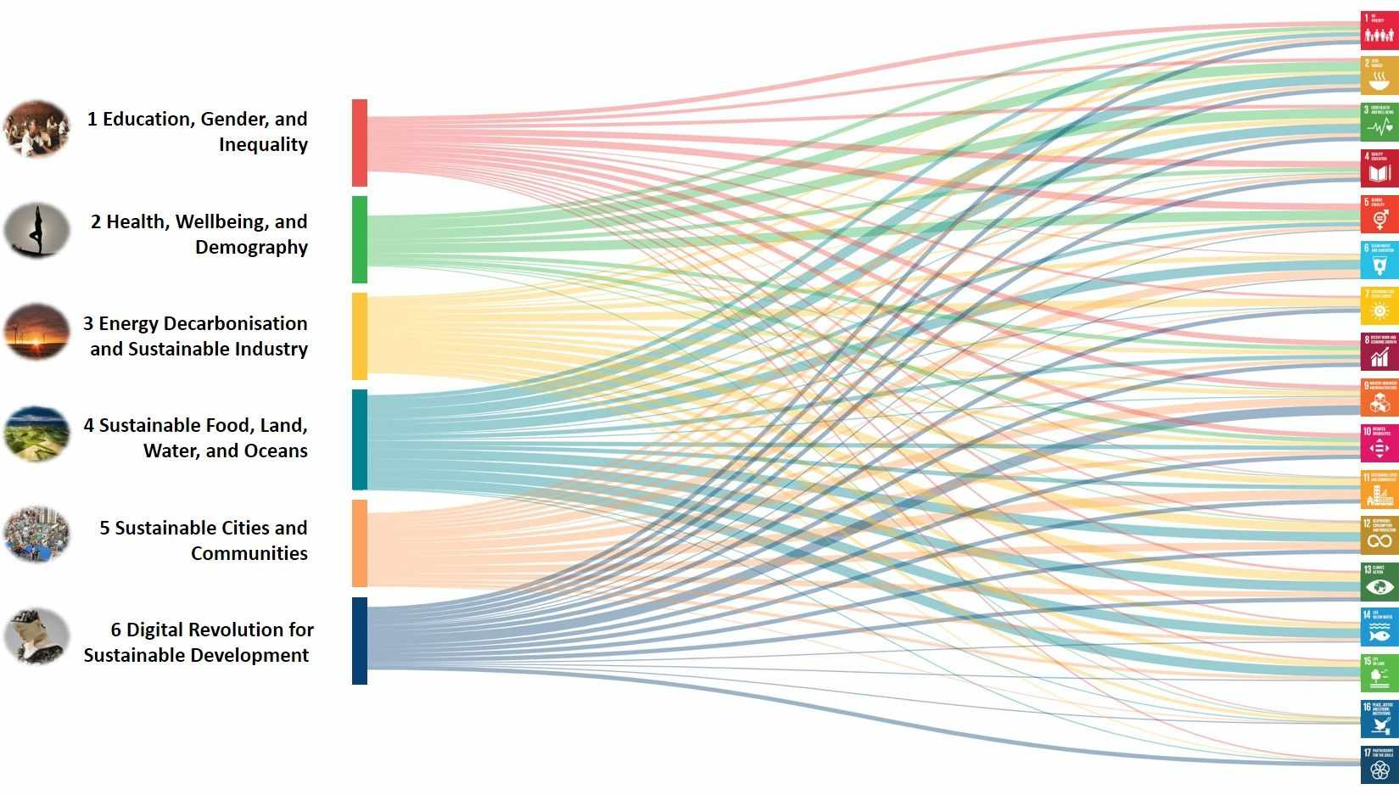
PROJECT TEAM Chairs Prof. Phoebe Koundouri Prof. Jeffrey Sachs Senior Members Athens University Economics & Business Enel Foundation Fondazione Eni Enrico Mattei, International Energy Agency University College London University of Rome Members All European SDSN National Hubs

Slide 15
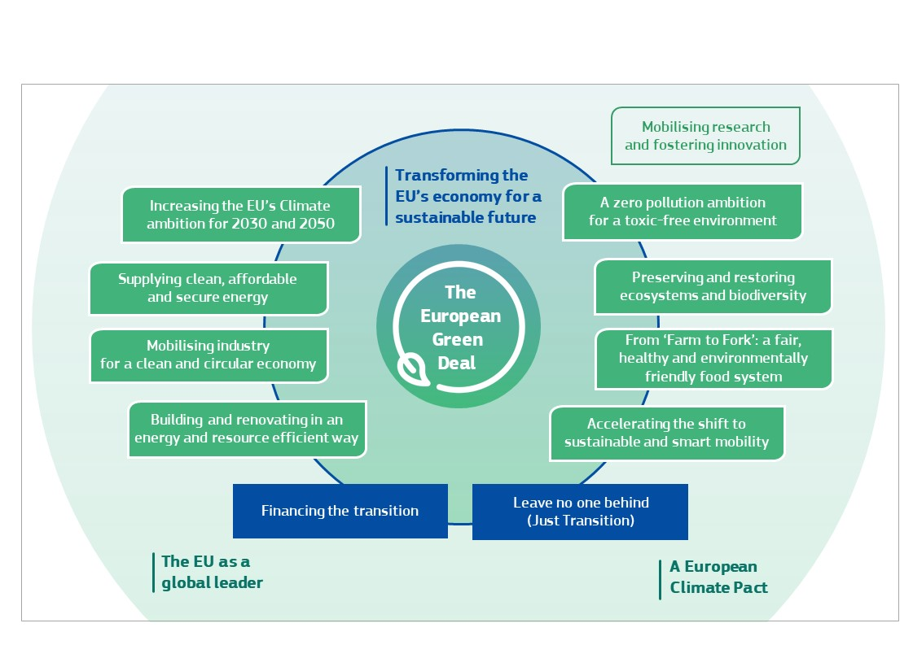
The European Green Deal (EGD) – Overview
The policy areas that are covered from the EGD are:
Biodiversity
From Farm to Fork
Sustainable agriculture
Clean energy
Sustainable industry
Building and renovating
Sustainable mobility
Eliminating pollution
Climate action
15

Slide 16
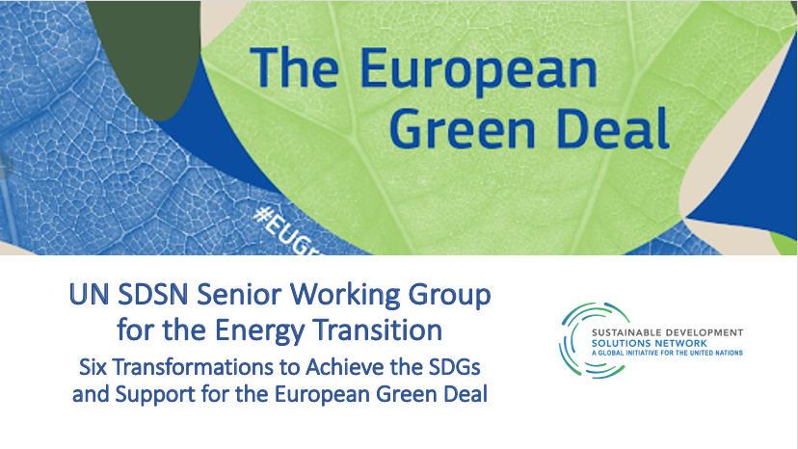
Six Transformations to Achieve the SDGs and Support for the European Green Deal: Senior Working Group for the Energy Transition
Joint implementation of the European Green Deal and SDGs: country-specific and EU upscale
Country-specific 3-D mapping:
(a) SDGs achievement (based on SDSN Indexes)
(b) European Green Deal Policies + Next Generation EU Recovery Fund + enhanced MFF
(c ) European semester process recommendations
Based on 3-D mapping, Technological Pathways, National Energy and Climate Plans, we construct recommendations for investment pathways 2020-2030 and until 2050, categorized in the Six Transformations (health, education, decarbonization, land-sea management, sustainable communities, digitalization).
Investment Pathways are supported by portfolios of funding sources (public, private, PPP).
Implication for Job Creation and Just Transition: country-specific and EU upscale

Slide 17
Who is it for?
EU MS’s Politicians/Decision Makers to facilitate identification investments and absorption of funds at National Level and to create cross-country alliances for a Sustainable Recovery
Public Sector and Business to facilitate Public-Private Partnerships and mobilize private resources for the Implementation of the EGD
Create a Climate Pact Manifesto to engage, together with politicians and policy makers, business, the financial sector and civil society (Systems Innovation Approach)

Slide 18
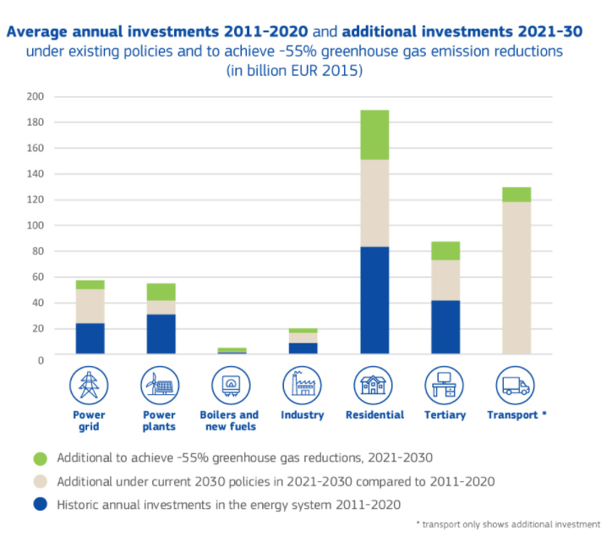
DECARBONIZATION: National Energy and Climate Plans:
For increased GHG emissions reduction target of 55% an increase in investment of €350 billion per year is needed compared to the previous decade
Notes:
To achieve the current EU 2030 climate and energy targets, annual investments related to energy production and use will need to increase in 2021-2030 by just over 1 percentage points of GDP on average, compared to the previous decade, that is, an increase of around €260 billion per year.
18

Slide 19
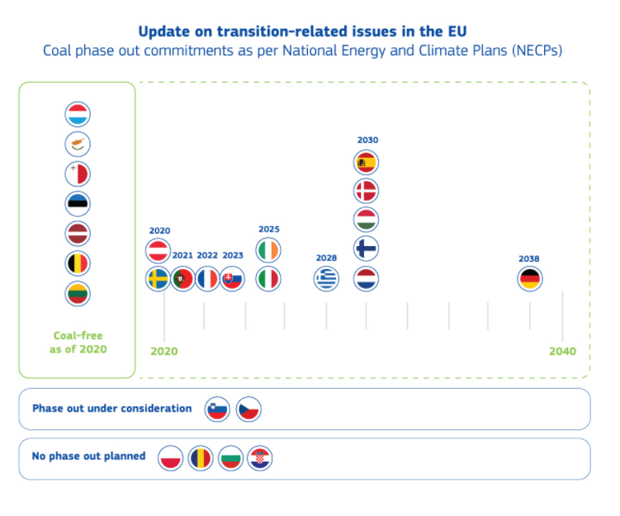
Phasing out coal in the final NECPs
21 MS:
Coal-Free: Estonia, Latvia, Lithuania, Belgium, Malta, Luxembourg, Cyprus
Or
Committed to phasing-out coal
Considering coal phase out: Slovenia and Czechia
Not planned phase out: Poland, Romania, Bulgaria, Croatia
Notes:
The use of coal is projected to decrease by 70% compared to 2015, with renewable electricity set to reach 60% of electricity produced by 2030.
Member States need to step up efforts to phase out fossil fuel subsidies.
19

Slide 20
Technological Pathways
National plans should cover the period to at least 2050 and should aim to equitably reach net zero emissions by 2050 and net negative emissions in the second half of the century.
EC Annual Sustainable Growth Strategy 2021, 17 September 2020
Reforms and Investments to create European flagships:
Power up: lay the foundation for hydrogen lead markets in Europe and the related investments
Renovate: improve the energy and resource efficiency of buildings
Recharge and Refuel: promote future-proof clean technologies
Connect: provide universal access to rapid broadband services
Modernize: EU-ID and key digital public services
Scale up: increase cloud capacities and develop powerful, cutting edge, and sustainable processors
Reskill and Upskill: focus investments and reforms on digital skills and educational and vocational training for all ages
Notes:
The pillars rely on 4 premises:
1. The development of comprehensive climate policy will depend on specific geographical and social contexts,
particularly in developing or low-income areas, in order to meet the needs of both society and the planet.
2. Great cooperation and coordination in terms of policy design and implementation are required: stakeholders will need to consider the integrated use of different resources, technologies, or processes to guarantee inclusion and
socioeconomic development of communities and enterprises’ competitiveness in the global market.
3. Flexible and innovation-receptive regulatory frameworks are pivotal to address the challenge.
4. Substantial efforts must be made to allocate consistent investments in support of research and development, as
technological breakthroughs will trigger innovation and shorten the path toward global decarbonization.
20

Slide 21
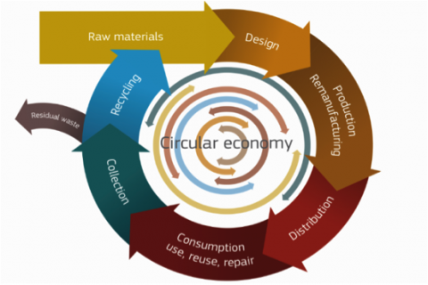
CIRCULAR ECONOMY
Savings of 600 billion euro for EU Business, 8% of their annual turnover, Relevant for SMEs
Creation of 580,000 jobs in innovative design and business models, research, recycling, re-manufacturing and product development
Reduction of EU carbon emissions by 450 million tones by 2030
Reducing Environmental Footprint: Optimize waste management will boost recycling and reduce landfill
Public-Private Partnerships best model for financing the transition to CE.

Slide 22
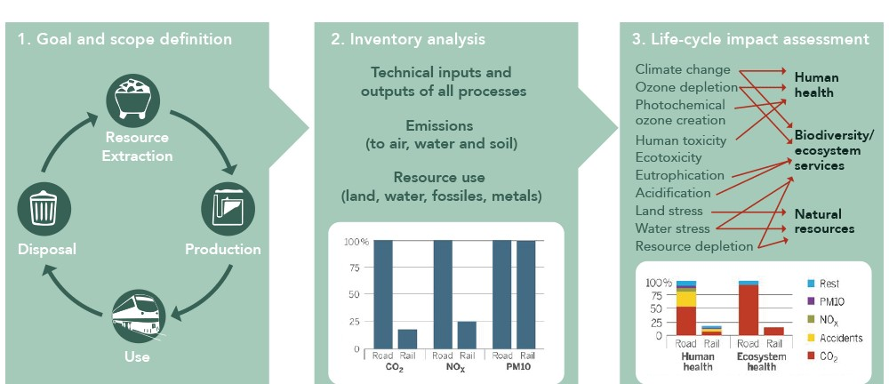
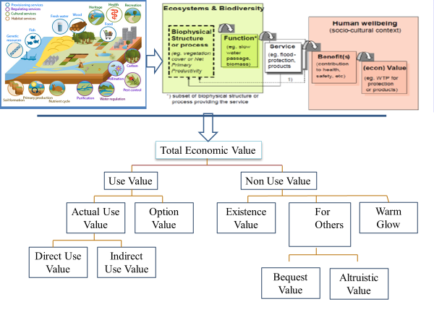
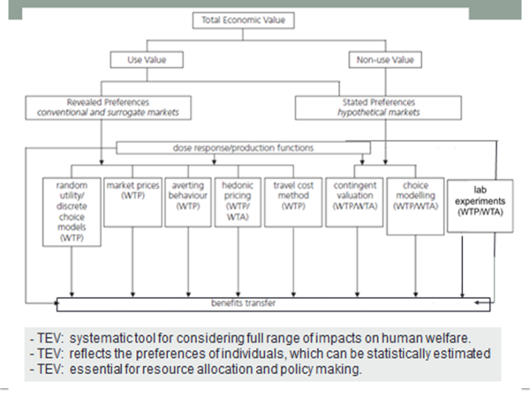
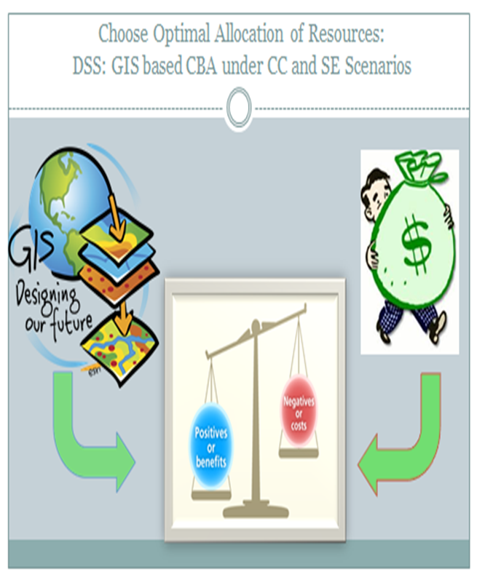
Measuring Socio-Economic Benefits of CE
Life Cycle Analysis (LCA) and Total Economic Valuation

Slide 23
Climate Change Adaptation Infrastructure
Adaptation programmes (early warning systems, making infrastructure resilient, improving dryland agriculture, or managing water resources) generate a triple dividend: avoided losses due to climate change, economic benefits from the investment programmes and social and environmental benefits.
Vulnerability indexes (VIs) should be developed: geographical/regional vulnerability; sectoral/economic vulnerability; and social vulnerability.
Just Transition (Mitigation & Adaptation) Fund
Notes:
23

Slide 24
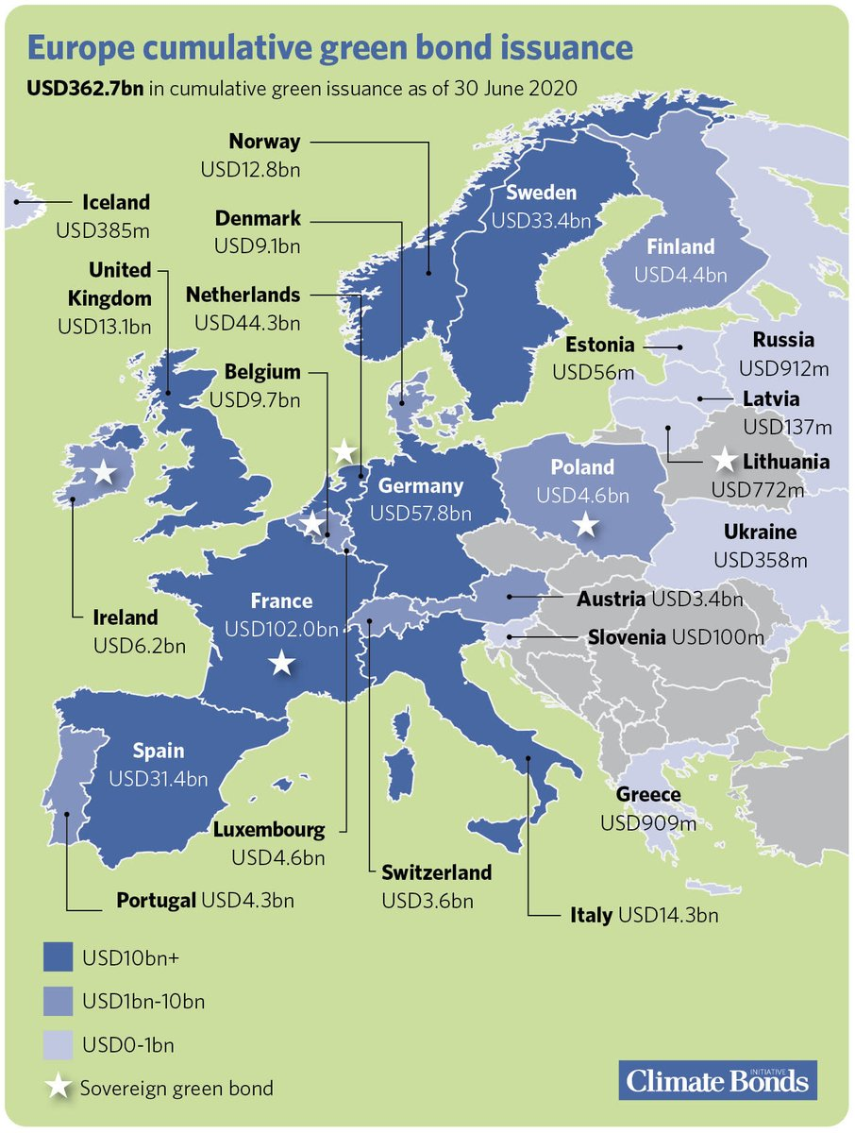
Efficiency-Equity-Sustainable Finance
Measures to counterbalance the regressive effects of decarbonization policies:
Lump-sum transfers
Reduction in income tax/ VAT or electricity tax
Targeted energy efficiency measures
Job retraining programs
Compensation funds for low-income groups
Notes:
Green bonds
The Enel Group has placed three green bonds on the European market with a total value of 3.5 billion euro, involving renewable installations, networks and infrastructure: for 1.25 billion in 2017, 1.25 billion in 2018 and 1 billion in 2019.
The categories relating to eligible projects are aligned with the Sustainable Development Goals of the United Nations (UN SDG), in particular Goals 7, 9, 11 and 13. In particular, the proceeds were used to finance:
* new projects for the development, construction and repowering of generation plants from renewable sources (green bond emission in 2017 and 2019);
* new projects for the development, construction, repowering and refinancing of generation plants from renewable sources as well as projects for transmission, distribution and smart grids (green bond emission in 2018).
Enel Group also launched the following bonds:
* General purpose SDG linked bond, $1.5 billion issued on the U.S. market in September 2019
* SDG-Linked loan agreement with Unicredit in the amount of €1 billion with a 5-year term on October 2019
* General Purpose SDG Linked Bond, €1 billion issued on the European market in October 2019
Measures https://www.enelfoundation.org/content/dam/enel-found/e-quality/E-quality%20study%20-%20final%20report.pdf
24

Slide 25
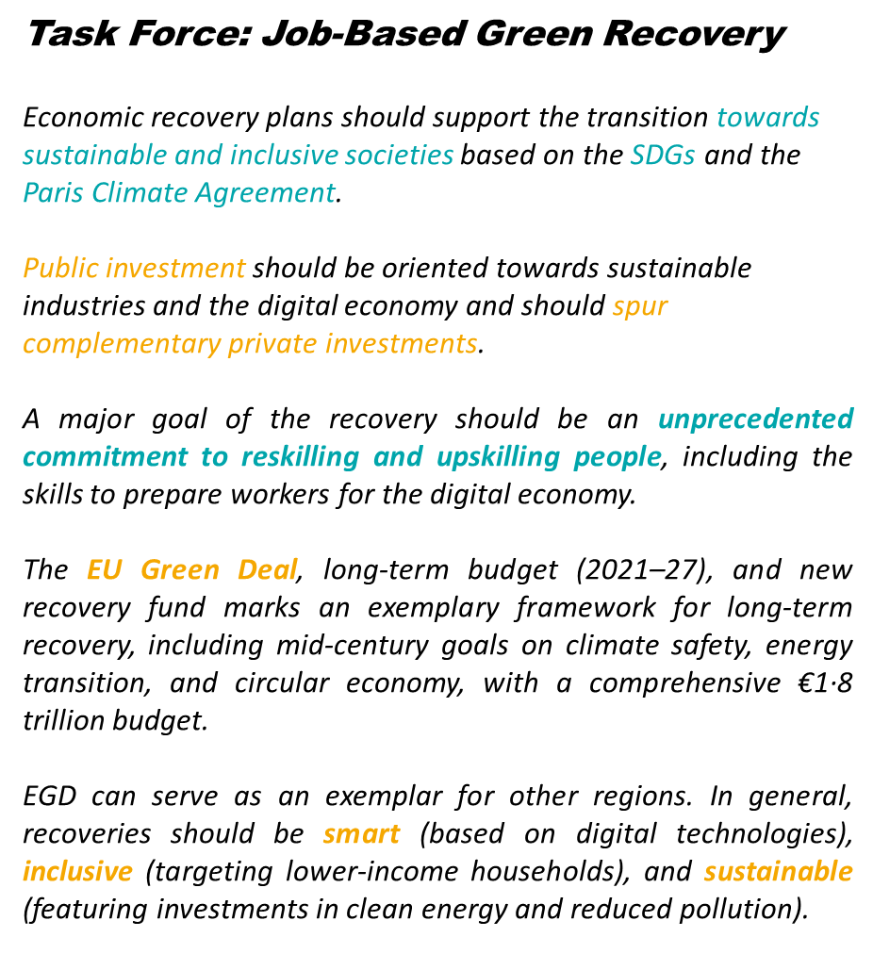
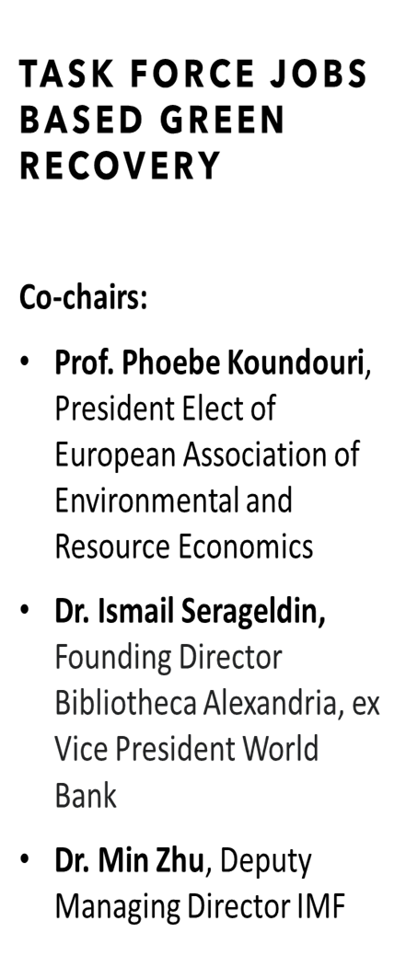

Slide 26
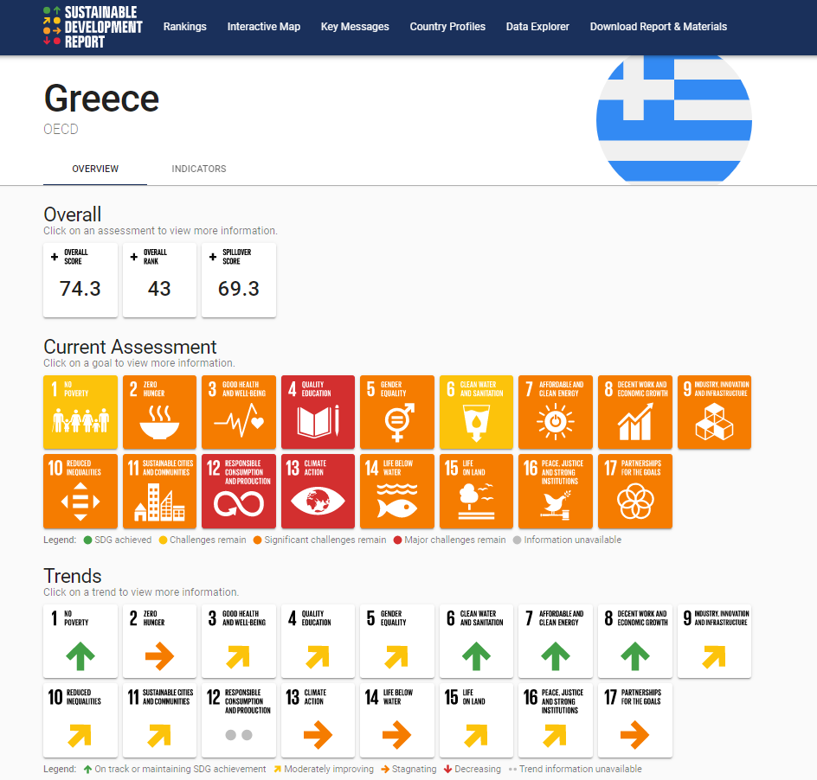

Slide 27
Cluster for Sustainability Transition
Transforming Research and Innovation into Climate Action
Director: Professor Phoebe Koundouri

Slide 28
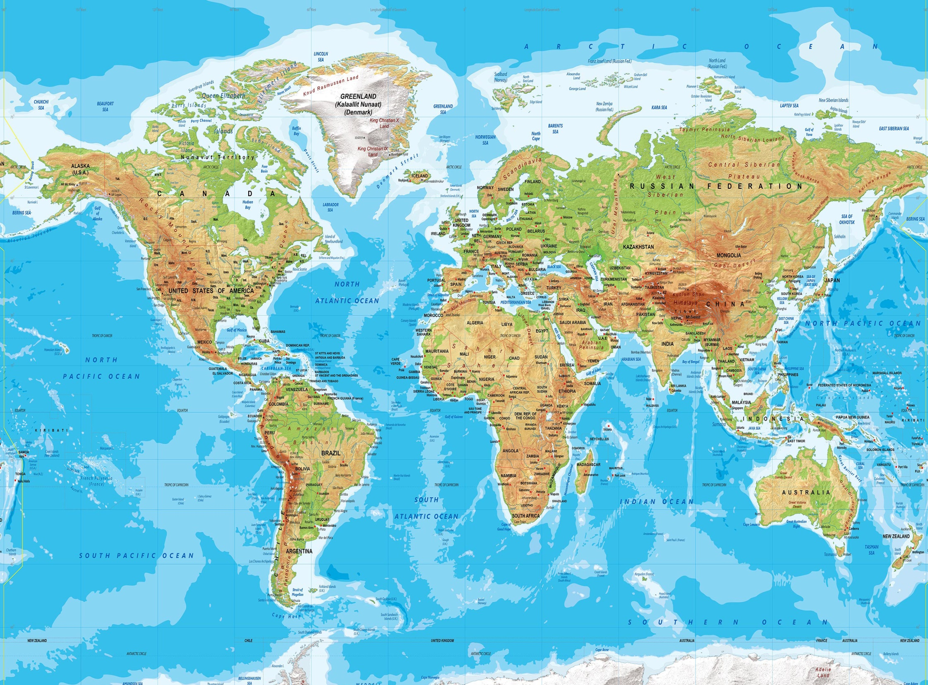
OUR PROJECTS
UN SDSN GREECE
ReSEES, AUEB
EIT Climate-KIC HUB Greece
Marine Coastal Management
Water Food Energy Nexus
Renewable Energy
Climate Change
Sustainable Finance
Biodiversity
Forest Management
Waste Management
Nuclear Energy

Slide 29
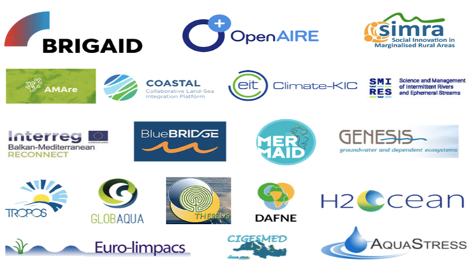
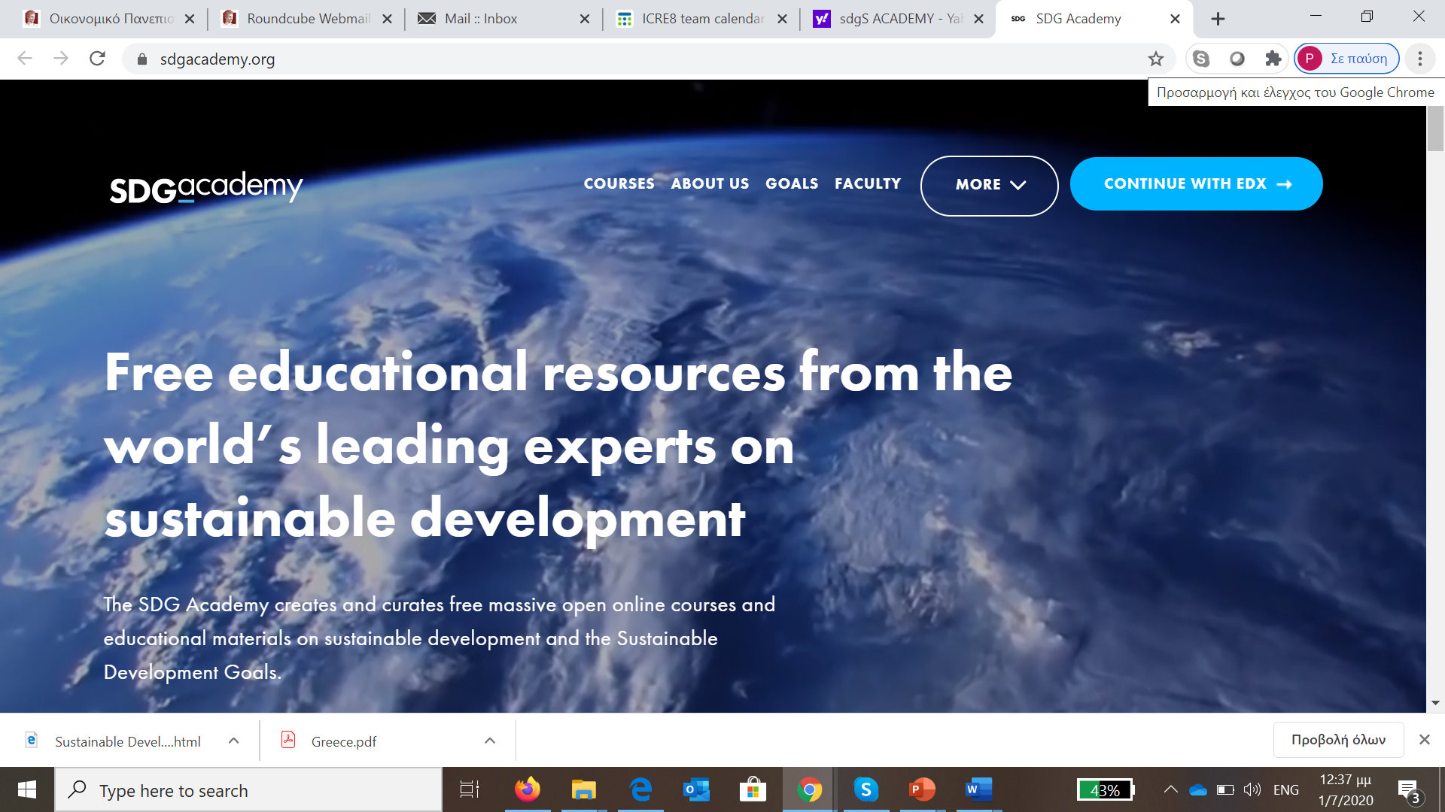
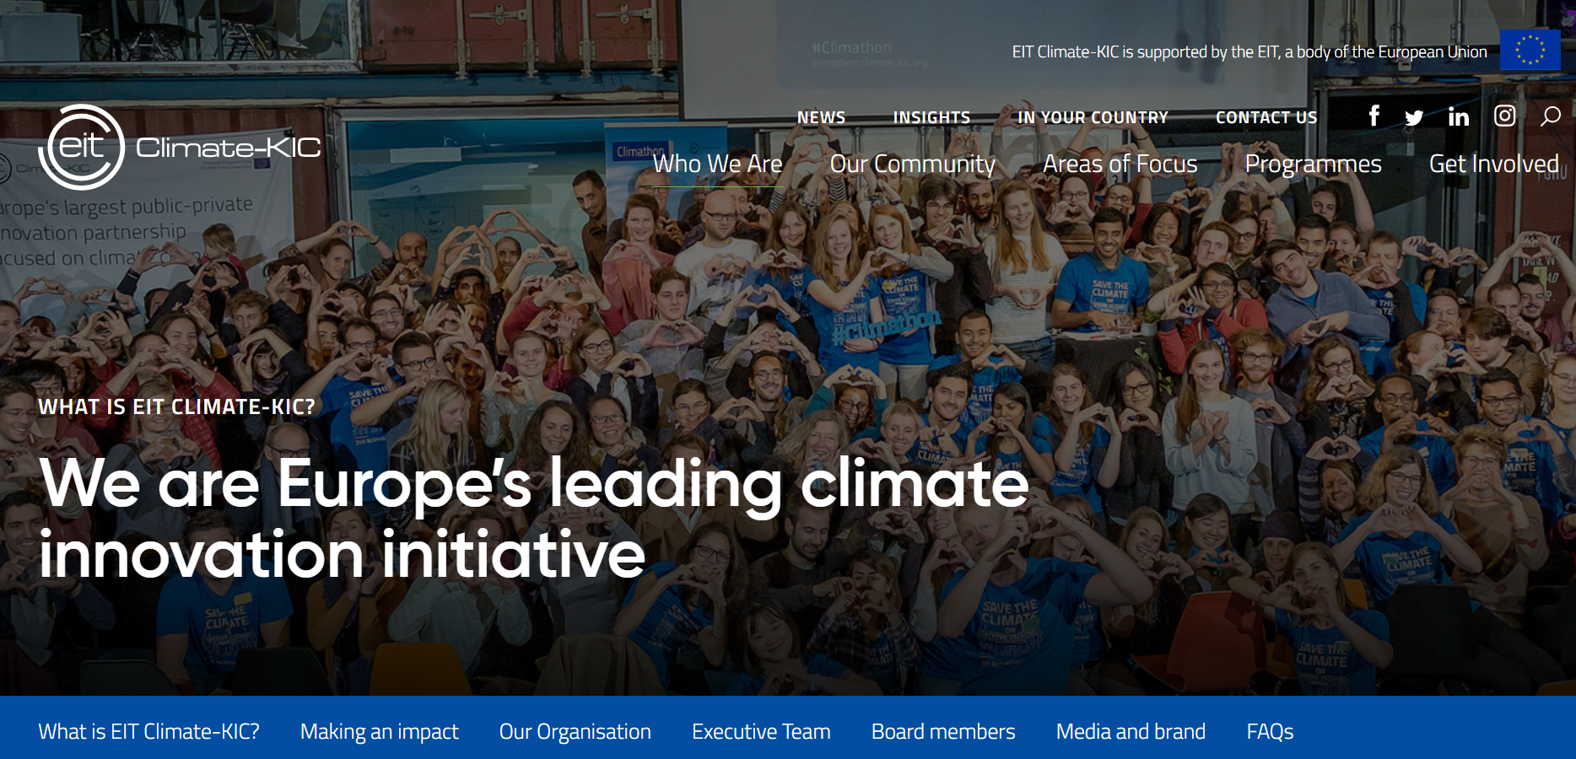
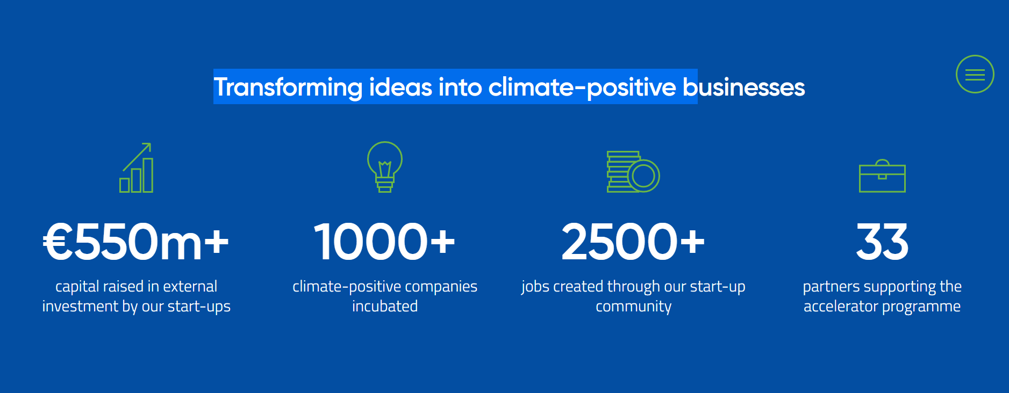
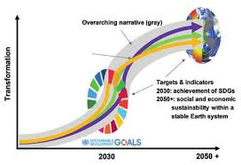
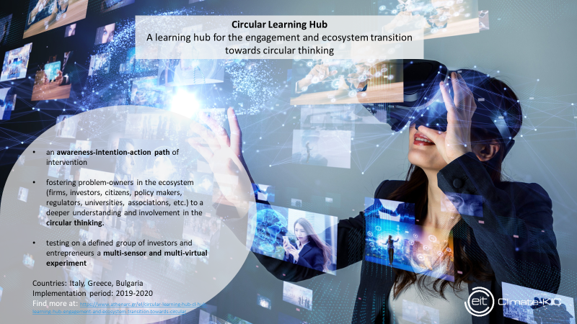
Cluster for Sustainability Transition Research, Deep Demonstration & Education
Research &
Global Initiatives
Deep Demonstration &
Innovation Acceleration
Education & Training
Climate Change
Committee
Notes:
29

Slide 30
Projects Circular Economy & Climate Change

Slide 31
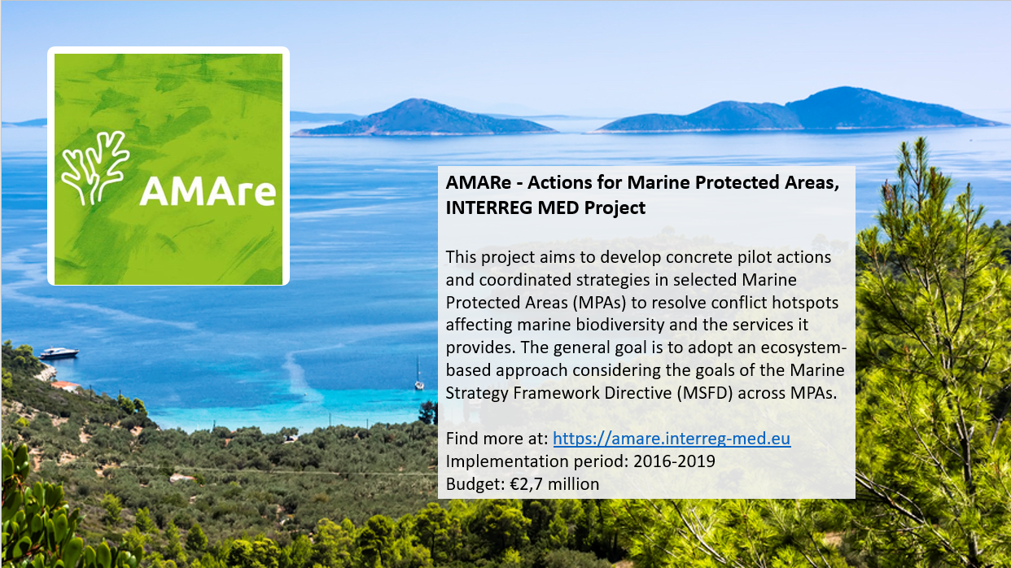
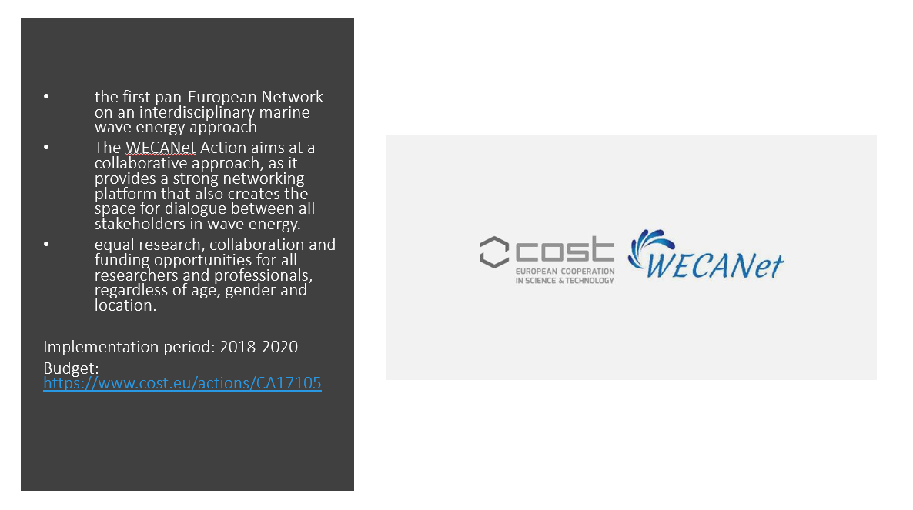
Blue
Growth

Slide 32
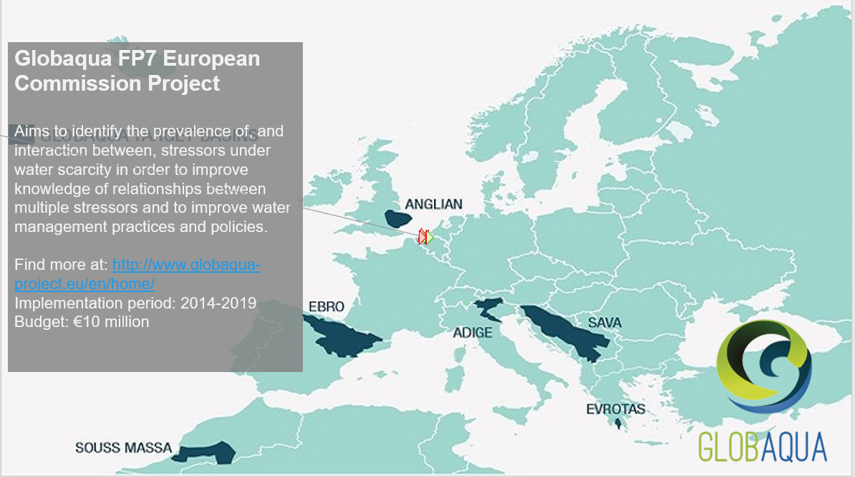
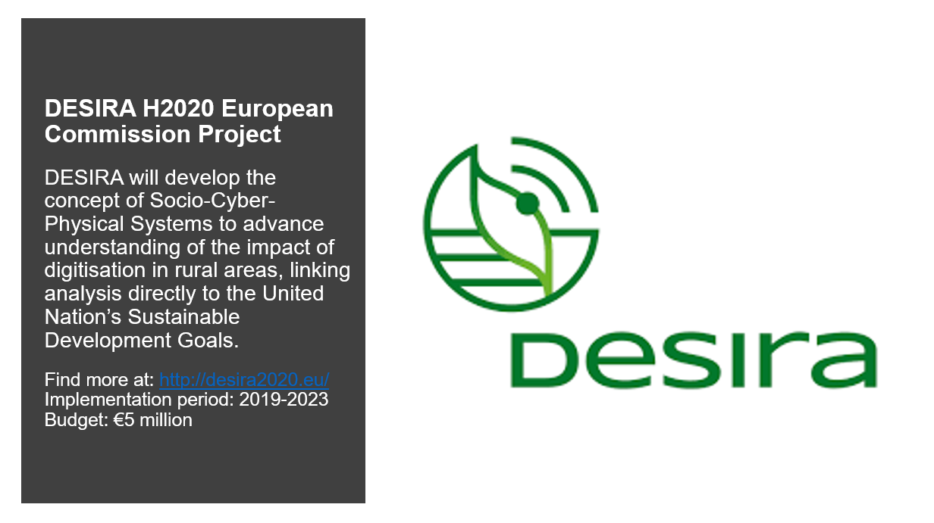
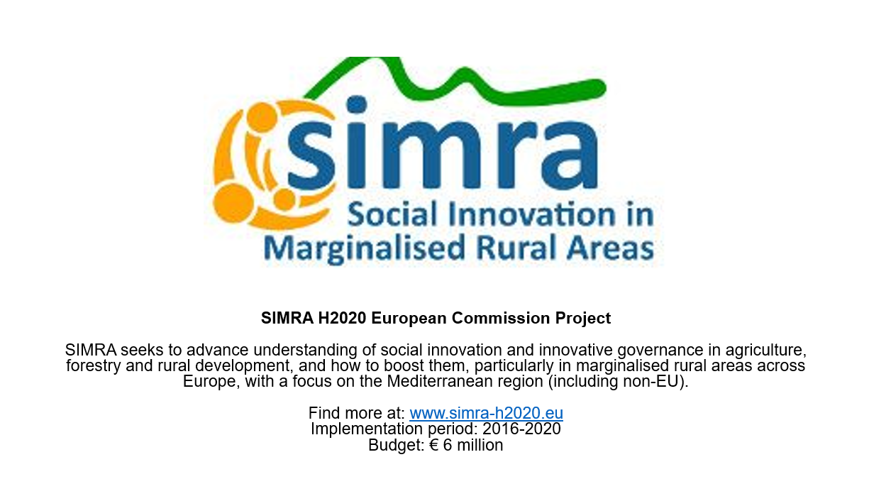
Projects Water-Food-Energy Nexus and Smart Agriculture

Slide 33
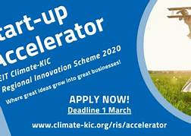
Greek Start-ups

