Slide 1
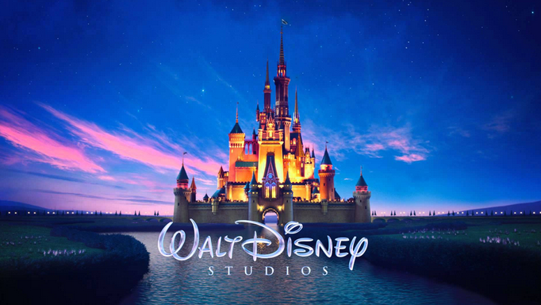
What do you know about…

Slide 2
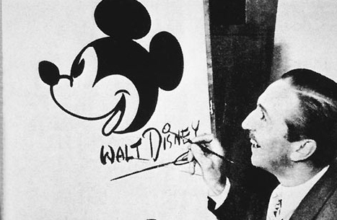
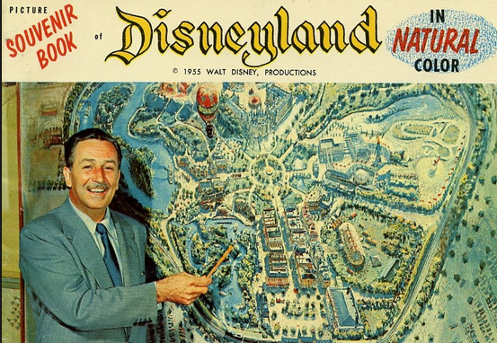
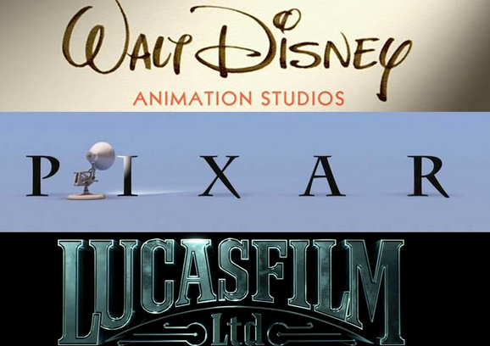

Slide 3
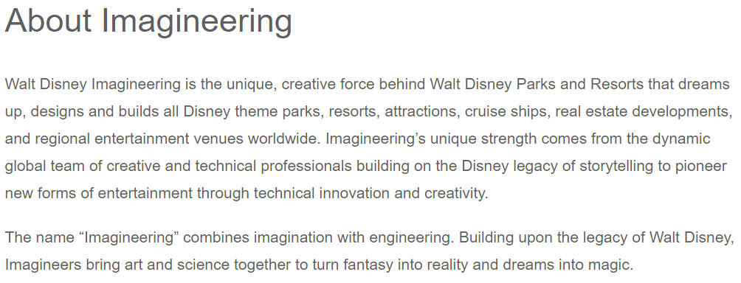
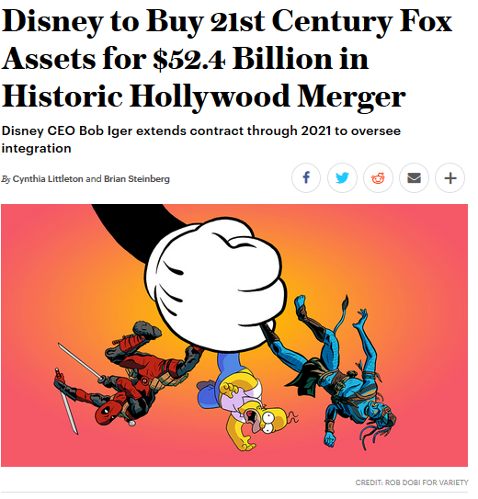
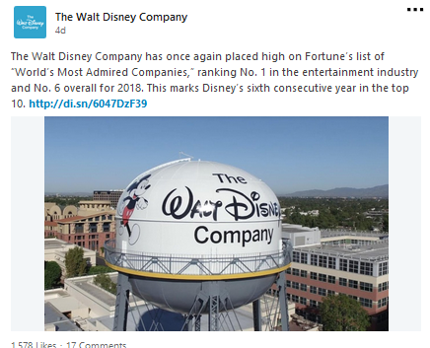

Slide 4
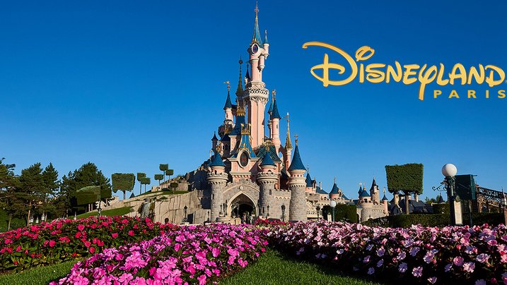
Disney Land In Europe

Slide 5
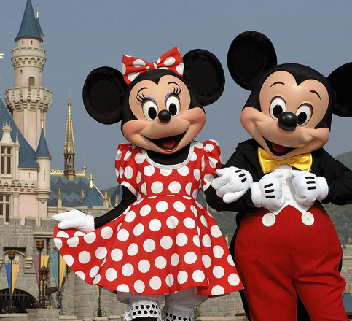
A billion dollar example: Euro Disneyland
Opened on April 12, 1992 at Marne-la-Vallee
France selected over Spain thanks to its geographic location; within a day’s drive for 30 million people
Investment of ±$2,5 billion, ‘the deal of the century’
Euro Disneyland followed very successful experience of Tokyo Disneyland in 1983
Disney had very high hopes on Euro Disneyland and had a 49% stake
Notes:
But Paris was chosen because of demographics and subsidies. About 17 million Europeans live less than a two-hour drive from Paris. Another 310 million can fly there in the same time or less. Also, the French government was so eager to attract Disney that it offered the company more than $1 billion in various incentives, all in the expectation that the project would create 30,000 French jobs.

Slide 6
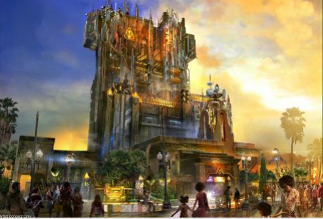
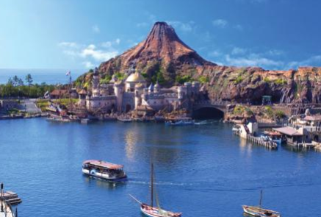
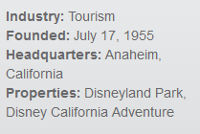
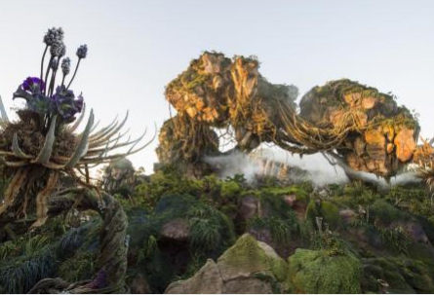
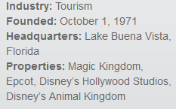
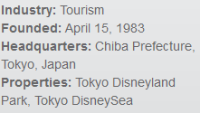
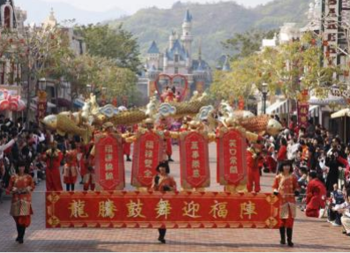
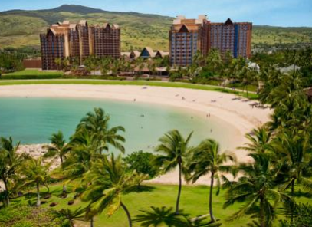
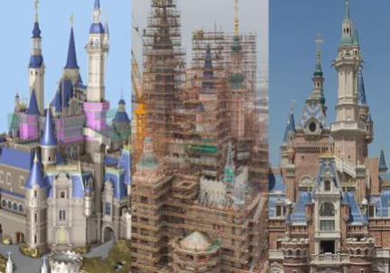
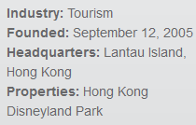
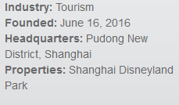

Slide 7
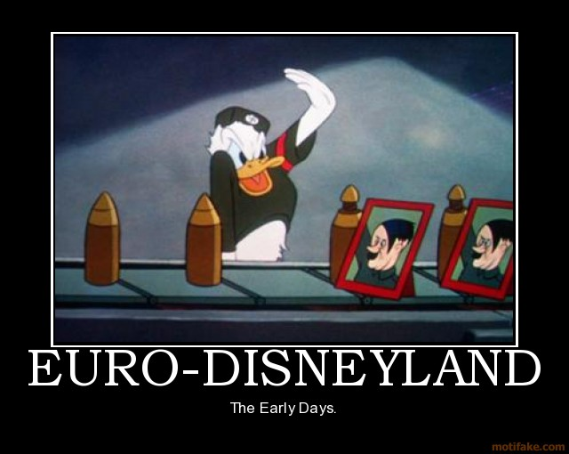
Cultural Imperialism…?
“Cultural Chernobyl” – theatre director
“I wish with all my heart that the rebels would set fire to Disneyland” – French intellectual
“Mickey Mouse is stifling individualism and transforming children into consumers”
“They are experts at seduction, and don’t hide the fact that they’re trying to seduce you” banker wined and dined at Orlando
Notes:
The minister of culture announced he would boycott the opening, proclaiming it to be an unwelcome symbol of American clichés and a consumer society. Unperturbed, Disney pushed ahead with the planned summer 1992 opening of the $5 billion park. Shortly after Euro-Disneyland opened, French farmers drove their tractors to the entrance and blocked it. This globally televised act of protest was aimed not at Disney but at the US government, which had been demanding that French agricultural subsidies be cut. Still, it focused world attention upon the loveless marriage of Disney and Paris.

Slide 8
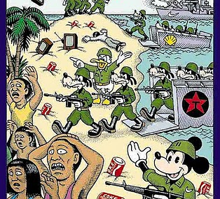
Disney vs. Euro ‘Cultureland’
Different spending patterns
Different eating habits
A moralising attitude (e.g. alcohol ban – eventually dropped -, cigarettes)
A paternalistic personnel management
Total and intentional ignorance of cultural differences
“Like the Japanese before them, Europeans will adapt to our spirit” (CEO Eurodisney)
Notes:
Then there were the operational errors. Disney’s policy of serving no alcohol in the park, since reversed caused astonishment in a country where a glass of wine for lunch is a given. Disney thought that Monday would be a light day for visitors and Friday a heavy one and allocated staff accordingly, but the reality was the reverse. Another unpleasant surprise was the hotel breakfast debacle. “We were told that Europeans ‘don’t take breakfast,’ so we downsized the restaurants,” recalled one Disney executive. “And guess what? Everybody showed up for breakfast. We were trying to serve 2,500 breakfasts in a 350-seat restaurant at some of the hotels. The lines were horrendous. Moreover, they didn’t want the typical French breakfast of croissants and coffee, which was our assumption. They wanted bacon and eggs.” Lunch turned out to be another problem. “Everybody wanted lunch at 12:30. The crowds were huge. Our smiling cast members had to calm down surly patrons and engage in some ‘behavior modification’ to teach them that they could eat lunch at 11:00 AM or 2:00 PM.”
There were major staffing problems too. Disney tried to use the same teamwork model with its staff that had worked so well in America and Japan, but it ran into trouble in France. In the first nine weeks of Euro-Disneyland’s operation, roughly 1,000 employees, 10 percent of the total, left. One former employee was a 22-year-old medical student from a nearby town who signed up for a weekend job. After two days of “brainwashing,” as he called Disney’s training, he left following a dispute with his supervisor over the timing of his lunch hour. Another former employee noted, “I don’t think that they realize what Europeans are like… that we ask questions and don’t think all the same way.”
One of the biggest problems, however, was that Europeans didn’t stay at the park as long as Disney expected. While Disney succeeded in getting close to 9 million visitors a year through the park gates, in line with its plans, most stayed only a day or two. Few stayed the four to five days that Disney had hoped for. It seems that most Europeans regard theme parks as places for day excursions. A theme park is just not seen as a destination for an extended vacation. This was a big shock for Disney. The company had invested billions in building luxury hotels next to the park-hotels that the day-trippers didn’t need and that stood half empty most of the time. To make matters worse, the French didn’t show up in the expected numbers. In 1994, only 40 percent of the park’s visitors were French. One puzzled executive noted that many visitors were Americans living in Europe or, stranger still, Japanese on a European vacation! As a result, by the end of 1994 Euro-Disneyland had cumulative losses of $2 billion.

Slide 9
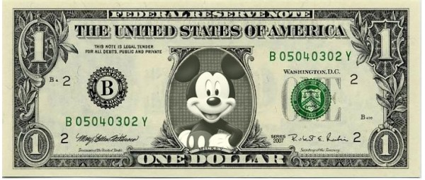
The ‘Price Tag’…
In 1993: 1 billion US$ losses (…and dramatic drop of price of share)
In 1994 (1st semester): 21% sales drop compared to previous year
In 1994-95: losses still at ± 1 million US$ a day!
In 1994, it was saved from bankruptcy by a $350 million investment from the Saudi royal family, which now owns 38% of shares
In January 2005 Disneyland Paris saved from bankruptcy by French government
In October 2014, Walt Disney announced a $1.25 billion bailout plan to rescue its subsidiary Disneyland Paris
To make a profit, the park needs about 15 million visitors a year
Recession signs were not taken into consideration → too high revenue expectations set and the park did not even manage to sell the tickets (quite high price).
However, problems of Eurodisney are obviously not entirely ‘cultural’
Notes:
The top management made wrong assumptions, which led them to take wrong management decisions. In fact, French habits and traditions were not taken in to account. For example, breakfast at the park was not served; instead in the French culture breakfast is one of the most important “moments” of the day. Moreover, alcoholic drinks were not allowed in the park: contrary French always have a glass of wine during their main meals. In addition, also the dress code requirements did not meet the French standards in work environments. And the fact that they were supposed to be always smiling and kind did not reflect the French attitude and the staff was not comfortable with these policies. Furthermore, the top management positions were al given to American, which made the situation even worse because they were incapable to fix the mistakes made from the very start. Instead, if they had hired French people to manage the park, they would have been able to assess these cultural differences in a more efficient way, avoiding such a cultural clash.
Second, it was given for granted that French entertainment culture was as the US one. Thus, staff and resources were allocated in the wrong way, because the peek days were not the same as the US Disney Land. This led to a lack of staff in crowded days and a surplus of staff in empty days affecting efficiency and profitability of the park negatively. Moreover, they assumes French would have gone to the park with their private transportation, thus they built many car parks which were most of the time empty, instead the parking were not big enough for buses, which was the more used transport used to get to the park.
Third, recession signs were not taken into consideration and too high expectations were placed in the profitability of this new Euro Disney. Thus, too high revenue expectations were set and the park did not even manage to sell the tickets available also due to the quite high price imposed. Moreover, the wrong allocation of staff and resources made the situation even worse and the park’s expenses almost were more than its revenues.
Cultural factors are crucial for the success of any business and to disregard and to “attack” others traditions and customs can be destructive. Before opening a business already well established in another country, the company has to do a very deep and targeted market research in order to better understand both the culture and how that same business can adapt to the different kind of need clients in the country might have. Moreover, the success of an organization depends on how united the organization is especially the executive, and it is essential to resolve workplace issues, make employees happy with policies and have excellent communication tools. In conclusion, a company should make use of cultural differences to have a competitive advantage over other entertainment parks and make it unique, not only a copy of the already existing ones.

Slide 10
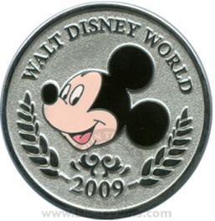
Lessons Learned from
Cultural differences may not necessarily be an ‘obstacle’
Need for cultural awareness, sensitivity and adjustment as critical managerial competence
1
2
3
4
Effect of culture on (international) business and management
every business function is subject to potential cultural differences
Cultural diversity can be a asset, but also ‘cultural collision’ if:
-Firm practices that are in conflict with local customs and values
-Employees are unable to accept or adjust to foreign customs

