Slide 1
Αρχιτεκτονική Υπολογιστών
Ενότητα # 7: ARM
Διδάσκων: Γεώργιος Κ. Πολύζος
Τμήμα: Πληροφορικής

Slide 2
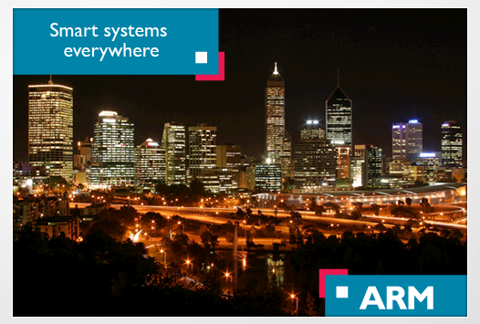
ARM A European (UK) Computer Architecture powerhouse
Based on
Wikipedia,
the ARM website and
Web PPTs

Slide 3
What’s hot!
Quiet revolution gathers pace Economist Intelligence Unit Report: Business leaders' insights about the business opportunities unlocked by the Internet of Things

Slide 4
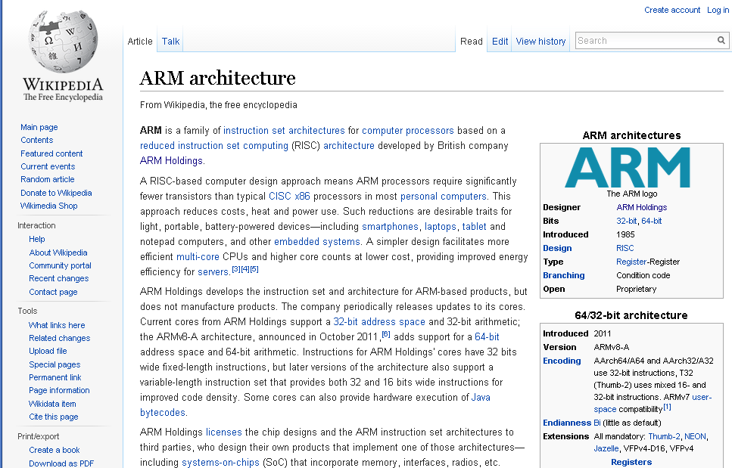

Slide 5
ARM architecture (1)
ARM is a family of instruction set architectures for computer processors based on a reduced instruction set computing (RISC) architecture
developed by British company ARM Holdings
A RISC-based computer design approach means ARM processors require significantly fewer transistors than typical CISC x86 processors in most personal computers

Slide 6
ARM architecture (2)
This approach reduces costs, heat and power use
Such reductions are desirable traits for light, portable, battery-powered devices—​including smartphones, laptops, tablet and notepad computers, and other embedded systems
A simpler design facilitates more efficient multi-core CPUs and higher core counts at lower cost, providing improved energy efficiency for servers

Slide 7
ARM Holdings (1)
ARM Holdings develops the instruction set and architecture for ARM-based products, but does not manufacture products
The company periodically releases updates to its cores
Some cores can also provide hardware execution of Java bytecodes

Slide 8
ARM Holdings (2)
ARM Holdings licenses the chip designs and the ARM instruction set architectures to third parties, who design their own products that implement one of those architectures—​including systems-on-chips (SoC) that incorporate memory, interfaces, radios, etc.
Currently, the widely used Cortex cores, older "classic" cores, and specialized SecurCore cores variants are available for each of these to include or exclude optional capabilities

Slide 9
ARM Holdings (3)
Companies that make chips that implement an ARM architecture include: Apple, AppliedMicro, Atmel, Broadcom, Freescale Semiconductor, Nvidia, NXP,Qualcomm, Samsung Electronics, ST Microelectronics and Texas Instruments
Qualcomm introduced new three-layer 3D chip stacking in their 2014-15 ARM SoCs such as in their first 20 nm 64-bit octa-core

Slide 10
ARM Holdings plc Business (1)
British multinational semiconductor and softwaredesign company
head office in Cambridge, UK
its largest business is designing processors (CPU) bearing the ARM name,
also designs software development tools, system-on-a-chip (SoC) infrastructure & software
it is market dominant in the field of processors for mobile phones and tablet computers
Processors based on ARM designs are in all classes of computing devices

Slide 11
ARM Holdings plc Business (2)
ARM's graphics processing units (GPU) are used in laptops, Android tablets (over 50% market share) and smartphones
e.g., some of Samsung's products such as the Samsung Galaxy Note 4 tablet & Samsung Galaxy S5 smartphone and smartwatches (Samsung Galaxy Gear)
ARM's main CPU competitors include
Intel (Atom), Imagination Technologies (MIPS) and AMD

Slide 12
ARM Holdings plc Business (3)
GPU competitors include
Imagination Technologies (PowerVR), Qualcomm (Adreno) and increasingly Nvidia and Intel
Qualcomm and Nvidia combine their GPUs with an ARM licensed CPU while Intel doesn't
ARM has a primary listing on the London Stock Exchange and is a constituent of the FTSE 100 Index & has a secondary listing on NASDAQ

Slide 13
History (1)
The British computer manufacturer Acorn Computers first developed ARM in the 1980s
to use in its personal computers
its first ARM-based products were coprocessor modules for the BBC Micro series of computers.
Acorn Computers considered how to move on from the relatively simple MOS Technology 6502 processor to address business markets like the one that was soon dominated by the IBM PC, launched in 1981

Slide 14
History (2)
The Acorn Business Computer (ABC) plan required that a number of second processors be made to work with the BBC Micro platform, but processors such as the Motorola 68000 and National Semiconductor 32016 were considered unsuitable, and the 6502 was not powerful enough for a graphics based user interface

Slide 15
History (3)
The MOS Technology 6502 was an 8-bit microprocessor that was designed by Chuck Peddle and Bill Mensch for MOS Technology. When it was introduced in 1975, the 6502 was, by a considerable margin, the least expensive full-featured microprocessor on the market. computer projects that would eventually result in the home computer revolution of the 1980s.
After testing all available processors and finding them lacking, Acorn decided it needed a new architecture.

Slide 16
History (4)
Inspired by white papers on the Berkeley RISC project, Acorn designed its own processor
A visit to the Western Design Center in Phoenix, where the 6502 was being updated by what was effectively a single-person company, showed Acorn engineers they did not need massive resources and facilities

Slide 17
History (5)
An engineer, Wilson, developed the instruction set, writing a simulation of the processor in BBC BASIC that ran on a BBC Micro with a second 6502 processor. This convinced Acorn engineers they were on the right track. Wilson approached Acorn's CEO, Hermann Hauser, and requested more resources. Once he had approval, he assembled a small team to implement Wilson's model in hardware

Slide 18
ARM architecture pervasiveness (1)
Globally ARM is the most widely used instruction set architecture in terms of quantity produced
The low power consumption of ARM processors has made them very popular
over 50 billion ARM processors have been produced as of 2014
of which 10 billion were produced in 2013 and
ARM-based chips are found in nearly 60% of the world’s mobile devices

Slide 19
ARM architecture pervasiveness (2)
The ARM architecture (32-bit) is the most widely used architecture in mobile devices, and most popular 32-bit one in embedded systems
In 2005, ~98% of all mobile phones sold used at least one ARM processor
According to ARM Holdings, in 2010 alone, producers of chips based on ARM architectures reported shipments of 6.1 billion ARM-based processors, representing 95% of smartphones, 35% of digital televisions and set-top boxes and 10% of mobile computers

Slide 20
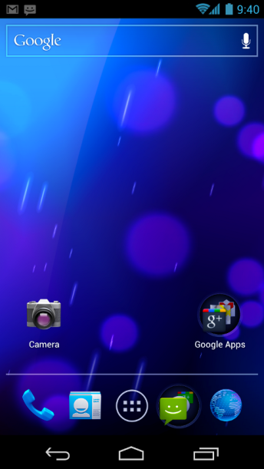
ARM (1) Operating system support
32-bit operating systems
Android runs on the ARM architecture
Embedded operating systems
supported by a large number of embedded and real-time operating systems, including Linux, Windows CE, Symbian, ChibiOS/RT,FreeRTOS, eCos, Integrity, Nucleus PLUS, MicroC/OS-II, PikeOS, QNX, RTEMS, RTXC Quadros, ThreadX, VxWorks, DRYOS, MQX, T-Kernel, OSE,SCIOPTA, OS-9 and RISC OS

Slide 21
ARM (2) Operating system support
Mobile device operating systems
the primary hardware environment for most mobile device operating systems such as iOS, Android, Windows Phone, Windows RT, Bada,Blackberry OS/Blackberry 10, MeeGo, Firefox OS, Tizen, Ubuntu Touch, Sailfish and webOS.Desktop/server operating systems

Slide 22
ARM (3) Operating system support
64-bit operating systems
Mobile device operating systems
iOS 7 and later, on 64-bit Apple SoCs, have ARMv8-A application support
Android supports ARMv8-A in the latest 5.0 version

Slide 23
ARM (4) Operating system support
Desktop/server operating systems
Support for ARMv8-A was merged into the Linux kernel version 3.7 in late 2012. ARMv8-A is supported by a number of Linux distributions, such as Debian
Windows applications can be recompiled to run on 32-bit or 64-bit ARM in Linux with Winelib

Slide 24
Τέλος Ενότητας # 7
Μάθημα: Αρχιτεκτονική Υπολογιστών
Ενότητα # 7: ARM
Διδάσκων: Γεώργιος Κ. Πολύζος
Τμήμα: Πληροφορικής

