Slide 1
Εξόρυξη γνώσης από Βάσεις Δεδομένων και τον Παγκόσμιο Ιστό
Ενότητα # 3: Supervised learning
Διδάσκων: Μιχάλης Βαζιργιάννης
Τμήμα: Προπτυχιακό Πρόγραμμα Σπουδών “Πληροφορικής”

Slide 2
Χρηματοδότηση
Το παρόν εκπαιδευτικό υλικό έχει αναπτυχθεί στα πλαίσια του εκπαιδευτικού έργου του διδάσκοντα.
Το έργο «Ανοικτά Ακαδημαϊκά Μαθήματα στο Οικονομικό Πανεπιστήμιο Αθηνών» έχει χρηματοδοτήσει μόνο τη αναδιαμόρφωση του εκπαιδευτικού υλικού.
Το έργο υλοποιείται στο πλαίσιο του Επιχειρησιακού Προγράμματος «Εκπαίδευση και Δια Βίου Μάθηση» και συγχρηματοδοτείται από την Ευρωπαϊκή Ένωση (Ευρωπαϊκό Κοινωνικό Ταμείο) και από εθνικούς πόρους.

Slide 3
Άδειες Χρήσης
Το παρόν εκπαιδευτικό υλικό υπόκειται σε άδειες χρήσης Creative Commons.
Οι εικόνες προέρχονται … .

Slide 4
Σκοποί ενότητας
Εισαγωγή και εξοικείωση με τις μεθόδους k-nn, regression, logistic regression, decision trees.

Slide 5
Περιεχόμενα ενότητας
Introduction to supervised learning
Regression
Naïve Bayes
K-nn
Decision Trees
Regression re-visited

Slide 6
Introduction to supervised learning
Μάθημα: Εξόρυξη γνώσης από Βάσεις Δεδομένων και τον Παγκόσμιο Ιστό
Ενότητα # 3: Supervised learning
Διδάσκων: Μιχάλης Βαζιργιάννης
Τμήμα: Προπτυχιακό Πρόγραμμα Σπουδών “Πληροφορικής”

Slide 7
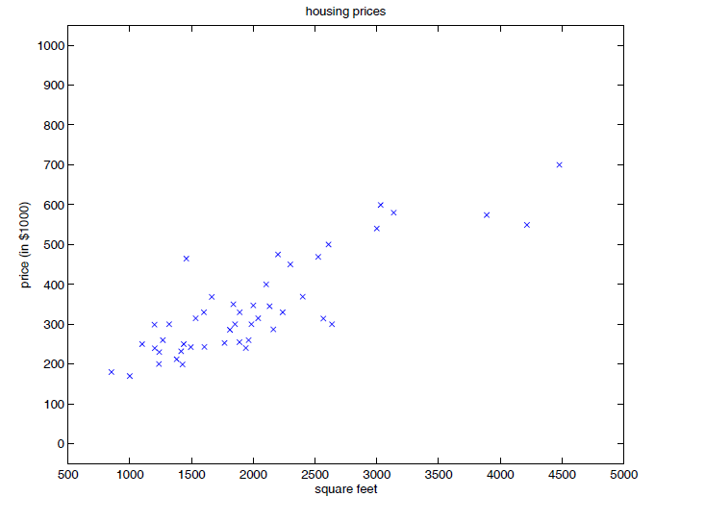
Prediction..
Can we predict the price of a house based on its size (suface in m^2) ?

Slide 8
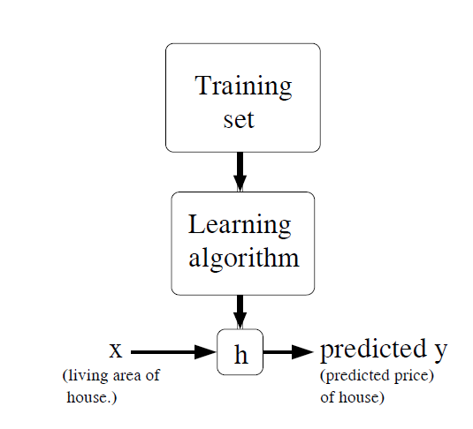
Prediction..
y continuous value: prediction
y discrete value: classification

Slide 9
Prediction..
x(i): “input” variables (input features)
y(i): “output” or target variable that we are trying to predict
A pair (x(i), y(i)) is called a training example,
The training set - a list of m training examples {(x(i), y(i)); i =1, . . . ,m}—is called a training set.
X : space of input values, Y : output values.
The supervised learning problem:
given a training set,
learn a function h : X → Y so that h(x) is a “good” predictor for the corresponding value of y.
For historical reasons, this function h is called a hypothesis.

Slide 10
Classes of classifiers
Class-conditional/probabilistic, based on p( x | c_{k} ),
Naïve Bayes (simple, but often effective in high dimensions)
Parametric generative models, e.g., Gaussian (can be effective in low-dimensional problems: leads to quadratic boundaries in general)
Regression-based, p( c_{k} | x ) directly
Logistic regression: simple, linear in “odds” space
Neural network: non-linear extension of logistic, can be difficult to work with
Discriminative models, focus on locating optimal decision boundaries
Linear discriminants, perceptrons: simple, sometimes effective
Support vector machines: generalization of linear discriminants, can be quite effective, computational complexity is an issue
Nearest neighbor: simple, can scale poorly in high dimensions
Decision trees: “swiss army knife”, often effective in high dimensionis

Slide 11
Regression
Μάθημα: Εξόρυξη γνώσης από Βάσεις Δεδομένων και τον Παγκόσμιο Ιστό
Ενότητα # 3: Supervised learning
Διδάσκων: Μιχάλης Βαζιργιάννης
Τμήμα: Προπτυχιακό Πρόγραμμα Σπουδών “Πληροφορικής”

Slide 12
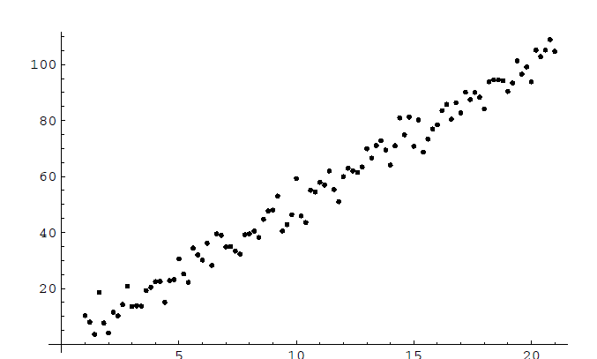
Regression
Aims at fitting a line to a set of observations
there is a straight line y = ax +b.

Slide 13
Regression
the individual point error is:
thus the error set is:
the total error is:
--------------------------------------------------------------------------------------------------------------------------------------------------
Based on notes at: http://www.williams.edu/go/math/sjmiller/public_html/BrownClasses/54/handouts/MethodLeastSquares.pdf

Slide 14
Least Squares method
The objective is to minimize
Thus to find values α, b such that:
Differentiation leads to:
(proof?)

Slide 15
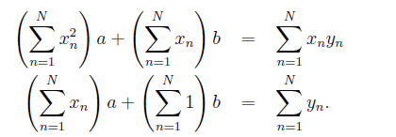
Least Squares method
Thus setting
Leads to:
Or equivalently:

Slide 16
Least Squares method
Or equivalently:
Implying:

Slide 17
Least Squares method
Solution exists only if is invertible
- i.e. if it determinant is not 0 – prove it!

Slide 18
Least Squares method
The method is generalized in a straight forward way:
Assume y = af(x) + bg(x) then the respective result is:
Exercise: Under what conditions is the matrix invertible?

Slide 19
Naïve Bayes
Μάθημα: Εξόρυξη γνώσης από Βάσεις Δεδομένων και τον Παγκόσμιο Ιστό
Ενότητα # 3: Supervised learning
Διδάσκων: Μιχάλης Βαζιργιάννης
Τμήμα: Προπτυχιακό Πρόγραμμα Σπουδών “Πληροφορικής”

Slide 20
Bayesian Classification: Why?
Probabilistic learning: Calculate explicit probabilities for hypothesis, among the most practical approaches to certain types of learning problems
Incremental: Each training example can incrementally increase/decrease the probability that a hypothesis is correct. Prior knowledge can be combined with observed data.
Probabilistic prediction: Predict multiple hypotheses, weighted by their probabilities
Standard: Even when Bayesian methods are computationally intractable, they can provide a standard of optimal decision making against which other methods can be measured

Slide 21
Bayesian classification
The classification problem may be formalized using a-posteriori probabilities:
P(C|X) = prob. that the sample tuple X=<x₁,…,x_{k}> is of class C.
E.g. P(class=N | outlook=sunny,windy=true,…)
Idea: assign to sample X the class label C such that P(C|X) is maximal

Slide 22
Estimating a-posteriori probabilities
Bayes theorem:
P(C|X) = P(X|C)·P(C) / P(X)
P(X) is constant for all classes
P(C) = relative freq of class C samples
C such that P(C|X) is maximum = C such that P(X|C)·P(C) is maximum
Problem: computing P(X|C) is unfeasible!

Slide 23
Naïve Bayesian Classification
Naïve assumption: attribute independence
P(x₁,…,x_{k}|C) = P(x₁|C)·…·P(x_{k}|C)
If i-th attribute is categorical: P(x_{i}|C) is estimated as the relative freq of samples having value x_{i} as i-th attribute in class C
If i-th attribute is continuous:
Real-valued variables discretized to create nominal versions
P(x_{i}|C) is estimated thru a Gaussian density function
Computationally feasible in both cases
Generative probabilistic model with conditional independence assumption on p( x | c_{k} ), i.e. p( x | c_{k} ) = Π p( x_{j} | c_{k} )
Typically used with nominal variables
(alternative is to model each p( x_{j} | c_{k} ) with a parametric model – less widely used)

Slide 24
Naïve Bayes Classifiers
Comments:
Simple to train (just estimate conditional probabilities for each feature-class pair)
Often works surprisingly well in practice
e.g., state of the art for text-classification, basis of many widely used spam filters
Feature selection can be helpful, e.g., information gain
Note that even if CI assumptions are not met, it may still be able to approximate the optimal decision boundaries (seems to happen in practice)
However…. on most problems can usually be beaten with a more complex model (plus more work)

Slide 25
Play-tennis example: estimating P(x_{i}|C)
outlook
P(sunny|p) = 2/9 | P(sunny|n) = 3/5
P(overcast|p) = 4/9 | P(overcast|n) = 0
P(rain|p) = 3/9 | P(rain|n) = 2/5
temperature
P(hot|p) = 2/9 | P(hot|n) = 2/5
P(mild|p) = 4/9 | P(mild|n) = 2/5
P(cool|p) = 3/9 | P(cool|n) = 1/5
humidity
P(high|p) = 3/9 | P(high|n) = 4/5
P(normal|p) = 6/9 | P(normal|n) = 2/5
windy
P(true|p) = 3/9 | P(true|n) = 3/5
P(false|p) = 6/9 | P(false|n) = 2/5
P(p) = 9/14
P(n) = 5/14

Slide 26
Play-tennis example: classifying X
An unseen sample X = <rain, hot, high, false>
P(X|p)·P(p) = P(rain|p)·P(hot|p)·P(high|p)·P(false|p)·P(p) = 3/9·2/9·3/9·6/9·9/14 = 0.010582
P(X|n)·P(n) = P(rain|n)·P(hot|n)·P(high|n)·P(false|n)·P(n) = 2/5·2/5·4/5·2/5·5/14 = 0.018286
Sample X is classified in class n (don’t play)

Slide 27
The independence hypothesis…
… makes computation possible
… yields optimal classifiers when satisfied
… but is seldom satisfied in practice, as attributes (variables) are often correlated.
Attempts to overcome this limitation:
Bayesian networks, that combine Bayesian reasoning with causal relationships between attributes
Decision trees, that reason on one attribute at the time, considering most important attributes first

Slide 28
K-nn
Μάθημα: Εξόρυξη γνώσης από Βάσεις Δεδομένων και τον Παγκόσμιο Ιστό
Ενότητα # 3: Supervised learning
Διδάσκων: Μιχάλης Βαζιργιάννης
Τμήμα: Προπτυχιακό Πρόγραμμα Σπουδών “Πληροφορικής”

Slide 29
Linear Discriminant Classifiers
Linear Discriminant Analysis (LDA)
Earliest known classifier (1936, R.A. Fisher)
See section 10.4 for math details
Find a projection onto a vector such that means for each class (2 classes) are separated as much as possible (with variances taken into account appropriately)
Reduces to a special case of parametric Gaussian classifier in certain situations
Many subsequent variations on this basic theme (e.g., regularized LDA)
Other linear discriminants
Decision boundary = (p-1) dimensional hyperplane in p dimensions
Perceptron learning algorithms (pre-dated neural networks)
Simple “error correction” based learning algorithms
SVMs: use a sophisticated “margin” idea for selecting the hyperplane

Slide 30
Nearest Neighbor Classifiers
kNN: select the k nearest neighbors to x from the training data and select the majority class from these neighbors
k is a parameter:
Small k: “noisier” estimates, Large k: “smoother” estimates
Best value of k often chosen by cross-validation
Comments
Virtually assumption free
Interesting theoretical properties: Bayes error < error(kNN) < 2 x Bayes error (asymptotically)
Disadvantages
Can scale poorly with dimensionality: sensitive to distance metric
Requires fast lookup at run-time to do classification with large n
Does not provide any interpretable “model”

Slide 31
Local Decision Boundaries
Boundary? Points that are equidistant
between points of class 1 and 2
Note: locally the boundary is
(1) linear (because of Euclidean distance)
(2) halfway between the 2 class points
(3) at right angles to connector
1
2
Feature 2
1
2
?
2
1
Feature 1

Slide 32
Finding the Decision Boundaries
1
2
Feature 2
1
2
?
2
1
Feature 1

Slide 33
Finding the Decision Boundaries
1
2
Feature 2
1
2
?
2
1
Feature 1

Slide 34
Finding the Decision Boundaries
1
2
Feature 2
1
2
?
2
1
Feature 1

Slide 35
Overall Boundary = Piecewise Linear
Decision Region
for Class 1
Decision Region
for Class 2
1
2
Feature 2
1
2
?
2
1
Feature 1

Slide 36
Decision Trees
Μάθημα: Εξόρυξη γνώσης από Βάσεις Δεδομένων και τον Παγκόσμιο Ιστό
Ενότητα # 3: Supervised learning
Διδάσκων: Μιχάλης Βαζιργιάννης
Τμήμα: Προπτυχιακό Πρόγραμμα Σπουδών “Πληροφορικής”

Slide 37
Decision Tree Classifiers
Widely used in practice
Can handle both real-valued and nominal inputs (unusual)
Good with high-dimensional data
similar algorithms as used in constructing regression trees
historically, developed both in statistics and computer science
Statistics:
Breiman, Friedman, Olshen and Stone, CART, 1984
Computer science:
Quinlan, ID3, C4.5 (1980’s-1990’s)

Slide 38
Entropy & Information gain
Entropy: measures the randomness of a statistical variable (or otherwise the information the variable carries)
Information gain is the change in entropy from a prior state to a state that takes some information as given:
IG(Ex,a) = H(Ex) − H(Ex | a)

Slide 39
Information Gain (ID3/C4.5)
Select the attribute with the highest information gain
Assume there are two classes, P and N
Let the set of examples S contain p elements of class P and n elements of class N
The amount of information, needed to decide if an arbitrary example in S belongs to P or N is defined as

Slide 40
Information Gain in Decision Tree Induction
Assume that using attribute A a set S will be partitioned into sets {S₁, S₂ , …, S_{v}}
If S_{i} contains p_{i} examples of P and n_{i} examples of N, the entropy, or the expected information needed to classify objects in all subtrees S_{i} is
The encoding information that would be gained by branching on A

Slide 41
Attribute Selection by Information Gain Computation
Class P: buys_computer = “yes”
Class N: buys_computer = “no”
I(p, n) = I(9, 5) =0.940
Compute the entropy for age:
Hence
Similarly

Slide 42
Decision Tree Example
Debt
Income

Slide 43
Decision Tree Example
Debt
Income > t1
??
t1
Income

Slide 44
Decision Tree Example
Debt
Income > t1
t2
Debt > t2
t1
Income
??

Slide 45
Decision Tree Example
Debt
Income > t1
t2
Debt > t2
t3
t1
Income
Income > t3

Slide 46
Decision Tree Example
Debt
Income > t1
t2
Debt > t2
t3
t1
Income
Income > t3
Note: tree boundaries are piecewise
linear and axis-parallel

Slide 47
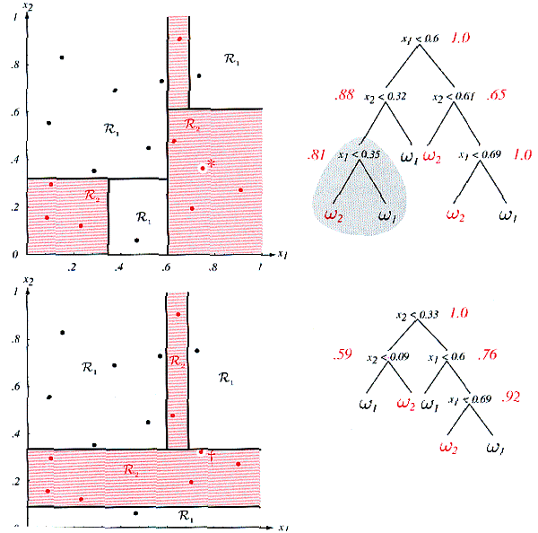
Decision Trees are not stable
Moving just one example slightly may lead to quite different trees and space partition!
Lack of stability against small perturbation of data.
Figure from Duda, Hart & Stork, Chap. 8

Slide 48
Decision Tree Pseudocode
node = tree-design (Data = {X,C})
For i = 1 to d
quality_variable(i) = quality_score(X_{i}, C)
end
node = {X_split, Threshold } for max{quality_variable}
{Data_right, Data_left} = split(Data, X_split, Threshold)
if node == leaf?
return(node)
else
node_right = tree-design(Data_right)
node_left = tree-design(Data_left)
end
end

Slide 49
Binary split selection criteria
Q(t) = N₁Q₁(t) + N₂Q₂(t), where t is the threshold
Let p_{1k} be the proportion of class k points in region 1
Error criterion for a branch
Q₁(t) = 1 - p_{1k*}
Gini index: Q₁(t) = Σ_{k} p_{1k} (1 - p_{1k})
Cross-entropy: Q₁(t) = Σ_{k} p_{1k} log p_{1k}
Cross-entropy and Gini work better in general
Tend to give higher rank to splits with more extreme class distributions
Consider [(300,100) (100,300)] split versus [(400,0) (200 200)]

Slide 50
Computational Complexity for a Binary Tree
At the root node, for each of p variables
Sort all values, compute quality for each split
O(pN log N) time for real-valued or ordinal variables
Subsequent internal node operations each take O(N’ log N’)
e.g., balanced tree of depth K requires
pN log N + 2(pN/2 log N/2) + 4(pN/4 log N/4) + …. 2^{K}(pN/2^{K} log N/2^{K})
= pN(logN + log(N/2) + log(N/4) + …… log N/2^{K})
This assumes data are in main memory
If data are on disk then repeated access of subsets at different nodes may be very slow (impossible to pre-index)

Slide 51
Splitting on a nominal attribute
Nominal attribute with m values
e.g., the name of a state or a city in marketing data
2^{m-1} possible subsets => exhaustive search is O(2^{m-1})
For small m, a simple approach is to branch on specific values
But for large m this may not work well
Neat trick for the 2-class problem:
For each predictor value calculate the proportion of class 1’s
Order the m values according to these proportions
Now treat as an ordinal variable and select the best split (linear in m)
This gives the optimal split for the Gini index, among all possible 2^{m-1} splits (Breiman et al, 1984).

Slide 52
How to Choose the Right-Sized Tree?
Predictive
Error
Error on Test Data
Error on Training Data
Size of Decision Tree
Ideal Range
for Tree Size

Slide 53
Choosing a Good Tree for Prediction
General idea
grow a large tree
prune it back to create a family of subtrees
“weakest link” pruning
score the subtrees and pick the best one
Massive data sizes (e.g., n ~ 100k data points)
use training data set to fit a set of trees
use a validation data set to score the subtrees
Smaller data sizes (e.g., n ~1k or less)
use cross-validation
use explicit penalty terms (e.g., Bayesian methods)

Slide 54
Why Trees are widely used in Practice
Can handle high dimensional data
builds a model using 1 dimension at time
Can handle any type of input variables
categorical, real-valued, etc
most other methods require data of a single type (e.g., only real-valued)
Trees are (somewhat) interpretable
domain expert can “read off” the tree’s logic
Tree algorithms are relatively easy to code and test

Slide 55
Limitations of Trees
Representational Bias
classification: piecewise linear boundaries, parallel to axes
regression: piecewise constant surfaces
High Variance
trees can be “unstable” as a function of the sample
e.g., small change in the data -> completely different tree
causes two problems
1. High variance contributes to prediction error
2. High variance reduces interpretability
Trees are good candidates for model combining
Often used with boosting and bagging
Trees do not scale well to massive data sets (e.g., N in millions)
repeated random access of subsets of the data

Slide 56
Regression re-visited *Inspired by notes of A. Ng (Stanford) on Machine Learning - CS 229
Μάθημα: Εξόρυξη γνώσης από Βάσεις Δεδομένων και τον Παγκόσμιο Ιστό
Ενότητα # 3: Supervised learning
Διδάσκων: Μιχάλης Βαζιργιάννης
Τμήμα: Προπτυχιακό Πρόγραμμα Σπουδών “Πληροφορικής”

Slide 57
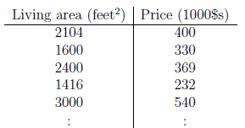
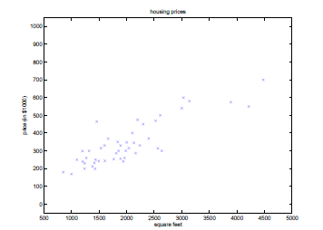
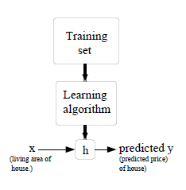
Prediction – Classification..

Slide 58
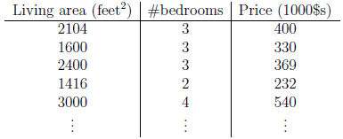
Learning – linear regression
H(θ): hypothesis
Θ: parameters (weights)
--------------------
Assume intercept x₀=1, hence
Define the cost function:

Slide 59
LMS – gradient descent
We want to choose θ to minimize J(θ).
gradient descent algorithm, which starts with some initial θ, and repeatedly performs the update:
simultaneously performed for all values of j = 0, . . . , n.
α: learning rate
to implement algorithm: partial derivative term on the right hand side.
for one training example (x, y):
Thus update rule:
LMS update rule - also known as the Widrow-Hoff learning rule.

Slide 60
LMS rule properties
gradient descent always converges (assuming the learning rate α is not too large) to the global minimum.
J is a convex quadratic function.
the magnitude of the update is proportional to the error term
For a training example where prediction nearly matches the actual value of y(i), small change on the parameters;
if our prediction h(x^{(i)}) has a large error (i.e., if it is very far from y^{(i)}) a larger change to the parameters will be made

Slide 61
LMS – batch gradient descent
* m number of training examples
The method looks at every sample for each step
Global optima – hence converges to local minimum
The “α” value should not be too high

Slide 62
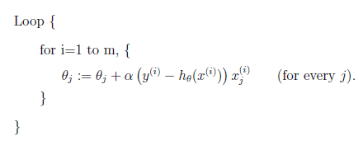
LMS – stochastic gradient descent
* m number of training examples
Parameters are updated for each training example
Lower complexity
Converges faster but may oscillate around values
for large training sets , stochastic gradient descent is often preferred over batch gradient descent.

Slide 63
LMS revisited – normal equations
Directly minimize J by derivation with respect to θ_{j}’s and setting them to 0
Some notation:

Slide 64
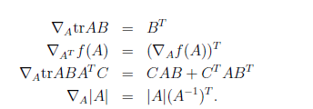
Trace operator properties
Trace operator:
Properties
Let A, B square matrices and α a real number:

Slide 65
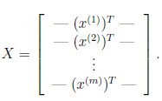
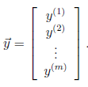
LMS revisited..
Aim to find the closed form of θ that minimizes J(θ)
Let X the training set of vectors and y the target values vector

Slide 66
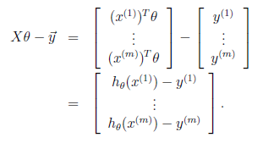
LMS revisited.. – direct error minimization
As then
Thus:
To minimize J, derivatives with respect to θ (with 2,3):
set the derivatives to 0:
normal equations:
Thus θ minimizing J(θ):

Slide 67
Regression – probabilistic interpretation
ε(i) some error function iid normally distributed
Maximize the likelihood:
Assuming independence:

Slide 68
Regression – probabilistic interpretation
Maximize the log likelihood
(proof)
Equivalent to minimize:
This is the J(θ).. Solved above..

Slide 69
Evaluating Classification Results (in general)
Summary statistics:
empirical estimate of score function on test data, eg., error rate
More detailed breakdown
E.g., “confusion matrices”
Can be quite useful in detecting systematic errors
Detection v. false-alarm plots (2 classes)
Binary classifier with real-valued output for each example, where higher means more likely to be class 1
For each possible threshold, calculate
Detection rate = fraction of class 1 detected
False alarm rate = fraction of class 2 detected
Plot y (detection rate) versus x (false alarm rate)
Also known as ROC, precision-recall, specificity/sensitivity

Slide 70
Bagging for Combining Classifiers
Training data sets of size N
Generate B “bootstrap” sampled data sets of size N
Bootstrap sample = sample with replacement
e.g. B = 100
Build B models (e.g., trees), one for each bootstrap sample
Intuition is that the bootstrapping “perturbs” the data enough to make the models more resistant to true variability
For prediction, combine the predictions from the B models
E.g., for classification p(c | x) = fraction of B models that predict c
Plus: generally improves accuracy on models such as trees
Negative: lose interpretability

Slide 71
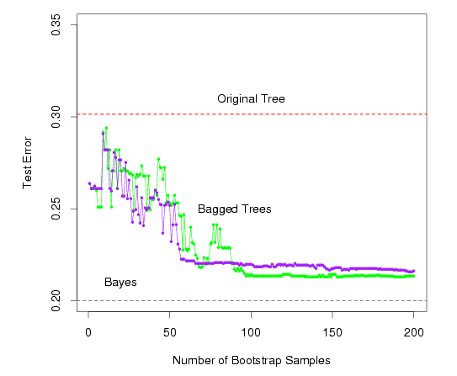
green = majority vote
purple = averaging
the probabilities
From Hastie, Tibshirani,
And Friedman, 2001

Slide 72
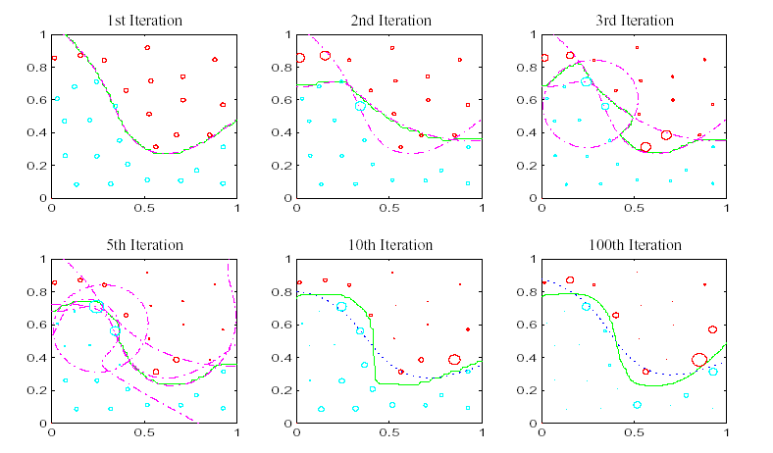
Illustration of Boosting:
Color of points = class label
Diameter of points = weight at each iteration
Dashed line: single stage classifier. Green line: combined, boosted classifier
Dotted blue in last two: bagging
(from G. Rätsch, Phd thesis, 2001)

Slide 73
References – Further material
- Regression & LSE
http://www.williams.edu/go/math/sjmiller/public_html/BrownClasses/54/mynotes52.htm
Supervised learning
Andrew NG, Stanford Univ, CS229 - Machine Learning
(http://www.stanford.edu/class/cs229/)

Slide 74
Τέλος Ενότητας # 3
Μάθημα: Εξόρυξη γνώσης από Βάσεις Δεδομένων και τον Παγκόσμιο Ιστό, Ενότητα # 3: Supervised learning
Διδάσκων: Μιχάλης Βαζιργιάννης, Τμήμα: Προπτυχιακό Πρόγραμμα Σπουδών “Πληροφορικής”

