Slide 1
NEGOTIATION ANALYSIS AND NEGOTIATING ENVIRONMENT
Spyros Blavoukos (sblavo@aueb.gr)
Professor
Department of International and European Studies
Athens University of Economics and Business

Slide 2
STUDYING negotiationS – KEY Concepts

Slide 3
What is Negotiation?
First written text describing a negotiation: Abraham in his negotiation with the Lord over the fate of Sodom [Genesis 18:23–33]
negotiation as one of the basic processes of decision-making:
dynamic, not static
parties, values, outcomes (success), and movement

Slide 4
Negotiation as a means to accomplish conflict management and conflict resolution.
Negotiation is the process of combining divergent/conflicting positions through communication into a joint decision.
Negotiation means giving something to get something:
“Many negotiators forget that if they want something, right is not enough: they have to either take it or buy it; if they can’t take it, they must buy it; and if they have to buy it, they have to pay for it, by giving something in exchange”

Slide 5
Fundamental Paradox
“If I am Tough, I increase the chances of a favorable agreement but decrease the chances of any agreement at all, whereas if I am Soft, I increase the chances for an agreement but decrease the chances for a favorable one.” [Zartman, 2008]

Slide 6
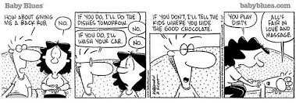
Negotiations and Right
“Many negotiators forget that if they want something, right is not enough: they have to either take it or buy it; if they can’t take it, they must buy it; and if they have to buy it, they have to pay for it, by giving something in exchange”

Slide 7
Negotiation Myopia
Two frequent cognitive mistakes:
fixed-pie bias can blind participants to the possible gains in a negotiation (up to 60%)
self-serving bias often produces impasse even when both parties can gain from agreement

Slide 8
Overcoming Negotiation Myopia
Rules of collective political engagement
careful incorporation of technical expertise,
repeated interactions,
penalty defaults,
and relative autonomy/flexibility/confidentiality in the conduct of negotiations

Slide 9
Studying Negotiations: Asking the right questions
“Who” is negotiating (parties + values)
“What” comes out of the negotiations (outcome)
“When” refers to the end of the process (element of time and timing)
But more importantly:
“How” are divergent viewpoints combined to produce a common agreement? (process - movement)

Slide 10
And Answering Them… [First Attempt]
HOW? divergent positions are combined by limiting alternatives.
Negotiation is a process of defining and reducing alternative positions until a unique combination is reached that is acceptable to all parties; it is a collective decision-making process

Slide 11
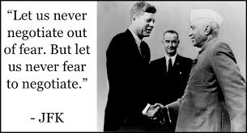
Limiting Alternatives…
FOUR WAYS:
make one alternative appear more attractive than others (promising side effects, predicting benefits inherent in the favored alternative).
make one alternative appear less attractive than others (threaten sanctions, warn of deprivations)
make one alternative appear to be already chosen (use of commitments and obligations)
make some alternatives appear to be already eliminated (fait accompli, simple incapacity)

Slide 12
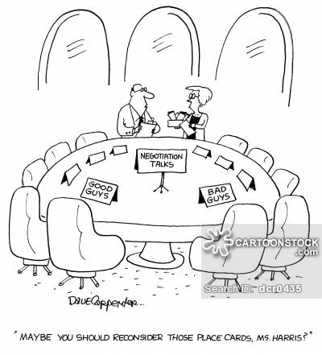
And Answering them…[Second Attempt]
HOW? divergent positions are combined by ensuring convergence of positions
simple coincidence of initial positions
concession (one party gives in to the other)
counter-concessions or compensation (the receiver of a concession makes also one in return, but on another matter)
compromise or joint concession
understanding (explicit convergence is bypassed and the debate goes on to implement an ambiguity) (Ikle 1964, pp. 14–22).

Slide 13
How Can We Tell Success…
Signature of an agreement: a nominal sign (parties expect to be better off with the agreement than without it and can do not better by either continuing negotiations or choosing an alternative outcome).
Empirical verification: are parties indeed better off?
by comparing their condition before and after the agreement
by comparing their position after the agreement with their presumed position at the same time in the absence of an agreement (counterfactual).
Results evaluated against the parties’ opening positions (problem: initial inflation of demands)

Slide 14
Key Theoretical Readings
Schelling (1960): “The Strategy of Conflict”, elements of power
Ikle (1964): “How Nations Negotiate”, different types of processes
Walton and McKersie (1965) “A Behavioral Theory of Labor Negotiations”, typology of process-driven outcomes

Slide 15
Studying negotiations - Different approaches

Slide 16
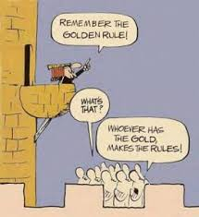
Structural analysis
based on a distribution of elements:
power-based approach:
parties’ relative positions (resource possessions) or
their relative ability to make their options prevail (or to counter the other’s efforts to make its options prevail)

Slide 17
Strategic analysis
Also based on an array of elements but its focus is on ends (goals), not means (power).
Key assumption (as portrayed in game theoretic matrices): outcomes determined by the relative array of their values to the parties, under conditions of rational choice.
Standard strategic models [Prisoners’ Dilemma Game (PDG) and Chicken Dilemma Game (CDG)].
Game theory records values as given and shows the strategies that will be chosen and the consequences of doing so.

Slide 18
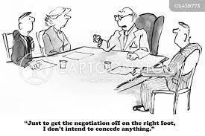
Process analysis
Explains outcomes through a series of concessions determined by some element inherent in each party’s position.
Concessions based on a comparative calculation of one’s own vs. opponent’s costs, or of one’s own costs vs. some acceptability level
On this basis, we seek to identify which party will concede how much until the final point of convergence is reached

Slide 19
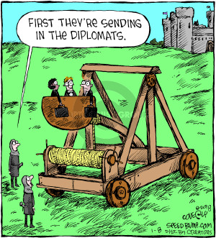
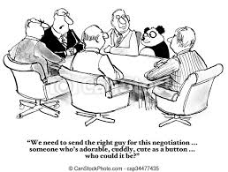
Behavioral analysis
Different explanation: focus on the negotiators
The terms of analysis used are the personalities of the negotiators, either directly or in interaction.
Personal predispositions that exist at a number of different levels, from biologically-ingrained needs to more influenceable attitudes.

