Slide 1
Διοίκηση Τεχνολογίας
Εργασία: “Types and Patterns of Innovation”
Πρόγραμμα:MBA Part-Time

Slide 2
Χρηματοδότηση
Το παρόν εκπαιδευτικό υλικό έχει αναπτυχθεί στα πλαίσια του εκπαιδευτικού έργου του διδάσκοντα.
Το έργο «Ανοικτά Ακαδημαϊκά Μαθήματα στο Οικονομικό Πανεπιστήμιο Αθηνών» έχει χρηματοδοτήσει μόνο τη αναδιαμόρφωση του εκπαιδευτικού υλικού.
Το έργο υλοποιείται στο πλαίσιο του Επιχειρησιακού Προγράμματος «Εκπαίδευση και Δια Βίου Μάθηση» και συγχρηματοδοτείται από την Ευρωπαϊκή Ένωση (Ευρωπαϊκό Κοινωνικό Ταμείο) και από εθνικούς πόρους.

Slide 3
Άδειες Χρήσης
Το παρόν εκπαιδευτικό υλικό υπόκειται σε άδειες χρήσης Creative Commons.

Slide 4
Overview
Reviewing dimensions used to distinguish types of Innovation
These dimensions are not independent
Technology trajectories → Used to represent technology’s rate of performance improvement – rate of adoption in the marketplaces → Described by S-curve patterns

Slide 5
Types of Innovation
Product Innovation Vs Process Innovation
- New products development versus new techniques that improve the effectiveness-efficiency of the production
- Often occur in tandem – Interaction
Radical Vs Incremental Innovation
- Totally new technology versus existing
- Radicalness is the combination of newness and the degree of differentness

Slide 6
Types of Innovation
Competence-Enhancing Innovation Vs Competence-Destroying Innovation
- Building on existing technology versus rendering existing technology obsolete
Architectural Vs Component Innovation
- Changing overall architecture versus changing individual components
- A strictly architectural innovation may reconfigure the way that components interact

Slide 7
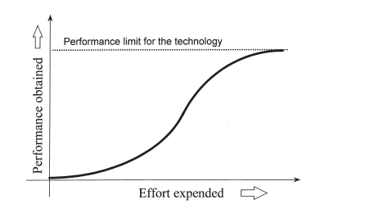
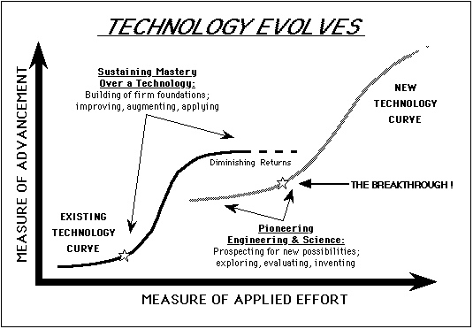
S-Curves in Technological Improvement
Early stages → Slow improvement due to poor understanding
Middle stages → The technology gains legitimacy
Technology begins to reach its inherent limits
Not always – They may rendered by new, disconti-nuous technologies

Slide 8
S-Curves in Technological Diffusion
Adoption is initially slow for an unfamiliar technology
It accelerates as the technology is better understood and utilized by the mass market
Many technologies become valuable only after a set of complementary resources are developed for them
Its ,in part, related to technology improvement.

Slide 9
Cons & Limitations of S-curves
Its not safe to use s-curves as a prescriptive tool
The true limits of a technology are rarely known in advance
Several factors may influence the life cycle of a technology(p.e. market changes, firm’s development activities etc)
The benefit of switching to a new technology for a firm depends on a number of factors, as the offered advantages, the new technology’s fit with the firm, the expected rate of diffusion etc.

Slide 10
Technology cycles – Utterback & Abernathy model
Fluid phase: Uncertainty about both technology and its markets. Firms experiment with various factors until they reach the dominant design(stable architecture)
Specific phase: The firms focus to improve components within the architecture

Slide 11
Technology cycles – Anderson & Tushman model
Anderson and Tushman argue that:
- A dominant design always rose to command the majority of market share, after the “Era of Ferment”
- The dominant design was never in the same form as the original discontinuity
During the “Era of Incremental Change” firms focus on improving efficiency and existing components. Many firms cease to invest for alternative design architectures
This explains in part why incumbent firms may have difficulty recognizing and reacting to discontinuous technology

Slide 12
Τέλος Εργασίας “Types and Patterns of Innovation”
Μάθημα: Διοίκηση Τεχνολογίας
Πρόγραμμα: MBA Part-Time

