Slide 1
Ασύρματες και Κινητές Επικοινωνίες
Ενότητα # 11: Mobile Transport Layer
Διδάσκων: Βασίλειος Σύρης
Τμήμα: Πληροφορικής

Slide 2
Congestion control in mobile & wireless networks
TCP assumes congestion if packets dropped ⇒ typically wrong in mobile & wireless networks
Unchanged TCP performance degrades severely
Packet loss in mobile & wireless networks can be due to
Wireless transmission errors
Mobility when node moves from one network attachment point to another while there are still packets in transit

Slide 3
Congestion control in mobile & wireless networks (cont.)
TCP reacts to packet loss with reduction of congestion window
Correct reaction when loss is due to link congestion
Rate of packets entering a queue is larger than rate at which packets leave queue
May not be correct reaction when loss is due to wireless transmission errors:
physical layer transmission rate should be reduced (or transmission power increased)

Slide 4
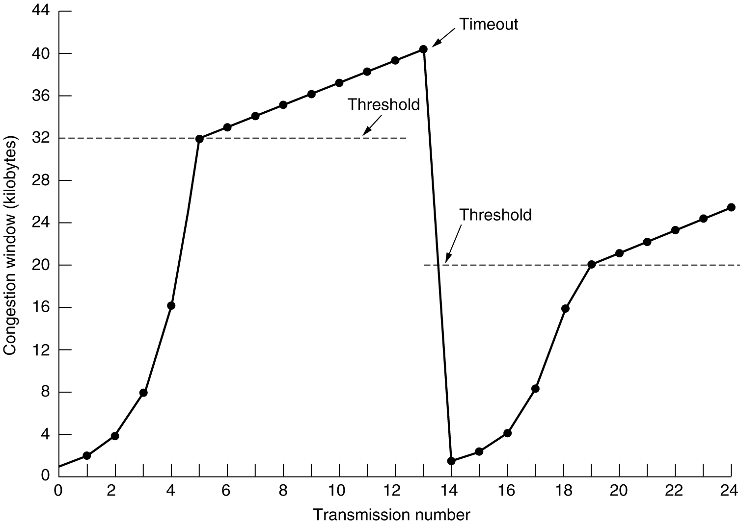
TCP congestion control
Congestion avoidance
Timeout after packet loss
Slow start

Slide 5
Solution
How to solve performance degradation of TCP over wireless
Ideal TCP behavior: TCP retransmits packets lost due to wireless transmission errors without taking congestion control actions
Ideal network behavior: hide transmission errors from TCP sender
Includes avoiding errors and indirect effects such as increase of delay & delay variation
Approaches try to achieve one of the above
Ideal behavior cannot be realized in practise

Slide 6
Alternative approaches
Link layer approach
TCP-unaware and TCP-aware
Split connection approach
Split end-to-end TCP connection
End-to-end approach
Explicit notification schemes

Slide 7
Link layer mechanisms
Forward Error Correction
Corrects small number of errors
Overhead incurred even when no errors occur
Link layer retransmission
Overhead incurred only when errors occur
Above mechanisms are TCP-unaware

Slide 8
Link layer retransmission issues
When to retransmit frame?
Link layer retransmission timeout
Negative acknowledgment
Maximum number of retransmissions?
Finite or infinite
Retransmissions hide losses by influence end-to-end delay
May have impact on TCP’s RTT estimation
Should link layer deliver packet in order or as they arrive?

Slide 9
Link layer retransmission issues (cont.)
Receiver 1
Sender
Receiver 2
Can cause head of line blocking in sender queue
Can cause congestion losses (queue overflow)

Slide 10
TCP-aware link layer
Snoop protocol, H. Balakrishnan et al. 1996
Transparent to TCP
End-to-end semantics not changed
Buffers packets at access point to do local retransmission in case of packet loss

Slide 11
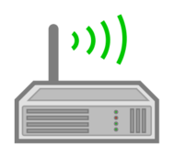
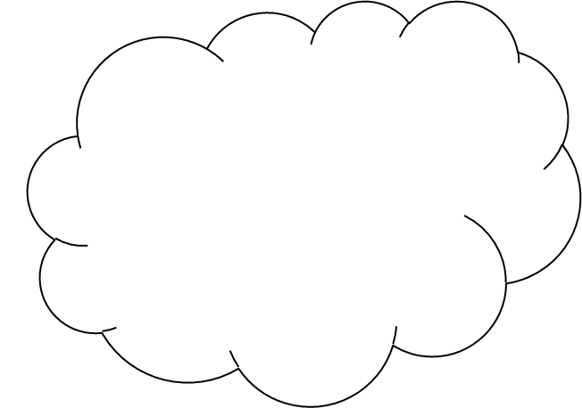
TCP-aware link layer (cont.)
Link layer retransmission
Access point
snoops packets in both direction to identify acks
buffers packets until ack identified
retransmits packets in case of timeout or dupacks

Slide 12
TCP-aware link layer features
Access point maintains soft state
Can recover if snoop agent crashes
Recovers errors only in direction from access point to mobile
Avoids retransmission at TCP sender by dropping dupacks from mobile
Cannot be applied if TCP data and acks traverse different path (asymmetric)
If RTT over wireless link small ⇒ simple (TCP-unaware) link layer retransmission performs equally well

Slide 13
Split connection approach
Indirect TCP, B.R. Badrinath et al. 1995
End-to-end TCP connection broken into one connection over wired part and one over wireless part of path
Two parts if there is one wireless link which is first or last hop
TCP over wireless link can be modified
However, benefits can exist even with unmodified TCP due to smaller RTT

Slide 14
Split connection approach (cont.)
“wireless” TCP
Normal/wired TCP
Agent at access point acts as proxy
Local retransmission in case of wireless losses
End-to-end semantics broken
Ack at fixed TCP sender does not mean mobile received packet
What happens if agent at access point crashes?

Slide 15
Split connection approach (contd.)
Access point maintains hard state
Unlike Snoop approach where access point maintains soft state
Split connection allows independent congestion control over two parts
Different congestion/error control protocols, timeouts, etc
Increased latency due to copying of packets across two connections

Slide 16
Explicit notification schemes
Approximate ideal behavior: TCP should retransmits packet in case of errors without taking congestion control actions
TCP sender needs to know cause of loss
wireless node identifies that loss is due to transmission error and notifies TCP sender
Variations
Who sends explicit notification and when
What sender does when notification received

Slide 17
Explicit Loss Notification (ELN)
H. Balakrishnan et al. 1998
Mobile node is TCP sender
Access point tracks holes in packer sequent receiver from mobile sender
When dupack received from receiver, access point compares seq # with recorded holes
In case of match sets ELN bit in dupack
If mobile sender receives dupack with ELN bit set: retransmits packet but does not reduce congestion window

Slide 18
Observations
A lot of investigation and many techniques have been proposed
Improvements for specific cases
Link layer retransmissions can improve performance without being TCP-aware
End-to-end techniques that do not require TCP specific support from lower layers, e.g. TCP Selective ACKnowledgements
Link layer techniques achieve higher gains compared to end-to-end schemes

Slide 19
Impact of mobility on TCP
Handoff occurs when a mobile starts communicating with new base station (or foreign agent in case of mobile IP)
Link layer handoffs
No change of IP address
TCP will not be aware of handoff
Link layer handles reliability
Increased packet delay
Network layer handoff
Need mobile IP
Packets can be lost while mobile moves to new base station

Slide 20
Improving TCP during mobility
Invoke fast retransmit after handoff
Buffer packets at base station (or foreign agent in case of mobile IP)
Forward packets to new base station
Use multicast
Send packets destined to mobile to current base station and base stations mobile is likely to visit next
Incurs throughput & buffering overhead

Slide 21
Τέλος Ενότητας # 11
Μάθημα: Ασύρματες και Κινητές Επικοινωνίες
Ενότητα # 11: Mobile Transport Layer
Διδάσκων: Βασίλειος Σύρης
Τμήμα: Πληροφορικής

