Slide 1
Negotiation Analysis and Negotiating Environment
Spyros Blavoukos (sblavo@aueb.gr)
Professor
Dept. of International and European Economic Studies
Athens University of Economics and Business

Slide 2
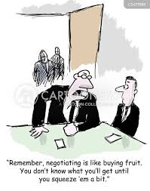
Negotiation techniques

Slide 3
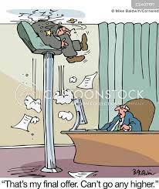
1. Take it or leave it
Submission of a final, non-negotiable offer (revealing –theoretically- the “reservation price”)
Usually, to catch the other side by surprise
Usually, an indication of negotiating power asymmetry
Value: saving time + push towards the final outcome
Need to be appropriately communicated, otherwise it may be considered an aggressive move and lead to the rupture of a relationship
Also, a means to disengage from a pointless and unproductive negotiation
How to neutralize it:
Is it indeed non-negotiable? Positive stance with a slightly changed counter-offer
Notes:
Μέξα-Ψύλλιας

Slide 4
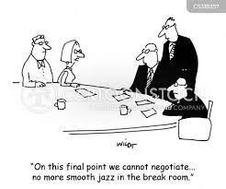
2. Nibbling
Requests for concessions of small size, after an agreement has been reached (not appropriate for the main objectives of a negotiation)
Usually, in negotiations of long duration – presented as something forgotten, not pre-scheduled
Last minute changes of marginal value
Presupposes a positive climate and cooperative attitude
(Small) danger of rocking the credibility of the negotiator (if done repeatedly)
Negotiation ethics: issue not raised from the beginning
How to neutralize:
Reciprocity (ask for similar changes)
Fully delimited negotiation agenda
Notes:
Σιδηροπούλου-Τσιαμάλου (ταξίδι στο εξωτερικό)
Κωνσταντάτου (franchise)
Τράγκας

Slide 5
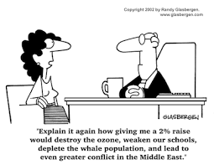
3. Snow Job
Overwhelming provision of data and information to confuse the other side
Use of technical jargon and invocation of special knowledge and expertise
Usual practice in courts: last minute, huge amount of data to avoid their full analysis
How to neutralise it:
Questions asked – clarifications requested
Time to reflect and assess
External advisor (especially on technical issues)
Notes:
Σαριδάκη (αγορά υπολογιστή)
ΧΧΧ (πραγματικό περιστατικό, οικοδομή)

Slide 6
4. Bogey
Presenting one position as important, although it is not, in order to trade it at a later stage with something really important
Presupposes no clear impression of each other’s priorities otherwise significant risk of exposure
Paradox: both parties may spend time and energy negotiating on issues non important while there is space for a mutually beneficial agreement
Notes:
Χύτος - Καρέλης

Slide 7
5. Foot in the Door / Door in the Face
Small demands that escalate (with internal consistency and rationale)
Excessive demands that will be rejected (the aim is to have the more reasonable ones that will follow to be accepted)
Takes advantage of the norms of consistency and reciprocity (feeling of guilt due to the rejection of the first offer behavioral manipulation
Important elements:
Short time between the demands/offers
Often, better performed by two negotiators
Notes:
Μπάλτσα – Χατζήογλου
Νώε – Χονδρογιάννη
Ζαμπέλης
Αρδίττης

Slide 8
6. Good guy-Bad guy
Two negotiators:
Willing and generous
Tough and unwilling to reach an agreement
Alternative with a higher-ranked negotiator (higher authority), who is absent and needs to be contacted
In multi-partners negotiating teams, it may actually be the case
Objective: exercise pressure
How to neutralize: make an offer to the ‘good guy’ and insist on getting an answer
Requires high level of coordination and homogeneity among the members of the team
Notes:
Σιδηροπούλου-Τσιαμάλου (άνδρας – γυναίκα: ζευγάρι σε ΄ψώνια)
Κωνσταντάτου (κατασκευαστικός όμιλος)

Slide 9
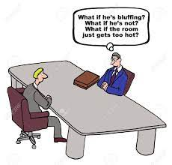
7. Bluffing
Creating false impression to the other side as per our own intentions-expectations-value of a negotiation
Lock in effect (in games, non-reversable movement: once you submit an offer, you can’t take it back → irreversibility increases effectiveness)
Important reputational cost (if spotted)
Undermines relations (output- and not relations-oriented)
Escalation potential (perhaps irrational – consistency trap) may increase the price

Slide 10
8. High Ball/ Low Ball
Very high/low opening positions to achieve the desired ‘anchoring’
Sufficient justification increases credibility and effectiveness
Risk of negotiation derailment (beyond the reservation price of the other side)
Risk of exposure (if initial opening is deconstructed)
How to neutralise it:
Continue negotiating as initially planned
Exploration and deconstruction (question any justification provided)

Slide 11
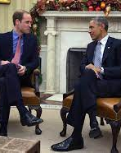
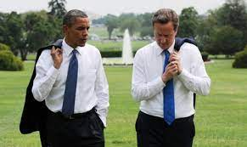
9. Mirroring
Forced similarity to cultivate trust
Verbal and non-verbal communication (use of same words, body language, etc)
Active listening, understanding, and empathy
Danger of ridiculisation, if overdoing it
Notes:
Μπάλτσα – Χατζήογλου
Κουνέλης (όμηροι)

