Slide 1
Ασύρματες και Κινητές Επικοινωνίες
Ενότητα # 7: Σύστημα Κινητής Τηλεφωνίας GSM και GPRS
Διδάσκων: Βασίλειος Σύρης
Τμήμα: Πληροφορικής

Slide 2
GSM frequency bands (common)
GSM: Global System for Mobile Communications
GSM-900 and GSM-1800
Europe, Middle East, Africa, most of Asia
GSM-850 and GSM-1900
USA, Canada, other countries in America
GSM-400 and GSM-450 rarer

Slide 3
Network architecture

Slide 4
Network elements
Mobile Station
Mobile Equipment
Identified by the International Mobile Equipment Identity (IMEI)
Subscriber Identity Module (SIM)
Contains a unique identification number called IMSI
It is removable, thus irrespective of a specific terminal

Slide 5
Base Station Subsystens
Base Station Subsystem (BSS)
Base Transceiver Station (BTS)
A BTS is comprised of radio transceivers, antennas, the interface to the PCM facility
BTS is the entity that connects the mobiles to a cellular network
Base Station Controller (BSC)
Its primary function is call maintenance, by deciding when to initiate a handover, changing the BTS transmitter power, etc.
A BSC is connected to a group of BTSs and manages the radio resources for them

Slide 6
Network Subsystem
Network Subsystem
Mobile Switching Center (MSC)
MSC provides functions such as registration, authentication, location updating, handovers and call routing to a roaming subscriber
Home Location Register (HLR)
The HLR contains all the administrative information and current location of each subscriber registered in the corresponding GSM network
Visitor Location Register (VLR)
Contains subscription information needed for call control, for all mobiles in the area of the associated MSC
Equipment Identity Register (EIR)
EIR is a database that contains a list of all valid mobile equipment on the network
Authentication Center (AUC)
Stores the secret key held in each user’s SIM card

Slide 7
Application Service Centers
Application Service Centers are responsible for GSM network add-on services
Operation and Maintenance Center (OMC)
Monitoring and control the network
Usually connect with MSC, BSC, HLR, and other service centers
Short Message Service Center (SMSC)
provide short message services
usually connect to MSC
Unstructured Supplementary Service Data Center (USSDC)
provide USSD service in the form of *ID*ID*info#
usually connect to HLR

Slide 8
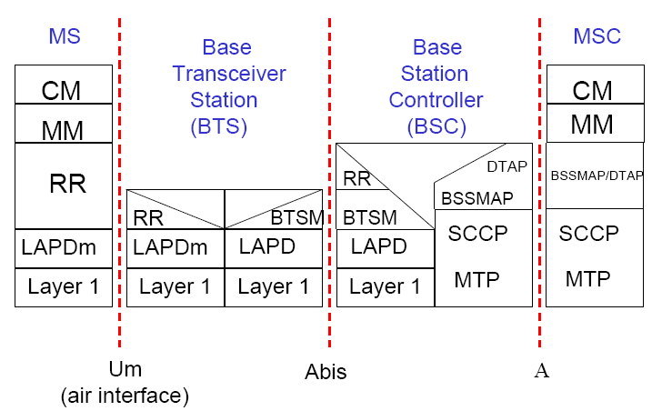
Protocol stack

Slide 9
GSM FDMA/TDMA

Slide 10
GSM channels
Physical channel: specific time slot and channel/carrier frequency
Logical channels
run over physical channels (not necessarily in all time slots)
two types: traffic and control
managed: setup, maintenance, tear-down
Control channels interspersed with traffic channels in well-defined ways

Slide 11
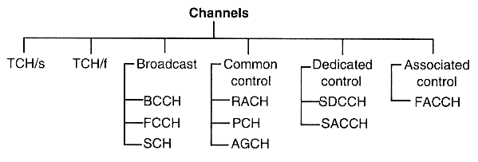
GSM logical channels
TCH: traffic
full-rate
half-rate
BCH: εκπομπής προς όλους
CCCH: ελέγχου, κοινό
DCCH: ελέγχου, ιδιαίτερο
ACCH: ελέγχου, σχετιζόμενο

Slide 12
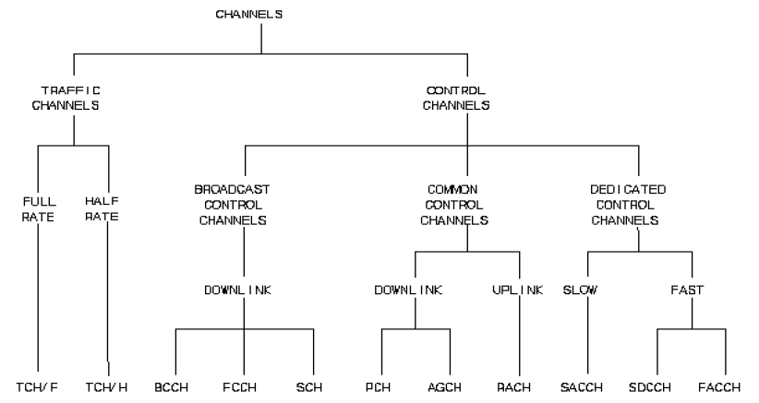
GSM logical channels (cont.)

Slide 13
Traffic channels
Full rate: 22.8 kbps
speech data: 13 kbps voice data + FEC
packet data: 12,6,3.6 kbps + FEC
Half rate: 11.4 kbps
To achieve higher rates multiple logical channels have to be allocated (GPRS does this)

Slide 14
Control channels
Help MS locate control channels
Provide information about
voice and control channel repetition cycle.
parameters in the cell
surrounding cells
paging
Allow random access attempts by the MS

Slide 15
Broadcast Control Channels
FCCH (Frequency Correction Channel)
carrier synchronization
base station “beacon” signal
SCH (Synchronization Channel)
frame synchronization
BCCH (Broadcast Control Channel)
cell ID, available services, etc

Slide 16
Common Control Channels
PCH (Paging Channel) - downlink
page a mobile
AGCH (Access Grant Channel) - downlink
reply to a random access request, assign dedicated control channel
RACH (Random Access Channel) – uplink
used by mobile to request dedicated control channel
messages from several mobiles can collide
Slotted Aloha used for contention resolution

Slide 17
Dedicated and Control Channels
SACCH (Slow Associated Control Channel)
in-band signaling
downlink: system info, power control
uplink: measurements
FACCH (Fast Associated Control Channel)
in-band time-critical signaling
call establishment progress, authentication, handover signaling
SDCCH (Stand-alone Dedicated Control Channel)
out-of-band signaling
call setup signaling, SMS, location update

Slide 18
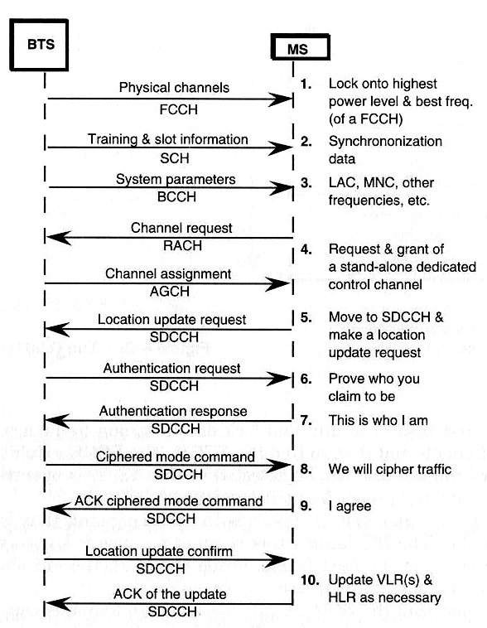
Mobile initialization

Slide 19
Location update

Slide 20
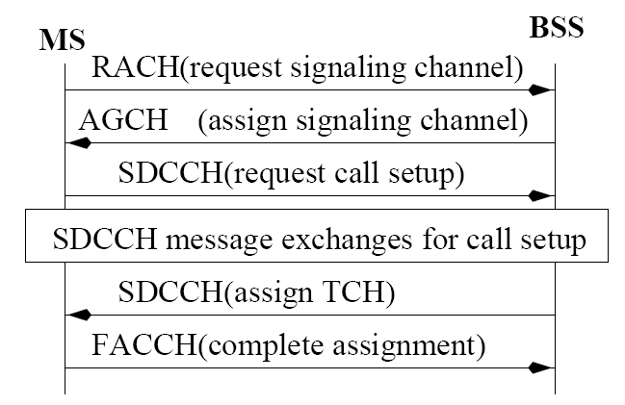
Call origination (MS->BSS)

Slide 21
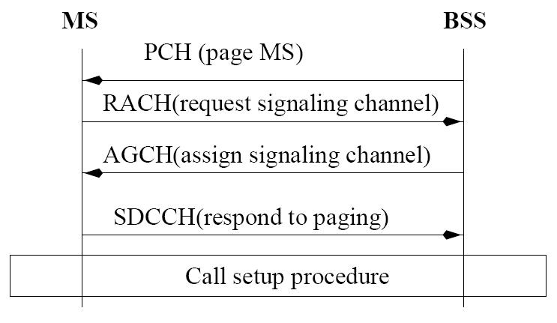
Call termination (BSS->MS)

Slide 22
Network elements
Mobile Station
Mobile Equipment
Identified by the International Mobile Equipment Identity (IMEI)
Subscriber Identity Module (SIM)
Contains a unique identification number called IMSI
It is removable, thus irrespective of a specific terminal

Slide 23
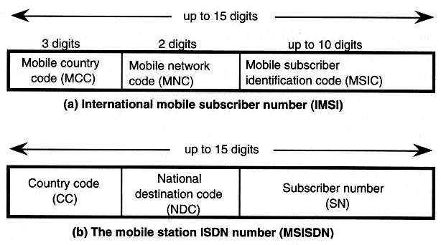
GSM identifiers
IMSI: non-dialable number
MCC Greece: 202
Bound to SIM
TMSI: Temporary MSI (confidentiality)
MS ISDN number (dialable)
Different MS ISDN can be associated to same SIM

Slide 24
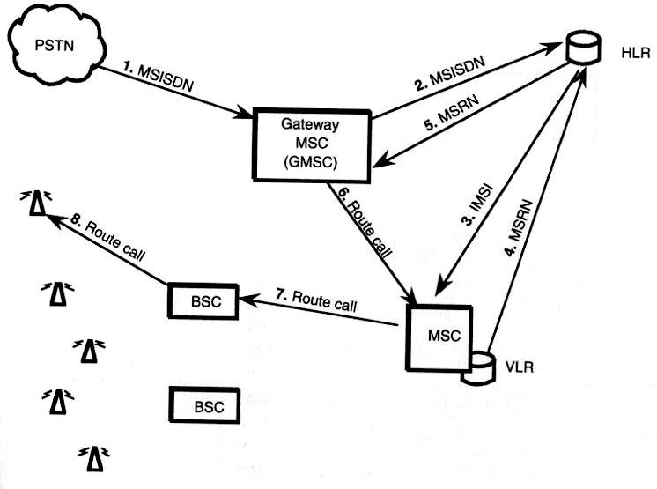
Call routing
IMSI: International Mobile Subscriber Identifier
MSISDN: MS ISDN (called number)
MSRN: Mobile Station Routing Number

Slide 25
Mobility management
Location Registration
Call delivery
Handoff Management
Handoff is caused by:
signal strength deterioration
user mobility
There are two kinds of handoff:
soft handoff
hard handoff
There are three ways to handoff:
network-controlled handoff
mobile-assisted handoff
mobile-controlled handoff
Rx
signal strength

Slide 26
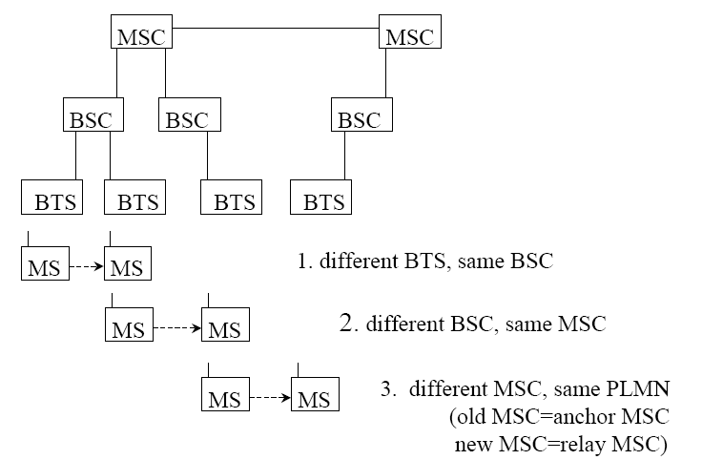
Three cases of handovers

Slide 27
Power control
Operator - dependent
Mobile:
Peak Tx power classes: GSM-900: 8,5,2,0.8 Watt (39,37,33,29 dBm), GSM-1800: 1,0.25,4 Watt (30,24,36 dBm)
minimum Tx power: GSM-900: 19mW, GSM-1800: 15mW
step: 2dBm
Base station:
8 classes: 320-2.5 Watt (55-34dBm)
Base station decides power control changes for both
Mobile measures signal strength, quality (BER) and reports to Base station
Goal: operate at lowest power level while maintaining acceptable signal quality

Slide 28
GPRS (General Packet Radio Service)
The major GSM Phase 2+ enhancement and an important step to 3G
considered 2.5G
Aims at providing data services to mobile users with high bandwidth efficiency and “always on” connectivity
Address shortcomings of GSM
Low data rates (up to 9.6 kbps)
Long connection setup
Expensive
Circuit-switched

Slide 29
GPRS (General Packet Radio Service)
The major GSM Phase 2+ enhancement and an important step to 3G
considered 2.5G
Aims at providing data services to mobile users with high bandwidth efficiency and “always on” connectivity
Address shortcomings of GSM
Low data rates (up to 9.6 kbps)
Long connection setup
Expensive
Circuit-switched

Slide 30
GPRS features
Data rates up to 172 kbps
Fast call setup times
“Always on” connectivity
Integrates IP infrastructure into the GSM network
Uses packet-switched mechanisms
more efficient for bursty traffic
allow volume-based charging

Slide 31
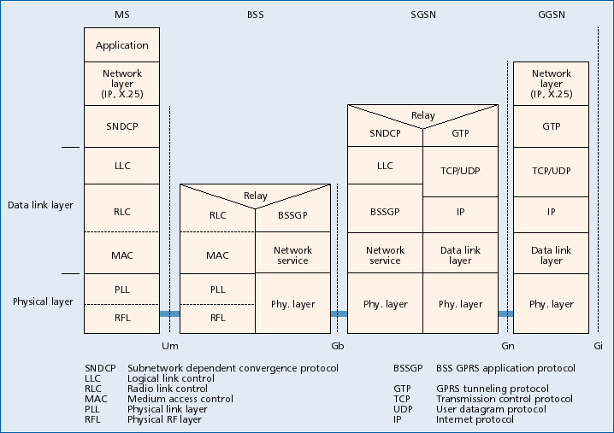
Protocol architecture

Slide 32
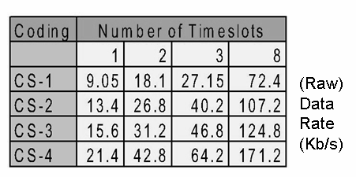
Channel coding & transmission rate
Coding used in every digital communication system to
increase channel capacity
protect against errors
GPRS uses 4 different coding schemes, depending on channel conditions
Up to 8 slots can be
combined
physical layer

Slide 33
QoS
GPRS Release 99 specified 4 traffic classes

Slide 34
High-level view

Slide 35
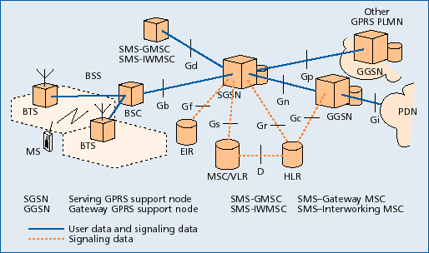
GPRS architecture
2 new nodes .
Serving GPRS Support Node (SGSN)
Gateway GPRS Support Node (GGSN)

Slide 36
Serving GPRS Support Node (SGSN)
Serving GPRS Support Node (SGSN) is responsible for:
Admission control
Routing, mobility management, location management, authentication, charging
Receiving and delivering data packets
Address translation and mapping
Encapsulation

Slide 37
Gateway GPRS Support Node (GGSN)
Gateway GPRS Support Node (GGSN)
acts as interface between GPRS backbone and external Packet Data Networks (PDN) or other Public Mobile Land Networks
converts GPRS packets coming from SGSN into the appropriate packet data protocol (PDP) format (e.g. IP)
converts the PDP addresses of incoming data packets to the GSM address of the destination user, and sends the readdressed packet sto the responsible SGSN

Slide 38
Additional enhancements
Base Station System (BSS): enhanced to recognize and send user data to the SGSN that is serving the area
Home Location Register (HLR): enhanced to register GPRS user profiles and respond to queries originating from SGSNs

Slide 39
Routing Scenarios
Scenario 1: A GPRS mobile station located in PLMN 1 sends packets to a host connected to the IP network
The SGSN that the MS is registered with encapsulates the IP packets, examines the PDP context, and routes them through the intra-PLMN GPRS backbone to the appropriate GGSN
The GGSN decapsulates the packets and sends them out on the IP network
IP routing mechanisms are used to transfer the packets to the access router of the destination network. The latter delivers the IP packets to the host
Scenario 2: Assume the home-PLMN of the MS is PLMN2. The host is now sending IP packets to the MS, which are sent out onto the IP network and are routed to the GGSN of PLMN2
The GGSN of PLMN2 queries the HLR and obtains the current location of the MS (PLMN1). It encapsulates the incoming IP packets and tunnels them to the appropriate SGSN in PLMN1
The SGSN decapsulates the packets and delivers them to the MS

Slide 40
GPRS processes
Attach process
Authentication process
PDP activation process
Detach process

Slide 41
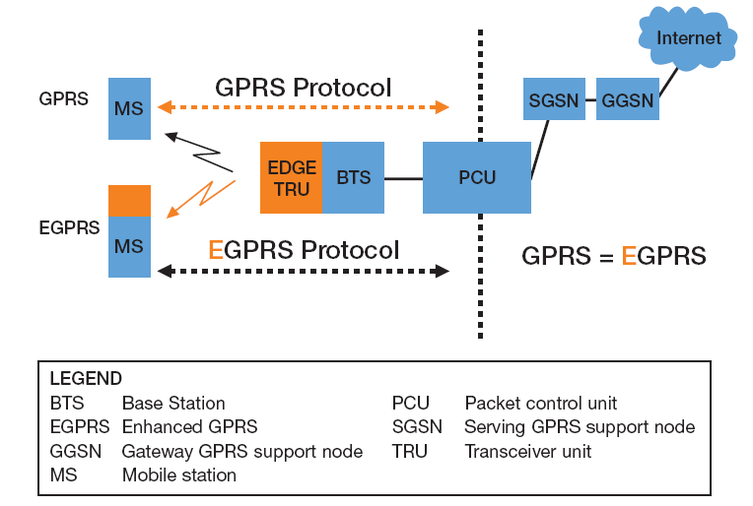
Enhanced Data for GSM Evolution (EDGE)
Higher data rates using 8PSK modulation
user rate 384 kbps (GPRS: 115 kbps)
Software-only update (Release 99)
EGPRS: EDGE enhancements to GPRS

Slide 42
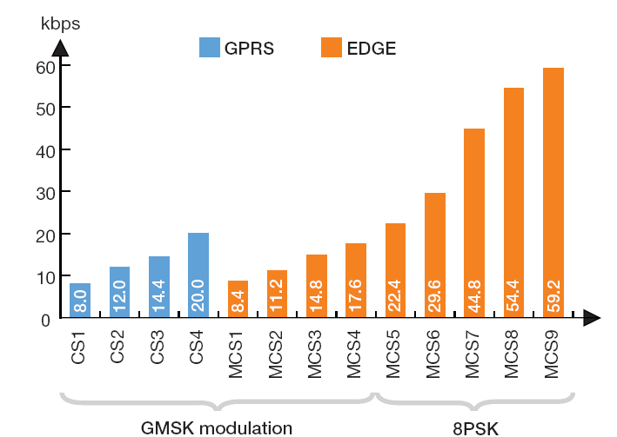
EDGE higher rates
RLC data rate

Slide 43
Τέλος Ενότητας # 7
Μάθημα: Ασύρματες και Κινητές Επικοινωνίες
Ενότητα # 7: Σύστημα Κινητής Τηλεφωνίας GSM και GPRS
Διδάσκων: Βασίλειος Σύρης
Τμήμα: Πληροφορικής

