Slide 1
Intro to optimization and mathematical programming
Examples on Project Selection, Promotion Planning, Markdown Optimization and Revenue Management

Slide 2
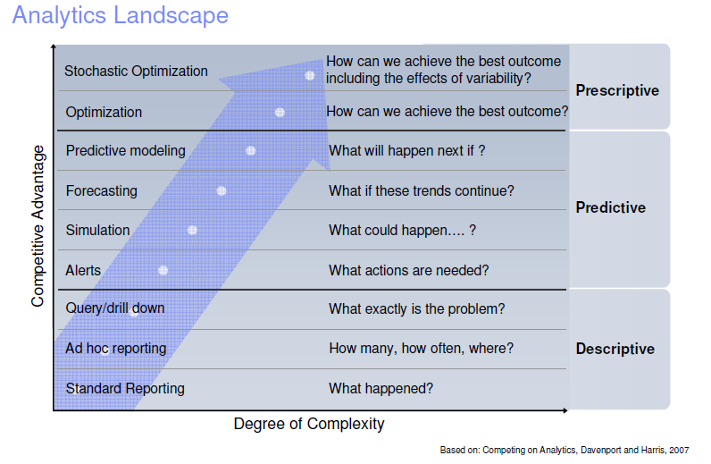
BASIC TERMINOLOGY

Slide 3
A brief introduction to Linear Programming

Slide 4
BASIC TERMINOLOGY
Give me your best data, and I will provide you the best solution
Optimization - finding values of decision variables that minimize (or maximize) something such as cost (or profit).
Decision Variables - the variables whose values the decision maker can choose.
Objective function - the equation that minimizes (or maximizes) the quantity of interest.
Constraints - limitations or restrictions that must be satisfied.

Slide 5
BASIC TERMINOLOGY
Feasible solution - is any set of values of the decision variables that satisfies all of the constraints.
Feasible region - the set of all feasible solutions.
Infeasible solution - is a solution where at least one constraint is not satisfied.
Optimal solution - values of the decision variables at the minimum (or maximum) point that satisfy some necessary optimality conditions
Global and local optimality – A local optimum is a solution that is optimal within a neighboring set of solutions. Global optimum is the optimal solution among all possible solutions

Slide 6
Evolution & Quality of Information
Depending on the Quality of Information:
Deterministic models have inputs that are known with certainty.
Stochastic models have one or more inputs that are not known with certainty.
Depending on the Evolution of Information:
Static models where all inputs are known in advanced (with certainty or uncertainty).
Dynamic models where input data is revealed in real time during the planning horizon.

Slide 7
Types of Deterministic Models
Linear versus Nonlinear
Linear/nonlinear functions for objective and/or constraints (LP / NLP)
Discrete versus Continuous
Continuous, integer, binary and/or mixed integer decision variables (ILP / IP/ MIP / MILP / MINLP)

Slide 8
Types of Deterministic Models
LINEAR PROGRAMMING (LP)
All variables are continuous ($X⊆ℝ$)
All functions ($f,g$) are linear
NONLINEAR PROGRAMMING (NLP)
All variables are continuous ($X⊆ℝ$)
Some functions ($f$ and/or $g$) are nonlinear
INTEGER PROGRAMMING (IP, ILP)
All variables required to be integral ($X⊆ℤ$)
All functions ($f,g$) are linear
Generalizes to general discrete $x$ and non-linear functions $f,g$
MIXED-INTEGER LINEAR PROGRAMMING (MIP, MILP)
Mix of integral and continuous variables
All functions ($f,g$) are linear
MIXED-INTEGER NONLINEAR PROGRAMMING (MINLP)
Mix of integral and continuous variables
Some functions ($f$ and/or $g$) are nonlinear

Slide 9
Optimization Methods
Algorithms are systematic procedures used to find optimal solutions to decision models.
Exact Mathematical Programming algorithms provide guarantee for finding the (global) optimum
Heuristic algorithms trade optimality for efficiency and they are used to find high quality solutions in a reasonable amount of time.

Slide 10
GENERAL OPTIMIZATION PROBLEM
$$\min_{x}{f(x)}$$
$$s.t. g\left(x\right)≤0$$
$$x∈X$$
where
= vector of variables
= objective function
= constraints
= domain of variables (e.g., $ℝ, \left[x^{L},x^{U}\right], ℤ,\left\{0,1\right\}$)
$$x$$
$$f$$
$$g$$
$$X$$

Slide 11
CLASSIFICATION
what type of problem is this ?
$$\begin{matrix}\min_{x,y,z} & 3x+8y−4z \\ s.t. & −2x+y≤5 \\ & \begin{aligned}3x−9z≥2 \\ 1≤x,y,z≤5\end{aligned}\end{matrix}$$

Slide 12
CLASSIFICATION
what type of problem is this ?
$$\begin{matrix}\min_{x,y,z} & 3/x+8y−4z \\ s.t. & −2x+y≤5 \\ & \begin{aligned}3x−9z≥2 \\ 1≤x,y,z≤5\end{aligned}\end{matrix}$$

Slide 13
CLASSIFICATION
what type of problem is this ?
$$\begin{matrix}\min_{x,y} & 3x+8y−4z^{2} \\ s.t. & −2x+y≤5 \\ & \begin{aligned}3x−9e^{z}≥2 \\ 1≤x,y≤5\end{aligned}\end{matrix}$$

Slide 14
CLASSIFICATION
what type of problem is this ?
$$\begin{matrix}\min_{x,y,z} & 3x+8y−4z^{2} \\ s.t. & −2x+y≤5 \\ & \begin{aligned}3x−9e^{z}≥2 \\ 1≤x,y,z≤5\end{aligned}\end{matrix}$$

Slide 15
CLASSIFICATION
what type of problem is this ?
$$\begin{matrix}\min_{x,y} & 3x+y \\ s.t. & −2x+y≤5 \\ & \begin{aligned}3x−9x≥2 \\ x≥1 \\ y∈\left\{1,4,5,7\right\}\end{aligned}\end{matrix}$$

Slide 16
CLASSIFICATION
what type of problem is this ?
$$\begin{matrix}\min_{x,y} & 3x+y \\ s.t. & −2x+y≤5 \\ & \begin{aligned}3x−9\ln{x}≥2 \\ x≥1 \\ y∈\left\{1,4,5,7\right\}\end{aligned}\end{matrix}$$

Slide 17
A brief introduction to Mixed Integer Linear Programming

Slide 18
Integer Programming Problems
Allocation of workers per shift
Production of cars per week
Number of bank branches operating in an area
All problems of allocation of resources, when some or all of these resources or activities can be allocated or undertaken at integer values.
Usually, these problems can be approximated using Linear Programming, and rounding-off to the nearest integer
ONE exception …

Slide 19
Problems with binary variables
A special category of Integer Problems
The variables take only the values 0 or 1 (binary variable)
These are logical variables … not physical variables
They represent logical decisions (YES/NO), not physical quantities
They cannot be solved sing LP – no rounding off can occur!
They need special “art” in the formulation
They appear very frequently in many problems:
Investment evaluation and selection
Distribution and vehicle routing
Production scheduling

Slide 20
The Knapsack Problem
Assume you are going for a 3-day safari.
Your knapsack can take items of total weight no more than 20 Kilos and total volume no more than 30 gallons
You are asked to choose among 10 items (foods), each one being characterised by a weight w_{i,} a volume v_{i,} and a value c_{i,}.
Your objective is to choose the best combination among the 10 items available, i.e. the ones that maximize the total value of your knapsack.

Slide 21
Knapsack problem: Solution
Let X_{i} =
Problem Formulation:
1, if item i (i = 1…10) is to be included in the knapsack
0, otherwise
Max Z = c₁X₁ + c₂X₂ + ... + c₁₀X₁₀
s.t.
w₁X₁ + w₂X₂ + ... + w₁₀X₁₀ ≤ 20
v₁X₁ + v₂X₂ + ... + v₁₀X₁₀ ≤ 30
X₁, ..., X₁₀ = 0/1

Slide 22
Variations around Knapsack problem
Assume that items1 and 2 are “competitive”, i.e. there is no sense in bringing both of them, since you will be consuming only one, (e.g. two types of toothpaste).
X₁ + X₂ ≤ 1
Assume that items 3 and 4 are “complementary”, i.e. if you take one with you, you also have to take the other as well, and vice versa (e.g. pasta and tomato sauce).
X₃ = X₄
Assume that foods 5 and 6 are “partially complementary”, i.e. if you take the first (e.g. coffee), you also have to take the second (e.g. milk). This in not true the other way.
X₅ ≤ X₆

Slide 23
Combinatorial Complexity of MILPs and the Travelling Salesman Problem

Slide 24
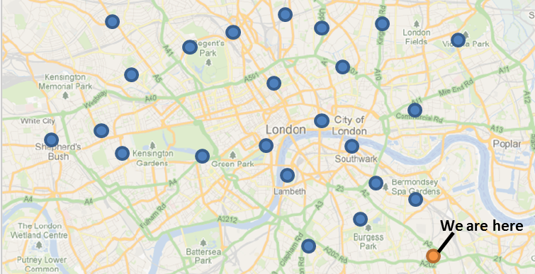
Travelling Salesman Problem
Electricity company needs to do meter readings in a set of geographically dispersed flats in central London
Draw the route…don’t have to get back to the depot
Goal: Minimise the total travelled distance and time
Lets apply the a heuristic approach
Notes:
OK. Let’s have our hands on. We operate an electricity company….
Just draw the route and we will discuss about these two both.
The goal is to minimise the total distance.

Slide 25
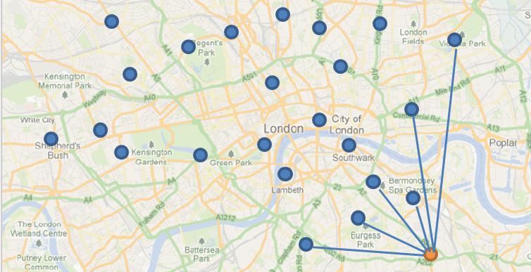
Travelling Salesman Problem
Step 1: Start from the depot
Step 2: Calculate all the distances (times) from the depot to all the set of geographical points

Slide 26
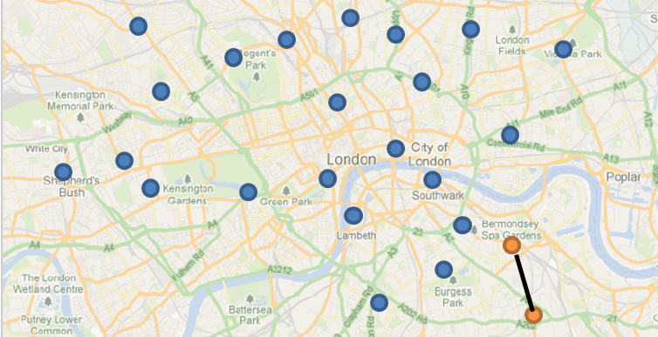
Travelling Salesman Problem
Step 3: Select the “Nearest Neighbor” and add it in the partial constructed route
Step 4: Start over again following step 1 from the last geographical point in the route

Slide 27
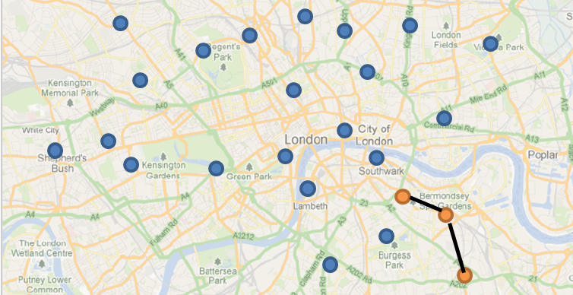
Travelling Salesman Problem
Step 3: Select the “Nearest Neighbor” and add it in the partial constructed route
Step 4: Start over again following step 1 from the last geographical point in the route

Slide 28
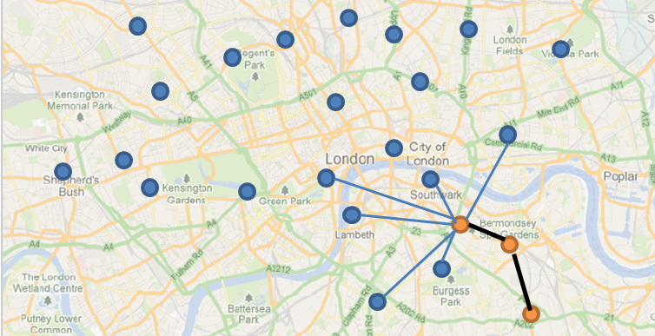
Travelling Salesman Problem
Step 1: Start from the last point
Step 2: Calculate all the distances (times) from the last point to all the set of geographical points

Slide 29
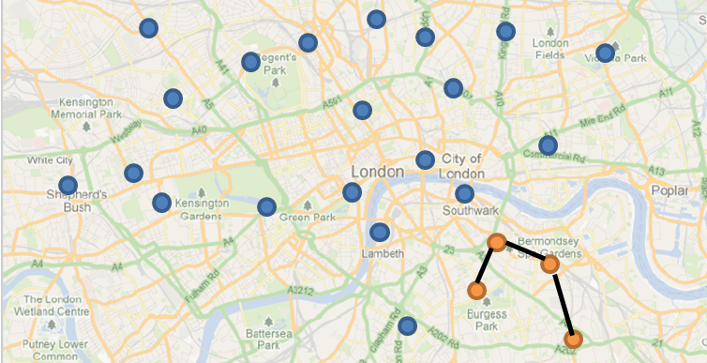
Travelling Salesman Problem
Step 3: Select the “Nearest Neighbor” and add it in the partial constructed route
Step 4: Start over again following step 1 from the last geographical point in the route

Slide 30
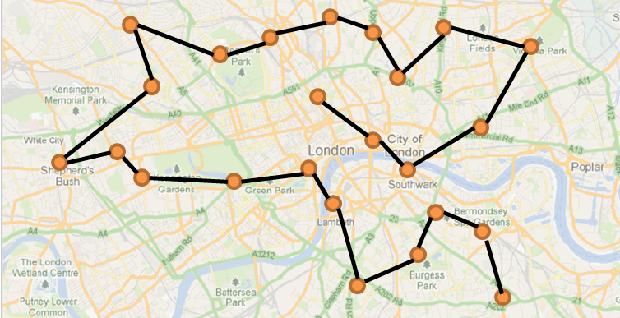
Travelling Salesman Problem
A feasible solution of the problem
Sequence of stops
Timings (exact time that the service will be delivered)
Total fuel consumption derived by the total travelled distance

Slide 31
Computational Complexity
Are TSP problems difficult, and if so, why?
Questions:
how many possible tours are there?
what happens if the number of customers increases?
suppose we have two trucks available
does the complexity of the problem change?
does the optimal solution change?

Slide 32
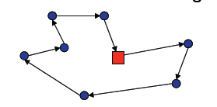
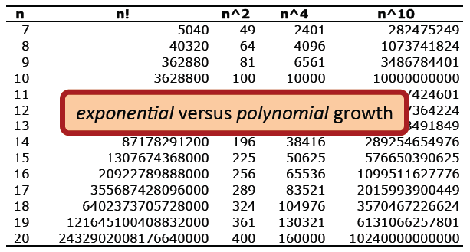
Exponential vs Polynomial
TSP -> Find a closed tour of minimum length serving all customers
For n customers, there are n! possible tours

Slide 33
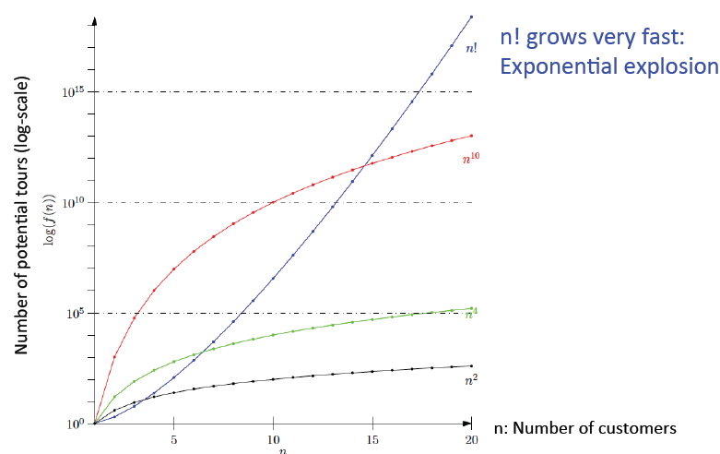
Exponential Explosion

Slide 34
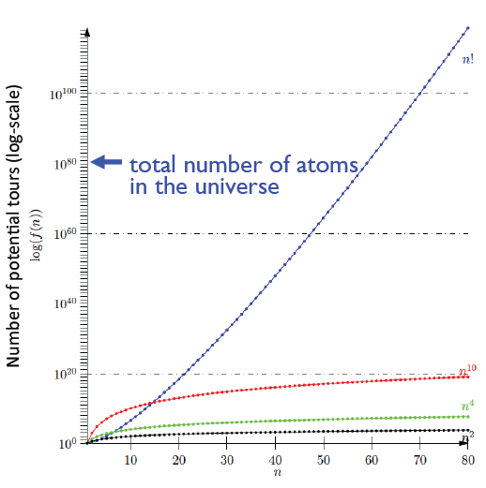
Number of atoms in the universe…
for 60 customers, there are 8.32×10^81 possible tours
this is more than the total number of atoms in the observable universe! (estimated to be around 10^80)
AMAZON serves daily thousand customers!

Slide 35
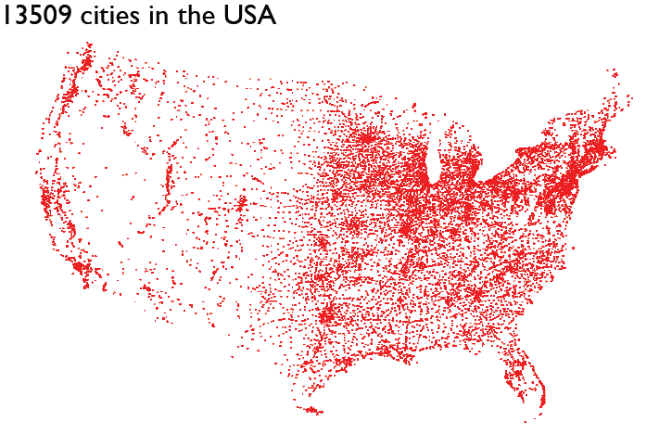
In which order to visit all US cities?
Applegate et al. 1998

Slide 36
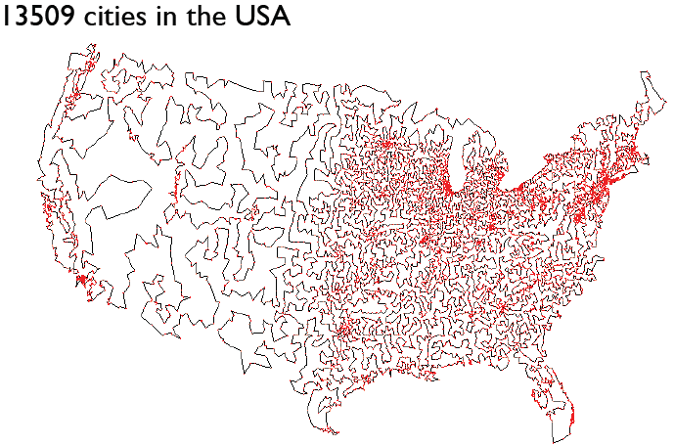
In which order to visit all US cities?
Applegate et al. 1998

Slide 37
TSP Solutions
Heuristics
Construction: build a feasible route.
Improvement: improve a feasible route.
Not necessarily optimal, but fast.
Performance depends on problem.
Worst case performance may be very poor.
Exact algorithms
Integer programming.
Branch and bound.
Optimal, but usually slow.
Difficult to include complications

Slide 38
Project Selection and Prioritization methods

Slide 39
Project Prioritization with limited resources and selection rules
Let’s assume that for the next quarter we have a budget of 50M.
The total number of associates is 40.
There are 5 project types.
 | Type
Consumer base growth | T1
DME Efficiency | T2
DME Effectiveness | T3
Employee / Marketeer effectiveness | T4
Productivity / cost avoidance | T5

Slide 40
Project Prioritization with limited resources and selection rules
Project characteristics
 | Inputs / Resources |  |  |  | Output
Project ID | Type | Team Size | Duration | Budget (in $M) | Return (in $M)
P1 | T1 | 3 | 3 | 4.1 | 4.2
P2 | T2 | 5 | 2 | 1.5 | 6.8
P3 | T3 | 5 | 2 | 5.8 | 16.5
P4 | T4 | 4 | 5 | 5.1 | 2.4
P5 | T5 | 3 | 3 | 2.7 | 5.9
P6 | T1 | 4 | 4 | 5.2 | 6.4
P7 | T2 | 3 | 3 | 2.9 | 6.2
P8 | T3 | 5 | 5 | 4.7 | 12
P9 | T4 | 3 | 5 | 4.1 | 3.1
P10 | T5 | 3 | 3 | 2.7 | 5.3
P11 | T1 | 5 | 3 | 4.5 | 7.2
P12 | T2 | 5 | 2 | 3.3 | 5.1
P13 | T3 | 5 | 3 | 8.2 | 4.7
P14 | T4 | 4 | 6 | 5.3 | 3.1
P15 | T5 | 5 | 6 | 7 | 9.1

Slide 41
Project Prioritization with limited resources and selection rules
Constraints and rules
We cannot exceed total budget (50M).
The sum of team sizes should be less than the total available number of associates 40.
We cannot allocate more than 160 man-months.
We cannot select more than 2 projects from each type.
We need at least one project from each type.
If we select P1, then we need to select also P7 and vice versa
We cannot select P3 and P10 together.
If we select project P6, then we need to select P12, but P12 can be selected independently.

Slide 42
Math Programming Model
Let x_{i} = 1 if you select project i
= 0 otherwise
max Z = 4.20x₁ + …. + 9.1x₁₅
s.t.
4.1x1 + …. + 7x15 ≤ 50 (budget)
3x1 + …. + 5x15 ≤ 40 (associates)
3*3x1 + …. + 5*6x15 ≤ 160 (man-months)
x1 + x6 + x11 ≤ 2 (Type 1 projects)
x2 + x7 + x12 ≤ 2 (Type 2 projects)
x3 + x8 + x13 ≤ 2 (Type 3 projects)
x4 + x9 + x14 ≤ 2 (Type 4 projects)
x5 + x10 + x15 ≤ 2 (Type 5 projects)
x1 + x6 + x11 ≥ 1 (Type 1 projects)
x2 + x7 + x12 ≥ 1 (Type 2 projects)
x3 + x8 + x13 ≥ 1 (Type 3 projects)
x4 + x9 + x14 ≥ 1 (Type 4 projects)
x5 + x10 + x15 ≥ 1 (Type 5 projects)
x6 ≤ x12
x3 + x10 ≤ 1
x1 = x7
xi = 0/1

Slide 43
Solution
Project selection
P2, P3, P5, P6, P8, P9, P11, P12 and P15
Project portfolio value: 72.1M
All constraints and rules satisfied
See attached excel file

Slide 44
Price and markdown optimization problems

Slide 45
Definitions, assumptions and business rules
Price ladder: The prices can only take a finite, discrete set of values (e.g. 24.99, 19.99).
Planning horizon: a given finite horizon of weeks or days (called hereafter periods). It can be a sales season (e.g. 16 weeks) or a full year (52 weeks).
Regular price: the list price of a product or the initial price at beginning of the planning horizon.
Flexible pricing vs only price reductions: Any price can be selected per period vs once the price has been reduced, it cannot increase again.

Slide 46
Definitions, assumptions and business rules
Willingness to pay (WTP): the maximum price at which a consumer would buy a product
Global market-response demand model: any dynamic pricing tool requires a model of how demand (individual or aggregate) responds to changes in prices.
Local price-response model: the demand of a single retailer as a function of the price offered. This function is unique for each channel or customer segment. It is the results of many factors, such as campaign effectiveness, location, customer’s perceived quality etc.
Measures of price sensitivity:
Slope. Measures how demand changes in response to a price change. For example, a 3-cent increase in price would result in a demand reduction of 2000 items per week.
Elasticity. Measures the ratio of the percentage change in demand to the percentage change in price. For example, an elasticity of 0.8 means that a 10% decrease in price would result an 8% increase in demand.

Slide 47
Definitions, assumptions and business rules
Fixed inventory: a retailer has a fixed inventory (or capacity) without the opportunity to reorder.
For example, a hotel has fixed number of rooms available per day. In apparel industry, firms commit to order quantities well in advance of a sales season with no re-stocking option.
Unlimited inventory: Retailer’s inventory is considered infinite. No bounds on the demand and physical constraints due to (re-)stocking.
Inventory replenishment: A fixed quantity is added to the inventory at given time intervals.
Fixed expiration date and salvage value: the inventory has a fixed expiration date (out of date) at which point the inventory either perishes or has a small salvage value.

Slide 48
Definitions, assumptions and business rules
Air travel or hotel rooms vs style- and seasonal-goods
The value of the air travel does not necessarily go down as the deadline approaches
The value of an air ticket earlier on is lower and customers typically expect price to go higher not to drop as they hold a ticket.
Although customers purchase tickets at different points in time, all of them consume it at the same time.
As the time-of-service approaches, WTP increases, and demand becomes less price-sensitive.

Slide 49
Definitions, assumptions and business rules
Air travel or hotel rooms vs consumer-packaged goods
Customer purchase consumer-packaged goods (CGP), e.g. soap, diapers, coffee, yogurt etc, repeatedly.
Customers are aware of past prices and promotions.
Running promotions too frequently may damage the brand equity.
Customers may stockpile products, so short-runs increases in demand due to promotions may come at the expense of reduced future demand.

Slide 50
Promotion optimization with fixed capacity
Typical problem for e-commerce platforms

Slide 51
Promotion optimization
Design an optimization model that takes the output from a predictive model and selects the optimal set of discounts for a given set of promotional products, whilst conforming to the business constraint of “stock depth”, which applies across all products on promotion.
The business cares broadly about sales volumes (no. of units) or profit. E.g. “prioritize sales volume over profitability for summer dresses, in this week’s promo”.
Notation
𝑖 ∈ 𝐼 → Set of products to be put on promotions
𝑑_{i} ∈ 𝐷 → Discount depth, or “% off” (e.g. d=0.3 or 30% off), for product 𝑖. Finite set of depths 𝐷 apply across ∀𝑖 ∈ 𝐼
𝑠_{id} → Forecasted sales for product 𝑖 at depth 𝑑
𝑏 → Stock depth of the promotion (𝑏∗ is the business target)
𝑘_{i} → Number of stock units available for product 𝑖
𝑝_{i} → Full price of product
𝑐_{i} → Cost of product 𝑖

Slide 52
Promotion optimization
Let x_{id} be a binary equal to 1 if discount depth d is selected for product i; 0, otherwise
Objectives
Sales volume: $\sum_{i∈I,d∈D}{x_{id}s_{id}}$
Profit: $\sum_{i∈I,d∈D}{x_{id}{[p_{i}\left(1−d\right)−c_{i}]s}_{id}}$
Constraints:
See attached excel file

Slide 53
Perishable product price optimization with fixed capacity, salvage value, and decreasing prices
Apparel, style and seasonal-goods, high-tech and perishable food

Slide 54
Problem Setting
Maximize revenue of the sales season (from a single product). This is often called markdown optimization problem.
Product perishes and has a low salvage value once the season is over.
Pricing is not flexible and only involves price reductions.
Markdown is needed to manage the demand and maximize revenue
Retailer initially sets high prices, and then “learns” the demand. Popular products sell quickly at high prices. Low-reservation-price products must be marked down.
The WTP changes over the planning horizon. At the beginning WTP is often high (e.g. buy a bathing suit at the start of the summer) and then gradually reduces.
During peak periods, the WTP often reduces, and consumers become more price-sensitive.
Every period the retailer re-runs the price optimization engine with updated info.

Slide 55
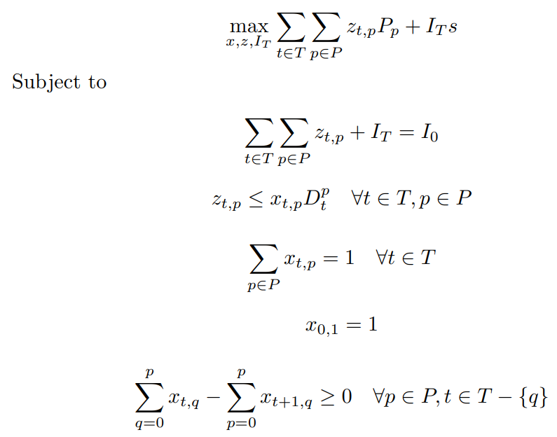
Markdown optimization problem
Input
Salvage price s
Price ladder (discrete set of prices P)
Initial inventory I₀
Demand matrix D_{tp}
Decision variables
Binary variable x_{tp} (1 if price p is selected for period t; otherwise 0)
Non-negative continuous variable z_{tp} to denote the estimated number of items that will be sold at period t for the selected price x_{tp}.
Continuous variables I_{T} refers to the inventory left at the end of the season

Slide 56
Example
Initial inventory 1000 items
Salvage value 10 euro
Prices {30, 40 and 50}
Demand forecast
Optimal strategy: Start with 50 euro until week 8, switch to 40 until week 13 and sell at 30 until the end of season.
Max revenue 25020 + 4260 = 29820 euro (unsold inventory 426)

Slide 57
Perishable product with fixed capacity and price flexibility
Air tickets, hotel rooms, car rentals, theater tickets

Slide 58
Problem Setting
Maximize revenue generated (from a single product)
Single product (e.g. hotel rooms of a calendar date, tickets of a soccer game)
Finite horizon (lead time) until the product is consumed (e.g. the date of the flight).
Fixed capacity (initial inventory) at period zero is given
Pricing is flexible
Product has zero value after consumption date

Slide 59
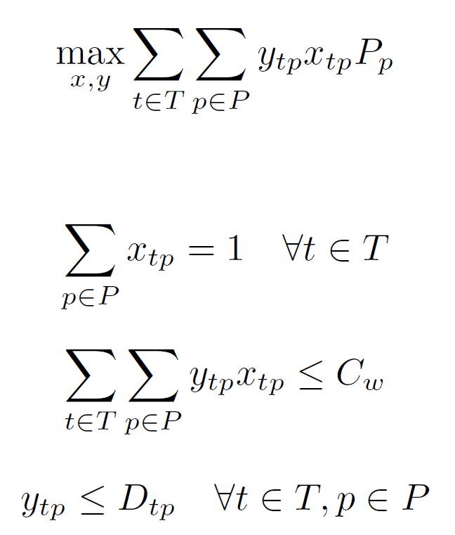
Revenue Maximization problem
Input data
Lead time (this will translate to a horizon T)
Price ladder (discrete set of prices P)
Demand matrix (forecasted demand per price per period – preprocessed)
Decision variables
Binary variable x_{tp} (1 if price p is selected for period t; otherwise 0)
Continuous variable y_{tp} number of items sold at period t

Slide 60
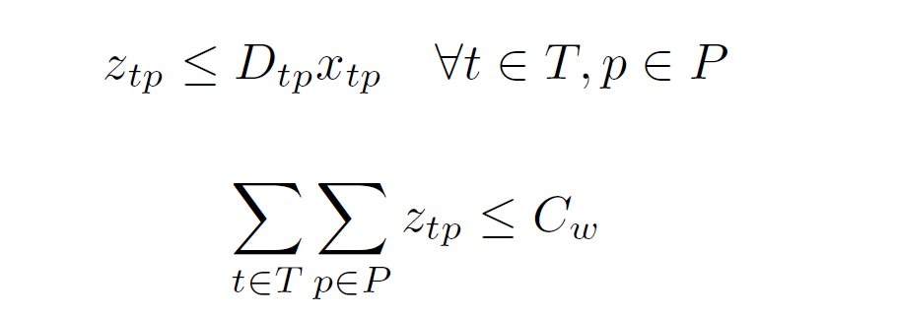
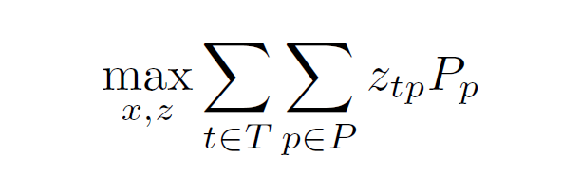
Revenue Maximization Problem
The objective function contains the products of continuous with binary variables and we need to linearize them.
Let a new non-negative continuous variable z, such that z = x × y. To that end, we remove the last 2 constraints and we append to the mathematical model the following set of constraints:
And we change the objective as follows:

Slide 61
Example
Lead time 3 days
Initial inventory 20 items
Demand matrix
Optimal strategy: Sell 19 items, Day 1, 69.99; Day 2, 69.99, Day 3, 99.99
Price / Day | 1 | 2 | 3
99.99 | 0 | 3 | 9
69.99 | 4 | 6 | 14
49.99 | 10 | 20 | 30

