Slide 1
Negotiation Analysis and Negotiating Environment
Spyros Blavoukos (sblavo@aueb.gr)
Professor
Dept. of International and European Economic Studies
Athens University of Economics and Business

Slide 2
The role of the chair in multilateral negotiations

Slide 3
Structure
Why do we need a Chair?
What is the cost of a Chair?
Resources of the Chair
Effectiveness and Autonomy of a Chair
EU Presidency – Key Features

Slide 4
Why do we need a Chair?
Chair as an institution is omni-present in multilateral negotiations
Why? To address collective action problems
Procedural control→ administrative issues and agenda management (shaping/setting)
Information asymmetries → disclosure of information about real preferences → mediation
Representation to third parties

Slide 5
What does a Chair do? Agenda management
Size and complexity of the agenda shrinks chances of negotiation success
Great number of negotiating parties
Different prioritization of issues
Time and resources required at the pre-negotiations stage on the negotiation agenda→ often, agenda failure
Functional need to delegate the task of agenda management to third parties (Chair)

Slide 6
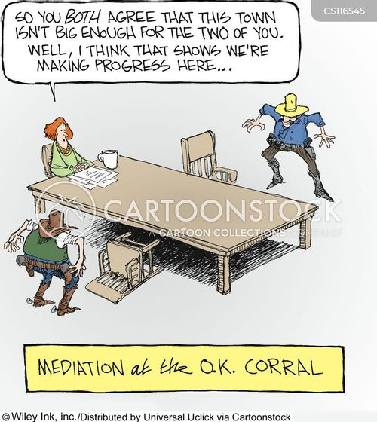
What does a Chair do? (Inter) Mediation
Negotiating partners:
(sometimes) no clear preferences
Tactical reasons for information concealing
Fear that clear preferences may increase vulnerability
Clear preferences limits the chances for tactical step backs (real vs. nominal preferences).
(Because of the non-disclosure of real preferences) ZOPA may not be traceable → negotiation failure not because of lack of common grounds but lack of proper information dissemination
Chair:
Collects and disseminates information (through bilateral meetings)
Drafts agreement texts as a point of departure for further negotiations

Slide 7
What does a Chair do? Representation
Need for representing the group
Negotiations with third parties, outside the negotiation structure
Participation and/or interactions with IOs, Conferences, fora as a collective entity

Slide 8
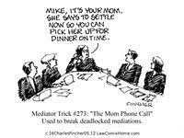
Resources of the Chair (1/2)
Asymmetrical access to information
Content expertise
Too costly for negotiating partners
Contribution of permanent secretariat or bureaucracy (institutional memory)

Slide 9
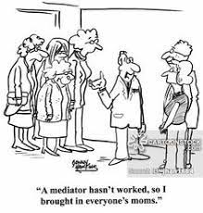
Resources of the Chair (2/2)
Process control and experience
Legal and procedural advice by the bureaucracy
Control:
Frequency of meetings
Time for deliberation
Type of negotiations (formal and informal caucuses – bilateral/trilateral/multilateral)
Drafting of agreement texts: single negotiating texts or competing proposals
Procedural rights: opening remarks setting the tone, right to speak, directing decision-making

Slide 10
TABLE 1: PARAMETERS OF CHAIR EFFECTIVENESS
PARAMETERS | OPERATIONALIZATION | IMPACT on CHAIR EFFECTIVENESS
Negotiating Contour | International Environment: Systemic Power Configuration | Conditions of amity : + / Polarization and enmity: -
 | CONTENT and STRUCTURE of NEGOTIATIONS Nature of Issue: Degree of Salience/Controversy Negotiation Structure Decision-Making Rules | - - Unanimity: -
ORGANIZATIONAL FEATURES | INSTITUTIONAL ENVIRONMENT Design (rotation/ election/ appointment) Process Control/Continuity/Duration of Tenure Operational Rules: Mandate (delineates formal process control) Constraints: Formal (control mechanisms) and informal (behavioral norms) | Narrow and Specific Mandate: - Efficient Control Mechanisms: -
 | RESOURCES Informational Chair Legitimacy and Authority Political Support by Other Parties (within/outside negotiations) | + + +
PERSONAL SKILLS | Personality-specific Features | +
 | Expertise | +
 | Leadership Potential | +
COUNTRY-OF-ORIGIN ATTRIBUTES | Power Reflection | ambiguous
 | Country Legitimacy and Authority | +

Slide 11
At What Cost?
The institutionalization of the Chair entails an ‘incomplete contracting’ (many grey zones)
Chair-agent may evolve to an autonomous actor with diverging preferences from the principals
Control mechanisms to curtail autonomy potential:
formal (appointment/renewal/dismissal, decision-making rules, office duration)
Informal (behavioural norms, like consensus seeking), ex post and ex ante

Slide 12
EU Presidency (1/2)
Hybrid form: rotation (Council) and permanent (European Council, Council on Foreign Relations, Eurogroup)
Rotational Presidency:
Evolutionary hypostasis of the Presidency
Functional need to coordinate the ever expanding works of the Council
Exploitation of the incomplete delimitation of its tasks and role

Slide 13
EU Presidency (2/2)
Why the permanent component?
Already from the Constitutional Treaty (2004)
President of the European Council: leadership gap
Rotational Presidency incapable of offering the necessary strategic guidance
High Representative: to improve coherence and consistency in EU’s foreign action
Rotational Presidency had coordination problems with the Commission

