Slide 1
Advanced Corporate Finance
M&A and corporate restructuring
MSc course in finance
Dr. Andrianos E. Tsekrekos

Slide 2
Topics Covered
Merger activity and merger waves
M&A as an “adjustment process”
Sensible and dubious reasons for mergers
Definitions of alternative restructuring strategies
Theories of mergers
Total value increased
Hubris
Agency
Redistribution
Conglomerate mergers
Performance of M&A
Shrinking to create value
Takeover defenses

Slide 3
1) Merger activity and waves
Observation: merger waves often coincide with:
- economic expansion (procyclicality)
- economic shocks (e.g. technological innovation)
Maksimovic & Philips (2000) ('74-'92)
- average rate of takeover activity: 3.89%
- during expansion years: about 7%
Mitchell & Mulherin (1996): '82-'89

Slide 4
1) Merger activity and waves (ctd)
1895-1904 :
advent of electricity, railroad
Horizontal mergers
1922-1929 :
Advent of auto, radio, merchandising
Vertical mergers
1967-1969-1973: conglomerate mergers
1988-1989: leveraged buyouts, raiders
1993- 2001 : internet, telecom, global economy

Slide 5
1) Merger activity and waves (ctd)
Last wave: 93/97-2000:
US: peak in 1999 with 1426 bn$
Rest of world in 2000 with 1652 bn$

Slide 6
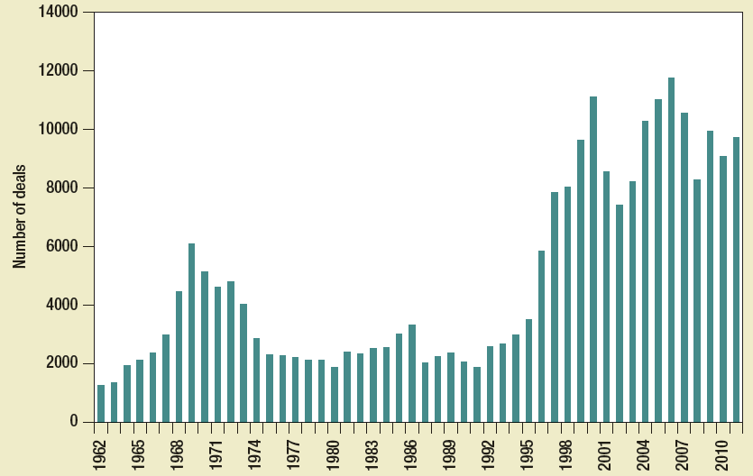
Number of mergers in united states, 1962-2011
Notes:
Number of deals over a period of 1962–2011.

Slide 7
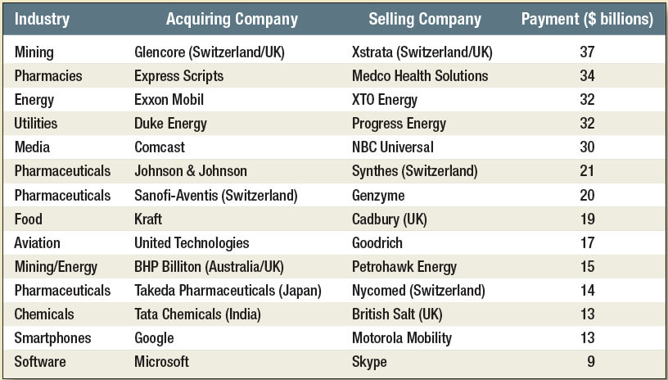
Recent mergers (up to 2011)
Notes:
This table gives data on recent megamergers.

Slide 8
2) M&A as an adjustment process
- M&A are response to economic change/shocks:
Technological change (eg internet)
Economies of scale (eg in communication, transportation costs)
Globalization
Change in market structure (eg in(de)creased competition)
New industries (telecom, internet…)
Regulatory change (EU, taxation,deregulation)
Change in economic growth, business cycle effect
Capital market effects (stock market, interest rates)

Slide 9
2) M&A as an adjustment process
Gort (1969): economic disturbance theory
M&A is procyclical: twice as much takeover activity in up than in down markets

Slide 10
3) Sensible motives for mergers
Economies of Scale
Larger firms can reduce per-unit cost by using excess capacity or spreading fixed costs across more units
Notes:
There are several sensible reasons for mergers and they are discussed in detail. Economies of scale can reduce costs through increased operational or administrative efficiencies.

Slide 11
3) Sensible motives for mergers
Economies of Vertical Integration
Control over suppliers can reduce costs
Overintegration can increase costs
Best when two business activities are inextricably linked
Notes:
Vertical integration reduces cost by increasing efficiency. “Vertical” integration can be either up or down, that is, suppliers or distributors. Overintegration may increase costs. There may be several suppliers or distributors prior to integration to foster competition, but after the merger they are all integrated into one, more efficient supplier or distributor.

Slide 12
3) Sensible motives for mergers
Complementary Resources
Merging may result in firms filling missing pieces in each other’s supply chains
Small firms can benefit from existing organization of large firms
Surplus Funds
If firm is mature, has few positive NPV projects available, acquisition may be best use of funds
Notes:
Paying out high dividends is often (but not always) a better use of surplus funds than acquisition.

Slide 13
3) Dubious reasons for mergers
Diversification
Investors should not pay premium for diversification; they can diversify themselves
Diversification easier and cheaper for stockholders than corporations
Notes:
The most dubious reason for a merger is diversification. Full diversification can easily be achieved by forming portfolios. Investors should not pay a premium for diversification since they can do it themselves.

Slide 14
3) Dubious reasons for mergers
Increasing Earnings per Share: Bootstrap Game
Acquiring firm has high P/E ratio
Selling firm has low P/E ratio (due to low number of shares)
After merger, acquiring firm has short-term EPS rise
Long term, acquirer will have slower than normal EPS growth due to share dilution.
Notes:
In this case, the acquiring firm has a high P/E ratio because of high-growth potential. The acquiring firm has short-term increase in EPS. But in the long-run, acquirer will suffer from a slower EPS growth rate.

Slide 15
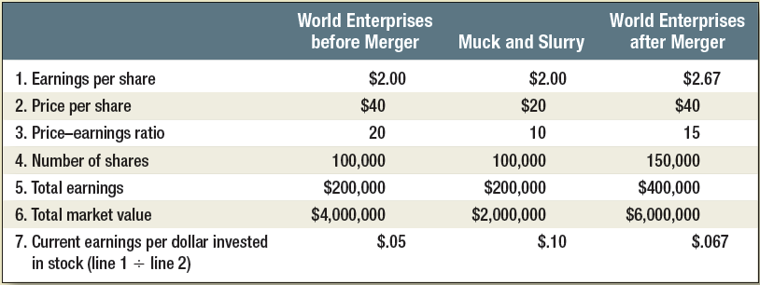
3) Dubious reasons for mergers
Notes:
The selling firm has a low P/E ratio due to slower growth. After the merger, the acquiring firm has a short-term increase in EPS. This is called the bootstrap game.

Slide 16
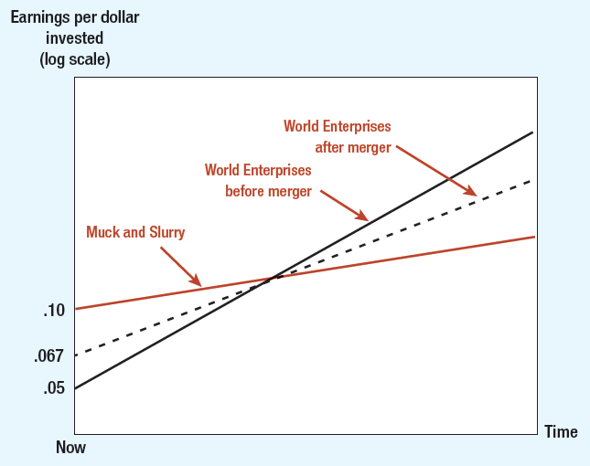
Effects of merger on earnings growth
Notes:
In the long run, the acquirer will have slower growth due to dilution. This graph shows why the acquirer will have a slower growth rate in the future. The acquirer has given up a future growth rate for an increase in current earnings.

Slide 17
4) Definitions of restructuring strategies
Growth strategies:
Mergers/takeovers
Tender offers/takeovers (debt, cash,stock offers)
Pooling of interest/merger
Joint ventures
Other forms of collaboration, eg franchising
Mergers/takeovers can be “consolidating” in nature

Slide 18
4) Definitions of restructuring strategies
M&A can take on various forms:
Raiders
Hostile takeovers
MBO/LBO
“friendly” merger

Slide 19
Acquisition tools
Tools Used to Acquire Companies
Proxy Contest
Tender Offer
Acquisition
Merger
Leveraged Buy-Out
Management Buy-Out
Notes:
These are different methods used to acquire companies.
Proxy contest: Attempt to gain control of a firm by soliciting a sufficient number of stockholder votes to replace the existing management.
Acquisition: Occurs when one corporation buys the stock or assets of another corporation
Leveraged buyout: Where an acquiring company’s capital structure is substantially higher debt than equity.
Management buyout: Occurs when managers of a firm form a new corporation and, with funds provided by a lender, acquire the firm.
Merger: When two or more corporations combine to form one corporation.
Tender offer: A publicly announced offer by the buyer to acquire shares of a single class of stock at a specified price.

Slide 20
4) Definitions of restructuring strategies
B) Shrinkage strategies:
Divestitures
Equity carve-outs
Spin-offs

Slide 21
5) Merger theories
Efficiency or synergy driven
Hubris
Agency problems (empire building)

Slide 22
5) Merger theories
 | Total gains | Gains to target | Gains to acquirer
Efficiency/ Synergies | Positive | Positive | Positive
Hubris | Zero | positive | negative
Agency problems | negative | positive | negative

Slide 23
5) Theories of mergers
A) Total value increased
Efficiency increases (restructuring)
Operating synergy (eg Vodafone)
Financial synergy (tax, more fin. bargaining power)
Information effects:
“sitting on a goldmine” effect
“kick in the pants” effect
“future target” effect

Slide 24
Estimating merger gains and costs
Questions
Is there overall economic gain to merger?
Do terms of merger make company and shareholders better off?
Notes:
The value of the combined firms should be greater than the sum of the values of the two separate firms.

Slide 25
Estimating merger gains and costs
Notes:
Economic gain is equal to the present value of new cash flows from synergies discounted at the cost of capital of the combined firm.
Gain = PV_{AB} – (PV_{A} + PV_{B})
Cost = cash paid – PV_{B}
NPV = gain – cost
NPV = (PV_{AB} – cash paid) – PV_{A}

Slide 26
Estimating merger gains and costs
Example
Two firms merge, creating $25 million in synergies. If Firm A buys Firm B for $65 million, cost is $15 million
Notes:
A numerical example illustrating the calculation of gain and cost of merger is shown.
PV_{A} = $200; PV_{B} = $50
Gain = +$25; PV_{AB} = $275
Cost = 65 – 50 = $15 million

Slide 27
Estimating merger gains and costs
Example
NPV to Firm A will be difference between gain and cost
Notes:
NPV = gain – cost;
NPV_{A} = 25 – 15 = +$10;
NPV = (PV_{AB} – cash paid) – PV_{A}
NPV = (275 – 65) – 200 = +$10 million

Slide 28
Estimating merger gains and costs
Economic Gain
Notes:
Economic gain = PV(increased earnings) = (net cash flows from synergies)/discount rate

Slide 29
Motives for mergers
Travelers and Citicorp (April 98) create a `financial supermarket’ (City group):
Travelers: mutual funds, insurance and brokerage services
Citicorp: checking, credit cards, foreign exchange opportunities and trusts
Pfizer and Warner Lambert (Nov. 99)
GlaxoWellcome and Smithkline Beecham (Jan 2000; $76 bn)
Vodafone and Mannesmann (Feb. 2000)

Slide 30
Vodafone-Mannesmann
On 3 February 2000 Vodafone Airtouch and Mannesmann agree to the largest merger in history. Two weeks earlier Chris Gent, Chief Executive of Vodafone, published a letter to Mannesmann's shareholders stating that ``A combination of the two companies will bring Mannesmann the scale and geographic presence it currently lacks by creating a global footprint covering 25 countries, including a leading presence in the key US market. ... The Combined Group will enjoy substantial revenue benefits from voice, data and internet services that will significantly enhance its growth prospects. This is why 100% of Mannesmann alone cannot make the 47.2% share of the Combined Group's proportionate EBITDA that Mannesmann's shareholders are being offered...

Slide 31
Vodafone-Mannesmann
Shareholders should take into account the greater revenue benefits and synergies available to the Combined Group compared with those available from the combination of Mannesmann and Orange... The potential revenue benefits between Vodafone and Mannesmann should be greater than the synergies available between Mannesmann and Orange given that Vodafone has 7 times more proportionate customers than Orange, and a higher UK business.’’ (PR Newswire, 01/18/2000)

Slide 32
5) Theories of mergers
B) Hubris & winner’s curse
See auction theory
overvaluation of target by bidders results from hubris (excessive self-confidence)

Slide 33
5) Theories of mergers
C) Agency problems
See capital structure theories
Mgt-stockholder problem (control/ownership)
Entrenchment
Jensen (1986) FCF hypothesis
Monitoring & collective action is costly
Takeovers as disciplining device (eg RBS-Natwest)

Slide 34
Free cash-flow hypothesis
NatWest has announced a further 1,650 job cuts as it launches details of its vigorous defence against the hostile £21bn ($35bn) Bank of Scotland takeover bid. The job losses are on top of the already announced programme to cut 10,000 retail banking jobs by 2001. ... Greenwich NatWest, Ulster Bank, Gartmore and NatWest Equity Partners are to be sold, with surplus capital returned to shareholders. ... NatWest poured scorn on Bank of Scotland's claims regarding cost savings and merger benefits, saying the Edinburgh firm was ``attempting to hijack cost savings that belong to NatWest shareholders"and claiming unrealistic merger benefits. (BBC, October 27, 1999)

Slide 35
Free Cashflow Hypothesis
The Royal Bank of Scotland (RBS) ended up winning the battle for NatWest. RBS has continued to pursue "diet deals," including $10.5 billion acquisition of Charter One Financial in May 2004.

Slide 36
5) Theories of mergers
- Other governance mechanisms:
Internal mechanisms:
Compensation arrangements (golden parachutes, stock options, ESOP,…)
Debt financing
Collective action & monitoring by board/shareholders
Spinoffs (to avoid cross-subsidization)

Slide 37
5) Theories of mergers
External mechanisms:
Proxy contest
Takeover threat
Competition
Ethics, reputation and law (agains fraud)
- Managerialism: mergers are the problem, not the solution (eg. Empire building, conglomerate mergers)

Slide 38
5) Theories of mergers
D) Redistribution
Takeovers may have redistributing effect:
Tax gains: from government to firms
Market power: from consumer to firms:
Concentration can lead to collusion & mkt power
Approval from antitrust authorities required
Redistribution from bondholders (eg LBOs)
Redistribution from labor to firms:
Pension fund reversions
“breach of trust or implicit contracts”:
- Affects mainly employees with firm-specific skills
- Could be efficient as well as inefficient

Slide 39
5) Theories of mergers
E) Conglomerate mergers:
Performance has been rather disappointing
Less compelling theoretical justifications
Financial synergies?
diversification→lower default probability→higher taxshield
Transfer from stockholders to bondholders
“diversification discount” caused by:
Internal inefficiency and agency
Increased info asymmetry (opaqueness)
Inefficient internal capital markets

Slide 40
6) Performance of M&A
Role of method of payment:
Cash
Stock
Debt
A mix of the above
Has influence on bid premium and returns to shareholders (asymmetric information)

Slide 41
Possible tax consequences when baycorp buys seacorp for $330,000
Captain B’s original investment in Seacorp was $300,000. Before merger, Seacorp’s assets were $50,000 marketable securities and boat with $150,000 book value, $280,000 market value
Notes:
This frame shows the differences between a taxable merger and a tax-free merger. If the payment is in the form of cash, then the acquisition is regarded as taxable. If the payment is largely in the form of shares, the acquisition is tax-free. In this case, shareholders are viewed as exchanging old shares for new shares (even exchange) and hence no capital gain or loss is recognized.

Slide 42
6) Performance of M&A
Studies of event returns
Target returns:
Stock offers: 15-20%
Cash offers: 25-30%
Acquirer returns: zero returns
B) Longer-run performance studies

Slide 43
7) Shrinking to create value
Divestitures
Buyer wants to refocus
Seller motivated by strategic complementarity
Many conglomerates subsequently divested

Slide 44
7) Shrinking to create value
B) Equity carveouts and spinoffs:
Carveouts usually followed by spinoffs
(eg. DuPont and Conoco, AT&T and Lucent)
Mechanism for creating a new company
Economic logic:
Carveout raises funds for parent company
Parent can refocus on its core business
Spinoff gives independence to subsidiary and allows management performance to be measured directly

Slide 45
7) Shrinking to create value
LBO:
Allows public company to be taken private and to be restructured
Heavily debt financed transaction
Called MBO if executed by management
Prevalent in 1980s:
Gives management high ownership and right incentives
Increased profitability and efficiency
Company subsequently sold in secondary IPO

Slide 46
8) Takeover defences
Defensive restructuring:
“scorched earth policy”, selling crown jewels
Issue new equity to “friendly” shareholders
Poison pills: warrants issued to existing shareholders giving them right to buy firm securities at very low prices in event of tender offer
Poison puts: allows bondholders to sell bonds at par to issuer or its successor
Golden parachutes (protects management)
Staggered boards

Slide 47
8) Takeover defences
Takeover Defenses
White Knight
Friendly potential acquirer sought by target company threatened by unwelcome acquirer
Shark Repellent
Amendments to company charter made to forestall takeover attempts
Poison Pill
Action taken by target firm to prevent acquisition, e.g., right for existing shareholders to buy additional shares at attractive price, should bidder acquire large holding
Notes:
This slide lists a number of takeover defenses.

Slide 48
Summary of takeover defenses
Notes:
Several takeover defenses are summarized. These are the most important.

Slide 49
9) Corporate governance
Mechanisms were discussed before
Recent cases of fraud
issues of investor protection (eg Russia)

