Slide 1
Ted Lappas
ted@aueb.gr

Slide 8
Dall-E
Dalle-2: https://labs.openai.com/
Dalle-3: https://chat.openai.com/
“Create a photorealistic image of Queen Cleopatra drinking a cocktail while watching a beautiful. sunset on the beach.”
“A photorealistic image of Elon Musk drinking a Coca Cola while driving a Tesla. He is looking at the camera and smiling. “

Slide 9
MIdjourney
Instructions: https://docs.midjourney.com/docs/quick-start
CheatSheet: https://docs.midjourney.com/docs/parameter-list
“Beautiful watercolor painting of famous structures, cities, and buildings, people on the street, 16k, ultra HD”
“Dot shaped style, sunset, orange sun, clouds, five rotating circles of clouds in a large sky, dot shaped waves, and orange yellow sunset clouds reflected on the waves, one boat is going out to sea, in the style of detailed dreamscapes, light black and orange, painted illustrations, dreamscape portraiture, skillful lighting, precisionist art, whimsical cartoonishness”
“a woman sitting on top of a lush green field, emaciated black evening gown, ffffound, mackenzie foy, stoya, ruffles, her gaze is downcast, rainy; 90's photograph, dress in voile, in the australian desert, black in, dressed in a worn --q 2 --v 5.2 --ar 3:4”
“https://letstryai.com/wp-content/uploads/2023/06/midjourney-prompts-for-editing-photos-example-1.jpg mysterious haunted house at night, the image should look like a shot from a horror movie --ar 16:9 --v 5”
“https://letstryai.com/wp-content/uploads/2023/06/midjourney-prompts-for-editing-photos-example-1.jpg Egyptian pyramid in the dessert, the image should look like a scene from a cartoon movie --ar 16:9 --v 5”

Slide 12
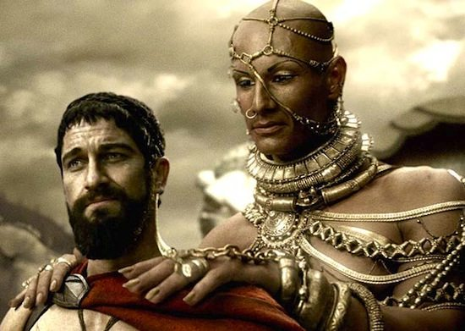
GPT-V
https://chat.openai.com/

Slide 13
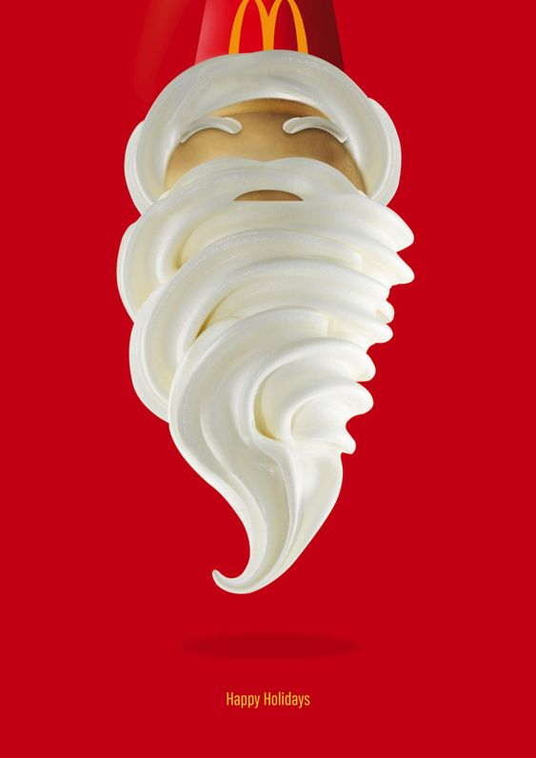
GPT-V

Slide 14
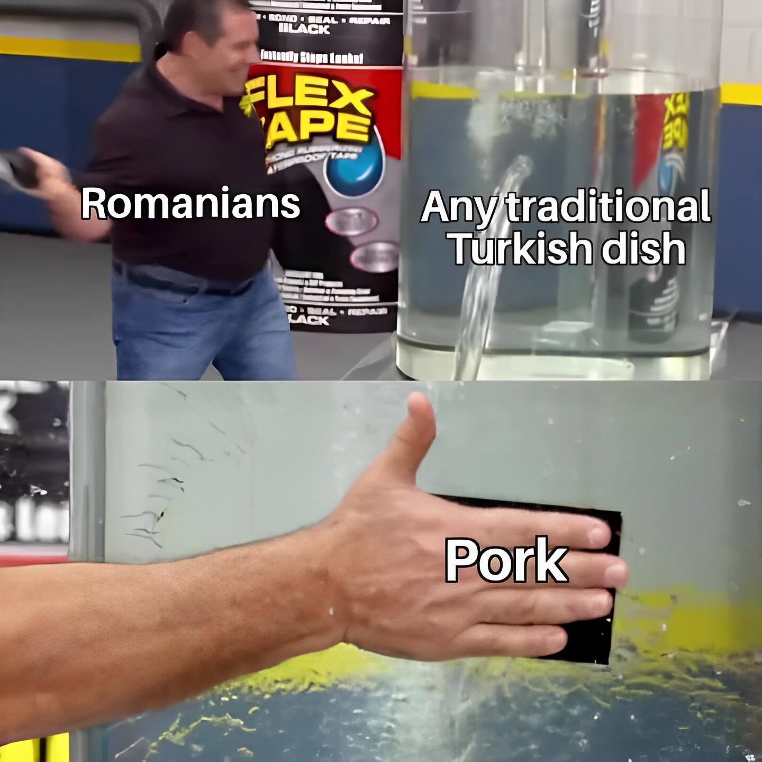
GPT-V

Slide 15
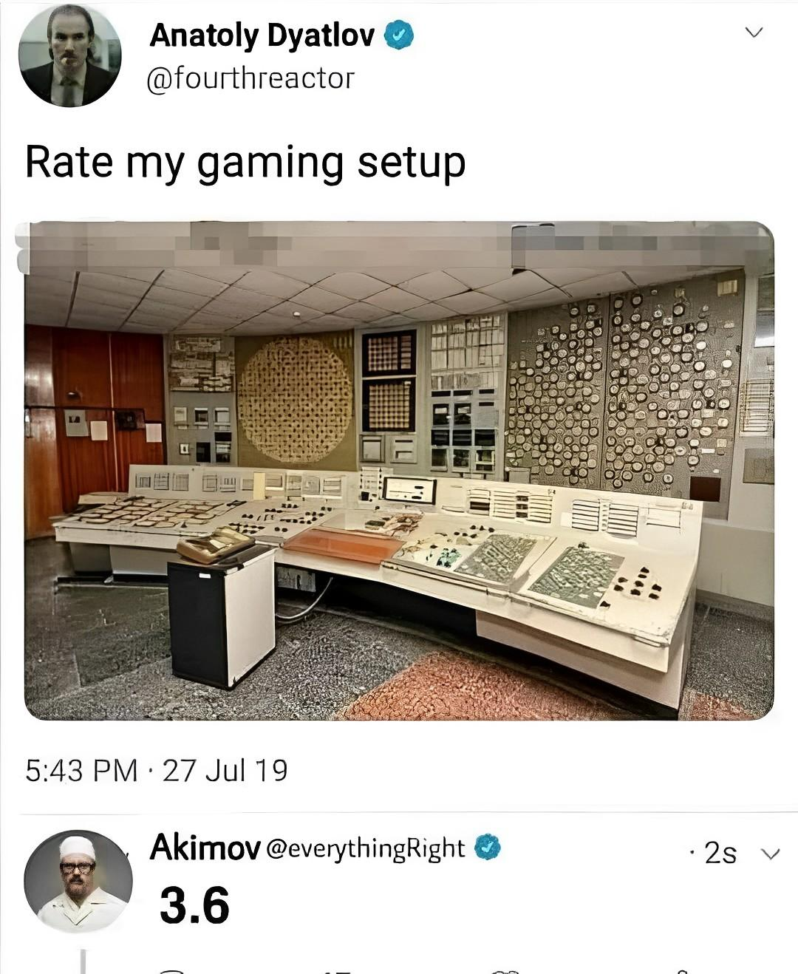
GPT-V

Slide 16
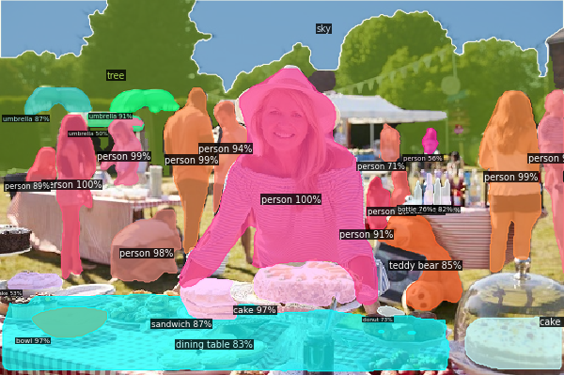
Semantic Segmentation

Slide 18
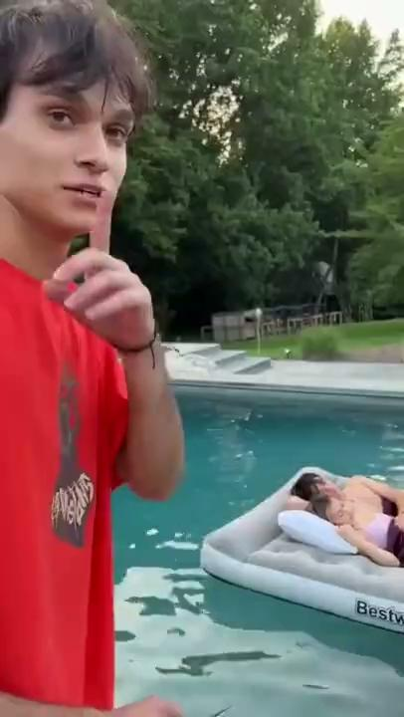
In this video, a hilarious prank unfolds at a lively swimming pool party. The star of the show is a man in a red shirt, who seems to be on a playful mission as he sneaks around the pool area. As the camera follows him, it captures a woman in a purple shirt lounging on an inflatable raft, blissfully unaware of the prankster's plan. With a cheeky grin, the man in the red shirt brandishes a pair of scissors, preparing to exact his revenge. As he approaches the raft, he makes a hush sign to the camera, ensuring that the woman remains undisturbed. The suspense builds as he gets closer to the raft, scissors in hand, and viewers eagerly anticipate the outcome of this entertaining prank. The video ends with laughter and amusement, leaving the audience in stitches and eager to share the fun with their friends.

Slide 20
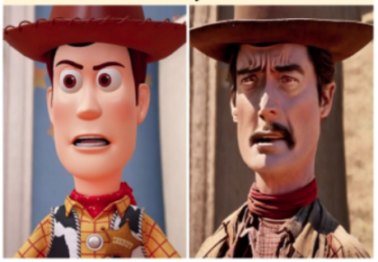
Instruct pix2pix

Slide 21
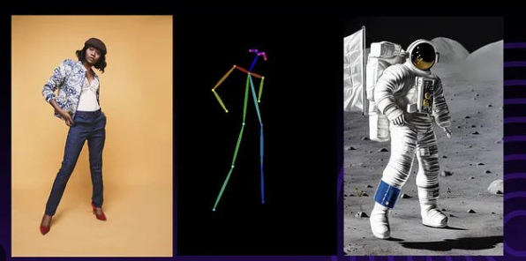
ControlNet (Examples)
ControlNet (Official)

Slide 22
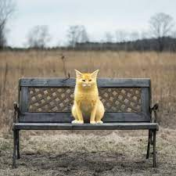
Inpainting

Slide 23
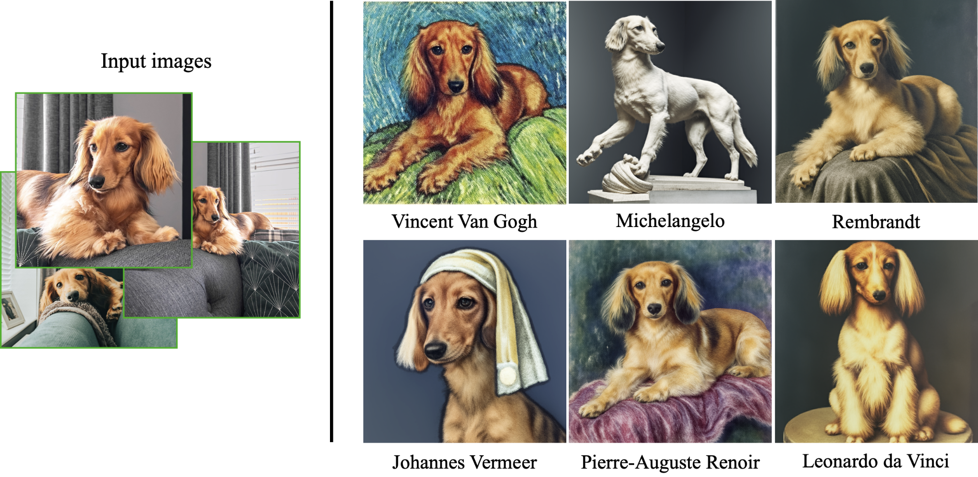
Dreambooth

Slide 25
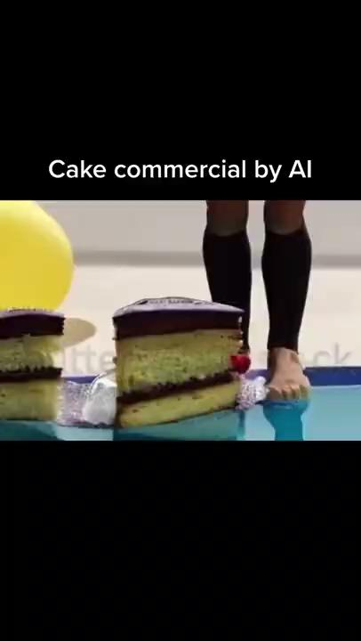

Slide 26
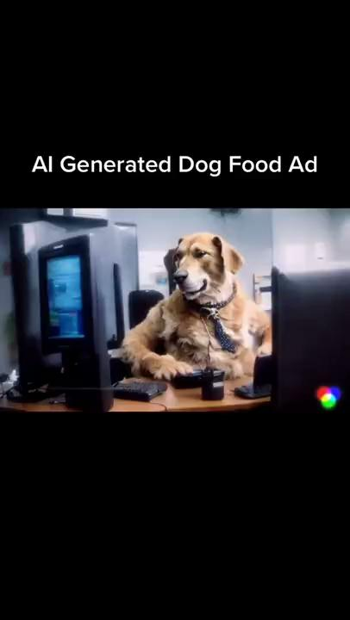

Slide 27
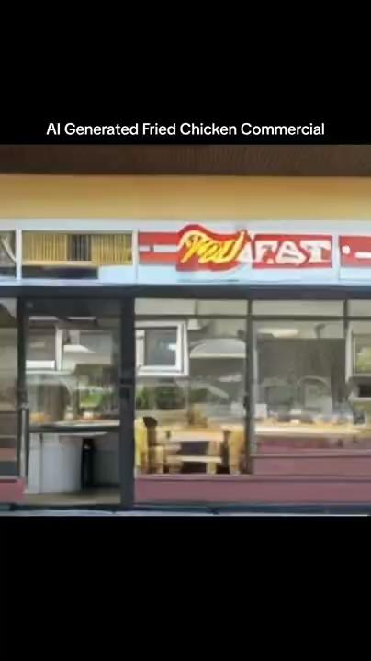

Slide 28
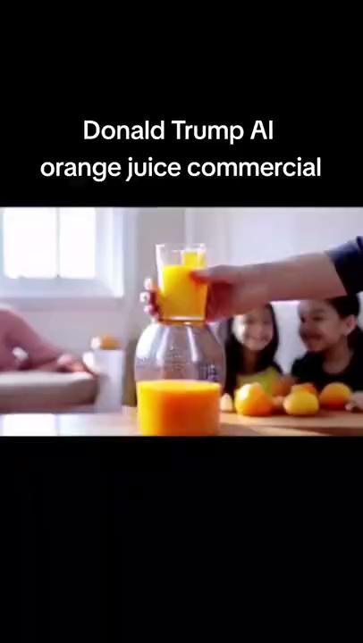

Slide 29
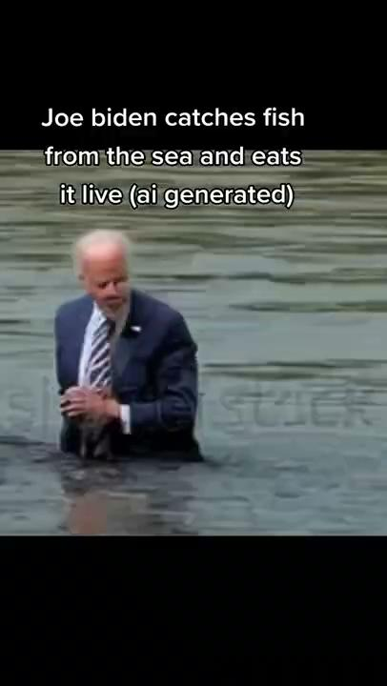

Slide 30
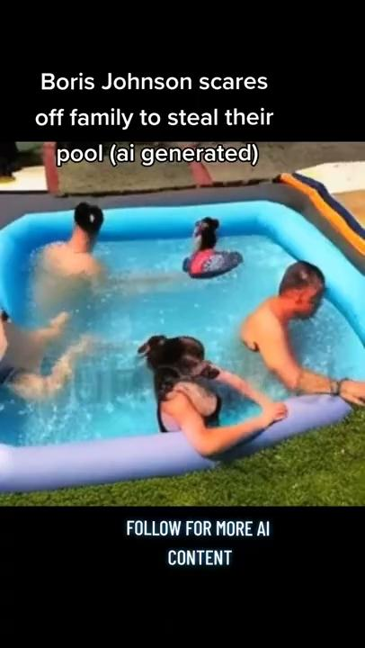

Slide 32
