Slide 1
Αρχιτεκτονική Υπολογιστών
Ενότητα # 6: RAID
Διδάσκων: Γεώργιος Κ. Πολύζος
Τμήμα: Πληροφορικής

Slide 2
RAID Redundant Array of Independent Disks David A. Patterson, Garth Gibson, and Randy H. Katz, A Case for Redundant Arrays of Inexpensive Disks (RAID) Proc. 1988 ACM SIGMOD international conference on management of data, Chicago, IL, USA, pp. 109-116, June 1988. DOI=10.1145/50202.50214 http://doi.acm.org/10.1145/50202.50214
Based on slides by…
Rakshith Venkatesh, John Kubiatowicz ,and Anthony D. Joseph

Slide 3
What is RAID?
Stands for Redundant Array of Independent Disks
enables greater levels of
Performance
reliability
By concurrent use of two or more ‘hard disk drives’
Through:
Mirroring
Stripping (of data) and
Error correction techniques

Slide 4
Array Reliability
Reliability of N disks = Reliability of 1 Disk ÷ N
50,000 Hours ÷ 70 disks = 700 hours
Disk system MTTF: Drops from 6 years to 1 month!
• Arrays (without redundancy) too unreliable to be useful!
Hot spares support reconstruction in parallel with
access: very high media availability can be achieved

Slide 5
RAID Basics (1)
Levels of RAID (those in RED are actually used):
RAID 0: striping with no parity (just bandwidth)
RAID 1: Mirroring (simple, fast, but requires 2x storage)
Reads faster, writes slower (why?)
RAID 2: bit interleaving with error-correcting codes (ECC)
Dedicated parity disk (RAID level 3), byte-level striping
Dedicated parity disk is write bottleneck, since every write also writes parity

Slide 6
RAID Basics (2)
RAID 4:dedicated parity disk, block-level striping
RAID 5: Rotating parity disk, block-level striping
most popular; rotating disk spreads out parity load
RAID 6: RAID 5 with two parity blocks (tolerates two failures)
RAID 10: Combines RAID 1 and RAID 0
RAID 6 for today’s drive sizes…

Slide 7
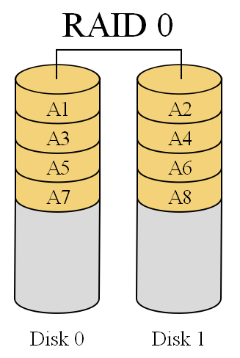
RAID 0 (1)
Splits data among two or more disks
Provides good performance
Lack of data redundancy
there is no fail over support
with this configuration

Slide 8
RAID 0 (2)
In the diagram to the right
the odd blocks are written to disk 0
the even blocks to disk 1 such that A1, A2, A3, A4, … would be the order of blocks read if read sequentially from the beginning
Used in read only NFS systems and gaming systems

Slide 9
RAID 0 analysis (1)
Failure Rate:
MTBF of RAID0 is roughly proportional to the number of disks in the array
Pr{disk fail} = 5%, then
Pr{(at least) one fails} = 1 – Pr{none fails} = 1 – (1-0.05)² = 9.75% [independent!]

Slide 10
RAID 0 analysis (2)
Performance:
The fragments are written to their respective disks simultaneously on the same sector
This allows smaller sections of the entire chunk of data to be read off the drive in parallel, hence good performance

Slide 11
RAID 1
RAID1 is ‘data mirroring’
Two copies of the data are held on two physical disks
the data is always identical
Twice as many disks are required to store the same data when compared to RAID 0
Array continues to operate so long as at least one drive is functioning

Slide 12
RAID 1: Disk Mirroring/Shadowing
recovery
group
Each disk is fully duplicated onto its "shadow“
Very high availability can be achieved
Bandwidth sacrifice on write:
Logical write = two physical writes
Reads may be optimized
Most expensive solution: 100% capacity overhead

Slide 13
RAID 1 analysis
Failure Rate:
If Pr{disk fail} = 5%, then the probability of both the drives failing in a 2 disk array is P{both fail} = (0.05)² = 0.25%.
Performance:
If we use independent disk controllers for each disk, then we can increase the read or write speeds by doing operations in parallel

Slide 14
RAID 5
RAID 5 is an ideal combination of good performance, good fault tolerance and high capacity and storage efficiency
An arrangement of parity and CRC to help rebuilding drive data in case of disk failures
“Distributed Parity” is the key word here

Slide 15
RAID 5: High I/O Rate Parity
D0
D1
D2
D3
P
Increasing
Logical
Disk
Addresses
1 logical write
becomes 4
physical I/Os
Independent writes
possible because of
interleaved parity
Reed-Solomon
Codes ("Q") for
protection during
reconstruction
D4
D5
D6
P
D7
D8
D9
P
D10
D11
D12
P
D13
D14
D15
Stripe
P
D16
D17
D18
D19
Stripe
Unit
Targeted for mixed
applications
D20
D21
D22
D23
P
.
.
.
.
.
.
.
.
.
.
.
.
.
.
.
Disk Columns

Slide 16
Problems of Disk Arrays: Small Writes
RAID-5: Small Write Algorithm
1 Logical Write = 2 Physical Reads + 2 Physical Writes
D0'
D0
D1
D2
D3
P
new
data
old
data
old
parity
(1. Read)
(2. Read)
+
XOR
+
XOR
(3. Write)
(4. Write)
D0'
D1
D2
D3
P'

Slide 17
RAID 5 analysis (1)
MTBF is slightly better than RAID 0
This is because failure of one disk is not quite a harm
We need more time if 2 or more disks fail
Performance is also as good as RAID 0, if not better.
We can read and write parallel blocks of data

Slide 18
RAID 5 analysis (2)
One of the drawbacks is that the write involves heavy parity calculations by the RAID controller
Write operations are slower compared to RAID 0
Pretty useful for general purpose uses where ‘read’s’ are more frequent the ‘write’s’

Slide 19
RAID 10
Combines RAID 1 and RAID 0
both - good performance and good failover handling
called ‘Nested RAID’

Slide 20
RAID 6+
RAID 6:
seen as the best way to guarantee data integrity → uses double parity
lesser MTBF compared to RAID5
drawback: longer write time

Slide 21
Implementations (1)
Software based RAID:
Software implementations are provided by many Operating Systems
A software layer sits above the disk device drivers and provides an abstraction layer between the logical drives (RAIDs) and physical drives
Server's processor is used to run the RAID software
Used for simpler configurations like RAID0 and RAID1

Slide 22
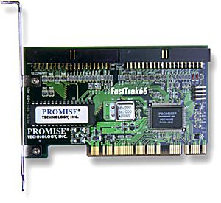
Implementations (2)
Hardware based RAID:
hardware implementation of RAID requires (at least) a special-purpose RAID controller
on a desktop system this may be built into the motherboard
the processor is not used for RAID calculations
A PCI-bus-based,
IDE/ATA hard disk RAID controller, supporting levels 0, 1, and 01.

Slide 23
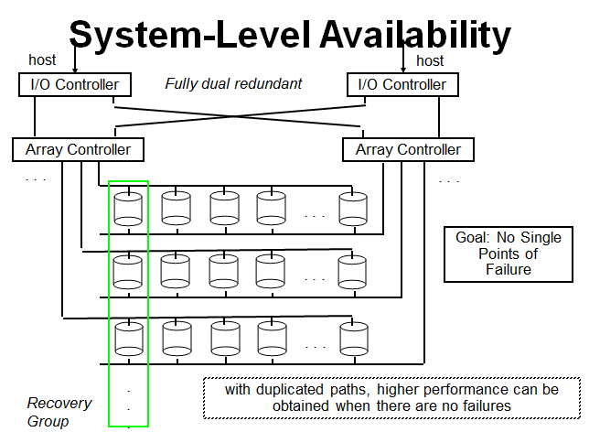

Slide 24
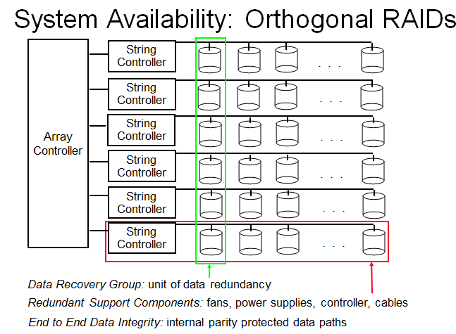

Slide 25
Road ahead… (1)
The expanded use of RAID-6 and other dual-parity schemes is a virtual certainty
RAID vendors to support "fast rebuild" features that can restore hundreds of gigabytes in just an hour or so!!
Striping (of data) would extend across RAID groups -- not just across drives within a group
Hot Spares!!

Slide 26
Road ahead… (2)
Improved disk diagnostic features should offer more reliable predictions of impending drive failures, allowing the rebuild process to begin before an actual fault occurs

Slide 27
Τέλος Ενότητας # 6
Μάθημα: Αρχιτεκτονική Υπολογιστών
Ενότητα # 6: RAID
Διδάσκων: Γεώργιος Κ. Πολύζος
Τμήμα: Πληροφορικής

