Slide 1

From the farm to your fridge, or the warehouse to your wardrobe, Maersk is developing solutions that meet customer needs from one end of the supply chain to the other.

Slide 2
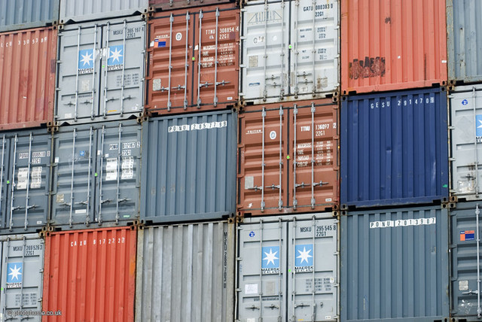
Highlights
Founded in 1928
Corporate office in Copenhagen, Denmark
611 vessels with a capacity of 3.1million TEU (Twenty-Foot Equivalent Unit)
59,000 customers worldwide
Approximately 12 million full containers shipped (2015)
Cover ports in almost every country in the world
46,000 port calls in 343 ports in 121 countries
Offer multiple weekly sailings on all our major trades
Strategy: Self-funded, EBIT 5%-points > peers and grow at least with the market
This Photo by Unknown Author is licensed under CC BY

Slide 3
Financial Figures
For more information on the Maersk Group and financial reports, please visit maersk.com
Earnings Quality Score | Industry Median | 2018
 | 38 | 49
EBITDA Margin | 14.2% | 9.9%
Operating Margin | 6.5% | 0.6%
Pretax Margin | 3.5% | (0.5%)
Net Margin | 3.1% | (1.5%)
Liquidity
Quick Ratio | 1.11 | 1.44
Current Ratio | 1.18 | 1.54
Cash Cycle (Days) | (0.4) | 51.0
Leverage
Assets/Equity | 2.43 | 1.74
Debt/Equity | 0.83 | 0.36
% LT Debt to Total Capital | 36.3% | 21.9%
(Total Debt - Cash) / EBITDA | 2.35 | 2.82

Slide 4

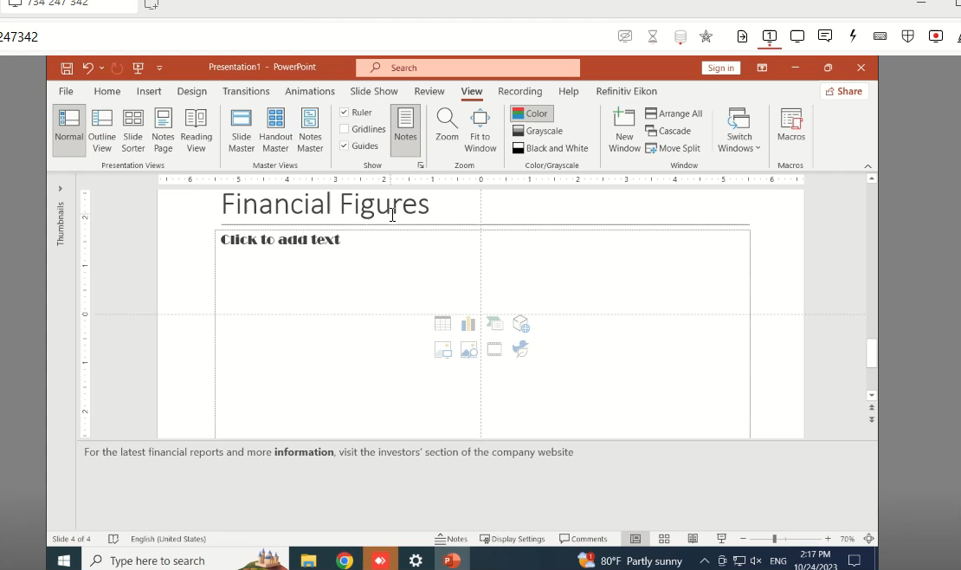

Slide 5


