Slide 1
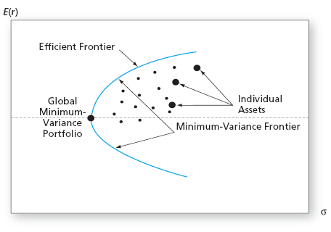
Portfolio Optimization
Taking the process one step forward…

Slide 2
Basics
Portfolio optimization is the process of choosing the proportions of various assets to be held in a portfolio, in such a way as to make the portfolio better than any other according to some criterion. The criterion will combine, directly or indirectly, considerations of the expected value of the portfolio's rate of return as well as of the return's dispersion and possibly other measures of financial risk.

Slide 3
Basics
Modern portfolio theory, fathered by Harry Markowitz in the 1950s, assumes that an investor wants to maximize a portfolio's expected return contingent on any given amount of risk, with risk measured by the standard deviation of the portfolio's rate of return. For efficient portfolios, achieving a higher expected return requires taking on more risk, so investors are faced with a trade-off between risk and expected return.

Slide 4
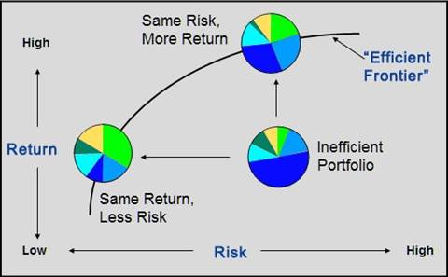
Basics

Slide 5
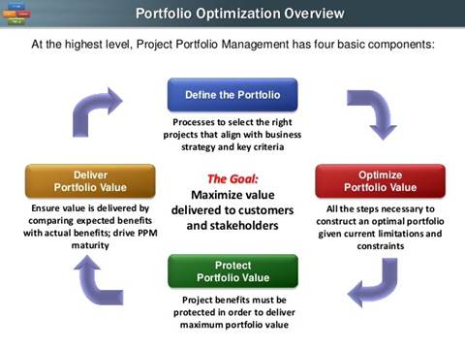
Overview

Slide 6
Optimization Problems
Problem 1: portfolio optimization is too hard
If you are using a spreadsheet, then this is indeed a problem. Spreadsheets are dangerous when given a complex task. Portfolio optimization qualifies as complex in this context. If you are using a more appropriate computing environment, then it isn’t really all that hard. There are a few issues that need to be dealt with, but taking them one at a time keeps the task from being overwhelming.

Slide 7
Optimization Problems
Solution
If you are using spreadsheets, my prescription is to switch to R. When there is real money on the line, using a spreadsheet for portfolio optimization seems to me to be penny wise and dollar foolish.

Slide 8
Optimization Problems
Problem 2: portfolio optimizers suggest too much trading
A major frustration with optimizers is that the turnover can be excessive.
Solution
All reasonable portfolio optimizers allow:
    turnover constraints
    transaction costs
Use either of these to reduce the turnover to a suitable amount.

Slide 9
Optimization Problems
Problem 3: expected returns are needed
First off, this isn’t strictly true. You can find minimum variance portfolios which need a variance matrix but not expected returns. The success of low volatility investing is a reason to go down this route.
But assuming that you are an active investor, you need expectations in some sense. There are a number of techniques that don’t require numerical expected returns.

Slide 10
Optimization Problems
Solution: target portfolio
Anyone should be able to provide an ideal target portfolio — the portfolio that you would like to hold when all constraints are ignored. Once you have the target portfolio, then you can get a portfolio that is “close” to the target but does obey the constraints. One of those constraints should almost surely be turnover.

Slide 11
Optimization Problems
Solution: reverse optimization
The technique of reverse optimization (also called implied alpha) can be used iteratively to try to find a portfolio that looks like what you want in terms of the expected returns that are implied. This avoids actually doing optimization, but it is labor-intensive and it depends on the constraints not spoiling the implied alphas (which is perhaps doubtful).

Slide 12
Optimization Problems
Solution: asset ranks
If you can order the assets in your universe in terms of expected returns, then it is feasible to produce expected returns to give to an optimizer. Ranking assets is much easier than giving numerical estimates of returns. A paper by Almgren and Chriss explains how to turn ranks into numerical expected returns.

Slide 13
Optimization Problems
Problem 4: mean-variance optimization is restrictive
There is a myth that mean-variance optimization is only useful when returns are normally distributed. That’s backwards. If returns are normally distributed, then mean-variance optimization is all that can be done — all other utilities will be equivalent. True, If the return distribution of any assets in the universe are not reasonably close to symmetric.

Slide 14
Optimization Problems
Solution
If indeed you are in a situation — including fixed income or options — where mean-variance optimization is not appropriate, then you should probably do scenario optimization.

Slide 15
Optimization Problems
Problem 5: portfolio optimization inputs are noisy estimates
Portfolio optimizers are stupid enough to believe what we tell them. The optimizer gives us a solution as if we really knew the expected returns and the variance matrix. In fact, (a) estimates of expected returns are almost total noise and (b) estimates of the variance matrix are quite noisy “almost total noise” applies to the best fund managers — the “almost” needs to be dropped for below-average fund managers.

Slide 16
Optimization Problems
Solution: Black-Litterman type operations
Some people think that doing something like Black-Litterman is a solution to this problem. It isn’t. If done intelligently, then it reduces — but does not eliminate — the noise in the expected returns.

Slide 17
Optimization Problems
Solution: robust optimization
The real solution to this problem goes by the name of robust optimization. I find this term unfortunate since there are several uses of the term “robust” which can easily be confused with the meaning of getting good solutions to a trade optimization from noisy inputs. There is a rather large selection of proposals for implementing solutions. Most of them are quite complicated.

Slide 18
Optimization Problems
Solution: shrinking
There is a simple and easily implemented solution (though the exact number probably needs to be found via experimentation).
It is easy to shrink the trade either by imposing a (stronger) turnover constraint or by increasing the transaction costs. How much to do that is an issue, of course, but the principle is simple. A guess is likely to be better than not doing it at all.

Slide 19
Optimization Problems
Problem 6: transaction costs are tricky
This is true. But there’s an even trickier bit: either the transaction costs need to be scaled to match the expected returns and variance, or the expected returns and variance need to be scaled to match the transaction costs. The three entities all appear in the utility function, and scaling is necessary for the utility to make sense.

Slide 20
Optimization Problems
Solution
The coward’s way out is just to impose a turnover constraint.
The other way is to work and think hard about trading costs. And probably to use an optimizer that allows flexible specification of costs.

Slide 21
Optimization Problems
Problem 7: risk and alpha factor alignment trouble
There has been talk among the portfolio optimization literati about alpha eating and factor alignment. The whole thing sounds seriously geeky. The gist of it is that if there are factors used in the expected returns that are not factors in the risk model, then the optimizer will think those factors are essentially riskless and use them too much.

Slide 22
Optimization Problems
Solution
One of the main “solutions” to this is to add the missing factors to the risk model. This of course assumes that there are factors in the expected returns model. The real problem is that factor models are the wrong technology to use as the variance matrix in optimizers. The solution, then, is better technology. My suggestion is to use Ledoit-Wolf estimates which shrink towards equal correlation.

