Slide 1


MSc International Shipping, Finance & Management
Asset Allocation
Diversify, go global — or loosen up
Theodore N. Krintas, CIIA, Ph.D.
Founder & CEO, Koubaras · Lecture 6 of 8 · May–July 2026

Slide 2
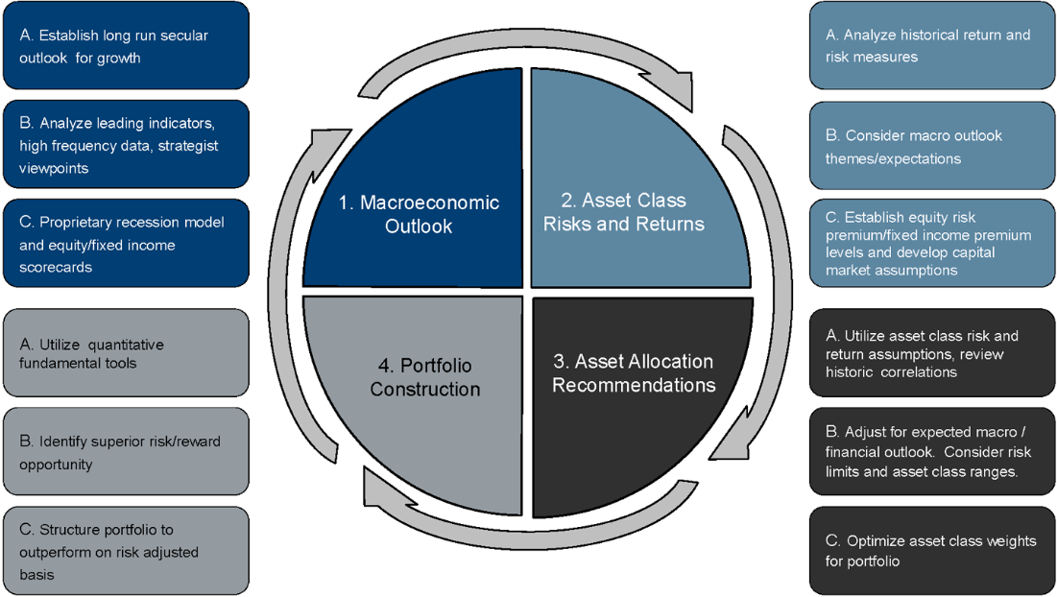
The Asset Allocation Process
Seven steps from client objectives to a monitored portfolio
1 · Objectives
Clarify goals, return needs, constraints and time horizon.
2 · Risk & Capacity
Assess both willingness and ability to bear risk.
3 · Market Outlook
Form capital-market assumptions across asset classes.
4 · Portfolio Construction
Translate inputs into a target asset-class mix.
5 · Recommendation
Document the policy portfolio and rationale.
6 · Implementation
Select vehicles; trade toward target weights.
7 · Monitor & Rebalance
Review, rebalance, and adapt as conditions change.
2

Slide 3
Three Factors Behind the Strategy
What every allocation decision is built upon
1
2
3
Time Horizon
Risk Tolerance
Financial Situation
How long until the money is needed? A longer runway allows more equity risk and time to recover from drawdowns; short horizons demand stability and liquidity.
The limits of risk the investor can accept — combining psychological willingness with the financial ability to absorb losses without derailing the plan.
Current net worth, income stability, and liabilities. Defines how much can be allocated to growth assets versus capital-preservation needs.
3

Slide 4
Strategic Allocation Profiles
The equity / fixed-income ladder, from income to growth
PROFILE
EQUITY
FIXED
MIX
Reading the ladder
Flexible Income
25%
75%
As the equity share rises, expected return climbs — but so does drawdown risk.
The right rung is chosen by the three factors on the previous slide, not by chasing return.
Each profile becomes the strategic anchor (S.A.A.) against which tactical tilts are later measured.
Conservative Balanced
40%
60%
Balanced
60%
40%
Conservative Growth
80%
20%
Strategic Growth
100%
0%
4

Slide 5
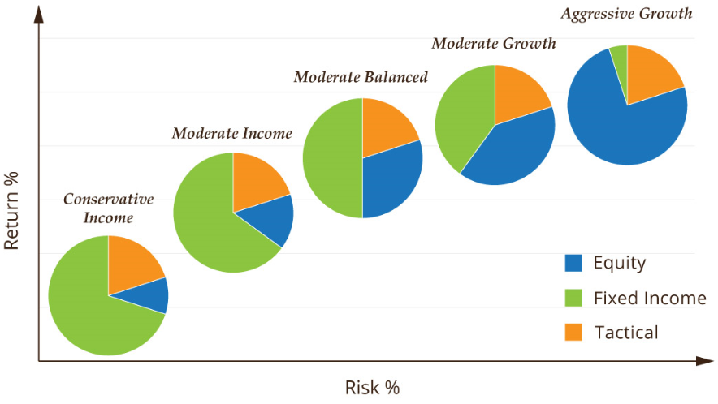
ETF Model Portfolios
Implementing each profile along the risk / return frontier
Conservative Income
Bond-heavy; low volatility, steady distributions.
Moderate Balanced
A diversified core blending equity and fixed income.
Moderate Growth
Equity-tilted with a tactical sleeve for flexibility.
Aggressive Growth
Predominantly equity; highest expected return and risk.
5

Slide 6
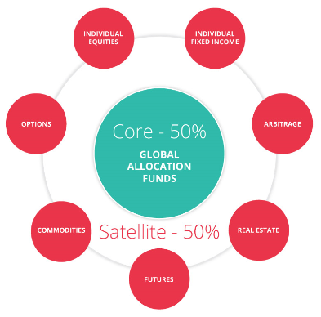
Core–Satellite Architecture
A low-cost strategic core, surrounded by targeted active bets
The Core (≈50%)
A broad, diversified, low-cost base — typically passive global allocation funds. It captures market beta cheaply and anchors the portfolio.
The Satellites (≈50%)
Smaller, deliberate active positions — themes, regions, or factors — that aim to add alpha around the core without dominating risk.
Passive core, active edge
The core stays passive and stable; satellites carry the conviction and can be tilted tactically as opportunities arise.
6

Slide 7
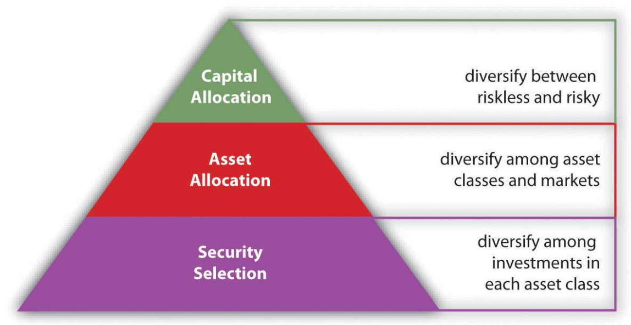
The Three Levels of Allocation
Where diversification happens — and where most of the return comes from
Capital Allocation
Split between riskless and risky assets — the single biggest driver of portfolio outcomes.
Asset Allocation
Diversify among asset classes and markets — equities, bonds, real assets, regions.
Security Selection
Diversify within each asset class — the finest, and least impactful, layer.
7

Slide 8
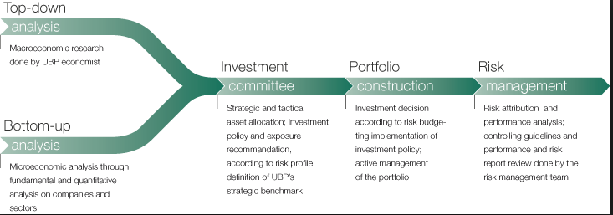
Top-Down vs Bottom-Up
Different routes to the same target portfolio
i
Investment Information
ii
Portfolio Construction
iii
Risk Management
Macro research feeds the top-down view; fundamental and quantitative analysis of companies builds the bottom-up view.
Investment decisions are aggregated into the portfolio, balancing competition for capital across ideas and asset classes.
Asset allocation and portfolio controls keep aggregate risk within the mandate — no single bet should dominate.
8

Slide 9
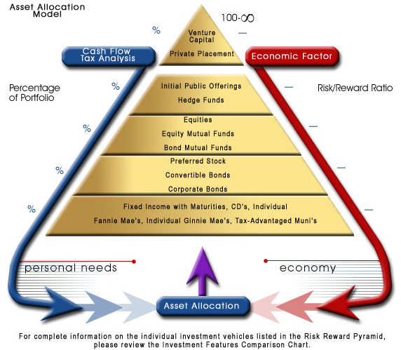
The Risk / Reward Pyramid
Personal needs at the base, return-seeking assets at the apex
Reading the pyramid
Base — security. Liquidity, emergency reserves and core needs come first.
Middle — income & growth. Diversified bonds and equities build wealth over time.
Apex — speculation. Only capital you can afford to lose belongs at the top.
9

Slide 10
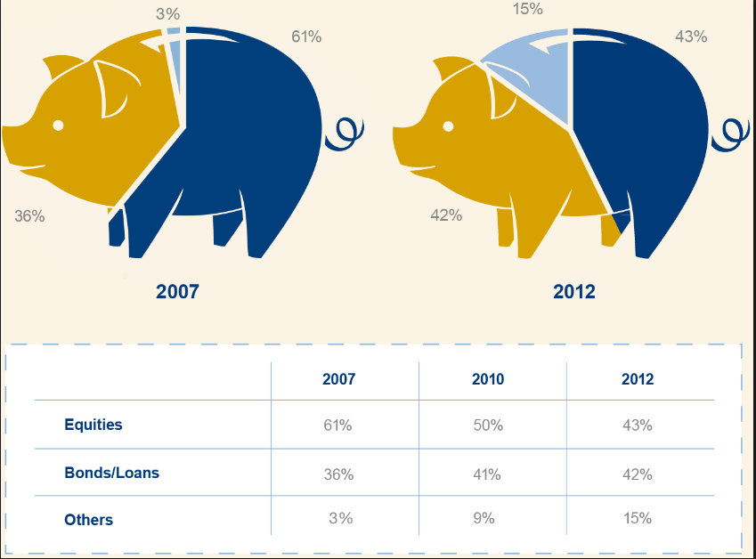
How Investor Profiles Shift
Allocations move with the cycle — and the rate regime
From the GFC to the rate-normalisation era
After 2008, investors fled equities into bonds and cash — risk aversion, not optimisation, drove allocations.
Through the 2010s, near-zero rates pushed capital back up the risk ladder (the “TINA” era — there is no alternative to equities).
Post-2022 changed the calculus: with policy rates back near 2% and bond yields positive again, fixed income is once more a genuine competitor for capital. The 60/40 is rehabilitated.
2007
2010
2013
Equities
41%
33%
37%
Bonds / Loans
34%
41%
38%
Other
25%
26%
25%
Illustrative allocations (UBS Investor Watch style); figures for teaching.
10

Slide 11
PART II
01
Strategic
Five Types of
Asset Allocation
02
Constant-Weighting
03
Tactical
From a fixed strategic mix to a fully integrated, dynamic process.
04
Dynamic
05
Insured & Integrated

Slide 12
Strategic & Constant-Weighting
The disciplined, rules-based foundations
TYPE 01
TYPE 02
Strategic (S.A.A.)
Constant-Weighting
Sets target allocations across asset classes based on long-run expected return, risk and correlation.
A proportional buy-and-hold combination — for example, a 60/40 mix held to long-term targets.
Periodically rebalanced back to target so drift does not quietly reshape the risk profile.
A continuous discipline laid over the strategic mix: hold the target weights constant.
As asset values diverge, rebalance — selling what has risen, buying what has fallen.
A built-in “buy low, sell high” mechanism; rebalance when any class drifts more than ~5% from target.
12

Slide 13
Tactical & Dynamic
Adding controlled flexibility to the core
TYPE 03
TYPE 04
Tactical (T.A.A.)
Dynamic
A moderately active overlay on the strategic mix to exploit shorter-term market conditions.
Deviations are deliberate and bounded — the difference from S.A.A. is the active weight.
Positions revert to strategic targets once the opportunity has played out.
Continuously adjusts the mix as markets and the economy evolve — the most active approach.
Sells weakening asset classes and adds to strengthening ones, leaning into prevailing trends.
Demands constant monitoring and conviction; trading and timing risk both rise sharply.
13

Slide 14
Insured & Integrated
Protecting a floor — and unifying the whole process
TYPE 05
TYPE 06
Insured Allocation
Integrated Allocation
Set a base portfolio value — a floor — that must not be breached.
Above the floor, manage actively to seek upside; as the cushion shrinks toward the floor, shift into risk-free assets to lock in the minimum.
Suits investors who need a guaranteed minimum while retaining some growth potential.
Considers economic expectations and risk together in one framework, rather than as separate steps.
The broadest approach — it can encompass strategic, tactical and dynamic methods at once.
ENCOMPASSES
Strategic
Tactical
Dynamic
Constant-Weighting
14

Slide 15
Strategic vs Tactical Allocation
The anchor (S.A.A.) and the bounded tilts (T.A.A.) around it
S.A.A.
T.A.A.
Strategic Asset Allocation
Tactical Asset Allocation
Sets target allocations for the various asset classes.
A moderately active overlay that complements S.A.A.
Factor analysis determines the original target mix.
Re-weights to exploit specific market conditions.
Built for a buy-and-hold strategy.
Driven by ongoing quantitative & qualitative risk analysis.
The long-run anchor the portfolio returns to.
Deviation from S.A.A. is the active weight.
Reverts to S.A.A. as conditions normalise.
15

Slide 16
S.A.A. — The Factor Framework
Inputs that set the strategic anchor
Expected
Return
What feeds the decision
Macro
Strategic weights are the output of a factor model, not a hunch.
Expected return and risk level set the equity / bond split; macro and micro views shape regional and sector exposure; fundamentals ground it in valuation.
The result is a defensible, documented policy portfolio — the benchmark for everything tactical.
S.A.A.
Risk Level
Fundamentals
Micro
16

Slide 17
S.A.A. — Balanced Portfolio
A €5.0m worked example: target allocation and required trades
ASSET CLASS
S.A.A.
TARGET (€)
CURRENT (€)
REQ. TRADE (€)
Cash
12.0%
600.000
0
600.000
Fixed Income
48.0%
2.400.000
3.200.000
Sovereign Eurozone
20.0%
1.000.000
650.000
350.000
Sovereign USA
15.0%
750.000
1.200.000
-450.000
Corporate EUR
8.0%
400.000
250.000
150.000
Corporate USD
5.0%
250.000
650.000
-400.000
Emerging Markets
0.0%
0
450.000
-450.000
Equity
32.0%
1.600.000
1.600.000
Europe
15.0%
750.000
650.000
100.000
USA
10.0%
500.000
500.000
0
Asia Pacific
7.0%
350.000
450.000
-100.000
Commodities / Metals
8.0%
400.000
200.000
Gold
5.0%
250.000
100.000
150.000
Oil
3.0%
150.000
100.000
50.000
TOTAL PORTFOLIO
100%
5.000.000
5.000.000
17

Slide 18
T.A.A. — The Factor Framework
Signals that drive the tactical tilts
Market
Valuations
What feeds the decision
Market
Momentum
Tactical weights respond to live conditions.
Valuations and momentum flag where markets are stretched or trending; central-bank policy and yield expectations reprice bonds; asset-specific catalysts complete the picture.
Each signal maps to a bounded active weight versus the S.A.A. anchor.
T.A.A.
Yield
Probabilities
Asset
Specific
Central Bank
Policy
18

Slide 19
Active Weight Generation (T.A.A.)
Mapping June 2026 market conditions to tactical tilts
ECB tightening
First hike since 2023 (deposit rate 2.25%); euro inflation re-accelerating to 3.2%.
▼
Reduce Eurozone sovereign & EUR-corporate duration.
US Treasuries as haven
Geopolitical risk + Fed on hold support real yields.
▲
Modest overweight US sovereigns; small US-corporate add.
Record US equities
S&P 500 at all-time highs (~7,600); AI-led concentration; oil-shock earnings risk flagged.
▼
Underweight US equity on stretched valuations.
Eurozone slowdown
Q1 2026 contraction; energy shock weighs on growth.
▼
Underweight European & Asia-Pacific equity.
Energy / Iran shock
Brent spiked ~+36% then eased toward $88 on Hormuz de-escalation hopes.
▲
Small tactical oil overweight as geopolitical hedge.
Gold off its highs
Recent gold selloff, but structural safe-haven bid persists.
▲
Hold a modest gold hedge near support.
Raise cash buffer
Elevated volatility (VIX off its March >30 peak); fund duration cut.
▼
Lift cash to cover margin and add optionality.
Illustrative teaching scenario — market conditions as of June 2026 (ECB, S&P 500, Brent, VIX). Not investment advice.
19

Slide 20
T.A.A. — Balanced Portfolio
The same €5.0m portfolio after applying the June 2026 active weights
ASSET CLASS
SAA
ACTIVE
TAA
TAA (€)
REQ. TRADE (€)
Cash
12.0%
+8.0%
20.0%
1.000.000
-400.000
Fixed Income
48.0%
46.0%
2.300.000
Sovereign Eurozone
20.0%
-3.0%
17.0%
850.000
150.000
Sovereign USA
15.0%
+2.0%
17.0%
850.000
-100.000
Corporate EUR
8.0%
-2.0%
6.0%
300.000
100.000
Corporate USD
5.0%
+1.0%
6.0%
300.000
-50.000
Emerging Markets
0.0%
0.0%
0.0%
0
0
Equity
32.0%
24.0%
1.200.000
Europe
15.0%
-3.0%
12.0%
600.000
150.000
USA
10.0%
-4.0%
6.0%
300.000
200.000
Asia Pacific
7.0%
-1.0%
6.0%
300.000
50.000
Commodities / Metals
8.0%
10.0%
500.000
Gold
5.0%
+1.0%
6.0%
300.000
-50.000
Oil
3.0%
+1.0%
4.0%
200.000
-50.000
TOTAL
100%
5.000.000
20

Slide 21
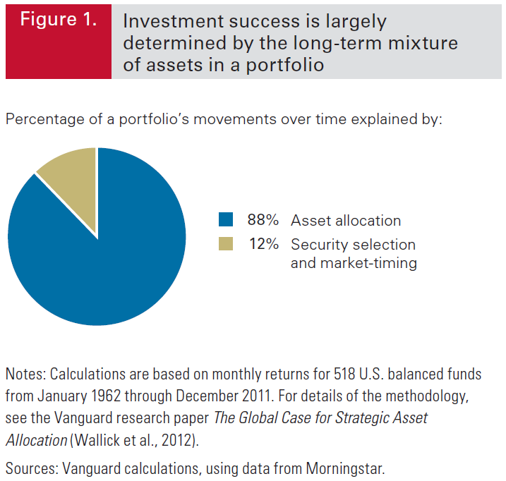
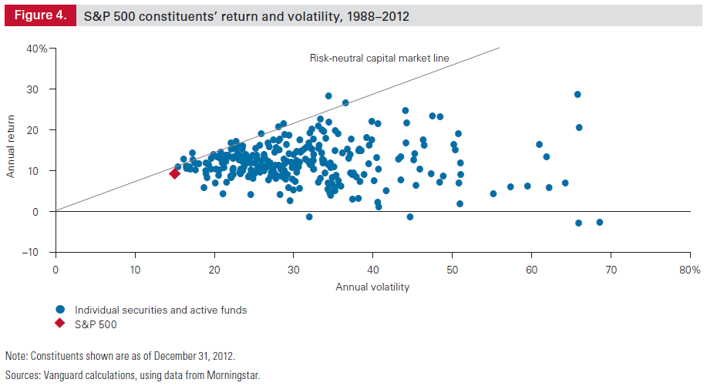
Allocation Drives Returns
Why the asset-class mix matters more than stock picking
88%
12%
of return variability
explained by asset allocation
from security selection
& market timing combined
Single-stock dispersion (S&P 500, 1988–2012) shows how wide and risky individual outcomes are — the case for diversifying.
21

Slide 22
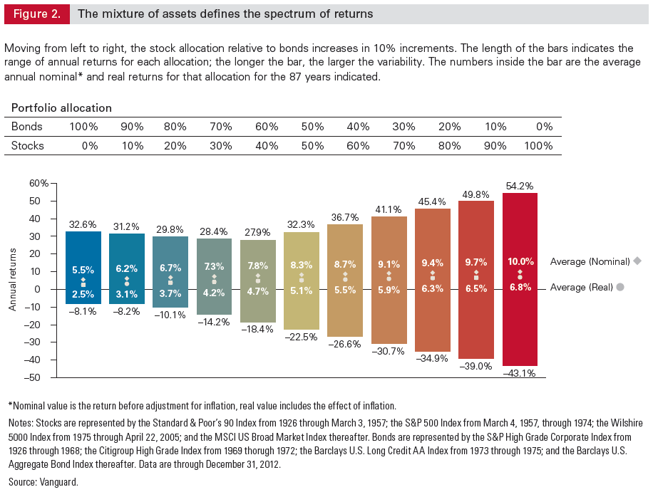
Rebalancing Discipline
More frequent rebalancing rarely pays for its costs
What the data shows
Across monthly, quarterly and annual rules for a 60/40 portfolio, returns and risk are remarkably similar.
Rebalancing more often raises turnover and cost without materially improving the outcome.
The discipline matters more than the frequency — rebalance on a sensible threshold, then leave it alone.
Source: Vanguard research; historical 60/40 equity/bond portfolio, 1926–2015.
22

Slide 23
Key Takeaways — Lecture 6
1
Asset allocation is the single largest driver of long-run results — roughly 88% of return variability — far outweighing security selection and market timing.
NEXT
2
Every allocation decision rests on three factors: time horizon, risk tolerance, and financial situation. The profile, from Flexible Income to Strategic Growth, follows from these.
Lecture 7
Portfolio Optimization
3
There are five strategy types: strategic, constant-weighting, tactical, dynamic, and insured / integrated — ranging from a fixed buy-and-hold mix to a fully active process.
4
S.A.A. sets the long-run anchor from a factor model; T.A.A. adds bounded active weights to exploit conditions, then reverts to the anchor.
5
The June 2026 example shows the method in action: ECB tightening, record US equities and an energy shock translate into a defensive, cash-heavier tactical tilt.
6
Rebalancing discipline beats rebalancing frequency — a sensible threshold captures the benefit without the cost of constant trading.
23

