Slide 1


MSc International Shipping, Finance & Management
Data Gathering
& Analysis
"Garbage in, garbage out…"
Theodore N. Krintas, CIIA, Ph.D.
Athens University of Economics and Business
Lecture 5 of 8 · May – July 2026

Slide 2
Why Data Quality Matters
"Garbage in, garbage out"
No analytical model, however sophisticated, can compensate for poor, incomplete, or biased input data. Investment decisions are only as good as the information on which they rest.
01
Accuracy
02
Timeliness
Data must correctly reflect the underlying reality — prices, volumes, financials, macro indicators.
Stale data is dangerous. Real-time and delayed feeds serve different decision types.
03
Completeness
04
Consistency
Missing data points can skew analysis — survivorship bias, gaps in time series, incomplete disclosures.
Definitions must be comparable across sources, time periods, geographies, and currencies.
05
Source Credibility
06
Context
Know your vendor: regulated, audited, primary vs. aggregated. Understand the chain of custody.
Raw numbers need framing — sector, cycle, peer group, history. Data without context misleads.
2

Slide 3

Data Platform · Part 1
Thomson
Reuters
◈ Global Market News
◈ Market Data & FX
◈ Research & Analysis
◈ Datastream

Slide 4
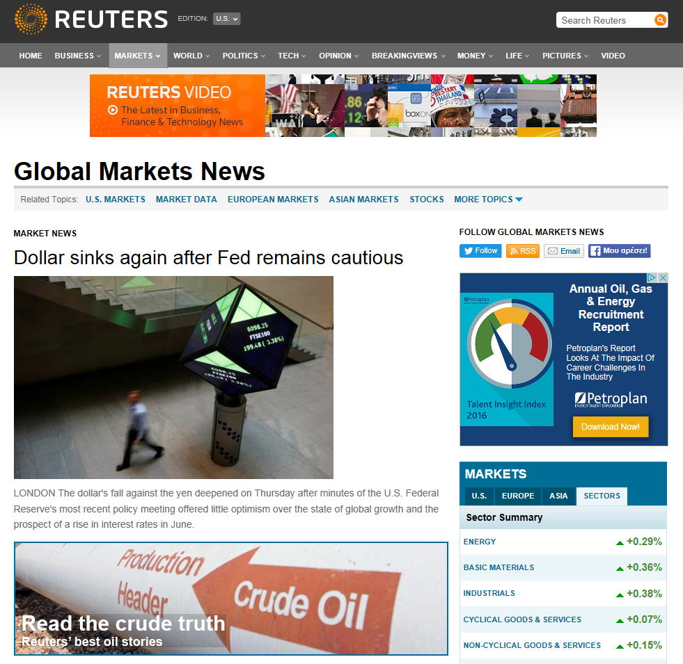
Reuters: Global Market News
Source: reuters.com
Breaking News Feed
Real-time headlines across markets, geopolitics, and economics. Essential for intraday context.
Sector Market Data
Live U.S./Europe/Asia sector summaries with % moves, embedded directly in the news stream.
Multi-Format Coverage
Articles, video, and data in one place — Reuters Video, BreakingViews opinion, and primary news.
Global Reach
Americas, EMEA, and Asia Pacific — all covered via a single integrated platform.
4

Slide 5
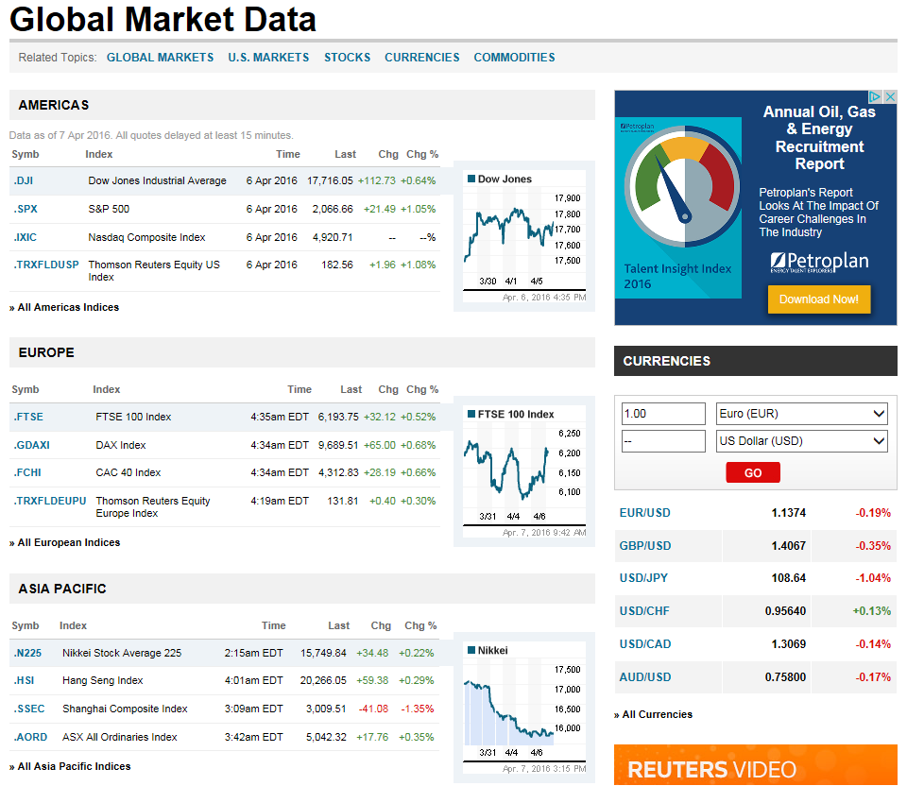
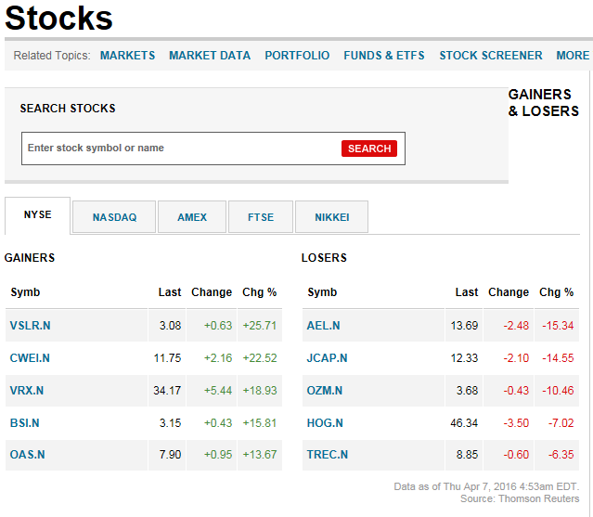
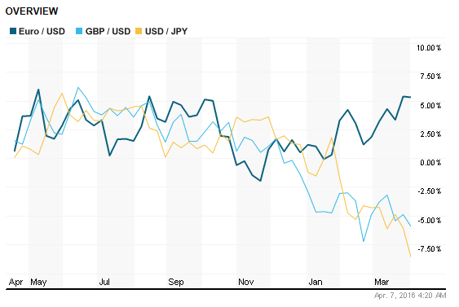
Source: reuters.com / markets
Reuters: Global Market Data — Equities & FX
Global Market Data
Stocks Screener
FX Rate Overview
Gainers/losers across NYSE, NASDAQ, FTSE, Nikkei in real time.
EUR/USD, GBP/USD, USD/JPY — 1-year normalised return chart.
Reuters.com provides free, real-time global market data — equities, FX, and commodities — across Americas, EMEA, and Asia Pacific, with integrated charting and sector summaries.
5

Slide 6
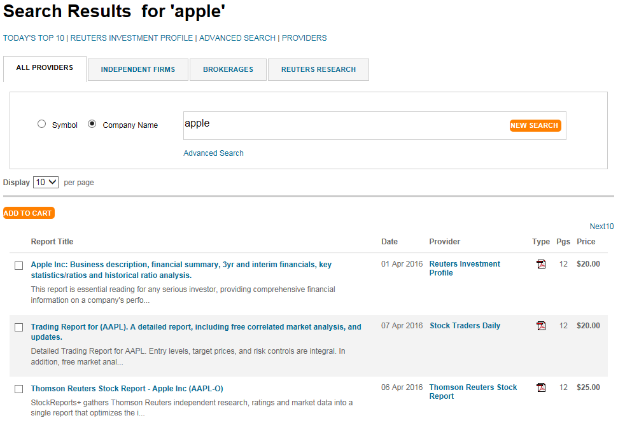
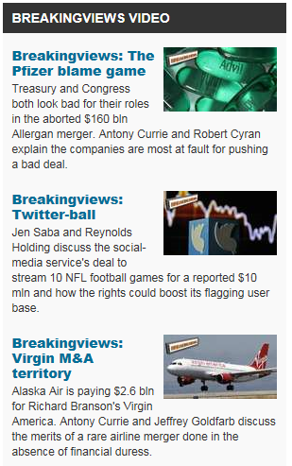
Reuters: Research Reports & BreakingViews
Source: reuters.com / research
Analyst Research Portal
BreakingViews Commentary
◈ Multi-provider research
◈ Report types & pricing
◈ BreakingViews editorial
Search across Independent Firms, Brokerages, and Reuters Research in one unified portal.
Investment profiles, stock reports, trading reports — from free to paid tiers (e.g. $20–$25/report).
Opinion-based analysis on M&A, policy, and corporate events from Reuters' specialist commentary team.
6

Slide 7
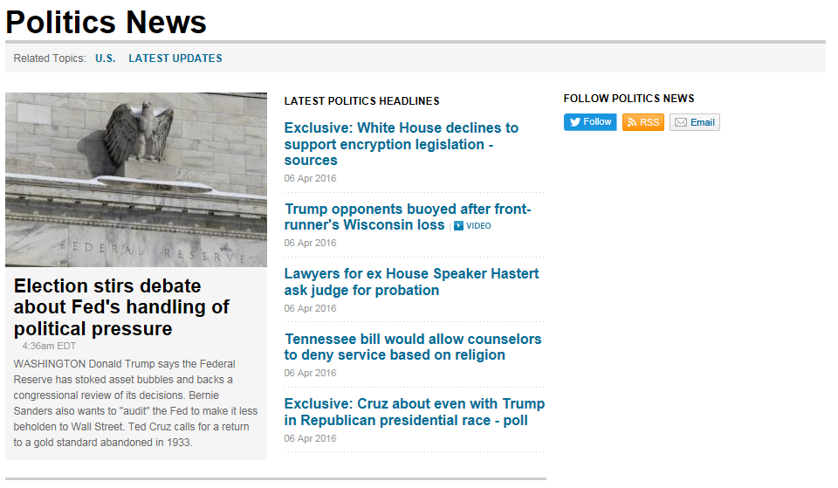
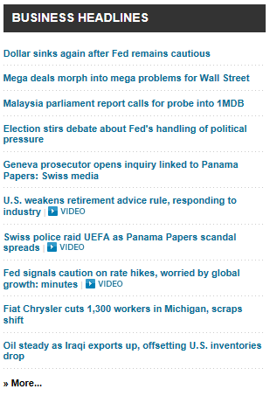
Reuters: News Coverage — Politics, Policy & Business
Politics News
Business Headlines
Why Political & Macro News Matters to Wealth Managers
Policy decisions (Fed rates, election outcomes, trade legislation) directly reprice asset classes.
M&A news and corporate events create event-driven investment opportunities and risk.
Cross-referencing political and business news reduces blind spots in fundamental analysis.
7

Slide 8
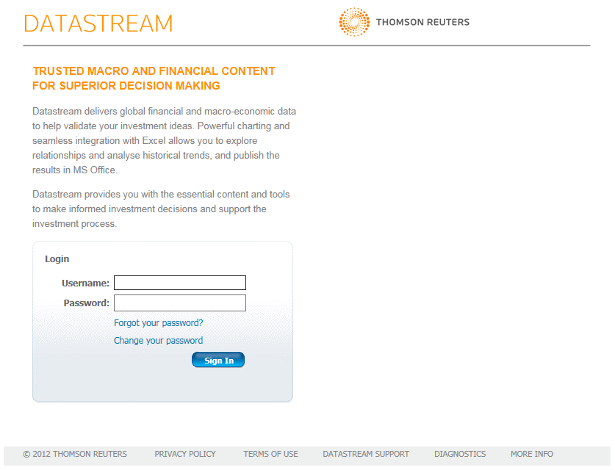
Thomson Reuters Datastream
Source: Thomson Reuters
Global Financial & Macro Data
Covers equities, fixed income, derivatives, currencies, commodities, and economic indicators across 175+ countries.
Historical Depth
Long time series going back decades — essential for backtesting, regression analysis, and cycle research.
Excel Integration
Seamless pull of data directly into Excel for modelling, charting, and quantitative analysis via Datastream Add-In.
Validation & Audit Trail
Data is quality-controlled and timestamped — critical for academic research, regulatory reporting, and CFA-grade analysis.
Datastream is the standard professional-grade research database for quantitative analysis in academia and institutional wealth management — used across CFA research, peer-reviewed finance studies, and portfolio backtesting.
8

Slide 9

Data Platform · Part 2
Bloomberg
Terminal
◈ Equity Index Screens
◈ Intraday Market Map
◈ Price Charts & Technicals
◈ Financial Analysis & Fundamentals
◈ Earnings Estimates
◈ Economic Calendar
◈ Multi-Asset Monitor

Slide 10
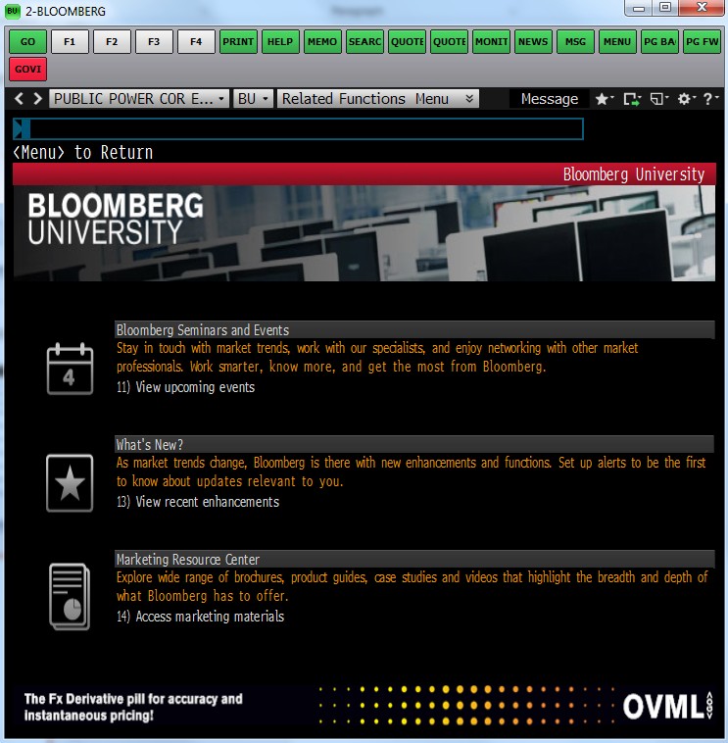
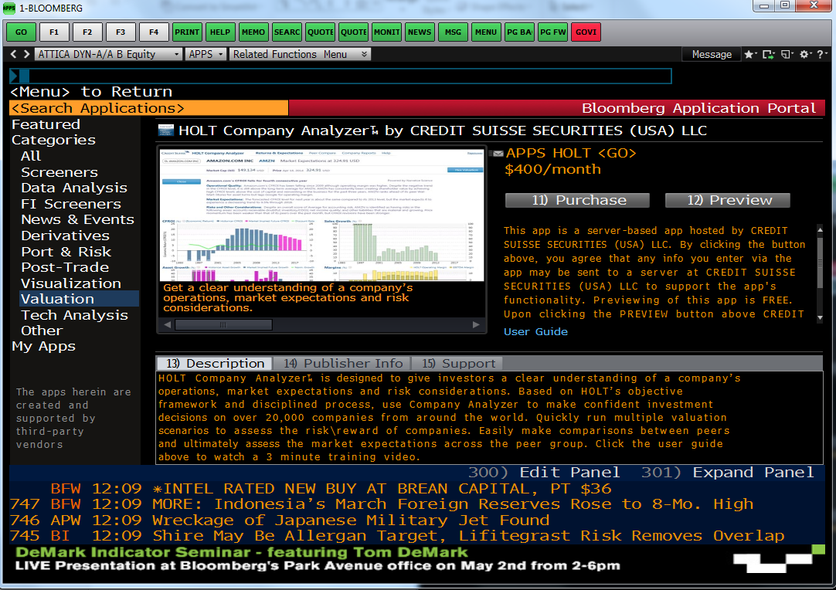
Bloomberg: Getting Started — University & Apps
Source: Bloomberg Terminal
Bloomberg University <BU GO>
Application Portal <APPS GO>
Bloomberg University
Application Portal
Command Language
Training videos, seminars, and certifications. Essential for mastering functions and data sources on the Terminal.
Third-party apps (e.g. HOLT Analyzer, Credit Suisse valuation tools) extend Terminal capability — some with additional fees.
Bloomberg functions accessed via tickers + mnemonics (e.g. AAPL US <Equity> FA <GO>). Learning the language is key.
10

Slide 11
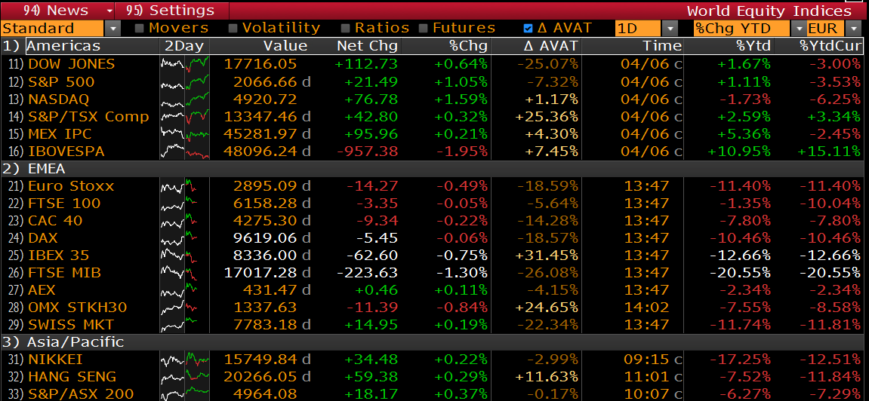
Bloomberg: World Equity Indices Screen <WEI GO>
Real-Time Prices
Multi-Region View
YTD Performance
Movers & Volatility
Live index levels with net change, % change, and AVAT (average volume at time) — all in one screen.
Americas, EMEA, and Asia/Pacific indices on one page — instant global market pulse.
Year-to-date return in local currency and EUR — critical for cross-border portfolio comparison.
Toggle to Movers, Volatility, Ratios, Futures — each view restructures the data for different use cases.
11

Slide 12
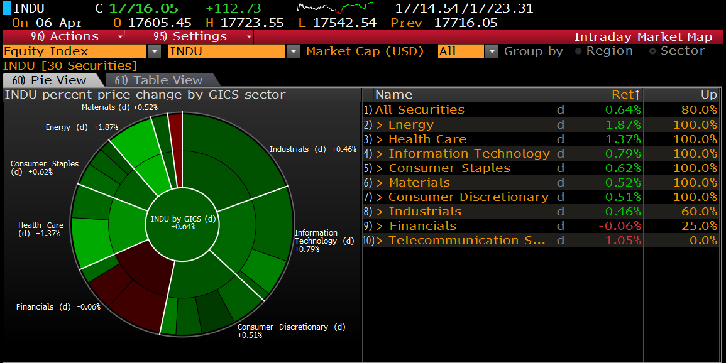
Bloomberg: Intraday Market Map & Sector Analysis
Bloomberg <IMAP GO>
GICS Sector Breakdown
Visual pie chart of index (e.g. INDU) by GICS sector — segment size = market cap weight, colour = direction.
Intraday % Return
Each sector labelled with its daily % change — green = positive, red = negative — updated in real time.
Sector Drill-Down
Click any sector to list constituent securities with individual returns and % of securities advancing.
Pie vs Table View
Toggle between visual pie (60) and tabular view (61) for different analytical preferences.
The Market Map is a wealth manager's intraday radar — immediately revealing where risk appetite is flowing and which sectors are leading or lagging, without reading a single headline.
12

Slide 13
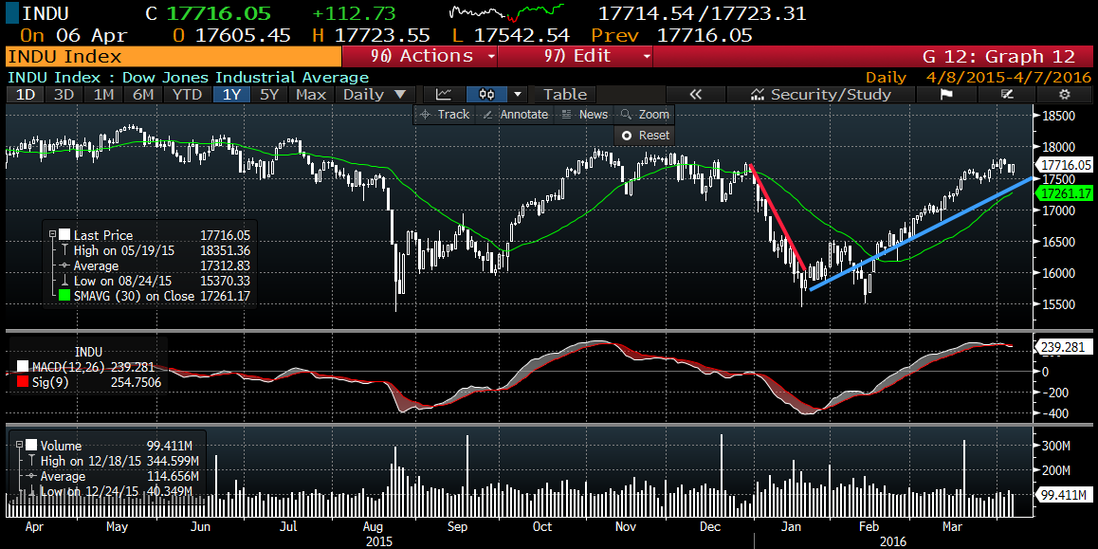
Bloomberg: Price Charting & Technical Analysis <GP GO>
Candlestick Charting
Volume Analysis
Time Range Flexibility
Annotations & Studies
OHLC daily bars with customisable overlays — MACD, SMA, Bollinger Bands, trend lines.
Volume bars at bottom panel signal conviction behind price moves — key for confirmation.
1D, 3D, 1M, 6M, YTD, 1Y, 5Y, Max — zoom in or out instantly for short-term or long-term perspective.
Draw trend lines, mark events, add news overlays, and compare multiple securities on one chart.
13

Slide 14
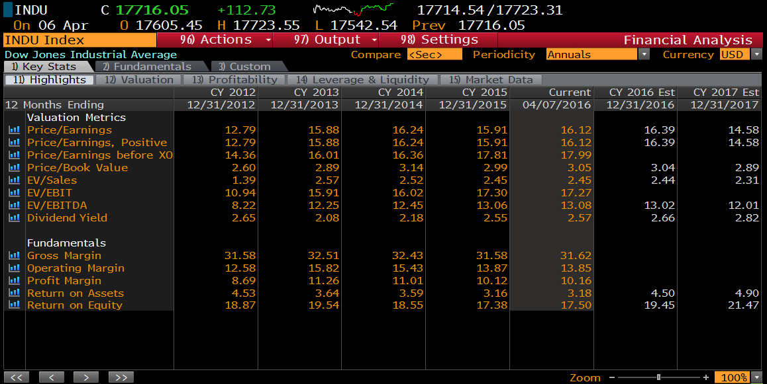
Bloomberg: Financial Analysis & Valuation <FA GO>
Bloomberg <FA GO>
Valuation Multiples
Profitability Ratios
Consensus Estimates
Tabs Navigation
P/E, P/B, EV/Sales, EV/EBIT, EV/EBITDA, Dividend Yield — current + historical CY2012–present.
Gross, Operating, Net margins; Return on Assets and Equity — longitudinal trend visible at a glance.
Forward CY2016 and CY2017 estimates embedded alongside actuals — analyst expectations in context.
Highlights → Valuation → Profitability → Leverage & Liquidity → Market Data in one <FA GO> screen.
14

Slide 15
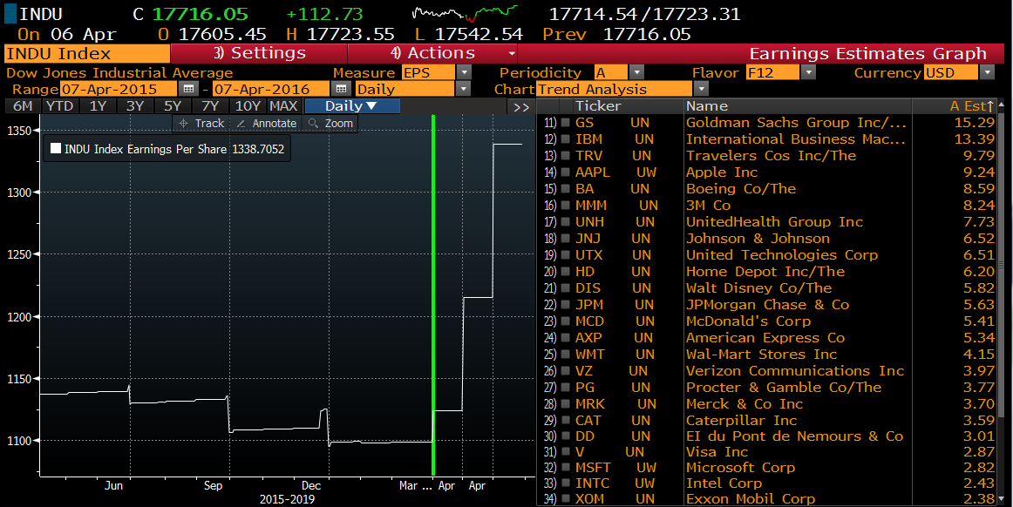
Bloomberg: Earnings Estimates Graph <EEG GO>
Index EPS Trend
Constituent EPS Ranking
Flavour Options
Peer Benchmarking
Visualises aggregate earnings-per-share over time for any index — reveals earnings cycle vs. price divergence.
All 30 Dow Jones constituents ranked by analyst EPS estimate — Goldman Sachs to Exxon, in one sorted list.
F12 = next 12 months forward, Annual, Custom period — adaptable to different investment horizons.
Compare individual company EPS to its sector or index aggregate — quickly identify under/outperformers.
15

Slide 16
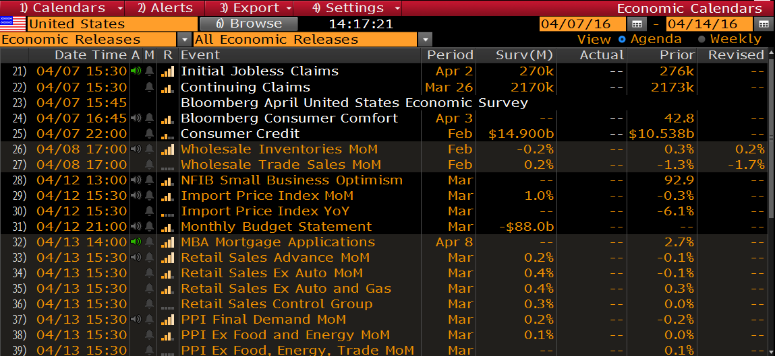
Bloomberg: Economic Calendar <ECAL GO>
Bloomberg <ECAL GO>
Event-by-Event Feed
Survey vs. Actual
Country Filter
Forward Calendar
Date, time, indicator name, survey consensus, actual result, prior reading, and revision — all in one row.
Instantly spot surprises — actual vs. consensus deviation drives short-term market price reactions.
Filter by country (US, EU, UK, China) and event importance level to focus on market-moving releases.
See what's coming — scroll ahead by week to plan for upcoming data releases affecting client portfolios.
16

Slide 17
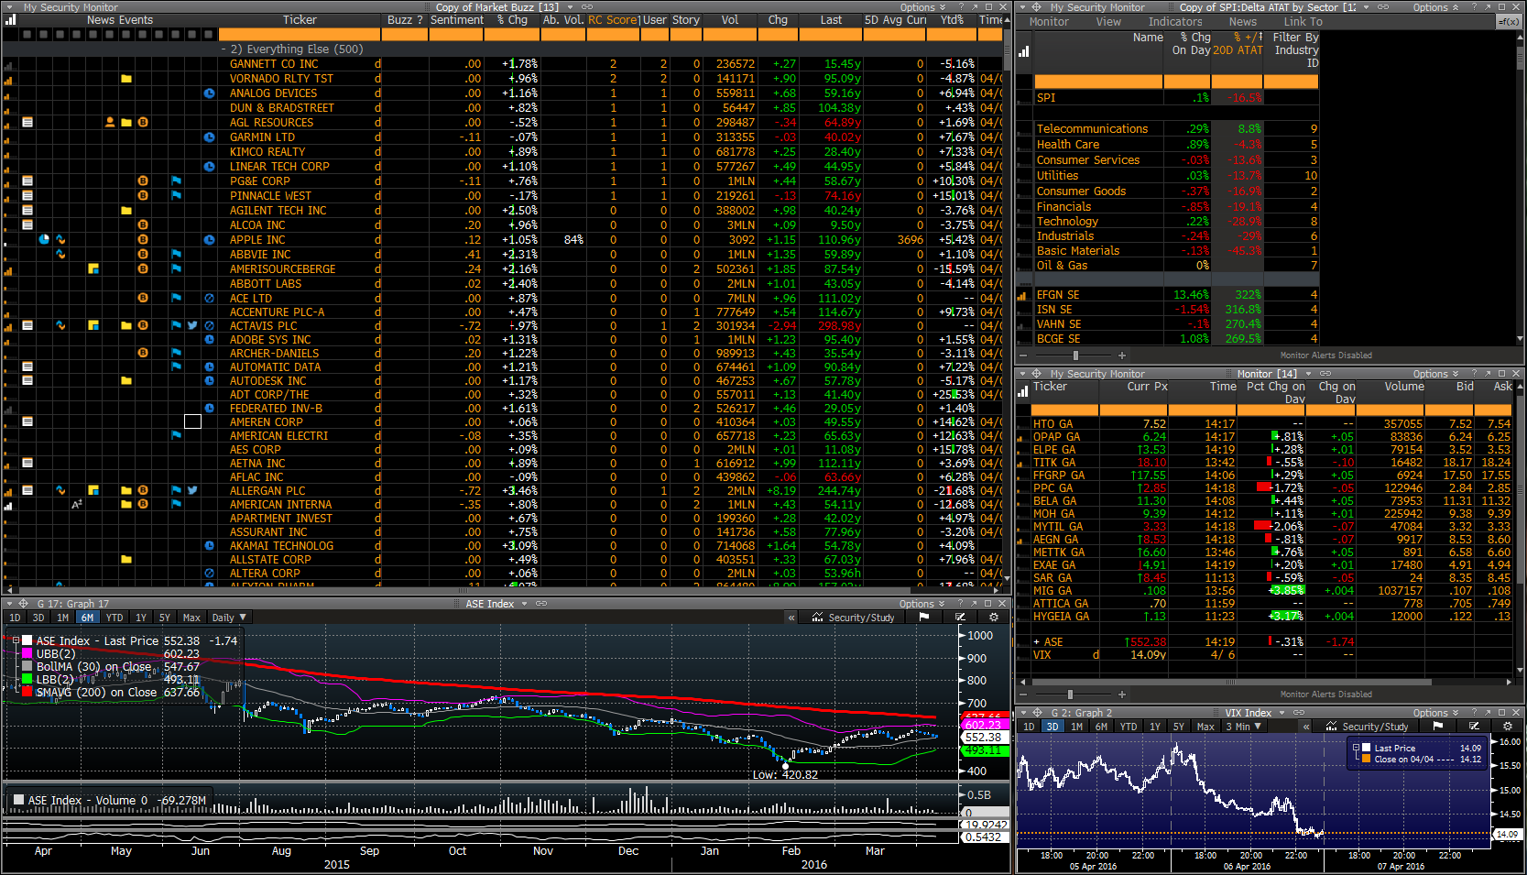
Bloomberg: Multi-Asset Professional Monitor
Security Monitor
Sector Delta (SPI)
Greek Market View
VIX Monitoring
Custom watchlist with live bid/ask, volume, sentiment, and RC Score — global and local stocks side by side.
Real-time sector contribution analysis — which industries are moving the index on the day.
ASE Index chart + Greek equities (OPAP, TITK, banks) — local market monitoring within the global platform.
Volatility index (VIX) intraday chart embedded in the workspace — risk-off signals visible at all times.
17

Slide 18

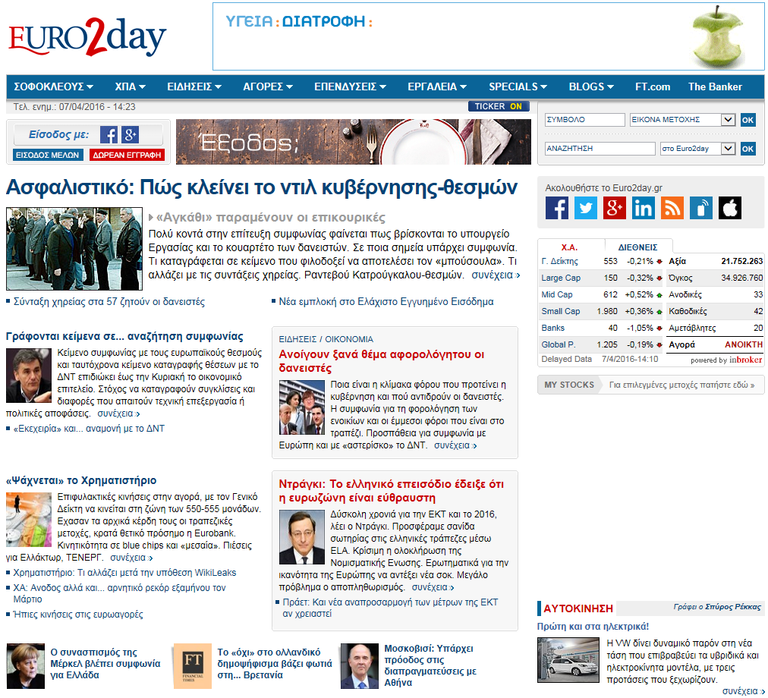

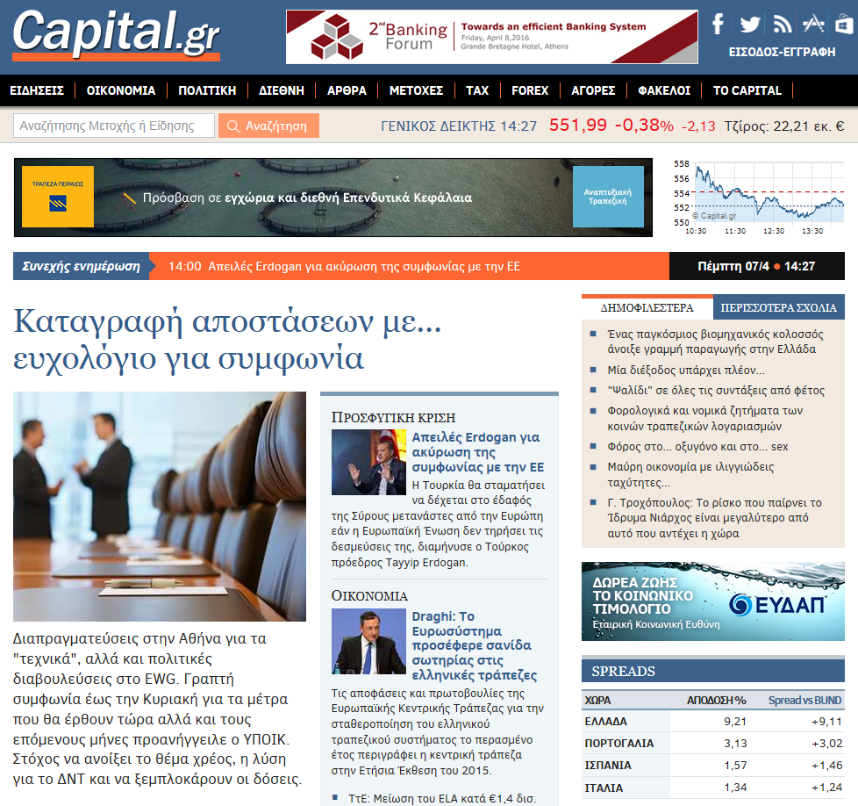
Local Players: Greek Financial Data Platforms
Athens Stock Exchange ecosystem
euro2day.gr — Greek Market News & Data
GlobalSoft (Profile)
Professional Greek equities and fixed income data provider — used by institutional players on the ASE. Feeds into Bloomberg, Reuters, and proprietary systems.
capital.gr — Financial News & ASE Spreads
Inforex S.A.
Greek-market financial data aggregator providing real-time prices, corporate announcements, and historical data for the Athens Stock Exchange.
18

Slide 19
Key Takeaways — Lecture 5
Data quality is the foundation of sound investment analysis — accuracy, timeliness, completeness, consistency, credibility, and context are the six pillars.
Thomson Reuters provides tiered access: free news and market data via reuters.com, professional research via the analyst portal, and institutional-grade historical data via Datastream.
Bloomberg Terminal is the standard professional tool: a single integrated environment covering live prices, charting, fundamentals, earnings, economics, and news via a command-based interface.
Key Bloomberg functions for wealth management: WEI (equity indices), IMAP (market map), GP (charts), FA (financial analysis), EEG (earnings estimates), ECAL (economic calendar).
Political and macro news are inseparable from market data — policy decisions, elections, and central bank actions reprice asset classes and must be tracked alongside quantitative data.
Local Greek platforms (euro2day.gr, capital.gr, GlobalSoft, Inforex) provide ASE-specific data, corporate announcements, and sovereign spread feeds not fully covered by global vendors.
The professional data workflow: news → market data → company fundamentals → economic context → portfolio monitoring — each layer adds depth and reduces analytical blind spots.
Next: Lecture 5
Portfolio Construction & Modern Portfolio Theory
19

