Slide 1


MSc International Shipping, Finance & Management
Investment
Building Blocks
Asset Classes · Allocation · Strategies
Theodore N. Krintas, CIIA, Ph.D.
Athens University of Economics and Business
Lecture 3 of 8 · May – July 2026

Slide 2
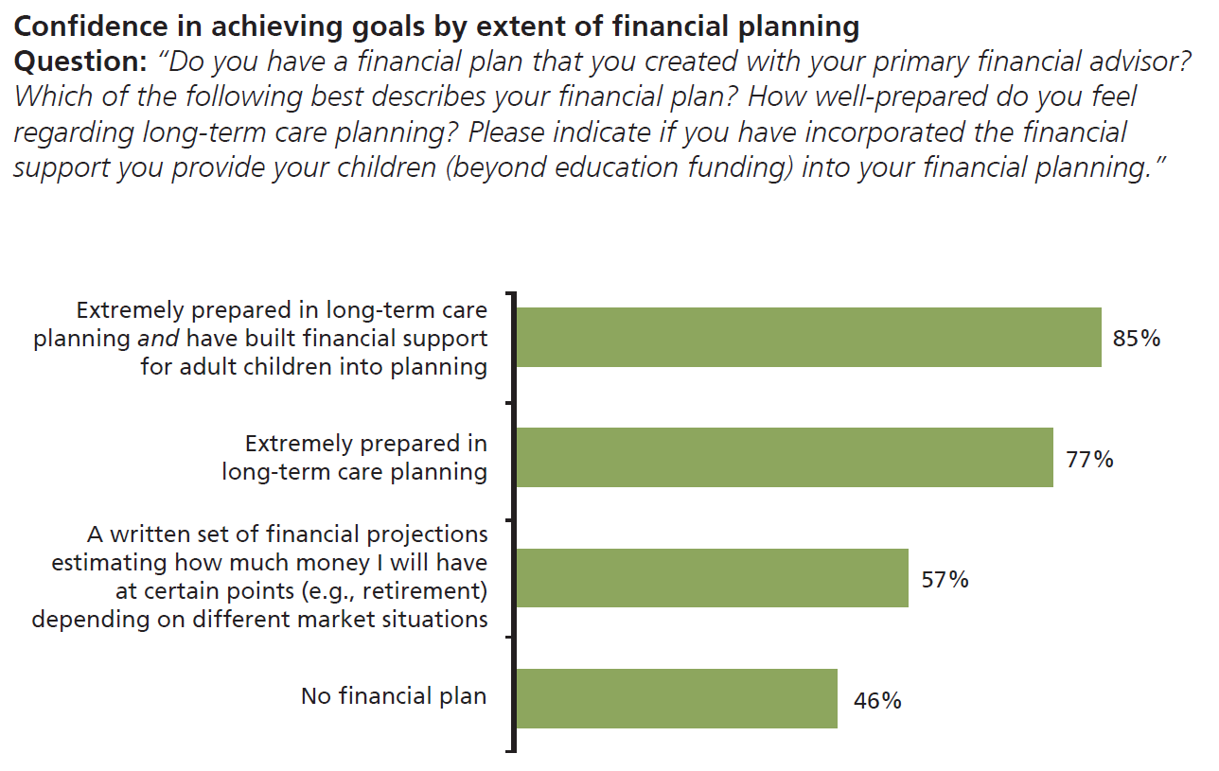

Research Spotlight: Client Confidence & Planning
Key Finding
Investors with a comprehensive financial plan — including long-term care and adult-child support — report 85% confidence in achieving their goals, vs. only 46% for those with no financial plan.
85%
With full financial plan
(incl. long-term care + children)
77%
Extremely prepared in
long-term care planning
46%
Confidence with
no financial plan
2

Slide 3
Research Spotlight: Investor Demographics
AGE EFFECTS
Younger Investors & Healthcare Costs in Retirement
Younger investors are significantly more concerned than older investors about affording healthcare costs and long-term care in retirement — issues still decades away. This forward-looking anxiety stems from watching parents navigate these challenges now, and from the complexity and uncertainty of future care availability and costs.
GENDER EFFECTS
Men & the Extension of the Provider Role
Men are significantly more likely than women to feel financially responsible for multiple generations — adult children, grandchildren, and parents — and derive greater satisfaction from providing that support. This shapes their longer time horizons and higher tolerance for inter-generational financial commitments.
3

Slide 4
Research: Asset Allocation — Theory vs. Practice
Finding 1
Inadequate advisory practice extends beyond HNW clients
If private wealth managers — who have more time, fewer clients, and greater resources than retail bankers — still provide insufficient investment advice, retail clients face an even steeper challenge accessing sound guidance. The problem is structural, not individual.
Finding 2
Modern allocation models exist but are rarely implemented
The survey finds that insufficient advice in private banking is not due to a lack of appropriate tools or concepts. Rather, modern allocation strategies simply are not adopted in practice. More training for practitioners could significantly increase investment returns for private clients.
Implication for practitioners: bridgeable gap between financial theory and practice will materially improve portfolio quality for private investors.
4

Slide 5
Asset Allocation Strategies: Practitioner Evaluation
Table 3 — Schröder (2013): Scores on 0–6 Likert scale (0=not useful, 6=very useful)
Strategy | Response Rate | (1) Spending Objectives | (2) Risk Prefs & Time Horizon | (3) Client Comms | Avg.
Mean-Variance Analysis | 76% | 0.95 | 1.58 | 1.56 | 1.36
Black-Litterman Model | 41% | 0.66 | 1.30 | 1.15 | 1.04
Asset-Liability Management | 65% | 1.34 | 1.54 | 1.59 | 1.49
Goal-Based Allocation | 67% | 1.51 | 1.72 | 1.61 | 1.61
Life-Cycle Portfolio Choice | 53% | 1.28 | 1.56 | 1.42 | 1.42
Portfolio Insurance (CPPI/OBPI) | 41% | 0.98 | 1.42 | 1.33 | 1.24
Dynamic Risk Budgeting | 55% | 1.15 | 1.53 | 1.33 | 1.34
Average | 57% | 1.12 | 1.52 | 1.43 | —
Goal-based allocation scores highest (avg 1.61) across all three dimensions — signalling practitioner preference for client-goal-anchored frameworks over abstract mean-variance optimisation.
5

Slide 6
Investment Risks & Parameters: Perceived Importance
Table 4: Investment Risks
Table 5: Investment Parameters
Likert scale 0–6 · Avg response rate 92.5%
Likert scale 0–6 · Avg response rate 95.2%
Stock-market risk
4.78
Client's risk aversion
5.07
Currency risk
4.16
Client's time horizon
4.93
Interest rate risk
4.05
Inflation risk
3.75
Nature of client's income
3.62
Business cycle risk
3.39
Current market conditions
3.54
Underperforming market
3.15
Specific spending objectives
3.48
Income / Professional
2.61
Longevity risk
2.51
General spending objectives
3.18
6

Slide 7
Incorporating Client Parameters Into Portfolios
Table 6 — Schröder (2013): How private wealth managers incorporate key client parameters
Panel A: Risk-Aversion
Panel B: Investment Time Horizon
n=157 respondents
n=153
Asset allocation from client utility function
40%
Life-cycle of assets
48%
Risk budgeting (VaR, CVaR, volatility)
46%
Mean-reverting asset class modelling
27%
Floor on wealth / maximum drawdown
43%
Dynamic risk budget constraints
34%
Portfolio optimisation incl. risk objectives
43%
Panel C: Spending Objectives
Panel D: Income Risk
n=153
n=156
Controlling spending-objective risk
33%
Yes — income risk incorporated
64%
Capacity to meet future spending objectives
50%
No
36%
Separation: performance vs. coverage portfolio
42%
7

Slide 8
Dynamic Allocation & Quantitative Models in Practice
MSc ISFM · Wealth Management · Lecture 3 of 8
Tables 7 & 8 — Schröder (2013)
Table 7: Dynamic Asset Allocation
Table 8: Quantitative Market Models
Panel A: Rebalancing
Use quantitative models: Yes
23%
Frequent rebalancing of weights
69%
Buy-and-hold over longer periods
31%
Correlated random walks
33% of Yes
Panel B: Optimisation technique
Mean-reverting models
63% of Yes
Multi-period optimisation
45%
Repeated single-period optimisation
55%
Markov-switching
10% of Yes
Panel C: Life-cycle implementation
Use quantitative models: No
77%
Use existing target-date funds
30%
Design specific allocation per client
70%
Key Insight
70% of wealth managers design client-specific life-cycle allocations, yet only 23% use quantitative market models — confirming that qualitative judgement dominates over model-driven approaches in private wealth practice.
8

Slide 9
The Investment
Building Blocks
All ingredients matter…
◈ Asset Classes
◈ Risk & Return
◈ Diversification
◈ Timing
◈ Volatility
◈ Strategies

Slide 10
Asset Classes: Benefits & Risks
Cash
Benefits
Risks
◈ Liquid; provides stable, predictable growth
▲ Lowest expected returns of all asset classes
◈ Best for short-term, conservative investors
▲ Returns may not keep pace with inflation
Bonds
◈ Historically better returns than cash
▲ Historically lower returns than equities
◈ Less volatile than equities
▲ Vulnerable to inflation & interest rate changes
Property
◈ Risk/return historically between equities & bonds
▲ Illiquid asset class
◈ Can outperform or underperform periodically
▲ Property bubbles can inflict large losses
Equities
◈ Historically highest long-term return
▲ Most volatile asset class
◈ Suitable for long time horizons
▲ Subject to market crashes and cyclical downturns
10

Slide 11
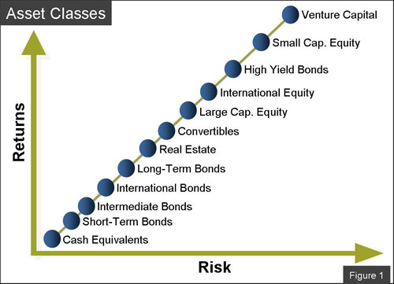
Assets & Returns: The Risk/Return Spectrum
Higher risk → higher expected return
The spectrum runs from cash equivalents (lowest risk/return) to venture capital (highest). The relationship is directional but not guaranteed.
Bonds sit between cash and equities
Long-term bonds carry duration risk; high-yield bonds add credit risk — moving them up the spectrum toward equity-like returns.
Diversification across the spectrum
Combining asset classes with different risk profiles can improve the portfolio's overall risk-adjusted return — the foundation of MPT.
Real assets occupy the middle
Real estate and convertibles sit mid-spectrum: moderate volatility but valuable as inflation hedges and diversifiers.
11

Slide 12
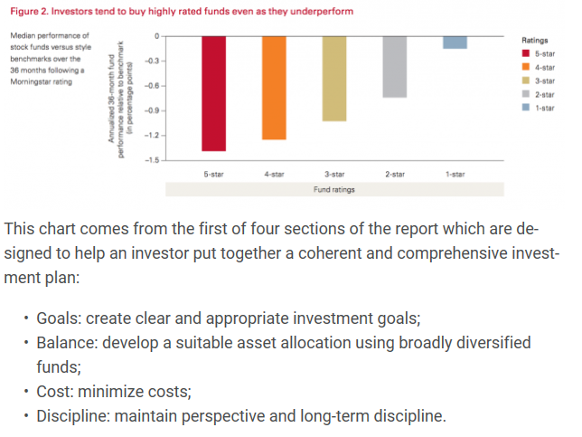
Asset Classes: The Ratings Paradox & Investor Goals
◎ Goals
Create clear and appropriate investment goals aligned to client life priorities.
◎ Balance
Develop suitable asset allocation using broadly diversified, low-cost funds.
◎ Cost
Minimise costs — fees compound just as returns do, eroding wealth over time.
Investors systematically chase 5-star rated funds — yet all ratings underperform their benchmark over the subsequent 36 months. Past ratings are poor predictors of future performance.
◎ Discipline
Maintain perspective and long-term discipline — avoid chasing ratings or trends.
12

Slide 13

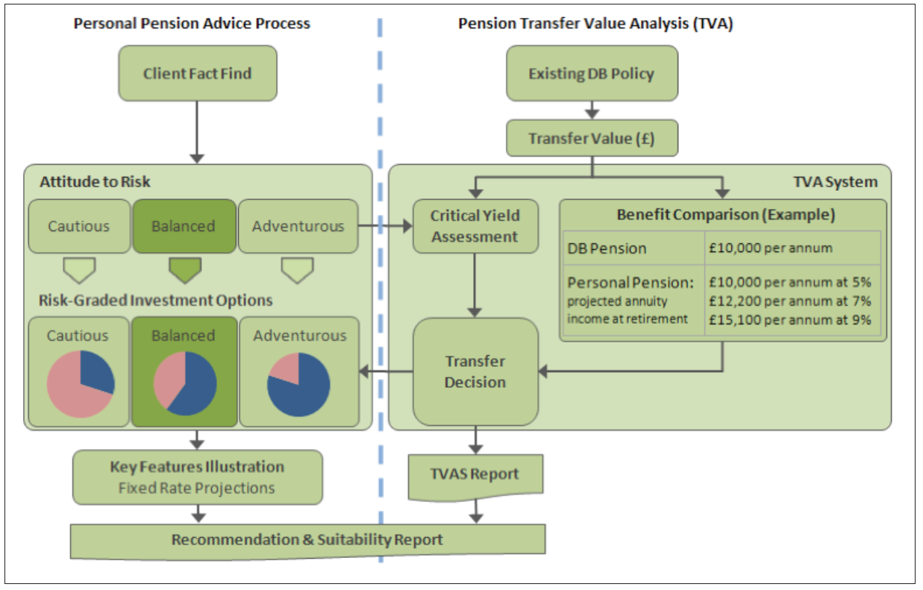
Pension Transfer Value Analysis
Integrating DB pension decisions into the client's broader wealth plan
Client Fact Find first
Attitude to risk drives investment options: Cautious, Balanced, or Adventurous profiles determine risk-graded allocations.
Critical Yield Assessment
Transfer Value Analysis system compares DB pension income to projected personal pension returns at 5%, 7%, and 9% growth.
Transfer Decision
Only if projected personal pension benefits can match or exceed DB pension income should a transfer be recommended.
Suitability Report required
All recommendations must be documented in a Key Features Illustration and full Suitability Report per regulatory standards.
13

Slide 14
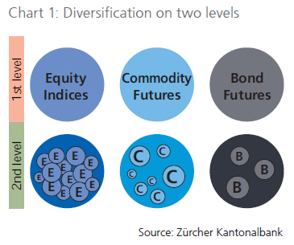

Diversification: Two Levels of Risk Reduction
1st Level
Cross-Asset Class Diversification
Combining Equity Indices, Commodity Futures, and Bond Futures reduces exposure to any single market's systematic risk. Each asset class responds differently to economic conditions.
2nd Level
Within-Asset-Class Diversification
Further granularity by diversifying within each class — individual equities within an index, individual commodities within futures, multiple bond issues. This reduces idiosyncratic risk.
Key Level
Diversification does not eliminate risk
Systematic (market-wide) risk cannot be diversified away. Diversification reduces idiosyncratic risk, but investors are always exposed to common macroeconomic factors.
14

Slide 15
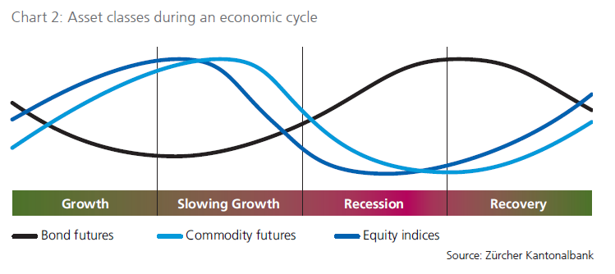
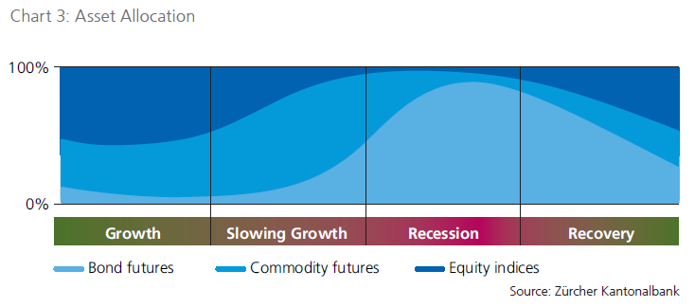
Timing: Asset Classes Through the Economic Cycle
15

Slide 16
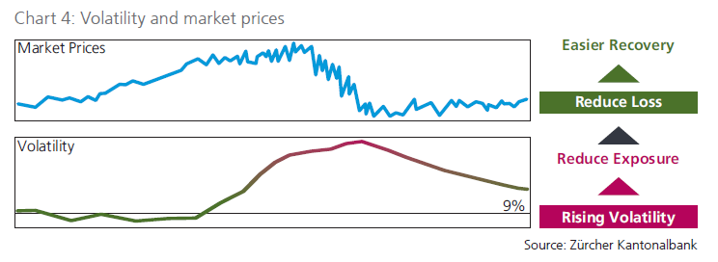
Volatility: Reading the Signal & Managing Exposure
Rising Volatility
Reduce Exposure
As volatility climbs, reduce portfolio risk before drawdowns accelerate. Pre-emptive derisking protects capital.
Peak Volatility
Reduce Loss
At extreme volatility peaks, further defensive positioning limits downside. Avoid panic selling at absolute lows.
Falling Volatility
Rebuild Position
As volatility subsides and prices stabilise, begin scaling back into risk assets to capture recovery upside.
Easier Recovery
Full Participation
Low-volatility recovery: portfolio fully deployed. Volatility monitoring continues to anticipate the next cycle.
16

Slide 17
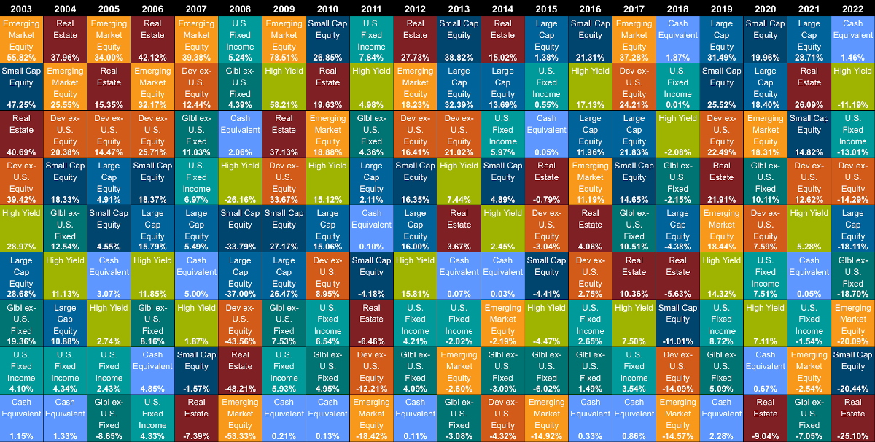
Periodic Returns: The Callan Table
Callan Periodic Table of Investment Returns — Year-End 2022 · 20-year cross-asset class performance ranking
No single asset class consistently leads. The table's shuffling pattern is the strongest empirical argument for broad diversification — last year's winner is often next year's laggard.
17

Slide 18
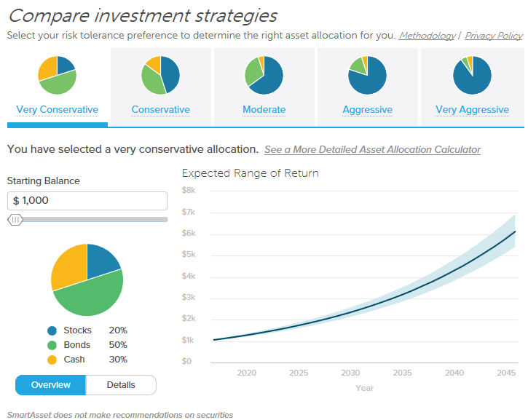
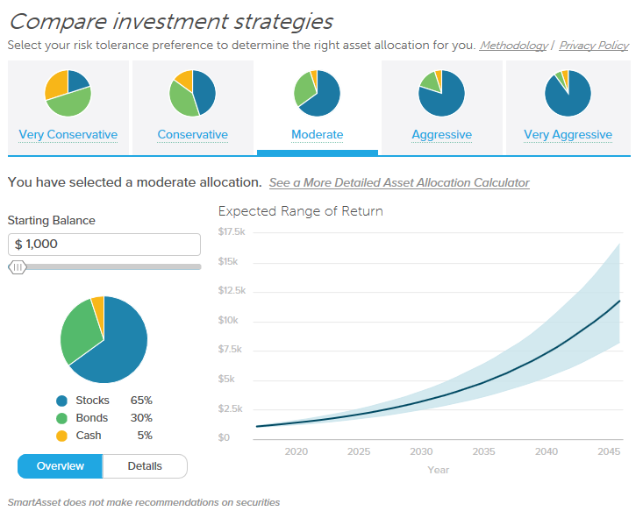
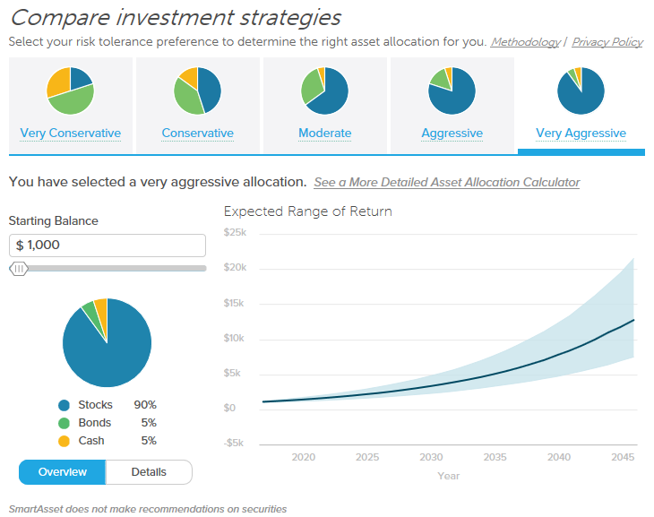
Investment Strategies: Risk Profile Comparison
Very Conservative
Moderate
Very Aggressive
Stocks 20% Bonds 50% Cash 30%
Stocks 65% Bonds 30% Cash 5%
Stocks 90% Bonds 5% Cash 5%
Short-term / capital preservation
Medium-term / balanced growth
Long-term / maximum growth
Suitable for investors near or in retirement, or with very low risk tolerance.
Balanced exposure — captures equity growth while maintaining fixed income buffer.
For long time horizons and high risk tolerance — maximum equity participation, wide return range.
18

Slide 19
Key Takeaways — Lecture 3
Research confirms that comprehensive financial planning dramatically improves investor confidence — with structured plans correlating to 85% confidence vs. 46% without.
Private wealth managers favour goal-based and asset-liability allocation models, yet modern quantitative tools remain underutilised in practice (only 23% use quant market models).
Each asset class — cash, bonds, property, equities — carries a distinct risk/return profile. No class consistently outperforms: the Callan table illustrates persistent rotation.
Diversification operates on two levels: across asset classes (systematic risk reduction) and within asset classes (idiosyncratic risk reduction).
Volatility is a signal, not just noise — rising volatility triggers exposure reduction; fading volatility is the re-entry cue.
Asset class performance is cycle-dependent. Bonds lead in recession; equities in growth. Tactical timing, informed by economic cycle positioning, enhances risk-adjusted returns.
Investment strategy selection must reflect the client's risk tolerance and time horizon — from very conservative (20/50/30) to very aggressive (90/5/5) allocations.
Next: Lecture 4
Portfolio Construction, Risk Management & Performance Measurement
19

