Slide 1

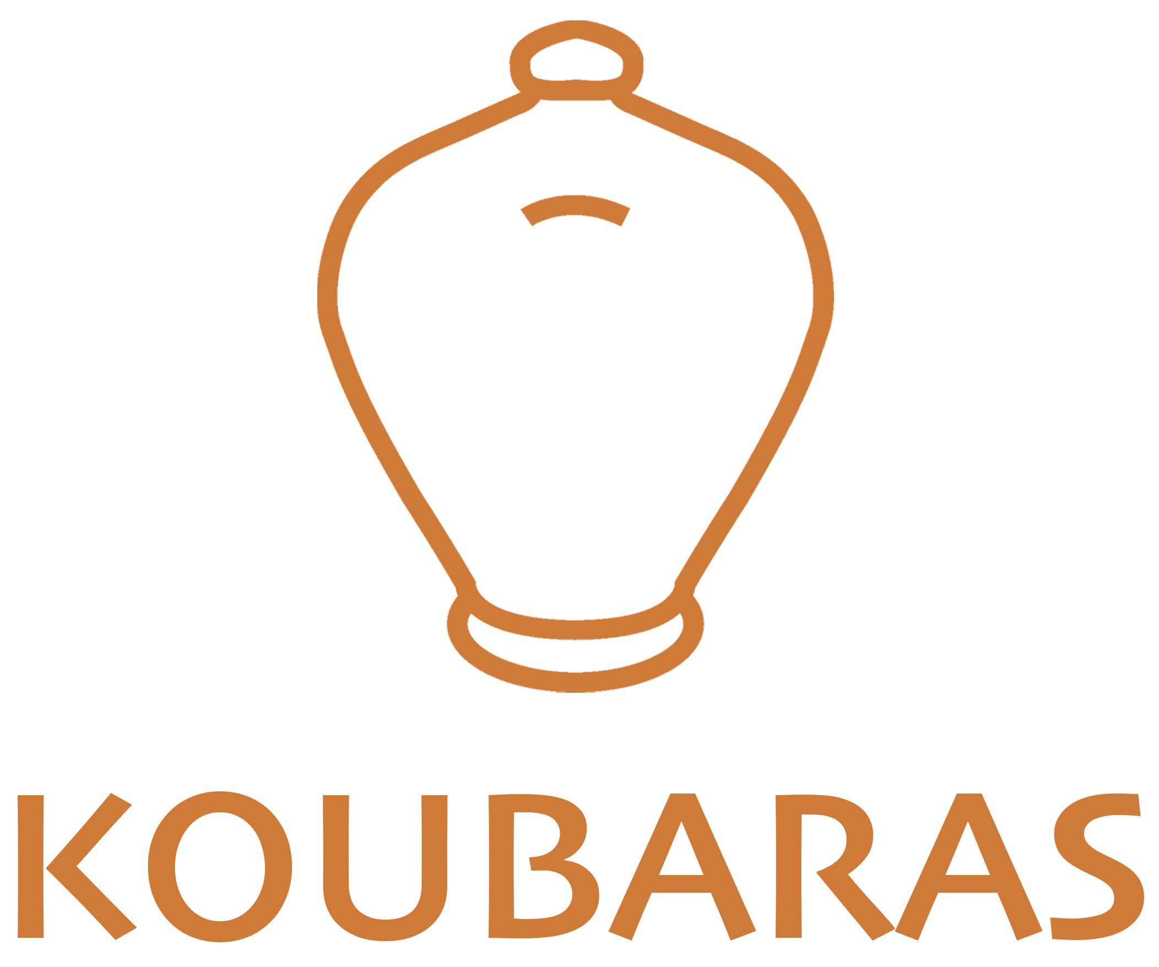
MSc International Shipping, Finance & Management
Wealth
Management
Lecture 1 of 8 · May – July 2026
Theodore N. Krintas, CIIA, Ph.D.
Athens University of Economics and Business

Slide 2
About the Lecturer
Theodore N. Krintas, CIIA, Ph.D.
This Course
Founder & CEO, Koubaras
8 Lectures · May – July 2026
35 years of Asset & Wealth Management experience
CIIA (Certified International Investment Analyst)
Ph.D. in Behavioral Economics
Extensive experience Startups, Family Business, Succession Processes and Multi Family Offices
External Professor at AUEB – MSc ISFM since 2017
Visiting Professor at Excelia Business School (France)
Lecture 1: Wealth Management Fundamentals
Lectures 2–4: Investment Strategies & Asset Classes
Lectures 5–6: Portfolio Construction & Risk
Lectures 7–8: Client Advisory & Planning
2

Slide 3
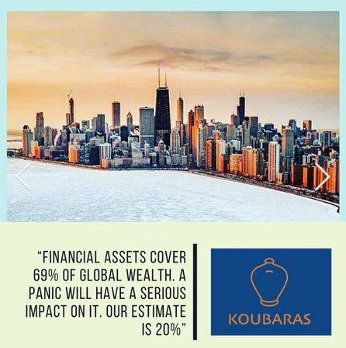
What Makes a Wealth Manager?
THE FIVE PILLARS OF A WEALTH MANAGER
01
Technical Expertise
Deep knowledge of financial instruments, asset classes, portfolio theory, tax law, and estate planning. Underpinned by CIIA, CFA, or CFP credentials.
02
Client Intelligence
Listening deeply, decoding unstated needs, and translating life goals into financial objectives — without presupposition.
03
Analytical Rigour
Evidence-based thinking: modelling scenarios, stress-testing plans, and challenging assumptions with data.
04
Ethical Compass
!
Unwavering fiduciary duty — always acting in the client's best interest, disclosing conflicts, and maintaining confidentiality.
05
Adaptive Communication
Translating complex financial concepts into clear, jargon-free language for clients across cultures and sophistication levels.
“A wealth manager is not merely a product seller — they are a trusted architect of financial lives.”
2a

Slide 4
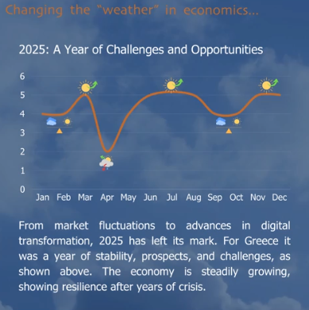
You, after this Course
✓
Define & frame wealth management
Articulate what WM is, how it differs from pure investment management, and where it sits in the financial services landscape.
✓
Map the full advisory process
Walk a client from discovery through planning, implementation, and ongoing monitoring with a structured methodology.
✓
Construct & manage portfolios
Apply asset allocation frameworks, evaluate risk-return trade-offs, and build goal-aligned, diversified portfolios on an asset class basis.
✓
Integrate tax, estate & risk planning
Identify cross-disciplinary needs — from inheritance structures to insurance gaps — and coordinate specialist solutions.
✓
Communicate and advise with confidence
Present investment recommendations and wealth plans to sophisticated clients with clarity, credibility, and ethical rigour.
2b

Slide 5
What Is Wealth Management?
Core Definition
Build
Grow assets through disciplined investment strategies
Wealth management integrates financial services to address the full spectrum of a client's needs — building, preserving, and managing wealth over time.
It combines investment management, financial planning, tax strategy, estate planning, and banking services into a unified, client-centred approach.
Preserve
Protect wealth against risk, inflation, and volatility
Transfer
Plan estates and legacies across generations
3

Slide 6
The Consultative Approach
A good wealth manager meets a client without any presupposition about what financial products or services are appropriate — the goal is first to understand the person, then to bring the right solutions.
01
02
03
Client-Centred
No Presupposition
Holistic Solutions
Every recommendation flows from a deep understanding of the client's goals, values, and circumstances.
Advisors approach each engagement with an open mind — product-agnostic and genuinely curious.
The right experts and products are assembled around the client's full picture, not pre-packaged.
4

Slide 7
Understanding Client Needs & Goals
The wealth manager's overriding objective is to understand what is important to the client and why — only then can appropriate experts and financial products be introduced.
Investment Management
Financial Planning
Portfolio construction, asset allocation, and active/passive strategies aligned to return and risk objectives.
Cash flow analysis, retirement projections, education funding, and life-event planning.
Tax Strategy
Estate & Legacy
Optimising after-tax returns through structuring, loss harvesting, and cross-border planning.
Trusts, succession planning, philanthropy, and intergenerational wealth transfer.
5

Slide 8
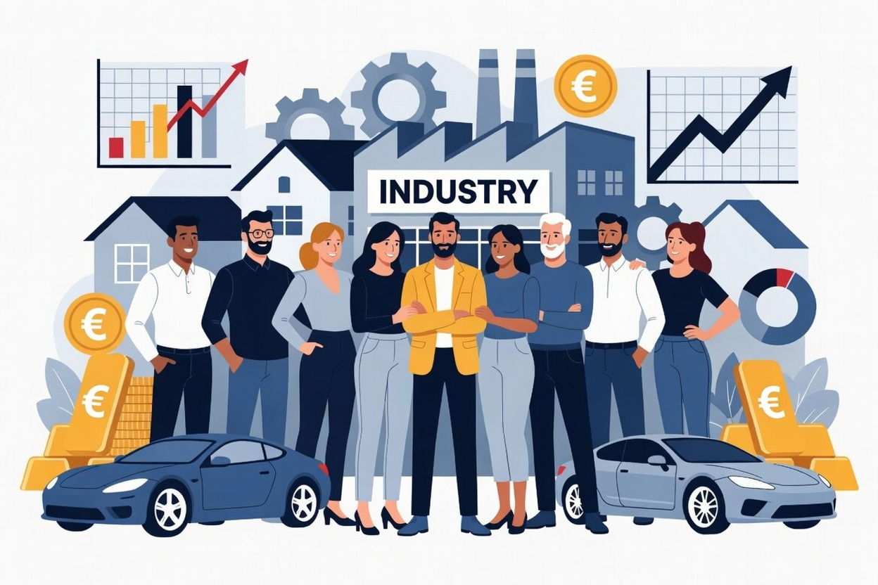
Asset Owners' Stakeholder Ecosystem
Clients &
Beneficiaries
Board &
Governance
Co-investors &
Partners
External
Managers
Information
Providers
Advisors &
Consultants
Service
Providers
Regulators &
Governments
6

Slide 9
Wealth Management in Practice
Leading global institutions deliver wealth management through distinct, client-tailored models:
Goldman Sachs PWM
Ultra-HNW Focus
Morgan Stanley WM
Comprehensive Advisory
Serves individuals, families, foundations & endowments with bespoke investment strategies and full access to GS capabilities.
Wide HNW and mass-affluent reach; financial planning, retirement, and investment solutions under one roof.
Barclays WM
Integrated Banking & WM
Fidelity / Cabot
Independent RIA Model
Combines private banking, investment management, and fiduciary services for international clients.
Boutique, fee-only registered investment advisors focused on objectivity, portfolio longevity, and personalised service.
7

Slide 10
Best Practices in Wealth Management
"Practices are what you do" — the operational disciplines that distinguish excellent advisors.
◈ Discovery & Profiling
◈ Goal-Based Planning
◈ Portfolio Construction
Structured client discovery to map goals, risk appetite, time horizons, and values.
Translate aspirations into measurable financial milestones with clear metrics.
Build diversified, cost-efficient portfolios aligned to client objectives.
◈ Risk Management
◈ Performance Reporting
◈ Ongoing Review
Continuous identification and mitigation of portfolio and life-stage risks.
Transparent, regular communication of portfolio performance vs. benchmarks.
Periodic rebalancing and plan updates as client circumstances evolve.
8

Slide 11

Total Wealth Management
The whole picture — eight interconnected disciplines
Retirement
Planning
Wealth Transfer
& Legacy
Planning
Tax
Planning
Investment
Planning &
Risk Mgmt
Income &
Distribution
Planning
Survivor
Protection
Estate
Planning
Asset
Protection
9

Slide 12

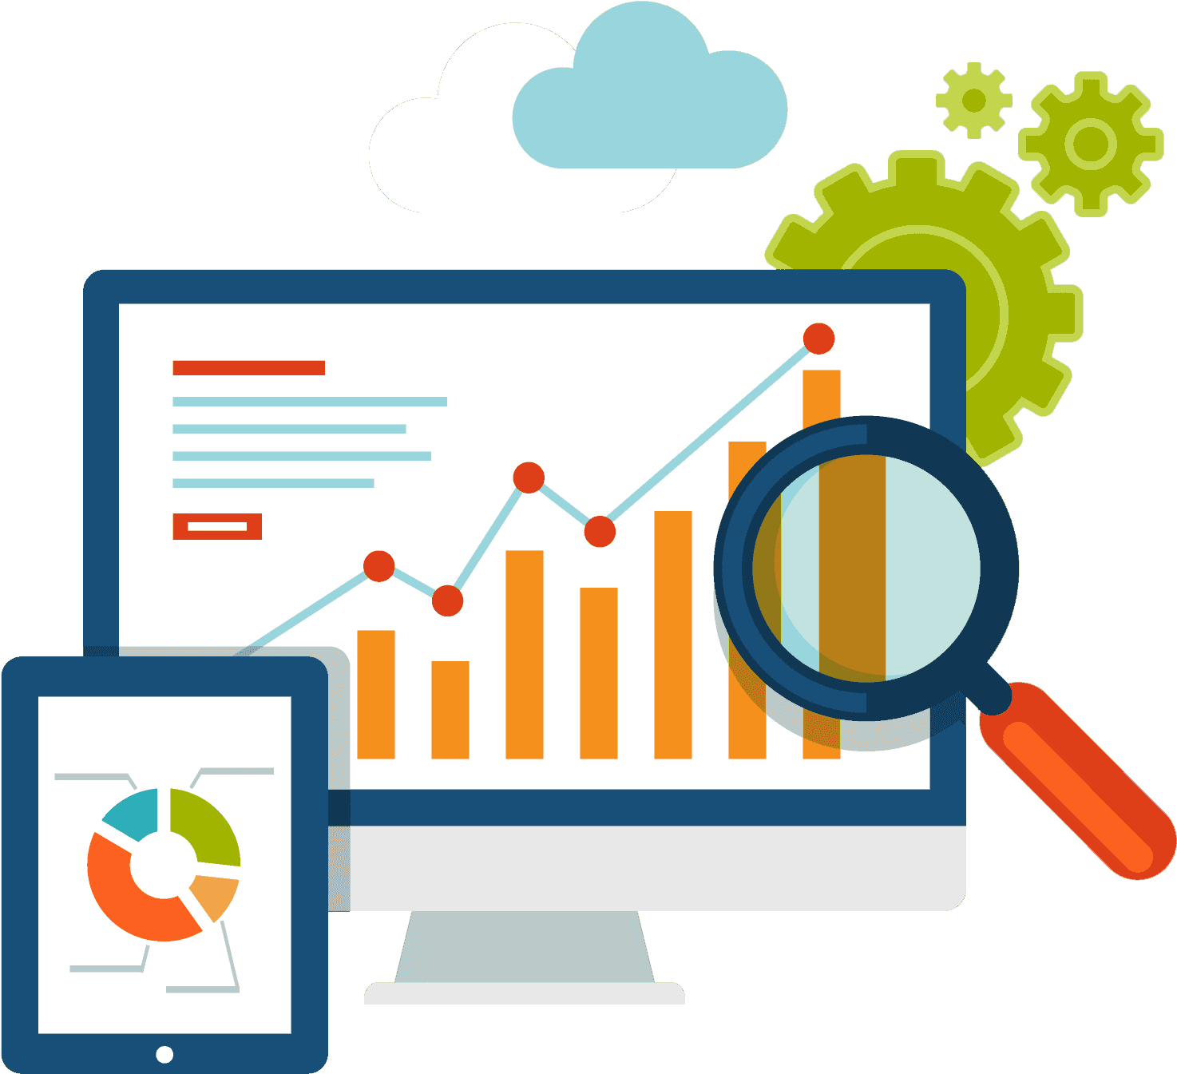
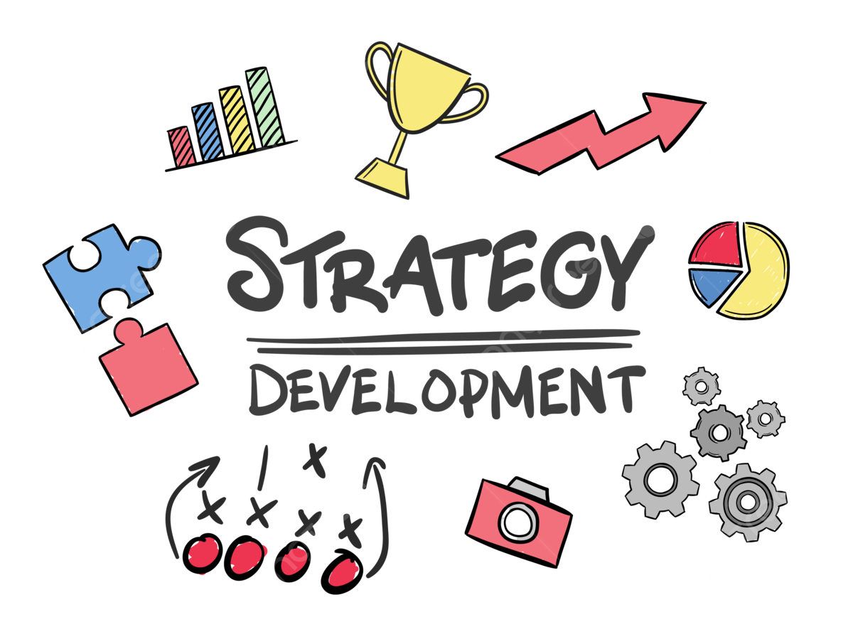
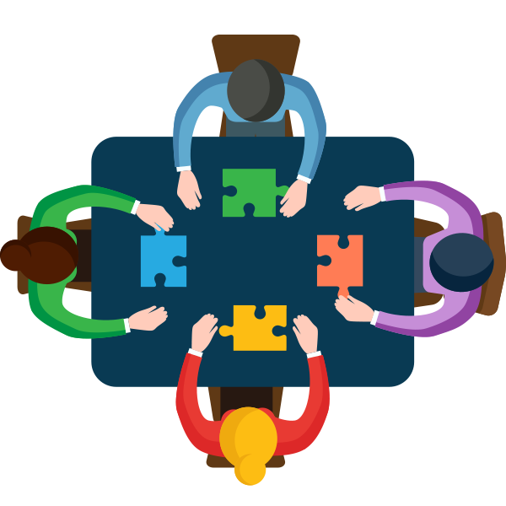
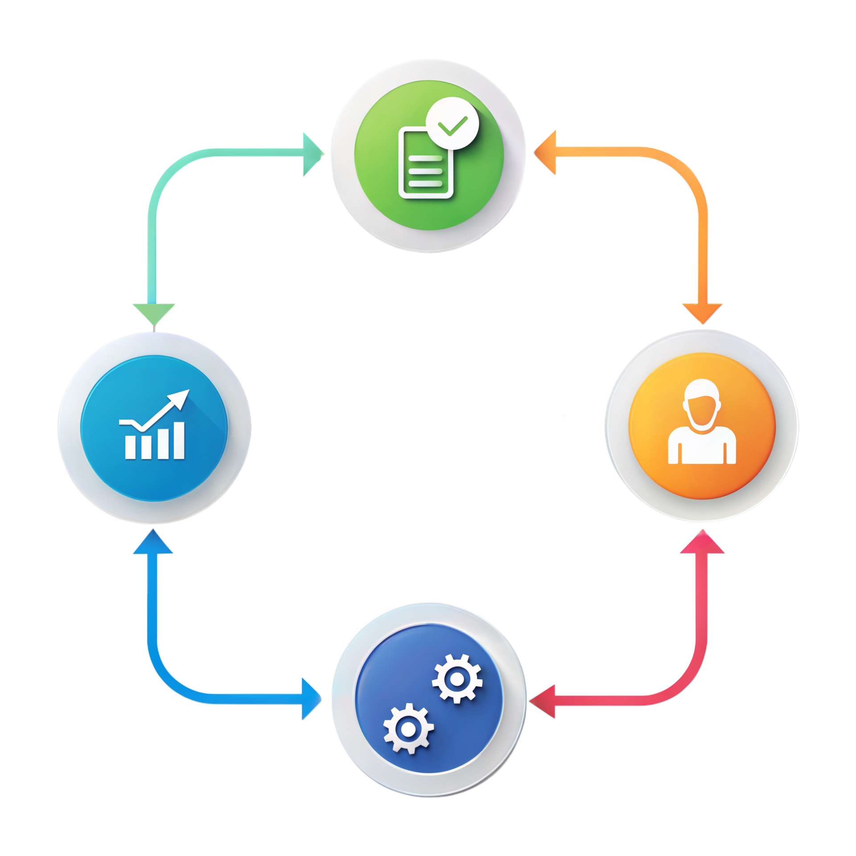
The Wealth Management Process
"That has always a beginning and never ends…"
1
2
3
4
5
Discover
Analyse
Strategise
Implement
Monitor
Understand goals, values, risk tolerance, time horizon
Assess current financial position and constraints
Develop tailored wealth & investment strategy
Execute portfolio construction and planning actions
Ongoing review, reporting, and rebalancing
↩ Continuous Cycle
10

Slide 13
The Investment Process
Fundamental research is hard work that constantly challenges a team's ability to draw the right conclusions. Specialised management teams analyse attractive instruments, build detailed financial models, and maintain constant dialogue with company executives and industry experts.
Step 1
Step 2
Step 3
Step 4
Define Universe
Idea Generation
Portfolio Construction
Risk Management
Screen the investable universe by geography, sector, asset class, liquidity, and risk parameters.
Generate ideas through fundamental analysis, valuation screens, and expert dialogue.
Translate high-conviction ideas into a diversified, risk-controlled portfolio.
Ongoing monitoring of factor exposure, drawdown limits, and rebalancing triggers.
→
→
→
11

Slide 14
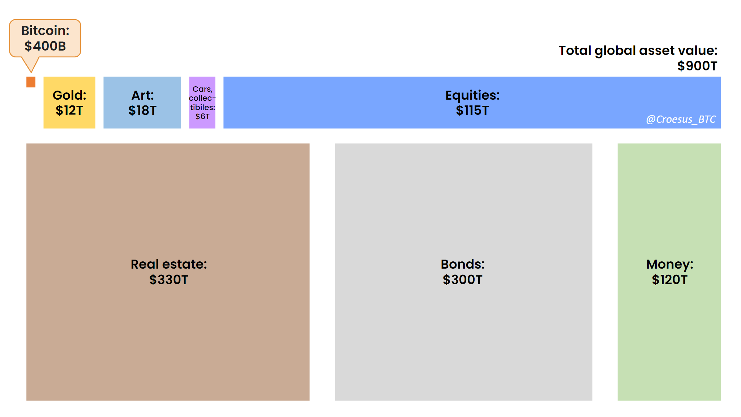
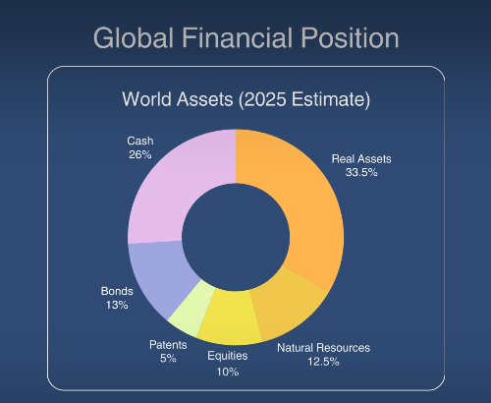
Define Universe
"That is huge, diversified and still “cornered”…"
11a

Slide 15


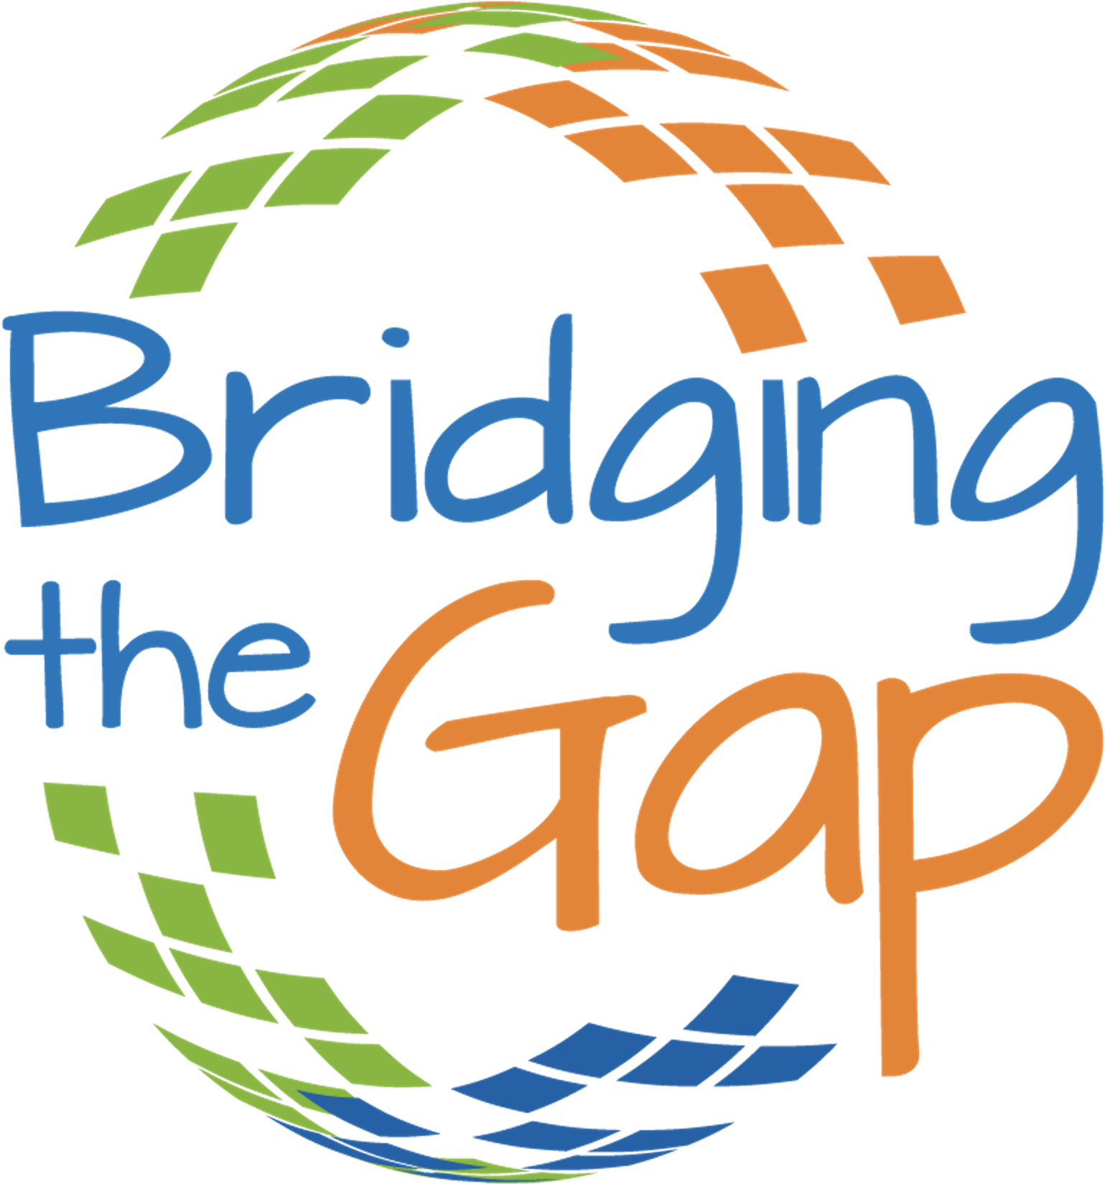
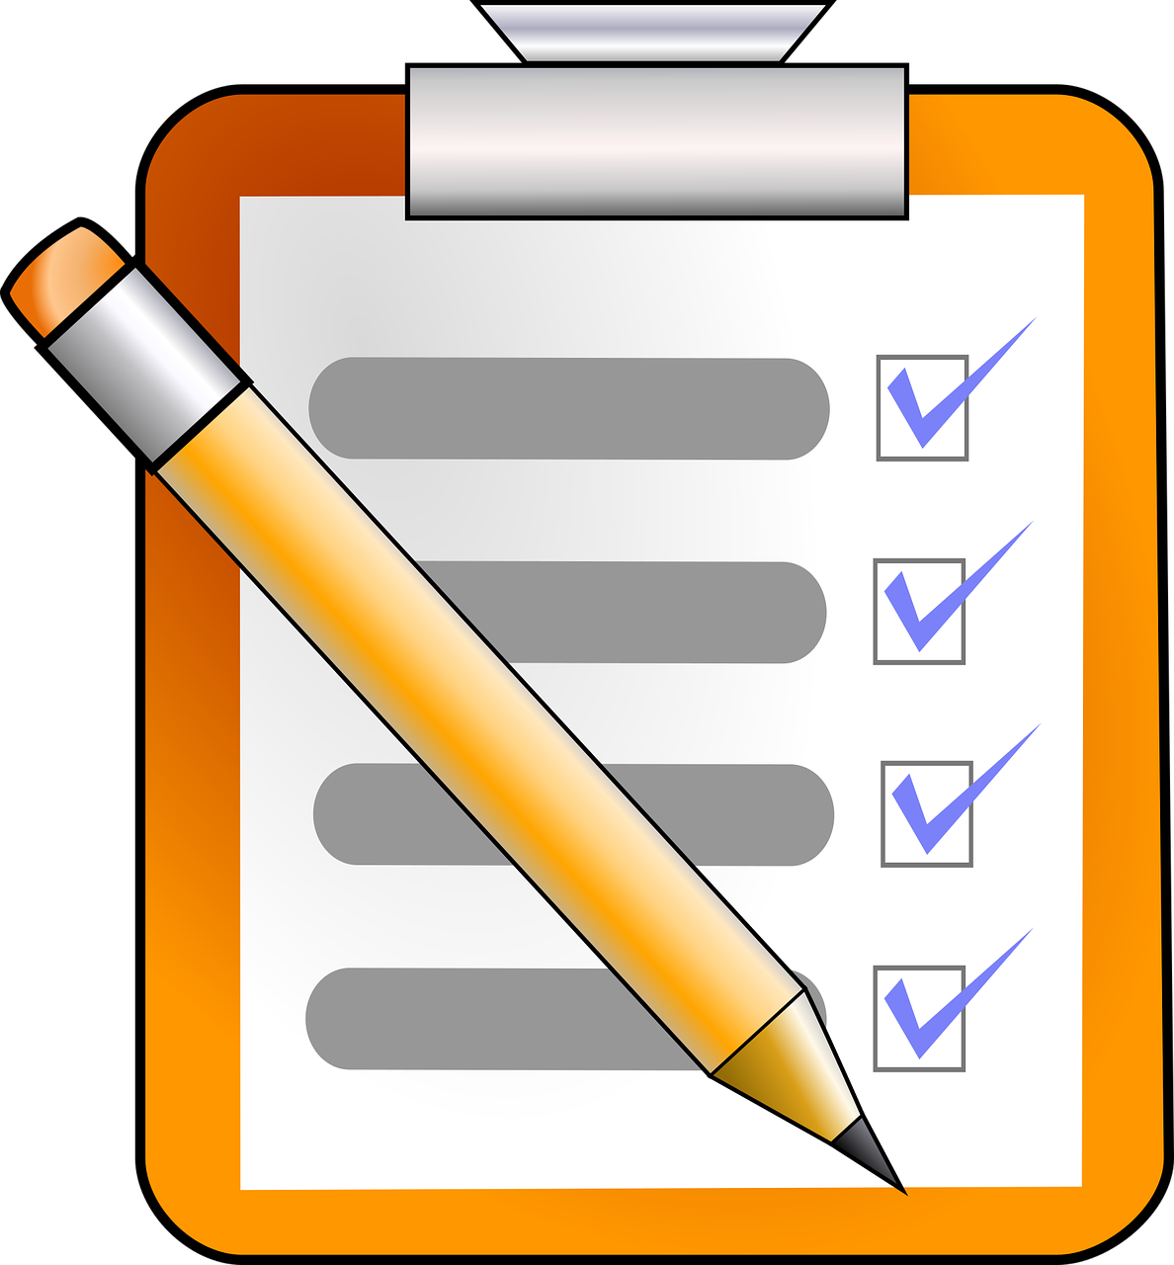
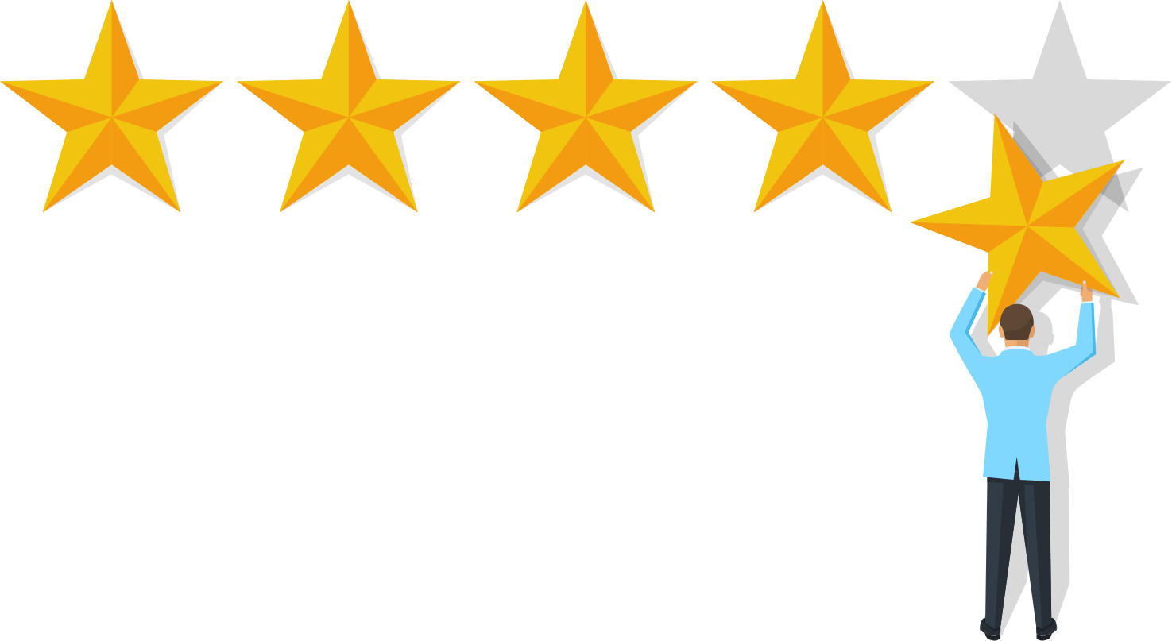
The Consultative Wealth Management Process
1
2
3
4
5
Engage
Discover
Analyse
Plan
Implement
& Review
Initial meeting, relationship building, scope definition
Deep-dive into goals, values, concerns, and constraints
Financial modelling, gap analysis, scenario planning
Develop and present the personalised wealth strategy
Execute plan, monitor progress, adapt as life evolves
12

Slide 16
DIY Investing vs. Professional Advisory
Dimension | DIY Investor | Wealth Manager
Knowledge | Self-directed, varies widely | Professional expertise, CIIA/CFA credentials
Time | Personal time required | Dedicated professional attention
Objectivity | Emotionally driven decisions | Disciplined, process-driven approach
Breadth | Limited to known instruments | Full spectrum of asset classes & strategies
Cost | Lower fees, hidden costs possible | Advisory fees, aligned incentives
Suitability | Self-assessed only | Regulated suitability assessment
13

Slide 17
Key Takeaways — Lecture 1
Wealth management is a holistic, client-centred discipline — not just investment management.
The consultative model starts with understanding the person, not presenting products.
The total wealth management covers investment, tax, estate, and income planning in an integrated way.
The investment process is rigorous: Universe → Ideas → Construction → Risk Management.
Professional advisory adds objectivity, breadth, and expertise that DIY investing cannot match.
Next: Lecture 2
Asset Classes, Capital Markets & Portfolio Theory
14

