Slide 1
Risk and Return
Portfolio Theory and Capital Market Theory

Slide 2
Introduction
In this lecture, we discuss issues related to risk and return
More specifically:
→ Discuss some practical issues on the process of going public
→ Discuss theoretical reasons of WHY firms go public
→ See what actual managers think on that issue (why they take their companies public)
→ Discuss the IPO under-prising effect (theory and practice)
Reading: lecture notes, textbook (Chapter 10, 11, 12), and indicative references at the end of the lecture

Slide 3
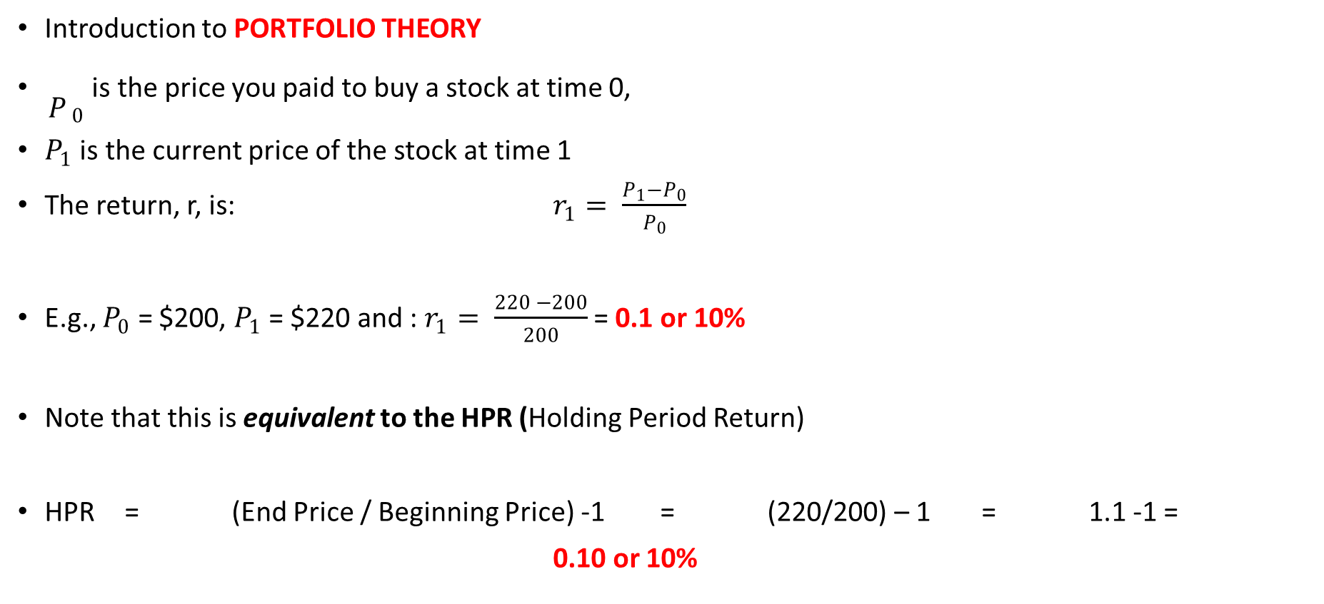
Risk & Return
Introduction to PORTFOLIO THEORY
${\begin{aligned} \\ P\end{aligned}}_{0}$ is the price you paid to buy a stock at time 0,
$P_{1}$ is the current price of the stock at time 1
The return, r, is: $r_{1}= \frac{P_{1}−P_{0}}{P_{0}}$
E.g., $P_{0}$ = $200, $P_{1}$ = $220 and : $r_{1}= \frac{220 −200}{200}$ = 0.1 or 10%
Note that this is equivalent to the HPR (Holding Period Return)
HPR = (End Price / Beginning Price) -1 = (220/200) – 1 = 1.1 -1 =
0.10 or 10%

Slide 4
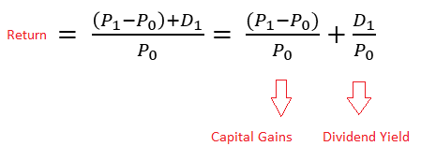
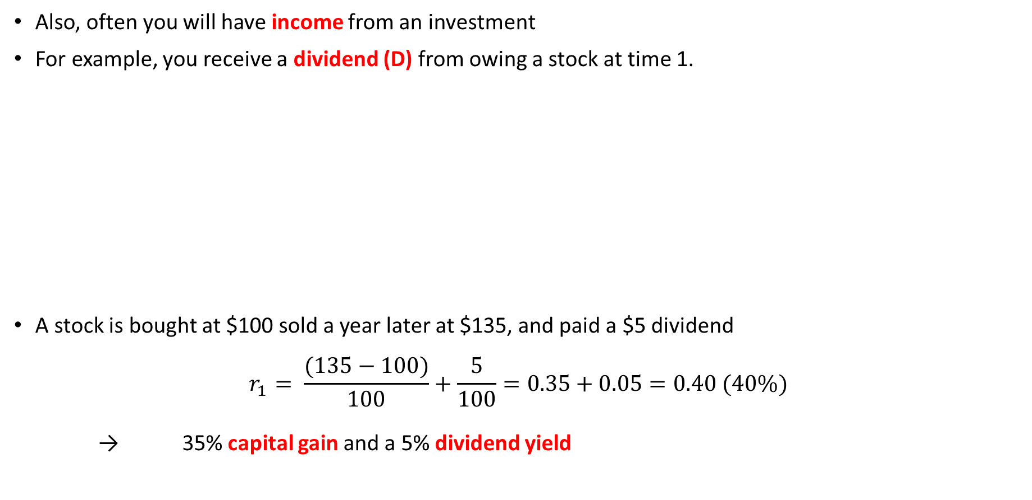
Risk & Return
Also, often you will have income from an investment
For example, you receive a dividend (D) from owing a stock at time 1.
A stock is bought at $100 sold a year later at $135, and paid a $5 dividend
$$r_{1}= \frac{(135−100)}{100}+\frac{5}{100}=0.35+0.05=0.40 (40\%)$$
→ 35% capital gain and a 5% dividend yield

Slide 5
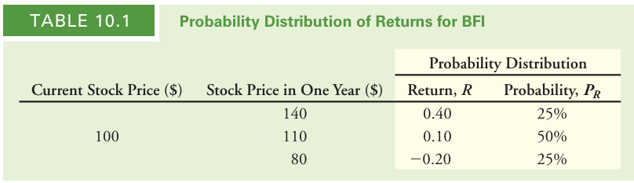
Risk & Return
To compare different stocks, we express their performance in terms of their returns
With risky investments returns may vary
Each possible return has some likelihood of occurring
We summarize this information with a probability distribution
→ assigns a probability (PR) that each possible return ® will occur
Assume BFI stock has the following characteristics:

Slide 6
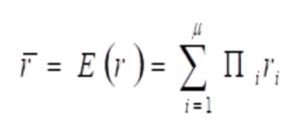
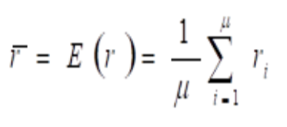
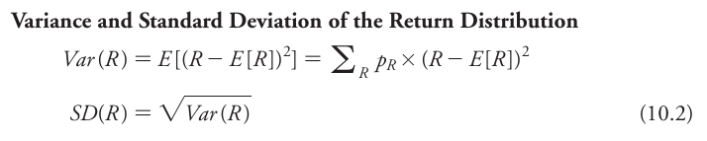
Risk & Return
The expected (mean) return for BFI is:
The expected (mean) return for BFI is:
Assuming equal probability:
Two common measures of the risk of a probability distribution are its variance and standard deviation:

Slide 7
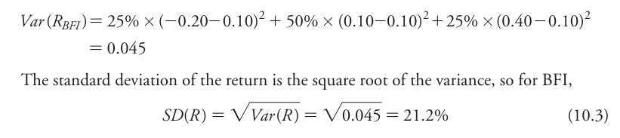
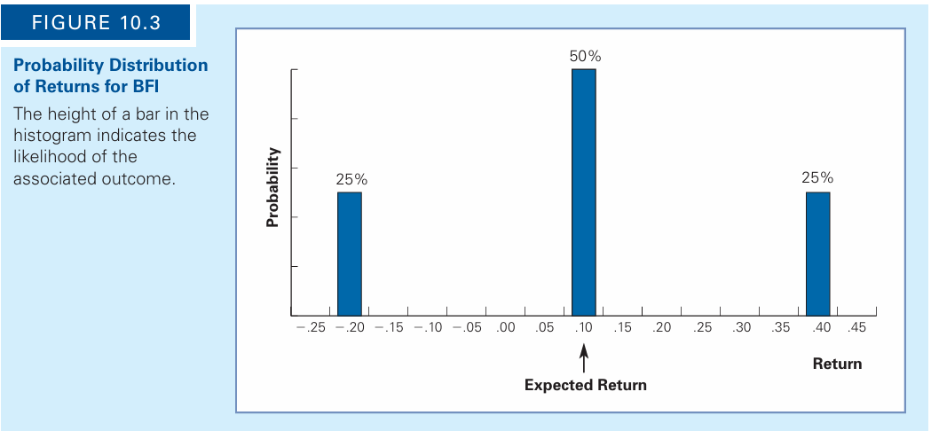
Risk & Return
Η τυπική απόκλιση της BFI είναι:

Slide 8
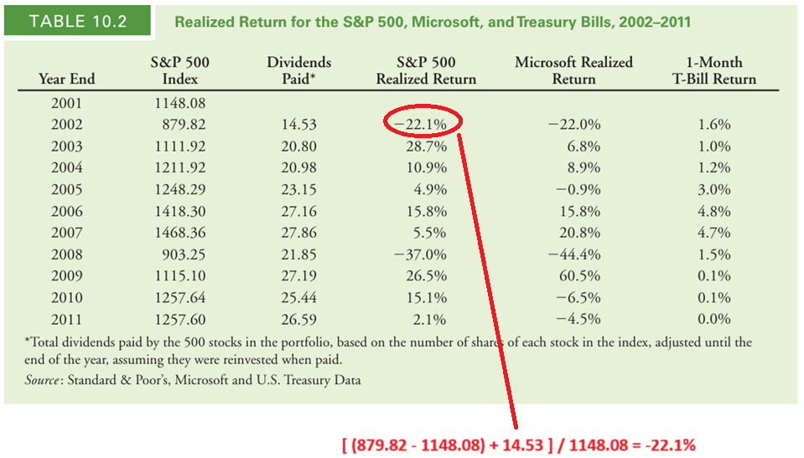
Risk & Return
How do we estimate expected returns and risk in practice?

Slide 9
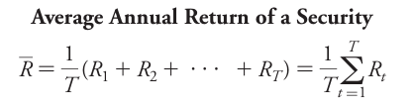
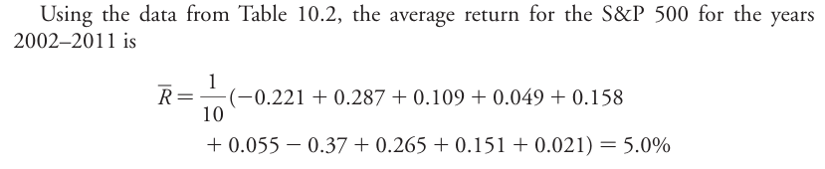
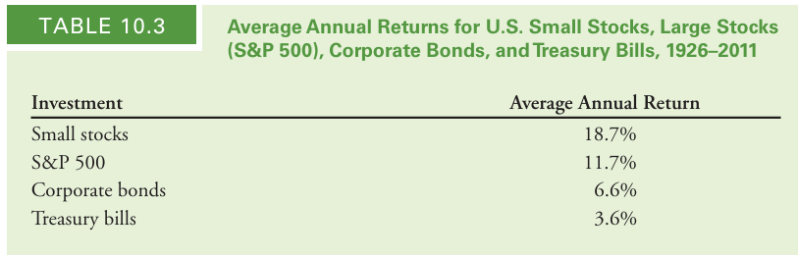
Risk & Return
average annual return of an investment during some period = the average of the annual realized returns

Slide 10
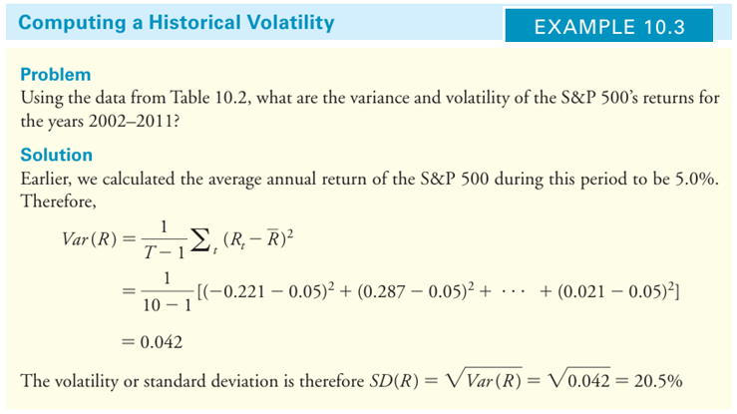
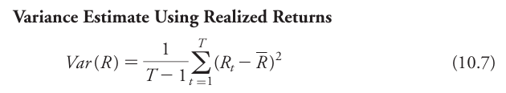
Risk & Return
To estimate the difference in variability, we estimate the standard deviation:

Slide 11
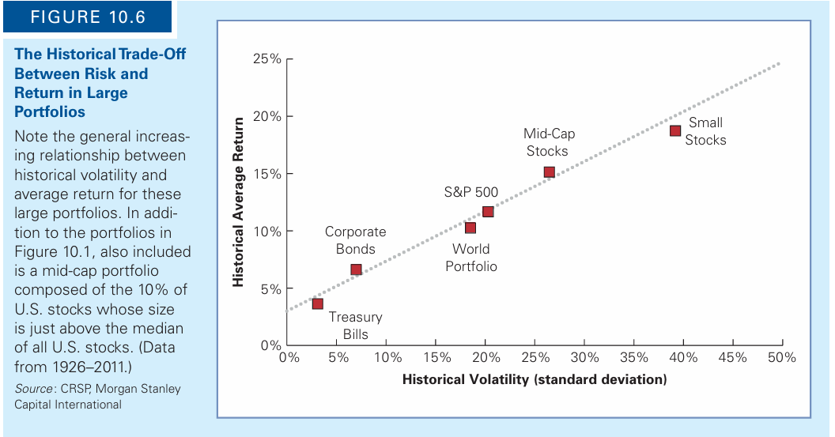
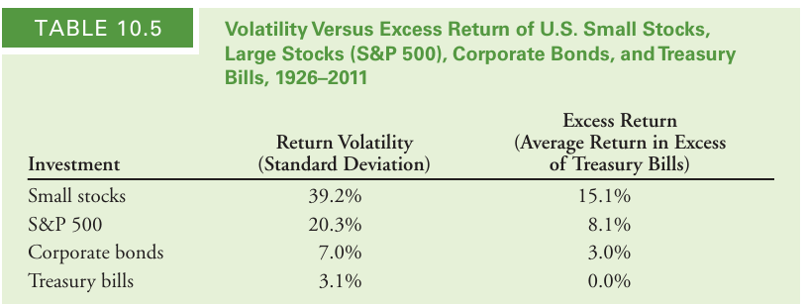
Risk & Return

Slide 12
Portfolio Risk & Return
Assume you have invested 30% in S1 and 70% in S2
Ε(r_{S1}) = (0.0514) and Ε(r_{S2}) = (0.1936)
The portfolio return is the weighted average of returns (weight = % invested in each stock):
That is: Ε(r_{χ}) = (0.3) Ε(r_{S1}) + (0.7) Ε(r_{S2}) = (0.3) (0.0514) + (0.7) (0.1936) = 0.15094 or 15%
The portfolio risk is a bit more complicated; it has 2 sources
1st source: w²_{S1} σ²_{S1} + w²_{ΑΤΤΙΚ} σ²_{ΑΤΤΙΚ}
2nd source which contains all possible pairs of covariances: w_{S1} w_{S2} σ_{S1, S2} + w_{S1} w_{S2} σ _{ΑΤΤΙΚ, S1} = 2 w_{S1} w_{S2} σ_{S1, S2}
Since σ_{S1,S2}= σ_{S2,S1} the total portfolio risk will be: σ²_{Χ} = w²_{S1} σ²_{S1} + w²_{S2} σ²_{S2} + 2 w_{S1} w_{S2} σ_{S1,S2}

Slide 13
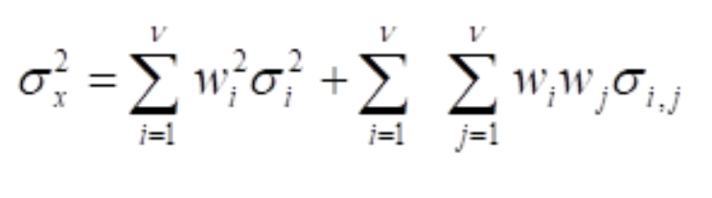
Portfolio Risk & Return
The portfolio risk is a bit more complicated; it has 2 sources
1st source: w²_{S1} σ²_{S1} + w²_{ΑΤΤΙΚ} σ²_{ΑΤΤΙΚ}
2nd source which contains all possible pairs of covariances:
w_{S1} w_{S2} σ_{S1, S2} + w_{S1} w_{S2} σ _{ΑΤΤΙΚ, S1} = 2 w_{S1} w_{S2} σ_{S1, S2}
Since σ_{S1,S2}= σ_{S2,S1} the total portfolio risk will be
σ²_{Χ} = w²_{S1} σ²_{S1} + w²_{S2} σ²_{S2} + 2 w_{S1} w_{S2} σ_{S1,S2}

Slide 14
Risk & Return
Portfolio Selection

Slide 15
Risk & Return
Investors should invest on the Efficient Frontier (CE)
Markowitz: expected rate of return of a portfolio is the weighted average of the expected return for the individual investments in the portfolio.
Portfolio Risk: function of not only of the SDs of individual assets but also of all pairs of covariances
In a large portfolio, correlations are critical for selecting assets to include in the portfolio

Slide 16
Capital Market Theory
Following the development of portfolio theory by Markowitz, two major theories have been derived for the valuation of risky assets.
Asset Pricing Models
Capital Asset Pricing Model (CAPM)
Arbitrage Pricing Theory (APT)
The Theory extends portfolio theory by developing a model for pricing all risky assets.
The CAPM, allows us to determine the required rate of return for any risky asset.

Slide 17
Capital Market Theory
Assumptions of Capital Market Theory
1. All investors are rational (Markowitz-efficient), i.e. invest in tangent points on the efficient frontier.
2. Investors can borrow or lend any amount of money at the risk-free rate
3. All investors have homogeneous expectations
4. All investors have the same one-period time horizon
5. All investments are infinitely divisible
6. There are no taxes or transaction costs
7. There is no inflation and interest rates are stable
8. Capital markets are in equilibrium.

Slide 18
Capital Market Theory
Risk-free asset: asset with zero variance
It has zero correlation with all other risky assets
This allows the development of a generalized theory of asset pricing
What happens to Portfolio Theory if we combine a risk-free asset with a portfolio of risky assets?
→ COV of R_{f} with any risky asset or portfolio = zero
→ Correlation of R_{f} with any risky asset or portfolio = zero
Sharpe, (1964) - Nobel Prize, Lintner (1965), Mossin (1966)

Slide 19
Capital Market Theory
Investors want to maximize expected returns
Portfolio M: market portfolio
(contains all risky assets)
It is the single portfolio that maximizes risk premium
Capital Market Line (CML)

Slide 20
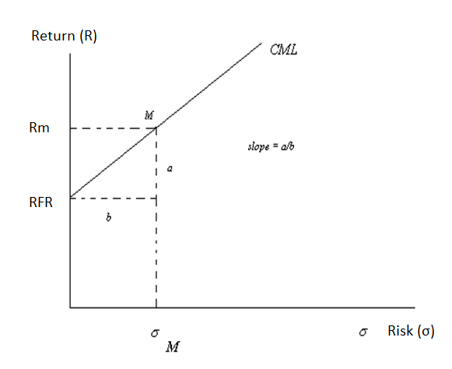
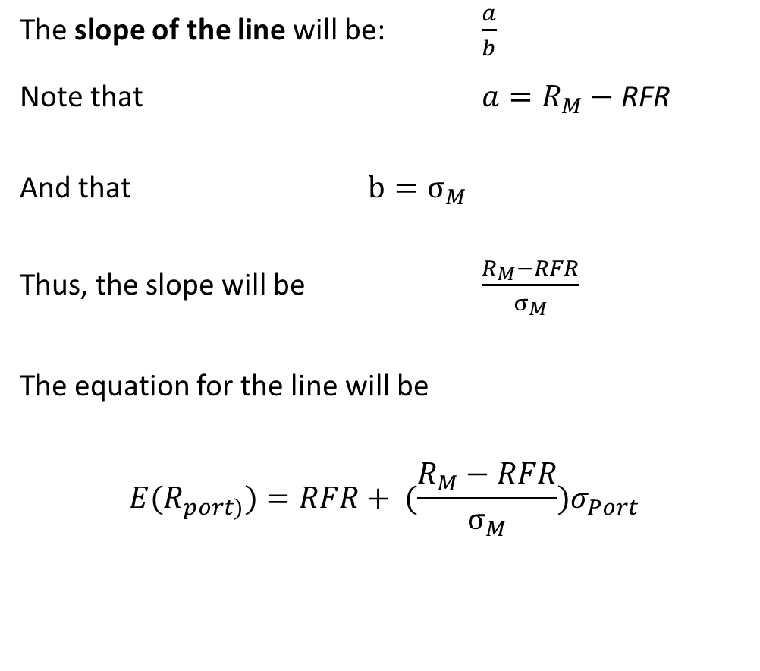
Capital Market Theory
The slope of the line will be: $\frac{a}{b}$
Note that $a=R_{M}−$ RFR
And that $b=σ_{M}$
Thus, the slope will be $\frac{R_{M}−RFR}{σ_{M}}$
The equation for the line will be
$${E(R}_{port)})=RFR+ ({\frac{R_{M}−RFR}{σ_{M}})σ}_{Port}$$

Slide 21
Capital Market Theory
The slope of the CML is the price of risk when the market is in equilibrium
Expected risk premium per unit of risk
For example, assume that :
r_{Μ} = 0.10
σ_{M} = 0.20
r_{f} = 0.05
The slope then is: (0.10-0.05) / 0.20 = 0.25
That is, for each 1% change in the risk of an efficient portfolio the market expects 0.25% increase in its return in order to maintain equilibrium.
The slope of the CML reflects the risk aversion of investors in equilibrium.
The steeper the slope the higher the risk aversion

Slide 22
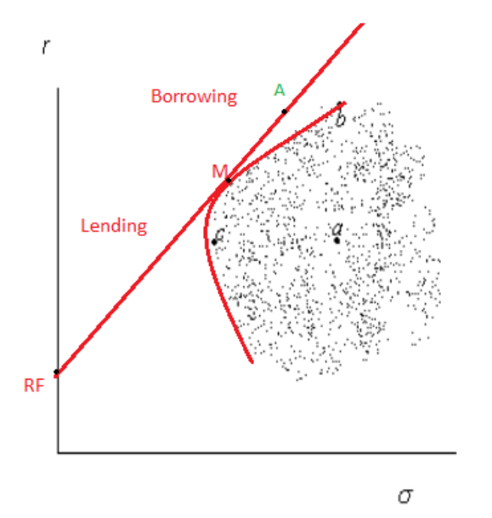
Capital Market Theory
You can go beyond Point M (e.g. at A)
How can they do it ?
One way is to borrow at the R_{F} rate and invest in M
Assume you borrow 50% of your wealth at R_{F}
Invest it in M
That is, invest -50% in RF and 150% in M)
E(R_{Portfolio}) = -0.5 R_{f} + 1.5 R_{M}

Slide 23
Capital Market Theory
→ Investors should only invest their funds in two types of assets—the RF and M
→ The weights depend on the investors risk tolerance
→ The new Efficient Frontier is now the Capital Market Line (CML)
→ M: must contain all risky assets in proportion to their relative market values
→ Theoretical Portfolio, completely diversified portfolio
→ All unique risk of assets (unsystematic risk) is offset
→ By implication, only systematic risk, is contained in M, and is important
→ Systematic risk varies over time and is determined by general factors (e.g. industrial production, interest rates, monetary policy, etc.)

Slide 24
Capital Market Theory

Slide 25
Capital Market Theory
Since all risky assets are a part of M, their rates of return in relation to M can be described as:
R_{it} = a_{i} + b_{i} R_{Mt} + e_{it}
Their Variance then is:

Slide 26
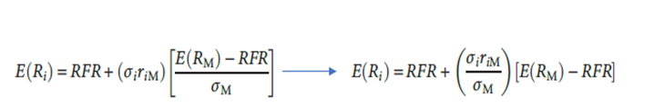
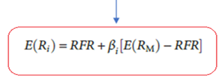
Capital Market Theory
In CML equation replace (σ_{port}) with that of the single security (σ_{i}).
Since only systematic risk matters reduce this to σ_{i} to include only the % in i
→ that is systematically related to the risk of M
How? Multiply σ_{i} by the correlation returns of i and returns of M (r_{iM}) and rearrange terms:
This is the Capital Asset Pricing Model (CAPM)

Slide 27
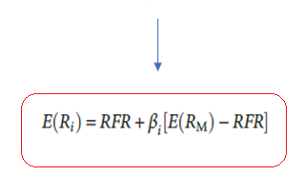
Capital Market Theory

Slide 28
Capital Market Theory
CAPM: risk is described in terms of beta (β_{i}), i.e. the non-diversifiable portion of risk with M
Beta = 1.30: the stock has a level of systematic risk that is 30% higher that the market risk
Beta = 0.60: the stock has a level of systematic risk that is 30% lower that the market risk
Beta of Portfolio M = 1
β_{i} = 1 average risk
β_{i} < 1 low risk
β_{i} > 1 high risk

Slide 29
Capital Market Theory
Assume we have 5 portfolios/stocks
Rf = 4% (0.04), (E(RM)) = (0.10)
This implies a market risk premium of 6 %
Returns differ ONLY DUE TO BETA RISK
The REQUIRED RETURNS ARE:
E(r_{i}) = R_{F} + b_{i} (E(R_{m}) – R_{F})
E(r_{A}) = 0.04 + 0.6 (0.10 – 0.04) = 0.076
E(r_{Β}) = 0.04 + 1.0 (0.10 – 0.04) = 0.1
E(r_{C}) = 0.04 + 1.25 (0.10 – 0.04) = 0.115
E(r_{D}) = 0.04 + 1.6 (0.10 – 0.04) = 0.136
E(r_{E}) = 0.04 - 0.2 (0.10 – 0.04) = 0.028

Slide 30
Capital Market Theory
Now suppose that due to analysis you have the following EXPECTED RETURNS
In equilibrium, all assets and portfolios should be on the SML
alpha = difference between required and expected return
If they plot above the SML → undervalued asset (you receive more that justified by risk); alpha is positive
If they plot below the SML → overvalued asset (you receive less that justified by risk); alpha is negative
If the alpha is zero, the stock properly valued

Slide 31
Capital Market Theory
Calculating beta
1) Run the regression:
Characteristic line
2) Use the formula:

Slide 32
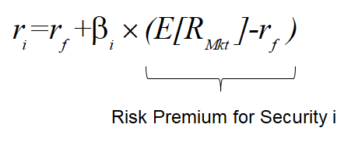
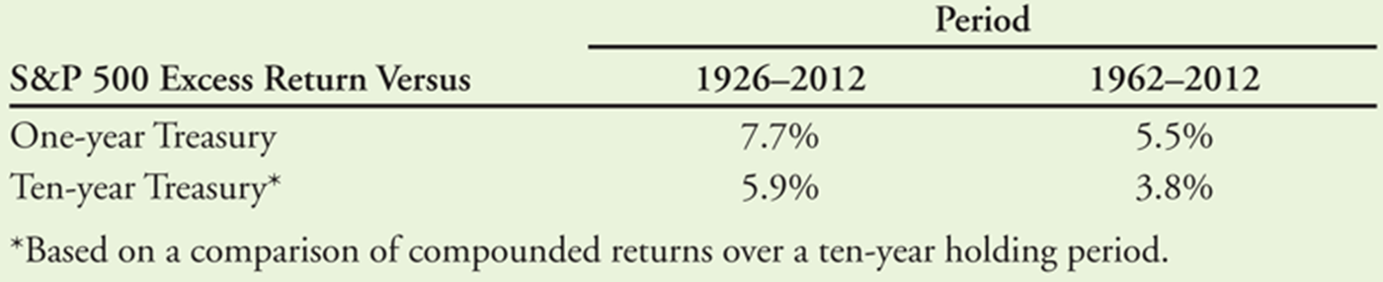
The Equity Cost of Capital
One way to estimate the equity cost of capital is by using the Capital Asset Pricing Model (CAPM)
Cost of capital of an investment = expected return of available investments with the same risk
Use the Security Market Line:
Market portfolio ? We can use the S&P 500
Risk Free Rate? We can use the on 10-year (or 30 year) U.S. Treasury securities

Slide 33
The Equity Cost of Capital

Slide 34
Debt Cost of Capital
Debt Yields
YtM (IRR) from bonds
Without default risk, YtM is a good estimate of investors’ expected rate of return.
With significant default risk YtM will overstate investors’ expected return
Consider a 1-year bond with YtM = y
For each $1 invested today, the issuer promises $(1+y) in1 year
If there is a probability p for default, the bond holders receive only $(1+y-L)
L is the expected loss per $1 of debt in the event of default.
Thus, the expected return of the bond is:
→ rd = (1-p)y + p(y-L) = y – pL
→ Yield to Maturity – Prob(default) X Expected Loss Rate

Slide 35
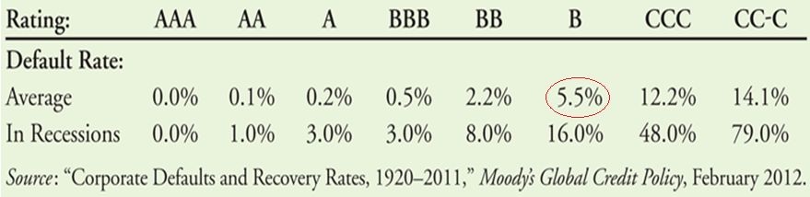
Debt Cost of Capital
The average loss rate (L) for unsecured debt is 60%.
During average times the annual default rate for B-rated bonds is 5.5% (see Table, source textbook)
Thus, the expected return to B-rated bondholders is 0.055 X 0.60 = 3.3% (r_{d} = y – pL) below the bond’s quoted yield.

Slide 36
Debt Cost of Capital

Slide 37
Cost of Capital for a Project

Slide 38
Cost of Capital for a Project
Asset (unlevered) cost of capital
  Expected return required by investors to hold the firm’s underlying assets.
  Weighted average of the firm’s equity and debt costs of capital
  Asset (unlevered) beta

Slide 39
Cost of Capital for a Project

Slide 40
Cost of Capital for a Project
When the firm has high cash balances; since cash = risk-free asset, → the risk of the firm’s assets is ↓
Thus, leverage should be measured in terms of net debt
→ Net Debt = Debt – Excess Cash and short-term investments

Slide 41
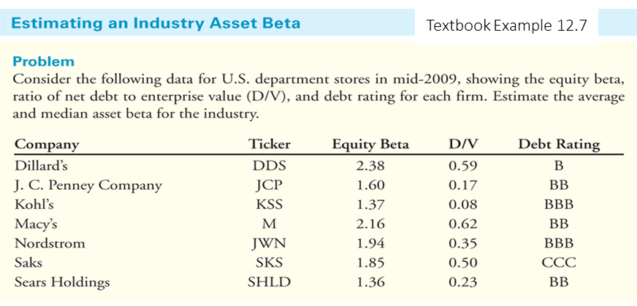
Cost of Capital for a Project
Industry Asset Betas
We can combine estimates of asset betas for multiple firms in the same industry
Doing this will reduce the estimation error of the estimated beta for the project.

Slide 42
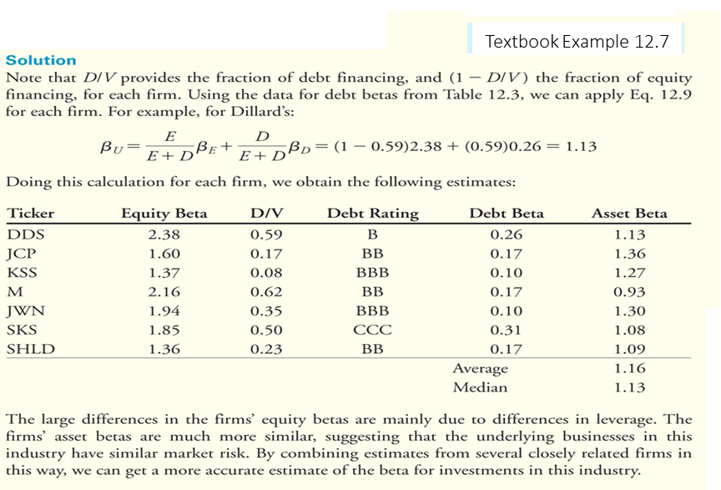
Cost of Capital for a Project

Slide 43
Thank You for your Attention !

