Slide 1
Capital Structure & Dividend Policy

Slide 2
Introduction
In this lecture, we discuss issues related to the capital structure and dividend policy of firms
More specifically:
→ Discuss some important issues of the Miller Modigliani Propositions
→ Demonstrate these issues with numerical examples
→ Discuss issues on payout policy
→ Dividends and share repurchases
Reading: lecture notes, textbook (Chapter 14, Chapter 15, Chapter 17) and indicative references at the end of the lecture

Slide 3
Capital Structure
Capital Structure
The term refers to the relative proportions of debt, equity, and other securities that a firm has outstanding
The most common choices are
→ financing with equity alone
→ financing through a combination of debt and equity
In what follows we will discuss the main theoretical issues for both alternatives

Slide 4
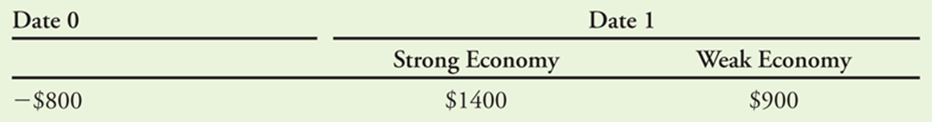
A simple example: Financing with Equity (see textbook)
Consider this investment project
  You will invest initially $800 today (year 0) and receive either $1400 or $900 next year
  → depending on the status of the economy, with each scenario equally likely (p=0.5)
  The cash flows depend on the business cycle; thus, they have uncertainty (market risk)
  As a result, you demand from the project a risk premium of 10% over the risk-free interest rate of 5%
  The cost of capital is 15%
  What is the NPV?

Slide 5
A simple example: Financing with Equity
The mean, expected, cash flow in year 1 is:
  (0.5)($1400) + (0.5)($900) = $1150
Thus, the NPV:
If you use only equity to finance the project, how much would you be willing to pay for the project?
“If you can raise $1000 by selling equity in the firm, after paying the investment cost of $800, you can keep the remaining $200, the NPV of the project NPV, as a profit”

Slide 6
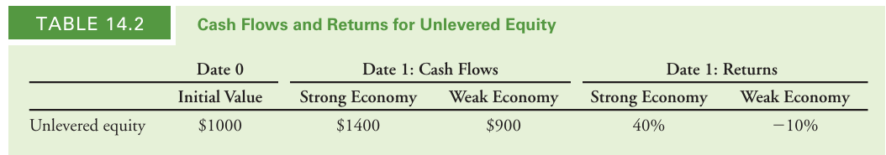
A simple example: Financing with Equity
Unlevered Equity: the equity in a firm that has no debt
Since there is no debt → cash flows of the unlevered equity = cash flows of the investment

Slide 7
A simple example: Financing with Equity
What is the return to the shareholders ?
Either (40%) or (–10%)
What is the expected return on the unlevered equity ?
(0.5)(40%) + (0.5)(-10%) = 15%
Since cost of capital of the investment = 15%
→ The shareholders are earning an appropriate return for their risk

Slide 8
Financing both with Debt and Equity
Now let us see a different case
In addition to selling equity, assume now that the firm borrows $500 initially.
Since the CFs will be enough to repay the debt (no risk), the appropriate rate is the risk free 5%
Thus, in year 1 the firm will owe to the loan ($500 × 1.05) = $525
Levered Equity: the equity in a company that also has debt outstanding
Since now there is also debt ($525) the shareholders will receive:
$875 ($1400 – $525 = $875) in a strong economy
$375 ($900 – $525 = $375) in a weak economy

Slide 9
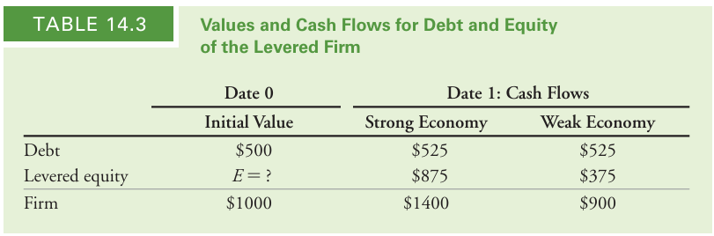
Financing both with Debt and Equity
The Q is: At what price (E) should the levered equity be sold?
That is: What is the optimal capital structure?

Slide 10
Financing both with Debt and Equity
Modigliani and Miller argued that in perfect capital markets:
→ the total value of a firm should not depend on its capital structure
The idea is simple: the firm’s total CFs are still equal the CFs from the investment
→ should have the same present value
Since, the CFs of (Debt + Equity) = CFs from the investment
→ The combined values of debt and equity = $1000 (Law of One Price)
Therefore, if debt =$500, levered equity should = $500 (E = $1000 – $500 = $500)

Slide 11
Financing both with Debt and Equity
Since the CFs of the levered equity < the CFs of the unlevered equity
→ the levered equity price should be lower ($500 versus $1000).
However, note that:
The firm will still raise capital of $1000 (issuing both debt and levered equity)
As a result, the firm should be indifferent between the two options for capital structure
Note though, that leverage increases risk for equity holders (see below)
→ the CFs of levered equity cannot be discounted at the same rate (15%) of unlevered equity
Thus, levered equity investors should require a higher expected return (compensation for ↑ risk)

Slide 12
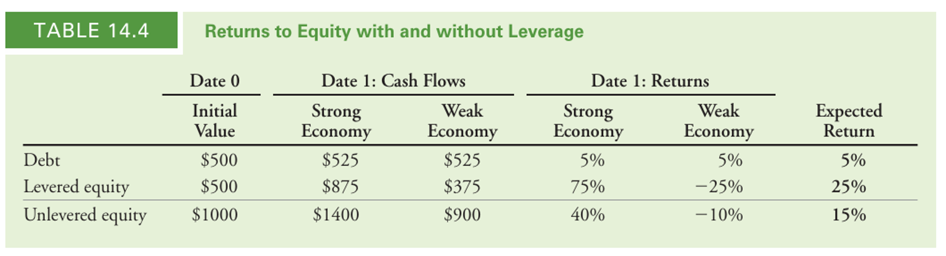
Financing both with Debt and Equity
The returns (R) for equity holders are different (levered equity and unlevered equity)
→R for unlevered equity = (40%) or (–10%); expected R = 15%
→R for levered equity = (75%) or (–25%); expected R = 25%
Higher uncertainty (risk)

Slide 13
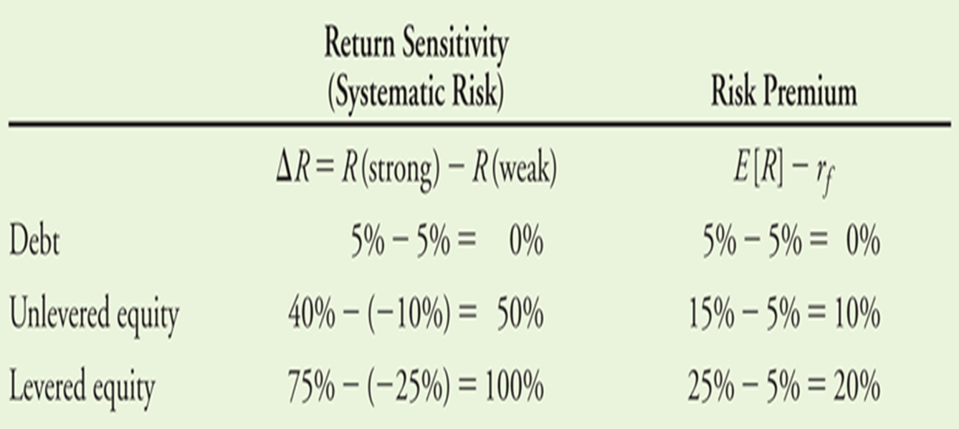
Financing both with Debt and Equity
Effect of Leverage on R and Risk
To evaluate the relationship: estimate the sensitivity Rs to systematic risk (economy)
Debt: no systematic risk; risk premium = 0
In our example, levered equity has twice the systematic risk of the unlevered equity
→ twice the risk premium

Slide 14
Financing both with Debt and Equity
Conclusions (In perfect capital markets)
  100% equity
  → expected return for equity holders 15%
  50% debt & 50% equity
  → the debt holders 5%
  → levered equity holders 25%
  Leverage increases the risk of equity
  Debt may be cheaper BUT it raises the cost of capital
  Average cost of capital with leverage = unlevered

Slide 15
Modigliani-Miller I (MM)
In perfect capital markets (PCMs) participants can trade the same set of securities at competitive market prices (PV of future CFs; no taxes; no transaction costs; no costs of issuing securities)
Law of One Price → leverage will not affect the total value of the firm
But it changes the allocation of CFs (not the total CFs) between debt and equity
A firm’s financing decisions do not change the CFs generated by its investments
Nor do they reveal new information about them
MM Proposition I:
“In a perfect capital market, the total value of a firm is equal to the market value of the total cash flows generated by its assets and is not affected by its choice of capital structure”

Slide 16
Modigliani-Miller I (MM)
MM: the firm’s value is not affected by its choice of capital structure
Assume that investors prefer an alternative capital structure (to the chosen by the firm)
MM: investors can borrow or lend on their own and achieve the same result
For example, an investor who would like more leverage than the firm has chosen can borrow and add leverage to his or her own portfolio
They use “Homemade Leverage”
Homemade Leverage is a perfect substitute for the use of leverage by the firm
→ if investors can borrow or lend at the same interest rate as the firm

Slide 17
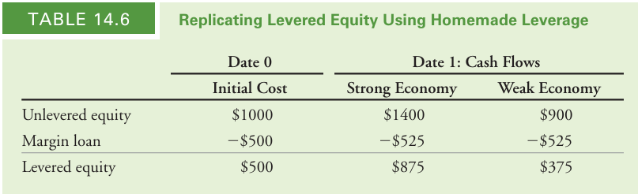
Modigliani-Miller I (MM)
Example: an all-equity firm but an investor prefers to hold levered equity
She can use leverage in her own portfolio (e.g., buy the stock on margin, see Table)
The CFs of the unlevered equity serve as collateral for loan (i.e., the loan is risk-free borrows at 5% rate)
The investor has replicated the payoffs to the levered equity for a cost of $500.
By the Law of One Price, the value of levered equity must also be $500.

Slide 18
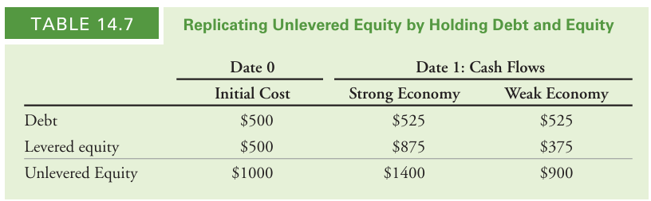
Modigliani-Miller I (MM)
Now suppose the firm uses debt, but the investor would prefer to hold unlevered equity.
The investor can replicate the payoffs of unlevered equity
→ Buy both the debt and the equity of the firm
Combining the CFs of the two securities produces cash flows identical to unlevered equity
For a total cost of $1000

Slide 19
Modigliani-Miller I (MM)
One application of MM Proposition I is the market value balance sheet of the firm
A market value balance sheet is like an accounting balance sheet but:
all assets and liabilities of the firm are included (even intangible assets such as reputation, brand name, or human capital, etc.)
all values are current market values rather than historical costs
The total value of all securities issued by the firm must equal the total value of the firm’s assets
It captures the idea that value is created by a firm’s choice of assets and investments
By choosing positive-NPV projects the firm can enhance its value.

Slide 20
Modigliani-Miller I (MM)
Using the market value balance sheet, we can compute the value of equity as follows:
Market Value of Equity =Market Value of Assets- Market Value of Debt and Other Liabilities

Slide 21
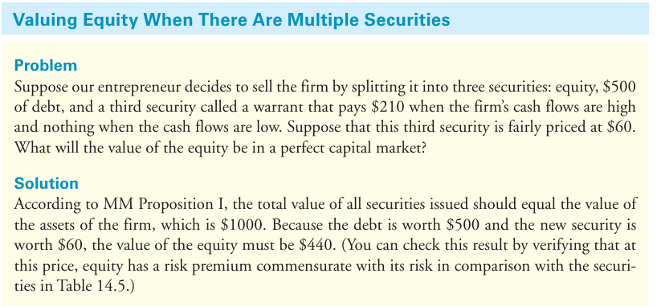
Modigliani-Miller I (MM)

Slide 22
Modigliani-Miller II (MM)
Why then the cost of capital differs for different securities? (See example above )
When the firm is financed only with equity, the equity holders require a 15% expected return
As an alternative, the firm can borrow at the risk-free rate of 5%.
Thus, debt has a lower cost of capital than equity, but it increases risk
→ increases the cost of capital of the firm’s equity
Here, we will discuss the impact of leverage on the equity cost of capital
We will see that it is unaffected by leverage
We will see that the savings from the low cost of debt capital
→ are exactly offset by a higher equity cost of capital
Thus, there are no net savings for the firm

Slide 23
Modigliani-Miller II (MM)
Using MM I we can arrive at MM Proposition II
Define as:
MV = Market Value
E = MV of equity in a levered firm
D = MV of debt in a levered firm
U = MV of equity in an unlevered firm
A = MV of the firm’s assets
Then, MM I states that:
Irrespective of whether the firm is unlevered or levered
→ the total MV of the firm’s securities = the MV of its assets

Slide 24
Modigliani-Miller II (MM)
  Because the return of a portfolio is equal to the weighted average of the returns of the securities in it, this equality implies the following relationship between the:
  (R_{E}) = return of levered equity
  (R_{D}) = return of debt
  Solving for R_{E}:
  Levered equity return = Unlevered return + premium due to leverage
  How much is the premium ?
  Depends on the amount of leverage (i.e., the market value debt-equity ratio, D/E)

Slide 25
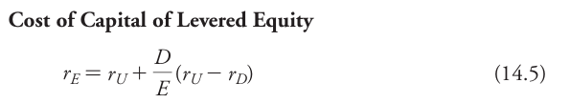
Modigliani-Miller II (MM)
This reveals the effect of leverage on the return of the levered equity
The levered equity return = unlevered return + an extra return due to leverage
MM Proposition II
The cost of capital of levered equity increases with the firm’s market value debt-equity ratio

Slide 26
Modigliani-Miller II (MM)
Based on our numerical example,
→ all-equity finance, the expected return on unlevered equity is 15%
→ if there is $500 of debt the expected return of the debt is 5%
Therefore, according to MM Proposition II, the expected return on equity for the levered firm is:

Slide 27
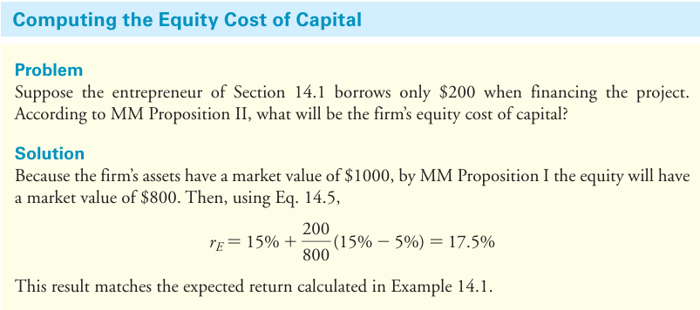
Modigliani-Miller II (MM)
Textbook Example 14.4

Slide 28
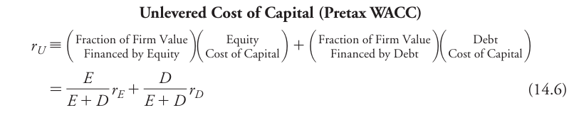
Capital Budgeting and the WACC
If a firm is financed with both E & D
→ Then the risk of its underlying assets will match the risk of a portfolio of its equity and debt
Thus, the appropriate cost of capital for the firm’s assets is the cost of capital of this portfolio
→ WACC = Weighted Average Cost of Capital

Slide 29
Capital Budgeting and the WACC
For an unlevered firm, all the free CFs by the assets are paid out to shareholders
The MV, risk, and cost of capital for the firm’s assets (r_{A}) and its equity coincide
If a firm is levered, r_{A} is equal to the firm’s WACC (Unlevered Cost of Capital (pretax WACC))
That is, with perfect capital markets, a firm’s WACC is independent of its capital structure
→ It is equal to its equity cost of capital if it is unlevered
→ Which matches the cost of capital of its assets.

Slide 30
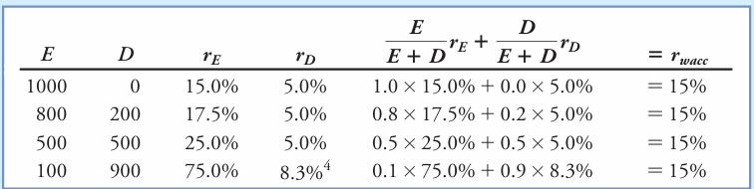
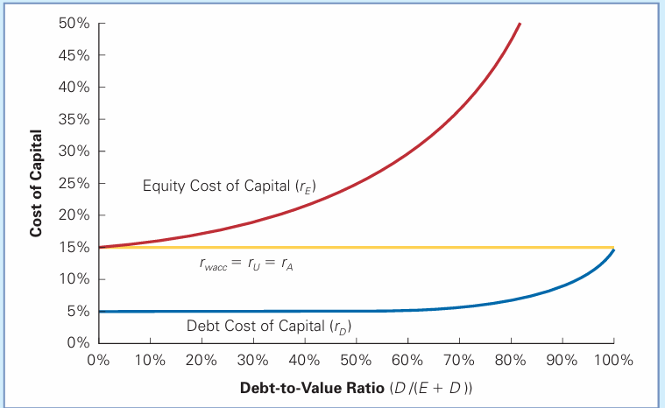
Capital Budgeting and the WACC
In PCMs the WACC is independent of its capital structure
Debt-to-Value Ratio = % of enterprise value that corresponds to debt
Based on the previous example let us calculate the WACC for alternative capital structures:
If you plot the costs you get → (see graph)

Slide 31
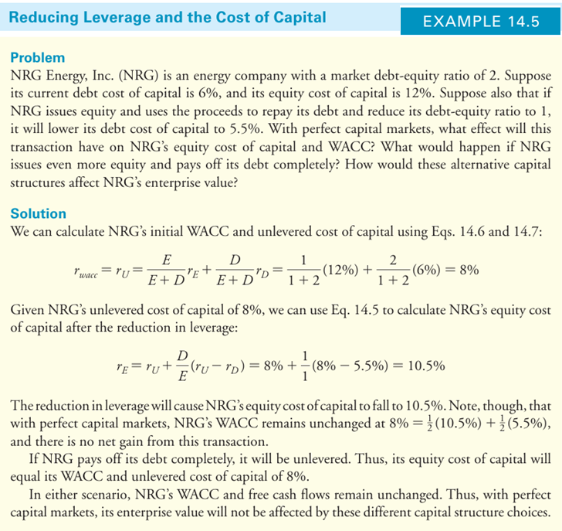
Capital Budgeting and the WACC

Slide 32
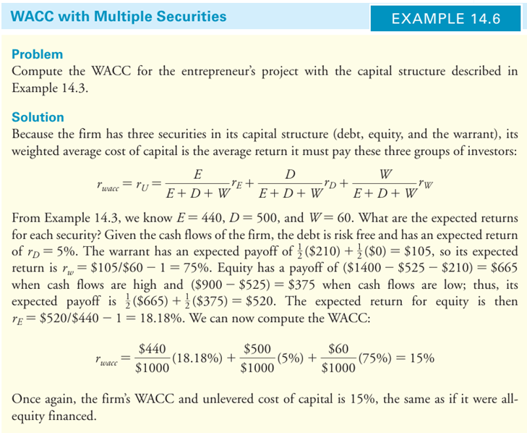
Capital Budgeting and the WACC

Slide 33


Levered and Unlevered Betas
Also, a firm’s unlevered or asset beta is the weighted average of its equity and debt beta
In addition, the unlevered beta measures the market risk of the firm’s underlying assets,
Thus, it can be used to assess the cost of capital for comparable investments
When a firm changes its capital structure without changing its investments, its unlevered beta will remain unaltered
However, its equity beta will change to reflect the effect of the capital structure change on its risk
Rearranging gets:

Slide 34
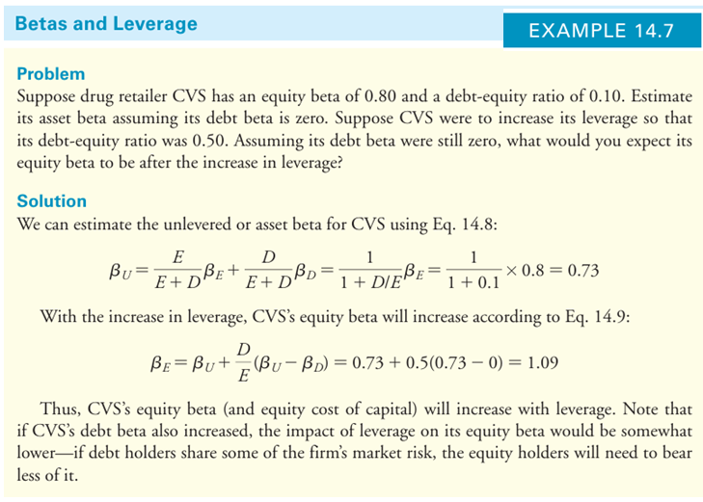
Levered and Unlevered Betas

Slide 35
Other Issues on Capital Structure
Leverage and EPS
Consider firm LVI, an all-equity firm
It expects EBIT = $10 m for the next year
It has 10 m shares outstanding
The stock is trading at $7.50
LVI is considering borrowing $15 m at 8% and use the funds to repurchase 2 m shares
Suppose LVI has no debt
Since there is no interest and no taxes, Earnings = EBIT, thus the EPS now are:

Slide 36
Other Issues on Capital Structure
If the firm borrows, they will have payments for $1.2 million/year ($15 million × 8%)
Thus, since the Earnings = EBIT – Interest
The expected earnings after interest = $8.8 million (10 – 1.2 = 8.8)
The EPS now become $8.8 million ÷ $8 million shares = $1.10
The expected EPS increase with leverage
Note, however, that the shareholders are NOT better off
Why ?
Because the risk of its EPS also increases
Think of it like this: EPS increases on average to compensate shareholders for the additional risk
The share price does not increase

Slide 37
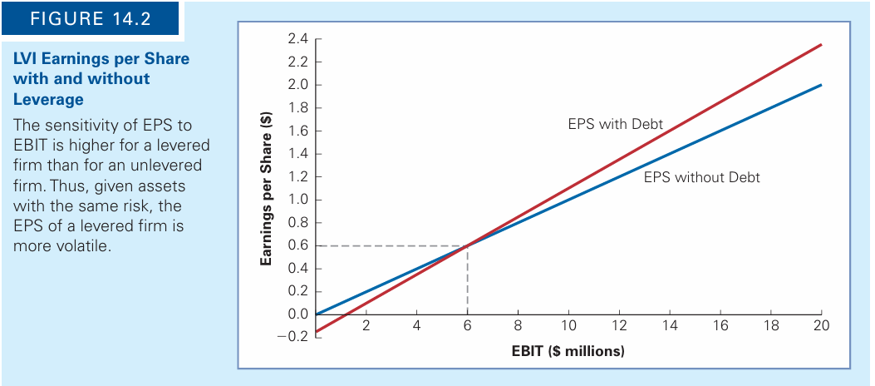
Other Issues on Capital Structure

Slide 38
Other Issues on Capital Structure
Dilution = An increase in the total of shares that will divide a fixed amount of earnings
Example
Jet Sky Airlines (JSA) currently has no debt and 500 m shares outstanding, at $16 per share
The firm announces that it will expand and needs $1 billion to buy new planes
This will be financed by issuing new equity
The current value of the equity and the assets of the firm is $8 billion
500 million shares × $16 per share = $8 billion
Suppose they sell 62.5 million new shares at $16 per share
To raise the $1 billion needed

Slide 39
Other Issues on Capital Structure
  The MV of the firm’s assets grows (an additional $1 b in cash) and the No of shares increases
  The value per share is unchanged at $16 per share
  As long as the firm sells the new shares of equity at a fair price, there will be no gain or loss to shareholders associated with the equity issue itself
  Any gain or loss associated with the transaction will result from the NPV of the investments the firm makes with the funds raised.

Slide 40
Conclusion
With perfect capital markets, financial transactions neither add nor destroy value
Instead, they represent a repackaging of risk (and therefore return)
The value of an enterprise is the present value of all its future distributions to security holders
→ It does not depend on the company’s capitalization
Any financial transaction that appears to be a good deal in terms of adding value
→ either is too good to be true
→ or is exploiting some type of market imperfection

Slide 41
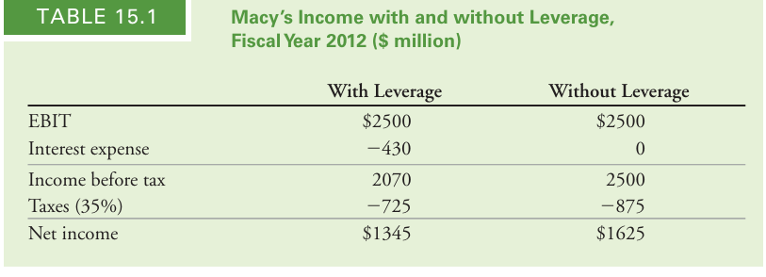
Debt and Taxes
Firms pay taxes on the income that they earn
However, the income is the profit after interest payments are deducted
Thus, interest expenses reduce the amount of the corporate tax that firms pay
→ incentive to use debt.
Example: in 2012 Macy’s, Inc., had
→ EBIT = $2.5 billion
→ Interest expenses = $430 million
→ A marginal corporate tax rate = 35%
In 2012 net income was lower with leverage than it would have been without leverage.
Thus, debt obligations reduced the income available to equity holders.

Slide 42
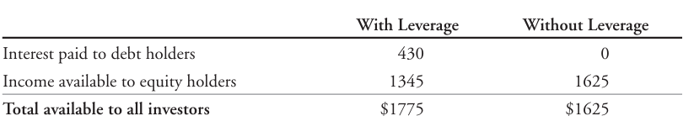
Debt and Taxes
But the total amount available to all investors was higher with leverage:
With leverage, Macy’s was able to pay out $1775 million in total to its investors, versus
→ only $1625 million without leverage, representing an increase of $150 million
Recall that the value of a firm is the total amount it can raise from all investors
→ not just equity holders

Slide 43
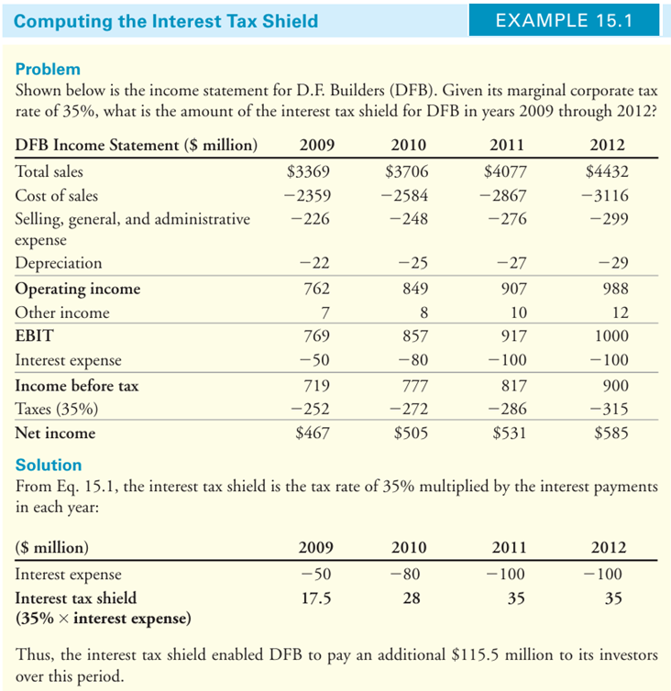
Debt and Taxes

Slide 44

Debt and Taxes
Interest tax shield provides a corporate tax benefit each year:
Because the CFs of the levered firm = the sum of the CFs from the unlevered firm + plus the interest tax shield
The Law of One Price suggests that this is the same for the PV of CFs
It can be shown:

Slide 45
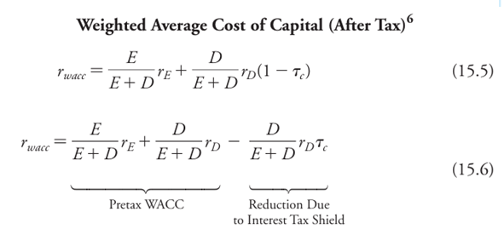
Debt and Taxes
Additionally, it can be shown that:

Slide 46
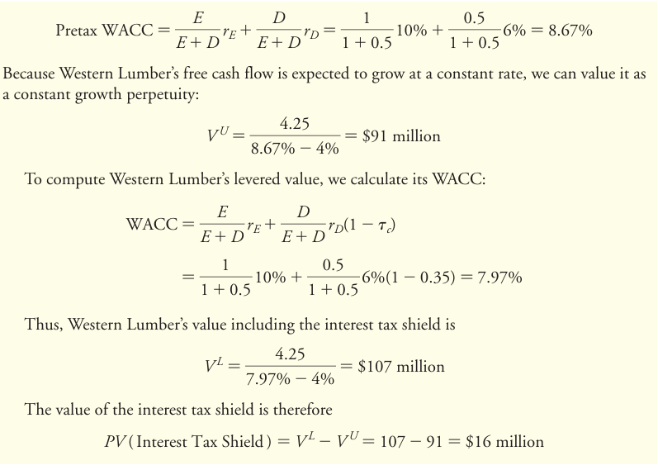

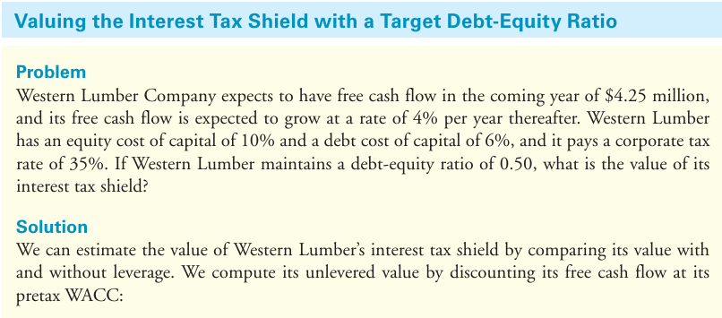

Slide 47
Indicative References
Textbook, Berk & DeMarzo, Corporate Finance, Chapter 14
Beck, T., Demirgüç-Kunt, A., Maksimovic, V. (2008). Financing patterns around the world: Are small firms different? Journal of Financial Economics 89, 467–487
DeAngelo, H. (2022). The Capital Structure Puzzle: What Are We Missing? JOURNAL OF FINANCIAL AND QUANTITATIVE ANALYSIS 57, 413–454
Graham, J., Leary, M. (2011). A Review of Empirical Capital Structure Research and Directions for the Future. Annual Review of Financial Economics 3, 309–45.
Harris, C., Roark, S. (2018). Cash flow risk and capital structure decisions. Finance Research Letters
Kayo, E., Kimura, H. (2011). Hierarchical determinants of capital structure. Journal of Banking & Finance 35, 358–371.
Myers, S., Majluf, N. (1984). Corporate financing and investment decisions when firms have information that investors do not have. Journal of Financial Economics 13 (2): 187–221.
Rauh, J., Sufi, A (2008). Capital Structure and Debt Structure. NBER Working Paper No. 14488
Titman, S., Wessels, R., 1988. The determinants of capital structure choice. The Journal of Finance 43, 1–19
Robb, A.M., Robinson, D.T. (2014). The capital structure decisions of new firms. The Review of Financial Studies 27, 153–179.

Slide 48
Dividend Policy

Slide 49
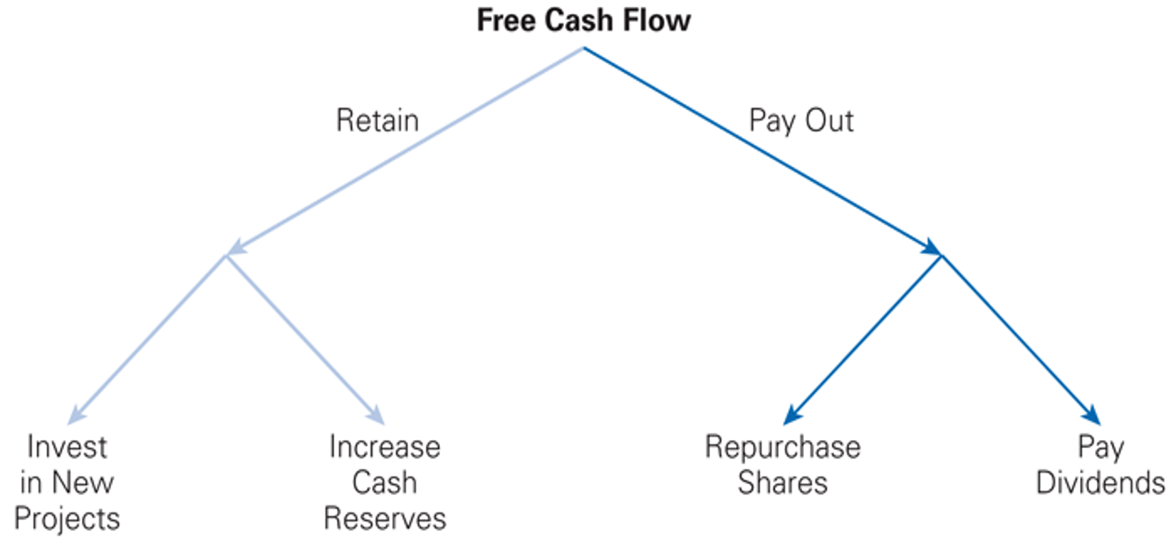
Dividend (Payout) Policy
Firms generate free cash flows; an important decision is what to do with them
If firms have new positive-NPV investment opportunities, they can it can reinvest the CFs
However, many mature firms often generate more CFs than they need to fund investments
In these cases, they may:
→ either hold cash reserves
→ or pay the cash to shareholders
If they pay shareholders, they then have to decide how

Slide 50
Dividend (Payout) Policy
Dividend: Important Dates
Declaration Date (DD) = when the Board of Directors authorizes the payment
Record Date (RD) = When a corporation pays a dividend to (registered) shareholders
Ex-dividend Date= 2 days before the RD; after which investors buying the stock are not eligible for a D
Payable Date (Distribution Date) = usually within 30 days after the RD, on which the D is paid
Cum-dividend = Just before the ex-dividend date, the stock trades cum-dividend (“with the dividend”), it means that anyone who buys the shares is entitled to the dividend

Slide 51
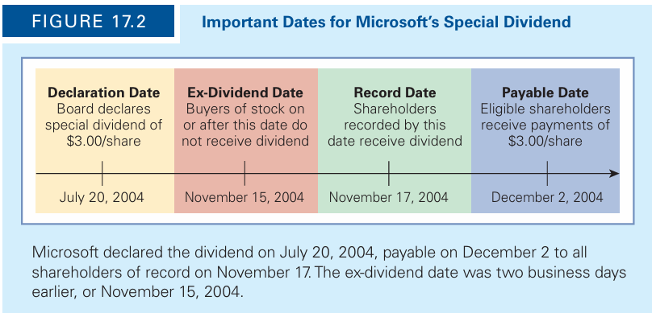
Textbook: Figure 17.2; Microsoft’s Special Dividend
Dividend (Payout) Policy
“In a perfect capital market, when a dividend is paid, the share price drops by the amount of the dividend when the stock begins to trade ex-dividend”

Slide 52
Dividend (Payout) Policy
Special Dividend = A one-time payment a firm makes, usually higher than a regular D
Stock Split (Stock Dividend) = a firm issues a D in shares rather than cash
Return of Capital = a corporation, instead of a D from current earnings, pays D from other sources (e.g., liquidation of assets)
Liquidating Dividend =when a corporation is terminated pays capital to shareholders
Share Repurchases (buyback) = a way to pay cash to stockholders; the corporation uses cash to buy its own shares, which are (usually) held in the corporate treasury.
→ They can be sold back to the market if the firms needs to raise funds in the future.

Slide 53
Share Repurchases
Open Market Repurchase
  A corporation announces that it will buy its own stocks in in the open market (like any investor)
  These type of repurchases are approximately 95% of all repurchase transactions
  The company may buy the shares within a year (or more)
  The company may not buy the full amount it originally announced (not obligated)
  The company must buy the shares in a way that does affect or manipulate the stock price
  “For example, SEC guidelines recommend that the firm not purchase more than 25% of the average daily trading volume in its shares on a single day, nor make purchases at the market open or within 30 minutes of the close of trade”

Slide 54
Share Repurchases
Tender Offers
The firm announces publicly an offer to all existing stockholders to buy back a specified % of outstanding shares, at a prespecified price, over a prespecified period
Usually at a 10%-20% premium to the current market price
Usually over 20 days
Tender Offers may depend on stockholders providing sufficient number of shares; if not, the corporation may cancel the tender offer
Dutch Auctions
A share repurchase procedure where the corporation provides different prices at which it is prepared to buy the stock, and equity holders in turn indicate how many shares they are willing to sell at each price
The firm then pays the lowest price at which it can buy back its desired number of shares

Slide 55
Share Repurchases
Targeted Repurchase
A corporation buys shares directly from a specific stockholder
The price is negotiated between the two parties
It may take place when a major equity holder wants to sell many stocks and the market is not adequately liquid
Greenmail
In cases where a major shareholder threats to buy (takeover) the firm and remove the management, the corporation buys out the shareholder
This often takes place at a high premium over the current market price

Slide 56

Dividends and Share Repurchases
Genron Corporation (hypothetical example, see textbook)
The Board of Directors are about to decide how to pay out $20 m excess cash to equity holders
The firm has no debt
The firm expects to generate additional free cash flows of $48 million per year in subsequent years
The equity cost of capital = unlevered cost of capital of 12%
10 m shares outstanding
Including the cash, the total market value is $420 million

Slide 57
Dividends and Share Repurchases
The Board has to decide how to pay out its $20 million in excess cash to shareholders
Cash dividends ? / Repurchasing shares ? / Raise additional cash and pay higher dividends ?
Will the stock price be affected? / Which policy ?
Policy 1: Pay Dividends
With 10 million shares outstanding, the firm will pay a $2 dividend
Expectations of future free CFs of $48 million per year
Thus, a dividend of $4.80 per share each year thereafter
Record date as December 14 / the ex-dividend date is December 12

Slide 58
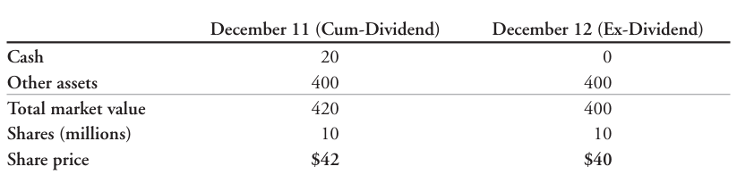
Dividends and Share Repurchases
The cum-dividend price should be:
After the ex-dividend date, new investors will not receive the D, and the share price will be:
The change in price can also be determined by the market value balance sheet (in millions):

Slide 59
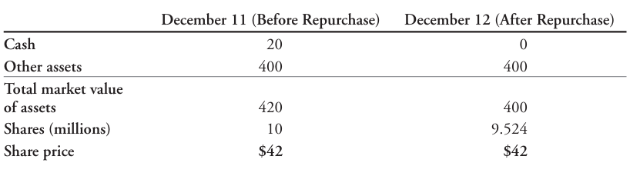
Dividends and Share Repurchases
Policy 2: Share Repurchase
The firm is using the $20 m cash to buy its shares on the open market
Since the stock price is $42, the firm can buy 476,000 shares ($20 m / $42)
They will now have 9.524 m shares outstanding (10m – 0.476)
The share price remains the same:

Slide 60
Dividends and Share Repurchases
Why will the repurchase have no impact on the share price?
After the repurchase, the future D = $5.04 per share ($48 m / 9.524 m shares)
The share price will be (assuming constant D at 5.04)
“In perfect capital markets, an open market share repurchase has no effect on the stock price, and the stock price is the same as the cum-dividend price if a dividend were paid instead”

Slide 61
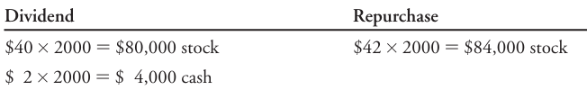
Dividends and Share Repurchases
Would an investor prefer that Genron issue a dividend or repurchase its stock?
Both policies lead to the same initial share price of $42.
Consider an investor who currently holds 2000 shares of Genron stock.
The investor’s holdings after a dividend or share repurchase are as follows:
In either case, the value of the investor’s portfolio is $84,000 immediately after the transaction.
The only difference is the distribution between cash and stock holdings.
The investor would prefer one approach or the other based on whether she needs the cash.

Slide 62
Dividends and Share Repurchases
“In perfect capital markets, investors are indifferent between the firm distributing funds
→ via dividends or
→ share repurchases”
Homemade dividend: Investors can replicate both pay-out procedures on their own
In our example,
→ if the firm repurchases shares and the investor wants cash, the investor can sell stocks and get cash
→ if the firm pays a dividend and the investor prefers stocks, the investor can use the cash from dividends and buy more stocks

Slide 63
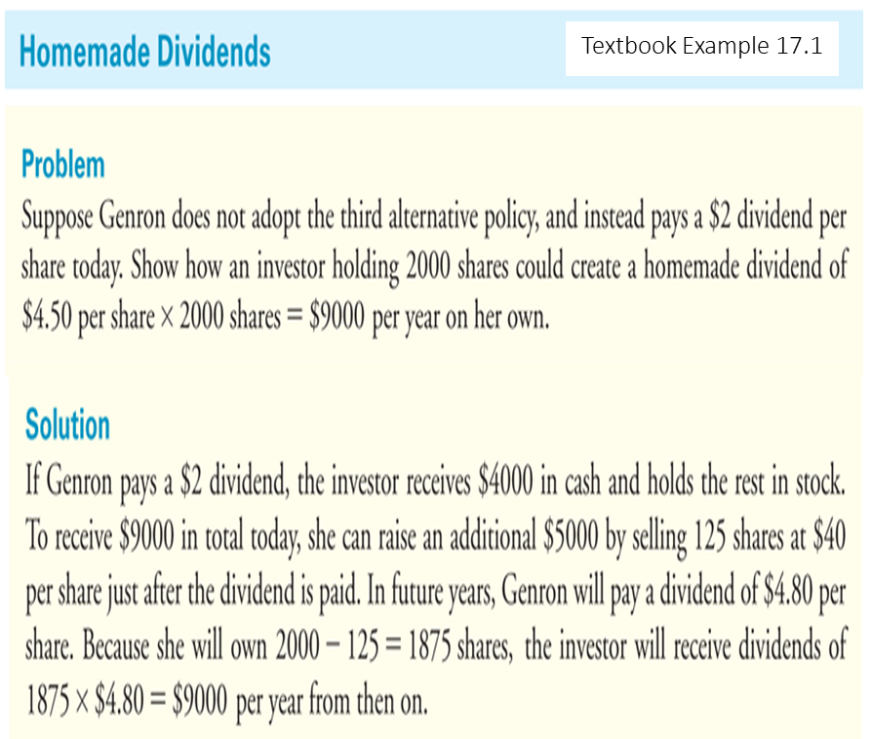
Dividends and Share Repurchases

Slide 64
Dividends and Share Repurchases
Policy 3: High Dividend (Equity Issue)
Suppose the firm pays D > $2, but only has $20 m in cash
Genron needs an additional $28 m, if thy want to start paying $48 today
They raise cash by selling new shares
With a price of $42, they could raise $28 m by selling 0.67 m shares ($28 m / $42)
The total number of shares = 10.67 m
The new D =
The cum-dividend price =
Note that the price remains unchanged

Slide 65
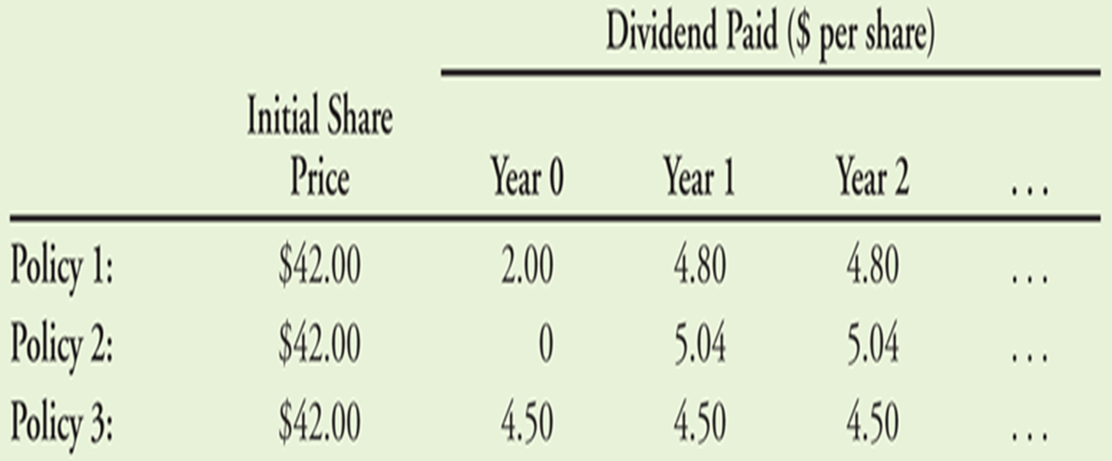
Modigliani–Miller & Dividend Policy
There is a trade-off between current and future dividends
If Genron pays a higher current dividend, future dividends will be lower
If Genron pays a lower current dividend, future dividends will be higher
Table 17.1 (textbook)

Slide 66
Modigliani–Miller & Dividend Policy
MM Dividend Irrelevance:
“In perfect capital markets, holding fixed the investment policy of a firm, the firm’s choice of dividend policy is irrelevant and does not affect the initial share price”
The free CFs determine the level of payouts to its investors
In a PCM the type of payout is irrelevant
In practice, capital markets are not perfect
→ imperfections determine the payout policy of a corporation

Slide 67
Modigliani–Miller & Dividend Policy
The Tax Disadvantage of Dividends
The higher tax rate on dividends makes it undesirable for a firm to raise funds to pay a dividend
If D are taxed at higher rates than capital gains, then if a firm issues shares to raise money and then use the cash to pay dividends
→ the shareholders are worse off (they will get back less than their initial investment)

Slide 68
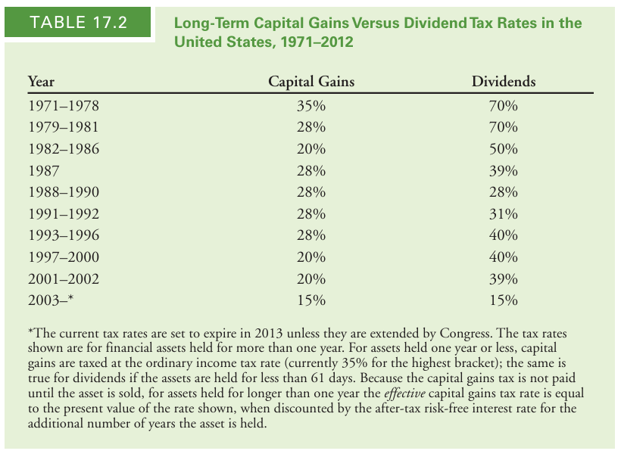
The Tax Disadvantage of Dividends

Slide 69
Modigliani–Miller & Dividend Policy

Slide 70
Optimal Dividend Policy with Taxes
If tax rate on D > the tax rate on capital gains
→ shareholders will pay lower taxes if a firm uses share repurchases
The tax savings will increase the value of a firm that uses share repurchases rather than D
The optimal dividend policy when the dividend tax rate > the capital gain tax rate:
→ pay no D
Historical data indicate that payment of D is ↓, while repurchases are ↑

Slide 71
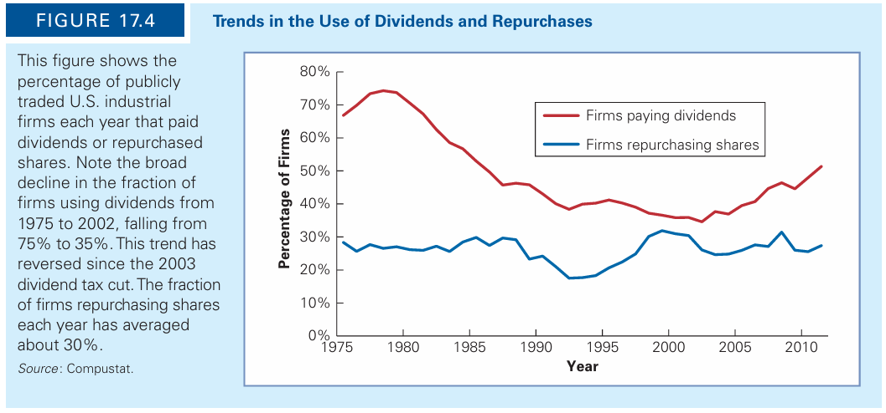
Textbook: Figure 17.4 Trends in the Use of Dividends and Repurchases
Optimal Dividend Policy with Taxes

Slide 72
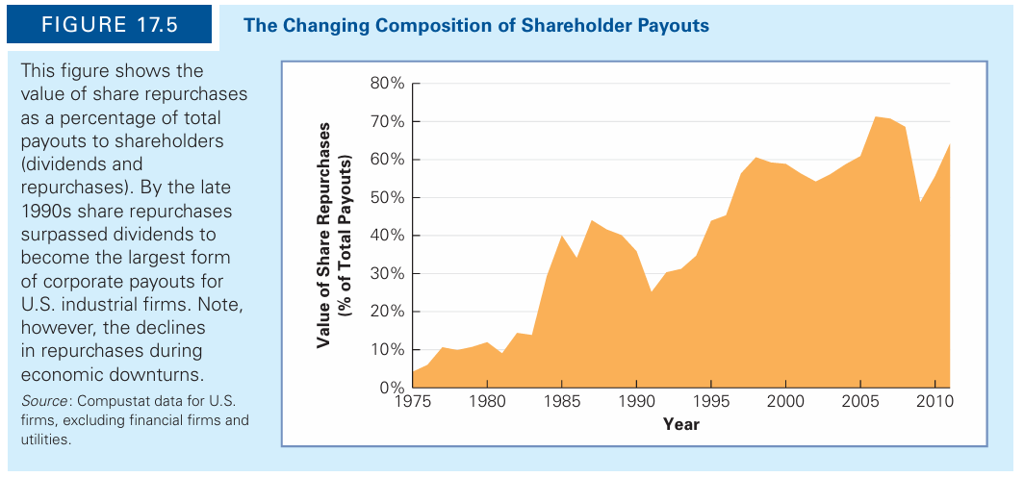
Textbook: Figure 17.5 The Changing Composition of Shareholder Payouts
Optimal Dividend Policy with Taxes

Slide 73
Dividend and Tax Clienteles
The preference for share repurchases rather than dividends
→ depends on the difference between the D tax rate and the capital gains tax rate
Tax rates vary by income, by jurisdiction, and by whether the stock is held in a retirement account
Thus, firms may attract different groups of investors depending on their dividend policy
Example: you buy a stock before ex-dividend and sell it just after
Arbitrage suggests that the equilibrium condition is:
→ t_{d} = investor’s dividend tax rate
→ t_{g} = capital gains tax rate

Slide 74
Dividend and Tax Clienteles
The above can also be expressed as:
Thus, the effective dividend tax rate is:
This is a measure of the additional tax paid by investors per dollar of after-tax capital gains income that is instead received as a dividend

Slide 75
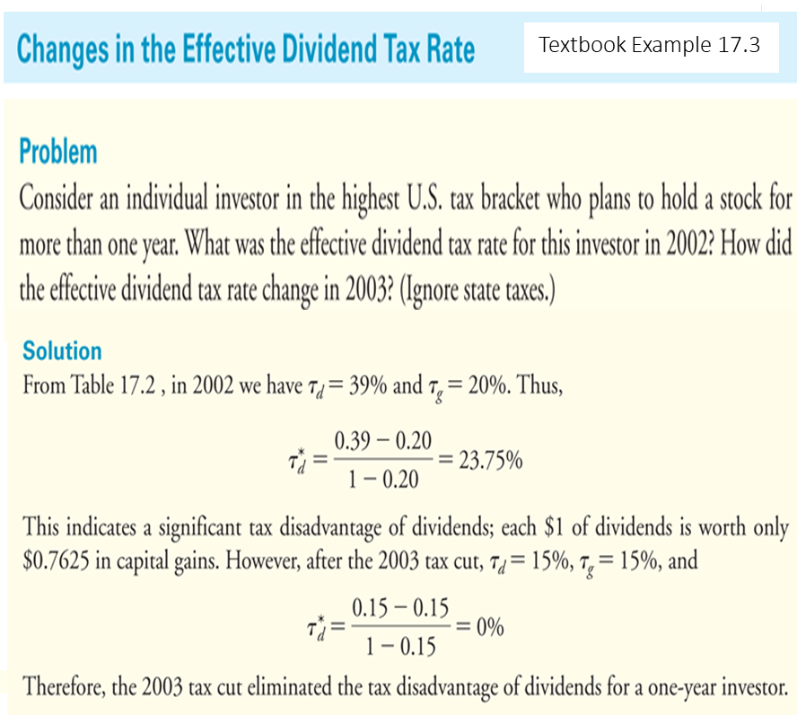
Dividend and Tax Clienteles

Slide 76
Tax Differences Across Investors
The effective dividend tax rate differs across investors for a variety of reasons.
  Income Level
  Investment Horizon
  Tax Jurisdiction
  Type of Investor or Investment Account
→ Investors with different tax rates have different dividend preferences
Clientele Effect: the dividend policy of a corporation reflects the tax preference of their clientele
Investors at the highest tax brackets → prefer stocks that pay no or low D
Investors that are tax-free and corporations → prefer stocks with high D

Slide 77
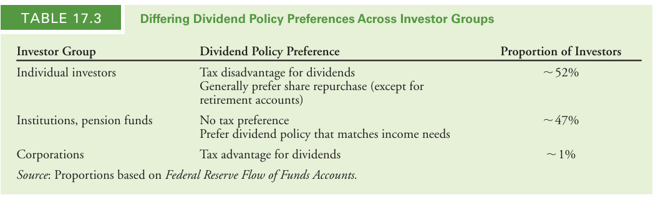
Textbook: Table 17.3 Differing Dividend Policy Preferences Across Investor Groups
Tax Differences Across Investors

Slide 78
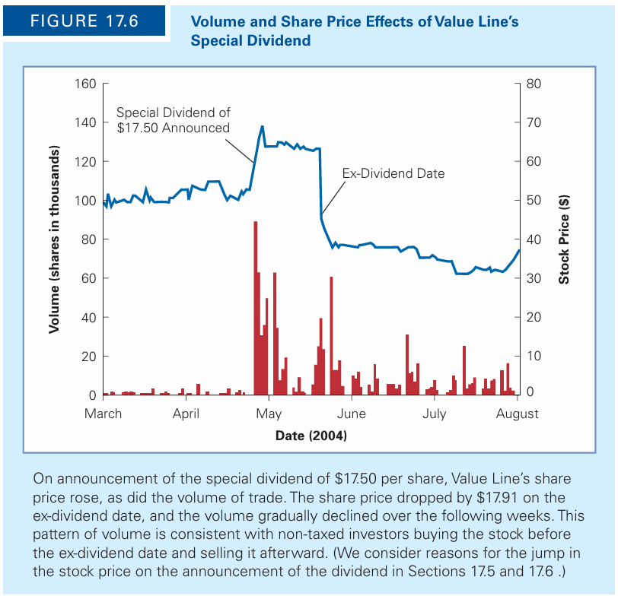
Tax Differences Across Investors
Dividend-capture theory
Absent transaction costs, investors can trade shares at the time of the dividend so that non-taxed investors receive the dividend
That is, non-taxed investors need not hold the high-dividend-paying stocks all the time
It is necessary only that they hold them when the dividend is actually paid.

Slide 79
Payout Vs Retention of Cash
In PCMs, if a corporation has taken all positive-NPV investments, it is indifferent between saving excess cash and paying it out
In market imperfections, there is a tradeoff: Retaining cash lowers the costs of raising funds, but it can also increase taxes and agency costs
Instead of investing in negative-NPV projects, a firm can use the cash to purchase financial assets
In PCMs, buying and selling securities is a zero-NPV transaction, so it should not affect firm value.
→ in PCMs the retention vs payout decision is irrelevant
MM Payout Irrelevance: “In perfect capital markets, if a firm invests excess cash flows in financial securities, the firm’s choice of payout versus retention is irrelevant and does not affect the initial share price”

Slide 80
Taxes and Cash Retention
The decision to pay out versus retain cash may also affect the taxes paid by shareholders
If a firm retains cash, the interest on retained cash is taxed twice:
→ it must pay corporate tax on the interest
→ investors will owe capital gains tax on the increased value of the firm
If the firm paid the cash to its shareholders instead, they could invest it and be taxed only once on the interest that they earn.
The cost of retaining cash therefore depends on the combined effect of the corporate and capital gains taxes, compared to the single tax on interest income:
Corporations, generally, retain cash to cover potential future cash shortfalls, e.g., if the believe that in the future they will not have enough from retained earnings t take positive-NPV projects

Slide 81
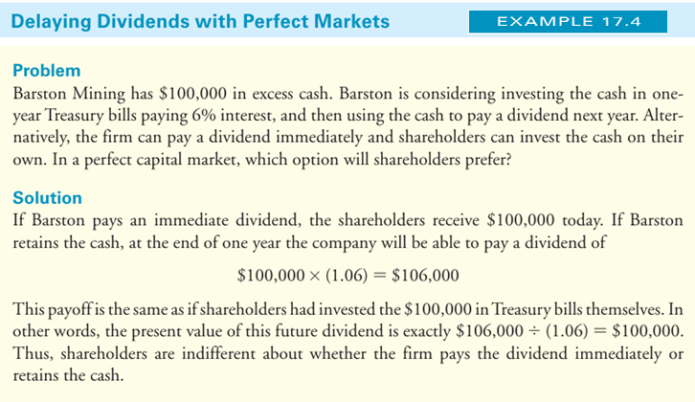
Taxes and Cash Retention

Slide 82
Taxes and Cash Retention
As the Example illustrates, there is no difference for shareholders
→ if the firm pays the cash immediately or
→ retains the cash and pays it out at a future date
Modigliani and Miller, financial policy irrelevance in perfect capital markets:
MM Payout Irrelevance:
“In perfect capital markets, if a firm invests excess cash flows in financial securities, the firm’s choice of payout versus retention is irrelevant and does not affect the initial value of the firm.”
Thus, the decision of whether to retain cash depends on market imperfections

Slide 83
Dividend Signaling Hypothesis
Asymmetric information is a market imperfection
In its presence the payout decisions may signal information to investors
Note that firms can change dividends at any time
→ in practice they vary the sizes of their dividends relatively infrequently
Note also that earnings often vary widely (much more compared to Dividends)
Dividend Smoothing: the practice of maintaining relatively constant
The firm’s dividend choice will contain information regarding management’s expectations:
When D ↑ a positive signal
When D ↓ a negative signal

Slide 84
Signaling and Share Repurchases
Share repurchases send a reliable signal that the stock is undervalued
Why?
If the stock was overvalued a share repurchase is costly for current shareholders
Assuming that the management of a corporation has superior info as regards to the corporation's future growth
Assuming they have the stockholder best interest in mind
Then, investors should have a positive reaction when repurchases are announced

Slide 85
Empirical Evidence - Dividend Policy (DP)
The literature on DP has two main views on cash dividends and the value of a firm
Miller and Modigliani (1961) → Dividends are irrelevant
Lintner (1965), Gordon (1959) → Dividends are important
As Baker and Weigand (2015) point out:
→ There is empirical evidence in support of the argument that managers believe that D should be tied to long term (permanent) increases in earnings
→ This is consistent with the idea that dividends and the value of the firm are related
→ Managers believe that D should be uninterrupted and are reluctant to cut them (unless forced)
→ This indicates support for the signalling hypothesis

Slide 86
Empirical Evidence - Dividend Policy (DP)
Overall, the empirical evidence shows that (see Baker and Weigand (2015)):
A. Main determinants of D are the stability of past dividends/earnings
The factors that have an impact on D decisions are not similar to all corporations
The characteristics of each firm, its corporate governance, differences in cultures and legal environments can have an impact on the implementation of DP
For example, DaSilva et al. (2004) point out that find that Anglo-American systems provide ↑ investor protection; German or European systems provide corporations higher flexibility for DP
B. Corporate managers believe that DP matters and are careful with it
The manage their DP rather than using the residual approach (pay out what is left after financing all available profitable investments - MM)
Corporate managers seem to support the dividend relevance hypothesis, i.e., that DP affect shareholder value

Slide 87
Empirical Evidence - Dividend Policy (DP)
Baker and Weigand (2015):
Up to the mid-1980s, US firms distributed cash to shareholders with cash D
Since then, more that 50% of distributions were in the form of share repurchases
Fama and French (2001):
In 1984 → 32% US industrial companies paid D
In 1999 → 16% US industrial companies paid D
Julio and Ikenberry (2004): % of US firms that paid D was at low 15% in 2001; it since has started to increase (more than 20% in 2004)
Empirical evidence indicates that this pattern is similar in Canada, Germany, France, Japan, and the UK and many other world countries (Fatemi and Bildik (2012) study 17,000 in 33 countries)
Amenta (2013): Large firms return to paying D
→ by 2013, 84% of the S&P500 firms paid D (pay-out ratio: 31.5%)

Slide 88
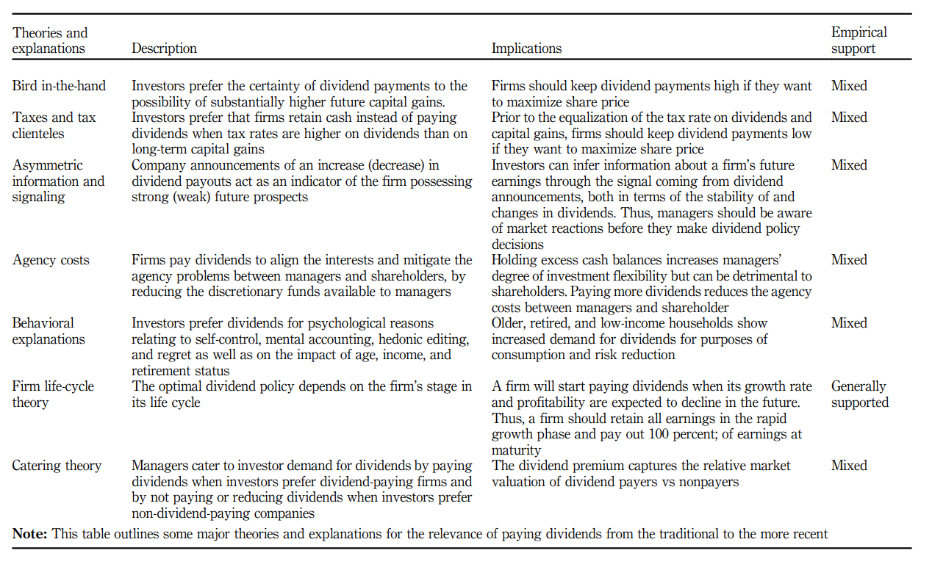
Empirical Evidence - Dividend Policy (DP)
Source: Baker and Weigand (2015)

Slide 89
Empirical Evidence - Dividend Policy (DP)
Why do firms pay dividends? Different theories
Firms want to communicate information to shareholders; they want to signal strong and healthy firm performance and the confidence of management as regards to the stability of earnings
Firms want to satisfy demand for payouts from investors (clientele effect); e.g. institutional investors (such as pension funds) want steady income
Investors prefer cash dividends today ("bird in the hand”) rather future capital gains
Regular dividend payments drive investors to perceive the stock as less risky
Shareholders demand it to reduce agency costs and keep management disciplined (e.g. management cannot spend excess cash in unprofitable projects)
The firm must distribute the free cash flows

Slide 90
Indicative References
Textbook, Berk & DeMarzo, Corporate Finance, Chapter 17
Amenta, M. (2013). FactSet: buyback quarterly S&P 500. Fact Research Systems Inc., pp. 1-13.
Baker, K., Weigand, R. (2015). Corporate dividend policy revisited. Managerial Finance 41 126-144
Black, F. (1976), “The dividend puzzle”, Journal of Portfolio Management, Vol. 2 No. 2, pp. 5-8.
Da Silva, L.S., Goergen, M. and Renneboog, L. (2004), Dividend Policy and Corporate Governance, Oxford University Press, Oxford.
Fama, E.F. and French, K.R. (2001). Disappearing dividends: changing firm characteristics or lower propensity to pay?, Journal of Financial Economics 60 3-43.
Fatemi, A. and Bildik, R. (2012). Yes, dividends are disappearing: worldwide evidence”, Journal of Banking and Finance 36, 662-677.
Gordon, M.J. (1959), “Dividends, earnings and stock prices”, Review of Economics and Statistics, Vol. 41 No. 2, pp. 99-105.
Julio, B. and Ikenberry, D. (2004)., Reappearing dividends, Journal of Applied Corporate Finance 16, 89-100.
Lintner, J. (1956), “Distribution of income of corporations among dividends, retained earnings and taxes”, American Economic Review, Vol. 46 No. 2, pp. 97-113.

Slide 91
Thank you for your attention !

