Slide 1
Debt Financing
Fixed Income Markets

Slide 2
Introduction
In this lecture, we discuss issues related to debt financing
More specifically we discuss:
→ Definitions and different types of debt securities (bonds)
→ Yields and yield spreads
→ The pricing of bonds using the yield curve
→ The risk of bonds (duration and convexity)
Reading: lecture notes, textbook (Chapter 5 and Chapter 6); indicative references at the end of the lecture

Slide 3
Fixed Income Markets
Bonds are debt securities (formal contracts) and differ from other types of borrowing (e.g., bank debt) because they are sold directly to investors
The issuer of a bond agrees to:
→ Pay fixed or floating interest (e.g., 5% every 6 months)
→ Repay the fixed principal at maturity (e.g., $1000)
What type of bonds are there ?
There are 4 main categories:
(1) Government Bonds (sovereign bonds, e.g., the U.S. Treasury)
(2) Corporate Bonds (corporate bonds from financial and non-financial corporations)
(3) Securitized/Collateralized/Structured bonds from governments or corporations
(4) High-yield and/or emerging market bonds

Slide 4
Fixed Income Markets
How big is the global bond market?
→ Global bond market capitalisation: approximately $120 trillion - $130 trillion
What is the % of each bond category in the global capitalisation?
→ Government securities: approximately 48%
→ Financial Corporation Securities approximately 37%
→ Non-Financial Corporation Securities approximately 13%
→ International Organisation Securities approximately2%
Who is the major market participant?
→ Institutional investors: about 90% to 95% of the trading

Slide 5
Fixed Income Markets

Slide 6
Fixed Income Markets - Definitions
Par Value (Face Value, Nominal Value, Principal Value)
→ the amount that has to be repaid at the end of the life of a bond
Issue price
→ the price at which investors buy the bonds when they are first issued , which will typically be approximately equal to the nominal amount
Maturity date
→ the date on which the issuer has to pay back the holders the nominal amount
The coupon rate
→ the interest rate that the issuer pays to the bond holders
Coupon Frequency
→ how often the coupon payments take place (once a year, twice a year, monthly, etc).

Slide 7
Fixed Income Markets - Definitions
Registered Bonds
→ The issuers maintain records of owners
→ As opposed to Bearer Bonds that are anonymous
Secured (Senior) Bonds
→ They are backed/guaranteed by some specified property (e.g. real estate assets)
Unsecured Bonds (Debentures)
→ They are backed only by the promise of the issuer to pay
Subordinate (Junior) Debentures
→ They are subordinated (junior) to other debentures

Slide 8
Fixed Income Markets - Definitions
An issuer may issue a bond with a Sinking Fund Provision
That is, the issuer may retire gradually the bond from the market before maturity
Example
Bond with a face value of $100,000,000, coupon rate 5%, maturity in 10 years, and a sinking fund of 25% for the last 4 years (years 7, 8, 9, 10)
→ In each of the last 4 years the issuer will retire $25,000,000 (25% of 100,000,000)
→ The bond will be repaid in a systematic fashion over its life

Slide 9
Fixed Income Markets - Definitions
An issuer may issue a bond with a Call Provision (Callable Bond)
The issuer has the right to ask to pay the Par value to the bondholders:
→ At pre-specified prices (usually with a premium)
→ At pre-specified dates
→ Before the actual maturity
There is usually a notice period to investors (e.g. 30 to 60 days before the call)
There is usually an initial protection period during which the issue cannot be called

Slide 10
Fixed Income Markets - Definitions
Example of a Callable Bond
Par Value: $100
Coupon rate: 3%
Issued: 28th of June 2011
Matures: 28th of June 2026
Protection period: 7 years
Callable between: 28th of June 2017 and 28th of June 2021
Callable when: On every coupon payment date
Call Prices: See Table

Slide 11
Fixed Income Markets – Definitions
An issuer may issue a bond with a Put Provision (Putable Bond)
The issuers provides for the bondholder to have the right to ask for a payment of the Par value from the issuer at pre-specified prices and pre-specified dates, before the actual maturity
Straight Bond (or Plain Vanilla Bond) = A bond with no option
Price of a Callable Bond = Price of the Straight Bond - Price of The Call Option
Price of a Puttable Bond = Price of the Straight Bond + Price of The Put Option

Slide 12
Fixed Income Markets – Definitions
An issuer may issue a bond with a Conversion Feature
The bond holder has the right but not the obligation instead of receiving the Par Value
→ To convert the bond to stocks at the maturity of the bond
→ According to a pre-specified conversion ratio
Hybrid security that combines elements of both debt and equity
Often issued by companies with a low credit rating and high growth potential
It may be callable or puttable
These are often Asset-Backed Securities, i.e. guaranteed by other loans, or personal property

Slide 13
Fixed Income Markets – Definitions
Conversion Price (CP) = Par Value / Conversion Ratio
If you do buy the bond and then convert it to stock, you will pay the:
Market Conversion Price (MCP) = Bond Market Price / Conversion Ratio
Note that if stock price > MCP → bond price will increase accordingly
When you buy a bond with a conversion feature you pay a premium over the current market price:
Premium = MCP – Current Stock Price
Why?
Even if the stock price falls, the price of the bond cannot fall bellow the intrinsic value of the stock
Thus, you can think of the premium as the price of the call option

Slide 14
Fixed Income Markets – Definitions
Example
A convertible bond with a Par Value of $1000 and a fixed coupon rate of 5%, maturity in 10 years
The Bond’s current market price is 107% or $1070
It has a conversion ratio of 25 (1 Bond = 25 Stocks)
The current stock price is $38, the annual dividend is $1.5, Div Yield = 3.9%
Conversion Price (CP) = 1000 / 25 = $40
Market Conversion Price (MCP) = 1070 / 25 = $42.8
Premium = $42.8 – $38 = $4.8
Premium as a %: 4.8 / 38 = 12.6%

Slide 15
Bond Prices
A. Price Quotation
For bonds listed in exchanges prices are quoted as a percentage (%) of their par value
A market price of 95.5 means that the bond trades at 95.5% of its Par value
→ If the par is 1000$ this means 955$
→ If the Par is 50000 this means 47750$ (50000 x 95.5%)
Fixed Income Markets – Definitions

Slide 16
Example of Corporate Bond Prices - Athens Exchange (ATHEX)
23/3/2026
CORPORATE BONDS - ATHEX | Last Price | Difference % | Bid Quantity x Price | Ask Quantity x Price | Last Transaction
AKTRB - 151225 - 5Χ - 1.000,00AKTRB1 | 102,98 | 0,37% | 2.000 x 101,781 | 14.000 x 102,980 | 13:05
CCECB - 250226 - 7Χ - 1.000,00CCECB1 | 97,5 | -0,01% | 17.000 x 97,700 | 2.000 x 98,000 | 13:01
CPLPB-22102021-5Χ-1.000,00CPLPB1 | 99,41 | -0,06% | 8.000 x 99,410 | 5.000 x 99,500 | 12:57
CPLPB - 260722 - 7Χ - 1.000,00CPLPB2 | 101,1 | 0,00% | 1.000 x 101,000 | 15.000 x 101,499 | 13:01
SBB - 110222 - 5Χ - 1000.00SBB1 | 99 | 0,00% | 10.000 x 98,400 | 3.000 x 99,000
ΑΡΑΙΓΟ-120319-7Χ-1.000,00ΑΡΑΙΓΟ1 | 100,15 | 0,78% | x | x | 17:25
ΑΡΑΙΓΟ-040725-7Χ-1.000,00ΑΡΑΙΓΟ2 | 100,18 | -0,08% | 7.000 x 99,678 | 23.000 x 100,180
ΓΕΚΤΕΡΝΑΟ-030720-7Χ-1.000,00ΓΕΚΤΕΡΝΑΟ2 | 98,7 | 0,20% | 10.000 x 98,700 | 13.000 x 99,000 | 13:02
ΓΕΚΤΕΡΝΑΟ -141221-7Χ- 1.000,00ΓΕΚΤΕΡΝΑΟ3 | 96 | -0,80% | 3.000 x 96,100 | 10.000 x 96,750
ΓΕΚΤΕΡΝΑΟ-290925-7Χ -1.0000,00ΓΕΚΤΕΡΝΑΟ4 | 97,7 | 0,21% | 2.000 x 97,351 | 3.000 x 97,700 | 12:58
ΕΛΧΑ-161121-7Χ-1.000,00ΕΛΧΑΟ1 | 96 | -0,23% | 2.000 x 95,880 | 25.000 x 96,500 | 12:56
ΙΝΛΟΤΟ-270224-5Χ-1.000,00ΙΝΛΟΤΟ1 | 102,5 | 0,98% | 5.000 x 101,510 | 14.000 x 102,450
ΙΝΤΕΚΟ-151223-5Χ-1.000,00ΙΝΤΕΚΟ1 | 102,8 | 0,00% | 5.000 x 102,600 | 19.000 x 102,800 | 13:00
LAMDADEVELΟ-210720-7Χ-1000,00ΛΑΜΔΑΟ1 | 99,9 | 0,15% | 6.000 x 99,540 | 7.000 x 99,899 | 12:58
ΛΑΜΔΑΟ - 181125 - 7Χ -1.000,00ΛΑΜΔΑΟ3 | 98,7 | 0,07% | 3.000 x 98,450 | 14.000 x 98,700 | 13:00
ΜΟΗΟ-230321-7Χ-1.000,00ΜΟΗΟ1 | 97,1 | -0,41% | 3.000 x 97,100 | 4.000 x 97,500 | 12:58
ΜΥΤΙΛΟ-100723-7Χ-1.000,00ΜΥΤΙΛΟ2 | 100,65 | 0,44% | 15.000 x 100,600 | 100.000 x 100,680 | 13:04
ΝΟΒΑΛ - 061221 - 7Χ - 1.000,00ΝΟΒΑΛΟ1 | 96,6 | -0,24% | 23.000 x 96,800 | 2.000 x 97,499 | 12:57
ΟΤΟΕΛΟ-230124-5Χ-1.000,00ΟΤΟΕΛΟ1 | 100,95 | -0,05% | 1.000 x 100,900 | 5.000 x 101,419 | 13:02
ΠΡΕΜΙΑ-250122-5Χ-1000,00ΠΡΕΜΙΑΟ1 | 98,45 | -0,76% | 10.000 x 98,750 | 4.000 x 99,400
ΠΡΟΝΤΕΑ - 200721 - 7Χ-1.000,00ΠΡΟΝΤΕΑΟ1 | 96 | 0,00% | 1.000 x 95,750 | 1.000 x 96,750 | 12:58
ΤΕΝΕΡΓΧΟ -221019-7Χ-1.000,00ΤΕΝΕΡΓΧΟ2 | 99,1 | -0,09% | 15.000 x 99,100 | 18.000 x 99,540

Slide 17
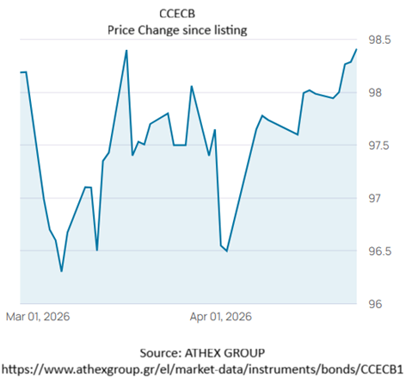
Example of Corporate Bond Prices - Athens Exchange (ATHEX)
 | Historical Data
Date | Close | Hi | Low | Volume | Value | Deals | YtM
20/3/2026 | 97,7 | 97,8 | 0,20% | 33.000 | 32.332,01 | 5 | 4,163
19/3/2026 | 97,5063 | 97,53 | -0,03% | 52.000 | 50.844,13 | 5 | 4,199
18/3/2026 | 97,5319 | 98 | 0,14% | 97.000 | 94.905,43 | 14 | 4,195
17/3/2026 | 97,4001 | 99,74 | -1,02% | 103.000 | 101.263,93 | 27 | 4,22
16/3/2026 | 98,4 | 98,4999 | 1,00% | 42.000 | 41.311,37 | 7 | 4,034
13/3/2026 | 97,429 | 97,51 | 0,08% | 97.000 | 94.708,18 | 9 | 4,216
12/3/2026 | 97,35 | 97,4799 | 0,88% | 161.000 | 157.036,71 | 25 | 4,231
11/3/2026 | 96,502 | 97,2901 | -0,62% | 42.000 | 40.680,27 | 13 | 4,392
10/3/2026 | 97,1 | 97,89 | 0,00% | 111.000 | 108.221,84 | 9 | 4,279
9/3/2026 | 97,1028 | 97,49 | 0,44% | 18.000 | 17.504,75 | 5 | 4,278
6/3/2026 | 96,6752 | 97,5 | 0,39% | 113.000 | 109.396,02 | 18 | 4,361
5/3/2026 | 96,3028 | 97,89 | -0,31% | 147.000 | 141.748,85 | 13 | 4,432
4/3/2026 | 96,6 | 96,6 | -0,10% | 298.000 | 286.639,87 | 33 | 4,376
3/3/2026 | 96,7 | 97 | -0,30% | 396.000 | 380.630,08 | 42 | 4,357
2/3/2026 | 96,99 | 98,5 | -1,22% | 600.000 | 581.728,75 | 57 | 4,302
CAPITAL CLEAN ENERGY CARRIERS CORP.

Slide 18
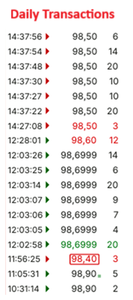
Example of Corporate Bond Prices - Athens Exchange (ATHEX)
Example Bond (Athens Stock Exchange) | 27/4/2026
Bond: CAPITAL CLEAN ENERGY CARRIERS CORP. | CCECB
Maturity | 25/2/2033
Coupon Rate 3,75 CCECB1 | 3,75
Par Value | 26/9/1902
Trading Info on 27/04/2016
Time | 15:26:54
Price at 16:15 27/4/2026 | 98,5
Price Change | 0,09%
Volume | 190
Transactions | 23
Open | 98,9
Low | 98,4
 |  | 15:26:54
 | Bid |  | ASK
Quantity) | Buy |  | Sell | Quantity
5 | 98,55 |  | 98,7 | 5
100 | 98,5 |  | 98,74 | 5
10 | 98,4501 |  | 98,75 | 5
6 | 98,4 |  | 98,78 | 100
3 | 98,25 |  | 98,7999 | 20

Slide 19
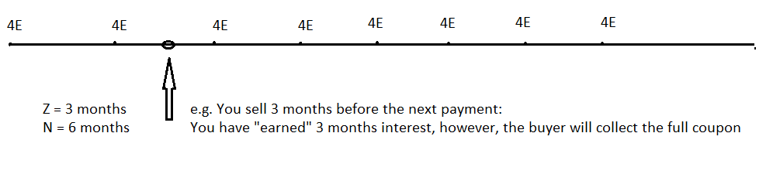
Fixed Income Markets – Definitions
B. Accrued Interest
Prices are quoted as clean (flat) bond prices, i.e., prices without accrued interest.
When clearing takes place, however, accrued interest is estimated and added to the final price
clean price = dirty price - accrued interest
dirty price = clean price + accrued interest

Slide 20
Fixed Income Markets – Definitions
Accrued Interest (AI) is estimated as: AI = C (Ζ/Ν)
→ Z = Days since last coupon payment to the deal
→ Ν = Days of interest period
→ C = Coupon payment
For example, you buy a bond with:
→ Coupon Rate: 3%
→ Par Value: 100 Euro
→ Market Value: 95%
→ Pays interest semi-annually
→ The last coupon payment was 50 days ago (year = 360)
How much will you pay at the end of the day?
Ν = 180, C = 1.5 (3/2) Euro, Z = 50
AI = 1.5 (50/180) = 0.461 Euro
You will pay: 95 + 0.46 = 95.46 Euro

Slide 21
Fixed Income Markets – Definitions
Domestic Bond
A firm issues a bond in the country of origin; the bond is denominated in the home currency, and is subject to the home country regulatory, legal, tax, environment
International Bond
A firm issues a bond in another country; the bond is denominated in the foreign currency, and is subject to the foreign country regulatory, legal, tax, environment
Eurobond
A firm issues and sells a bond to investors in many different countries simultaneously; the issue is organized by a syndication of banks and may be denominated in any currency, the market is self-regulated, and the issuing period is fast. Wholesale market. Home investors may not have access.

Slide 22
Fixed Income Markets – Definitions
Zero-coupon bonds (discount bonds, zeros)
Bonds that do not pay interest (coupons)
They trade at discounts but at maturity the bond holder receive the full face value.
The prices of zero-coupon bonds usually fluctuate much more compared to coupon bonds (they only have one final cash flow)
For example, a 3-year zero with:
Par Value of $100
Current Market Value $78.67

Slide 23
Fixed Income Markets – Securitization
An issuer may issue a bond whose cash flows are guaranteed from various assets
The process is called Securitization
→ the issue of securities that are based on other assets (usually loans) that are pulled together
It is basically the sale of existing loans from banks and other organizations
Firms can raise new capital by (i) loans, (ii) bonds, (iii) stocks
However, stocks dilute the ownership and may be expensive to issue, while loans and bonds may be also expensive and subject to interest rate risk
Alternatively, firms can use existing assets to guarantee the issue of a new bond and thus achieve a lower cost of capital

Slide 24
Fixed Income Markets – Securitization
For example, consider a bank that has:
→ a growth rate in deposits of 5% and
→ a growth rate in the demand for new loans of 25%
The bank needs capital to finance new loans to customers (new deposits are not enough)
Instead of issuing stocks or new traditional bonds it may:
→ Pull together 30,000 existing mortgage loans to existing customers
→ Put these loans to a portfolio (“reference portfolio”)
→ Sell this portfolio for cash to another company (“Special Purpose Vehicle”, SPV)
→ The SPV then issues a bond and sells it to investors (the securitized bond)
→ The coupon payments and the repayment of the principal of this bond are “secured” (guaranteed) by the cash flows from the mortgages included in the reference portfolio
→ Since the new bond has lower risk due to the guarantees, its coupon rate will be lower
Thus, the cost of raising money by the bank will be lower

Slide 25
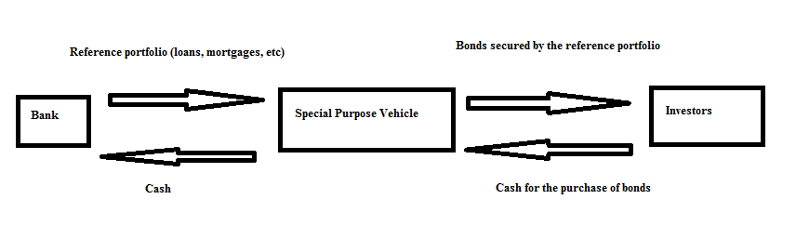
Fixed Income Markets – Securitization

Slide 26
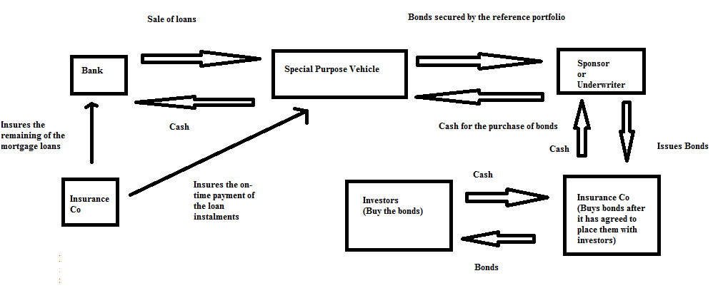
Fixed Income Markets – Securitization

Slide 27
Fixed Income Markets – Securitization
The bank not only receives cash but also transfers the credit risk involved in the loans.
Originator: the initial owner of the assets
Issuer: the SPV issues securities to finance the buying of the portfolio at fixed rates or floating rates
→ If the originator goes bankrupt the assets remain with the SPV
Arranger: an investment bank that helps to set up the structure
Credit rating agencies (CRAs): they rate the securities that are issued

Slide 28
Fixed Income Markets – Securitization
Main Advantages to Issuer
Funding costs
It may be cheaper to issuing stocks or bonds – e.g., a firm with low credit rating but secure cash inflows flows can securitize the high rated cash flows and borrow at lower rates.
Lock profits
If a firm securitizes future cash inflows the potential profit is locked
Transfer of risks
A company can transfer risks to investors
Liquidity
A future cash flow can be spent now

Slide 29
Fixed Income Markets – Securitization
Main Disadvantages to Issuer
The quality of the portfolio is lowered
If a firm securitizes the high creditworthy risks it is left with the low creditworthy risks
Cost
Management costs, legal fees, underwriting fees, etc. It may be more efficient for large deals.

Slide 30
Fixed Income Markets – Collateralised Debt Obligation (CDO)
Structured ABSs, guaranteed by a diversified pool of various debt obligations, such as (among others):
Sovereign bonds (Collateralised Bond Obligation, CBO)
Corporate bonds (Collateralised Bond Obligation, CBO)
Bank loans (Collateralised Loan Obligations, CLOs)
Credit card loans
Leases
Mortgages
CDOs (Squared-CDOs)
ABSs

Slide 31
Fixed Income Markets – Catastrophe bonds (cat bonds)
Catastrophe bonds (cat bonds) are an attempt to merge insurance risk with financial markets
The insurance sector shares risks from specific catastrophic events (e.g., major earthquakes)
Consider a securitization deal where the reference portfolio is insurance contracts
Consider a bond issued by an insurance firm whose payment depends on physical events
Usually, they pay a high coupon rate and the face value
→ in the case where a catastrophic event DOES NOT occur
If it a catastrophic event does occur:
→ the firm may keep the coupons and/or the principal (depending) and pay the claims

Slide 32
Fixed Income Markets – Catastrophe bonds (cat bonds)
Example
Consider an insurance firm Z that has insured from earthquakes a large number of clients in country X
Firm Z could create a SPV with an investment bank to issue a 3-year Cat Bond
The bond could pay Euribor + 12%
If an earthquake does not occur within the next 3 years, investors will enjoy a good returns
If an earthquake occurs within the next 3 years, firm Z keeps the principal to pay claims

Slide 33
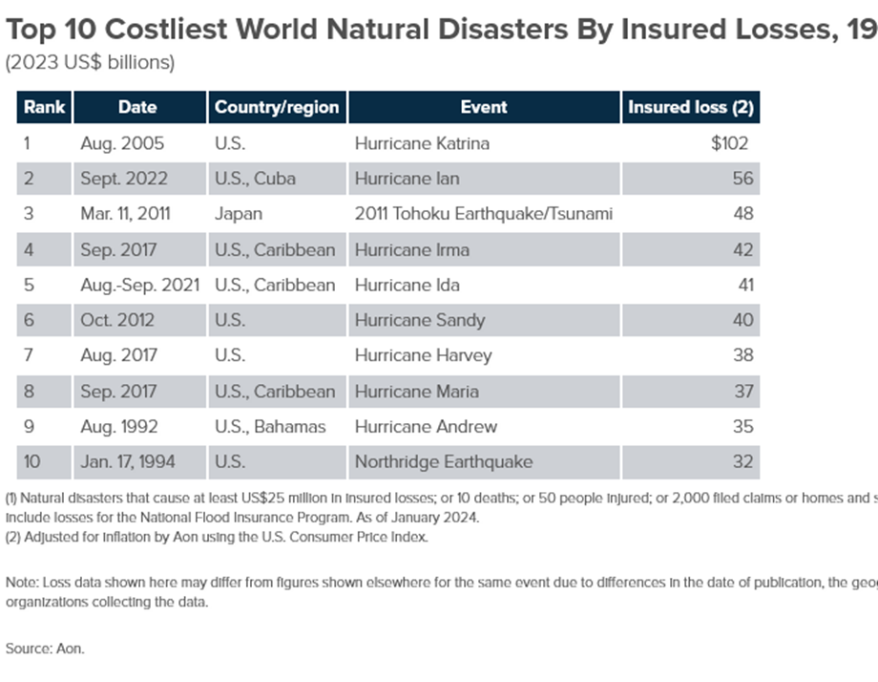
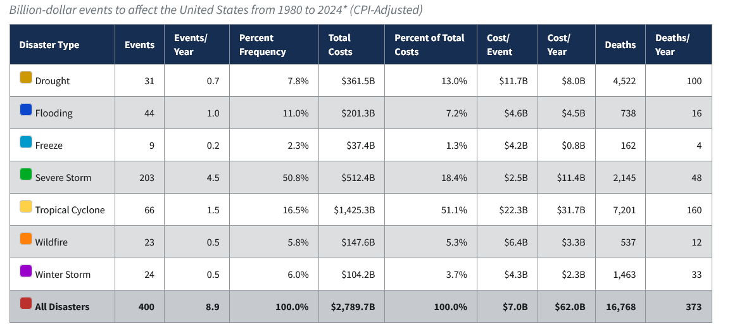
Fixed Income Markets – Catastrophe bonds (cat bonds)
Πηγή: NOAA National Centers for Environmental Information (NCEI) U.S. Billion-Dollar Weather and Climate Disasters (2024). https://www.ncei.noaa.gov/access/billions/, DOI: 10.25921/stkw-7w73

Slide 34
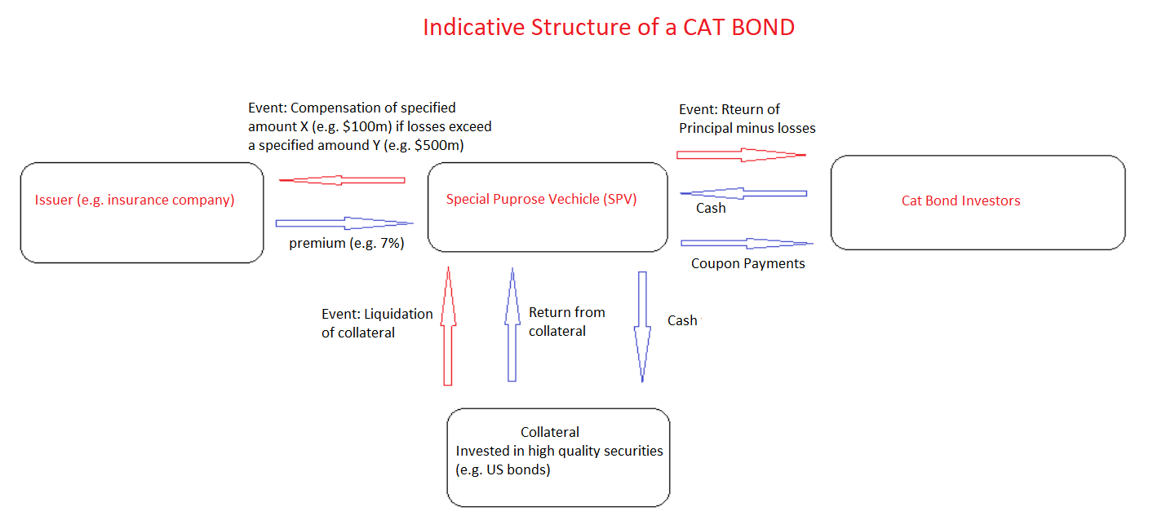
Fixed Income Markets – Catastrophe bonds (cat bonds)

Slide 35
Fixed Income Markets – Catastrophe bonds (cat bonds)
Advantages to Investors
CAT bonds invest the money in high quality investments (e.g. US gov bonds); no credit risk
CAT bonds have low correlations with the returns of other securities
→ ideal candidates for portfolio diversification
During financial crises their prices are not significantly affected

Slide 36
Fixed Income Markets – Catastrophe bonds (cat bonds)
Generally, we have 3 cases were payment is due:
Indemnity: when the bond pays real insurable damages from insurance companies
Industry Loss: when the bond pays total losses to the whole insurance market
Parametric: when the bond pays once certain events occur that exceed a standard limit
→ (e.g. when a hurricane is above level 4)
US issuance, indicative:
1997 - $1 billion annually
2007 - $5 billion annually
2017 - $10 billion annually

Slide 37
Fixed Income Markets – Catastrophe bonds (cat bonds)
2024 – 2025: Cat bonds of $21.7 billions were issued
93% in N America
$5 billion in Florida
(see: https://www.artemis.bm/news/three-dominant-trends-revealed-in-record-period-of-cat-bond-issuance-pennay-aon-securities)

Slide 38
Fixed Income Markets – Catastrophe bonds (cat bonds)
Indicative example - World Bank:
2024: WB Bank issued 4 cat bonds ($595 million, maturity 2028) providing to the Government of Mexico
→ Protection $295m from earthquakes
→ Protection $300m from hurricanes
Class A: $225M low-risk earthquake coverage
Class B: $70M high-risk earthquake coverage
Class C: $125M Atlantic hurricane coverage
Class D: $175M Pacific hurricanes coverage
Risk Transfer: Government of Mexico → World Bank → cat bond investors
→ Mexico pays a premium, which the World Bank transfers to investors
Payment parameters based on hurricane central pressure, the magnitude and depth of an earthquake, location of the event; with the WB an SPV is not necessary

Slide 39
Fixed Income Markets – Catastrophe bonds (cat bonds)
Note: “World Bank is the manager of the structuring, documentation, marketing, and execution of this transaction, leveraging its experience and reputation, large institutional investor base, and bond issuance infrastructure, including its capital-at-risk notes program.”
Πηγή: https://thedocs.worldbank.org/en/doc/8f7222d60ec54d0b6571131b754319c1-0340012025/original/Case-Study-Mexico-2024-Cat-Bond.pdf

Slide 40
Fixed Income Markets – Catastrophe bonds (cat bonds)
Cat Bonds are considered insurance-linked securities (ILS)
Generally, we have 3 types of issuers
→ Insurance Companies
→ Reinsurers
→ State Catastrophe Funds (e.g. California Earthquake Authority (CEA))
Typical Investors (indicative, % vary overtime) →

Slide 41
Fixed Income Markets – Catastrophe bonds (cat bonds)
To conclude, Cat Bonds:
Are usually floating-rate securities
Pay principal at maturity (unless an event occurs)
Common sizes are between $50 million to $500 million
The mean maturity is 3 to 4 years
The revenue from the bond is invested as a dedicated collateral in safe (high quality) investments such as US T-bills)
Coupons are paid quarterly or monthly
2022-2023: average annual return of a cat bond portfolio = 6.7%
2022-2023: average Sharpe ratio of a cat bond portfolio = 1.16 (S&P = 0.5)

Slide 42
Fixed Income Markets – Structured Bonds
Issuers may also borrow by issuing bonds that have complex structures
These structures may depend on the issuer expectations and/or client expectations
These adjustable asset structures often address the needs of specific investors
These bonds are often called Structured Bonds and are hybrid securities, i.e., combine:
(i) elements of fixed income securities (maturity, coupon, Par)
(ii) elements of assets whose return varies with trends or other variables (equities, exchange rates, interest rates, commodities, options, futures, debt, etc.).

Slide 43
Fixed Income Markets – Structured Bonds
There is no single definition for these bonds
There is a large variety
Most contain a "principal guarantee" at maturity
Example of a structured bond issued by a government:
Par Value: €100,000,000.00
Issue date: 1/7/2007
Maturity date: 1/7/2017
Coupon rate: At 1/7/2008 and 1/7/2009 it will pay 8%
For the remaining eight years it will pay:
→ 5% if the equity index FTSE/XXXX has a negative return on that year
→ 1% in any other case

Slide 44
Fixed Income Markets – Structured Bonds
Example of a structured bond issued by a government:
Issue price: 100%
Maturity: 12 years (Issue date: Feb 2007)
Coupon rate: For the first two years 6,25%
For the remaining ten years
→ if the difference between the 10-year interbank Euroswap rate and the 2- year interbank Euroswap rate is < 1% it will pay the product of this difference times five
→ If the difference between the 10-year interbank Euroswap rate and the 2- year interbank Euroswap rate is > 1% it will pay the 3-month Euribor+1.5%

Slide 45
Fixed Income Markets – Structured Bonds
Assume that 10-year interbank Euroswap rate = 3%
2-year interbank Euroswap rate = 2.5%
Difference: 0.5%
Coupon = 0.5% times 5 = 2.5%
Assume that 10-year interbank Euroswap rate = 3%
2-year interbank Euroswap rate = 1.5%
Difference: 1.5%
Coupon = 3-month Euribor + 1.50 %

Slide 46
Fixed Income Markets – Structured Bonds
The issuance of such products is standard in international markets in order to raise long term funds:
→ for governments
→ for international organizations
Issuing takes place as in other bonds (underwriting)
These bonds often trade in secondary markets
The bondholders face the
→ credit/default risk of the issuer and
→ market risk (changes in discount rates)

Slide 47
Fixed Income Markets – Credit Default Swaps (CDS)
A very important instrument in fixed income markets is the CDS contract
The CDS is a derivative instrument that provides “insurance” to debtholders in case of “credit events”
It is an agreement between two parties that allows one party (the debt holder) to transfer the credit risk of a borrower to another party (e.g. an investment bank)
In return the party that buys “protection” pays a periodic premium (the CDS premium)

Slide 48
Fixed Income Markets – Credit Default Swap (CDS)
Nowadays most contracts are based on standard forms as specified by the International Swaps and Derivatives Association (ISDA) where the following terms are defined:
The reference entity (the issuer of the underlying instrument, e.g., a firm)
The reference obligation (the instrument, e.g., a bond)
The termination date (e.g. 5 years)
The calculation agent (usually the dealer or the seller of the CDS)
The credit event (e.g., default, restructuring, etc., see below)
The premium payments (usually quarterly)

Slide 49
Fixed Income Markets – Credit Default Swap (CDS)
The credit event (default) may be:
→ A Failure to pay, i.e., the issuer of the underlying cannot make payments
→ A Repudiation, i.e., a disagreement over the validity of contractual debt obligations
→ A Moratorium: i.e., a suspension of contractual debt obligations
→ A Restructuring, i.e., when an entity restructures contractual debt obligations
→ A Government intervention, i.e., actions that affect the contractual debt obligations
→ In some cases, a downgrade of the credit rating, etc.
In case of a “credit event” the buyer may:
→ Deliver to the seller the bond and receive the face value of the bond
→ Receive from the seller the difference between the face value of the bond and the current market price of the bond
Note that, historically, only about 0.2% of firms with a credit rating above ΒΒΒ eventually default

Slide 50
Fixed Income Markets – Credit Default Swap (CDS)
Example
An Investor A buys from Investment Bank B a 3-year CDS contract on the bond issued by Company C
A owns $100,000,000 worth of Bond C
Assume that the current CDS spread on BOND C is 0.4% (i.e., 40 basis points; 1 bp = 0.01%)
A will pay to B $400,000 annually (i.e., 0.4% of $100,000,000)
If there is no credit event for Company C during the following 3 years
→ Investor A has paid $400,000 x 3 = $1,200,000 to Investment Bank B and the CDS expires
If there is a credit event for Company C during the following 3 years, say at the end of the 2nd year
→ Investor A has paid $400,000 x 2 = $800,000 to Investment Bank B
→ Investment Bank B will pay to Investor A $100,000,000

Slide 51
Fixed Income Markets – Credit Default Swap (CDS)
The periodic spread on a CDS is an indicator of the credit risk (Blommestein, et al., 2016)
The periodic spread level indicates the probability of default (see graph later)
Spreads are traded continuously and reflect the varying market expectations and beliefs
For example, consider BOND C above.
If negative news arrive in the market about company C, the spread may rise to, say, 0.8%.
In that case a new buyer of a 3-year CDS on BONDC will be required to pay $800,000 as an insurance.
Of course, Investor A now owns a more valuable contract
→ He/she may sell it back to the market and receive the difference

Slide 52
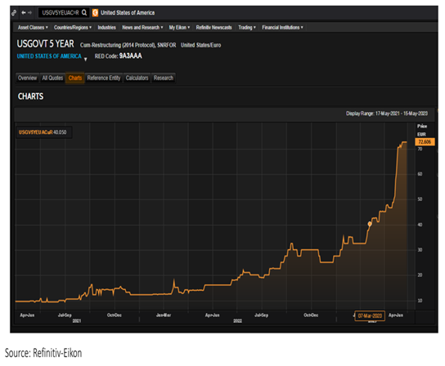
CDS spreads, 5/7/2023
Fixed Income Markets – Credit Default Swap (CDS)

Slide 53
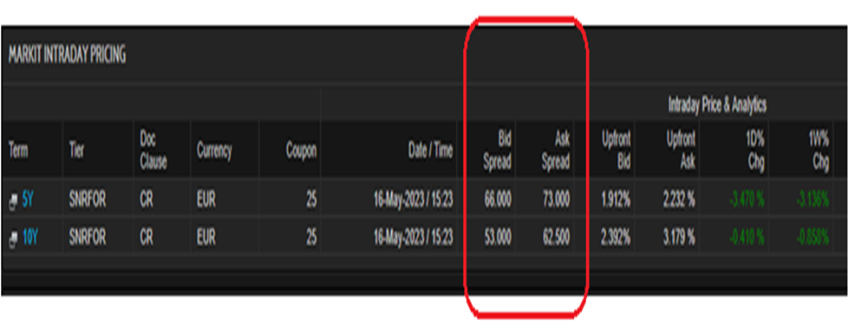
CDS spreads on US Bonds, 5/7/2023
Fixed Income Markets – Credit Default Swap (CDS)

Slide 54
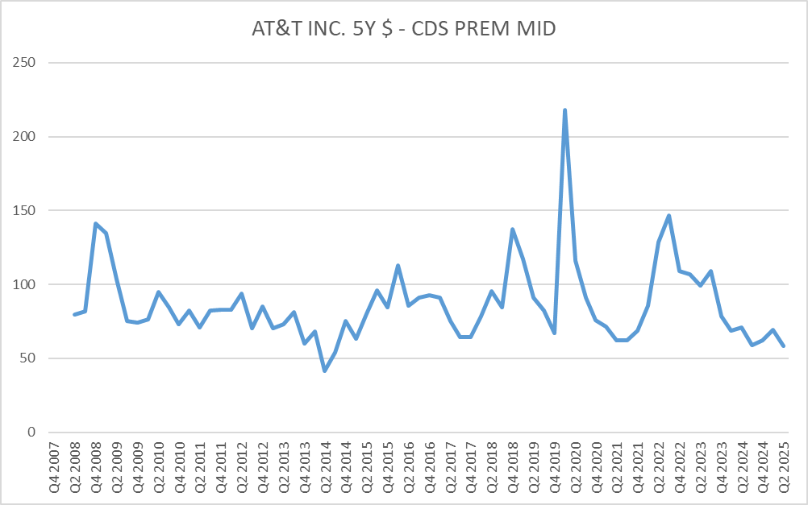
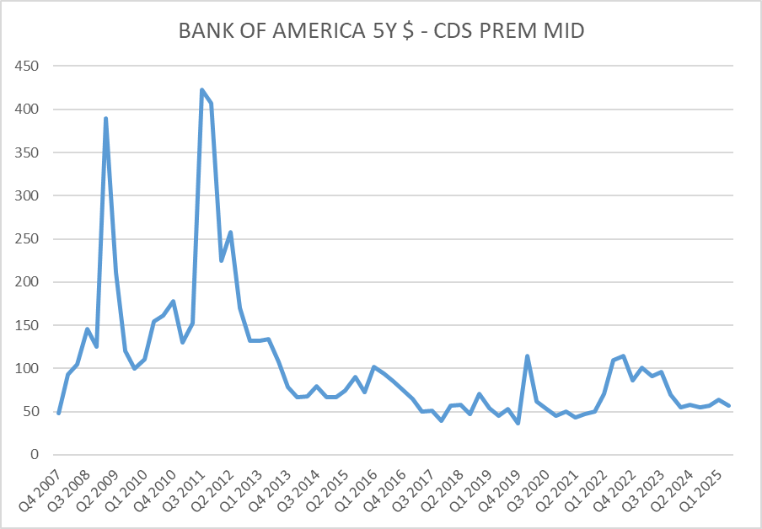
Fixed Income Markets – Credit Default Swap (CDS)

Slide 55
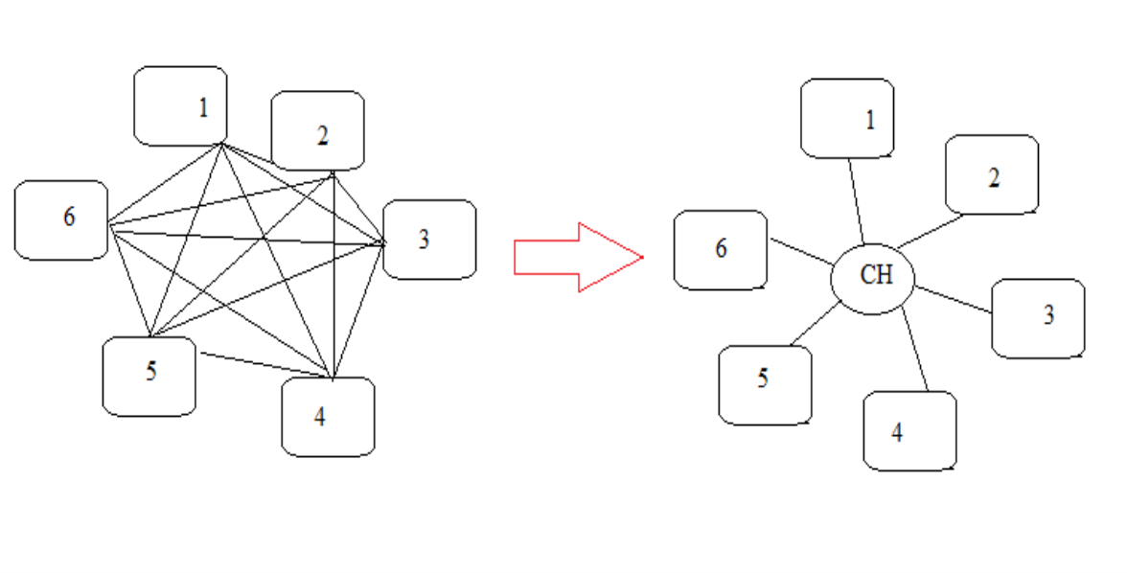
Fixed Income Markets – Credit Default Swap (CDS)
Initially CDS were exchanged in a bilateral system (see left graph)
→ where every trader had to contact all other traders to negotiate prices; a very complex clearing system with high systemic risk and many limitations
In 2009 ISDA administered a key change and introduced a centralised clearing system (see right graph):
→ Two central clearing houses (US, Europe) to act as the central counterparty
→ Standardized contracts

Slide 56
Fixed Income Markets – Credit Default Swap (CDS)
Central Counterparty Clearing House (CCP)
Exist in many countries to clear transactions, and are often operated by major banks who assume a large part of the credit risk during clearing
They become counterparties for both the buyer and the seller and guarantee in case one party defaults
They reduce the following risks:
→ Counterparty risk
→ Operational risk
→ Clearing risk
→ Market risk
→ Legal risk

Slide 57
Fixed Income Markets – Credit Default Swap (CDS)
Also, often buyers were not required to own (hold) the underlying entity
These developments lead to a significant growth in the CDS market
For instance, the market cap of the global CDS market was:
→ $600 billion in 2001
→ $5.4 trillion in 2004
→ $26 trillion in 2006
→ $62 trillion in 2007
→ $38 trillion in 2022
2013-2016: very low interest rates lead to an increase of demand for risk hedging with CDS
After 2011: the market was regulated (Basel Accord, Basel III) with margins, guarantees, restrictions in CDS short selling in the EU, etc.
These changes increased the costs and reduced the demand for CDS

Slide 58
Fixed Income Markets – Credit Default Swap (CDS)
Uses of CDS by market participants
Hedging
→ Investors in bonds/loans (e.g., banks) can use CDS to reduce their exposure to default risk
Speculation
→ Investors and traders can use CDS to take positions without owning the underlying debt
Signaling
→ Investors can use CDS spreads to understand the market expectations about credit risk
→ For example, an increase in spreads imply increasing default risk
Note that, historically, only about 0.2% of firms with a credit rating above ΒΒΒ eventually default
→ Thus, in the vast majority of CDS there is never a payment of the face value

Slide 59
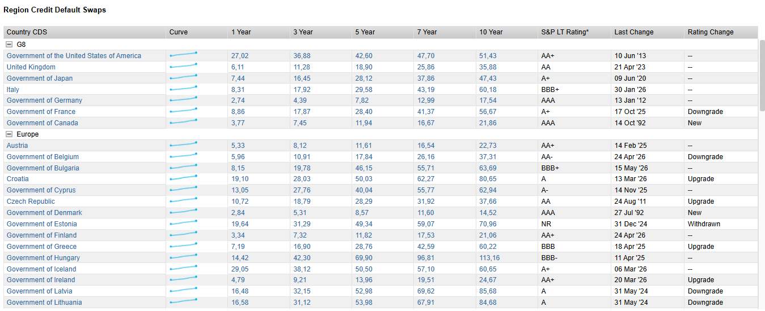
Αγορές CDS (source: Factset, 9-06-2026)

Slide 60
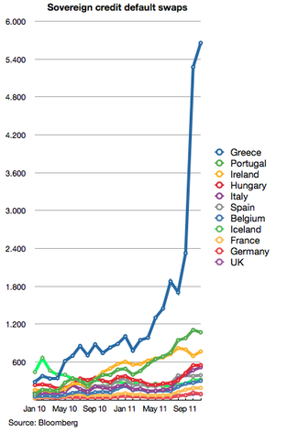
Fixed Income Markets – Credit Default Swap (CDS)

Slide 61
Fixed Income Markets – Credit Default Swap (CDS)
Credit Risk Transfer
Single-name CDSs are a very efficient tool (liquidity, and accessibility) for risk management (Duffee and Zhou, 2001)
Increased Loan Supply
Single-name CDS help banks to cover exposure in loan/default risk, thus frees regulatory capital (banks need to keep less capital for emergency - Basel III), and as a result, many lenders increased the loans they provided. Cebenoyan & Strahan (2004) find that banks that use CDS reserve less capital, provide more loans to higher risk borrowers, had lower risk exposure, had higher profits
Synthetic Investments
CDS buyers are not obliged to own the underlying, thus making it easier to open positions; this adds liquidity
Price Discovery
CDS prices reveal the expectations of investors to non-market participants

Slide 62
Bond Yields

Slide 63
Fixed Income Markets – Bond Yields
There are three main ways to calculate the return of a bond
Current Yield
It relates the annual coupon (C) to the current market price (P₀): CY = C / P₀
18-year bond, coupon rate, 5%, current price $780, par $1000 CY = $50 / $780 = 0.064
2-year bond, coupon rate 9%, current price $1,400, par $1000 CY = $90 / $1,400 = 0.064
Yield to Maturity
The Internal Rate of Return (IRR) of a Bond; the rate that makes the NPV=0
Yield to Call
The Internal Rate of Return (IRR) of a Bond until the call date (for callable bonds)

Slide 64
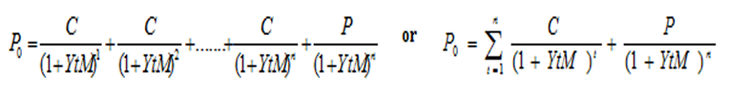
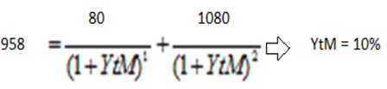
Fixed Income Markets – Bond Yields
The most important and most widely used is the Yield-to-Maturity, YtM, yield
The “required return” of a bond; the Internal Rate of Return (IRR) of a bond
The YtM changes constantly (the market prices changes daily)
It reflects the market expectations
Example of YtM
A 2-year zero coupon bond with face value of $1,000 and a coupon rate = 8%
Par = $1,000, Market Price = $958, coupon payment: annually

Slide 65
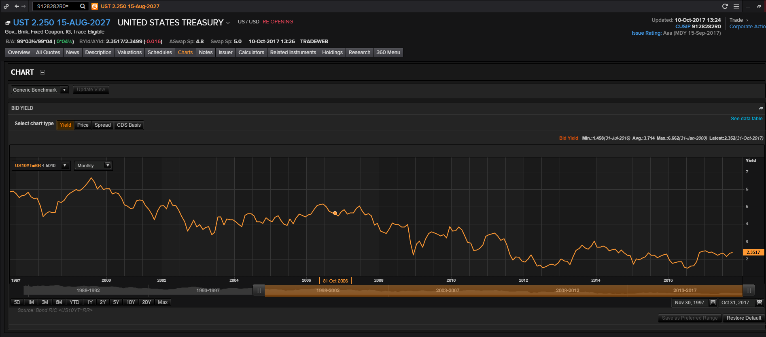
Fixed Income Markets – Bond Yields

Slide 66
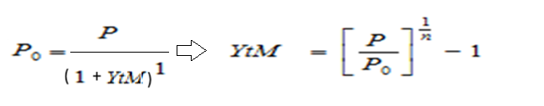
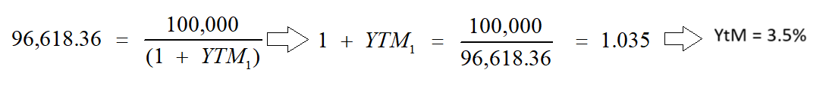
Fixed Income Markets – Bond Yields
The YtM for a zero-coupon bond is obtained as:
Example 1
A one-year zero with a current market price of 96,618.36 and a Par Value of 100,000 has a YtM of:
Example 2
A 10-year zero with a current market price of $300 and a Par Value of $1000 has a YtM of:
YtM = [1000 / 300 ] ^{1/10} – 1 = 12.8%

Slide 67
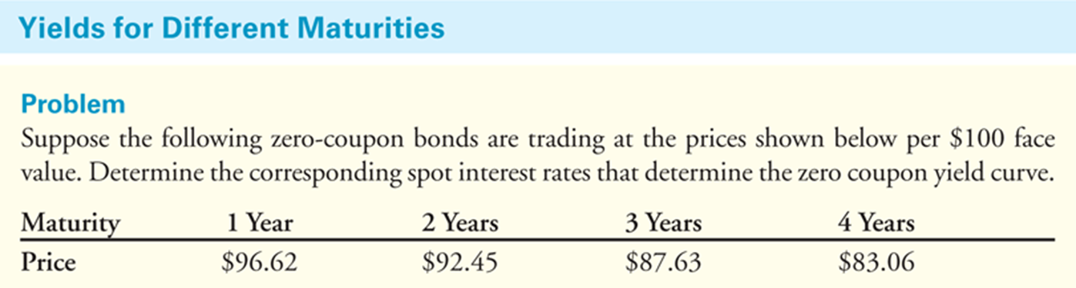
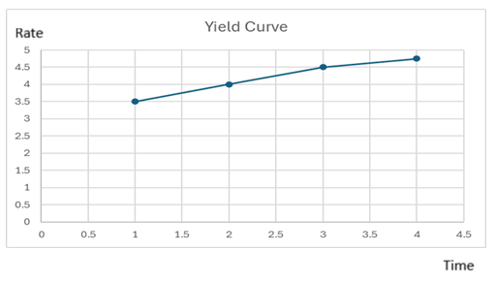
Fixed Income Markets – Bond Yields
Textbook Example 6.1

Slide 68
Fixed Income Markets – Bond Yields
Overall, we can say that we have the following yields for a bond:
Nominal (the coupon rate)
Current (current income rate)
To Maturity (the return if the bond is kept to maturity)
To Call (the return if the bond is kept to the first call)

Slide 69
Fixed Income Markets – Bond Yields
Another important related concept is the Yield Spread (the difference in YtM between two bonds)
Usually, for government bonds one country is used as the “base” against which we measure the spread
In Eurozone = German bonds
It shows the difference in lending rates between two countries, e.g.:
→ if the YtM of German 10-year bonds is 2% and
→ the YtM of Greek 10-year bonds is 6%,
→ the spread is 4%,
That is, Greece will have to pay 4% more than Germany for 10-year lending
In other words, investors demand higher compensation due to higher risk

Slide 70
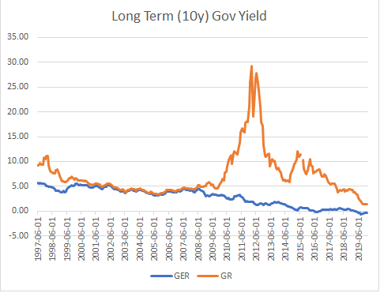
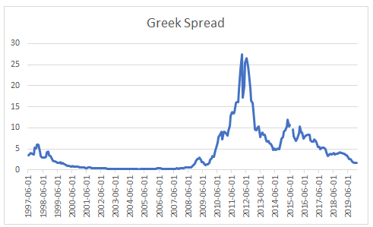
Yield Spread: The difference between yields on differing debt instruments
E.g. the 5-year T-bond is at 5% and the 30-year T-bond is at 6% → the yield spread is 1%.
Fixed Income Markets – Bond Yields

Slide 71
Fixed Income Markets – Bond Yields (see textbook)

Slide 72
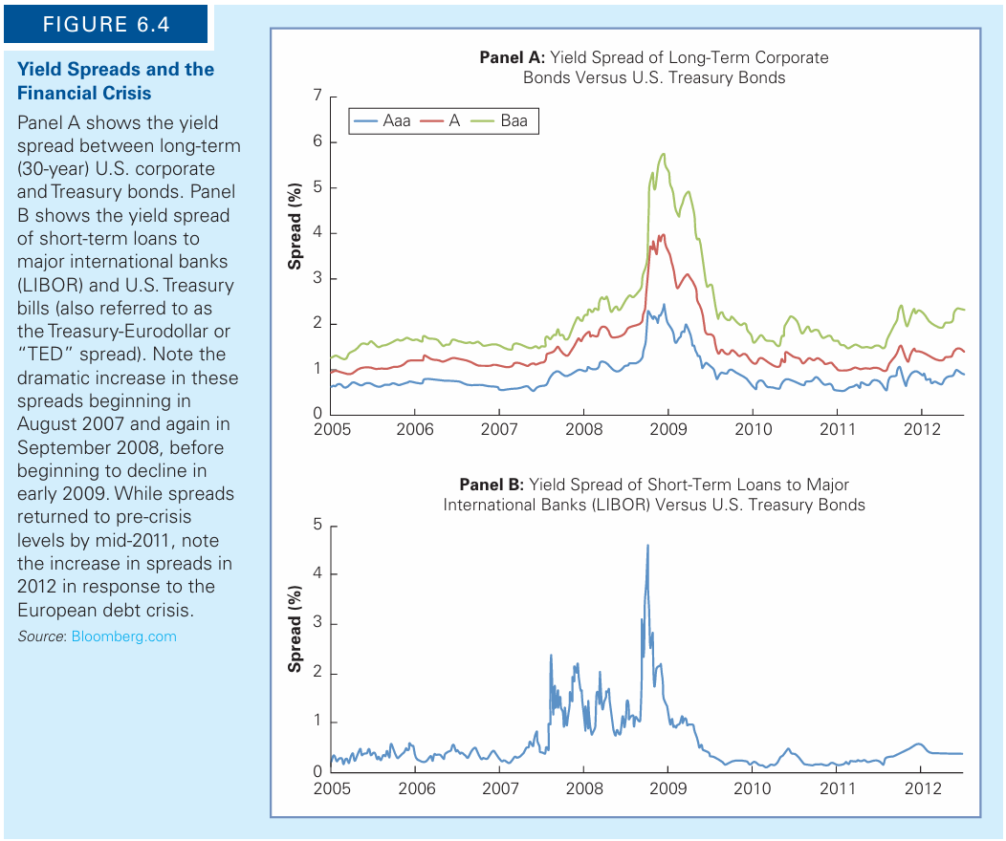
Fixed Income Markets – Bond Yields (see textbook)

Slide 73
Fixed Income Markets – Bond Yields
Yield spreads reveal important information
Recall that in order to obtain the YtM we use the current price of a bond
The current price of a bond changes on a daily basis reflecting available information
Thus, yields change on a daily basis to reflect all available information about the bond and the issuer
As a result, when, say, negative info arrives in the market:
→ investors sell
→ bond prices fall
→ yields rise
→ spreads (relative to the benchmark also rise

Slide 74
Bond Valuation

Slide 75
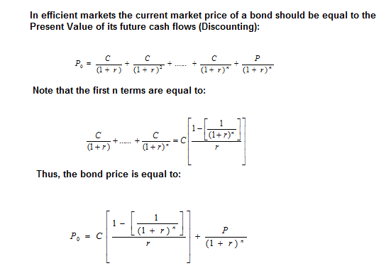
Fixed Income Markets – Bond Valuation

Slide 76
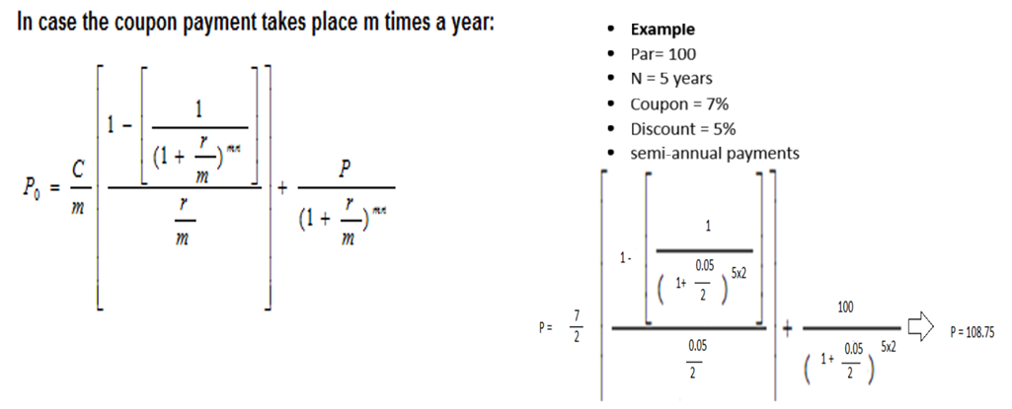
Fixed Income Markets – Bond Valuation

Slide 77
Fixed Income Markets – Bond Valuation
Let us estimate the price of this bond for different discount rates
The results are presented in the Table and the Graph
Conclusion
(i) if the coupon rate > YtM → bond trades at a premium
(ii) if the coupon rate < YtM → bond trades at a discount
(iii) if the coupon rate = YtM → bond trades at Par

Slide 78
Fixed Income Markets – Bond Valuation
What happens if we do not assume a constant discount rate?
Consider the following problem: find the price of a 3-year Government bond (Par = $100, coupon rate = 5%, annual payment) when we expect that the discount rate will change over time.
P₀ = [ 5 / (1+S₀₁) ] + [ 5 / (1+S₀₂)² ] + [ (5 + 100) / (1+S₀₃)³ ]
S₀₁: proper discount rate for period 0 (today) to period 1 (in one year)
S₀₂: proper discount rate for period 0 (today) to period 2 (in two years)
S₀₃: proper discount rate for period 0 (today) to period 3 (in three years)

Slide 79
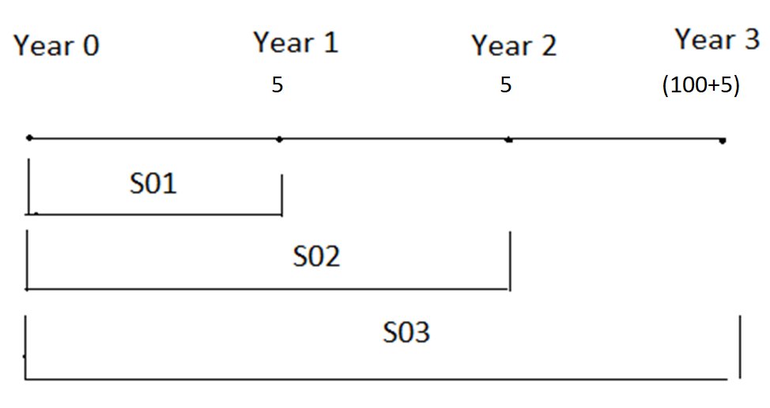
Fixed Income Markets – Bond Valuation

Slide 80
Fixed Income Markets – Bond Valuation
Assume that in currently we can find zero-coupon Government bonds (i.e., same issuer) that mature in:
→ 1 year from today with current price 93.5
→ 2 years from today with current price 91.8
→ 3 years from today with current price 89.2
→ Par Value = $100
We know that: P₀ = P / (1+r)^{n}
Thus, the YtM of a zero coupon is : YtM = [P / P₀]^{1/n} -1

Slide 81
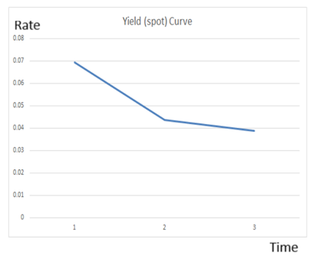
Fixed Income Markets – Bond Valuation
Thus, the YtM for the zeros are:
→ YtM₀₁ = (P/P₀)^{1/1} -1 = (100/93.5) -1 = 0.069
→ YtM₀₂ = (P/P₀)^{1/2} -1 = (100/91.8)^{0.5} – 1 = 0.043
→ YtM₀₃ = (P/P₀)^{1/3} -1 = (100/89.2)^{0.33} -1 = 0.038
This is the yield curve
Since we want to price a Gov Bond with 3 cash flows
Since there are 1-y, 2-y, 3-y Gov zeros with YtM 6.9%, 4.3%, 3.8%, respectively
Then, according to the Law of one price
→ These are the proper discount rates

Slide 82
Fixed Income Markets – Bond Valuation
Thus, the price should be:
P₀ = [ 5 / (1 + 0.069) ] + [ 5 / (1 + 0.043)²] + [ (5 + 100) / (1+ 0.03.8)³] = 102.9
The rates we used are called spot rates

Slide 83
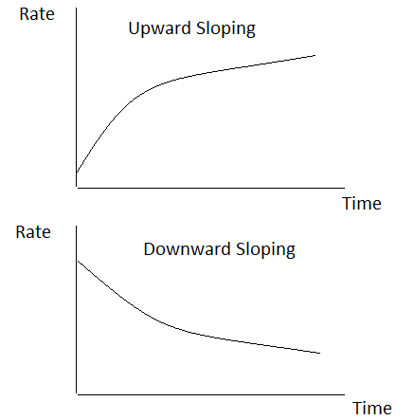
Possible shapes of the yield curve
Fixed Income Markets – Bond Valuation

Slide 84
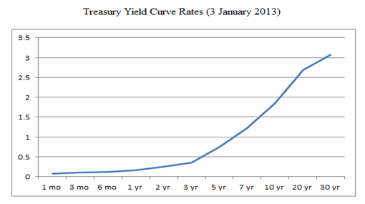
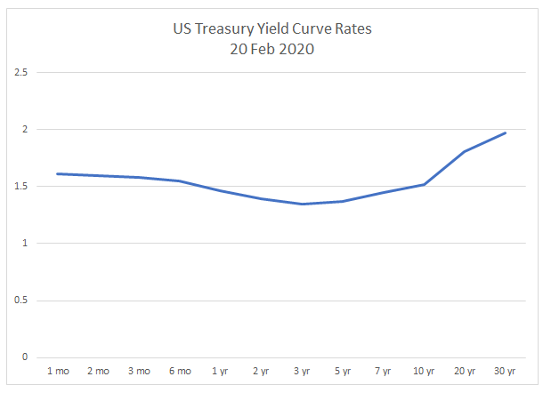
Source of data: FRED, Fed of St Louis.
Fixed Income Markets – Bond Valuation

Slide 85
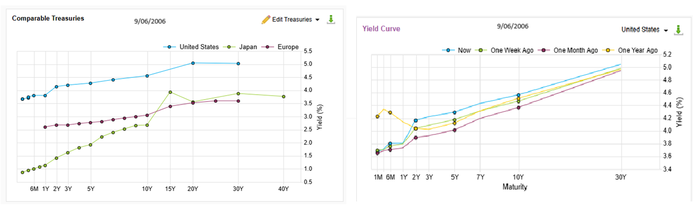
Fixed Income Markets – Bond Valuation
Source: Factset.com

Slide 86
Fixed Income Markets – Bond Valuation
Yield Curve & recessions (US)
Yield spreads: the difference between the 10-year and 2-year Treasury
Research shows that under normal conditions the long-term yields should be higher than the short-term yields (riskier, more uncertainty)
→ upward-sloping curve
However, sometimes this pattern is reversed
Research shows that when this happens, usually an economic recession follows

Slide 87
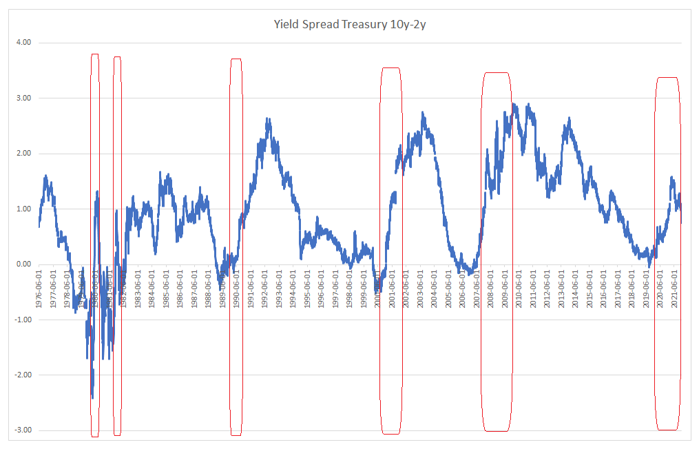
Yield Curve & recessions (US)
Fixed Income Markets – Bond Valuation
Source: https://fred.stlouisfed.org/series/T10Y2Y

Slide 88
Fixed Income Markets – Bond Valuation
Spot Rates – Forward Rates
The discount rate we use for the valuation is called the Spot rate, S
The spot rates are YtM (required returns) from zero coupon bonds
We can use S to obtain Forward rates
Example: we agree today on a loan of 900 that will start in 1 year from now and be paid (1000) in 3 years from today:
900 = 1000 / (1 + f₁₃)²
↔ f₁₃ = (1000 / 900)^{1/2} – 1
↔ f₁₃ = 5.4%

Slide 89
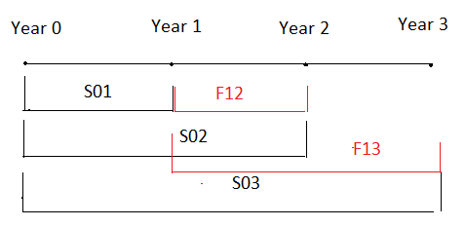
Spot Rates – Forward Rates
Fixed Income Markets – Bond Valuation

Slide 90
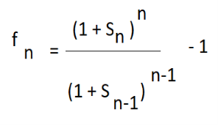
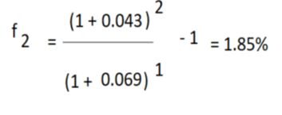
Fixed Income Markets – Bond Valuation
Assume that you have 1 Euro available, and you want to invest it for 2 years
You can:
→ buy a 2-y zero; r = 1 (1 + S₀₂)²
→ buy a 1-y zero and agree to invest the proceeds at the end of the 1st year; r = (1 + S₀₁) (1 + f₁₂)
If markets are efficient and there is equilibrium, then:
1 (1 + S₀₂)² = 1 (1 + S₀₁) (1 + f₁₂) ↔ (1 + f₁₂) = (1 + S₀₂)² / (1 + S₀₁)
Rearranging, the forward rate is:
Based on the above example, where S₁ = 6.9%, S₂ = 4.3%

Slide 91
Fixed Income Markets – Bond Valuation
What determines the Term Structure (shape) of the yield curve ?
Expectations Hypothesis
The shape is the result of interest rate expectations: “…..Under such conditions, the equilibrium long-term rate is the rate the long-term bond investor would expect to earn through successive investments in short-term bonds over the term to maturity of the long-term bond”
Liquidity Preference (Term Premium) Hypothesis
Long-term bonds should provide higher returns than short-term bonds due to higher uncertainty and volatility for long-maturity bonds
The implication is that the yield curve should be upward sloping and, thus, other shapes are temporary departures from normality
It is often considered as an extension of the expectations hypothesis

Slide 92
Fixed Income Markets – Bond Valuation
Segmented Market Hypothesis / Preferred Habitat Hypothesis / Institutional Theory
The idea is that different institutional investors have different maturity needs
They belong to different segments of the bond market and focus on securities that are:
→ short-term
→ intermediate-term
→ long-term
For instance, consider banks who have short/intermediate maturity liabilities
→ They want to invest in short/intermediate maturity bonds.
The shape is determined by the preferences of institutional investors in each segment

Slide 93
Bond Risk

Slide 94
Bond Risk – Credit Rating
Probability of default - Bond Ratings
How can investors assess the likelihood of default? They cannot.
Many independent companies (Credit Rating Agencies, CRAs) rate the creditworthiness of bonds
Thus, investors can consult the ratings and assess the creditworthiness bonds
The rating depends on the risk of bankruptcy as well as the bondholders’ ability to lay claim to the firm’s assets in the event of such a bankruptcy.
Debt issues with a low-priority claim in bankruptcy will have a lower rating compared to
→ issues from the same company that have a high priority in bankruptcy or that are backed by a specific asset such as a building or a plant.

Slide 95
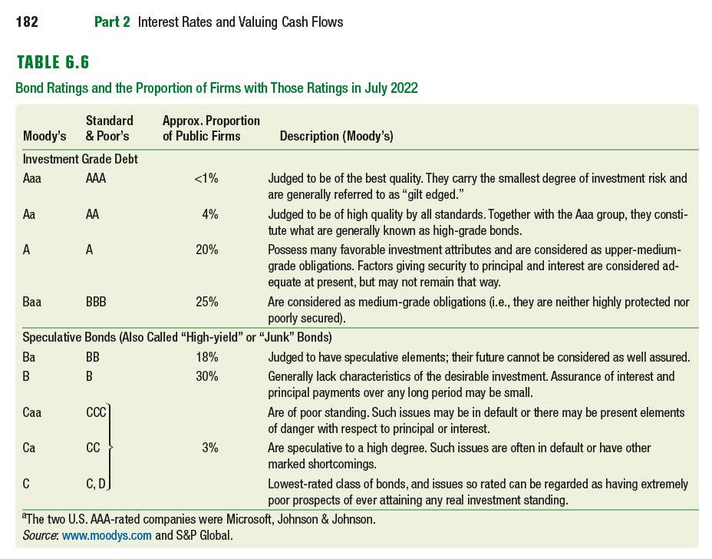
Bond Risk – Credit Rating (see textbook)
Source: See textbook

Slide 96
Bond Risk – Credit Rating
Indicative S&P country ratings (as of May 2025)

Slide 97
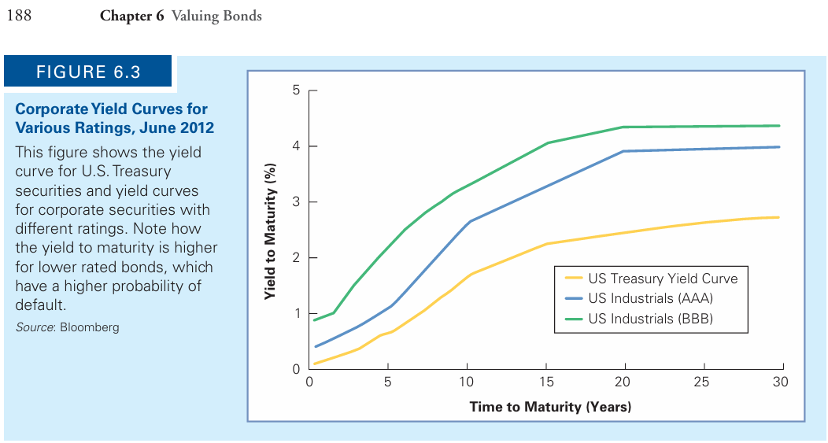
Bond Risk – Credit Rating (see textbook)

Slide 98
Bond Risk
What is the major source of risk for bond holders (assume no default risk) ?
Interest rate volatility
Thus, in order to estimate bond risk or uncertainty we could use the sensitivity of the bond price to interest rate changes, i.e., the interest rate sensitivity of a bond
A certain change in rates can cause very different % price changes to different bonds; i.e., bond prices have different sensitivity to rate changes
The sensitivity of a bond’s price to changes in interest rates is measured by the bond’s duration (D)
  Bonds with high durations are highly sensitive to interest rate changes.
  Bonds with low durations are less sensitive to interest rate changes.

Slide 99
Bond Risk
Macaulay (1938) suggested to measure this uncertainty with DURATION (D)
The weighted average of the term structure of the bond’s cash flows
Often, we use the modified Duration (D*), discussed below….
With this term we know that
→ for every 1% change in interest rate
→ the price of the bond with D* = Χ
→ will change by Χ%

Slide 100
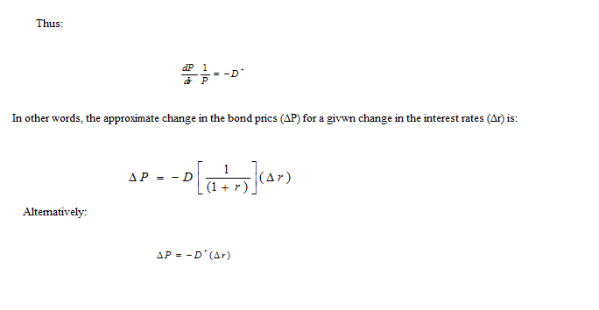
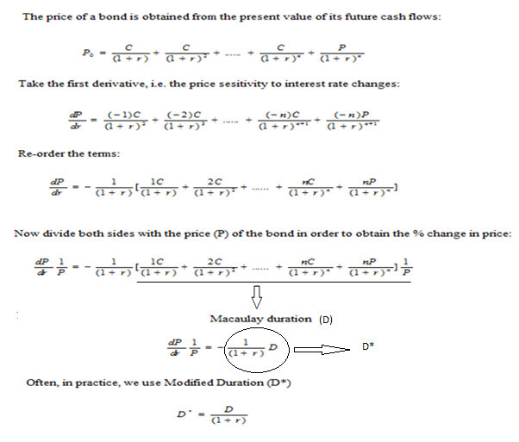
Derivation of Duration
Bond Risk

Slide 101
Bond Risk
Estimate Duration:
Maturity : 2-year
Coupon rate : 6%
Coupon payments : Annual
Discount rate : 4%
Par : 100
If you expect yields to decline by 0.75%
(75 basis points)
The change in the bond price will be:
%ΔP = -1.86 (-0.75) = 1.40%

Slide 102

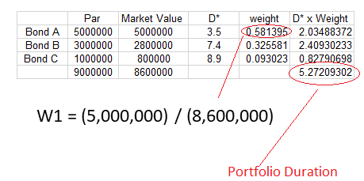
Bond Risk - Portfolio Duration
The duration of a portfolio is equal to the weighted average of the Duration of each bond in the portfolio:

Slide 103
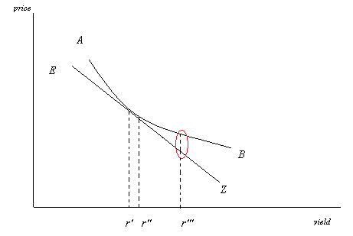
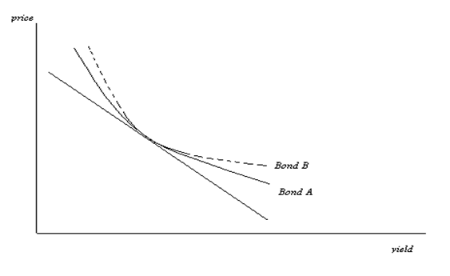
Bond Risk - Problems with D

Slide 104
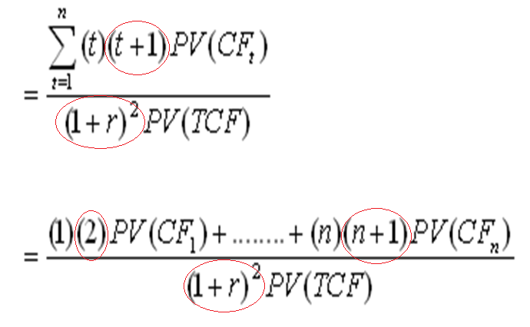

Bond Risk - Convexity

Slide 105
Duration, Convexity, and interest rate changes
It can be shown that the approximate change in the price of a bond for a given change in the rates (Δr) due to convexity will be equal to:
ΔΡ = -D* (Δr) + (0,5) C (Δr)²

Slide 106
Bond Risk - Duration
Assume that you expect a major decline in interest rates (i.e. prices will ↑)
You want a bond portfolio with as high duration as possible (max sensitivity)
→ For example, invest in long-maturity bonds
(And visa versa)

Slide 107
Thank you for your Attention !

Slide 108
Indicative Sources, References, and Reading
Reilly, F.K., Brown, K.C., (2008). Investment Analysis and Portfolio Management, 2008, ed: South-Western College Pub, ISBN-10: 0324656122
Brealey, R. A., Myers, S.C. (1996) “Principles of Corporate Finance”, MaGraw Hill Companies, Inc.
Copeland T.E. και Weston J.F. (1988) “Financial Theory and Corporate Practice” 3η Έκδοση, Addison Wesly.
Fabozzi, F. (2016) Bond Markets, Analysis, and Strategies, 9th Edition, 2016, Pearson
Jones, C.P. (1991) “Investments, Analysis and Management”,John Wiley & Sons.
International Swaps and Derivatives Association https://www.isda.org
Culp, C., van der Merwe, A., Stärkle, B. (2016). Single-name Credit Default Swaps: A Review of the Empirical Literature. ISDA, 2016.

