Slide 1
Equity Financing
An Introduction to Equity Valuation
&
Financial Statement Analysis

Slide 2
Introduction
One important question is how can we price a stock for an IPO?
Or how do we price equity (stocks) in general ?
In this lecture, we discuss issues related to equity valuation and analysis
More specifically:
→ Methodologies on equity valuation (discount models, comparables)
→ Financial Statement Analysis (ratio analysis)
→ See what the Equity Research Report is
→ Practical (indicative) examples of valuation of listed companies
Reading: lecture notes, textbook (Chapter 2 and Chapter 9)

Slide 3
Equity Valuation Methodologies
When valuing equity (stocks) we have two main approaches:
1) Discount the Future Cash Flows
This approach rests on the fundamental idea in financial economics that the “fair”, “theoretical”, “intrinsic” value of any asset/project/investment is simply the Present Value of the future cash flows; thus, an analyst/investor can discount the future earnings, cash flows, dividends
Present Value of: Dividends / Earnings / Free Cash Flows
2) Multiples (relative valuation and ratio analysis)
This approach rests on fundamental idea that an asset should have a value comparable to similar assets (similar in terms of maturity, uncertainty, industry, etc.)
For instance, if the market stock price of a similar (comparable) firms is, on average, 5 times the earnings, then the price of our firm should be similar (P/E, P/B, P/CF, ratios etc.)

Slide 4
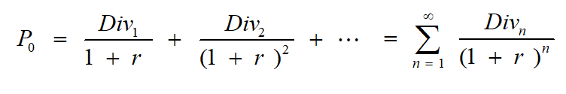
Dividend Discount Model (DDM)
As you know, the current price (P₀) of any asset should be
→ equal to the present value of the future cash flows
Assuming the only relevant cash flows for an investor in a stock are the future dividends (Div) and that the firm has no maturity date we have the:
Dividend Discount Model (DDM)
This model may be modified, depending on our assumptions on the growth of Div

Slide 5
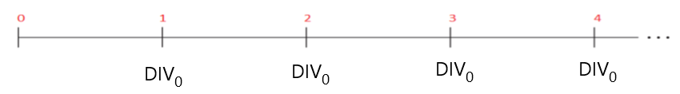
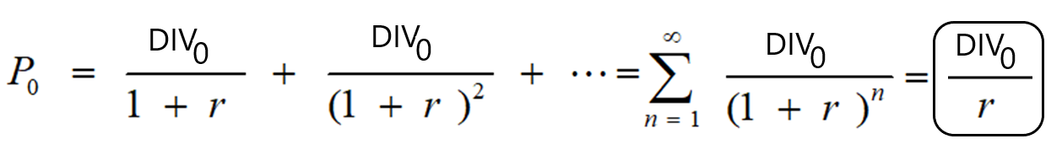
Dividend Discount Model (DDM)
For instance, when the current dividend is expected to remain constant (no growth, static firm):
We know that the Present Value formula with constant Cash Flows (CF), is equal to (CF / r), where r is the appropriate discount rate. Thus, the DDM boils down to:
Example: firm AAA has a dividend of 5 Euro, and we expect that this will remain constant for ever.
The appropriate discount rate is 11% (r=11%)
Thus, P₀ = (5 / 0.11) = 45.5 Euro

Slide 6
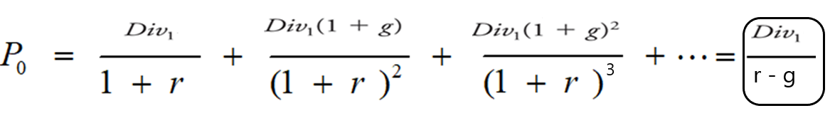
Dividend Discount Model (DDM)
Alternatively, we may expect that the dividend will increase with a constant growth rate, g, for ever
Then, we are talking about a Growing Perpetuity and the DDM boils down to:
Example: firm BBB has a dividend of 0.3 Euros, we expect that it will grow annually at a constant rate (g) of 7.5% for ever, and the discount rate (r) is 10%,
P₀ = D₀ (1+g) / (r - g) = Div₁ / (r - g)
Thus, P₀ = 0.3 (1 + 0.075) / (0.10 – 0.075) = 12.8 Euros

Slide 7
Dividend Discount Model (DDM)
Also, we may expect that growth rates will vary over time (Variable Growth Model)
For example, assume that you analyse firm CCC, and you expect that due to a new product:
→ the growth rate (g₁) will be 7% for the next 3 years
However, as competitors catch up in year 4,
→ the growth rate (g₂) will fall to 4% and will remain there for the future
Assume that the firm has Earnings Per Share (EPS) = 1 Euro now (year 0), distributes 35% as dividends (that will remain constant) and has a discount rate of 10%.
How will you evaluate this company ?
You can estimate the present value of the dividends for the first 3 years first and
→ then use the constant growth model from year 4 onwards

Slide 8
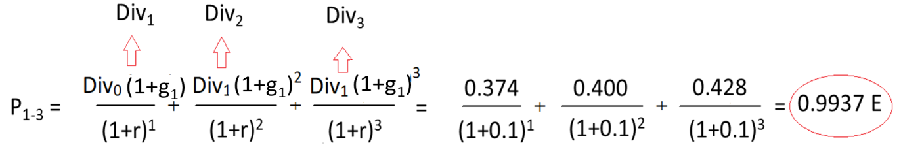
Dividend Discount Model (DDM)
Firstly, estimate the expected dividends for the first 3 years:
Div₀ = EPS x 35% = 1 x 35% → Div₀ = 0.350 E
Div₁ = Div₀ (1+g₁) = 0.350 (1+0.07) → Div₁ = 0.374 E
Div₂ = Div₁ (1+g₁) = 0.374 (1+0.07) → Div₂ = 0.400 E
Div₃ = Div₂ (1+g₁) = 0.400 (1+0.07) → Div₃ = 0.428 E
Secondly, estimate the Present Value of the expected dividends for the first 3 years:

Slide 9
Dividend Discount Model (DDM)
Thirdly, estimate the expected dividend at year 4 with g₂ = 4%:
Div₄ = Div₃ (1+g) = 0.428 (1+0.04) = Div₄ = 0.44512 E
Fourthly, estimate the Present Value of the expected Dividends from year 4 inwards, assuming a constant growth rate (constant growth model):
P₄ = Div₄ / (r - g) = 0.44512 / (0.1 – 0.04) = 7.43 E
Fifthly, discount that to the present to find the PV:
PV of P₄ = P₄ / (1+r)³ = 7.43 (1+0.1)³ = 5.56 E

Slide 10
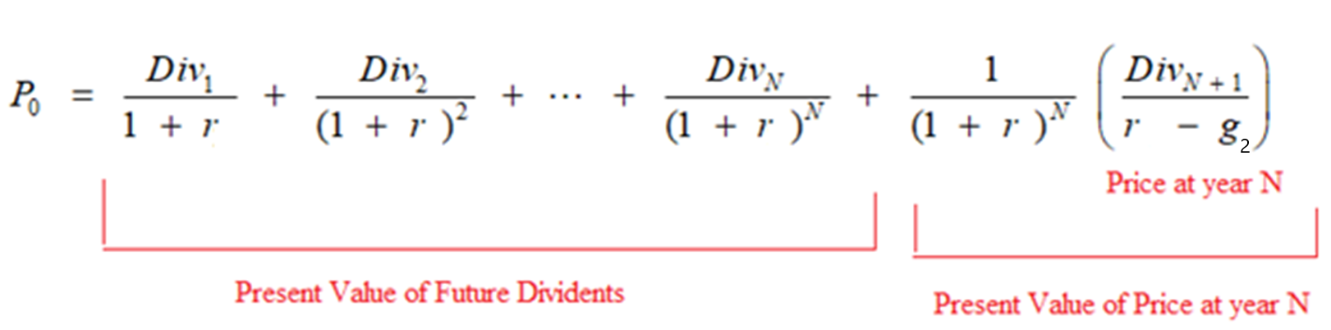
Dividend Discount Model (DDM)
Finally, add the Present Values to find the overall PV, i.e. the theoretical current stock price:
P₀ = PV of P₁₋₃ + PV of P₄ = 0.9937 + 5.56 = 6.553 Euro
The overall formula is:
Note that here, the analyst can add to the formula as many steps as he/she likes, depending on the expectations

Slide 11

Dividend Discount Model (DDM)
When applying this model, the analyst is faced with two issues:
How do we estimate the appropriate discount rate (r) ?
How do we estimate the appropriate growth rate (g) ?
There are many different approaches, we shall consider two indicative approaches
The Discount Rate: one could use the Capital Asset Pricing Model (CAPM, see later lectures)
That is, the return on stock i, should be equal to the risk-free rate plus a premium depending on the (unique) systematic risk of the stock
For example, the systematic risk (beta) of stock XYZ is b = 1.5
The return on the Market Portfolio (e.g. S&P500) is: R_{M} = 10%
The Risk-Free Rate (e.g. US treasury Bill) is: R_{f} = 4%
The appropriate discount rate for listed for XYZ is r = 4% + 1.5 (10% – 4%)] = 13 %

Slide 12
Dividend Discount Model (DDM)
The growth rate (g)
Q: Where will the growth come from ? A: From New Investments
Q: How will you finance new investments ? A: From Retained Earnings
Q: By how much will retained earnings grow? A: By the Return on New Investments (e.g. ROE)
Thus,
Growth (∆ in Earnings) = New Investments x Return on New Investments
Growth (∆ in Earnings) = (Earnings x Retention Rate) x Return on New Investments
Growth (∆ in Earnings) = (Retained Earnings) x Return on New Investments
g = retention rate x Return on New Investments
Assume that a firm keeps 60% of its earnings for re-investment and the ROE is 12%.
How much is g ?
g = 0.6 x 0.12 = 0.072 or 7.2%

Slide 13
Dividend Discount Model (DDM)
Example
Cboe Global Markets, Inc. (CBOE) is listed in the NYSE
On 16/5/2022 the share price was $109.38
Earnings Per Share (EPS) = $4.67, Dividend Per Share (Div₀) = $1.92
Beta (calculated from monthly data over the past 5 years) = 0.66
As an analyst,
→ you expect g₁ = 1%, for the following 2 years
Then, due to new innovative systems that will be in place,
→ you expect g₂ = 4% for years 3 and 4
After the 5th year the growth rate will be stable and
→ you expect g₃ = 5% for ever
The R_{f} = 0.01 and R_{M} =0.095
Is the stock fairly valued in the market, based on these assumptions?

Slide 14
Dividend Discount Model (DDM)
Firstly, you need to calculate the appropriate discount rate, using the CAPM:
R_{CBOE}= R_{f} + b (R_{M} - R_{F}) = 0.001 + 0.66 (0.095 – 0.001) = 0.0661
Secondly, you need to calculate the future dividends for years 1 to 5:
DIV₁ = DIV₀ (1 + g₁) = 1.9200 (1 + 1%) = 1.9392
DIV₂ = DIV₁ (1 + g₁) = 1.9392 (1 + 1%) = 1.9585
DIV₃ = DIV₂ (1 + g₂) = 1.9585 (1 + 4%) = 2.0369
DIV₄ = DIV₃ (1 + g₂) = 2.0369 (1 + 4%) = 2.1184
DIV₅ = DIV₄ (1 + g₃) = 2.1184 (1 + 5% ) = 2.2243

Slide 15
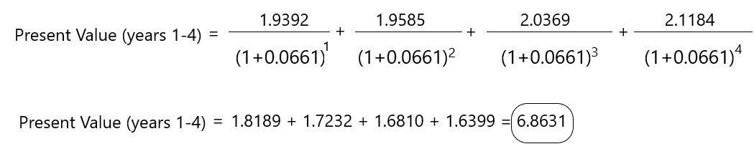
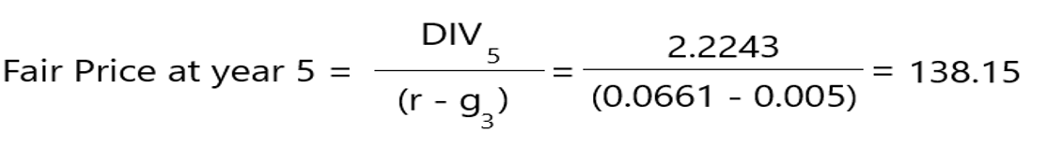
Dividend Discount Model (DDM)
Thirdly, you need to discount these cash flows at the appropriate discount rate
Let us start with the first 4 years:
Fourthly, you need to find the present value of the dividend in year 5 that will be paid for ever at a constant growth rate (g3=5%)
So, at the beginning of year 5 (or at end of year 4) it will be:

Slide 16
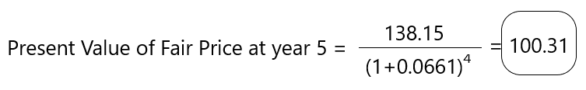
Dividend Discount Model (DDM)
Fifthly, you need to discount that to the present (year 0)
Finally, you need to add all the Present Values: $6.8631 + $100.31 = $107.18
Market price = $109.38
Fair Price (PV of Future Dividends) = $107.18
The stock is valued in the market close to its fair value (slightly overvalued)

Slide 17
Dividend Discount Model (DDM)
Let us see Indicative Applications for corporate managers
You are a manager of a listed company, and you want to increase your stock price
→ should you reduce your dividend and invest more ?
→ should you increase divided and reduce investments ?
The correct answer depends on the profitability of investments:
↓ DIV → ↑ investment → ↑ price ONLY IF new investments have an NPV > 0

Slide 18
Dividend Discount Model (DDM)
Let us demonstrate the impact with an example:
Firm X expects next year EPS of 7 Euro (DIV₁)
Firm X usually pays all EPS as dividends
The current stock price is 62 Euros
The management team is considering to adopt a dividend pay out policy of 70%
The retained earnings (30%) will be used for new investment (e.g., new facilities)
The Return on Equity (ROE) of the firm is 14%
The discount rate remains unchanged
Can you estimate the effect on the stock price, assuming constant growth?

Slide 19
Dividend Discount Model (DDM)
Firstly, you need to estimate X’s required return (cost of capital) - no growth now (g=0):
P₀ = Div₁ / (r - g) → r = ( Div₁ / P₀ )+ g → r = (Div₁ / P₀) (since g =0) → r = 11.2%
Secondly, you need to find the new dividend with the new strategy:
Div₁ = EPS x 0.70 = 7 x 0.70 = → Div₁ = 4.9 Euros
Thirdly, you need to find g:
g =retention rate x ROE = 0.30 x 0.14 → g = 4.2%
Fourthly, you need to find the price with the new strategy:
P₀ = Div₁ / (r-g) = 4.9 / (0.112 – 0.042) → P₀ = 70
Result ? The stock price is expected to increase from 62 to 70, if X cuts div and invests
Why ? The new investments have a return of 14% > discount rate (11.2%)

Slide 20
Dividend Discount Model (DDM)
What if the return on the new investments is 8% (ROE = 8%) ?
Firstly, you need to find g:
g = retention rate x ROE = 0.30 x 0.08 → g = 2.4%
Secondly you need to find new stock price:
P₀ = Div₁ / (r-g) = 4.9 / (0.112 – 0.024) → P₀ = 55.6
Result ? The stock price is expected to decrease from 62 to 55 if X cuts div and invests
Why ? The new investments have a return of 8% > discount rate (11.2%)
In other words, the NPV of the new investments is negative (NPV< 0)
In the previous case, the NPV of the new investments was positive (NPV>0)

Slide 21
The Discounted Free Cash Flow Model
Another approach is to try to estimate the value of the firm to all investors
→ both debt and equity holders
Above, the we adopted the point of view of the equity investor, but dividends are relevant to equity investors only
One approach is to use the overall Free Cash Flows of the firm
Example
Assume that a Firm Y has the Final Free Cash Flows as in the following Table
Sales are expected to grow at 3% in year 2, 4% in year 3, and 5% in year 4.
After that, the cash flows are expected to grow at a constant rate of 2% for ever.
The appropriate discount rate is 10%, and Y has 10,000,000 shares.
If the current market price is 2 Euros per share is the stock fairly valued ?

Slide 22
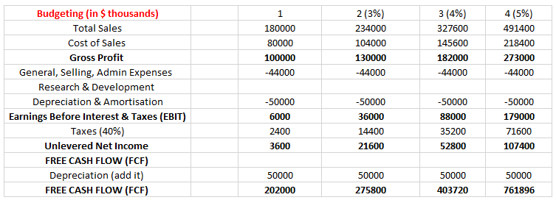
The Discounted Free Cash Flow Model
The Free Cash Flows of the firm are as follows (see also next lectures)

Slide 23
The Discounted Free Cash Flow Model
Apply the models we have seen so far not to the Dividends but to the Cash Flows:
Firstly, find the Present Value of the Cash Flows for the first 4 years (discount rate = 8%):
Secondly, find the PV of the CF in year 5:
(CF₄ (1+g₂)) / (r-g) = ((761896) * (1+0.02)) / (0.10 – 0.02 ) = 777133.92 / 0.08 = 9,714,174
Thirdly, find the total Present Value: 1,303,993.341 + 9,714,171 = 11,081,167 Euros
Fourthly, divide with the number of shares ourtstanding to find the fair Stock Price
PV(CFs) / No of Shares = 11,081,167 / 10m shares = 1,1 Euro (Overvalued in the market)

Slide 24
The Discounted Free Cash Flow Model
Since we are valuing the firm to all investors we cannot use the equity cost of capital
We must use a rate that applies for both debt and equity holders
That is, the Weighted Average Cost of Capital (WACC)
WACC = r_{e} (% of Equity) + r_{d} (% of Debt) (1-tax rate)
Where,
r_{e} = cost of equity
r_{d} = cost of debt
% of Equity = E / (E+D)
% of Debt = D / (E+D)

Slide 25
Multiples
The second approach to equity valuation is to use multiples/comparables
Here the idea is that we evaluate the firm based on the values of other comparable firms that have similar future cash flows
We usually estimate ratios of the stock price (value) to some measure of profitability or cash flow:
The Price/Cash Flow Ratio (P/CF)
The Price/Book Value Ratio (P/B)
The Price/Sales Ratio (P/S)
The Price-Earnings Ratio (P/E)
The theory behind is the “Law of One Price”, i.e. the theory that
→ if we have two “identical” investments they must have the same value
By identical we mean similar cash flows, similar risk, etc.

Slide 26
Multiples
P/E ratio
This is the ratio of the expected Earnings Per Share (EPS) divided with the current Stock Price
For example, firm Z has expected EPS = $4 and market P = $40
Its P/E = 10
What variables determine the P/E ratio ?
The model implies that the P/E ratio is determined by:
The dividend payout ratio (D/E)
The required return (r)
The growth rate (g)

Slide 27
Multiples
P/E ratio
This ratio shows how much investors are willing to pay for each $ of a company's earnings
For instance, a P/E of 10 means that the stock price is 10 times its earnings
In other words, investors are currently willing to pay 10 times its expected EPS to buy the stock
Alternatively, if the company pays all earnings as dividends investors will break even in 10 years
Compare this with another firm that has a P/E of 25
The firm with the P/E of 25 is
→ Either significantly more expensive (overvalued)
→ Or has very significant growth opportunities (that is why its price is so high)

Slide 28
Multiples
Can I use the P/E ratio for pricing ?
Yes, according to this approach, the stock price is equal to the product of EPS with a comparable P/E ratio (the average P/E ratio of comparable firms)
Examples
ABC, a car maker industry, has a stock price of 35.8 and EPS 3.25
The average (comparable) P/E in the automobile industry is 7.5
ABC’s price should be 7.5 x 3.25 = 24.3 Euros (overvalued)
XYZ is a glass maker stock has EPS of 1.50
The average P/E ratio of the glass making industry is 20
What should be XYZ’s price?
XYZ’s price should be 1.5 x 20 = 30 Euros

Slide 29
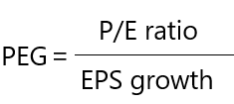
Multiples
Often, investors assume that firms with a higher P/E ratio have higher expected growth
For example, tech firms tend to have higher P/E ratios
However, one limitation of the P/E ratio is that it does not include expected earnings growth, thus it may be difficult to assess whether:
→ the high P/E ratio is due to higher expected growth or that
→ the stock is simply overvalued
In such cases we may use the price/earnings to growth ratio (PEG ratio):
With PEG we can compare the valuations of different sectors (stocks) with different P/E ratios

Slide 30
Multiples
As with all estimates, it depends crucially on the inputs
For example, it depends on earnings growth estimates (5-y estimate ?, 3-y estimate ?, you should always use reliable sources)
For example, some analysts use
→ historical growth (“trailing” P/E, past 12 months) while others use
→ expected future growth (“forward” P/E, projected earnings for the next 12 months )
Generally, when PEG < 1.0 it implies that the company is undervalued
The Tech stock may seem more attractive (high P/E); but when we compare it with the Energy stock, we see that the high P/E is not justified/supported with its excepted growth
The Energy stock, on the other hand, is cheap compared to its expected growth rate (trading at a discount, undervalued ?)

Slide 31
Multiples
The analysis is similar with other multiples
For instance, other valuation ratios that we often use are:
The Price to Book Ratio (P/B) ratio = Stock Market Price / Book Stock Price
The Price to Sales (P/S) ratio = Stock Market Price / Sales per stock
The Price to Cash Flow to Price (P/CF) ratio = Stock Market Price / Cash Flow per share
The Dividend Yield (DY) = Dividend / Stock Market Price
On average, the higher the ratios the more expensive (overvalued) the stock
* the first ratio may also often be expressed as the Book to Market (B/M) ratio

Slide 32
Multiples
Empirical studies show that, on average:
Low (P/B) stock portfolios outperform high (P/B) stock portfolios
Low (P/S) stock portfolios outperform high (P/S) stock portfolios
Low (P/E) stock portfolios outperform high (P/E) stock portfolios
Low (P/CF) stock portfolios outperform low (P/CF) stock portfolios
High (DY) stock portfolios outperform low (DY) stock portfolios
This is known as the Value Effect (Value Anomaly):
→ value stocks (i.e. stocks with low ratios)
tend to outperform
→ growth stocks (i.e. stocks with high ratios)

Slide 33
Cash Flow to Price Portfolios Cumulative Returns (Germany)
Source: K French database see references

Slide 34
Multiples
Another approach is to use the concept of the Enterprise Value
Enterprise Value = MV of Equity + Debt – Cash
It is an estimate of how much it would cost to buy the company, pay its debt and keep the cash; the value to whole firm to all investors (equity and debt holders, etc.)
By contrast, the MV of Equity (Market Capitalization) is the value to equity holders only
Enterprise Value / EBITA
Enterprise Value / EBIT
A low ratio compared to past ratios of the firm → undervalued
A high ratio compared to past ratios of the firm → overvalued

Slide 35
Multiples - Limitations
When valuing a firm using multiples, there is no clear guidance about how to adjust for differences in expected future growth rates, risk, or differences in accounting policies.
Comparables only provide information regarding the value of a firm relative to other firms in the comparison set.
Using multiples will not help us determine if an entire industry is overvalued
Discounted cash flows methods have the advantage that they can incorporate specific information about the firm’s cost of capital or future growth.
The discounted cash flow methods have the potential to be more accurate than the use of a valuation multiple.

Slide 36
Financial Statement Analysis
  A significant role in valuation is played by the analysis of the Financial Statement
  An analyst/investor will perform Financial Statement Analysis (FSA) to:
  Compare the performance of the firm over time
  Compare the performance of the firm with the industry/competotors
  Peer group analysis: establish a benchmark, (firms that have similar activity, same sector, similar assets, similar operation)
  Ratio Analysis – Important Ratios
  Profitability Ratios (financial efficiency, capacity for increased return on invested capital)
  Liquidity Ratios (ability to meet maturing short-term obligations, ability to avoid insolvency)
  Leverage Ratios (how assets are financed: equity or liabilities)
  Valuation Ratios (see also above)

Slide 37
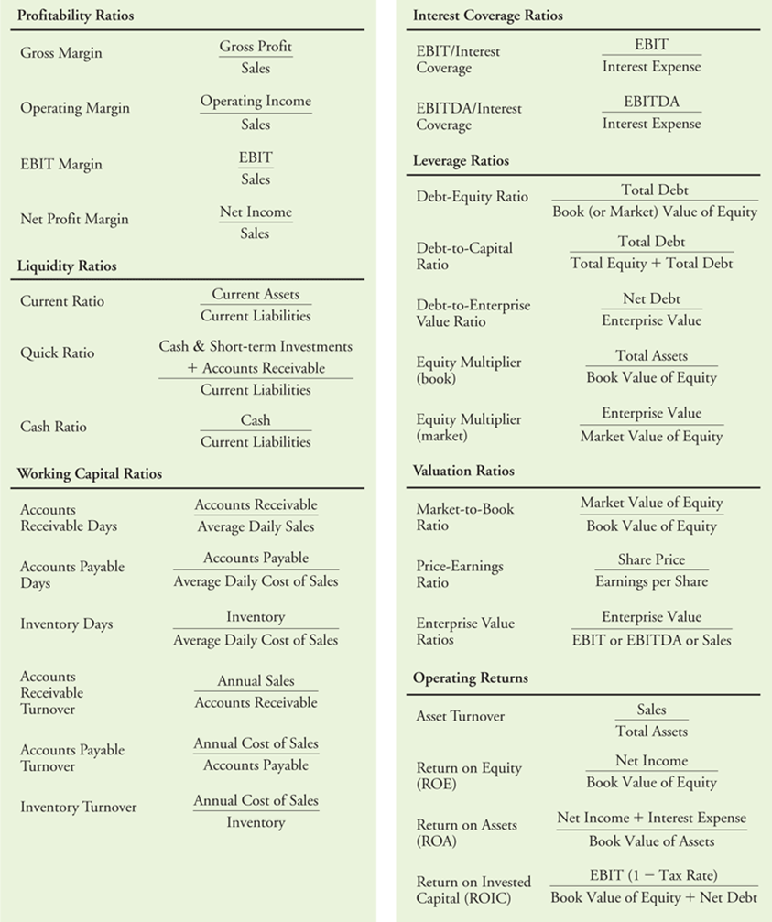
Financial Statement Analysis

Slide 38
Financial Statement Analysis
Before we procced discussing FSA let us first review the most important Financial Statements
→ accounting reports with past information
They are issued on a regular basis to communicate financial information to stakeholders
In most countries they are filled with the relevant regulators
They are also sent to the shareholders
They must be understandable and accurate
They are evaluated by a neutral third party (auditors)
The auditors ensure they are prepared according to the relevant regulations/guidelines

Slide 39
Financial Statement Analysis
The Financial Accounting Standards Board (FASB) in the USA established the:
→ Generally Accepted Accounting Principles (GAAP)
GAAP: provides a common set of rules and a standard format for public companies to use when they prepare their reports.
This standardization also makes it easier to compare the financial results of different firms.
Important harmonization (1973) when 10 countries (including the US) established the:
→ International Accounting Standards Committee
This led to the International Financial Reporting Standards (IFRS).

Slide 40
Financial Statements
  1. Balance Sheet (lists the firm’s assets and liabilities)
  2. Income Statement (revenues and expenses over a period of time)
  3. Statement of Cash Flows (the amount of cash the firm has earned)
  4. Statement of Stockholders’ Equity (equity explained broken down to the amount that came from issuing shares versus retained earnings)

Slide 41
The Balance Sheet
The financial position of a Firm (snapshot)
Balance Sheet Identity:
Assets = Liabilities + Stockholder’s Equity
Assets: what X owns
Liabilities: what X owes
Stockholder’s Equity: the difference between assets and liabilities
It is the owners' equity or what will remain if X pays all the liabilities

Slide 42
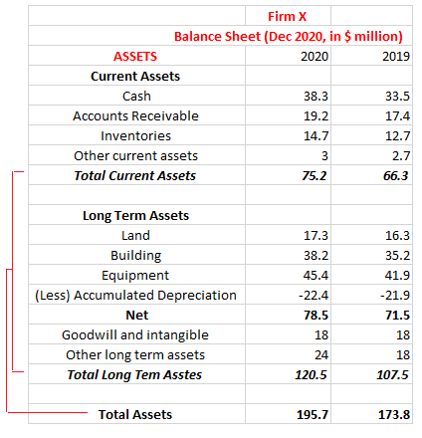
The Balance Sheet
Total Assets =
Current Assets + Long Term Assets
→ Current Assets
    Cash (or be cash in the next year)
    Marketable Securities
    Accounts Receivable
    Inventories
    Other Current Assets (e.g., pre-paid expenses, etc.)

Slide 43
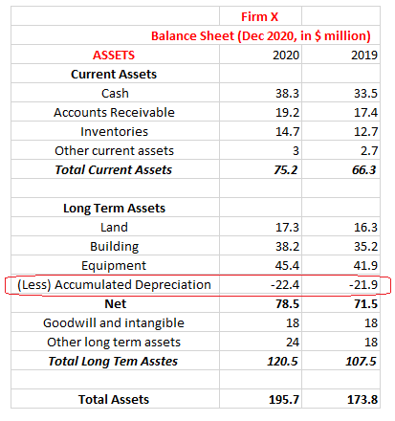
The Balance Sheet
→ Long-Term Assets
Land, Plant, & Equipment
Investments in Long-term Securities
Depreciation
→ Firm X reduces the value of its fixed assets (not land) over time according to a depreciation schedule.
→ This schedule depends on the asset duration (life)
→ Depreciation is not a cash expense, but a recognition that assets become less valuable over time
Book Value of asset =
Acquisition cost – Accumulated depreciation

Slide 44
The Balance Sheet
Goodwill and intangible assets
Intangible asset: a Firm buys (acquisition) another firm at a premium price (value)
This premium value includes brand names, customer base, customer relations, patents, trademarks, copyrights, etc)
These are not physical assets = Intangible
For example, Firm X paid $20 million in 2019 for a firm whose tangible assets had a book value of $2 million.
The remaining $18 million appears as goodwill and intangible assets.

Slide 45
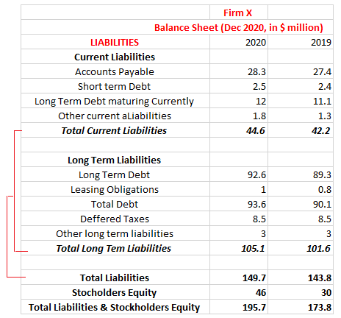
The Balance Sheet
  Total Liabilities =
  Current Liabilities + Long Term Liabilities
  Current Liabilities
  To be paid within the year
    Accounts Payable
    Short-Term Debt
    Long-Term Debt maturing within the year
    Other Current Liabilities
      Taxes
      Wages

Slide 46
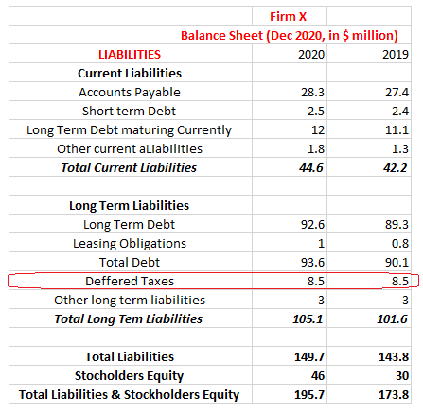
The Balance Sheet
  Long-Term Liabilities
  Long-Term Debt
  Leases
  Deferred Taxes (taxes owed but not yet paid)
  Eventually they will be paid (appear as a liability)

Slide 47
The Balance Sheet
Stockholder’s Equity
Book Value (BV) of Equity =
Book Value of Assets – Book Value of Liabilities
May be negative (potential bankruptcy ?)
Market Value of Equity =
Stock Market Price x No of Shares Outstanding
Cannot be negative and may differ from BV
(Market Capitalization)

Slide 48
The Balance Sheet
Important Ratio (see also above):
Book to Market Ratio (BM) = Book Value of Equity / Market Value of Equity
Market to Book Ratio (MB) = Market Value of Equity / Book Value of Equity
Empirical studies indicate that we can predict the future returns based on the B/M ratio
Stocks with a High B/M ratio tend to have higher future returns compared to Low B/M stocks
High B/M stocks (value stocks) are often considered to be undervalued while
Low B/M stocks (growth stocks) are often considered to be overvalued
Thus, “value anomaly”, “value effect”, “value vs growth effect”

Slide 49
The Balance Sheet
Firm X has 4 million shares outstanding in 2020 and the share price is 18 $ per share
What is the market value (capitalisation)?
4 m x $18 = $72 million
What is the B/M ratio? 46/72 = 0,63
What is the M/B ratio? 72/46 = 1,56
Investors are willing to pay 1.5 times the book value to buy the stock

Slide 50
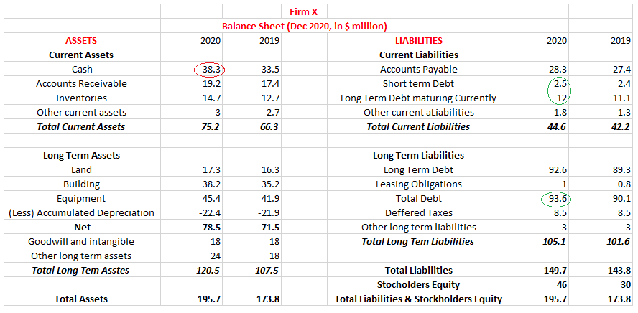
The Balance Sheet
Total Enterprise Value (TEV)
TEV = MV of Equity + Debt – Cash
Market capitalization: $72 m
Debt: $108.1
Cash balance: $38.3m
TEV = 72 + 108.1 – 38.3 = $141.8m
Buy all equity, pay debts, keep the cash

Slide 51
The Balance Sheet
Final Comments
Many assets are valued on historical cost rather than their current values
Many valuable assets may not be captured on the balance sheet
E.g., the expertise, reputation, customer relations, R&D, etc.

Slide 52
Income Statement
IS = the “bottom line”, the Profit and Loss statement, or “P&L”
The statement of financial performance lists the firm’s revenues and expenses
Net income = a measure of profitability
Net Income = earnings
Balance sheet: shows assets and liabilities at a given point in time
Income statement: shows the flow of revenues and expenses generated by assets & liabilities

Slide 53
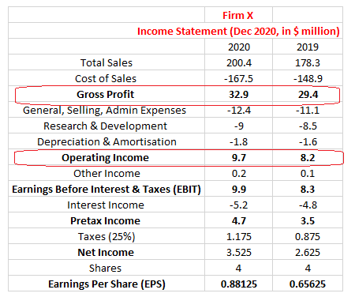
Income Statement
To estimate Net Income:
Total Sales/Revenues
minus
Cost of Sales
equals
Gross Profit
minus
Operating Expenses (Selling, General, and Administrative Expenses, R&D, Depreciation & Amortization)
equals
Operating Income

Slide 54
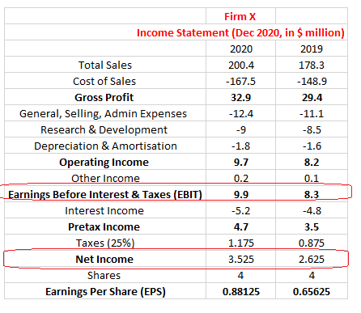
Income Statement
Operating Income
plus/minus
Other Income/Other Expenses
equals
Earnings Before Interest and Taxes (EBIT)
plus/minus
Interest Income/Interest Expense
equals
Pre-Tax Income
minus
Taxes
equals
Net Income

Slide 55
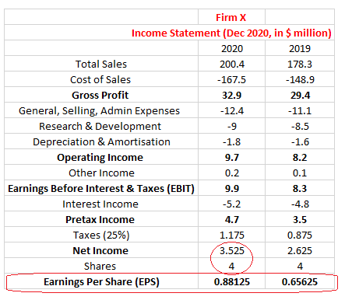
Income Statement
Net income =
Total earnings of equity holders
We often need it on a per-share basis
EPS =
Net Income / Shares Outstanding
EPS = $3.525m / 4m Shares =
$0.88125 per Share

Slide 56
Income Statement
Let us see some concepts in a bit more detail now
What is the Gross Profit ?
It is the income from selling the product
The first two lines list the revenues & costs from sales of products
The cost of sales is directly related to producing the goods (e.g., manufacturing costs)
Gross profit: sales revenues minus the costs

Slide 57
Income Statement
What is the Operating Expenses ?
It is the expenses from the ordinary course of running the business that are not directly related to production, such as:
→ Administration expenses
→ Overhead expenses
→ Salaries
→ Marketing and R&D expenses, etc.
Depreciation: it is NOT a cash expense (estimate of costs from using the assets)
Gross profit - operating expenses = Operating income

Slide 58
Income Statement
What is EBIT ?
When we adjust Operating Income for other sources of income/expenses
e.g. financial investments
We get EBIT

Slide 59
Statement of Cash Flows
Another important Financial Statement is the Statement of Cash Flows
It is a measure of the firm’s profit over time
It does not indicate how much cash the firm has generated
Why ?
1) non-cash entries on the IS (depreciation and amortization)
2) Some uses of cash (e.g., costs of inventory) do not appear in the IS

Slide 60
Statement of Cash Flows
To compile it we use info from both the income statement and balance sheet
It determines how much cash the firm has generated
It determines how that cash has been allocated, during a set period.
From the investor point of view, it contains very important information
The statement of cash flows has 3 sections:
operating activities
investment activities
financing activities

Slide 61
Statement of Cash Flows
Operating Activities
  Starts with net income from the income statement and then makes adjustments
  Adjusts net income by all non-cash items related to operating activities and changes in net working capital
  Adjusts changes to net working capital that arise from changes to accounts receivable, accounts payable, or inventory.
    Accounts Receivable – deduct the increases. Why ?
    When the firm sells a product with credit (and receives no cash) it is like the firm is lending to the customer.
    This reduces the available cash, and the increase must be deducted in accounts receivable.
    Accounts Payable – add the increases. Why ?
    The same reasoning. Accounts payable is like the firm is borrowing from suppliers, which increases the cash available.

Slide 62
Statement of Cash Flows
Inventories – deduct the increases. Why ?
Inventory increases do not contribute to net income because the products are not sold yet
However, the cost of increasing inventory is a cash expense
Depreciation: we deduct it when calculating the net income; however, it is not a cash outflow.
Thus, we need to add it back when calculating the cash generated
Add back any non-cash expenses (deferred taxes, etc.)

Slide 63
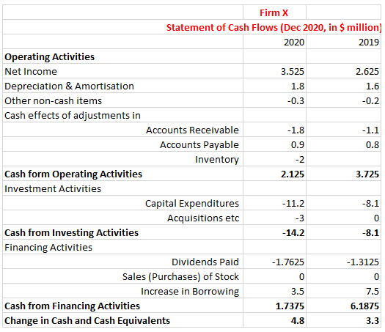
Statement of Cash Flows
Investing Activities
  Examples
  Buy/Sell Securities
  Capital Expenditures = Buy new property, plant, equipment.
  Subtract the actual capital expenditure that the firm made.
  Financing Activities
  Dividends (cash outflow)
  Increases/Decreases in Borrowing
  Retained Earnings =
  Net Income - Dividends

Slide 64
Example
Assume that Firm X had an extra 2 million depreciation expense in 2020.
If the tax rate is 25%, how the earnings be affected?
Depreciation is an expense.
Thus, Operating Income, EBIT and Pre-tax income will go down by $2 million (see red)
However, it would also reduce the tax bill by $2 m x 25%, i.e., $0.5m (see green).
So net income will go down by ($2m - $0.5m) = $1.5m (see blue)

Slide 65
Other Financial Statement Information
Management Discussion and Analysis (MD&A)
An introduction to the financial statements where the management discusses/analyses:
The events during the year that the statements cover (significant events, etc)
Targets, projects, plans
Risks and liquidity issues
Disclosure of off-balance sheet transactions, etc.

Slide 66
Other Financial Statement Information
Notes to the Financial Statements
Extensive notes with detailed info on the statements:
Info on accounting assumptions
Info on subsidiaries
Indo on stock-based compensation plans
Info on outstanding debt
Info on mergers and acquisitions, spin-offs, leases, taxes, etc

Slide 67
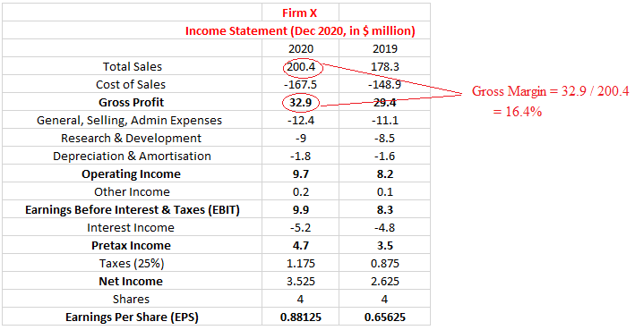
Financial Statement Analysis
Important Profitability Ratios
Gross Margin = Gross Profit / Sales
Operating Margin= Operating Income / Sales
EBIT Margin = EBIT / Sales
Net Profit Margin= Net Income / Sales

Slide 68
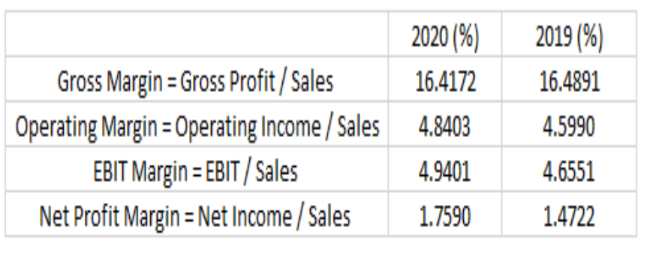
Financial Statement Analysis
Gross margin: shows the ability to sell for more than the cost
In 2020, X had gross margin of 16.41%, approximately the same as in 2019.
Operating margin: how much is earned before interest and taxes from each dollar of sales
In 2020, X had a margin of 4.84% slightly increased form 2019 (4.59%).
EBIT margin: Comparing across industry, shows the relative efficiency of each firm
In 2020, X had a margin of 4.94%; if the industry’s average margin was 7.8%, X is less

Slide 69
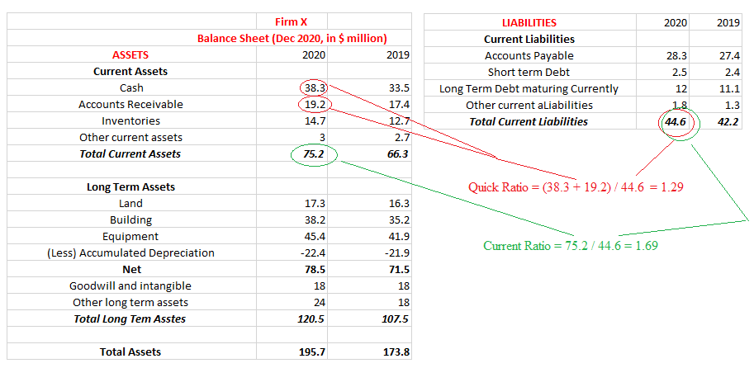
Financial Statement Analysis
2. Important Liquidity Ratios
(financial solvency or liquidity)
Current Ratio = Current Assets / Current Liabilities
Quick Ratio = (Cash + Short-Term Investments + Accounts Receivable) / Current Liabilities
Cash Ratio = Cash / Current Liabilities

Slide 70
Financial Statement Analysis
Current Ratio: whether the firm has sufficient working capital to meet its short-term needs
In 2020, X had a current ratio of 1.69 slightly improved from 2019 (1.57)
Quick Ratio: Stringent test of liquidity (the ↑ ratio the ↓ the risk of a cash shortfall)
In 2020, X had a quick ratio of 1.29 slightly improved from 2019 (1.21)

Slide 71
Financial Statement Analysis
Interest Coverage Ratio = EBIT/Interest
Used to evaluate the ability of the firm to meet its interest obligations
For example, Firm X’s EBIT/Interest in 2020 is 9.9 / 5.2 = 1.90 (up from 1.73)
A ↑ high ratio indicates that the firm is earning much more than is necessary to meet its required interest payments
Note that creditors often look for high ratio (above 5) for high-quality borrowers.
If the ratio is below 1.5, the ability of the firm to repay debts is in doubt
Also used: EBITDA/Interest

Slide 72
Financial Statement Analysis
If we combine income statement and balance sheet info, we can see how efficient the firm is in using its Net Working Capital (NWC)
WC = the difference between a company’s current assets and current liabilities
WC = measures a firm’s liquidity, operational efficiency, and short-term financial health
E.g., measure the speed at which a firm is turning sales into cash
Working Capital Ratios
Accounts Receivable Days = Accounts Receivable / Average Daily Sales
Accounts Payable Days = Accounts Payable / Average Daily Cost of Sales
Inventory Days = Inventory / Average Daily Cost of Sales

Slide 73
Financial Statement Analysis
Important Working Capital Ratios
1. Accounts Receivable Days = Accounts Receivable / Average Daily Sales
In 2020, X had average daily sales (200.4 / 365) of $0.55m slightly increase from 2019 ($0.49m)
In 2020 X had Accounts Receivable Days = 19.2 / 0.55 = 34.97 days (up from 35.62 in 2019)
X receivables represent 34.97 days’ worth of sales
This implies that it took company X over a month to collect payment

Slide 74
Financial Statement Analysis
2. Accounts Payable Days = Accounts Payable / Average Daily Cost of Sales
In 2020, X had average daily cost of sales (Cost of Sales / 365) = $167.5m / 365 = $0.46m (from 0.41)
In 2020 X had Accounts Payable Days = 28.3 / 0.46 = 61.67 days (down from 67.17 in 2019)
X payables represent 61.67 days’ worth of sales
This implies that it took company X over two months to pay payables

Slide 75
Financial Statement Analysis
3. Inventory Days = Inventory / Average Daily Cost of Sales
In 2020 X had Inventory Days = 14.7 / 0.46 = 32.03 (up from 31.13 in 2019)
It takes company X 32 days to turn inventory to sales
This differs significantly between different industries

Slide 76
Financial Statement Analysis
Other Working Capital Ratios: Turnover Ratios
Another way to evaluate working capital is to express revenues/costs
→ as a multiple of the corresponding working capital account
Accounts Receivable Turnover = Sales / Accounts Receivable
Accounts Payable Turnover = Cost of Sales / Accounts Payable
Inventory Turnover = Cost of Sales / Inventory

Slide 77
Financial Statement Analysis
Accounts Receivable Turnover = Sales / Accounts Receivable
It shows how efficient is the firm in collecting debt from credit to customers
The ↓ the ratio the ↑ the efficiency
For example, Firm X Accounts Receivable Turnover in 2020 is 200.4 / 19.2 = 10.44
X collects its receivables about 10 times (on average) per year,
That is, it converts receivables to cash about 10 times per year.
Should be followed over time to see if it improves or deteriorates

Slide 78
Financial Statement Analysis
Accounts Payable Turnover = Cost of Sales / Accounts Payable
A short-term evaluation of liquidity; how fast the firm pays off its suppliers
A higher ratio suggests faster payments and strong creditworthiness
How many times the firm pays off its accounts payable in the year.
For example, Firm X Accounts Payable Turnover in 2020 is 167.5 / 28.3 = 5.92

Slide 79

Financial Statement Analysis
Inventory Turnover = Cost of Sales / Inventory
For example, Firm X inventory turnover in 2020 is 167.5 / 14.7 = 11.39
That is, X sold approximately 11 times its stock of inventory during the year
On average, the higher the turnover the more efficient the use of the working capital

Slide 80
Financial Statement Analysis
There are wide differences across industries.
The average large U.S. firm had about 45 days’ worth of receivables and 65 days’ worth of inventory in 2012
However, airlines have minimal accounts receivable or inventory, as their customers pay in advance, and they sell a transportation service as opposed to a physical commodity
On the other hand, distillers and wine producers tend to have very large inventory (over 300 days on average), as their products are often aged prior to sale.
(see, Berk & DeMarzo)

Slide 81
Financial Statement Analysis
3. Important Leverage Ratios
How much the firm relies on debt for financing (leverage), varies between industries
Debt to Equity Ratio = Total Debt / Total Equity
A ↑ ratio → ↑ risk (aggressive firm, finances growth with debt)
Debt to Capital Ratio = Total Debt / ( Total Equity + Total Debt)
(if we assume for simplicity that total debt = total liabilities in our example, i.e., 149.7 )
Sometimes the book value of equity is negative thus, the ratio has no meaning.
Thus, it makes more sense to compare debt with the market value of equity.

Slide 82
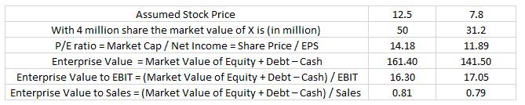
Financial Statement Analysis
4. Important Valuation Ratios (see also above)
P/E ratio = Market Cap / Net Income = Share Price / EPS
Enterprise Value to EBIT = (Market Value of Equity + Debt – Cash) / EBIT
Enterprise Value to Sales = (Market Value of Equity + Debt – Cash) / Sales

Slide 83
Financial Statement Analysis
5. Important Operating Return Ratios (evaluate financial performance)
Return on Equity (ROE) = Net Income / Book Value of Equity
Depends on the industry, for big cap listed firms about 12%-15% is acceptable
For example, Firm X’s ROE in 2020 is 3.525 / 46 = 7.66% (up from 8.88%)
Return on Assets (ROA) = Net Income + Interest Expense / Total Assets
How efficient is the firm in using assets for profit; it is less sensitive to leverage than ROE, but it is sensitive to working capital: e.g., the same ↑ in receivables and payables will ↑ total assets and ↓ ROA
Return on Invested Capital (ROIC) = EBIT (1-Tax Rate) / Book Value of Equity + Net Debt

Slide 84
Equity Research Report

Slide 85
Equity Research Report
An important piece of information for an investors is the Equity Research Report
This is a detailed report/document that is prepared by a professional financial analyst
The aim of the report is assisting investors on the decision to buy/hold/sell the stock
We discuss it here to demonstrate the relevant information that needs to be evaluated by investors
It includes (among others):
→ a valuation of the firm
→ an analysis of the risks involved
→ an investment thesis
→ a target price

Slide 86
Equity Research Report
A. Basic information regarding the company (indicative):
Where the stock is trading (exchange)
Ticker symbol
In what sector / industry the company operates
Current information about the stock (e.g., price)
Recommendation (buy/sell/hold) and target price
Market capitalization and free float (i.e., % of stocks available for trading)
Major shareholders

Slide 87
Equity Research Report
B. Description of the business of the firm and overview of the industry / competition
What the firm produces and/or the services it offers/sells
The factors that affect the revenues and the costs
Analysis of the competition in the sector / industry
Many analysts are employing the 5 forces of Porter (see, Porter (1979)):
→ Threat of new entrants
→ Bargaining power of suppliers
→ Bargaining power of buyers
→ Threat of substitute products or services
→ Competitive rivalry

Slide 88
Equity Research Report
C. Investment Summary and Valuation
Recent industry and/or company trends and info
Earnings forecast
Valuation analysis
→ Discounted cash flow models (find intrinsic value)
→ Relative valuation (industry and company ratios, see next)

Slide 89
Equity Research Report
D. Financial Analysis and Investment Risks
Financial performance (historical)
Future performance (forecast)
Discuss what affects the firm's earnings (read the footnotes, examine one-off events, accounting practices, etc.)
Discuss/identify both financial (e.g. exchange rate) and operational (e.g. new technology) risks that might affect profitability
Are there any changes in regulation that may affect the firm / industry?
Is the firm involved in legal disputes ?

Slide 90
Equity Research Report
E. Environmental, Social and Governance (ESG) Analysis
Discuss the firm’s policies on ESG matters, such as (among others):
Carbon emissions, pollution, energy efficiency, etc.
Human rights issues, community engagement, diversity, etc.
The Board of Directors composition (% of female directors?)
The Board of Directors compensation, anti-corruption issues

Slide 91
Equity Research Report
E. Environmental, Social and Governance (ESG) Analysis
Discuss the firm’s policies on ESG matters:
Environmental factor (E): the impact of the firm on the environment, e.g. carbon footprint, resources used such as toxic chemicals for manufacturing, sustainability/innovation in the supply chain, reporting on issues such as energy use, greenhouse emissions, pollution, waste, etc
Social factor (S): the impact of the firm on the society (immediate and broader community), e.g. human resources of the firm (gender racial diversity/inequality, human rights, fair pay, tax paying taxes, sourcing locally, supporting local projects, etc
Governance factor (G): Board of Director composition,, transparency, compensation schemes, diversity, relations with shareholders, other ESG values, etc.

Slide 92
Equity Research Report
When a firm adopts the ESG framework, it is expected that:
There will be a positive impact on firm value, by improving operational performance
→ It will gain stakeholder trust
→ It will increase interest from investors, make access to capital easier
→ It will have a positive impact on shareholder engagement / reduce agency costs
→ It will increase competitiveness
→ It will reduce risks and, thus, it may lead to lower borrowing costs

Slide 93
Equity Research Report
ESG Risk Management is the procedure of:
Identification of ESG risks
Assessment of ESG risks
Mitigation of ESG risks
Examples of Risks
Supreme Courts have accepted that a parent company can be sued because a subsidiary caused damage to the environment and/or abuses of human rights
Parent companies can be held liable for oil leaks and pollution from subsidiaries in other countries
Parent companies can be sued for human rights violations from subsidiaries in other countries
Companies can be sued for corporate fraud, corruption
Company X makes deceptive statements to mislead the public about its sustainable practices (greenwashing)

Slide 94
Equity Research Report
Thus, ESG risks may have a significant impact on:
The profits of the firm
The reputation of a firm
The survival of the firm
Legal disputes about ESG issues have costed large US listed firms more than half a trillion $ in the past decade, e.g.:
→ Old power lines of a utility company caused major wildfires; compensation and fines
→ An auto manufacturer admitted faked emissions tests, and the costs were many billions (auto recalls, fines, settlements, etc)
Firms must identify the risks and mitigate them: the cost should be lower compared to the cost of letting the risk unmitigated

Slide 95
Equity Research Report
The analyst will obtain the relevant information from the Financial Statements
→ Financial statements analysis (see above)
Balance Sheet: financial position, assets, liabilities and debt, shareholder equity, etc.
Income Statement: revenues, costs, profits
Cash Flow Statement: analysis of operating, investing, and financing activities.

Slide 96
Equity Research Report
Important (indicative) ratios to examine
Price-to-earnings (P/E) ratio = current stock price / earnings per share
Helps with valuation (see also the relevant discussion later)
It shows how we pay for each $ of earnings
Example
On 23/4/2026 Tesla had a stock price of $387 and EPS of $1.08
The P/E ratio for Tesla is (387 / 1.08) = 358
It suggests that market participants expect very high future growth
Important: compare with industry average (see discussion earlier)

Slide 97
Equity Research Report
Price-to-book (P/B) ratio = market price / book value
Helps identifying undervalued stocks
Example
On 6/30/2025 Ford had a P/B ratio of 0.95
This indicates that the stock may be undervalued
→ Ford’s assets might be worth more than its current stock market price
The D/E ratio = total debt / shareholders’ equity
Shows if a firm relies on debt (and by how much)
Firms that have high D/E ratios are generally considered riskier

Slide 98
Equity Research Report
Return on equity (ROE) = net income / shareholders' equity
It measures profitability and shows the efficiently in generating profits from investments
Earnings per share = (net income – preferred dividends) / total outstanding shares
It shows how much profit the firm generates
Dividend yield = (annual dividend per share / stock price) × 100
Important for passive investors

Slide 99
Equity Research Report
Discuss in class
Indicative examples of reports, see (among others):
https://www.apcapitalresearch.com/Images/Equity%20Research/JP%20Morgan.pdf
https://www.cfainstitute.org/sites/default/files/docs/insights/events/research-challenge/rc-2025-winning-written-report-kozminski-university.pdf
https://www.rbcdirectinvesting.com/_assets-custom/pdf/Qualitative-Equity-Research%20Report-Canada.pdf
https://en.zhaojin.com.cn/upload/2013-12-26/1330130542.pdf
https://www.dbs.com/content/article/pdf/US_clover/Tesla.pdf

Slide 100
Indicative Example of Pricing
Ford Motor Company
May 2025

Slide 103
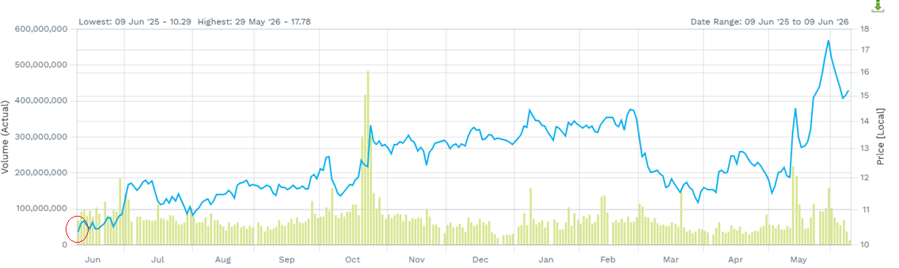
Ford Price History June 2025 – June 2026

Slide 107
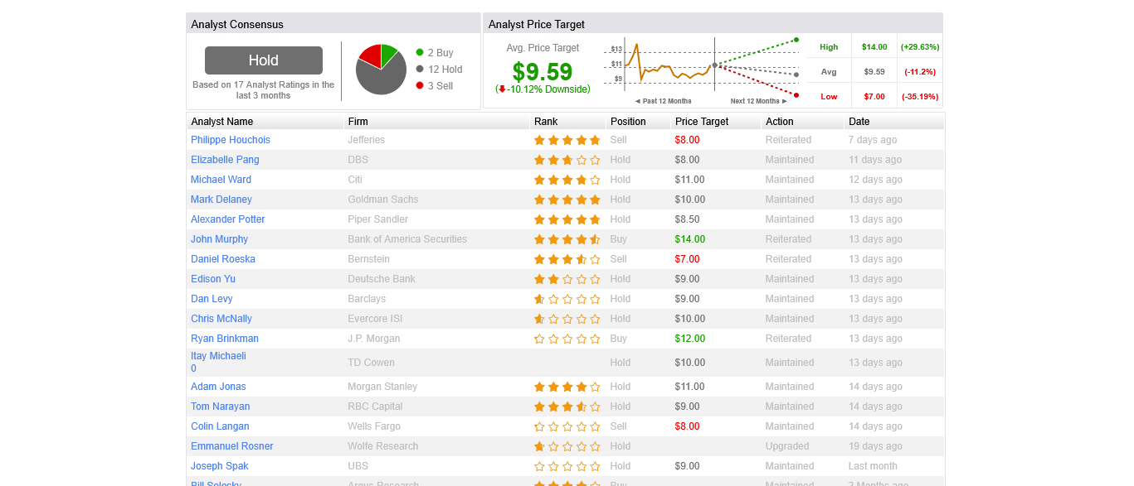

Slide 108
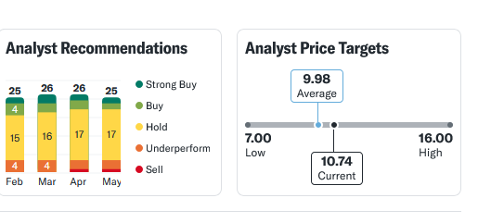
Source: Yahoo Finance (May 2025)

Slide 109
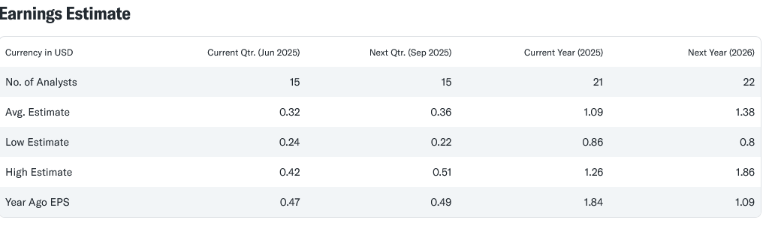
Source: Yahoo Finance (May 2025)

Slide 110
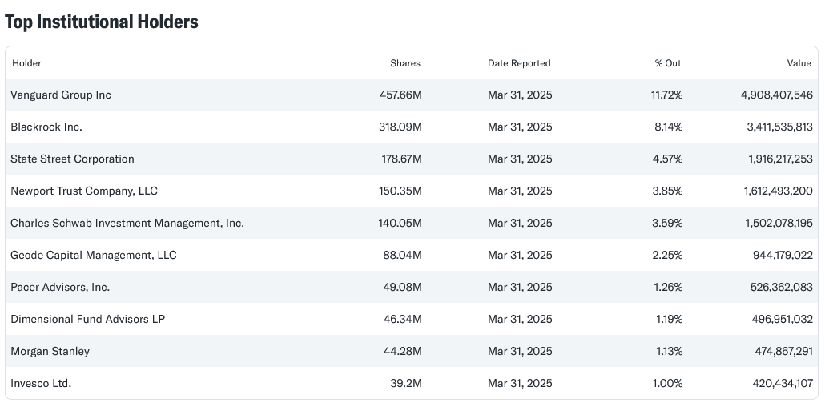
Source: Yahoo Finance (May 2025)

Slide 111
Thank you for your attention !

