Slide 1


Erasmus
Change Management
Organizational Culture: The Invisible Catalyst of Change
Professor Maria Vakola
Athens University of Economics and Business

Slide 2


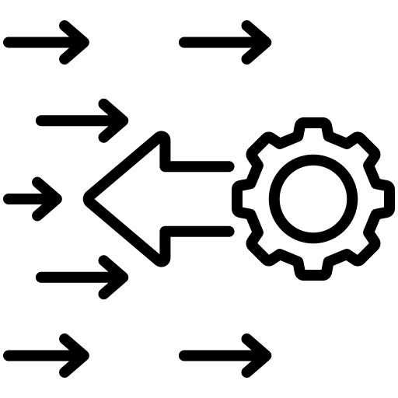


Organizational Culture
Contents
The definition and significance of organizational culture
Organizational culture and change
Measuring Organizational Culture
The differences between the current and desired state

Slide 3

The definition and significance of organizational culture

Slide 4

What is
organizational culture?
It refers to the set of set of values, beliefs, symbols and behavioral patterns shared by an organization’s members.
It is the ‘glue’ that binds us together and differentiates us from our competitors.
It is what guides how decisions are made, how people collaborate, and how events are interpreted within the organization.
It is the way things are done around here

Slide 5
Why is it important?
It can eat strategy and change (of course) for breakfast.
More specifically:
It influences employee motivation, commitment, and satisfaction.
It determines how change and innovation are handled.
It can act as a catalyst for growth or as a barrier to transformation.
It shapes the identity and character of the organization.

Slide 6




Let’s look at culture as an onion
Outer layer
Visible elements
To first level is the outer shell - the visible elements.
What is easily visible:
dress code
offices
logos
language

Slide 7
Let’s look at culture as an onion
Middle level
The second level includes more abstract elements, such as rules, social norms, and shared beliefs about what is considered right and wrong.
Beliefs, Rules and Attitudes
Example
Belief: Customers at our bank must always be served quickly and effectively.
Social norm: Employees respond to customer email emails within 24 hours.

Slide 8
Let’s look at culture as an onion
The heart of the onion
The third level concerns the core assumptions/perceptions, i.e., deeply embedded assumptions at the center of an organization’s values that shape the basic organizational culture.
These are often unconscious perceptions that are taken (almost) for granted.
Core assumptions/perceptions

Slide 9
The ‘onion’ in relation to change
The deeper we go, the more difficult is to change the elements of culture.
Outer manifestations can change easily (new offices, new logo), but the core assumptions change very slowly.
Real real culture change requires working “at the core of the onion”.

Slide 10
Organizational culture and change

Slide 11

Is it difficult to change an organization’s culture?
It is a process that requires more time compared to other changes, but this change is achievable.
How can an organization’s culture change?

Slide 12
How can an organization’s culture change?
Steps
Aligning all
processes with the vision of change
Leadership/Commitment and resources
Defining the desired organizational culture
  Where are we and where do we want to go?
Measuring the existing organizational culture
04
03
02
01

Slide 13

To model by Quinn & Cameron
The culture model Quinn and Cameron, or Competing Values Framework (Competing Values Framework - CVF), categorizes the organizational culture into four types:
Clan
Adhocracy
Market
Hierarchy
This is defined based on orientation along two axes:
flexibility vs. stability
internal focus vs. external focus
The model helps organizations understand their dominant culture, its strengths, and how it affects their performance and ability to adapt.

Slide 14
CVF model by
Quinn & Cameron
Flexibility
HUMAN RESOURCES
MODEL
MODEL OF THE
OPEN
SYSTEMS
Internal Focus
External Focus
MODEL
OF
BUREAUCRACY
MODEL
OF
PERFORMANCE
Control

Slide 15
Measuring Organizational Culture

Slide 16
Culture Gap - Exercise
Emphasis on
Human
Resources
50
Innovation
40
30
20
10
10
20
30
Bureaucratic
Model
40
Customer
Orientation
50
HOW IT SHOULD BE -----------
HOW IT IS NOW

Slide 17



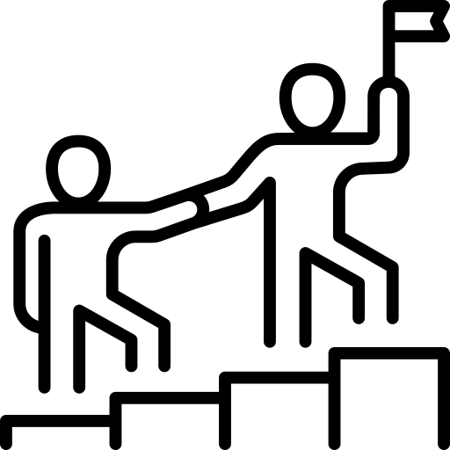

Is there a chance it can change?
Training and Development
Communication
Performance Appraisal
Leadership
Selection

Slide 18
Success Factors and the Role of Organizational Silence
Professor Maria Vakola
Athens University of Economics and Business

Slide 19




Success Factors
Contents
Trust
Fairness
Psychological Safety
Organizational Silence

Slide 20
Trust

Slide 21
Trust
Trust develops slowly and is lost quickly.
The willingness to be vulnerable towards another person, based on:
Integrity (Integrity)
“Keeps their word”
Competence (Competence)
Benevolence (Benevolence)
“Can do the job”
“Cares about me”

Slide 22




Trust
Creates psychological safety → people speak openly, share ideas, acknowledge mistakes.
Associated with productivity and employee commitment.
Strengthens collaboration and team cohesion.
Reduces anxiety, conflict, and resistance to change.

Slide 23
Trust
Example
With trust
Management announces a digital transformation with a credible timeline. It clearly explains the “why” and the benefits for employees and customers. The branch manager listens to the team’s concerns, answers questions honestly, and acknowledges that there will be difficulties at first.
At the same time, they show commitment that everyone will receive training and support.
In the first month there are delays; management explains and communicates the action plan.
Without trust
Management simply announces that “from Monday the system changes”. It gives no adequate explanations nor room for questions.
Rumours spread that the change will bring layoffs.
The manager avoids speaking openly, saying only “these are the instructions, do what you can”.
In the first month when delays arise, the ‘witch hunt’ and mutual accusations begin.

Slide 24






How is trust built?
Honesty (even with bad news? Yes)
Taking responsibility and leading by example
In difficult situations, simply trying is enough
Words must match actions
Objectivity in decisions /
Communicating the criteria /
Fairness
Support and respect

Slide 25
Psychological Safety

Slide 26
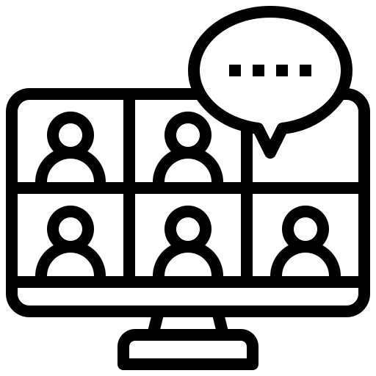
Psychological Safety
Have you ever wanted to challenge a decision in a meeting but ended up feeling it was safer for you to say nothing?
This tendency leads to mistakes that could have been avoided, wrong decisions that could have been prevented, and missed opportunities that in some cases are very costly, as well as talented people who decide they do not want to work this way and leave the organization, and the loss of innovative ideas and proposals.
What is the solution?
Creating a climate where people feel psychologically safe because no one will
  mock them
  blame them
  ignore them

Slide 27

Very often we see
When an employee decides to raise difficult questions with their manager about a critical or sensitive issue, there is a risk that the questions will be misinterpreted as a personal attack or as a lack of respect or cooperation on their part.
Depending on the leader and the team, this could put the employee’s job or reputation at risk.

Slide 28
Is your team or your workplace psychologically safe?
Do team members sometimes reject others because they are different?
Is it difficult to ask for help from other team members?
When working with members of this team, are your unique skills and talents valued and utilized?
If you make a mistake in this team, will it be held against you?
Is it safe to take a risk in this team?
Would anyone in the team deliberately act in a way that undermines efforts?
Can members of this team raise problems and difficult issues?

Slide 29
Organizational Silence

Slide 30
What is silence. silence?
Organizational Silence
“Organizational silence. silence is defined as the phenomenon whereby employees choose not to express their views, concerns, or observations about organizational problems, even when they possess essential and relevant information.”
(Morrison & Milliken, 2000· Vakola & Bouradas, 2005)
Psychological safety goes hand in hand with another enemy of change.
Organizational silence.

Slide 31
Silence can take
different forms:
Characteristic types of silence
Defensive silence (defensive silence)
Motivation: fear of negative consequences (punishment, rejection, loss of position).
Example: “I won’t say anything about the error in the system, because I might get blamed.”
Acquiescent silence (acquiescent silence)
Motivation: futility, the belief that “nothing ever changes”.
Example: “There is no point in speaking up, nothing will change anyway.”
Prosocial silence (prosocial silence)
Motivation: protection of others or the team.
Example: “I won’t say that my colleague made a mistake so they don’t look bad in front of management.”

Slide 32

Brief Exercise
The company announces a structural change: the merger of two departments and the transfer of employees to new teams.
During the presentation, several employees realize that the new structure will create role overlaps and delays in workflow.
Nevertheless, no one speaks up.
Employee thought:
«Even if we say something, nothing will change. The decisions have already been made.”
Result: Employees passively comply with the change, but problems emerge later in practice, slowing down the performance of the new structure.

Slide 33
A | Marta has noticed that the new expense reporting process has a systematic error causing double-billing. She mentioned it to a colleague who seem to be involved and knew about it. During the all-hands meeting, the CFO asks if anyone has spotted issues with the rollout. Marta stays silent.
Type of silence:

Slide 34
B | Carlos has worked at the company for 11 years. Every year, the engagement survey asks for ideas to improve cross-team communication. Every year, nothing changes. This year, Carlos skips most of the open-ended questions.
Type of silence:

Slide 35
C | Yuki knows that her colleague Dimitri has been making calculation errors in client reports. She decides not to flag this to their manager because Dmitri is going through a difficult personal situation and she does not want to create problems for him.
Type of silence:

Slide 36
Silence is a barrier to change
Why it is a barrier to change:
It reproduces the vicious cycle of silence: the more employees stay silent, the harder it becomes to speak up in the future.
It conceals critical information needed for improvement.
It weakens learning and innovation, and therefore the organization’s ability to adapt.
It maintains inertia and allows problems to continue without resolution.
It creates a climate of fear and insecurity, which reduces commitment.

Slide 37

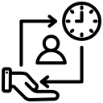

How is a climate of psychological safety without organizational silence created?
Leaders
01
I lead by example in how I handle difficult conversations or disagreements.
02
I dedicate time in meetings to what we learned from a collaboration or the implementation of a project.
03
I give space to team members to express themselves (without criticism and dismissive comments).

Slide 38
How is a climate of psychological safety without organizational silence created?
The organization
Makes it clear that it does not tolerate behaviors inconsistent with psychological safety (in communication, handling disagreements, in promotions).
Provides training in such skills (about time).

Slide 39
How is a climate of psychological safety without organizational silence created?
All of us
We listen actively
- without interrupting or mentally searching for disagreements
We provide feedback
with respect
We engage politely in disagreements and conflicts
(we do not need to offend others when we disagree with them)
We ask for others’ opinions
«I would like your view on the new system to be implemented soon”

Slide 40
Thank you very much!

