Slide 1

Change Management
Professor Maria Vakola Athens University of Economics and Business

Slide 2
Module 1: Introduction to Change
What is organizational change?
Why is it important?
How many kinds of changes do we have?
Why do changes fail?

Slide 3
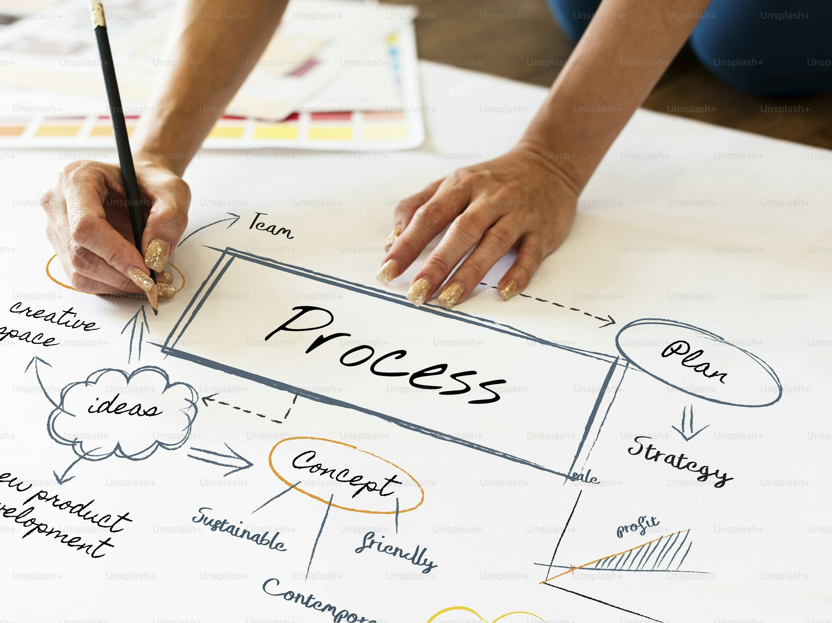
What is organizational change?

Slide 4
Organizational change is a process of transition

Slide 5

Transition processes
Organisational level Team level Individual level

Slide 6
Examples
Change of Strategy (e.g., new market, new business model) Change of Organizational Structure (e.g., reorganization, merger of departments) Change of Leadership or Ownership (e.g., new CEO, acquisition) Technology Change (e.g., digital transformation, new ERP systems) Change of Organizational Culture (e.g., from hierarchical to customer-centric) Change of Policies & Procedures (e.g., new equality and diversity policies) Change of Location or Infrastructure (e.g., relocation, new offices) Change of Work Model (e.g., hybrid, remote-first) Change of Evaluation System or Remuneration

Slide 7
Examples
Change of Team Leadership (new team leader or project manager) Change of Team Composition (new members, departures, redistribution of roles) Change of Responsibilities (redistribution of tasks) Change of Collaboration Mode (e.g., cross-functional teams) Change Team Goals (e.g., new KPIs) Changing Tools and Technologies Used by the Team Change in the Way of Communication (new tools, new habits) Change in Routines and Meetings (e.g., daily morning meeting) Change Team Culture (e.g., from individual to collaborative) Change in the Group's Perception of Purpose (e.g., new priorities)

Slide 8

Individual Exercise
Think about the transitions you've made. Make a list Was it easy or difficult? What factors helped you and which made it difficult for you?

Slide 9


Change brings turbulence

Slide 10
Bad news;
Good news;

Slide 11

Bad News
70% of change programs fail

Slide 12

Good news
We know why

Slide 13
Think about why changes fail? Make your list and compare your own list with the next slide

Slide 14
Reasons for failure
There is no strategy and vision/Leadership Commitment Ineffective Communication Organizational Culture Resistance Against Change Problematic Design Limited resources/Lack of change management skills

Slide 15
Features of the changes
Gradual or radical? Top-down or bottom-up? Reactive or proactive?

Slide 16
Section 2: Models of Change in Practice
The oldest change model-Lewin Model
The most famous model of change-Kotter's model
The most practical model of change- ADKAR
Model Comparison

Slide 17

LEWIN’S MODEL
Unfreezing
Moving
Refreezing

Slide 18
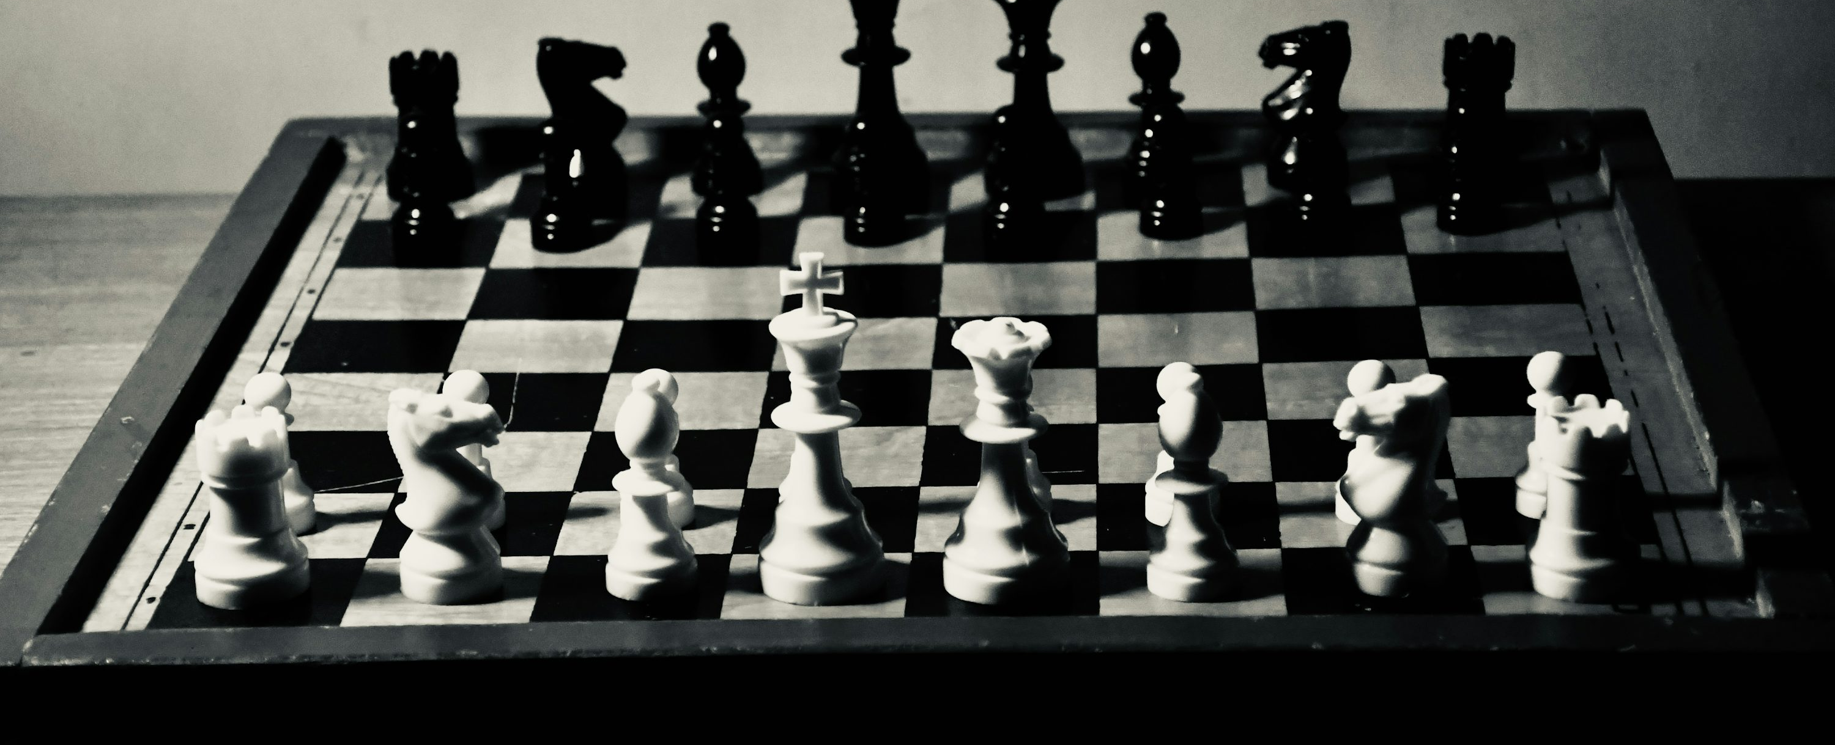
Force Field Analysis
Force Field Analysis is one of the most well-known tools for understanding and managing change in organizations. It focuses on how the forces that promote or hinder change affect the outcome. Driving Forces and Restraining Forces Change occurs when the forces in favor of change prevail over resistance. Review of the model

Slide 19
Example Hybrid work Each factor has a different intensity
Some positives Cost reduction Time Saving Increase flexibility-satisfaction Attracting and retaining talent Work-life balance
Some negatives Isolation/Alienation Fear of problems with productivity Risk of inequality between employees Organizational culture and group identity

Slide 20
Stage 1
Creating a sense of urgency Awareness of the need for change Change is necessary The benefits of change Inactivity Risks How is the sense of urgency created?

Slide 21
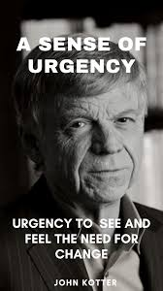
Sense of urgency
Presentation of data and data Impact and risk analysis Real cases that succeeded or failed Recognizing Opportunities and Benefits Internal campaign Workshops/Communities Open dialogue

Slide 22
Stage 2
Building a Strong Leadership Coalition A team of people with influence, authority, knowledge and commitment To promote and support change in the organization. Driving force to drive and implement change

Slide 23
Stages 3 and 4
Creating a vision Developing a clear vision that outlines the desired future state of the organization after the change. Define concrete initiatives and strategies that will contribute to achieving this vision. Vision Communication Activating employees and stakeholders who are willing to support and actively contribute to change. Cultivating a sense of ownership and active participation throughout the organization.

Slide 24
Στάδιο 5
Ενδυνάμωση της υλοποίησης/δράσης
Εντοπισμός και εξάλειψη εμποδίων ή παραγόντων που θα μπορούσαν να παρεμποδίσουν την πρόοδο της πρωτοβουλίας αλλαγής.
Ενδυνάμωση των εργαζομένων μέσω της παροχής των απαραίτητων πόρων και υποστήριξης.

Slide 25

Stage 6
Quick Wins Create and recognize small, visible successes from the early stages of the change process. These victories boost momentum, boost morale, and demonstrate progress.

Slide 26
Stages 7 and 8
Consolidation of the positives of change and its continuation The increased credibility of the business must lead to new initiatives here Selection and development of people based on the vision of change Incorporating the changes Change must become part of the organizational culture. To make evident the contribution of new practices to the success of the business

Slide 27
ADKAR
The ADKAR Model outlines the five key stages that each individual must go through to successfully adopt a change (Prosci, Jeff Hiatt, 2006) The name ADKAR is an acronym from the five English words: Awareness Desire Knowledge Ability Reinforcement

Slide 28
ADKAR
Awareness Understanding why change is necessary. Why are we changing? What is the danger if we don't change? Desire (Desire / Commitment) Personal motivation and willingness to participate in change. Do I want to participate? What does this mean for me? Knowledge Knowledge of how to implement change, what exactly is required. What should I learn or do differently? Ability (Ability / Application) Developing competences and skills to implement change effectively. Can I do it in practice? Do I have the skills and tools? Reinforcement (Ενίσχυση / Διατήρηση) Ensuring that change is consolidated, strengthened, and we don't go back to old practices. How will we ensure that the new situation is maintained?

Slide 29
Individual Exercise
I would like you to think about all three models that have just been introduced Do they have any points in common? Differences?

Slide 30
Common Points
Focus on people Step-by-step approach Similar issues, need for change, communication Committing and consolidating change

Slide 31
Differences
Criterion | Lewin (1947) | Kotter (1996) | ADKAR (2006)
Approach | Theoretical, general | Practical with 8 stages | Individual‑focused, outcome‑based
Focus | Organizational systems and structures | Change leadership and organizational‑level influence | Individual acceptance of change
Stages / Steps | 3 stages: Unfreezing → Change → Refreezing | 8 steps (From Urgency to Culture) | 5 steps (Awareness to Reinforcement)
Level of Application | Organizational / systemic | Organizational, top‑down | Individual and team level, with bottom‑up participation
Type of Change | Large organizational transitions | Strategic organizational transformations | Individual behavioral changes within the broader change
Advantage | Simplicity, timelessness | Practical, clear roadmap for leaders | Diagnostic clarity regarding individual needs
Weakness | Too general, lacks specific guidelines | Linear, less flexible | Not sufficient alone for organizational‑level change

Slide 32
Summary
Lewin provides the theoretical and general foundation. Kotter offers a structured process for leading organizational‑level change. The ADKAR model focuses on what individuals need in order to succeed during change.

Slide 33
Module 3 The Individual Impact on Organizational Change: The Role of Change Agents
From passivity to action
Who are the agents of change?
Change is us
Success Stories

Slide 34

Theoretical models, data, percentages, analyses of successes or failures are excellent advisors. But changes are implemented through people, that is, through you

Slide 35
Agents of change
Change agents are individuals or groups who undertake to initiate, facilitate, and manage organizational change.
Their role is crucial, as they guide teams and individuals through times of transition, helping them adapt to new processes, technologies, or organizational structures.

Slide 36
What exactly does an agent of change do? (I)
Detects the need for change It identifies opportunities, risks, and malfunctions that require change. It collects data, observes trends, and understands problems. Convinces of the need for change It clearly explains the "why" of the change. It highlights the benefits and risks of stagnation. It uses data, examples, and inspires through storytelling. Facilitates the implementation of change It guides individuals and teams to the new reality. It provides tools, training, and support. It encourages the testing of new practices. Faces resistance He listens and understands the concerns. He manages fear and insecurity with empathy. It identifies and addresses obstacles with practical solutions. Inspires and motivates It acts as a positive pattern of behavior. It transmits energy, optimism and confidence. It inspires a sense of purpose and participation.

Slide 37
What exactly does a change agent do? (II)
Communicates and builds bridges Bridges management and employees. Maintains open and continuous communication. Builds trust-based relationships and activates collaboration networks.
Monitors and evaluates progress Checks the implementation of the change and identifies deviations. Highlights small and large successes. Learns from mistakes and adjusts the strategy.
Secures necessary resources Identifies which resources are required (time, people, technology, money). Advocates for resources or suggests solutions for their optimal use. Ensures that all stakeholders have the necessary means for success.
Perseveres when others stop Does not abandon the effort when conditions become difficult. Keeps momentum and interest “alive” even during periods of fatigue or disappointment. Draws strength from the vision and the belief that the change is both feasible and necessary.

Slide 38
Practical Examples
Story 1 Maria works in the Customer Service Department and notices that customers are complaining about delays in responses. She prepares a short presentation with statistics and examples from other companies and presents it to management, convincing her team that a new digital communication platform is necessary.

Slide 39
Practical Examples
Story 2
Kostas is responsible for a project to digitize internal processes. Although everyone was enthusiastic at the beginning, over time the team became “tired” and started to lose interest. Kostas repeatedly reminds them of the benefits, organizes small wins, highlights progress, and keeps the change “alive.”

Slide 40
Change Agents
By assignment or by initiative From all hierarchical levels

Slide 41
Also
Each change agent brings something unique to the change. There is no ideal change agent. Not all change agents contribute in the same way. The role of informal leaders.

Slide 42
“Two different behaviours in the same situation”
Christina and Giorgos work in the same sales department of a large company that recently decided to implement a new CRM system. Management explained that this tool would help the team organize their contacts better, monitor customers more easily, and improve their results.
Like everyone else, both Christina and Giorgos initially had doubts. Christina, however, decided to give the new process a chance. She attended the training sessions, asked how the tool could save her time, and began experimenting with it. Once she learned some practical “tricks,” she shared them with her colleagues. When some complained that “the old Excel sheets were easier,” Christina replied: “Look, I thought the same at first, but if we look at it differently, this will help us be more organized.” She didn’t try to impose anything—she simply continued with a positive attitude, making small but steady moves that made a difference.
Giorgos, on the other hand, also attended the same training sessions. But from the beginning, he appeared indifferent. “Always new systems… in the end, we’ll go back to Excel anyway,” he said. He wasn’t negative or obstructive; he simply showed no interest. He did the basics but never tried to understand how the system could help him. He continued keeping his information in his own files “until we see if this thing actually works.” He didn’t offer help to anyone and expected others to solve his problems.

Slide 43
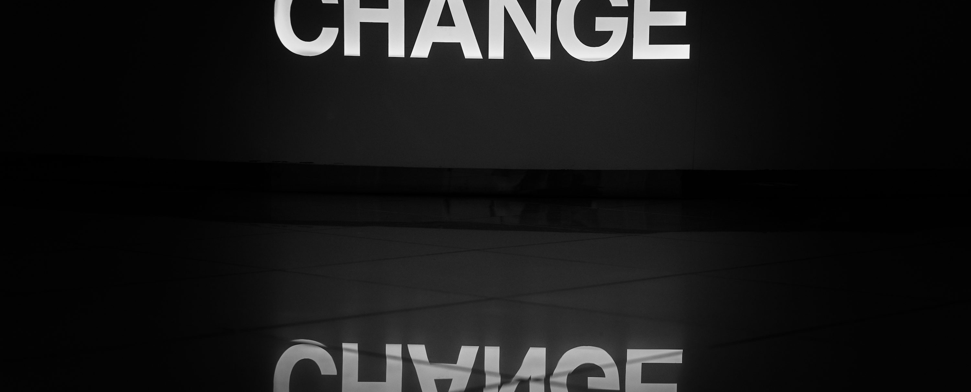
Advantages and Disadvantages
Internal Change Agent External Change Agent

Slide 44
Group exercise

Slide 45

** ** | Internal Change Agents | External Change Agents
Advantages | ✔ Know the organization and its culture | ✔ Objectivity and neutrality
 | ✔ Have already built trust-based relationships | ✔ Expertise, experience, and best practices
 | ✔ Are committed long‑term to the success of the organization | ✔ Ability to challenge the status quo
 | ✔ Are immediately available and flexible | ✔ Enhance the credibility of the change effort
Disadvantages | ✖ Limited objectivity due to internal relationships | ✖ Do not know the organization and culture in depth
 | ✖ Possible distrust from colleagues | ✖ Limited commitment after the project ends
 | ✖ May lack specialized knowledge on specific issues | ✖ High cost of services
 | ✖ Difficulty challenging the status quo | ✖ Risk of proposing non‑tailored solutions

Slide 46
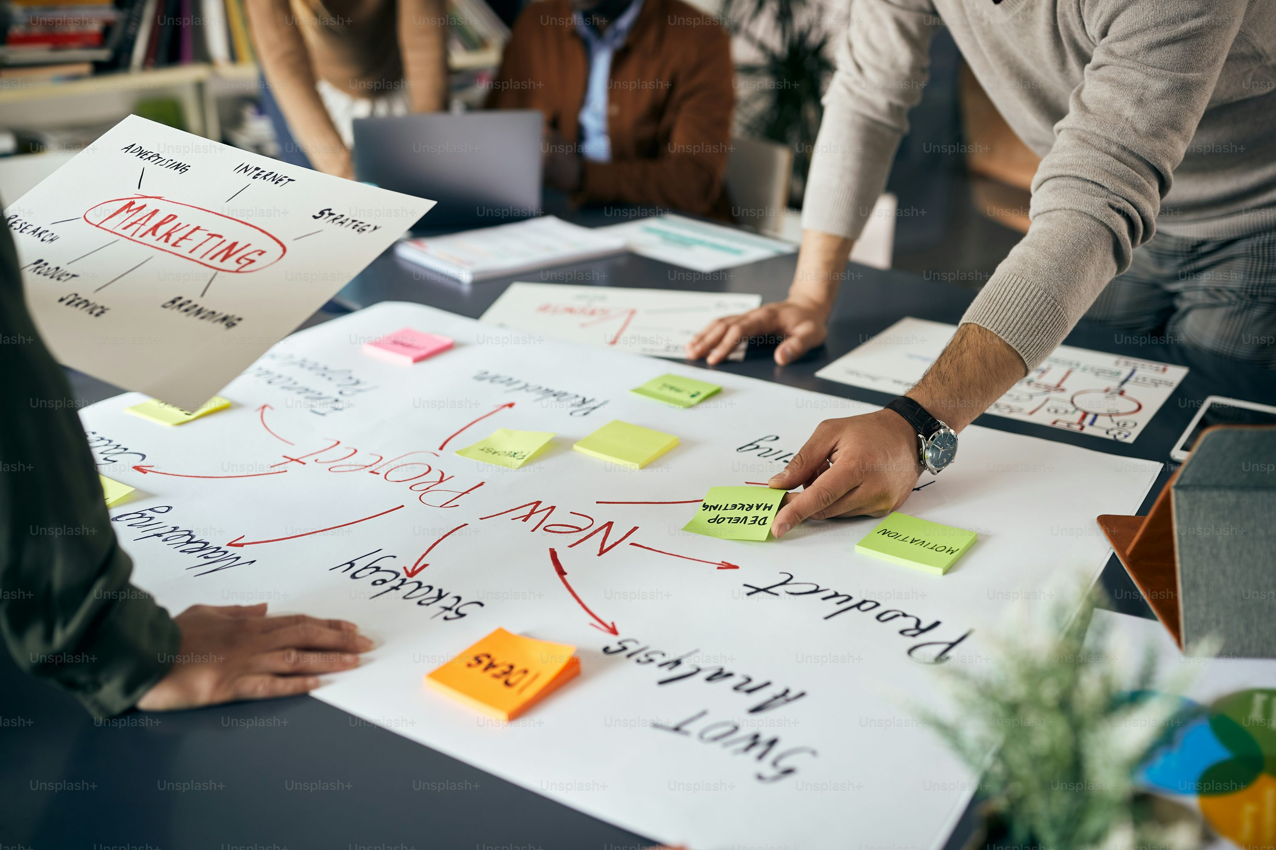
Characteristics of Change Agents
For change agents to be effective, they need to develop the following abilities and skills: We will identify these characteristics together through a business game.

Slide 47
Experiential Exercise: Selecting the Change Agents
The scenario You have been invited by the company as business consultants to help modernize it and prevent bankruptcy.

Slide 48
Exercise
You will have to select three change agents from the employees that will be described next. For each employee, there is a short description to help you make your selection.

Slide 49


Systemic thinking

Slide 50

Has it ever happened to you to implement a seemingly small or harmless change—such as changing a form—and suddenly chaos breaks out?

Slide 51


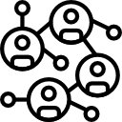

WHY;
This happens because the change touches
connections and relationships within the system
issues that remain unresolved from the past

Slide 52

The organization as a system
A bank is not a collection of isolated departments or processes. It is a complex, living system in which people, technologies, processes, and cultures interact with one another.

Slide 53
Change as a system
Imagine a bank that decides to change the loan approval limits.
It seems like a simple policy change. However, it affects the sales department, the risk management department, customer service, and ultimately the customers’ perception of the bank. The relationships between departments shift, new pressures are created, and old problems that were previously hidden may surface.

Slide 54
Systemic Thinking
Systemic thinking is the ability to see beyond events and understand the patterns, structures, and mental models that generate those events.
“A way of thinking and a practice that helps us see patterns and the relationships between them, instead of focusing only on isolated events, and understand how to change entire systems effectively.” (The Fifth Discipline, Peter Senge, 1990/2006)

Slide 55

Systemic Thinking in Practice
The problem A bank notices that applications for housing loans are taking a long time to be processed, and customer satisfaction is dropping. What would you do? Exactly—you would try to find out why.

Slide 56

Systemic Thinking in Practice
You spoke with the department manager, and she informed you that the number of staff in her department is relatively lower compared to departments with a similar average workload. What did you decide? To increase the number of employees in that department. A logical step?

Slide 57



A few months later
There is tension between departments because they also wanted the new hires or transfers
Processing times have improved only slightly
Payroll costs have increased
When we make a positive change, such as new hires, keep in mind that we do not always get positive results.

Slide 58




Surface-level root cause analysis
Increasing staff was not enough; even more staff would be needed.
.
Perhaps the staff need better training to become more productive.
The technological system does not support us.
.
There is no motivation.
.

Slide 59
Let’s look at it more closely
1.
2.
Data
Inputs
There are delays in processing and approvals. Is it happening all year? In all types of loans? When did the problem start? We look for patterns.
What feeds the system? In our case, the loan advisors. Could there be problems here? Yes. To meet their targets, the advisors submit incomplete applications, creating many delays
.

Slide 60

Let’s look at it more closely
What maintains a dysfunction?
Beliefs / Mental models
Try to identify the belief that sustains the pattern. How can it change?
In our example: “It doesn’t matter if we send incomplete applications; what matters is meeting our targets.”

Slide 61
Conclusion
Systemic thinking requires us to look beyond events, search for patterns, and examine the underlying beliefs that shape them. Only then can we choose interventions that create meaningful, lasting results.

Slide 62

Agile methodology

Slide 63
Agile methodology
Agile came into change management to make the process more flexible, relying on collaboration and continuous learning—rather than on large, rigid project‑management plans that quickly become outdated.
Agile methodology began in software development (with the Agile Manifesto in 2001) and later moved into organizational change as organizations recognized the increasing complexity of their environment.
Core Principle Instead of long‑term, inflexible planning, Agile focuses on small, quick steps and continuous learning and adaptation.

Slide 64

How is Agile applied to change?
We collect feedback from employees and customers at every stage.
.
We provide frequent updates on results so the whole team knows the progress.
.
We test changes on a small scale, learn quickly, and iterate.
Teams have autonomy to find solutions and improve processes.
The goal is to respond to real data, not to follow outdated plans.

Slide 65
Ευχαριστώ πολύ!

