Slide 1

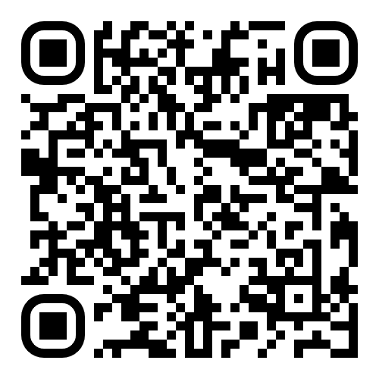
University Kore of Enna invites you to complete the following pre-employment assessment
The aim is to understand elements related to key soft skills that best describe you
A well-known company is recruiting
for a vacant position
Scan the QR code to begin
⬇️
Imagine you want to apply
Note
The recruitment scenario is fictional and used only as a context.
Please answer as yourself, using your real opinions
You will be invited next week to complete the second part of this assessment.
Please use the same email address for both parts.
Thank you!
Questions?
Questions? giuliana.nasonte@unikorestudent.it | palmira.faraci@unikore.it

