Slide 1
Introduction to Finance 1
Spyros Spyrou
sspyrou@aueb.gr

Slide 2
Introduction
What is Finance ?
The discipline that examines financial systems and markets, financial assets, money, and investments, among others.
Indicative financial assets: bonds, shares, loans, derivatives (options, futures, etc), commodities (oil, gold, etc), currencies, etc
It has many sub-disciplines: corporate finance, investment and portfolio management, risk management, international finance, mergers and acquisitions, behavioral finance, alternative investments (hedge funds, commodities), real estate finance, mathematical finance, financial legislation and regulation, among others
Financial system: describes the capital flows (transfer of funds) between users of funds (corporations and governments) and savers (e.g., households)
The mechanism through which the transfer is possible is the price mechanism (the price of loans, shares, etc)

Slide 3
Introduction
Corporate finance examines how managers take decisions. The main goal of a manager should be maximising the value of the firm for shareholders. Other important decisions have to do with:
Capital structure → what types of funds will be employed (optimal mix of debt and equity)
Capital budgeting → what projects to choose for the firm to investment
Dividend policy → how to best utilize the profits (reinvest in the firm or provide as dividends to shareholders)
Investment management examines how different investments are managed, that is the asset allocation, the diversification of the portfolios, the risk assumed, the investment goals and horizon. Important issues, among others, are:
Analysis → Fundamental, technical, quantitative, qualitative
Portfolio optimization → how to select the optimal portfolio
Investment style and philosophy → value vs growth, small vs big, active vs passive
Risk management

Slide 4
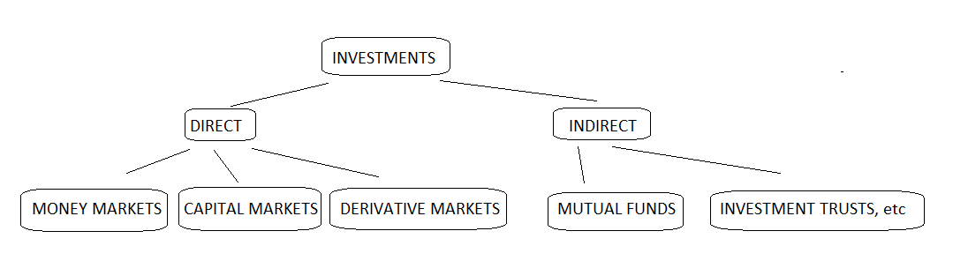
Markets
Money markets: borrowing and lending in the short term (up to a year).
Capital markets: for long-term assets, which are those with maturities of greater than one year (equity-stock and debt-bond) market.
Derivative markets: contracts that are negotiated today for future delivery of assets.
Collective Investments: pool of money collected from many investors for the purpose of investing in securities, e.g. Mutual Funds, etc.

Slide 5
Markets
The market capitalisation of stock markets (value of listed companies across the world) is greater than $79.2 trillion in 2018, according to the World Bank
→ up from 2.5 trillion dollars in 1975
The market capitalisation of bond markets (listed, debt by companies, government agencies, etc) is greater than $40.7 trillion in 2018, according to the Securities Industry and Financial Markets Association
→ more than $14.4 trillion in US Treasury debt
→ more than $9.2 trillion in mortgage-related bonds
→ more than $8.8 trillion in corporate bonds
→ more than $3.8 billion in municipal bonds.

Slide 6
Markets Example: Euronext
Euronext was formed in 2000 following a merger of the Amsterdam Stock Exchange, Brussels Stock Exchange, and Paris Bourse, in order to take advantage of the harmonization of the financial markets of the European Union.
In 2001, Euronext acquired the shares of the London International Financial Futures and Options Exchange (LIFFE), forming Euronext LIFFE.
In 2002 the group merged with the Portuguese stock exchange
Euronext acquired the Irish Stock Exchange in March 2018
Euronext merged with New York Stock Exchange (NYSE Group, Inc) on April 4, 2007 to form NYSE Euronext
On November 13, 2013, Intercontinental Exchange (NYSE: ICE) acquired NYSE Euronext.

Slide 7
Markets
PRIMARY CAPITAL MARKETS
Where new issues of bonds and stocks (governments, companies, etc) to raise funds.
SECONDARY FINANCIAL MARKETS
Here the outstanding issues are traded, i.e. the securities that have already been issued at the primary market. Note that the funds here are exchanged between investors and do not go to the entity that issued the security.

Slide 8
Markets
Why are secondary markets important ?
Liquidity: initial investors know that they can sell their investments at a later stage and, thus, they invest in Initial Public Offerings, or in stocks in general
Price Discovery: the prevailing market price in the secondary market is determined by demand and supply (which is in turn determined by information). Thus if you want to know how the other investors believe that a stock is worth you look at the current market price.
New issues in the primary market: their prices (and yields for bonds) are related (based) on the outstanding securities in the secondary market.

Slide 9
Markets
A good market should have some specific attributes…..
Information must be timely and accurate (volume, prices, bids, offers, etc).
Investors must be able to buy/sell a security quickly and at a fair price (liquidity). That is the price must be close to the price of previous trades,
Price continuity: prices should not change between trades in the absence of new information.

Slide 10
Markets
A good market should have some specific attributes…..
There should be many potential traders (buyers/sellers) willing to trade at prices above and below the current market price (Depth).
There should be Low Transaction Costs (usually calculated as a % of the trade value)
Markets should be informationally efficient: prices reflect adequately, quickly, and accurately, all available the information)

Slide 11
Markets
Two asset classes (stocks, bonds) have a significant weight in the majority of portfolios
In most countries, about 50% of pension funds are invested in equities, although several eastern European countries, and Latin American countries plus India have a higher proportion in fixed income assets (around 75%) (data from OECD)
Why stocks? Hedge against inflation
Stocks: offer the possibility of generating higher returns (for higher risk) because company earnings tend to rise with inflation
Bonds: Coupon payments; on the other hand, in general, are not linked to inflation
Therefore, equities are seen to offer better protection against unanticipated inflation

Slide 12
Investors
A. Institutional Investors
pension funds
mutual funds
exchange-traded funds (ETFs)
hedge funds
insurance companies
Corporations
REITs
Charities and educational establishments, among others
B. Individual investors

Slide 13
Financing Decisions: Equity Vs Debt
When a firm needs external financing, it has available 2 types of capital: equity and debt.
Capital Structure: what % of debt, equity, and other securities a company firm has outstanding
Debt → borrowing money (e.g., loans, issuing bonds)
Advantages: owners do not give up control of the firm; fixed repayments; easy to forecast expenses; fixed term of repayment, interest payments are tac-deductible, etc
Equity → selling a % of equity in the firm (e.g., issuing stocks, IPO)
Advantages: no obligation to repay the funds ; no additional financial burden to the firm
Disadvantages: share your profits; consult with your new equity partners for decisions
Between 1985 and 2018 the aggregated global IPO volume was about $4.36 tr (Helbing, 2019)

Slide 14
Financing Decisions: Equity Vs Debt
Indicative sources of Debt Financing
Issuing Bonds
Loans (e.g. bank loans)
Business lines of credit
Invoice factoring
Indicative sources of Equity Financing
Listing on an exchange (IPO)
Venture capital firms
Corporate investors
Angel investors
Crowdfunding

Slide 15
Financing Decisions: Equity Vs Debt
Venture capital: firms, group or individual investors, investment banks and/or other financial institutions investors who review the firm and, if they see a long-term growth potential, buy a % of the firms for cash
They also may offer know-how and managerial expertise/guidance, expertise and access to business networks
There is no obligation to repay VCs if the company bankrupts
However, they have to give their consent to business decisions and the process may take long time and be complicated
They usually have a 3 to 5 year investment horizon and then they leave the firm (cash out); many VCs have a fixed life of 10 years
They may offer funds for: (a) financing early stages of a firm; (b) financing the expansion of the firm, and (c) financing for acquisitions etc.

Slide 16
Financing Decisions: Equity Vs Debt
Angel investor: an investor who provides funds for a firm (or a start-up firm), often receiving convertible debt or equity (the money may come from a trust, investment fund, etc)
They usually support start-ups for the early stages, when the risks are very high, and other investors are not willing to step in
Survey results (Wilbur Labs): approximately 70% of entrepreneurs face business failure; approximately 66% face failure within the first 25 months of launching the company
Some Angel investors use online procedures (e.g., equity crowdfunding)
Others, organize themselves into groups or networks
They invest their own capital (unlike VCs who use pooled and professionally managed funds)

Slide 17
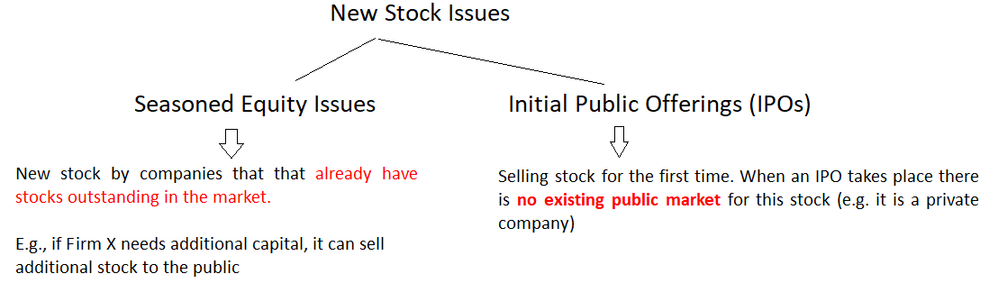
Issuing Securities

Slide 18
Issuing Securities
New issues are typically underwritten by investment bankers
Underwriting: a very important function in financial markets; the procedure where a market participant (e.g. an institution such as an investment bank) assumes financial risk for a compensation (underwriting fee).
The term comes from the early process where each individual or institution that assumed the risk had to write their name under the exposure they where assuming (the risk, the amount of money)
The process is essential for IPOs: determines the firm’s value

Slide 19
Issuing Securities
A usual procedure is that they underwriter “guarantees” the issue, in the sense that they buy the stocks from the issue from the issuing company and then sell the securities to investors ("firm commitment”)
The lead underwriter advices the firm on issues such as pricing, timing, and organises a “road show” to meet potential institutional investors.
The underwriter accepts the risk of selling the new issue
“An investment banker performs three functions which may be of value to an issuer of new securities: underwriting, advising, and distribution” (Baron, 1982).
In some cases we have a "best efforts" agreement: the underwriter does not guarantee the amount

Slide 20
Issuing Securities
Securities underwriting: the procedure where investment banks raise funds on behalf of firms and governments via the process of issuing securities (e.g. stocks, bonds).
The investment bank usually guarantees a price for these securities
It facilitates the issuance of the securities
Sells the securities to investor
A usual practice in many countries is that the underwriter is obligated to buy the securities from the issuer at a specified price and subsequently sell them to the public
→ In case of insufficient demand the underwriter will have to hold the securities (assumes risk)
To mitigate the risk the often form a syndicate of banks (each bank will buy a % of the issue)
Profit: the "underwriting spread“, i.e. the difference in the price they buy and the price they sell

Slide 21
Issuing Securities

Slide 22
Issuing Securities
Underwriting: other services to issuers
Advice on whether to issue equity or raise debt
Advice on the timing
Determine the price of the stock to be issued
Documentation: provide assistance with regulatory authorities (documents, requirements, listing criteria, registration documents for listing, etc)
Prepare the obligatory information statements (prospectus) and documents for the public (financial position of the firm, management issues, industry and competition, funding purposes, assessment of the risk of the issue and the company, etc) and securities' risk assessment.

Slide 23
Issuing Securities
Book building: the procedure where the issuer appoints the underwriter (bookrunner) to examine and document the (confidential) demand by investors for the stock to be issued within a pre-specified price range (lower – higher price)
The underwriter accepts (invited) bids from large interested investors (e.g. institutional investors) rather than these investors participate directly in the public offer
The demand (bids) is kept off-market and the price is determined after the book is closed by the bookrunner and the issuer
Often, some investors (bidders) may receive a greater allocation than others
Usually when this process is ongoing, regulations demand that there is no market trading of the issue
This procedure assists the issuer and underwriter to determine the price of the stock

Slide 24
Issuing Securities
Roadshow: the top management of the company that is about to issue securities is meeting with interested investors in different countries or continents
In these meetings the point is that the management discusses with interested investors, present their firm’s strategy, growth opportunities, financial data, etc
Financial analysts of the underwriter (investment bank), that have analysed the company that is about to procced with an IPO, often participate and present their analysis
Regulations require that for an IPO a large number of informative documents and forms are prepared and submitted by the issuer to the Stock Exchange and the Regulators (registration -compliance)
The financial analysts play a crucial role in ensuring that the documentation (prospectus, etc) that contains the necessary information to the public is correct, and accurate, in order the investor takes an informed decision with all the available information being reflected on the forms

Slide 25
Issuing Securities
An IPO can be a very costly process; the firm will have to comply with very strict regulation requirements that ensure the transparency and the availability of information to investors, that investors are protected, the market is not abused, etc
Underwriting fee, e.g. from about 7% for small IPOs to 3.5% for large IPOs, on average; in the US for the period between 2001 and 2021 there were 2,567 IPOs with a mean spread for the underwriter of 6.63% an average first-day return of 18.5%
Registration Costs, Listing Fees, Application Fees (e.g. in the US (SEC) about $130 per $1 m of the offering, in NASDAQ there is an annual fee between 40,000-80,000 approximately and an initial listing fee of 50,000-75,000 approximately, etc)
Legal costs, Accounting costs, Taxes
(for more details see, among others, see Ritter at https://site.warrington.ufl.edu/ritter/files/IPOs-Underwriting.pdf and PWC at https://www.pwc.com/us/en/services/consulting/deals/library/cost-of-an-ipo.html)

Slide 26
Issuing Securities
The reputation of the underwriter
Many studies find that the reputation (quality) of the underwriter seems to reduce the asymmetry of information in IPOs and to reduce the first day abnormal return phenomenon (see below) (see Beatty and Ritter, 1986; Loughran and Ritter, 2004; among others)
The book-building process
Studies find that it has a stabilising effect on the price of the stock
The syndicate structure
Studies find that the size of the syndicate (how many banks are involved in the underwriting of an IPO) has a positive correlation with the size of the IPO (gross proceeds)
Financial analysts
Research shows that when the quality of the financial analysis is high, it increases the chances of the bank being selected to participate in the syndicate team

Slide 27
Issuing Securities
Bernoussi, Dereeper, and Schwienbacher (2013) examine the relation between the structure of a syndicate and the reputation of the lead manager
They examine 1542 IPOs (Germany, France, UK) for the 1995-2005 period and report that most IPOs (about 60%) had a single bank as an underwriter
This is due to the fact that most IPOS in Europe (at the time) were relatively small,
They also report that “….reputable underwriters tend to concentrate on larger issuances, for which we find a positive link between lead underwriter reputation and syndicate size”
See: Bernoussi, A., Dereeper, S, Schwienbacher, A. (2013). Underwriting Syndicate Structure and Lead Manager Reputation: An Empirical Study on European Stock Markets. Dans Finance 2013/2 (Vol. 34), pages 7-34.

Slide 28
Issuing Securities
Binay, Gatchev, and Pirinsky (2007) report that the underwriters have a tendency to favor institutional investors that they have previously worked with, when they allocate the stocks of IPOs
Also that “….regular investors benefit more than casual investors in IPOs through greater participation in underpriced issues….”
This effect is stronger in cases where there are IPOs with strong demand, or IPOs form firms that are not very liquid, or IPOs by less reputable underwriters.
Binay, M., Gatchev, V., Pirinsky, C. (2007). The Role of Underwriter-Investor Relationships in the IPO Process. Journal of Financial and Quantitative Analysis 42(3), 785 - 809

Slide 29
The time Value of Money
time value of money: invested money returns new money with time
Do you prefer 1 Euro today or 1 Euro in 1 year ?
Obviously 1 Euro now
Do you prefer 1.10 Euro in 1 year ?
You cannot answer unless you now your investment alternatives
This demonstrates the notion of interest and cost of capital

Slide 30
The time Value of Money
The interest (I) on a capital (P), with an interest rate (r), in a year (t) is given by:
I = P * r * t
→ Find the interest of 10,000 € invested for 1 year at an interest rate of 10%:
Ι = 10,000 x 0.10 x 1 = 1,000 €
The interest rate is always expressed on an ANNUAL basis

Slide 31
The time Value of Money
When the time of interest is in months (m) we must transform the formula:
I = P * r * (m/12)
→ Find the interest of 10,000 € invested for 8 months at an interest rate of 10%:
Ι = 10,000 x 0.10 x (8/12) = 666.6 €
When the time of interest is in days (d) we must again transform the formula:
I = P * r * (d/360)
→ Find the interest of 10,000 € invested for 60 days at an interest rate of 10%:
Ι = 10,000 x 0.10 x (60/360) = 166.6 €

Slide 32
The time Value of Money
The Future Value (FV) of a Cash Flow (CF) invested today for (n) time periods at a given rate (r) is estimated as:
The (compound factor)
→ provides the final value of a monetary unit compounded at r for n periods
Invest 100€ at r = 10% for 1 year, it will become: FV = 100 * (1.10)¹ = 110€
(or 100 + 10% * 100)
Invest 100€ at r = 10% for 2 years, it will become: FV = 100*(1.10)² = 121€
(or 100 + 10%*100 + 10%*(100+10%*100))

Slide 33
The time Value of Money
Investing for many years:
Invest 10,000 € with r= 6% for 5, 10 and 15 years
FV5 = 10,000 (1 + 0.06)⁵ = 13,382.26
FV10 = 10,000 (1 + 0.06)¹⁰ = 17,908.48
FV15 = 10,000 (1 + 0.06)¹⁵ = 23,965.58

Slide 34
The time Value of Money
If the interest is capitalised m tines per year, for n years:
You deposit 100,000 in a bank at 10% and the capital the interest is paid twice a year (every 6 months) for 5 years

Slide 35
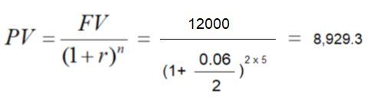
The time Value of Money
Present Value (PV)
Discounting - discounted cash flows
In 5 years, you will receive 12,000 €. How much are they worth now ?
The interest rate is 6% and the compounding takes place twice a year.

Slide 36
The time Value of Money
Cash flows – timeline
Assume that during the following 5 years you will receive 100, 230, 80, -120 and 250 Euro, respectively. If the discount rate is 5%, find the PV.

Slide 37
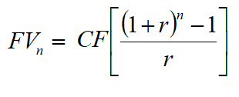
The time Value of Money
Annuity: several periodic payments/receipts within a given time:
Perpetuity: an annuity that runs forever (no maturity). Its PV is:
For a perpetuity where the CF increase at a constant rate of growth g:
(if, r > g)

Slide 38
Stock Valuation

Slide 39
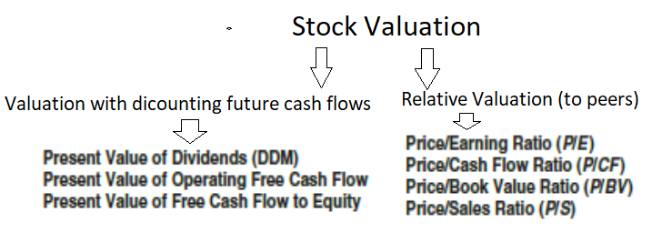
Stock Valuation

Slide 40
Stock Valuation
3 analytical steps (usually)
Economy → Industry → Company
General Economic Influences
Monetary and fiscal policy
E.g., fiscal policy (tax cuts) can encourage spending, consumption, and thus, the sales of goods and services and the cash flows of firms, among others
E.g., a restrictive monetary policy that increases interest rates, increases the cost for firms, for mortgages, for loans, etc

Slide 41
Stock Valuation
Industry
Different industries react differently to the business cycle.
Cyclical industries (e.g, steel, autos, airlines) follow the cycle and do better (suffer more ) during economic expansions (recessions)
Noncyclical industries or defensive industries (e.g., retail food, utilities, pharmaceuticals) do not increase with expansions but also do not suffer with recessions.

Slide 42
Stock Valuation
Company Analysis
After determining an industry’s outlook, an investor can analyze and compare an individual firm’s performance relative to the entire industry using financial ratios and cash flow values.
You undertake company analysis to identify the best company in a promising industry. This involves examining a firm’s past performance and, more important, its future prospects.
After you understand the firm and its outlook, you can estimate its value using one of several valuation models. An important point that will be emphasized is that it is your estimated inputs to the valuation models that are critical, and the quality of these inputs depends on your prior market-industry-company analysis.
In the final step, you compare your estimated intrinsic value to the prevailing market price of the firm’s stock and decide whether its stock is a good investment. Your final goal is to select the best stock within a desirable industry and include it in your portfolio based on its relationship (correlation) with all other assets in your portfolio.

Slide 43
Stock Valuation
Estimated Values and Market Prices
To ensure that you receive your required return on an investment, you must estimate the intrinsic value of the investment at your required rate of return and then compare this estimated intrinsic value to the prevailing market price.
You should not buy an investment if its market price exceeds your estimated value because the difference will prevent you from receiving your required rate of return on the investment. In contrast, if the estimated intrinsic value of the investment exceeds the market price, you should buy the investment. In summary:
If Estimated Intrinsic Value > Market Price, Buy or Hold it if You Own It.
If Estimated Intrinsic Value < Market Price, Don’t Buy or Sell it if You Own It.

Slide 44
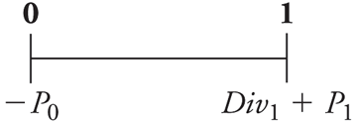
Stock Valuation
  A One-Year Investor
  Potential Cash Flows: Dividend and Sale of Stock
  Since the cash flows are risky, we must discount them at the equity cost of capital.

Slide 45
Stock Valuation
Total Return = Dividend Yield + Capital Gain Rate
    The expected total return of the stock should equal the expected return of other investments available in the market with equivalent risk.

Slide 46
Example
Company X pays dividends of 0.40 Euro, and its stock Price is expected in 1 year to be 35 Euros
Investments with similar risk have a rate of return of 10%
How much would you pay (max) for this stock ?
Calculate expected capital gains and dividend yield

Slide 47
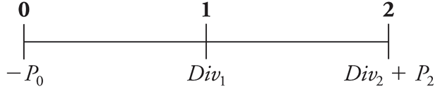
Stock Valuation
What is the price if we plan on holding the stock for two years?

Slide 48
The Dividend-Discount Model Equation
What is the price if we plan on holding the stock for N years?
This is known as the Dividend Discount Model: it holds for any horizon N.
Thus, all investors (with the same beliefs) will attach the same value to the stock, independent of their investment horizons.
The price of any stock is equal to the present value of the expected future dividends it will pay

Slide 49
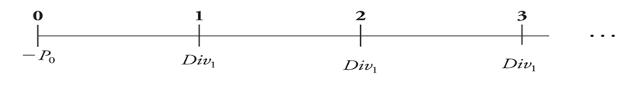
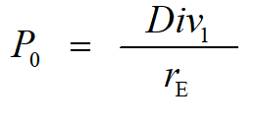
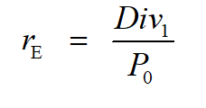
Applying the Discount-Dividend Model
No Growth Dividend Model
  Assume that dividends will NOT grow at all, forever
  DIV₁ = D₀ (see above, perpetuity)

Slide 50
Example
Assume the following data for the stock of Cboe Global Markets
Assume constant dividends (no growth)
Is the stock correctly valued in the market?

Slide 51
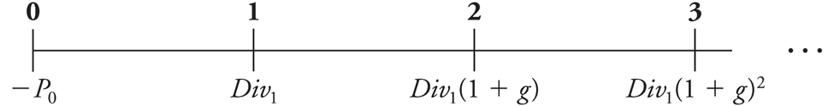
Applying the Discount-Dividend Model
Constant Dividend Growth Model
  Assume that dividends will grow at a constant rate, g, forever
  DIV₁ = D₀ (1+g) (see above, perpetuity with constant growth)

Slide 52
The Dividend Discount Model
How to estimate g ?
Q: where will the growth come from ?
A: New Investments
Q: How will you finance new investments ?
A: Retained Earnings
Q: By how much will retained earnings grow?
A: Return on New Investments

Slide 53
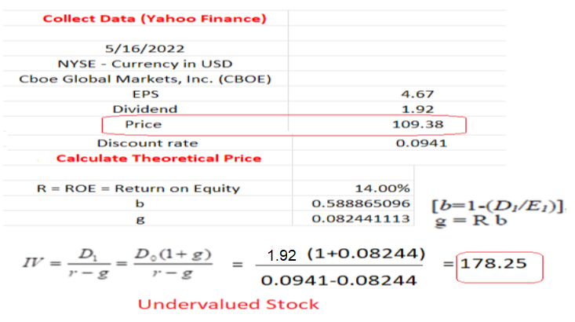
Example
Assume the following data for the stock of Cboe Global Markets
Assume constant growth in dividends
Is the stock correctly valued in the market?

Slide 54
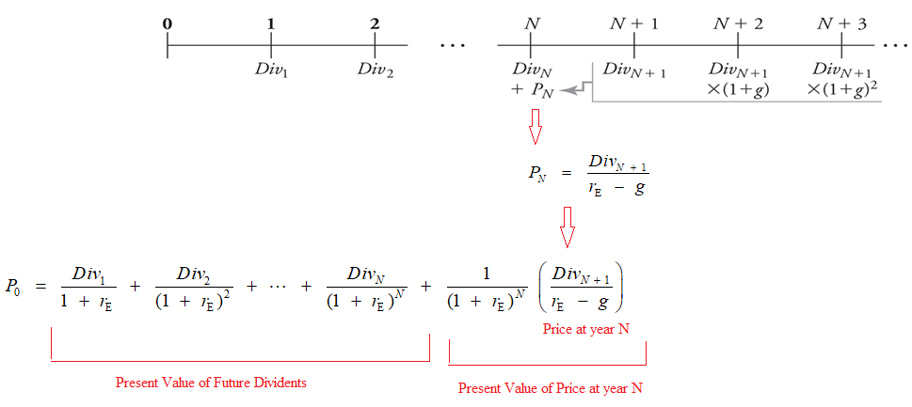
Different (changing) Growth Rates
When growth is not constant, we can use the general form of the model to value a firm

Slide 55
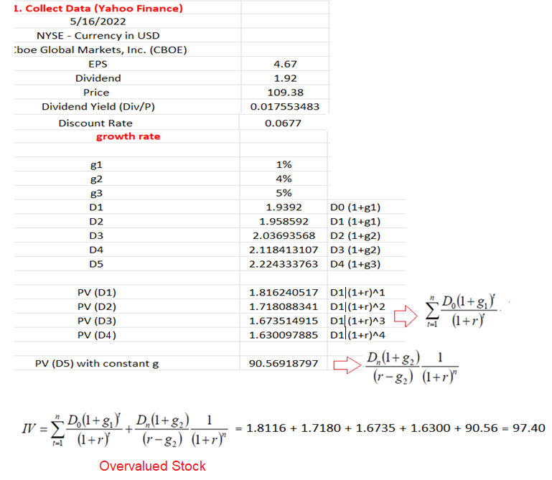
Example
Assume the following data for the stock of Cboe Global Markets
Assume changing growth in dividends: ,
1% for the next 2 years,
4% for years 3 and 4, and
5% constant thereafter
Is the stock correctly valued?

Slide 56
Example 2
Co X
Stock price 21.7 $
Current Dividend 1,3$
Discount rate 8%
We expect:
g₁ = 4% for the first 5 years
g₂ = 2% from year 6 onwards

Slide 57
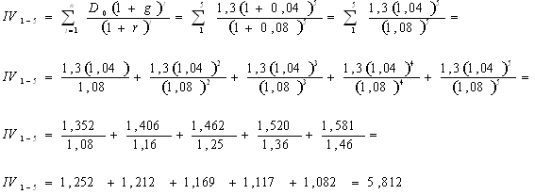
Thus, IV₁₋₅ + IV₆ = 5.812 + 18.3 = 24.1 $
Undervalued stock

Slide 58
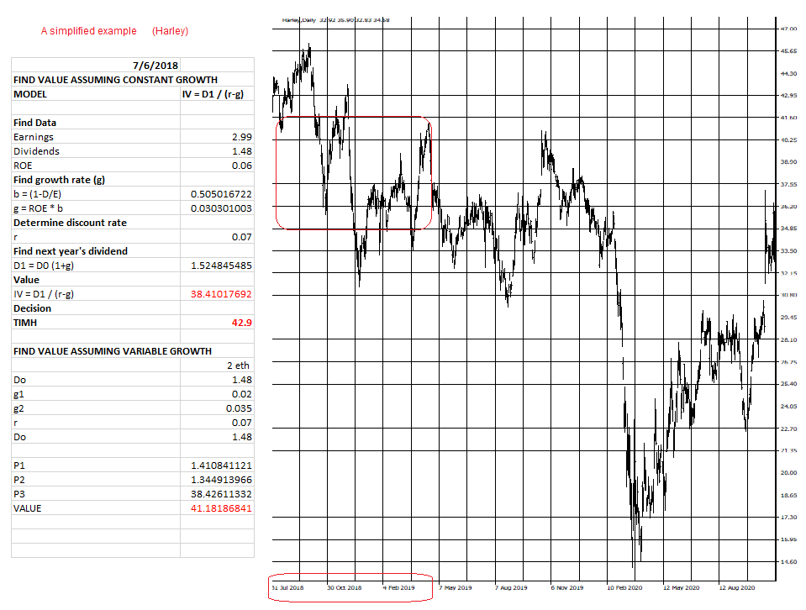
A simplified example (Harley)

Slide 59
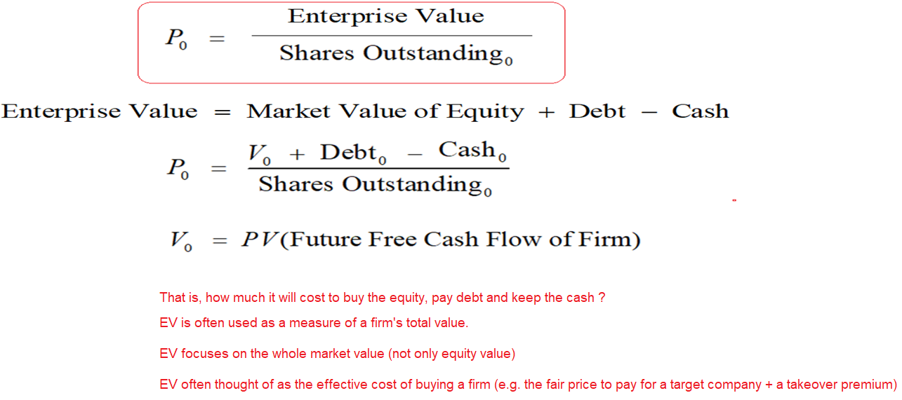
The Discounted Free Cash Flow Model

Slide 60
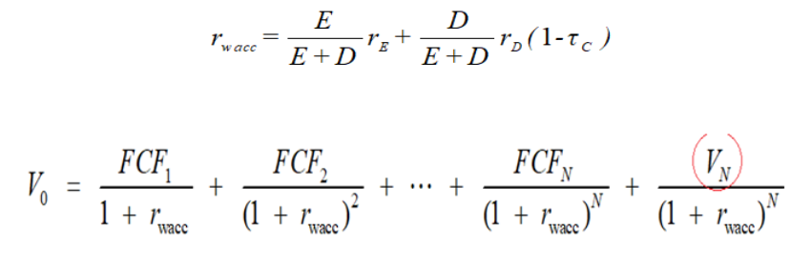
The Discounted Free Cash Flow Model
Here, since we are using cash flows relevant to both equity and debt holders, we should use as a discount rate the firm’s weighted average cost of capital (WACC), r_{wacc}. If the firm has no debt, r_{wacc} = r_{E}.

Slide 61
Valuation Multiples
Here, we estimate certain financial ratios for the firm and compare it to industry averages, competitor firms, and/or some other relative measure
For example, the Price-Earnings Ratio, P/E Ratio
It is the share price divided by earnings per share
The stock price should be equal to the product of EPS with a comparable P/E ratio

Slide 62
Example
Company X has Earnings per Share (EPS) of 1.5 $
Comparable firms have a P/E ratio of 22 $
What should be X’s price in the market ?
It should be 33 $
If the stock is trading at 35$, it is overvalued in the market

Slide 63
Example

Slide 64
Valuation Multiples
Other important ratios:
P / B ratio (stock value / book value)
CF / P ratio (the free cash flow per stock of the firm / the stock price)
P / Sales ratio (the stock price / sales of the firm per share)
On average, stocks with low P/B ratios are considered undervalued
The value of the firm / with the EBITA (see above for V₀)

Slide 65
Firm-Fundamental Anomalies
Empirical studies show that, on average:
Low Price to Book (P/B) stocks outperform High P/B stocks
Low Price to Sales (P/S) P/S stocks outperform high P/S stocks
Low Price to Earnings (P/E) low P/E stocks outperform high P/E stocks
Cash Flow to Price (CF/P): high CF/P ratios outperform low CF/P stocks
High Dividend Yield (DY): high DY stocks outperform low DY stocks
Low market capitalization stocks outperform high market capitalization stocks (Size Effect)

Slide 66
Active Equity Portfolio Management Strategies
VALUE STOCKS
Low Price/Book
Low P/E
High Yield
Cyclicals
Regulated Industries
GROWTH STOCKS
High EPS Growth
High Profitability
Higher Valuations
Consumer & Services
Health & Technology

Slide 67
Risk and Return

Slide 68
Asset Returns
Understanding how return and risk is presented is crucial since historical returns are often used by investors when attempting to estimate the expected rates of return and risk for an asset class.
The first measure is the historical rate of return on an individual investment over the time period the investment is held (that is, the holding period return, HPR).
The second measure is the average historical rate of return for an individual investment over a number of time periods.
The third measure is the average rate of return for a portfolio of investments.
The fourth measure, given the historical rates of return, is the risk for a historical time series of returns (that is, the variance and standard deviation).

Slide 69
Asset Returns
You will often have to compare investments with widely different prices or lives, e.g.
→ a $10 stock that pays no dividends
→ a stock selling for $150 that pays dividends of $5 a year
To properly evaluate these two investments, you must accurately compare their historical rates of return.
When we invest, we defer current consumption in order to add to our wealth so that we can consume more in the future.
→ thus, we are concerned with the change in wealth resulting from this investment.

Slide 70
Asset Returns
You commit $100 to an investment at the beginning of the year and you get back $110 at the end of the year.
The year of investment is the holding period
The return you get is the Holding Period Return (HPR) estimated as:
HPR = END VALUE / START VALUE = 110/100 = 1.1
HPR: is ALWAYS POSITIVE
HPR > 1.0 → increase in wealth (positive return)
HPR < 1.0 → decline in wealth (negative return)
HPR = 0.0 → you lost all your money (wealth) invested

Slide 71
Asset Returns
Investors evaluate returns in percentage terms on an annual basis
Why ?
Easier to directly compare alternative investments with different attributes
To convert HPR to an annual % rate:
Holding Period Yield (HPY):
HPY = HPR – 1 → 1.10 - 1 = 0.10 or 10%

Slide 72
Asset Returns
Longer periods of time (n years) ?
Annual HPR = HPR ^{1/n}
You invest now 100 and will get 140 in 2 years (n=2)
→ HPR = END VALUE / START VALUE = 140 / 100 = 1.4
→ Annual HPR = 1.40 ^{1/2} = 1.1832
→ Annual HPY = 1.1832 – 1 = 0.1832 or 18.32%

Slide 73
Asset Returns
In case of losses: You invest 100 and get back 75 in 2 years
→ HPR = 75/100 = 0.75
→ Annual HPR = 0.75 ^{1/2} = 0.866
→ Annual HPY = 0.866 – 1 = -0.134 or -13.4%

Slide 74
Asset Returns
Invest 100 and get 112 for less than a year, 6 months:
→ HPR = 112/100 = 1.12
→ Annual HPR = 0.75 ^{1/0.5} = 1.2544
→ Annual HPY = 1.2544 – 1 = 0.2544 or 25.44%

Slide 75
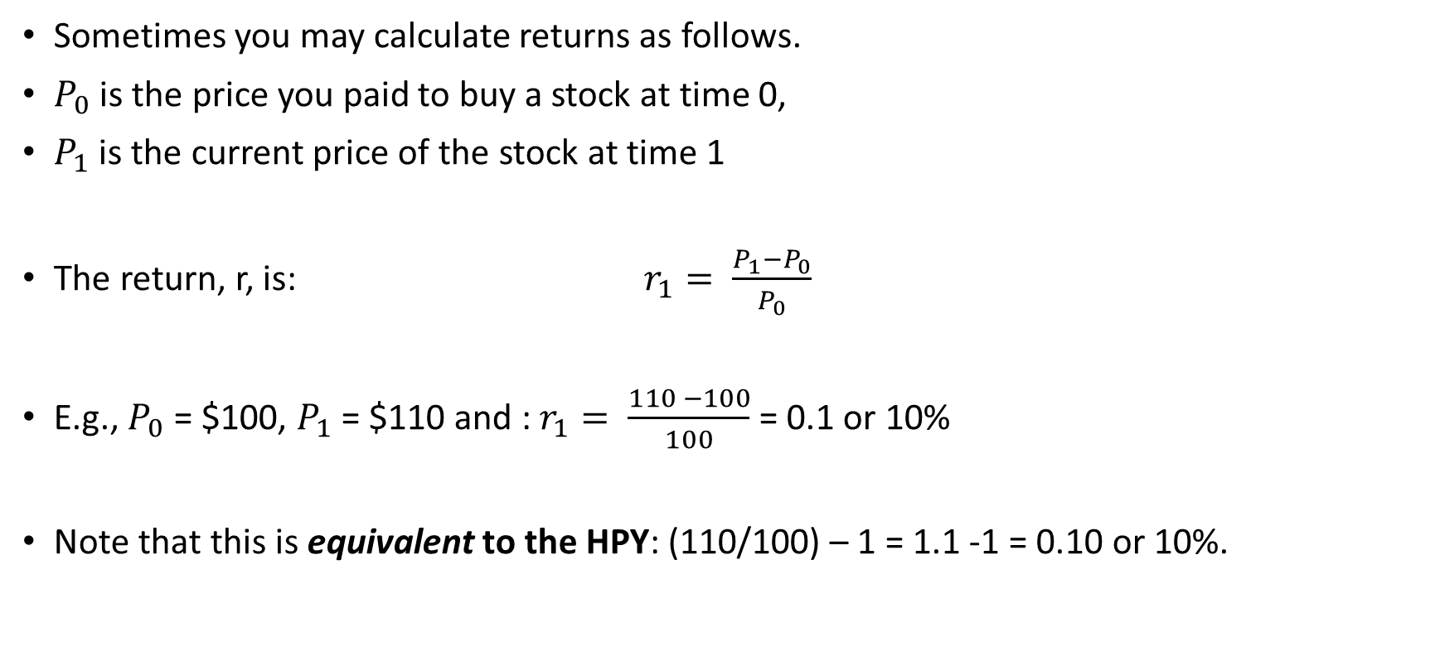
Asset Returns
Sometimes you may calculate returns as follows.
$P_{0}$ is the price you paid to buy a stock at time 0,
$P_{1}$ is the current price of the stock at time 1
The return, r, is: $r_{1}= \frac{P_{1}−P_{0}}{P_{0}}$
E.g., $P_{0}$ = $100, $P_{1}$ = $110 and : $r_{1}= \frac{110 −100}{100}$ = 0.1 or 10%
Note that this is equivalent to the HPY: (110/100) – 1 = 1.1 -1 = 0.10 or 10%.

Slide 76
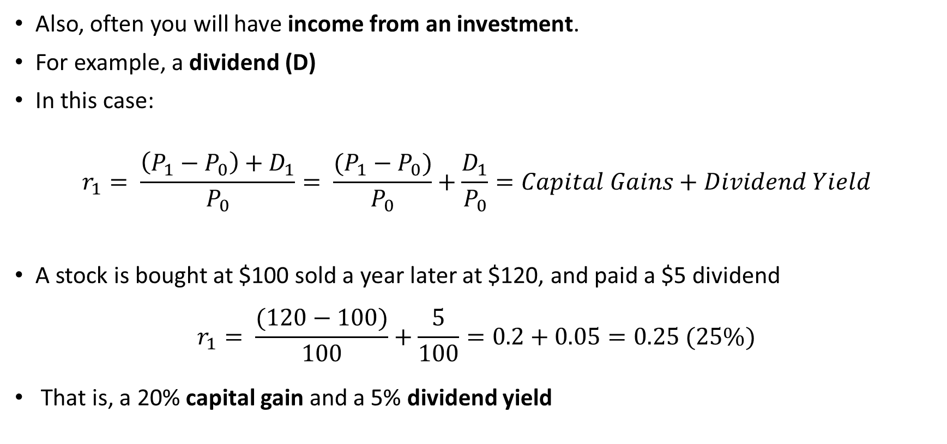
Asset Returns
Also, often you will have income from an investment.
For example, a dividend (D)
In this case:
$$r_{1}= \frac{\left(P_{1}−P_{0}\right)+D_{1}}{P_{0}}= \frac{(P_{1}−P_{0})}{P_{0}}+\frac{D_{1}}{P_{0}}=Capital Gains+Dividend Yield$$
A stock is bought at $100 sold a year later at $120, and paid a $5 dividend
$$r_{1}= \frac{(120−100)}{100}+\frac{5}{100}=0.2+0.05=0.25 (25\%)$$
That is, a 20% capital gain and a 5% dividend yield

Slide 77
Asset Returns
Two summary measures of asset return:
→ The arithmetic mean return (AM), to estimate expected value for an individual year
→ The geometric mean return (GM), to estimate long-term performance (measures the compound annual return) The AM is best used as an
When rates of return are the same for all years, the GM will be equal to the AM.
If the rates of return vary over the years, the GM will always be lower than the AM.

Slide 78

Asset Returns
Arithmetic Mean (AM) $AM= \frac{\sum_{i=1}^{n}{{HPY}_{n}}}{n}$
Geometric Mean (GM)

Slide 79

Asset Returns & Risk
Expected Returns
Assign probability values to returns:
$$E\left(r_{i}\right)=\sum_{i=1}^{n}{p_{i}r_{i}}$$
Risk
Dispersion of possible returns (uncertainty, volatility)
Variance and Standard Deviation of expected returns
$$σ^{2}=\sum_{i=1}^{n}{p_{i}[r_{i}−E(r_{i})]^{2}}$$
$$σ=\sqrt{σ^{2}}$$

Slide 80
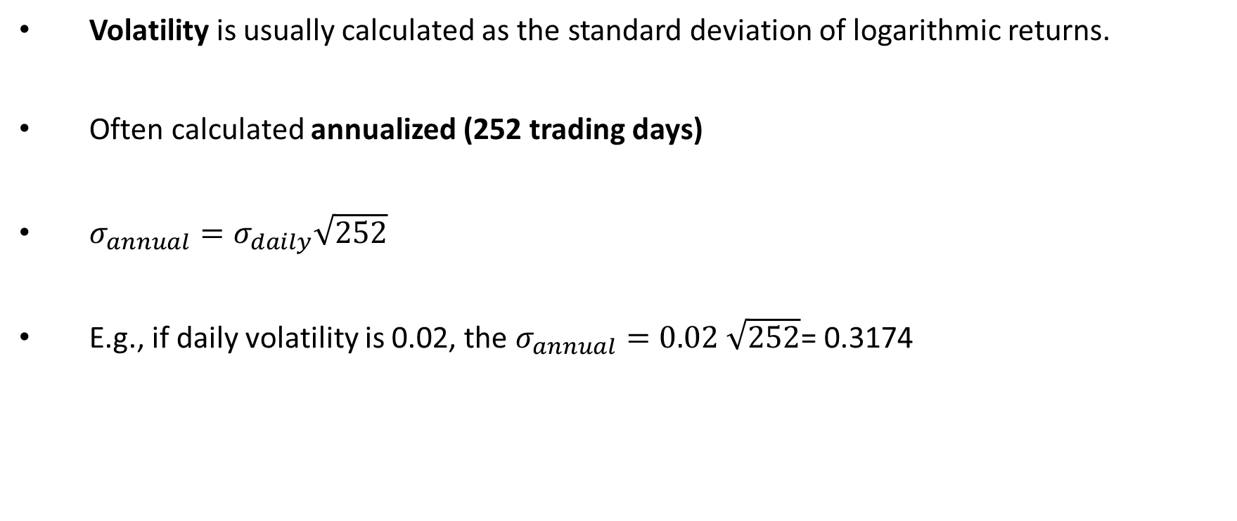
Asset Returns & Risk
Volatility is usually calculated as the standard deviation of logarithmic returns.
Often calculated annualized (252 trading days)
$σ_{annual}=σ_{daily}\sqrt{252}$
E.g., if daily volatility is 0.02, the $σ_{annual}=0.02 \sqrt{252}$= 0.3174

Slide 81
Asset Returns & Risk
Calculating historical returns and risk in practice: we assume that every year (month, etc.) is a different “scenario” with the same probability of occurring.
Consider DAX 30 (Portfolio of German stocks, 30 highest capitalization stocks)

Slide 82
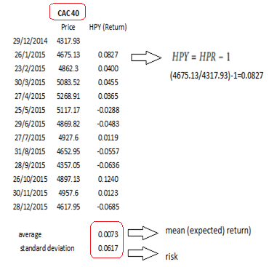
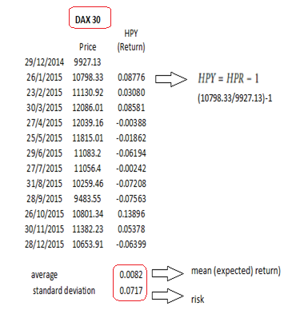
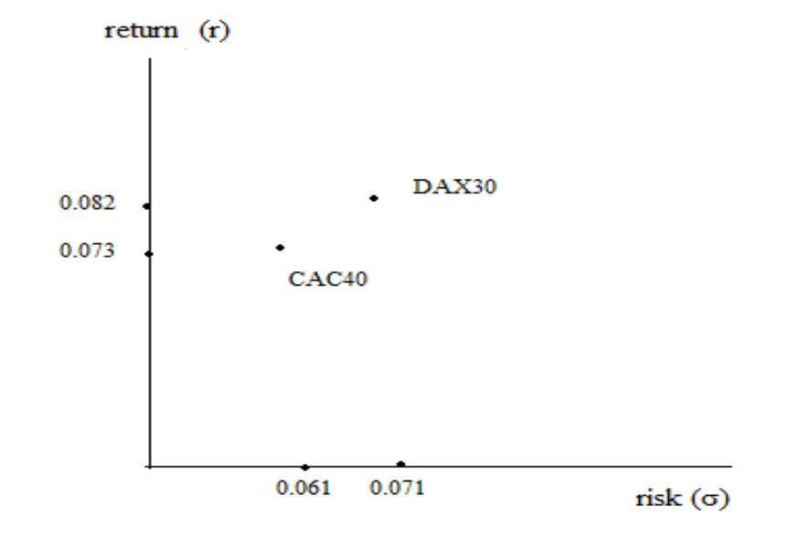
Asset Returns & Risk
Consider two investments (market indexes, assume no dividends) with the prices:
(You can easily calculate (e.g., in Excel) historical returns and risk)

Slide 83
Once you have returns and volatility for each asset……..
Example for 30 stocks

Slide 84
Coefficient of Variation
If two assets have the same return but different risk:
→ choose the investment with the lower risk
If two assets have the same risk but different return:
→ choose the investment with the higher return
What if they have different returns and different risk ?
→ Calculate risk per unit of expected return
Coefficient of Variation (CV) = Standard Deviation / Expected Return

Slide 85

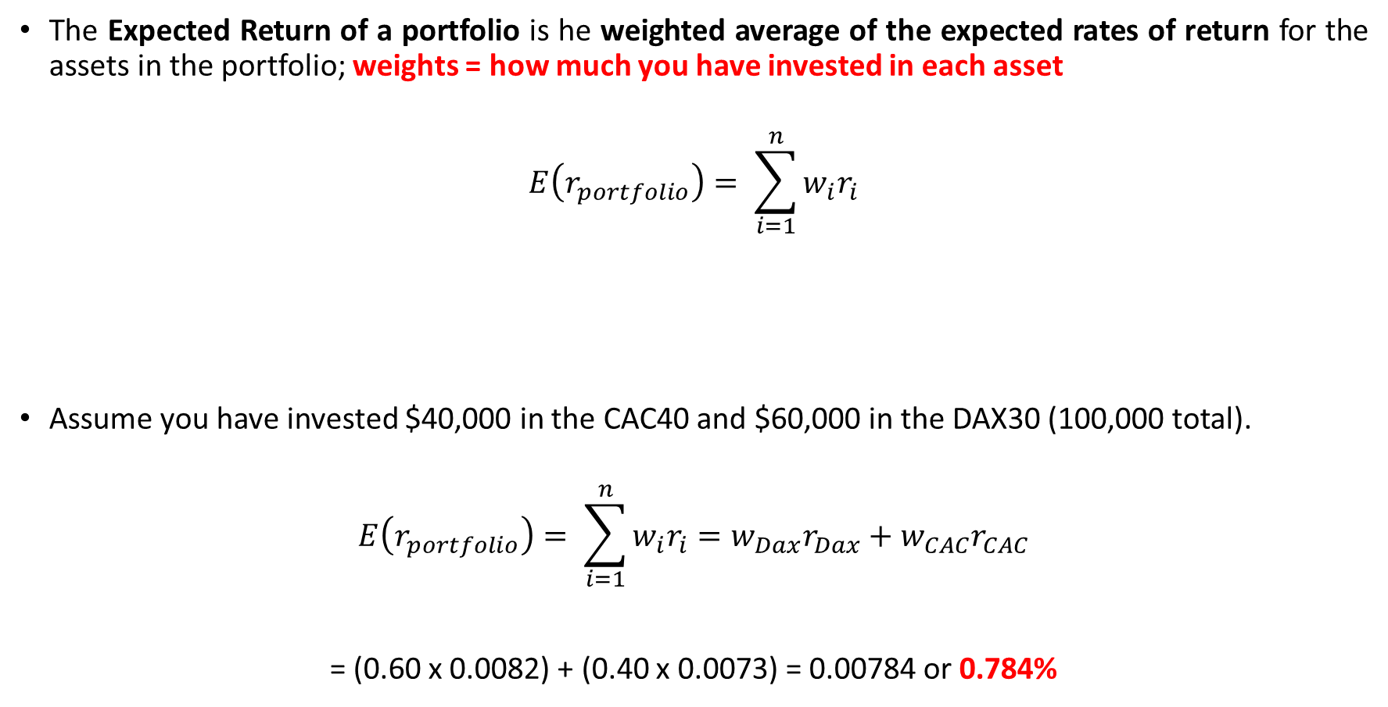
Portfolio Return
The Expected Return of a portfolio is he weighted average of the expected rates of return for the assets in the portfolio; weights = how much you have invested in each asset
$$E\left(r_{portfolio}\right)= \sum_{i=1}^{n}{w_{i}r_{i}}$$
Assume you have invested $40,000 in the CAC40 and $60,000 in the DAX30 (100,000 total).
$$E\left(r_{portfolio}\right)= \sum_{i=1}^{n}{w_{i}r_{i}}=w_{Dax}r_{Dax}+w_{CAC}r_{CAC}$$
= (0.60 x 0.0082) + (0.40 x 0.0073) = 0.00784 or 0.784%

Slide 86
Portfolio Risk
Portfolio Risk: more complicated
The overall risk of the portfolio comes from two sources
→ The risk of individual securities in the portfolio
→ The risk of their co-movement
Thus, you must calculate by how much asset returns move together
Covariance, Correlation, allow us to measure the co-movement of returns.

Slide 87

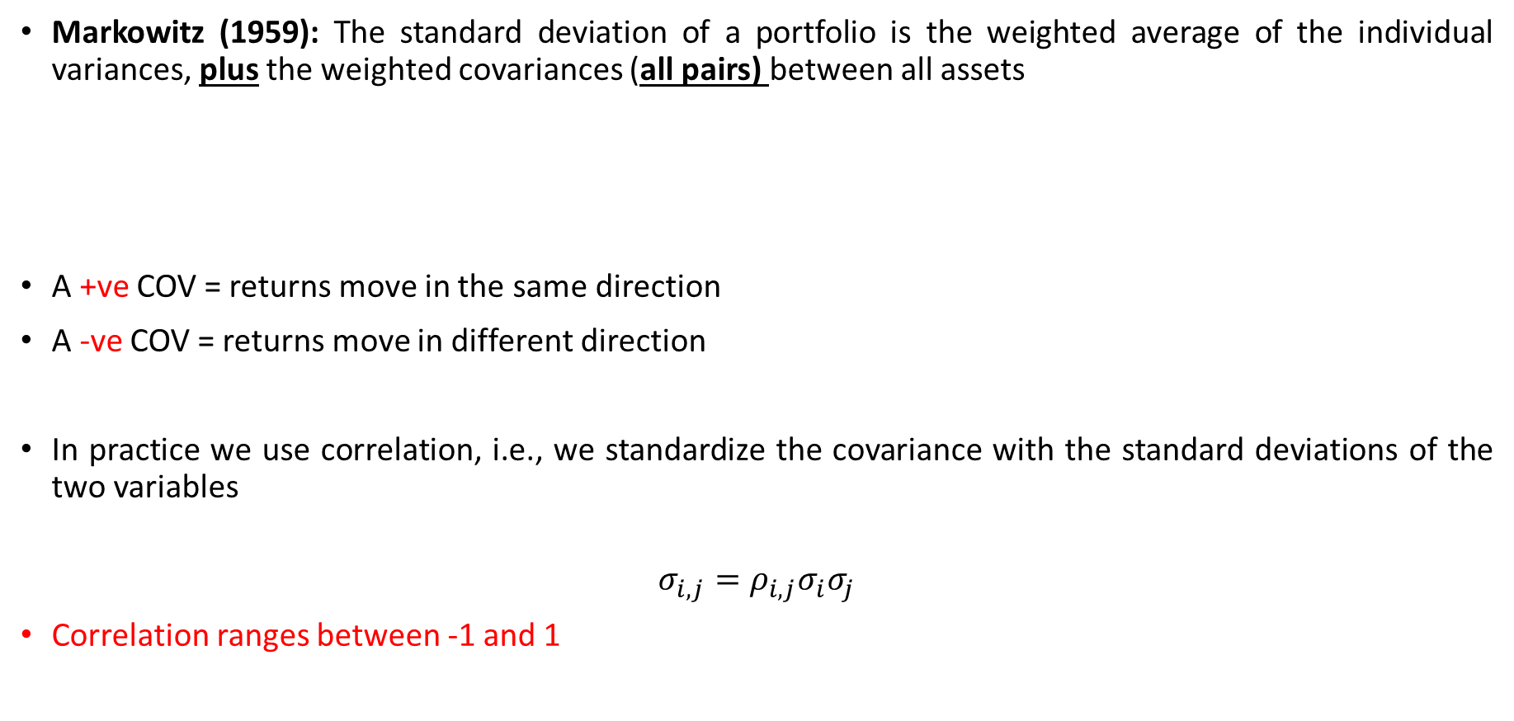
Portfolio Risk
Markowitz (1959): The standard deviation of a portfolio is the weighted average of the individual variances, plus the weighted covariances (all pairs) between all assets
A +ve COV = returns move in the same direction
A -ve COV = returns move in different direction
In practice we use correlation, i.e., we standardize the covariance with the standard deviations of the two variables
$$σ_{i,j}=ρ_{i,j}σ_{i}σ_{j}$$
Correlation ranges between -1 and 1

Slide 88
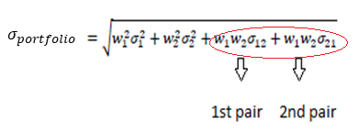

Portfolio Risk
For a two-stock portfolio this becomes:
Note that the two pairs are equal:
Covariance and Correlation are related: $σ_{i,j}=ρ_{i,j}σ_{i}σ_{j}$
In practice, often we calculate portfolio risk:

Slide 89
Portfolio Risk
For a 4 stock Portfolio

Slide 90
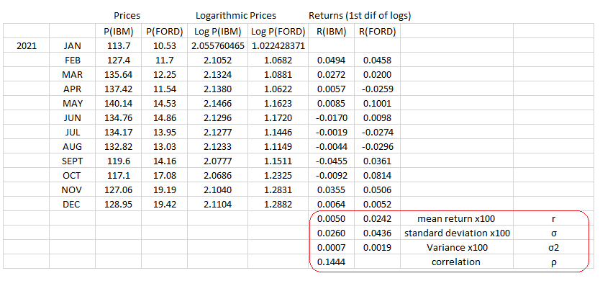
Efficient Portfolios – An Example, 2 stocks

Slide 91
Efficient Portfolios – An Example, 2 stocks

Slide 92
Efficient Portfolios – An Example, 2 stocks
Would you invest 100% of your wealth in IBM, i.e. portfolio A ?
As our example demonstrates you have portfolio C (60% in IBM and 40% in Ford) that has:
BOTH a higher expected Return AND LOWER volatility
Thus, investing in Portfolio A is inefficient.

Slide 93
Short sales
When you expect a stock price will go up you go long (buy the stock)
When you believe that a stock is overvalued and its price will fall soon, you go short.
Sort sale: you sell a stock that you do not own
That is, you borrow the stock and then sell it
You have an obligation to buy it back later and return it to the owner
Short sales make up anything between 15% - 30%, approximately of total trading volume and are crucial for the informational efficiency of capital markets (Boehmer, Jones, and Zhang, 2008; Diether, Lee, and Werner, 2009; Harris, 2003; Grossman and Stiglitz, 1980).

Slide 94
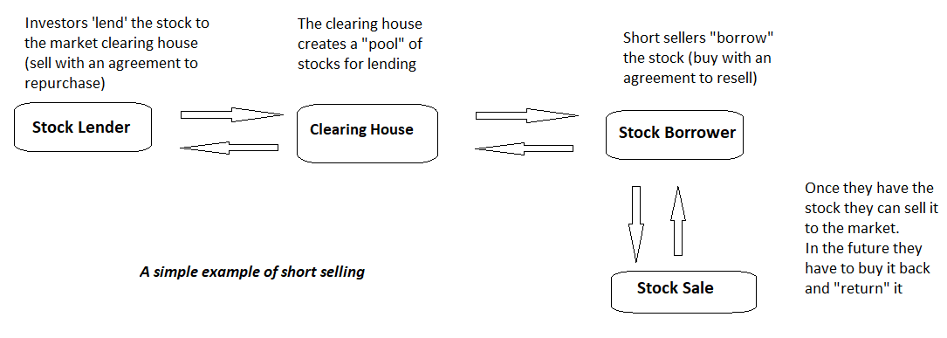
Short sales – a simplified example

Slide 95
Short Sales
The role of Arbitrage
Investors are rational and try to maximize utility
However, even if some investors are not rational, if their investments are random (uncorrelated) and there is a large number of such investors
→ their investments will cancel each other out and will not affect efficient prices
Furthermore, even if some investors are not rational if their investments are NOT random (correlated)
→ Rational Arbitrage will lead prices to equilibrium

Slide 96
Short Sales
Efficient Market Hypothesis -The role of Arbitrage
Assume that stock A is overvalued (compared to its theoretical fair price) due to the behavior of non-rational investors
Rational investors will notice this deviation from equilibrium and will sell short stock A, buying simultaneously a similar or substitute stock B to cover their risk
That is, they sell an expensive stock A and buy a similar cheaper stock B
This process will increase the selling pressure on stock A and lower its price (higher supply)
It will continue until stock A reaches its fair price

Slide 97
Short Sales
Assume that stock A is undervalued (compared to its theoretical fair price) due to the behavior of non-rational investors
Rational investors will notice this deviation from equilibrium and will buy stock A, selling short simultaneously a similar or substitute stock B to cover their risk
That is, they buy the cheap stock A and sell the expensive similar stock B
This process will increase the buying pressure on stock A and raise its price (higher demand)
It will continue until stock A reaches its fair price

Slide 98
Short Sales
Efficient Market Hypothesis - The role of Arbitrage
This way the deviation from the fair price will be short-lived and corrected soon, due to the competition between rational investors
In addition, since the non-rational investors transact in under-valued or over-valued investments will gradually loose money and will be eliminated from the market

Slide 99
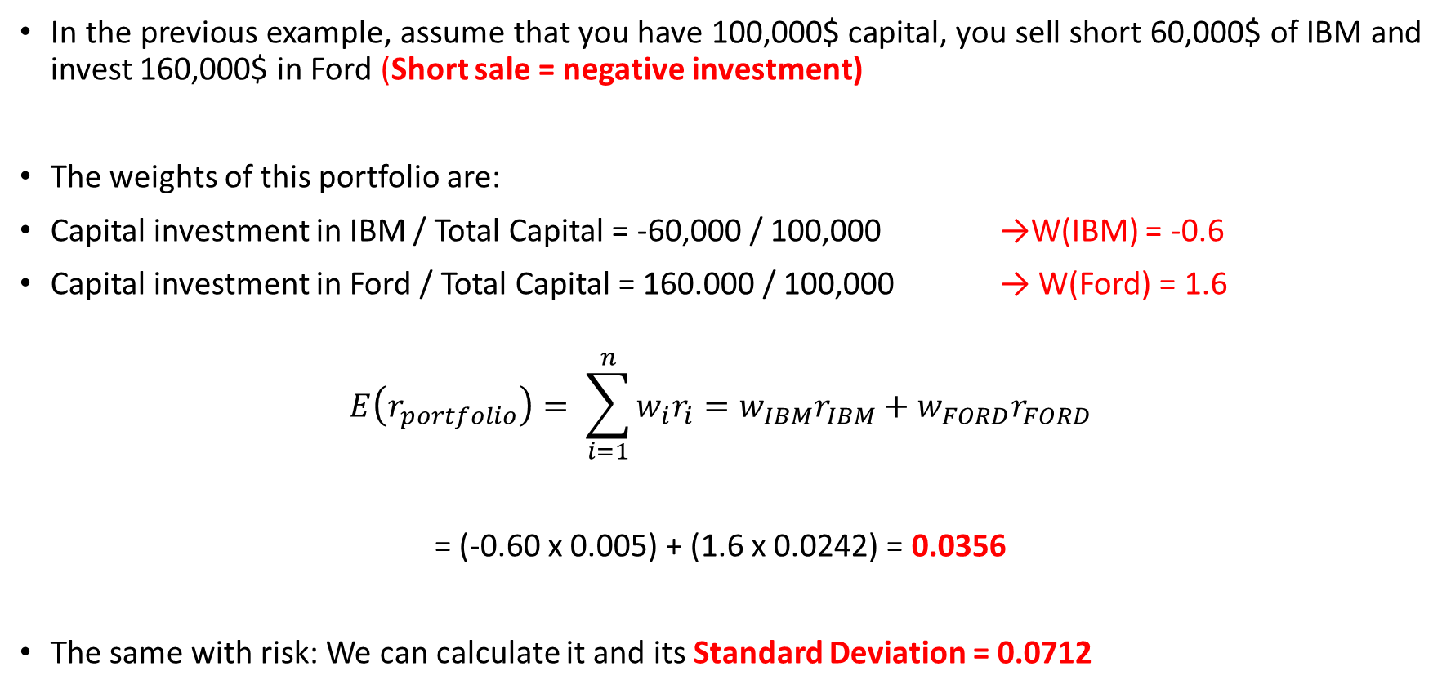
Short Sales
In the previous example, assume that you have 100,000$ capital, you sell short 60,000$ of IBM and invest 160,000$ in Ford (Short sale = negative investment)
The weights of this portfolio are:
Capital investment in IBM / Total Capital = -60,000 / 100,000 →W(IBM) = -0.6
Capital investment in Ford / Total Capital = 160.000 / 100,000 → W(Ford) = 1.6
$$E\left(r_{portfolio}\right)= \sum_{i=1}^{n}{w_{i}r_{i}}=w_{IBM}r_{IBM}+w_{FORD}r_{FORD}$$
= (-0.60 x 0.005) + (1.6 x 0.0242) = 0.0356
The same with risk: We can calculate it and its Standard Deviation = 0.0712

Slide 100
Efficient Portfolios – An Example – Short Sales

Slide 101
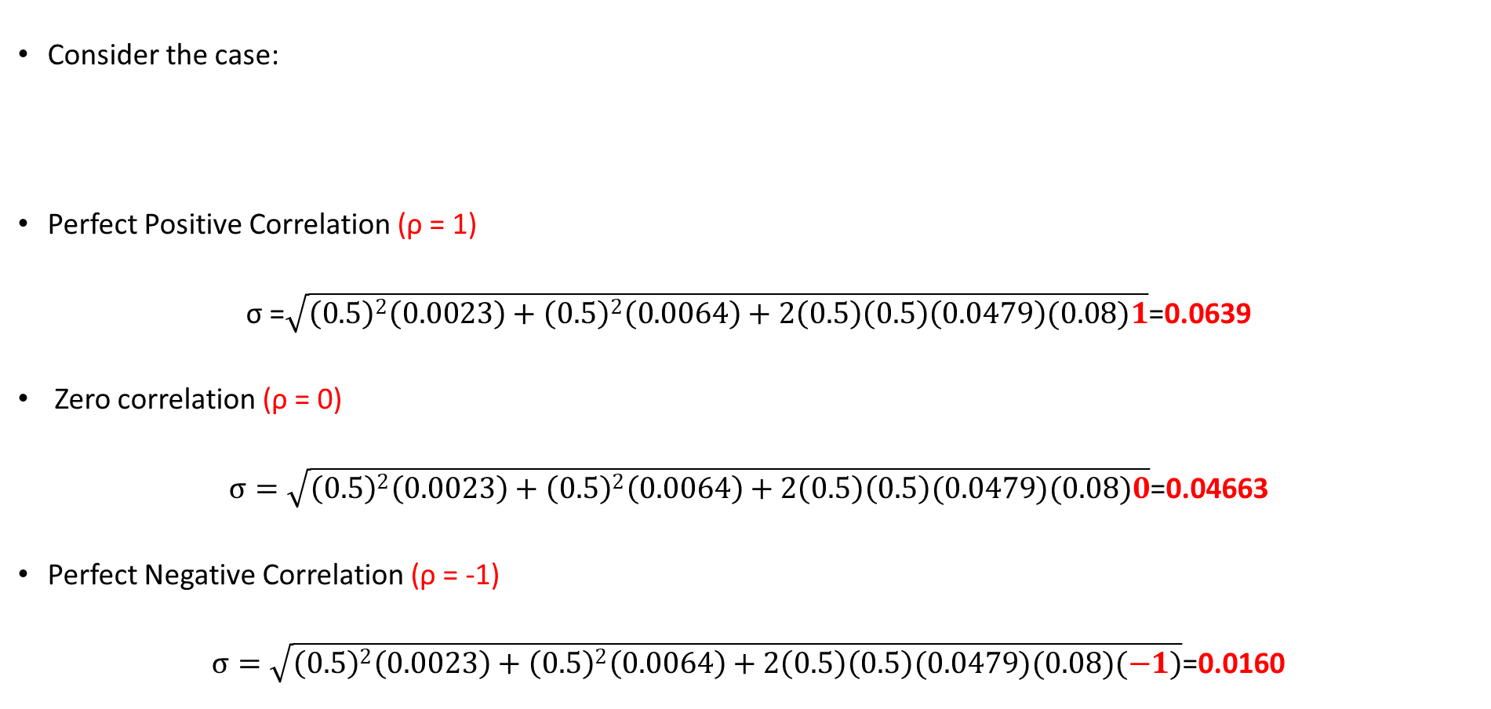
Portfolio Risk and Correlation
Consider the case:
Perfect Positive Correlation (ρ = 1)
σ =$\sqrt{{\left(0.5\right)}^{2}\left(0.0023\right)+{\left(0.5\right)}^{2}\left(0.0064\right)+2\left(0.5\right)\left(0.5\right)\left(0.0479\right)(0.08)1}$=0.0639
Zero correlation (ρ = 0)
$σ=\sqrt{{\left(0.5\right)}^{2}\left(0.0023\right)+{\left(0.5\right)}^{2}\left(0.0064\right)+2\left(0.5\right)\left(0.5\right)(0.0479)(0.08)0}$=0.04663
Perfect Negative Correlation (ρ = -1)
$σ=\sqrt{{\left(0.5\right)}^{2}\left(0.0023\right)+{\left(0.5\right)}^{2}\left(0.0064\right)+2\left(0.5\right)\left(0.5\right)(0.0479)(0.08)(−1)}$=0.0160

Slide 102
Portfolio Theory - The Efficient Frontier
Plot all available Portfolios
The curve (BC) is the efficient frontier
Efficient Frontier: all the portfolios that have:
The max return for every given level of risk, or
The min risk for every given level of return
Assumption: Investors are risk averse, i.e. between two investments with the same risk they will select the one with the min risk

Slide 103
Portfolio Theory - The Efficient Frontier
Investors will select where on the efficient frontier they want to be (i.e., which portfolio they want) based on their own utility curves
Their utility curves represent the risk-return tradeoff they are willing to make between expected return and risk and,
Optimal portfolio for each investor is the point of tangency between the highest utility curve and the efficient frontier
If two investors choose the same portfolio
→ they have same utility curve

Slide 104
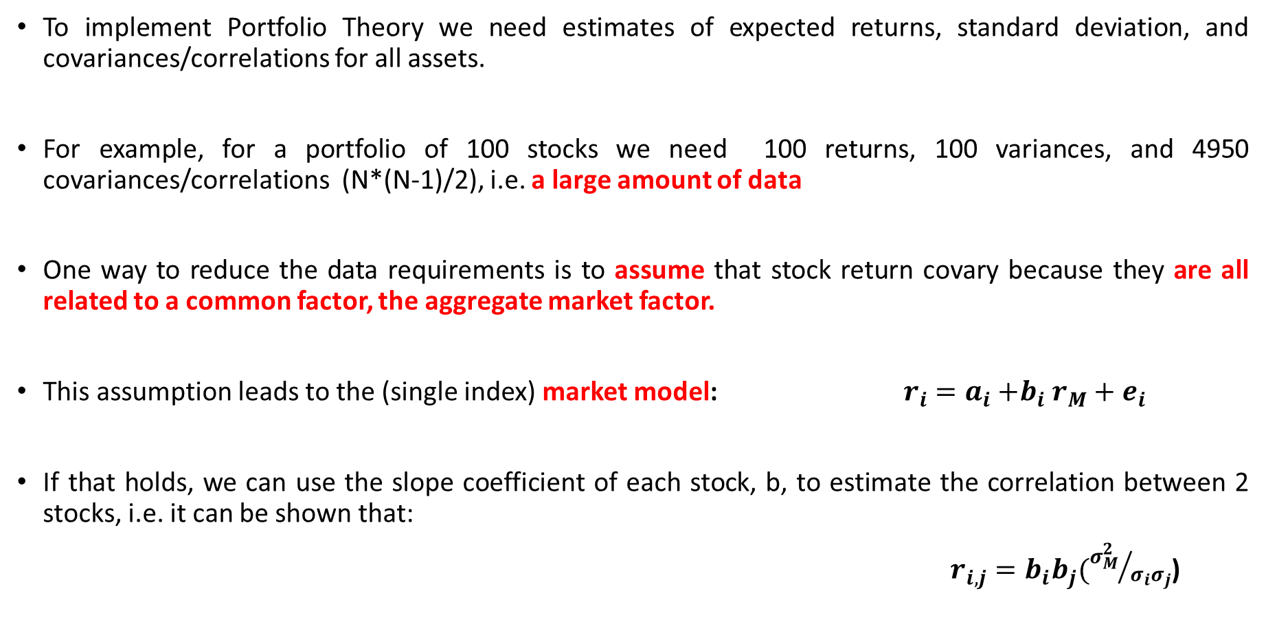
Portfolio Theory - The Efficient Frontier
To implement Portfolio Theory we need estimates of expected returns, standard deviation, and covariances/correlations for all assets.
For example, for a portfolio of 100 stocks we need 100 returns, 100 variances, and 4950 covariances/correlations (N*(N-1)/2), i.e. a large amount of data
One way to reduce the data requirements is to assume that stock return covary because they are all related to a common factor, the aggregate market factor.
This assumption leads to the (single index) market model: $r_{i}=a_{i}{+b}_{i}r_{M}+e_{i}$
If that holds, we can use the slope coefficient of each stock, b, to estimate the correlation between 2 stocks, i.e. it can be shown that:
$r_{i,j}=b_{i}b_{j}({σ_{M}^{2}}/{σ_{i}σ_{j}}$)

Slide 105
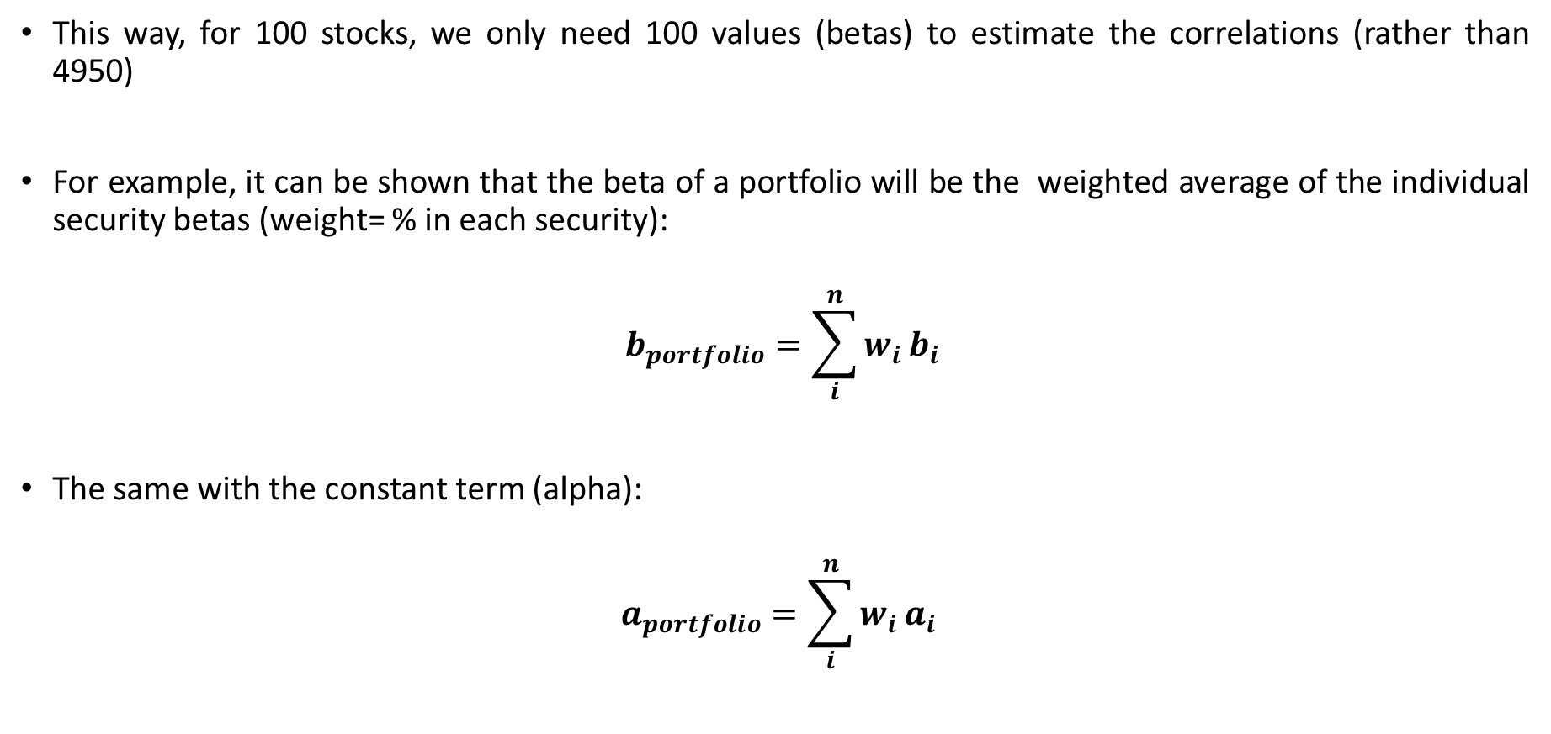
Portfolio Theory - The Efficient Frontier
This way, for 100 stocks, we only need 100 values (betas) to estimate the correlations (rather than 4950)
For example, it can be shown that the beta of a portfolio will be the weighted average of the individual security betas (weight= % in each security):
$$b_{portfolio}=\sum_{i}^{n}{w_{i}}b_{i}$$
The same with the constant term (alpha):
$$a_{portfolio}=\sum_{i}^{n}{w_{i}}a_{i}$$

Slide 106
Portfolio Theory - The Efficient Frontier
Markowitz Portfolio Theory – Main Points
Expected risk = standard deviation of returns
Portfolio Return = weighted average of the expected individual returns
Portfolio Risk = the risk of individual assets plus all pairs of covariances
Changing the weights between assets yields many different portfolios
Risk Diversification = combine securities/portfolios with low or negative correlation
Efficient Frontier = includes the optimal (dominant) portfolios i.e., the portfolios that have max return for given risk or, min risk for given return
Investors choose portfolios based on their utility curves (point of tangency with the efficient frontier)

Slide 107
Asset Pricing Models

Slide 108
Asset Pricing Models
What is missing from Portfolio Theory is an asset that has a risk-free (zero variance) rate of return, such as a government short term security
Economists (Sharpe, 1964; Lintner, 1965; Mossin, 1966) extended Portfolio Theory including such an assets and developed a generalized model:
→ Capital Market Theory (CMT)
→ Capital Asset Pricing Model (CAPM)
With CAPM we are now able to estimate the required rate of return for any risky security

Slide 109
Capital Market Theory
Assumptions of CMT
Investors are Markowitz-efficient (tangent points)
Investors can borrow or lend any amount of money at the risk-free rate
Investors have homogeneous expectations (identical probability distributions for returns)
Investors have a one-period time horizon
Investments are infinitely divisible
No taxes or transaction costs
Inflation is fully anticipated.
Capital markets are in equilibrium.

Slide 110
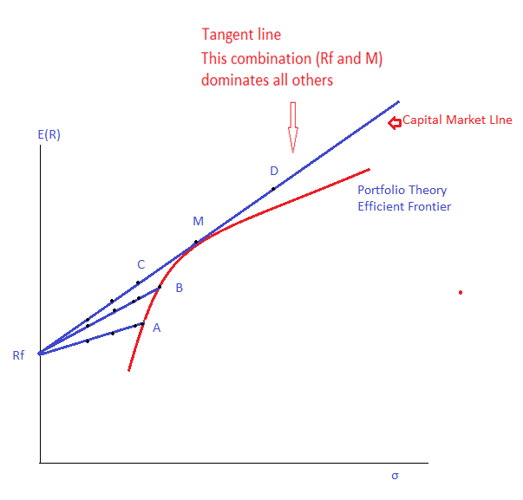
Capital Market Theory
Combine Rf with portfolios on the efficient frontier
Rf and Portfolio A, line RfA
By varying the weights in Rf and A you move along the line RfA
Rf and Portfolio B, line RfB
It dominates the previous lines
Rf and Portfolio M, line RfM
It dominates the previous lines

Slide 111
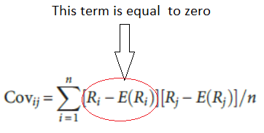

Capital Market Theory
The Rf asset has zero Covariance and Correlation with all other assets
The reason is that it has certain returns (no uncertainty) and, thus, its expected return is equal to its current return Rf = E(Rf); thus, its covariance with other assets is zero
Also, its volatility σ_{Rf} = 0 (no uncertainty) thus ${ρ_{i,Rf}= σ}_{i,Rf}/σ_{Rf}σ_{i}$= 0

Slide 112
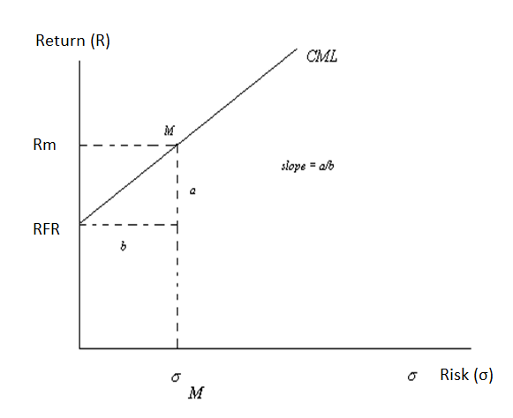
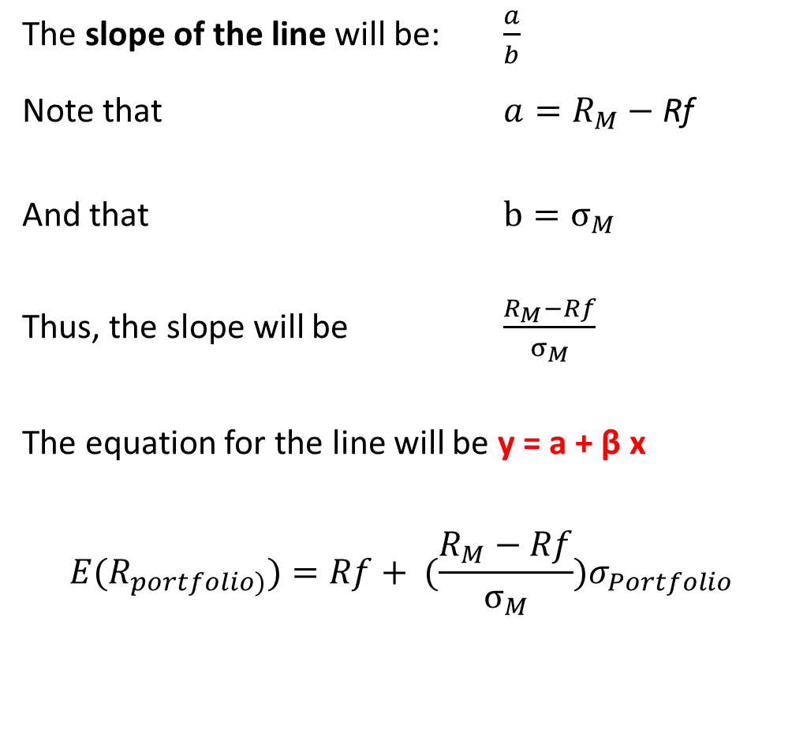
Capital Market Theory
The slope of the line will be: $\frac{a}{b}$
Note that $a=R_{M}−$ Rf
And that $b=σ_{M}$
Thus, the slope will be $\frac{R_{M}−Rf}{σ_{M}}$
The equation for the line will be y = a + β x
$${E(R}_{portfolio)})=Rf+ ({\frac{R_{M}−Rf}{σ_{M}})σ}_{Portfolio}$$

Slide 113
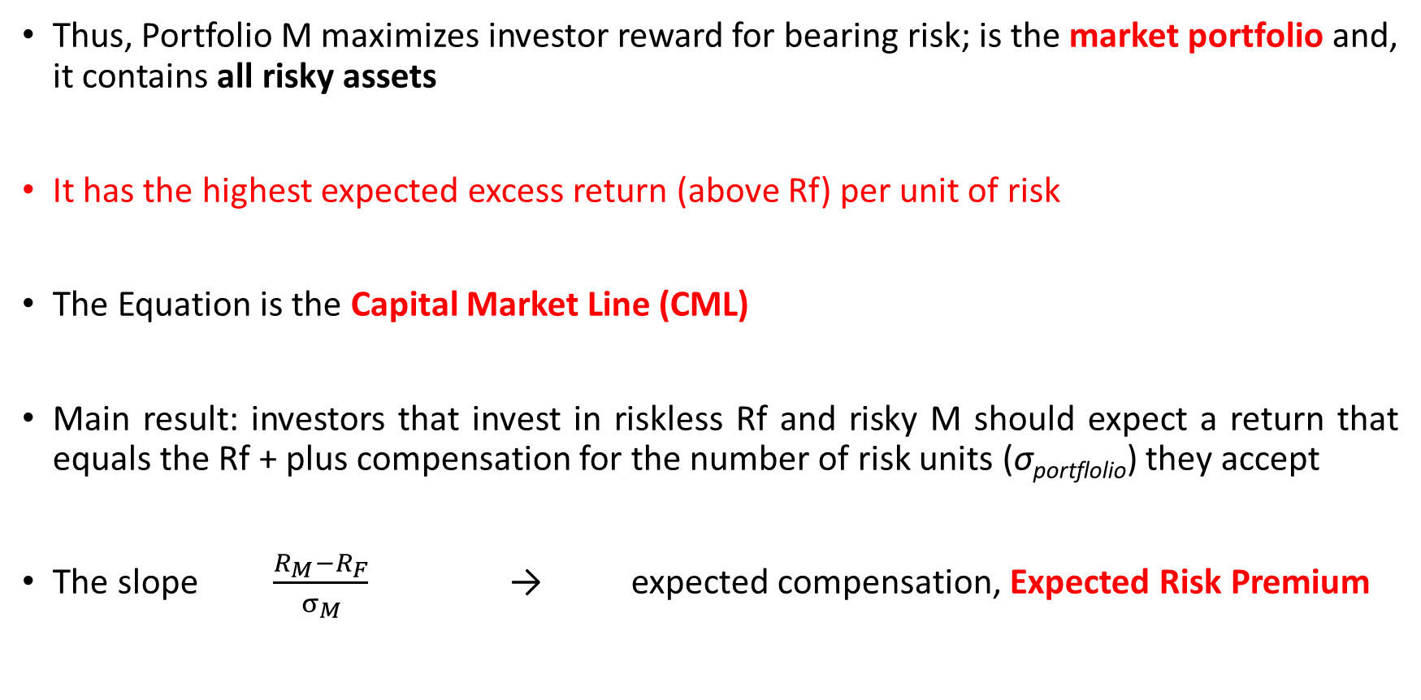
Capital Market Line
Thus, Portfolio M maximizes investor reward for bearing risk; is the market portfolio and, it contains all risky assets
It has the highest expected excess return (above Rf) per unit of risk
The Equation is the Capital Market Line (CML)
Main result: investors that invest in riskless Rf and risky M should expect a return that equals the Rf + plus compensation for the number of risk units (σ_{portflolio}) they accept
The slope $\frac{R_{M}−R_{F}}{σ_{M}}$ → expected compensation, Expected Risk Premium

Slide 114
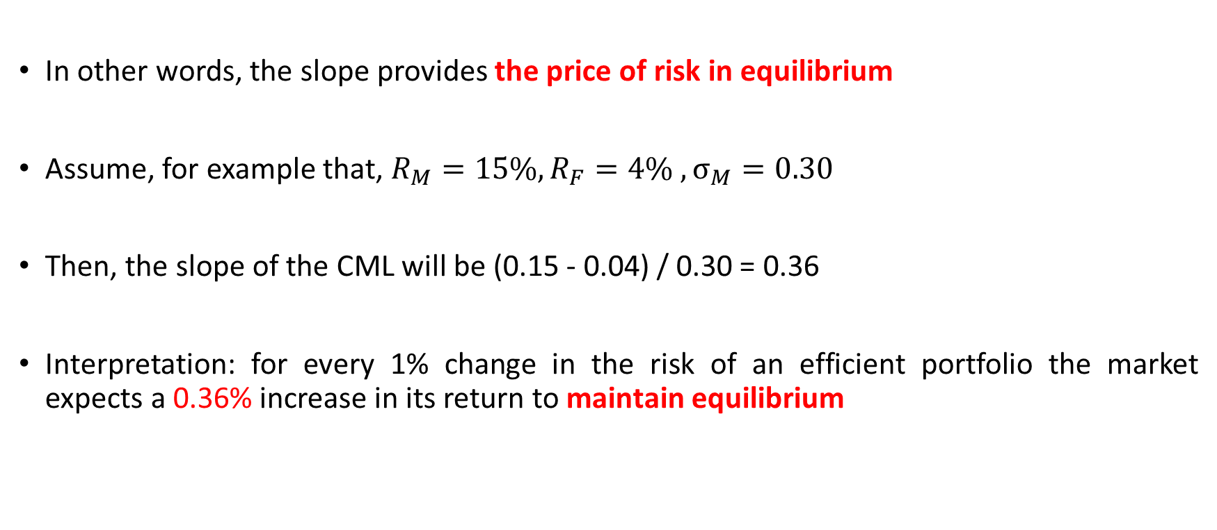
Capital Market Line
In other words, the slope provides the price of risk in equilibrium
Assume, for example that, $R_{M}=15\%, R_{F}=4\% , σ_{M}=0.30$
Then, the slope of the CML will be (0.15 - 0.04) / 0.30 = 0.36
Interpretation: for every 1% change in the risk of an efficient portfolio the market expects a 0.36% increase in its return to maintain equilibrium

Slide 115
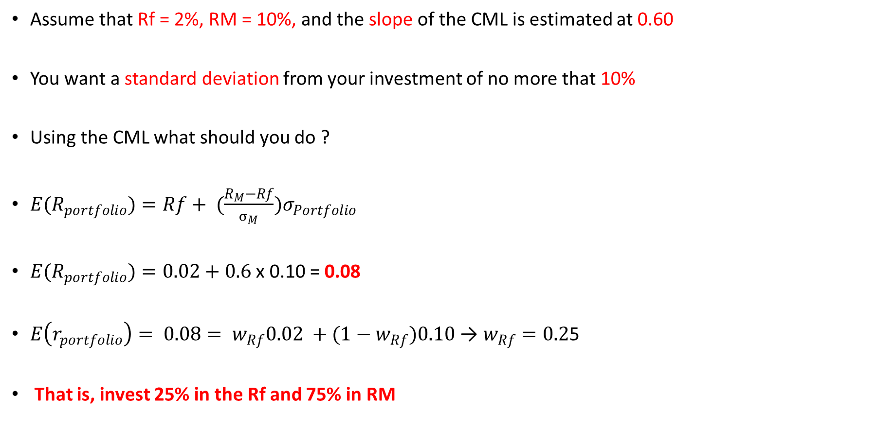
Capital Market Line
Assume that Rf = 2%, RM = 10%, and the slope of the CML is estimated at 0.60
You want a standard deviation from your investment of no more that 10%
Using the CML what should you do ?
${E(R}_{portfolio})=Rf+ ({\frac{R_{M}−Rf}{σ_{M}})σ}_{Portfolio}$
${E(R}_{portfolio})=0.02+0.6$ x 0.10 = 0.08
$E\left(r_{portfolio}\right)= {0.08= w}_{Rf}0.02 +{(1−w}_{Rf})0.10$ → $w_{Rf}=0.2$5
That is, invest 25% in the Rf and 75% in RM

Slide 116
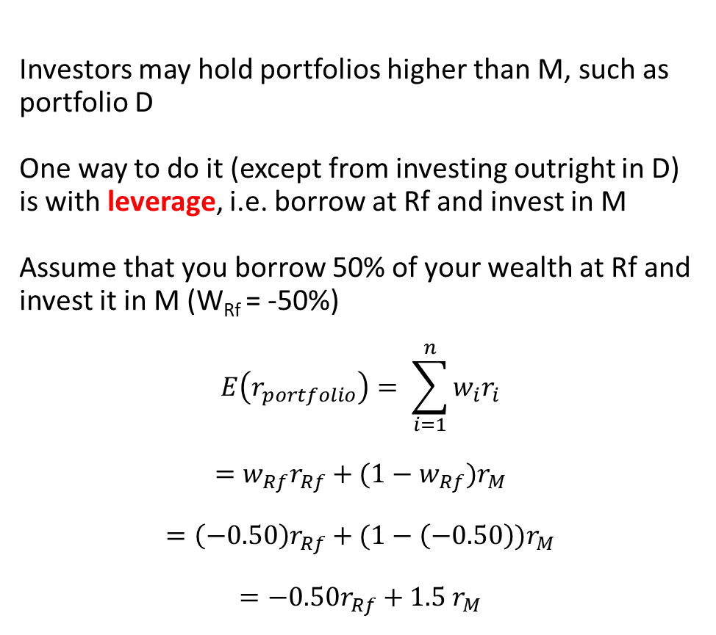
Investors may hold portfolios higher than M, such as portfolio D
One way to do it (except from investing outright in D) is with leverage, i.e. borrow at Rf and invest in M
Assume that you borrow 50% of your wealth at Rf and invest it in M (W_{Rf} = -50%)
$$E\left(r_{portfolio}\right)= \sum_{i=1}^{n}{w_{i}r_{i}}$$
$$=w_{Rf}r_{Rf}+{(1−w}_{Rf})r_{M}$$
$$=\left(−0.50\right)r_{Rf}+(1−\left(−0.50\right){)r}_{M}$$
$$=−0.50r_{Rf}+1.5 r_{M}$$
Capital Market Line

Slide 117
Capital Market Line
→ Investors should only invest in two types of assets: Rf and M
→ Their tolerance for risk will determine the weights
→ Portfolio M is the only relevant portfolio and it must contain all risky assets (stocks, bonds, gold, etc)
→ Their weights in M will depend on their market values.
→ The CML becomes is the new efficient frontier of portfolios
→ Portfolio M is completely diversified portfolio (no unique risk)
→ Unique risk = risk of single assets is offset - unsystematic risk
→ Only systematic risk (market risk, e.g. from macro fundamentals) remains in M
→ Systematic risk = the standard deviation RM, affected by the volatility in variables such as interest rates, industrial production, earnings, etc.

Slide 118
Capital Market Line
If a portfolio is totally diversified = correlation with M = 1
Diversified = all unsystematic or unique risk is eliminated
Thus, only systematic risk is left, which cannot be diversified away.
Thus, totally diversified portfolios would correlate perfectly with M

Slide 119
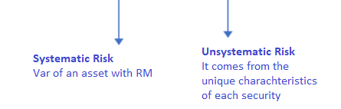
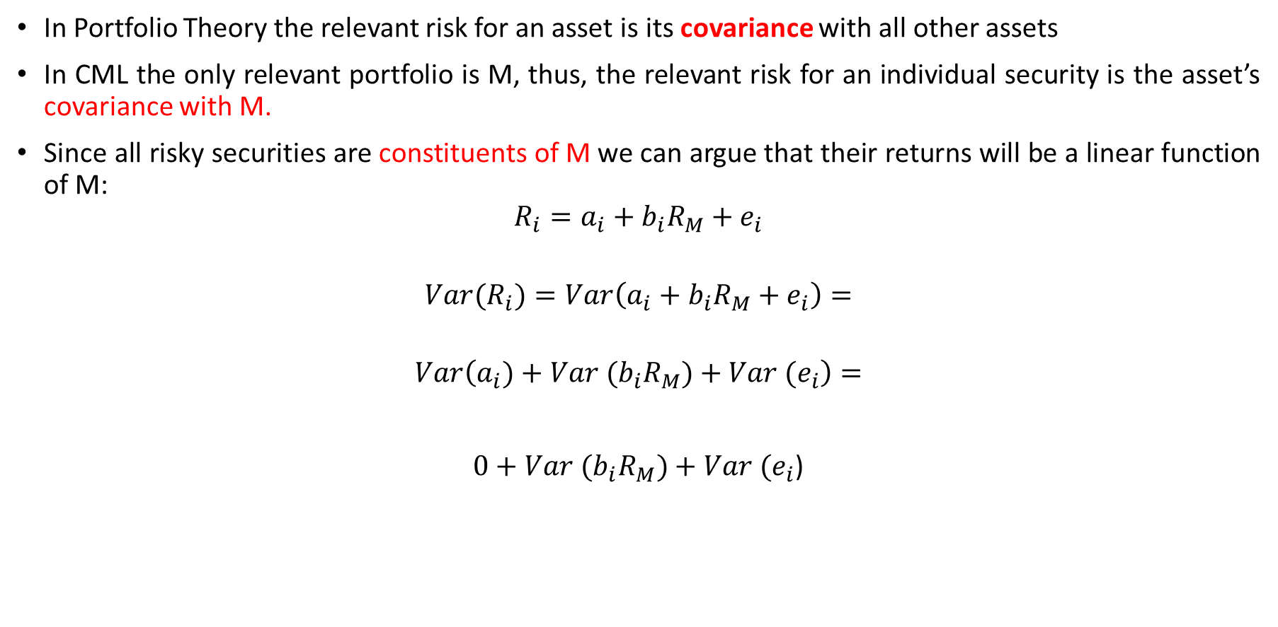
Capital Market Line
In Portfolio Theory the relevant risk for an asset is its covariance with all other assets
In CML the only relevant portfolio is M, thus, the relevant risk for an individual security is the asset’s covariance with M.
Since all risky securities are constituents of M we can argue that their returns will be a linear function of M:
$$R_{i}=a_{i}+b_{i}R_{M}+e_{i}$$
$${Var(R}_{i})=Var\left(a_{i}+b_{i}R_{M}+e_{i}\right)=$$
$$Var\left(a_{i})+Var (b_{i}R_{M})+{Var (e}_{i}\right)=$$
$0+$ $Var (b_{i}R_{M})+{Var (e}_{i}$)

Slide 120
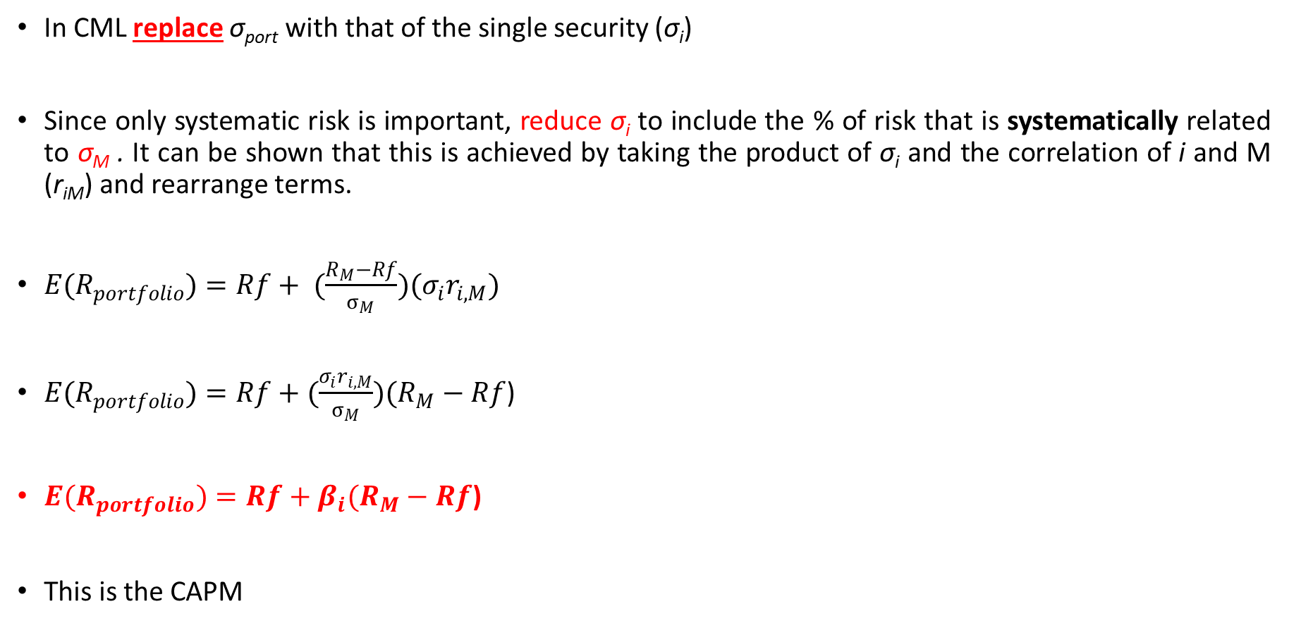
The Capital Asset Pricing Model (CAPM)
In CML replace σ_{port} with that of the single security (σ_{i})
Since only systematic risk is important, reduce σ_{i} to include the % of risk that is systematically related to σ_{M} . It can be shown that this is achieved by taking the product of σ_{i} and the correlation of i and M (r_{iM}) and rearrange terms.
${E(R}_{portfolio})=Rf+ ({\frac{R_{M}−Rf}{σ_{M}})(σ}_{i}r_{i,M})$
${E(R}_{portfolio})=Rf+(\frac{{σ_{i}r}_{i,M}}{σ_{M}})(R_{M}−Rf$)
${E(R}_{portfolio})=Rf+β_{i}(R_{M}−Rf$)
This is the CAPM

Slide 121
The Capital Asset Pricing Model (CAPM)
CAPM: risk is now an asset’s beta (β_{i})
Beta captures the non-diversifiable portion of market risk
A stock with a beta of 1.40 is 40% more risky than the market
A stock with a beta of 0.80 is 20% less risky than the market.
M has a beta = 1.00
CAPM: only the overall market risk premium (E(RM) − RFR) matters.
The risk premium can be reduced or increased for each asset depending on its market beta (βi).

Slide 122
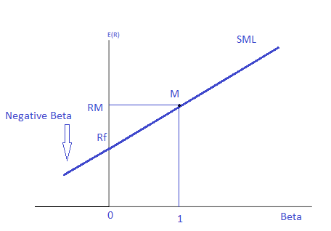
The Capital Asset Pricing Model (CAPM)
The graphical representation of the CAPM is the Security Market Line (SML)
It demonstrates the risk-return trade-off (linear)
Main differences
→ CML measures risk with σ
→ SML measures risk with β
→ CML can be applied only to diversified portfolios
→ SML can be applied to any individual asset or portfolio

Slide 123
The Capital Asset Pricing Model (CAPM)
Example
Assume that we have 5 stocks with beta as in the Table:
R_{f}=4%, R_{M} = 10%, i.e. risk premium = 6%.
Based on these data the equilibrium required returns (SML) are:

Slide 124
The Capital Asset Pricing Model (CAPM)
Asset E has a -ve beta (not often in reality), thus its equilibrium return will be below the risk free rate.
The required returns differ only because they have different betas
In equilibrium, all assets and all assets should be priced in a way that their rates of return are consistent with their risk, i.e. they should all be on the Security Market Line
Assets that plot above or below the SML are not correctly valued
E.g. above the SML → undervalued
(you get a return that is above what is required based on systematic risk)
E.g. below the SML → overvalued
(you get a return that is below what is required based on systematic risk)

Slide 125
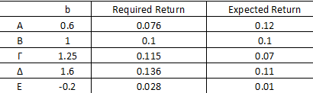
The Capital Asset Pricing Model (CAPM)
Assume now that using another way of analysis (e.g. fundamental analysis) we have estimated the following expected returns for our stocks (see Table)
We can see that the excepted and required return are different
For example, for stock A the CAPM required return is 0.076, while the expected is 0.12.
That is, the stock is undervalued, its expected return is higher to the return required based on its systematic risk

Slide 126
The Capital Asset Pricing Model (CAPM)

Slide 127
The Capital Asset Pricing Model (CAPM)
This difference between equilibrium required return and expected return is often called alpha (excess return)
If the stock plots above the CAPM → undervalued → alpha is positive
If the stock plots below the CAPM → overvalued → alpha is negative
If the stock plots on the CAPM → fairly valued → alpha is about zero

Slide 128

The Capital Asset Pricing Model (CAPM)
How to calculate betas in practice?
A. Use the following expression:
If we assume that the Market portfolio is the S&P500 and we want the IBM beta (see previous examples…)
(indicative example, sample specific result….)

Slide 129
The Capital Asset Pricing Model (CAPM)
B. Estimate the regression:
α_{i} = intercept,
ε_{it} = random error (unsystematic risk)
Characteristic line with the market portfolio
Excel: Data, Data Analysis, Regression
Result: beta = 0.189
(line, approximately….)

Slide 130
The Capital Asset Pricing Model (CAPM)
A stock’s beta tells us how sensitive are the cash flows and revenues of the firm to the general market and economic conditions
For example, the stock returns of a stock with beta = 2 change by 2 times the change in the overall market
When the market return is down by 1% the stock will fall by 2%, on average.
Some sectors are more sensitive (e.g. cyclical sectors) than others

Slide 131
The Capital Asset Pricing Model (CAPM)
CMT builds on Markowitz portfolio theory; borrowing and lending at risk-free rate (Rf)
CML: efficient frontier, the line that starts at the Rf and is tangent to the Markowitz efficient frontier, at M
M: the single portfolio that maximizes the expected risk premium with respect to risk
With CML portfolios have diversified away all unsystematic risk
SML (CAPM): generalizes this for individual assets/portfolio
CAPM: only beta risk is relevant (systematic risk)
CML and SML: the relationship between risk and return positive and linear
SML: can help find undervalued or overvalued assets

Slide 132
Multifactor Models
Arbitrage Pricing Theory (Ross, 1976, 1977)
Assumptions:
Perfect competition in capital markets
More wealth is always preferred to less wealth by investors
Return Generating Process: a stochastic process that is expressed as a linear function of a set of K risk factors; all unsystematic risk is diversified away.
It does not assume (like the CAPM) investor utility functions, that returns follow a normal distribution, that there is a mean-variance efficient market portfolio (M)

Slide 133
Thank You for your Attention !

