Slide 1
Modelling Long Run Relationships: Cointegration

Slide 2
Cointegration: an intuitive explanation based on economics 101

Slide 3
Consider the simplest economics model; demand & supply
There are 3 variables involved: quantity demanded (Qd), quantity supplied (Qs), price (P)
By the way, even in the simplest setup, there is no distinction between dependent and independent variables (they all affect and interact with each other), keep this at the back of your head****
What is equilibrium? A certain (unique) price that makes quantity demanded equal to the quantity supplied (Qs = Qd) or Qs – Qd =0
Note that there is a linear combination that relates to eqm (1, -1)

Slide 4
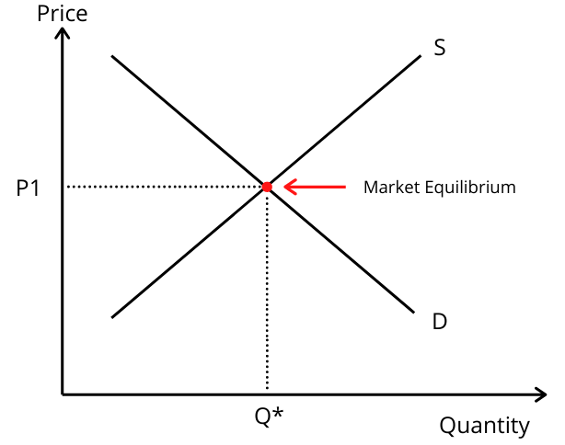

Slide 5
Graphically, the point of intersection between the demand and supply curves
What happens there? NOTHING, that’s why it is called equilibrium
Using physics jargon, the system is in equilibrium, all forces cancel each other out, and nothing changes.
Hence in eqm: ΔQs = ΔQd = ΔP = 0.

Slide 6
How does the system work if it is in disequilibrium?
Suppose the price is too high (relatively to the eqm price)
Then, we observe excess supply (demand is too low relatively to the supply)
The system in order to return to its equilibrium state, starts making some adjustments:
The price starts falling, and as this happens, quantity demanded starts increasing, while quantity supplied starts dropping
Mathematically, ΔQs < 0 , ΔQd > 0, ΔP <0
The exact opposite would happen if the price was too low

Slide 7
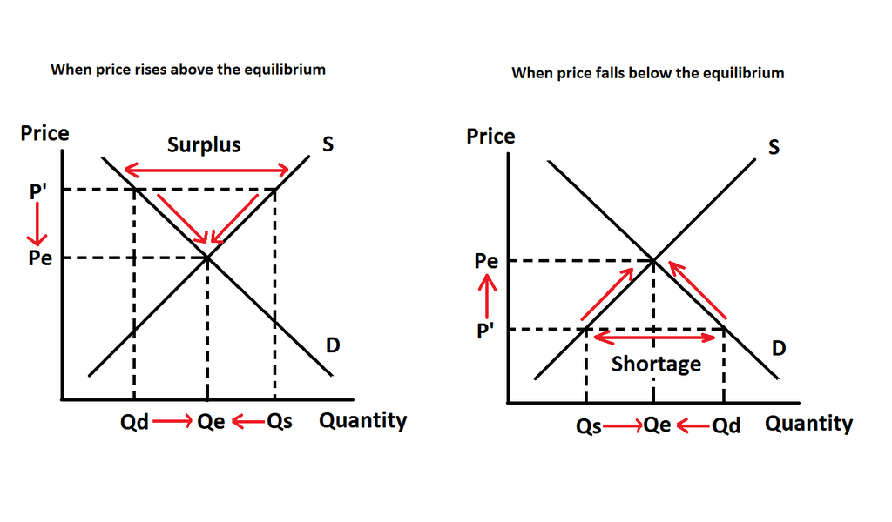

Slide 8
So, we observe that the system develops some dynamics, with the variables involved making an adjustment so as the system to reach the eqm
The eqm behaves as an attractor (if we are away from eqm, there are forces developed, which make an attempt to bring the system back to equilibrium)
So the system might be occasionally (in fact quite often) in disequilibrium, even for quite some time, but if the eqm is meaningful there are will an observed dynamic adjustment towards eqm

Slide 9
Cointegration: the econometrics of it and its implications
Assume two time series, each of which is I(1) **non-stationary
In principle, their linear combination will also be non-stationary
If however, there exists a linear combination that is stationary, then the series are cointegrated, and vice versa,
If two series are cointegrated, there exists a linear combination of them that is stationary
If the series are cointegrated, then there is a long run relationship between them (and vice versa)
Hence, their co-behaviour will be such that deviations from their long run relationship should be eliminated

Slide 10
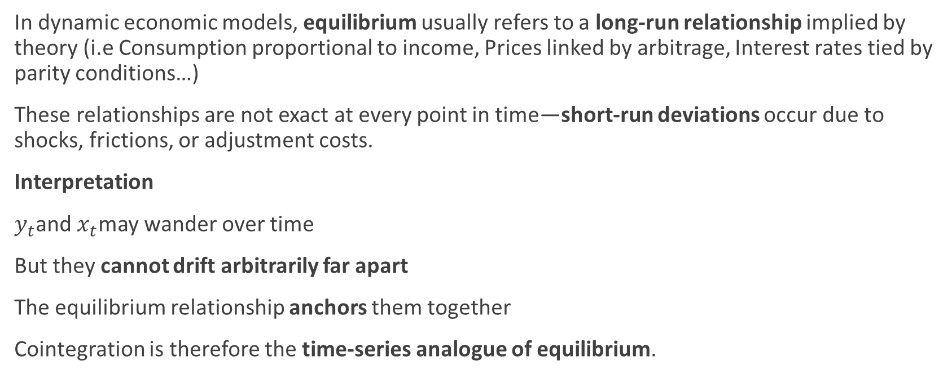
Cointegration and Equilibrium (chatgpt)
In dynamic economic models, equilibrium usually refers to a long-run relationship implied by theory (i.e Consumption proportional to income, Prices linked by arbitrage, Interest rates tied by parity conditions…)
These relationships are not exact at every point in time—short-run deviations occur due to shocks, frictions, or adjustment costs.
Interpretation
$y_{t}$and $x_{t}$may wander over time
But they cannot drift arbitrarily far apart
The equilibrium relationship anchors them together
Cointegration is therefore the time-series analogue of equilibrium.

Slide 11
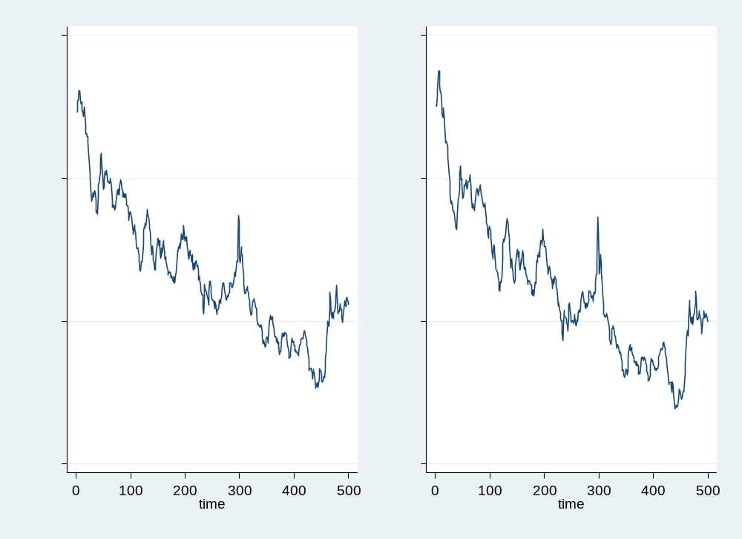
Individual behaviors, typical I(1)

Slide 12
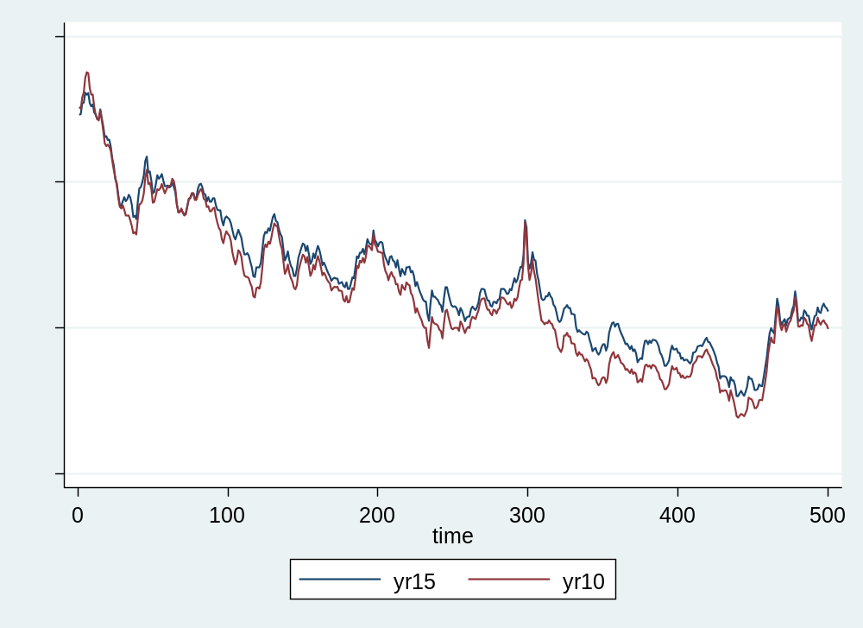
But looking at their joint behavior…

Slide 13
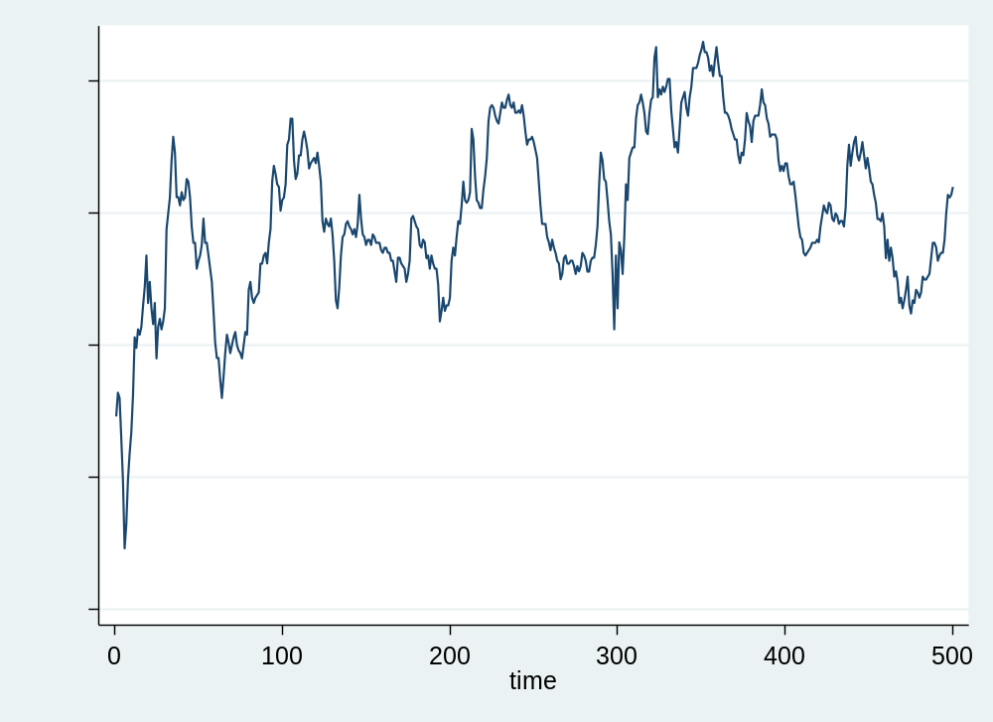
Behavior of ‘disequilibrium’

Slide 14
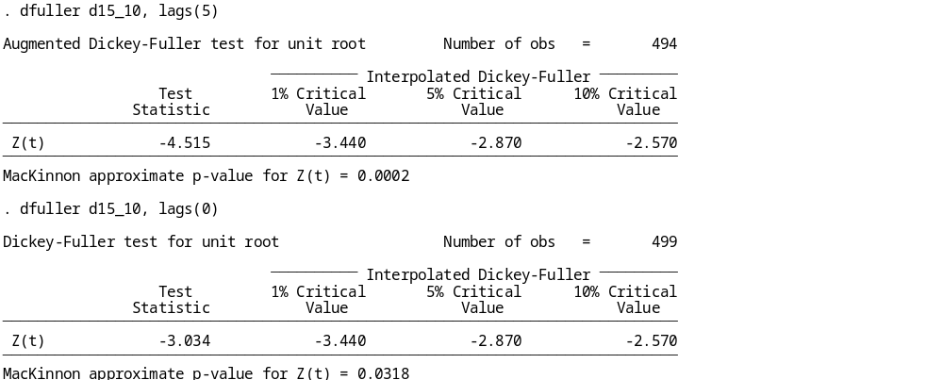
Stationarity of ‘disequilibrium’

Slide 15
Consider two time series, Y_{t} and X_{t}
If both are stationary, I(0), then OLS is appropriate
If they have different orders of integration, then they cannot be related (since one has stable time properties and the other has properties that change overtime///hence to be related would be a contradiction in terms)
The interesting case is if both are I(1) ***that is each one of them is non-stationary

Slide 16
In principle any linear combination of non-stationary time series will also be non-stationary
So a model of the form Y_{t} = α + β* X_{t} + u, which implies a linear combination of the two series (Y_{t} - α - β* X_{t} ), will generate a non-stationary outcome
IF HOWEVER A LINEAR COMBINATION EXISTS THAT IS STATIONARY, THEN THE TWO SERIES ARE SAID TO BE COINTEGRATED

Slide 17
Note the following:
If two time series are NOT COINTEGRATED, then they can have a relationship only in the short run (in terms of their Δs)
If two time series ARE COINTEGRATED, then they are linked by a long run relationship (that is their levels are also related)

Slide 18
How can we test that?
Recall the original model Y_{t} = α + β* X_{t} + u, and the linear combination of the two series (Y_{t} - α - β* X_{t} ) which is equal to u
The initial testing procedure for cointegration was proposed by Engle and Granger, and is called Engle-Granger 2-step method

Slide 19
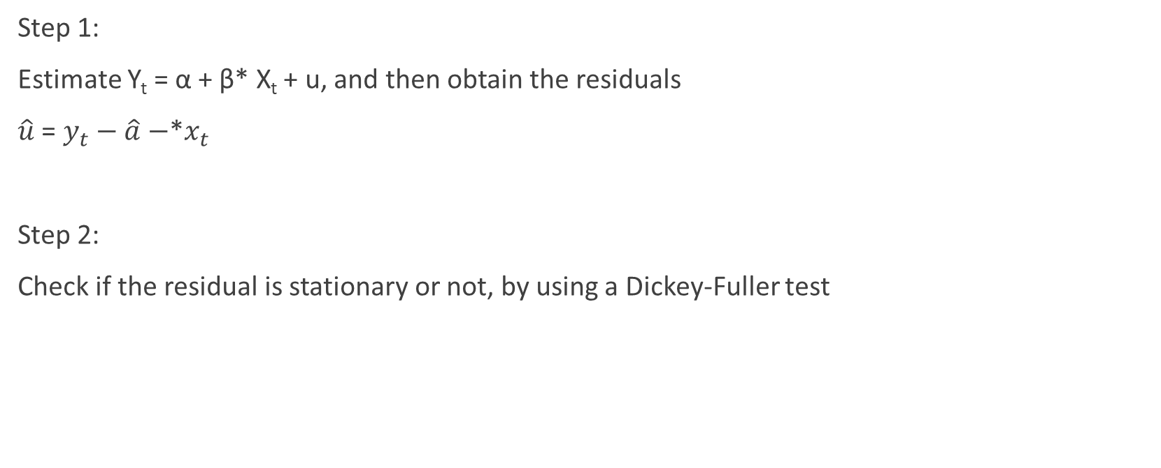
The Engle-Granger 2-step method
Step 1:
Estimate Y_{t} = α + β* X_{t} + u, and then obtain the residuals
$\hat{u}$ = $y_{t}−\hat{a}−$*$x_{t}$
Step 2:
Check if the residual is stationary or not, by using a Dickey-Fuller test

Slide 20
From step 2, there are only two possible outcomes:
Outcome 1: The residuals are non-stationary, which implies that the linear combination from which they were generated was also non-stationary. Hence, Y_{t} and X_{t} ARE NOT COINTEGRATED
Outcome 2: The residuals are stationary, which implies that the linear combination from which they were generated was also stationary. Hence, Y_{t} and X_{t} ARE NOT COINTEGRATED
How to proceed with modelling depends on which outcome we encounter
Below I will provide a roadmap of how one should proceed

Slide 21
The Engle-Granger Representation Theorem

Slide 22
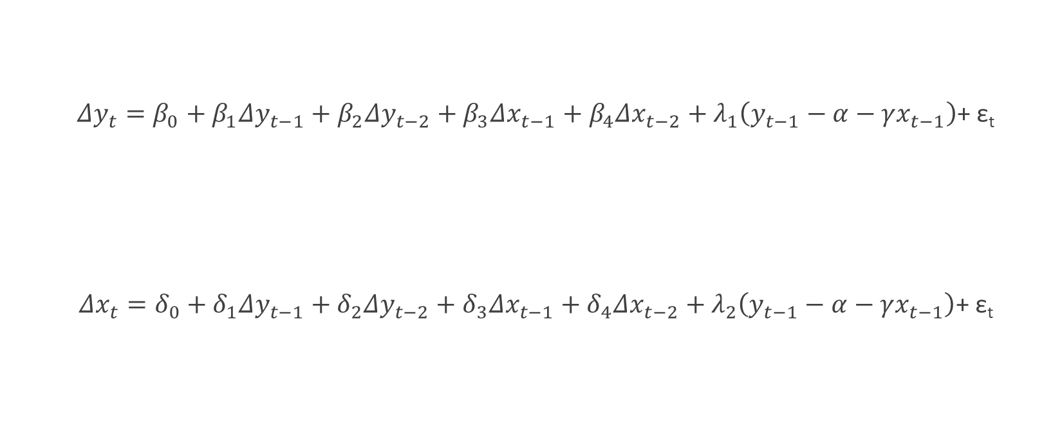
A bivariate case with 2 lags
$Δy_{t}=β_{0}+β_{1}Δy_{t−1}+β_{2}Δy_{t−2}+β_{3}Δx_{t−1}+β_{4}Δx_{t−2}+λ_{1}\left(y_{t−1}−α−γx_{t−1}\right)$+ ε_{t}
$Δx_{t}=δ_{0}+δ_{1}Δy_{t−1}+δ_{2}Δy_{t−2}+δ_{3}Δx_{t−1}+δ_{4}Δx_{t−2}+λ_{2}\left(y_{t−1}−α−γx_{t−1}\right)$+ ε_{t}

Slide 23
Y, X both non-stationary
Y and X
Not cointegrated
Estimate model in first differences:
ΔY = γ + δ*ΔX + ε
Y and X are cointegrated
Estimate
ΔY = γ + δ*ΔX + λ*(Y_{t-1} –α – γ*X_{t-1}) +ε

Slide 24
(Y_{t-1} –α –γ*X_{t-1}) is called Error Correction Mechanism (ECM) and captures the distance from the equilibrium to which the variable must respond to
λ is called Speed-of-Adjustment and captures the speed with which the dependent variable moves (since it is in Δ) in order to restore statistical equilibrium
In fact, 1 / abs(λ), measures how many periods it takes until the system goes back to equilibrium
For instance, if λ = 0.2, then 1 / 0.2 = 5
If your data in monthly (daily) frequency, then any deviation from equilibrium takes on average 5 months (days) to be eliminated

Slide 25
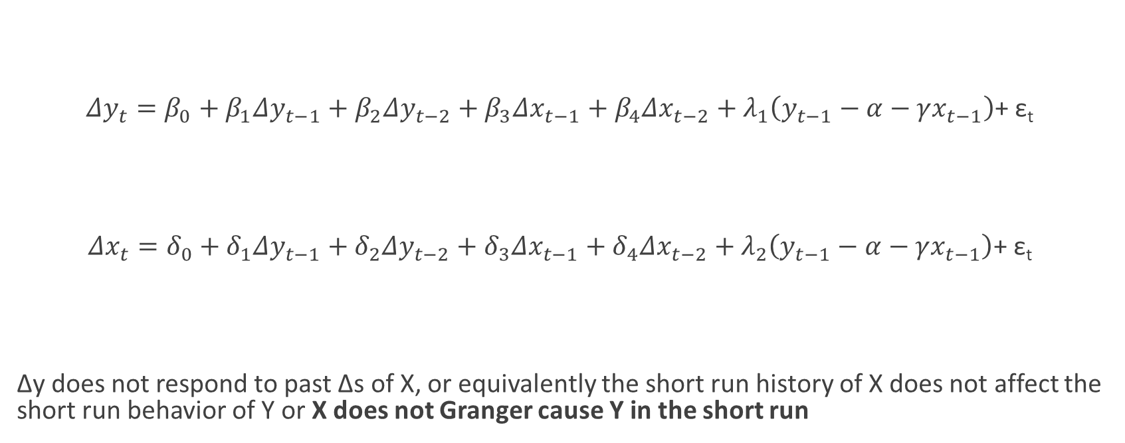

Both Series are I(1) and cointegrated. What If β₃=β₄=0?
$Δy_{t}=β_{0}+β_{1}Δy_{t−1}+β_{2}Δy_{t−2}+β_{3}Δx_{t−1}+β_{4}Δx_{t−2}+λ_{1}\left(y_{t−1}−α−γx_{t−1}\right)$+ ε_{t}
$Δx_{t}=δ_{0}+δ_{1}Δy_{t−1}+δ_{2}Δy_{t−2}+δ_{3}Δx_{t−1}+δ_{4}Δx_{t−2}+λ_{2}\left(y_{t−1}−α−γx_{t−1}\right)$+ ε_{t}
Δy does not respond to past Δs of X, or equivalently the short run history of X does not affect the short run behavior of Y or X does not Granger cause Y in the short run

Slide 26

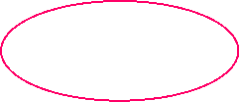
Both Series are I(1) and cointegrated. What If δ₁=δ₂=0?
$Δy_{t}=β_{0}+β_{1}Δy_{t−1}+β_{2}Δy_{t−2}+β_{3}Δx_{t−1}+β_{4}Δx_{t−2}+λ_{1}\left(y_{t−1}−α−γx_{t−1}\right)$+ ε_{t}
$Δx_{t}=δ_{0}+δ_{1}Δy_{t−1}+δ_{2}Δy_{t−2}+δ_{3}Δx_{t−1}+δ_{4}Δx_{t−2}+λ_{2}\left(y_{t−1}−α−γx_{t−1}\right)$+ ε_{t}
ΔX does not respond to past Δs of Y, or equivalently the short run history of Y does not affect the short run behavior of X or Y does not Granger cause X in the short run

Slide 27
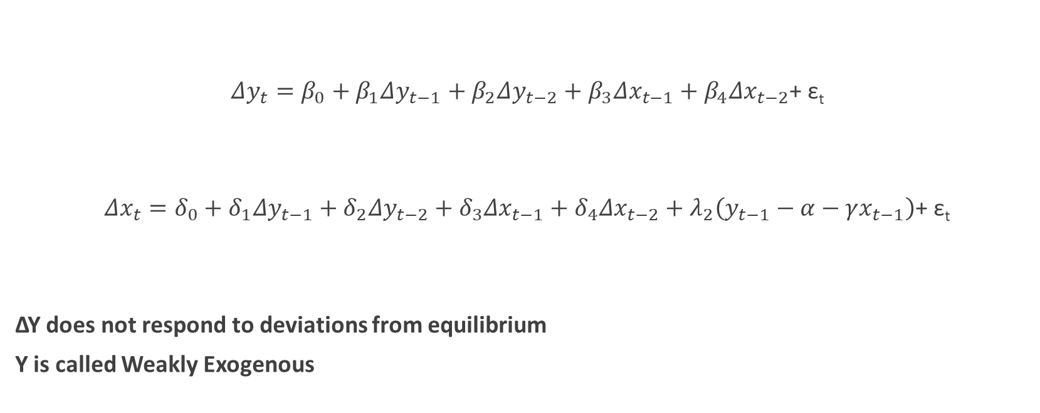
Both Series are I(1) and cointegrated. What If λ₁=0?
$Δy_{t}=β_{0}+β_{1}Δy_{t−1}+β_{2}Δy_{t−2}+β_{3}Δx_{t−1}+β_{4}Δx_{t−2}$+ ε_{t}
$Δx_{t}=δ_{0}+δ_{1}Δy_{t−1}+δ_{2}Δy_{t−2}+δ_{3}Δx_{t−1}+δ_{4}Δx_{t−2}+λ_{2}\left(y_{t−1}−α−γx_{t−1}\right)$+ ε_{t}
ΔΥ does not respond to deviations from equilibrium
Y is called Weakly Exogenous

Slide 28
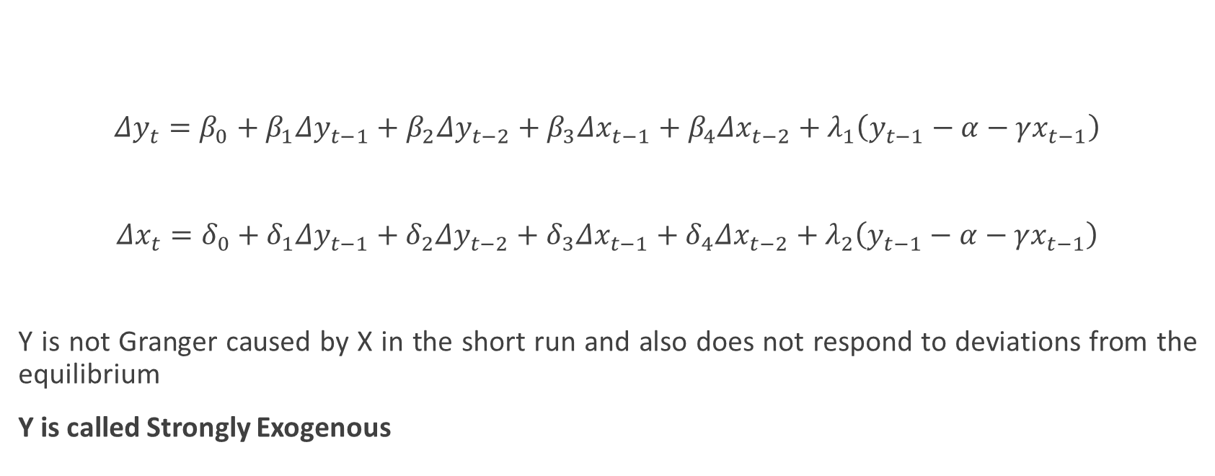


Series are I(1) and cointegrated. What If β₃=β₄=0 and λ₁=0?
$Δy_{t}=β_{0}+β_{1}Δy_{t−1}+β_{2}Δy_{t−2}+β_{3}Δx_{t−1}+β_{4}Δx_{t−2}+λ_{1}\left(y_{t−1}−α−γx_{t−1}\right)$
$Δx_{t}=δ_{0}+δ_{1}Δy_{t−1}+δ_{2}Δy_{t−2}+δ_{3}Δx_{t−1}+δ_{4}Δx_{t−2}+λ_{2}\left(y_{t−1}−α−γx_{t−1}\right)$
Y is not Granger caused by X in the short run and also does not respond to deviations from the equilibrium
Y is called Strongly Exogenous

Slide 29
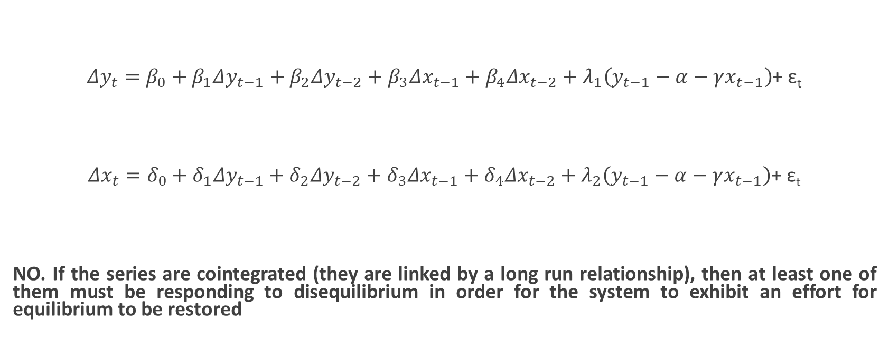
Series are cointegrated. Can λ₁ and λ₂ be zero at the same time?
$Δy_{t}=β_{0}+β_{1}Δy_{t−1}+β_{2}Δy_{t−2}+β_{3}Δx_{t−1}+β_{4}Δx_{t−2}+λ_{1}\left(y_{t−1}−α−γx_{t−1}\right)$+ ε_{t}
$Δx_{t}=δ_{0}+δ_{1}Δy_{t−1}+δ_{2}Δy_{t−2}+δ_{3}Δx_{t−1}+δ_{4}Δx_{t−2}+λ_{2}\left(y_{t−1}−α−γx_{t−1}\right)$+ ε_{t}
NO. If the series are cointegrated (they are linked by a long run relationship), then at least one of them must be responding to disequilibrium in order for the system to exhibit an effort for equilibrium to be restored

Slide 30
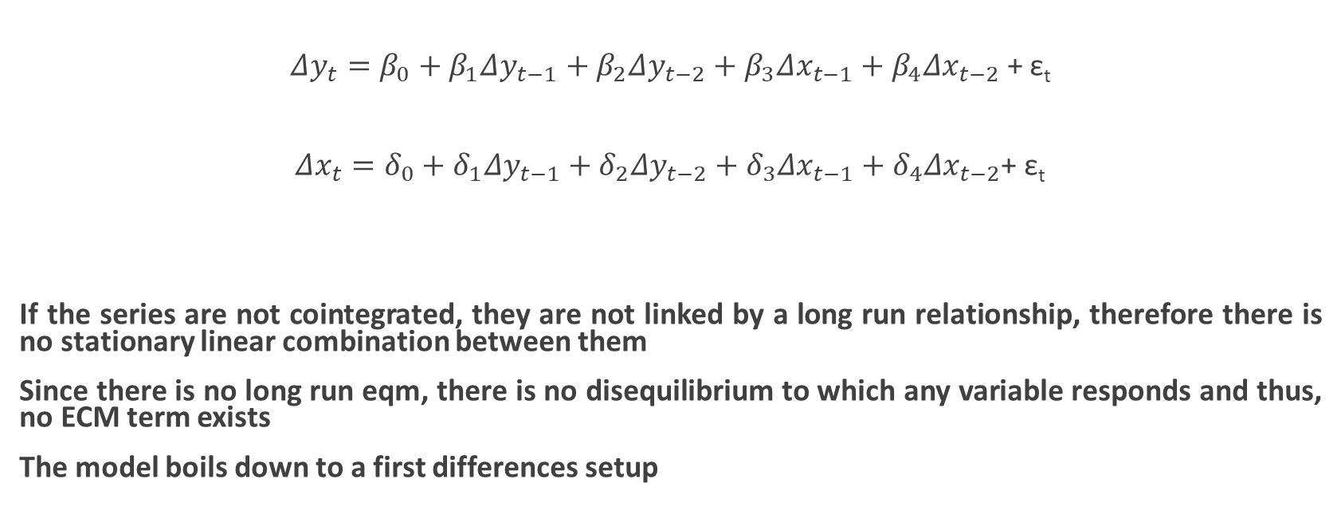
What If both series are I(1) but not cointegrated?
$Δy_{t}=β_{0}+β_{1}Δy_{t−1}+β_{2}Δy_{t−2}+β_{3}Δx_{t−1}+β_{4}Δx_{t−2}$ + ε_{t}
$Δx_{t}=δ_{0}+δ_{1}Δy_{t−1}+δ_{2}Δy_{t−2}+δ_{3}Δx_{t−1}+δ_{4}Δx_{t−2}$+ ε_{t}
If the series are not cointegrated, they are not linked by a long run relationship, therefore there is no stationary linear combination between them
Since there is no long run eqm, there is no disequilibrium to which any variable responds and thus, no ECM term exists
The model boils down to a first differences setup

Slide 31
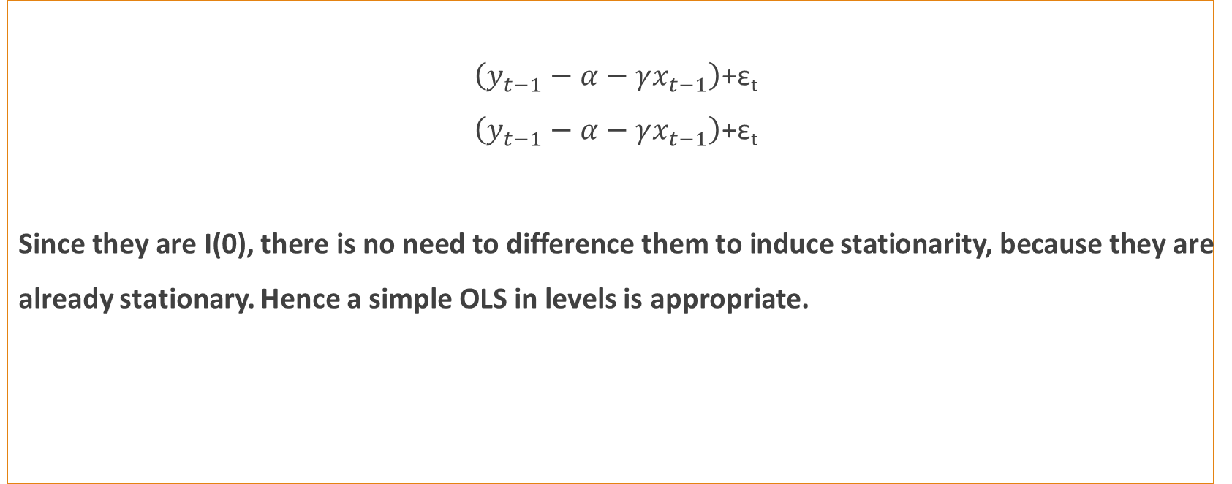
What If both series are I(0)?
$\left(y_{t−1}−α−γx_{t−1}\right)$+ε_{t}
$\left(y_{t−1}−α−γx_{t−1}\right)$+ε_{t}
Since they are I(0), there is no need to difference them to induce stationarity, because they are already stationary. Hence a simple OLS in levels is appropriate.

Slide 32
Engle-Granger 2-step method for 15 year vs 10 year corporate bond yields

Slide 33
