Slide 1
Time Series data: uncovering their fundamental properties

Slide 2
Stationarity vs Non-Stationarity
Every time series variable is classified either as STATIONARY or NON-STATIONARY
Strong STATIONARITY: all properties of the data generating process remain constant overtime
Weak STATIONARITY: the mean and the variance of the variable remain constant overtime
NON-STATIONARITY: properties change overtime

Slide 3
The AutoRegressive 1, AR(1) model
The AR(1) is the main playing field, based on its properties we decide whether the series is stationary or not
AR(1) with no drift:
y_{t} = φy_{t-1} + u_{t}

Slide 4
The Impact of Shocks
y_{t} = φy_{t-1} + u_{t}
Let φ take any value for now.
We can write: y_{t-1} = φy_{t-2} + u_{t-1}
y_{t-2} = φy_{t-3} + u_{t-2}
Substituting yields: y_{t} = φ(φy_{t-2} + u_{t-1}) + u_{t}
= φ²y_{t-2} + φu_{t-1} + u_{t}
Substituting again for y_{t-2}: y_{t} = φ²(φy_{t-3} + u_{t-2}) + φu_{t-1} + u_{t}
= φ³ y_{t-3} + φ²u_{t-2} + φu_{t-1} + u_{t}
T successive substitutions of this type lead to:
y_{t} = φ^{T} y₀ + φu_{t-1} + φ²u_{t-2} + φ³u_{t-3} + ...+ φ^{T}u₀ + u_{t}
K. Drakos
4

Slide 5
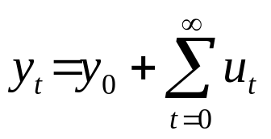
The Impact of Shocks for
Stationary and Non-stationary Series
We have 3 cases:
1. φ<1 ⇒ φ^{T}→0 as T→∞
So the shocks to the system gradually die away.
2. φ=1 ⇒ φ^{T} =1∀ T
So shocks persist in the system and never die away. We obtain:
as T→∞
So just an infinite sum of past shocks plus some starting value of y₀.
3. φ>1. Now given shocks become more influential as time goes on, since if φ>1, φ³>φ²>φ etc.
K. Drakos
5

Slide 6
6
For a time series {X_{t}} we define as autocovariance (ACV) of k-order the quantity:
Cov(X_{t}, X_{t+k}) = E[(X_{t} - μ) (X_{t+k} - μ)] = γ_{k} , k = ±1, ±2
The term "auto" is prefixed because the members of the series are generated from the same stochastic process. The ACV function is an even function of k. that is because:
Cov(X_{t}, X_{t+k}) = Cov(X_{t+k}, X_{t}) = Cov(X_{t}, X_{t-k}) = γ-_{k}
Obviously, γ₀ = Cov(X_{t}, X_{t}) = Var(X_{t})

Slide 7
7
Positive first-order autocovariance means that there is a tendency for the next observation to be towards the same side (sign) as the previous one with respect to the mean.
For a time series {X_{t}} we define as autocorrelation (ACR) of k-order the quantity: ρ_{k}
The graph of ρ_{k} is called correlogram.
Because γ_{k} = γ-_{k} it can be shown that ρ_{k} = ρ-_{k}
Obviously the ACR function has the same properties with the ACV function, and furthermore satisfies the condition ρ₀ =1
Note that the autocorrelation function is dimensionless, that is, independent of the scale of measurement of the time series.
The correlogram of a stationary series will die out very fast, after the first k-lags, whereas in the case of a non-stationary series it will be very persistent, and die out very slowly.

Slide 8
y_{t} = y_{t-1} + u_{t}
Random Walk

Slide 9
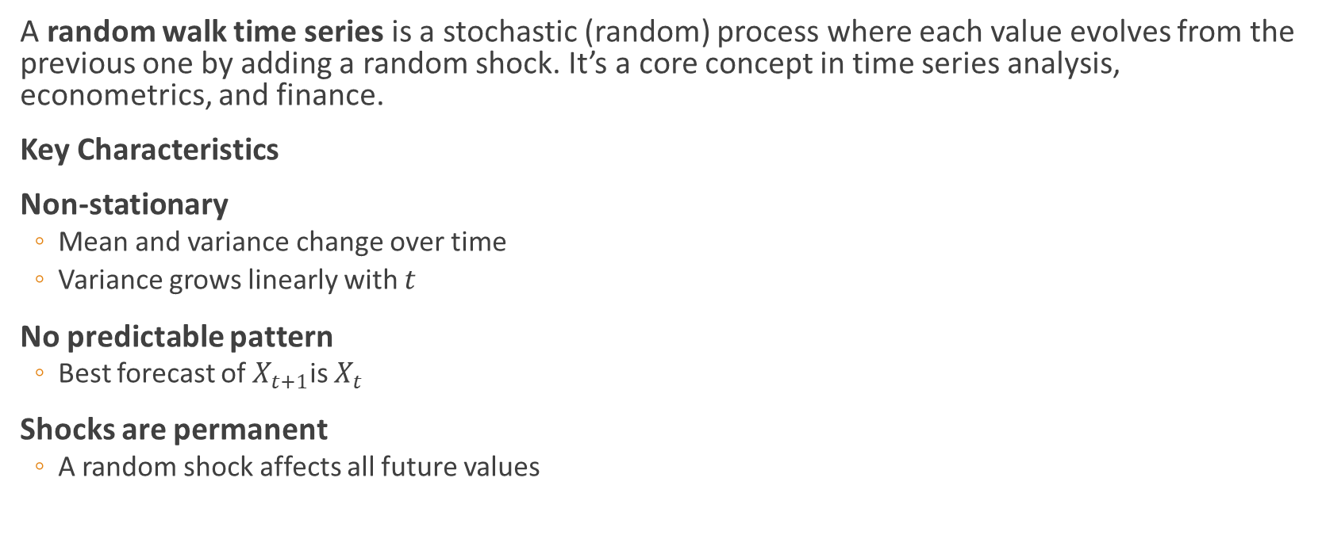
Random walk (chatgpt)
A random walk time series is a stochastic (random) process where each value evolves from the previous one by adding a random shock. It’s a core concept in time series analysis, econometrics, and finance.
Key Characteristics
Non-stationary
  Mean and variance change over time
  Variance grows linearly with $t$
No predictable pattern
  Best forecast of $X_{t+1}$is $X_{t}$
Shocks are permanent
  A random shock affects all future values

Slide 10
(chatgpt) Here are the key implications of a random walk time series, especially in analysis, forecasting, and modeling:
Best forecast = last observed value
Forecast errors grow with horizon
Long-term forecasts are highly uncertain
Adding more past data does not improve long-run prediction accuracy
Implication: Random walks are essentially unpredictable beyond the current value.
Mean and variance change over time, standard regression assumption fail, regression gives misleading results

Slide 11
How can we identify non-stationary time series?
Basically, there are three layers for such identification, which successively become more formal
Layer 1: observe and assess the time series graph (look for manifestation of changing properties overtime)
Layer 2: calculate the correlogram of the time series (look for the size of persistence)
Layer 3: conduct a unit root test

Slide 12

Layer 1: time series graph

Slide 13
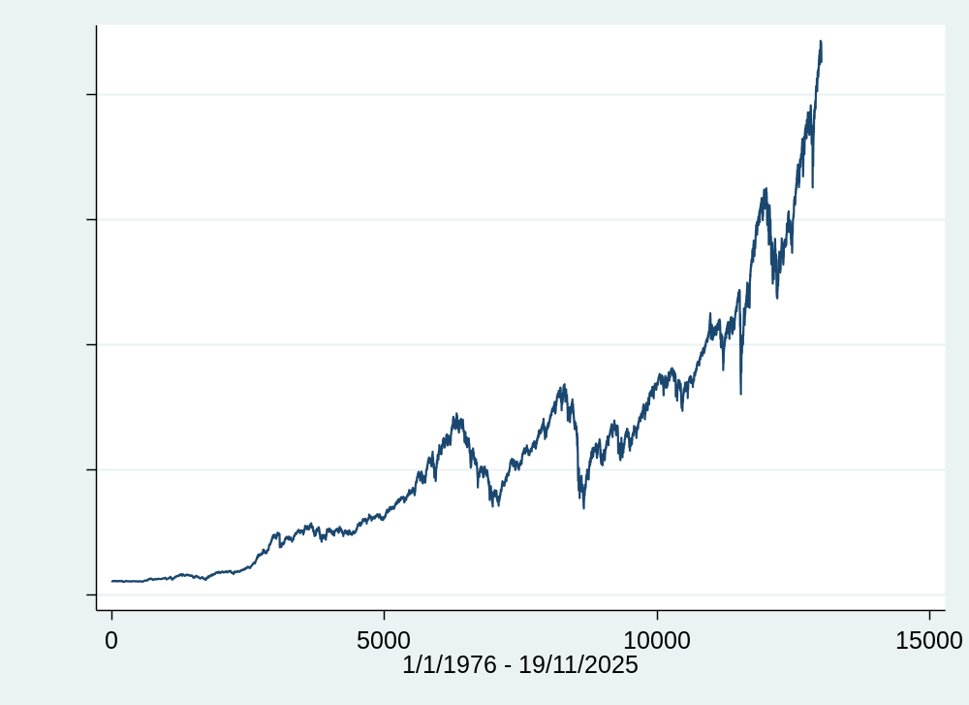

Slide 14
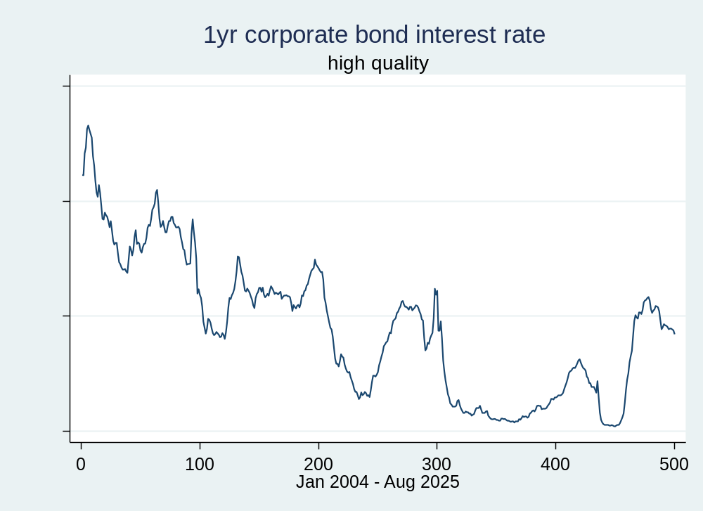

Slide 15
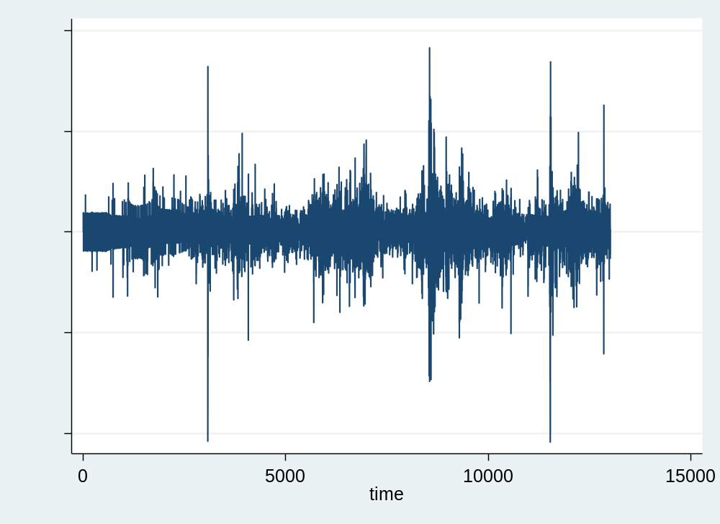

Slide 16
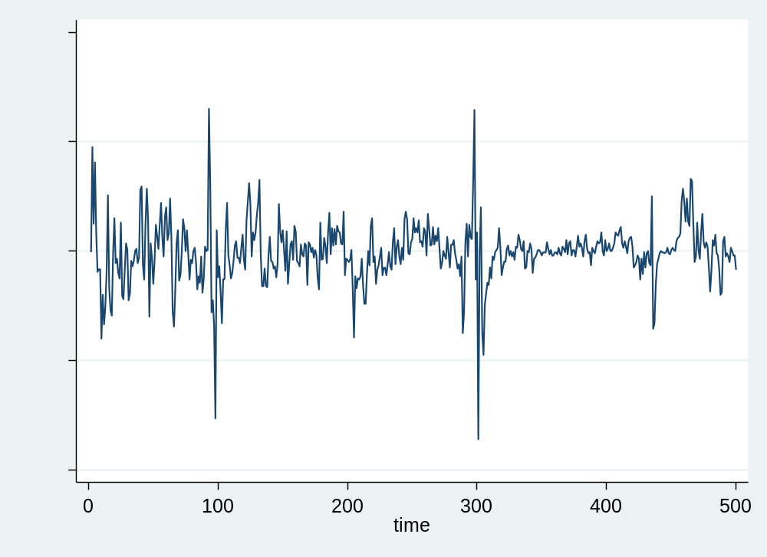

Slide 17

Layer 2: calculate the correlogram of the time series

Slide 18
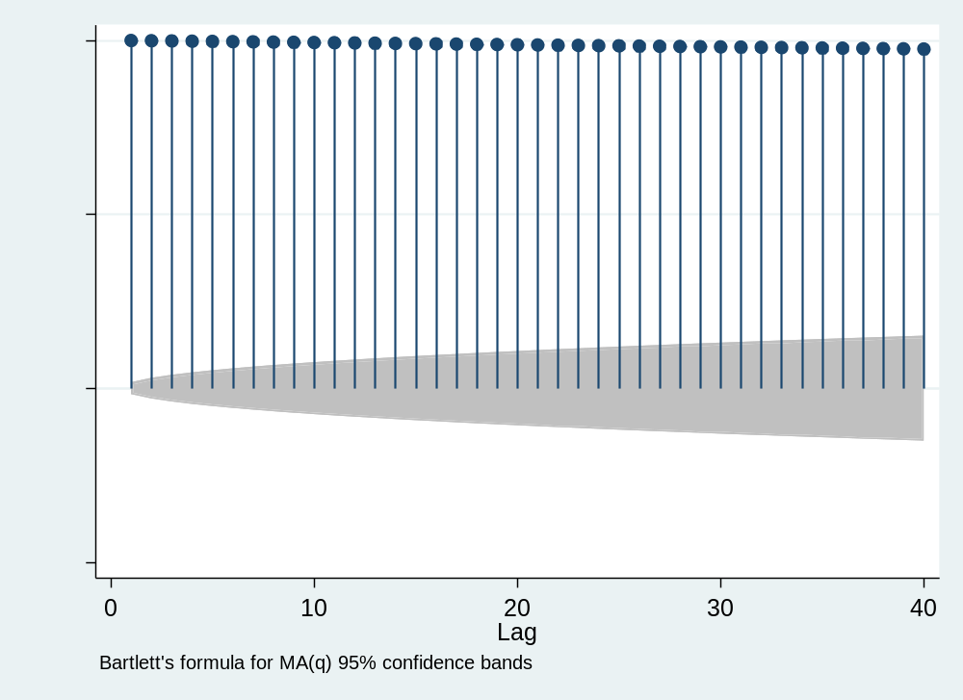

Slide 19
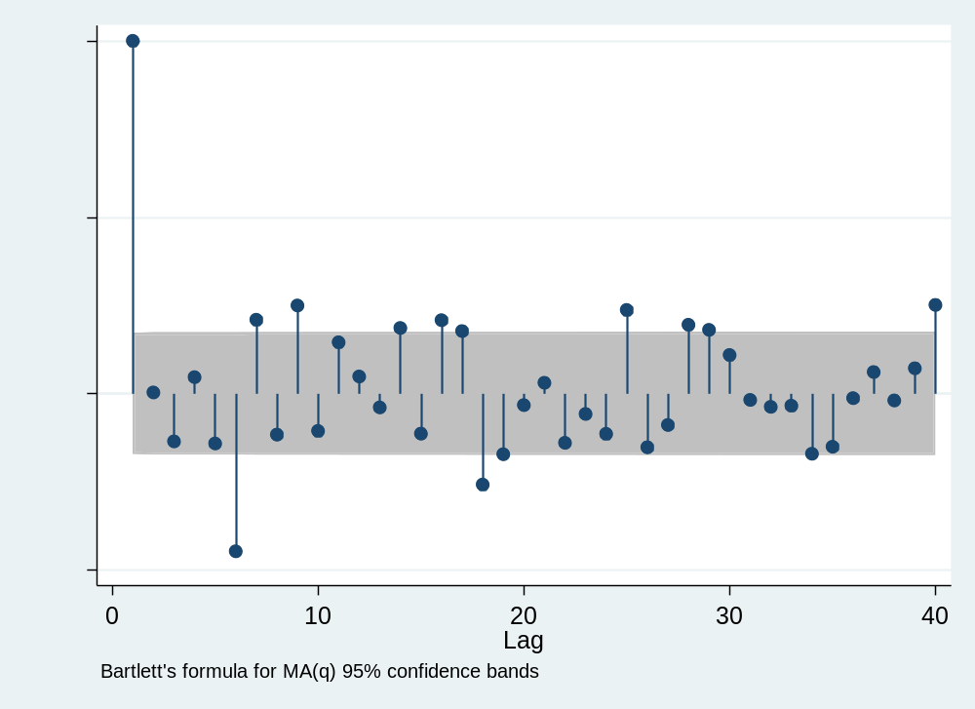

Slide 20
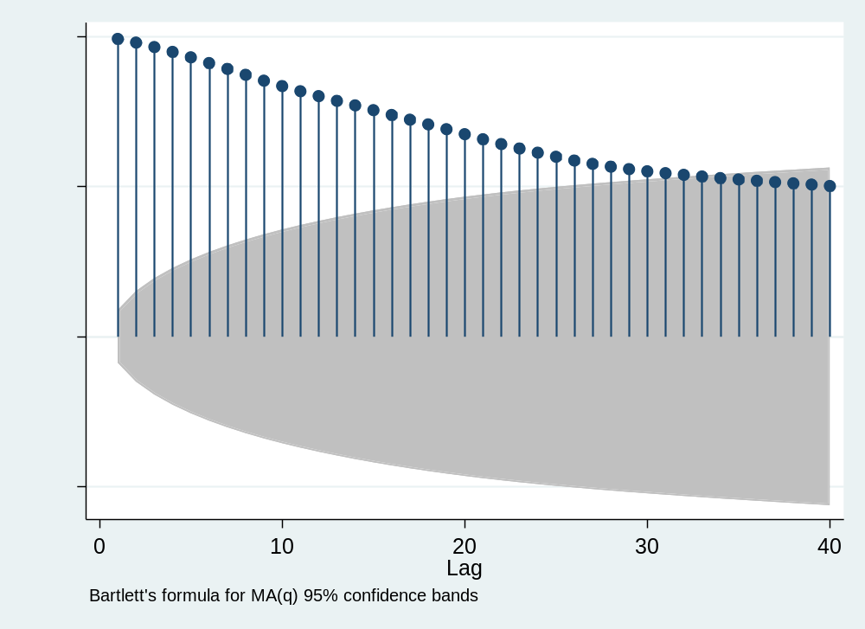

Slide 21
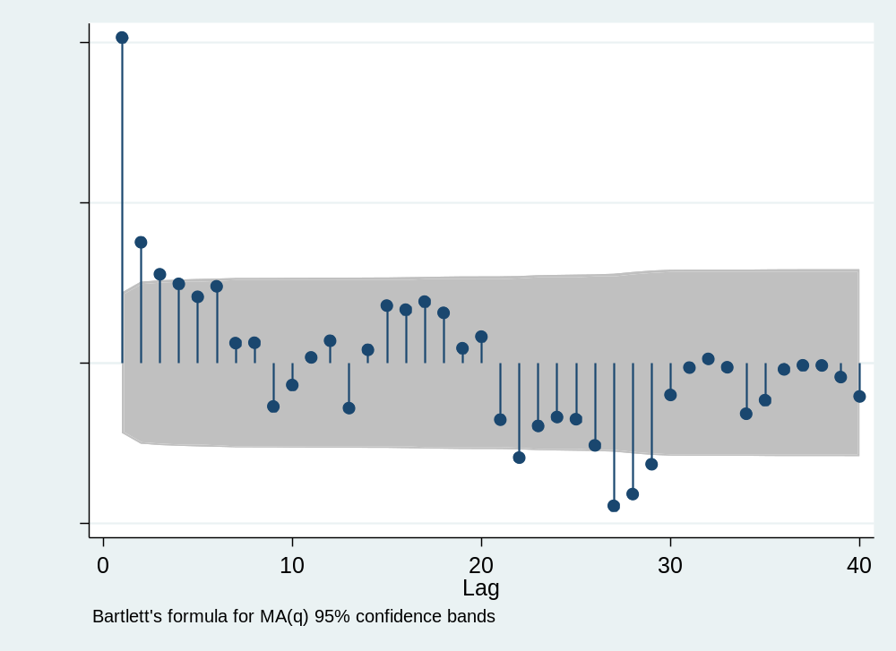

Slide 22

Layer 3: unit root testing

Slide 23
How do we test for a unit root?
The early and pioneering work on testing for a unit root in time series was done by Dickey and Fuller (Dickey and Fuller 1979, Fuller 1976). The basic objective of the test is to test the null hypothesis that φ =1 in:
y_{t} = φy_{t-1} + u_{t}
against the one-sided alternative φ <1. So we have
H₀: series contains a unit root
vs. H₁: series is stationary.
We usually use the regression:
Δy_{t} = ψy_{t-1} + u_{t}
so that a test of φ=1 is equivalent to a test of ψ=0 (since φ-1=ψ).
K. Drakos
23

Slide 24
Different forms for the DF Test Regressions
Dickey Fuller tests are also known as τ tests: τ, τ_{μ}, τ_{τ}.
The null (H₀) and alternative (H₁) models in each case are
i) H₀: y_{t} = y_{t-1}+u_{t}
H₁: y_{t} = φy_{t-1}+u_{t}, φ<1
This is a test for a random walk against a stationary autoregressive process of order one (AR(1))
ii) H₀: y_{t} = y_{t-1}+u_{t}
H₁: y_{t} = φy_{t-1}+μ+u_{t}, φ<1
This is a test for a random walk against a stationary AR(1) with drift.
iii) H₀: y_{t} = y_{t-1}+u_{t}
H₁: y_{t} = φy_{t-1}+μ+λt+u_{t}, φ<1
This is a test for a random walk against a stationary AR(1) with drift and a time trend.
K. Drakos
24

Slide 25
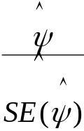
Computing the DF Test Statistic
We can write
Δy_{t}=u_{t}
where Δy_{t} = y_{t}- y_{t-1}, and the alternatives may be expressed as
Δy_{t} = ψy_{t-1}+μ+λt +u_{t}
with μ=λ=0 in case i), and λ=0 in case ii) and ψ=φ-1. In each case, the tests are based on the t-ratio on the y_{t-1} term in the estimated regression of Δy_{t} on y_{t-1}, plus a constant in case ii) and a constant and trend in case iii). The test statistics are defined as
test statistic =
The test statistic does not follow the usual t-distribution under the null, since the null is one of non-stationarity, but rather follows a non-standard distribution. Critical values are derived from Monte Carlo experiments in, for example, Fuller (1976). Relevant examples of the distribution are shown in table 4.1 below
K. Drakos
25

Slide 26
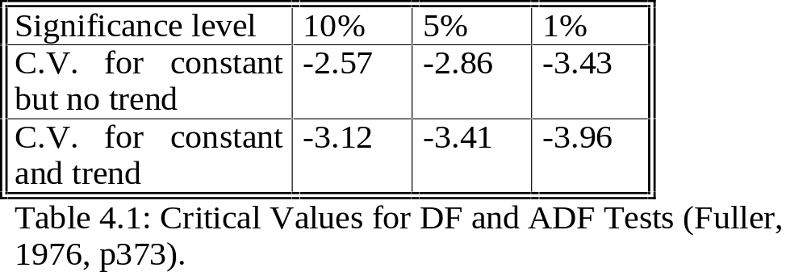
Critical Values for the DF Test
The null hypothesis of a unit root is rejected in favour of the stationary alternative
in each case if the test statistic is more negative than the critical value.
K. Drakos
26

Slide 27
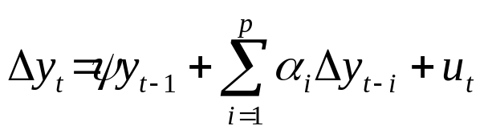
The Augmented Dickey Fuller (ADF) Test
The tests above are only valid if u_{t} is white noise. In particular, u_{t} will be autocorrelated if there was autocorrelation in the dependent variable of the regression (Δy_{t}) which we have not modelled. The solution is to “augment” the test using p lags of the dependent variable. The alternative model in case (i) is now written:
The same critical values from the DF tables are used as before. A problem now arises in determining the optimal number of lags of the dependent variable.
There are 2 ways
- use the frequency of the data to decide
- use information criteria
K. Drakos
27

Slide 28
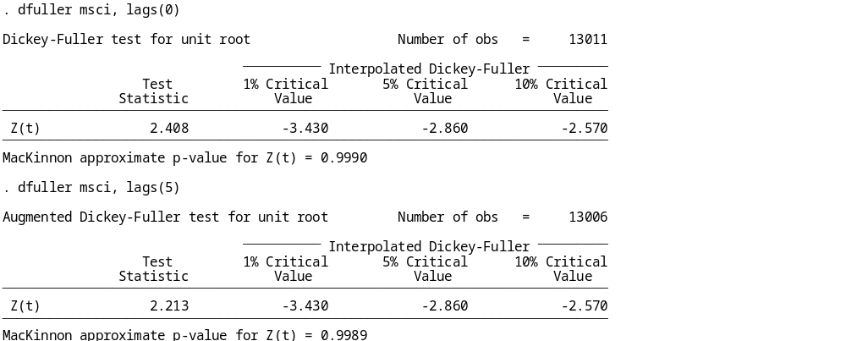

Slide 29
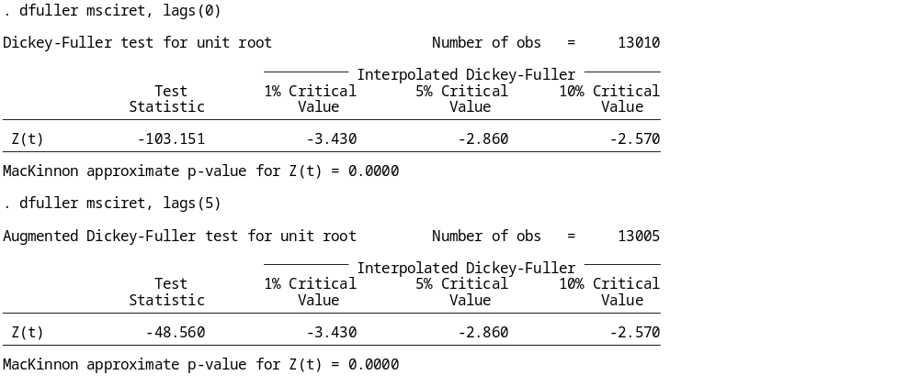

Slide 30
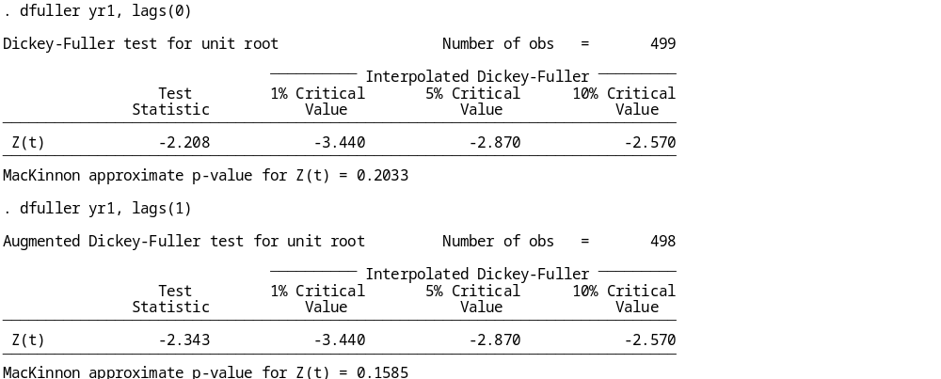

Slide 31
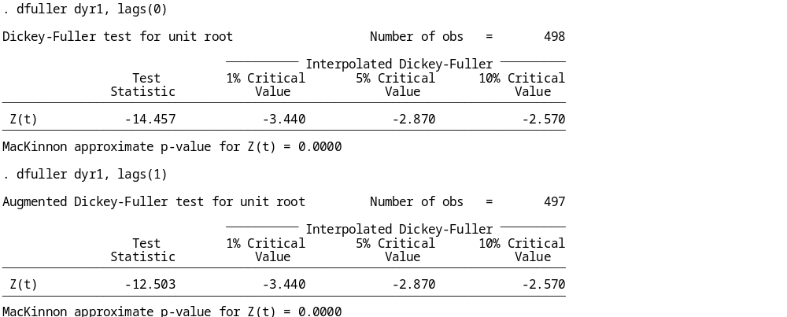

Slide 32
Testing for Higher Orders of Integration
Consider the simple regression:
Δy_{t} = ψy_{t-1} + u_{t}
We test H₀: ψ=0 vs. H₁: ψ<0.
If H₀ is rejected we simply conclude that y_{t} does not contain a unit root.
But what do we conclude if H₀ is not rejected? The series contains a unit root, but is that it? No! What if y_{t}∼I(2)? We would still not have rejected. So we now need to test
H₀: y_{t}∼I(2) vs. H₁: y_{t}∼I(1)
We would continue to test for a further unit root until we rejected H₀.
We now regress Δ²y_{t} on Δy_{t-1} (plus lags of Δ²y_{t} if necessary).
Now we test H₀: Δy_{t}∼I(1) which is equivalent to H₀: y_{t}∼I(2).
So in this case, if we do not reject (unlikely), we conclude that y_{t} is at least I(2).
K. Drakos
32

Slide 33
Inducing stationarity
Going back to the Random walk with drift:
y_{t} = μ + y_{t-1} + u_{t}
If we let Δy_{t} = y_{t} - y_{t-1}
and L y_{t} = y_{t-1}
so (1-L) y_{t} = y_{t} - L y_{t} = y_{t} - y_{t-1}
If we take (1) and subtract y_{t-1} from both sides:
y_{t} - y_{t-1} = μ + u_{t}
Δy_{t} = μ + u_{t}
We say that we have induced stationarity by “differencing once”.
K. Drakos
33

Slide 34
Order of integration or I-ness
Consider again the simplest stochastic trend model:
y_{t} = y_{t-1} + u_{t}
or Δy_{t} = u_{t}
We can generalise this concept to consider the case where the series contains more than one “unit root”. That is, we would need to apply the first difference operator, Δ, more than once to induce stationarity.
Definition
If a non-stationary series, y_{t} must be differenced d times before it becomes stationary, then it is said to be integrated of order d. We write y_{t} ∼I(d).
So if y_{t} ∼ I(d) then Δ^{d}y_{t}∼ I(0).
An I(0) series is a stationary series
An I(1) series contains one unit root,
e.g. y_{t} = y_{t-1} + u_{t}
K. Drakos
34

Slide 35
Characteristics of I(0), I(1) and I(2) Series
An I(2) series contains two unit roots and so would require differencing twice to induce stationarity.
I(1) and I(2) series can wander a long way from their mean value and cross this mean value rarely.
I(0) series should cross the mean frequently.
The vast majority of economic and financial series contain a single unit root, although some are stationary and consumer prices (and in some cases exchange rates) have been argued to have 2 unit roots.
K. Drakos
35

