Slide 1
Time Varying Volatility Modelling

Slide 2
Motivation
the linear structural (and time series) models cannot explain a number of important features common to much financial data
- leptokurtosis
- volatility clustering or volatility pooling
- leverage effects
Our “traditional” structural model could be something like:
y_{t} = β₁ + β₂x_{2t} + ... + β_{k}x_{kt} + u_{t,} or more compactly y = Xβ + u
We also assumed that u_{t} ∼ N(0,σ²).

Slide 3
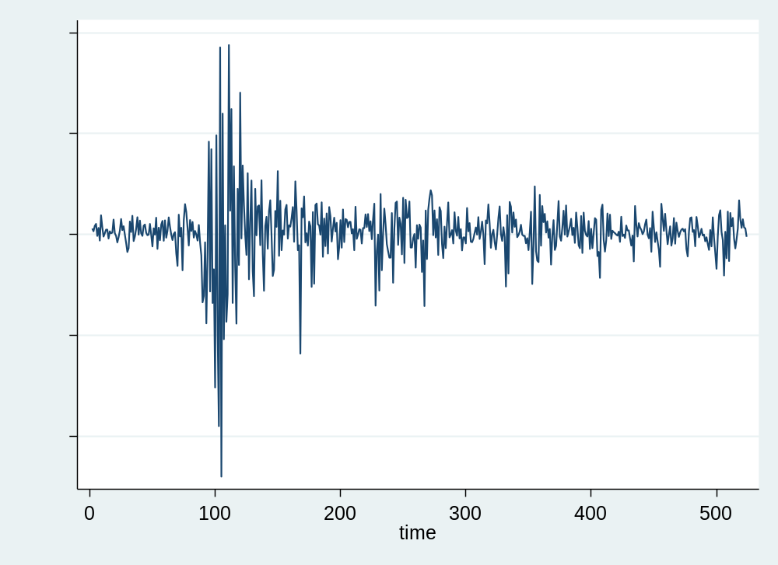

Slide 4
Models for Volatility
Modelling and forecasting stock market volatility has been the subject of vast empirical and theoretical investigation
There are a number of motivations for this line of inquiry:
  Volatility is one of the most important concepts in finance
  Volatility, as measured by the standard deviation or variance of returns, is often used as a crude measure of the total risk of financial assets
  Many value-at-risk models for measuring market risk require the estimation or forecast of a volatility parameter
  The volatility of stock market prices also enters directly into the Black–Scholes formula for deriving the prices of traded options
We will now examine several volatility models.

Slide 5
Historical Volatility
The simplest model for volatility is the historical estimate
Historical volatility simply involves calculating the variance (or standard deviation) of returns in the usual way over some historical period
This then becomes the volatility forecast for all future periods
Evidence suggests that the use of volatility predicted from more sophisticated time series models will lead to more accurate forecasts and option valuations
Historical volatility is still useful as a benchmark for comparing the forecasting ability of more complex time models

Slide 6

Heteroscedasticity Revisited
An example of a structural model is
with u_{t} ∼ N(0, ).
The assumption that the variance of the errors is constant is known as
homoscedasticity, i.e. Var (u_{t}) = .
What if the variance of the errors is not constant?
- heteroscedasticity
- would imply that standard error estimates could be wrong.
Is the variance of the errors likely to be constant over time? Not for financial data.

Slide 7


Autoregressive Conditionally Heteroscedastic
(ARCH) Models
So use a model which does not assume that the variance is constant.
Recall the definition of the variance of u_{t}:
= Var(u_{t}⏐ u_{t-1}, u_{t-2},...) = E[(u_{t}-E(u_{t}))²⏐ u_{t-1}, u_{t-2},...]
We usually assume that E(u_{t}) = 0
so = Var(u_{t} ⏐ u_{t-1}, u_{t-2},...) = E[u_{t}²⏐ u_{t-1}, u_{t-2},...].
What could the current value of the variance of the errors plausibly depend upon?
  Previous squared error terms.
This leads to the autoregressive conditionally heteroscedastic model for the variance of the errors:
= α₀ + α₁
This is known as an ARCH(1) model
The ARCH model due to Engle (1982) has proved very useful in finance.

Slide 8




Autoregressive Conditionally Heteroscedastic
(ARCH) Models (cont’d)
The full model would be
y_{t} = β₁ + β₂x_{2t} + ... + β_{k}x_{kt} + u_{t} , u_{t} ∼ N(0, )
where = α₀ + α₁
We can easily extend this to the general case where the error variance depends on q lags of squared errors:
= α₀ + α₁ +α₂ +...+α_{q}
This is an ARCH(q) model.
Instead of calling the variance , in the literature it is usually called h_{t}, so the model is
y_{t} = β₁ + β₂x_{2t} + ... + β_{k}x_{kt} + u_{t} , u_{t} ∼ N(0,h_{t})
where h_{t} = α₀ + α₁ +α₂ +...+α_{q}

Slide 9


Testing for “ARCH Effects”
1. First, run any postulated linear regression of the form given in the equation
above, e.g. y_{t} = β₁ + β₂x_{2t} + ... + β_{k}x_{kt} + u_{t}
saving the residuals, .
2. Then square the residuals, and regress them on q own lags to test for ARCH
of order q, i.e. run the regression
where v_{t} is iid.
Obtain R² from this regression
3. The test statistic is defined as TR² (the number of observations multiplied by the coefficient of multiple correlation) from the last regression, and is distributed as a χ²(q).

Slide 10
Testing for “ARCH Effects” (cont’d)
4. The null and alternative hypotheses are
H₀ : γ₁ = 0 and γ₂ = 0 and γ₃ = 0 and ... and γ_{q} = 0
H₁ : γ₁ ≠ 0 or γ₂ ≠ 0 or γ₃ ≠ 0 or ... or γ_{q} ≠ 0.
If the value of the test statistic is greater than the critical value from the χ² distribution, then reject the null hypothesis.
Note that the ARCH test is also sometimes applied directly to returns instead of the residuals from Stage 1 above.

Slide 11
Estimation of ARCH / GARCH Models
Since the model is no longer of the usual linear form, we cannot use OLS.
We use another technique known as maximum likelihood.
The method works by finding the most likely values of the parameters given the actual data.
More specifically, we form a log-likelihood function and maximise it.

Slide 12
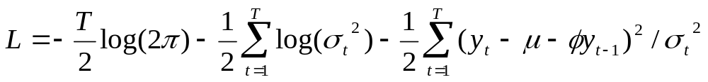
Estimation of ARCH / GARCH Models (cont’d)
The steps involved in actually estimating an ARCH or GARCH model are as follows
Specify the appropriate equations for the mean and the variance - e.g. an AR(1)- GARCH(1,1) model:
Specify the log-likelihood function to maximise:
3. The computer will maximise the function and give parameter values and their standard errors

Slide 13
Problems with ARCH(q) Models
How do we decide on q?
The required value of q might be very large
Non-negativity constraints might be violated.
  When we estimate an ARCH model, we require α_{i} >0 ∀ i=1,2,...,q (since variance cannot be negative)
A natural extension of an ARCH(q) model which gets around some of these problems is a GARCH model.

Slide 14
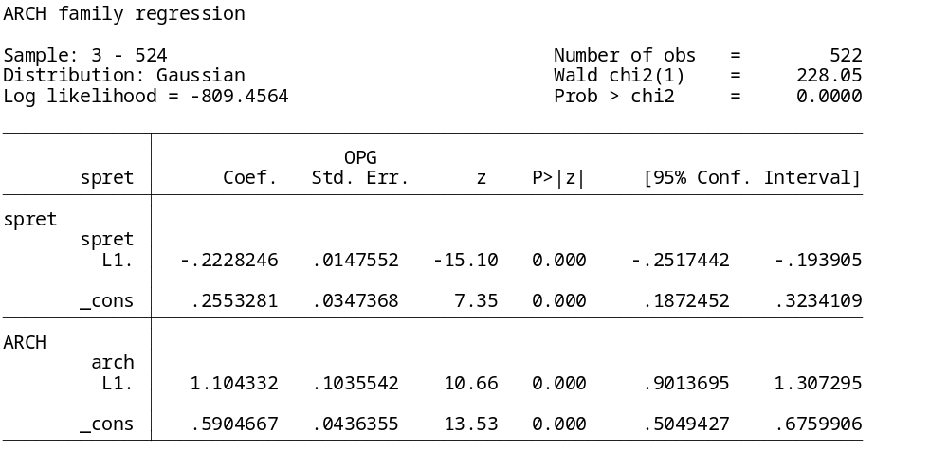


arch spret l.spret, arch(1/1)

Slide 15
Generalised ARCH (GARCH) Models
Due to Bollerslev (1986). Allow the conditional variance to be dependent upon previous own lags
The variance equation is now
(1)
This is a GARCH(1,1) model, which is like an ARMA(1,1) model for the variance equation.
We could also write
Substituting into (1) for σ_{t-1}² :

Slide 16
Generalised ARCH (GARCH) Models (cont’d)
Now substituting into (2) for σ_{t-2}²
An infinite number of successive substitutions would yield
So the GARCH(1,1) model can be written as an infinite order ARCH model.
We can again extend the GARCH(1,1) model to a GARCH(p,q):

Slide 17
Generalised ARCH (GARCH) Models (cont’d)
But in general a GARCH(1,1) model will be sufficient to capture the volatility clustering in the data.
Why is GARCH Better than ARCH?
- more parsimonious - avoids overfitting
- less likely to breech non-negativity constraints

Slide 18
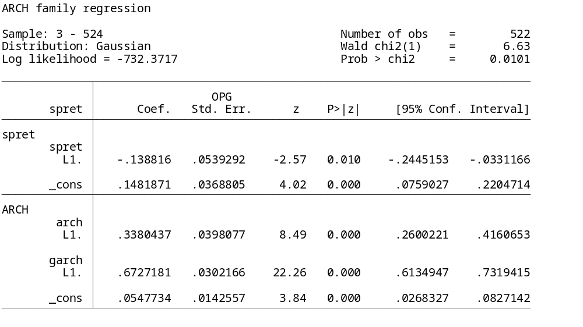





arch spret l.spret, arch(1/1) garch(1/1)

Slide 19
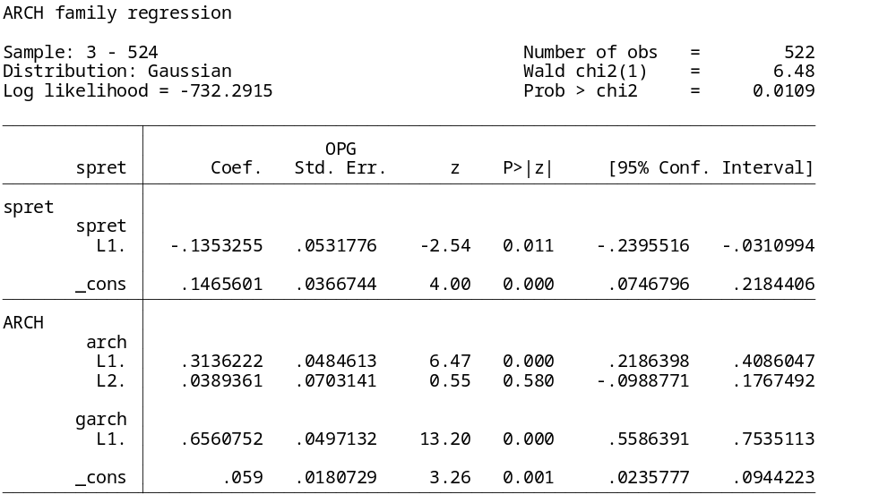

arch spret l.spret, arch(1/2) garch(1/1)

Slide 20

GARCH-in Mean
We expect a risk to be compensated by a higher return. So why not let the return of a security be partly determined by its risk?
Engle, Lilien and Robins (1987) suggested the ARCH-M specification. A GARCH-M model would be
δ can be interpreted as a sort of risk premium.
It is possible to combine all or some of these models together to get more complex “hybrid” models - e.g. an ARMA-EGARCH(1,1)-M model.

Slide 21
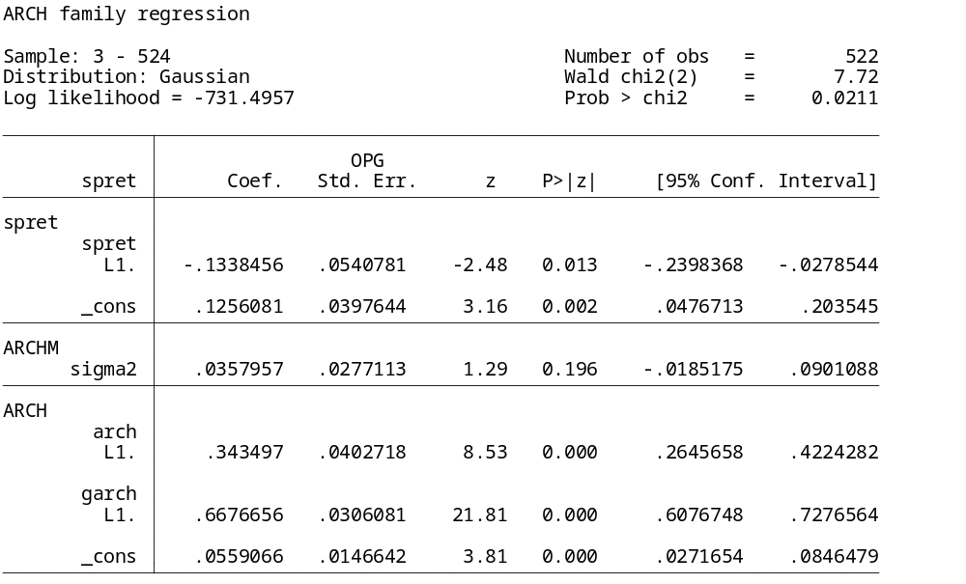

arch spret l.spret, arch(1/1) garch(1/1) archm

Slide 22
Extensions to the Basic GARCH Model
Since the GARCH model was developed, a huge number of extensions and variants have been proposed. Three of the most important examples are EGARCH, GJR, and GARCH-M models.
Problems with GARCH(p,q) Models:
- Non-negativity constraints may still be violated
- GARCH models cannot account for leverage effects
Possible solutions: the exponential GARCH (EGARCH) model or the GJR model, which are asymmetric GARCH models.

Slide 23
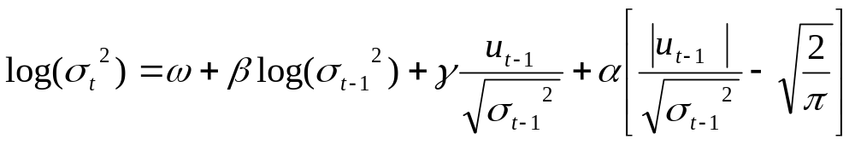
The EGARCH Model
Suggested by Nelson (1991). The variance equation is given by
Advantages of the model
- Since we model the log(σ_{t}²), then even if the parameters are negative, σ_{t}²
will be positive.
- We can account for the leverage effect: if the relationship between
volatility and returns is negative, γ, will be negative.

Slide 24
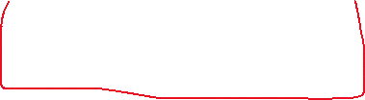


The GJR Model
Due to Glosten, Jaganathan and Runkle
where I_{t-1} = 1 if u_{t-1} < 0
= 0 otherwise
For a leverage effect, we would see γ > 0.
We require α₁ + γ ≥ 0 and α₁ ≥ 0 for non-negativity.

Slide 25
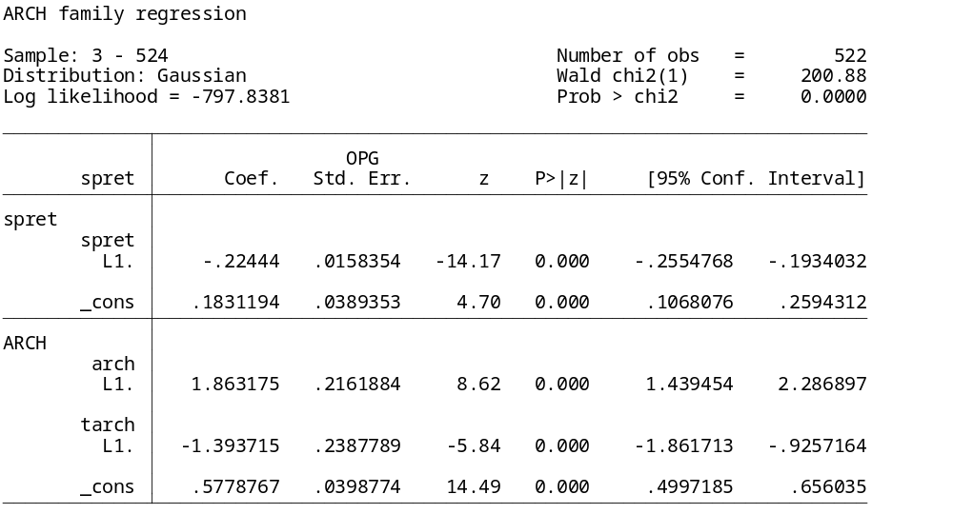


The Glosten, Jaganathan and Runkle (GJR) threshold ARCH arch spret l.spret, arch(1/1) tarch(1/1)

