Slide 1
Nonlinear Regression Functions

Slide 2
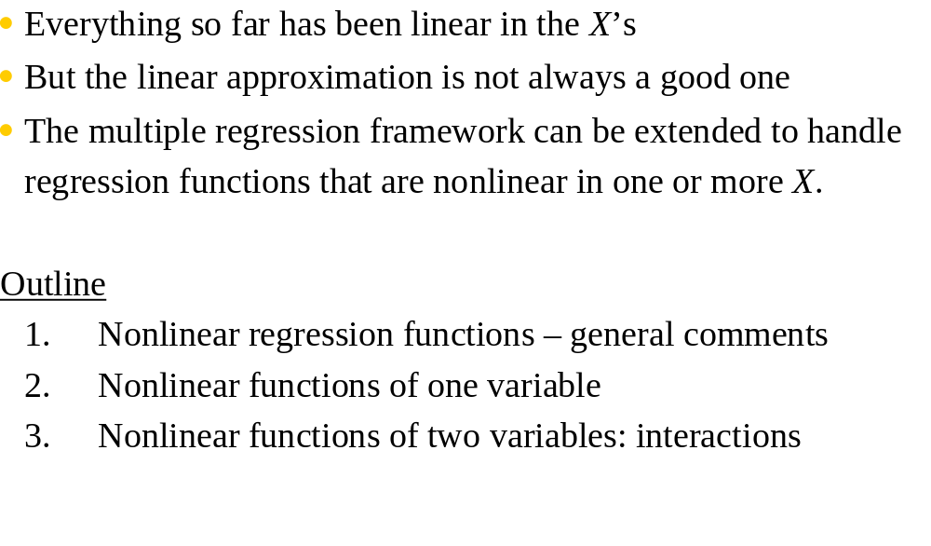
Nonlinear Regression Functions

Slide 3
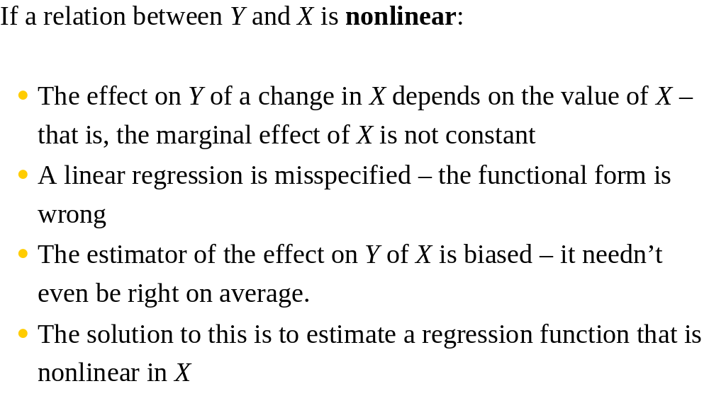
Nonlinear Regression Population Regression Functions – General Ideas

Slide 4
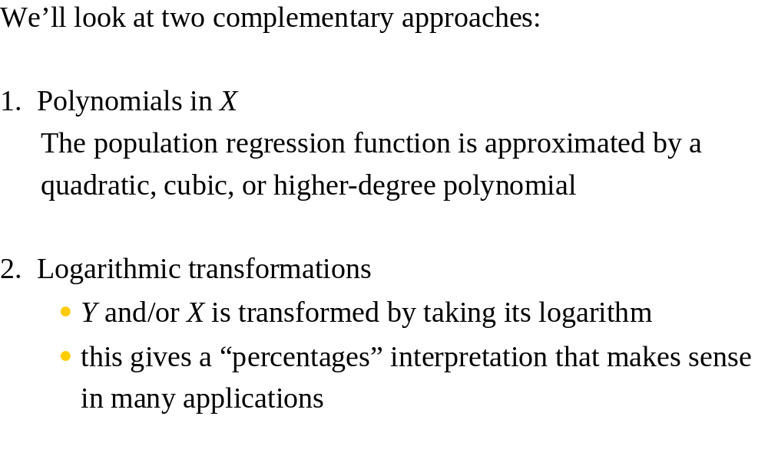
Nonlinear Functions of a Single Independent Variable

Slide 5
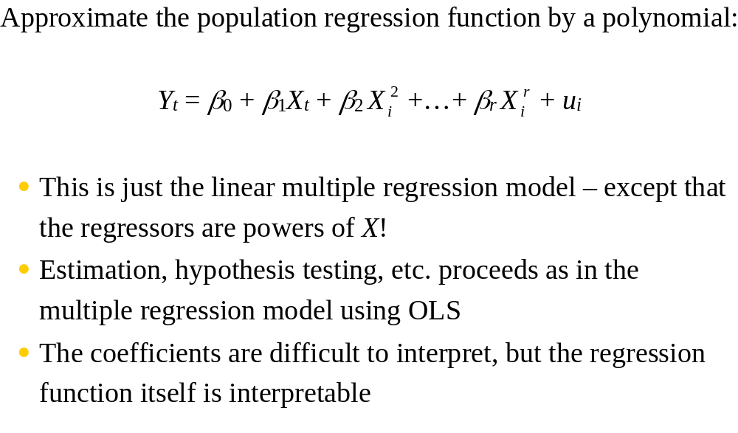
1. Polynomials in X

Slide 6
A restricted-unrestricted view of the polynomials
Y = α + β*Χ + γ*Χ² + δ*X³ + u the cubic model
Y = α + β*Χ + γ*Χ² + u the quadratic model
Y = α + β*Χ + u the linear model
Notice that the linear model is nested in the quadratic model, and the quadratic is nested in the cubic model
If δ = γ = 0 in the cubic model, we obtain the linear case
If δ = 0 in the cubic model, we obtain the quadratic case
If γ = 0 in the quadratic case, we obtain the linear case

Slide 7
In a linear model, ΔY/ΔX = β, therefore, the reaction of Y to changes in X is constant
In the quadratic case (Y = α + β*Χ + γ*Χ² + u) though,
ΔY/ΔX = β + 2*γ*X, which clearly shows that the reaction of Y to changes in X is itself a function of X
In other words, Y reacts differently at different levels of X

Slide 8
ΔY/ΔX = β + 2*γ*X
β determines the slope of the relationship
When β>0, Y reacts positively to X
When β<0, Y reacts negatively to X
γ determines the rate of response
When γ>0, the response has an increasing nature
When γ<0, the response has a decreasing nature

Slide 9
Sign of β | Sign of γ | Response of Y to X
β > 0 | γ > 0 | Positive, with an increasing rate
β < 0 | γ < 0 | Negative, with a decreasing rate
β > 0 | γ < 0 | Positive, with a decreasing rate
β < 0 | γ > 0 | Negative, with an increasing rate

Slide 10
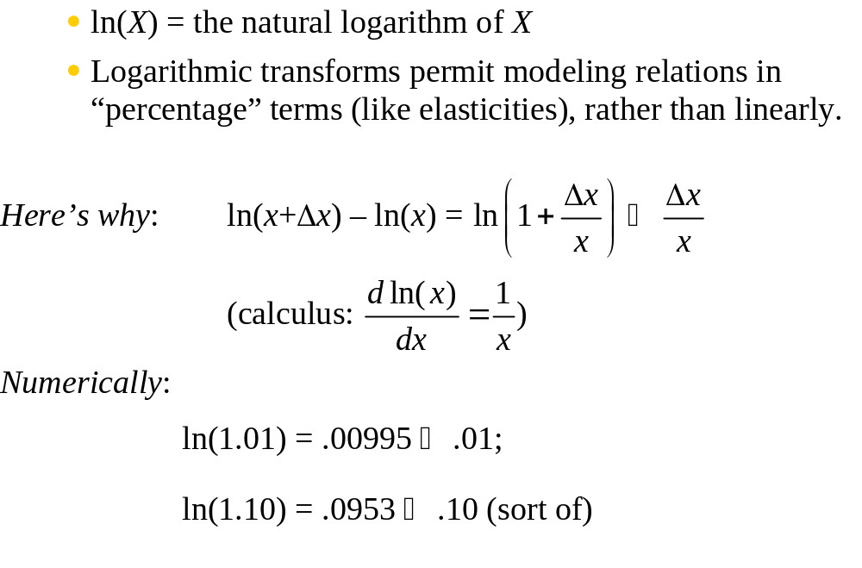
2. Logarithmic functions of Y and/or X

Slide 11
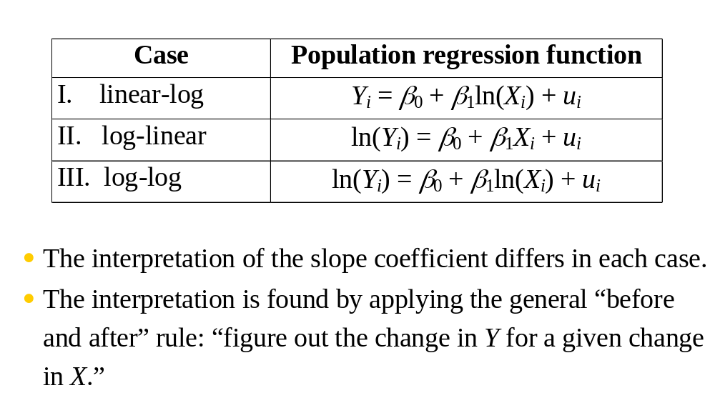
The three log regression specifications:

Slide 12
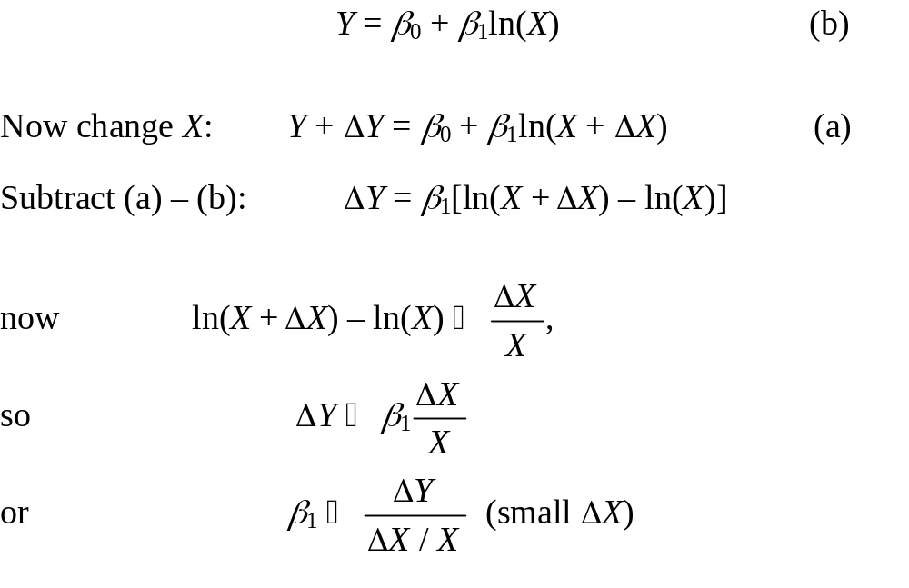
I. Linear-log population regression function

Slide 13
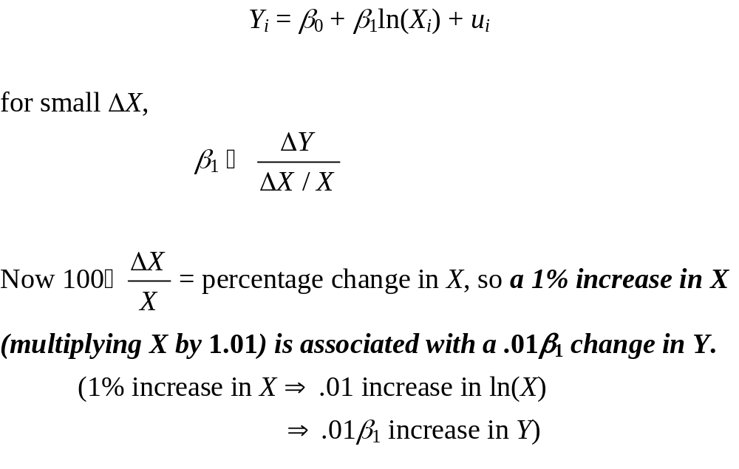
Linear-log case, continued

Slide 14
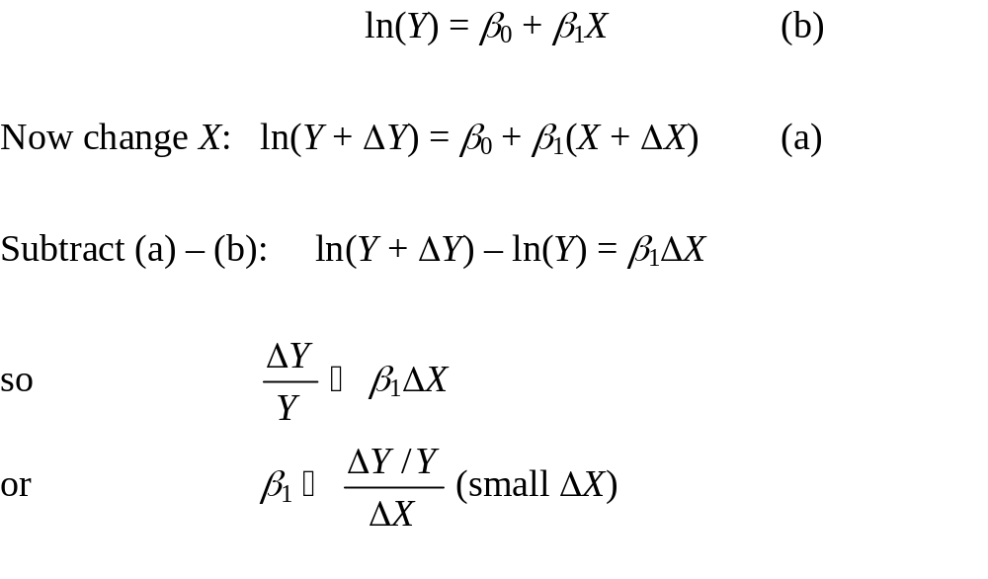
II. Log-linear population regression function

Slide 15
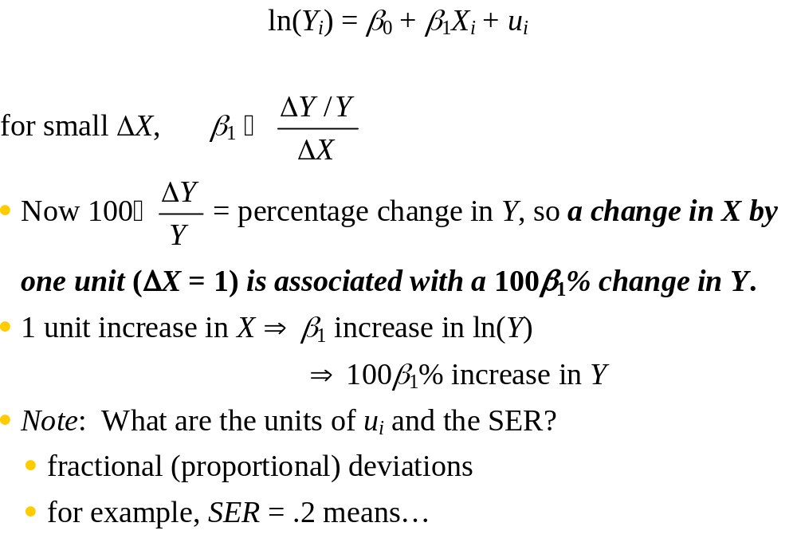
Log-linear case, continued

Slide 16
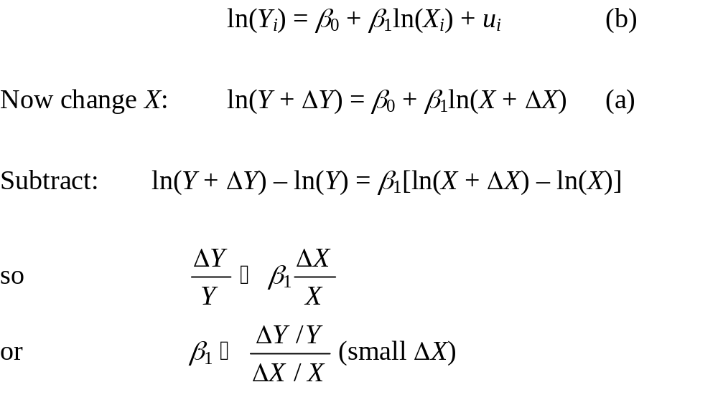
III. Log-log population regression function

Slide 17
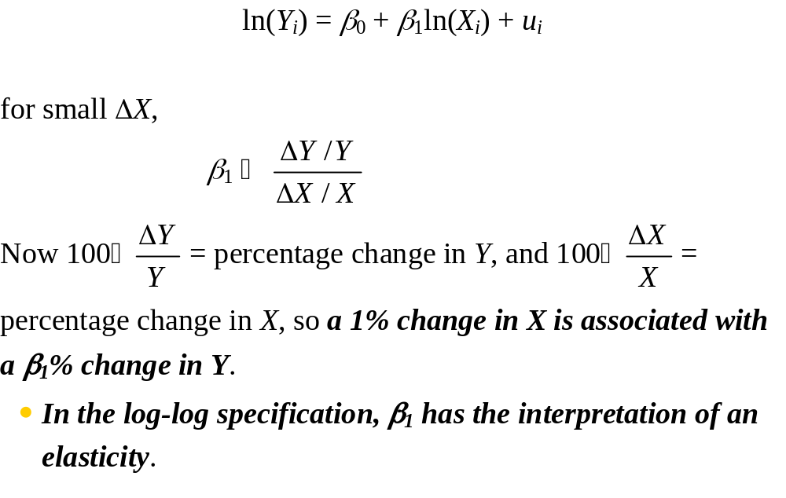
Log-log case, continued

Slide 18
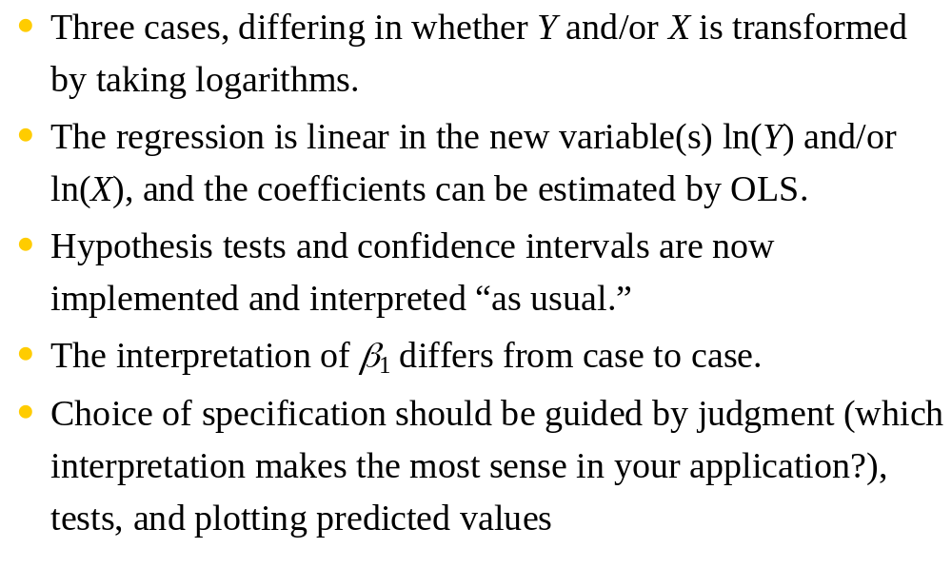
Summary: Logarithmic transformations

Slide 19
The use of dummy variables
A dummy is deployed in order to capture a phenomenon (or a situation) that has only two possible outcomes, that are exhaustive and mutually exclusive, and these outcomes are not numerical in nature
These, may arise in contexts such as:
before/after a milestone event (e.g. the outbreak of a crisis, the introduction of a new regulation)
a qualitative phenomenon such as north/south, listed/non-listed, adoption/non-adoption etc

Slide 20
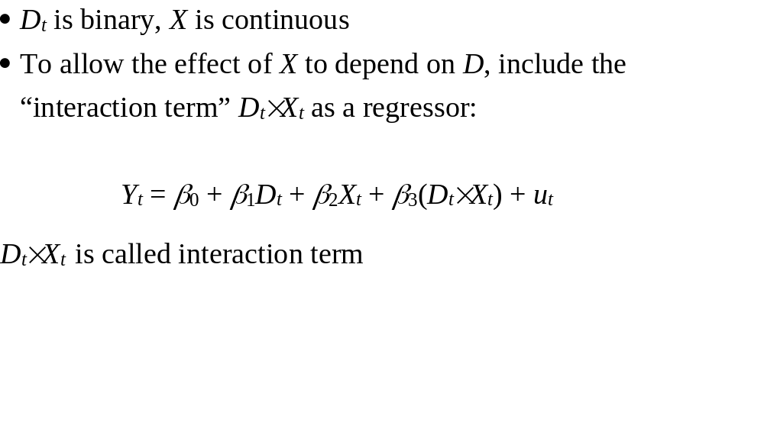
Interactions between continuous and binary variables

Slide 21
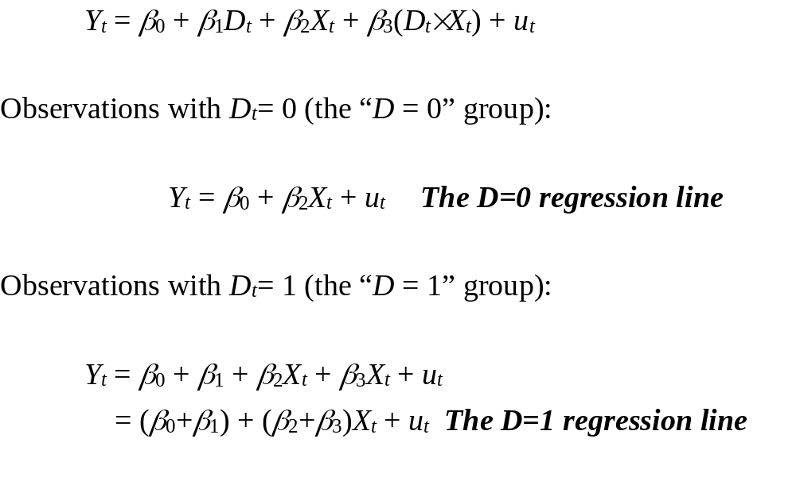
Binary-continuous interactions: the two regression lines

Slide 22
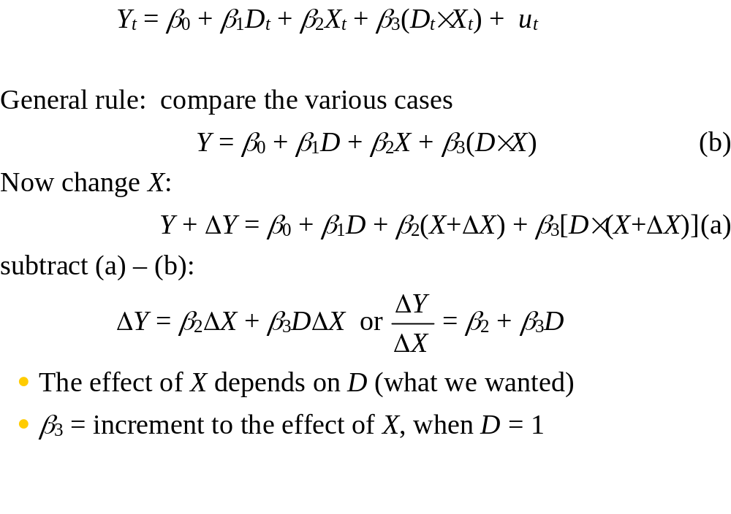
Interpreting the coefficients

Slide 23
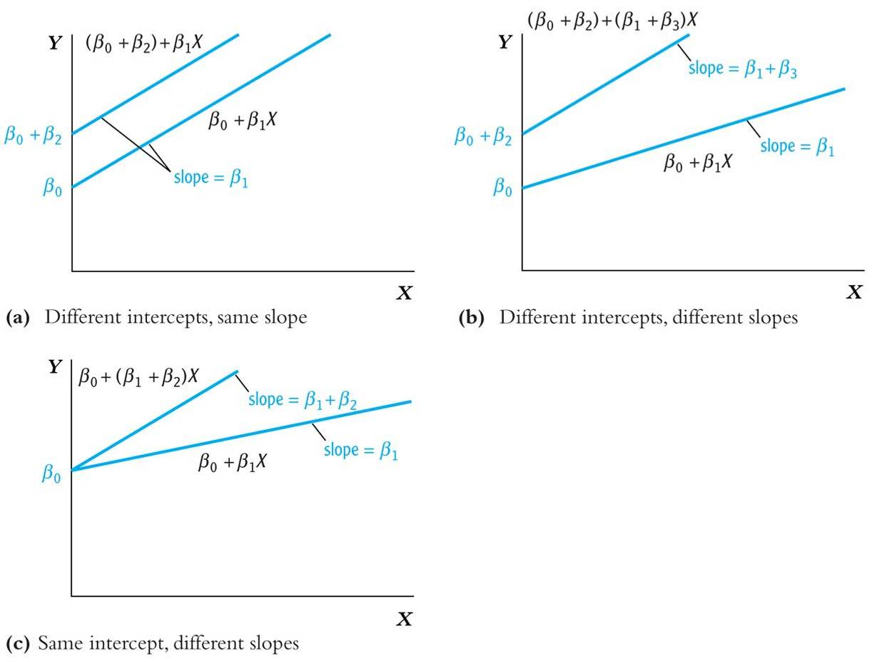
Binary-continuous interactions, ctd.

Slide 24
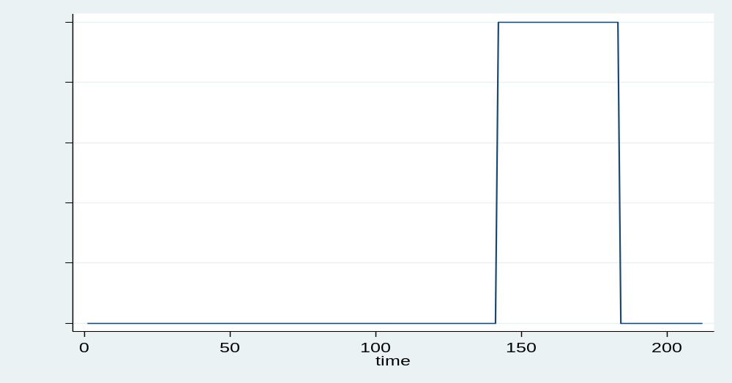
Did Covid have an impact?

Slide 25
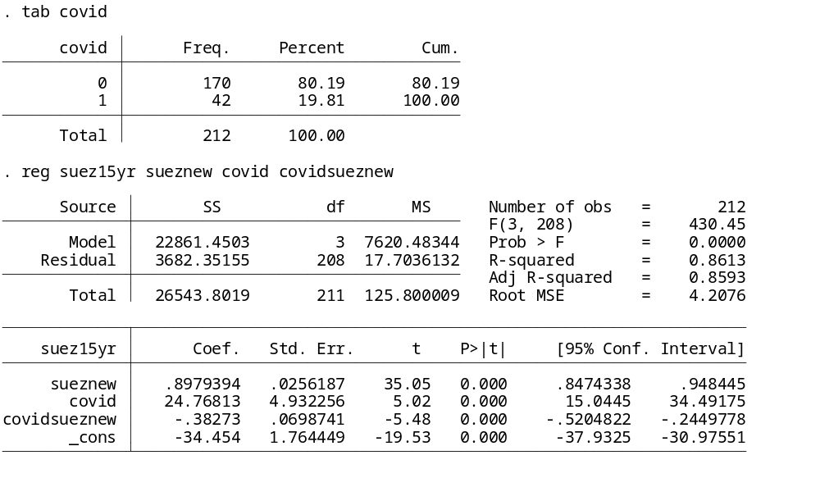
suezmax15yr = α + β*suezmaxnew + γ*COVID + δ*COVID*suezmaxnew + u

Slide 26
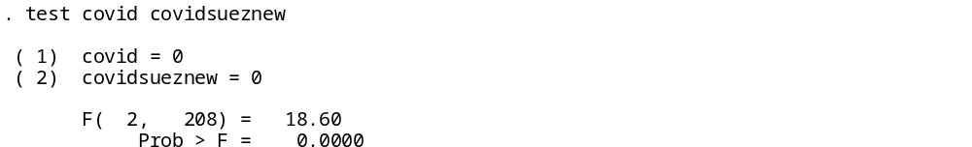
The intercept is increased by 24.76 in the covid period compared to the non-covid period
The reaction of second-hand price to new building price is by 0.382 lower in the covid period compared to the non-covid period

Slide 27
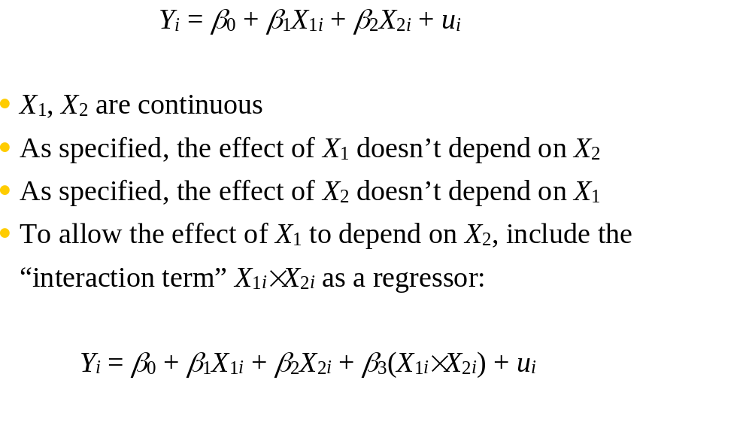
Interactions between two continuous variables

Slide 28
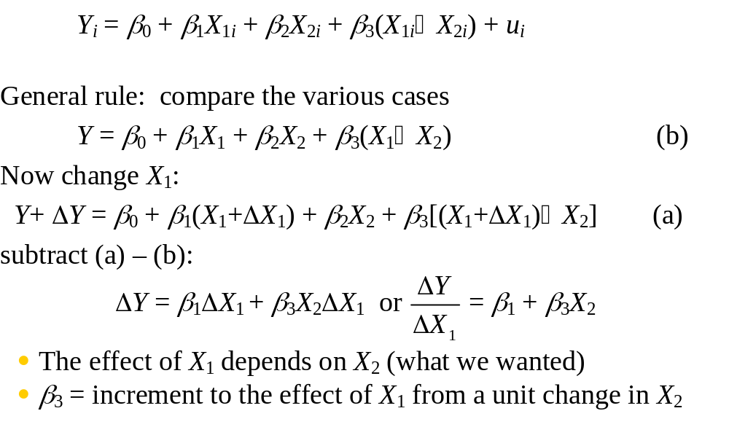
Interpreting the coefficients:

