Slide 1

Data DNA

Slide 2
Data DNA
The analyst needs to comprehend the Data DNA before designing data analysis because:
DNA type determines to a large extent the choice of appropriate econometric method.
source of variation
format of measurement
As you will see there is a wide variety of data types, which means that an analyst must possess in her arsenal many weapons.

Slide 3
source of variation
cross-sectional (atemporal): data represent a snapshot of a single point in time (or various time points have been artificially collapsed on a single point) for various cross-sectional members.
Typical notation: Y_{i}, X_{i}
For example:
a survey based on a random sample of firms or individuals, or ports.
Thus, the variation stems from differences between cross sectional members.

Slide 4
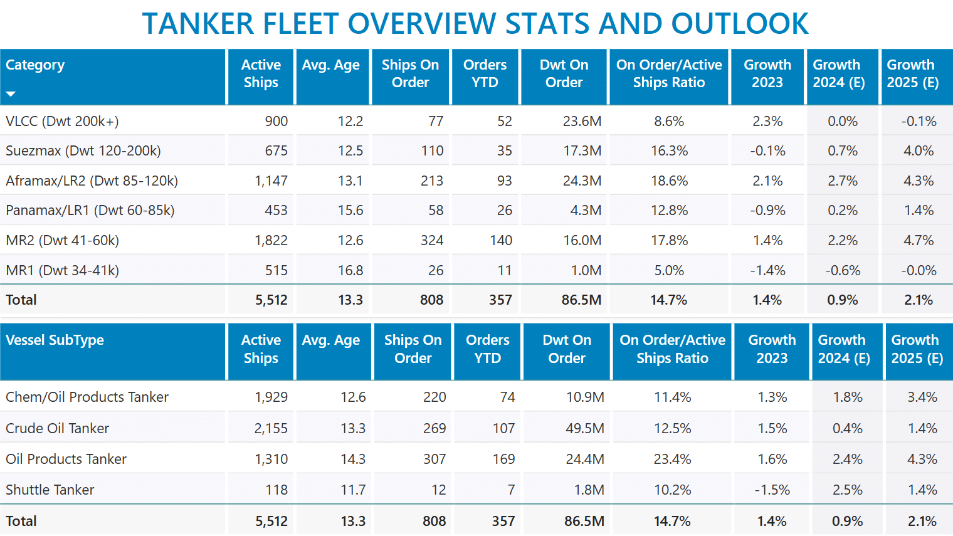

Slide 5
source of variation cont
time series: data are collected sequentially in time (and most of the time with a fixed periodicity),
Typical notation: Y_{t}, X_{t}
The cross-sectional dimension is unity. Hence, the data track a single cross-sectional unit over time.
For example: a maritime firm, a shipping or a stock market index, a household, a country, tracked over time.
Thus, the variation stems from differences within the cross sectional unit, reflecting the effect of passage of time.

Slide 6
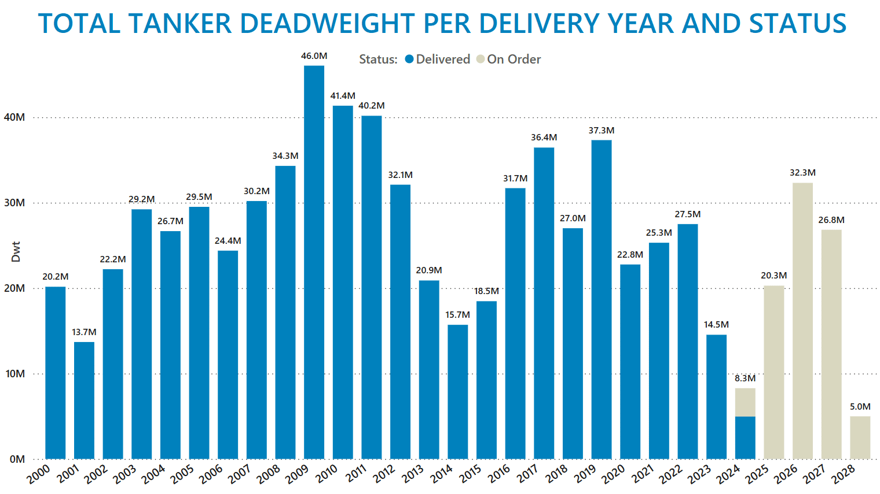

Slide 7
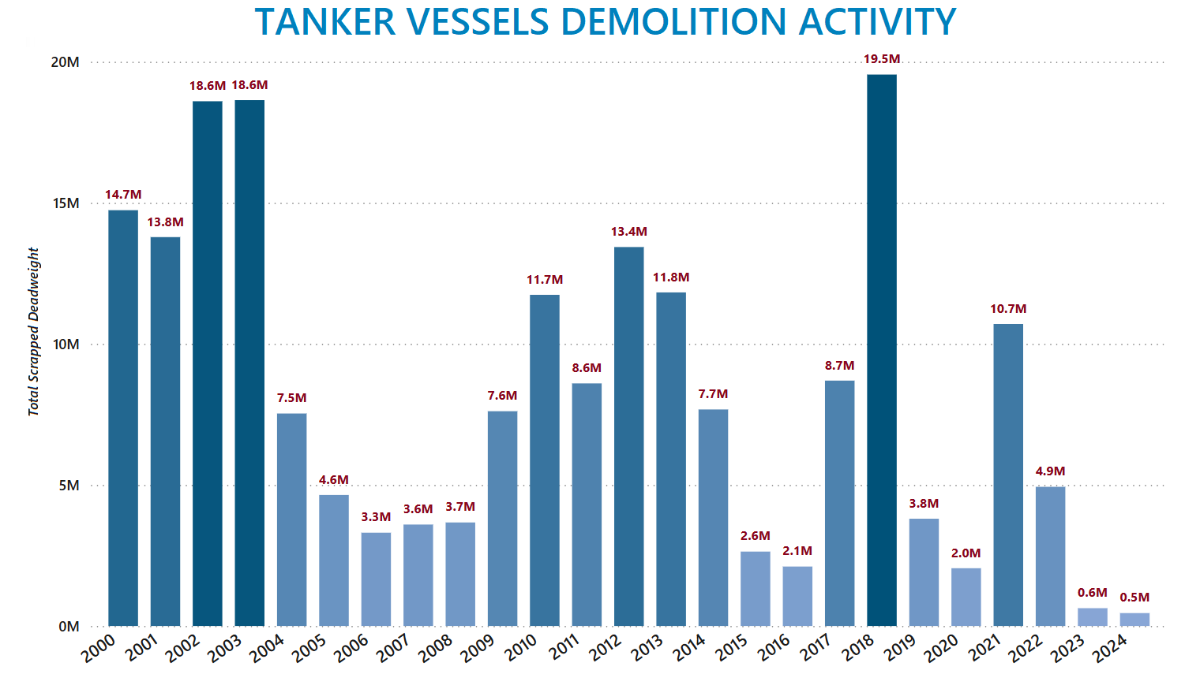

Slide 8
source of variation cont
Panel: data for various cross-sectional members are collected repeatedly in time.
For example, follow: a set of maritime firms, or stocks, or a set of countries over a number of time periods.
Typical notation: Y_{it}, X_{it}
Thus, the overall variation stems from:
(i) differences between cross-sectional members, and
(ii) differences within every cross-sectional member, reflecting the effect of passage of time.

Slide 9
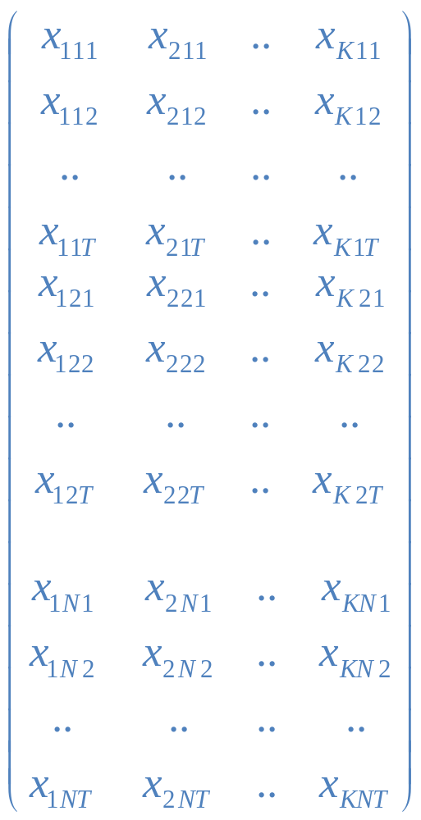
The Basic Data Structure
Wave 1
Cross-sectional member 1
Wave T
Wave 1
Cross-sectional member 2
Wave T
Wave 1
Cross-sectional member N
Wave T

Slide 10
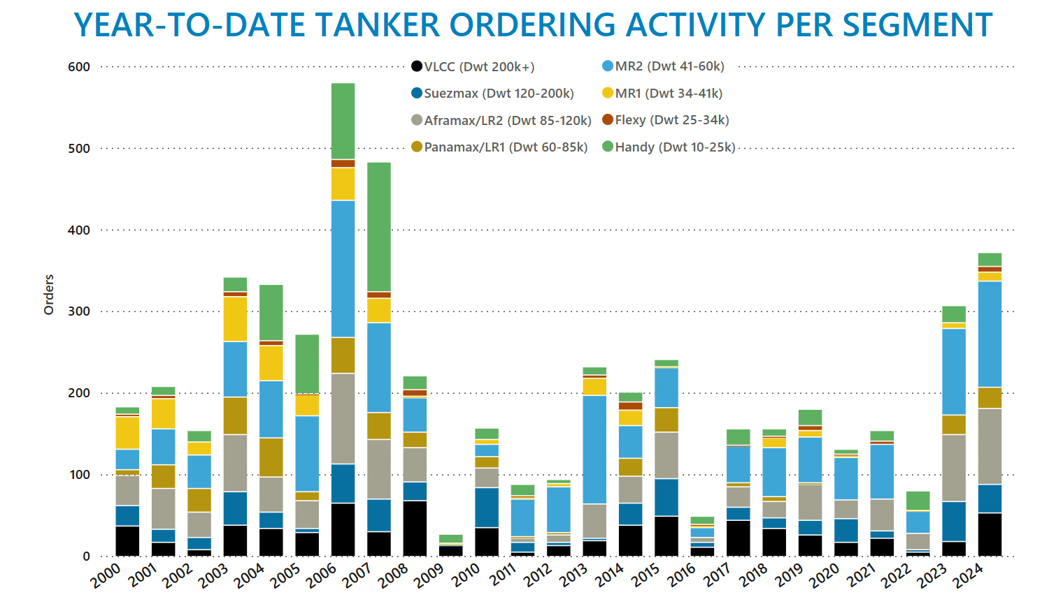

Slide 11
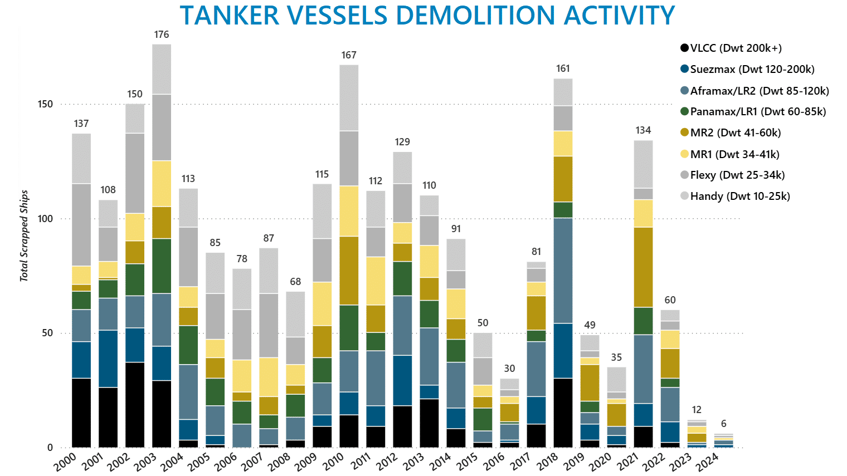

Slide 12
format of measurement
A: continuous (Baltic index, freight rates, stock prices, stock returns, roe, gdp growth),
B: discrete
B1: dichotomous (default vs. non-default, export vs. non-export, dividend paying vs. no paying dividend),
B2: ordered (port rankings, credit ratings)
B3: categorical (choice of transportation mode) (rarely encountered in economics and finance)
B4: count (fleet size per unit of time, orderbook per unit of time, number of defaults per unit of time)

Slide 13
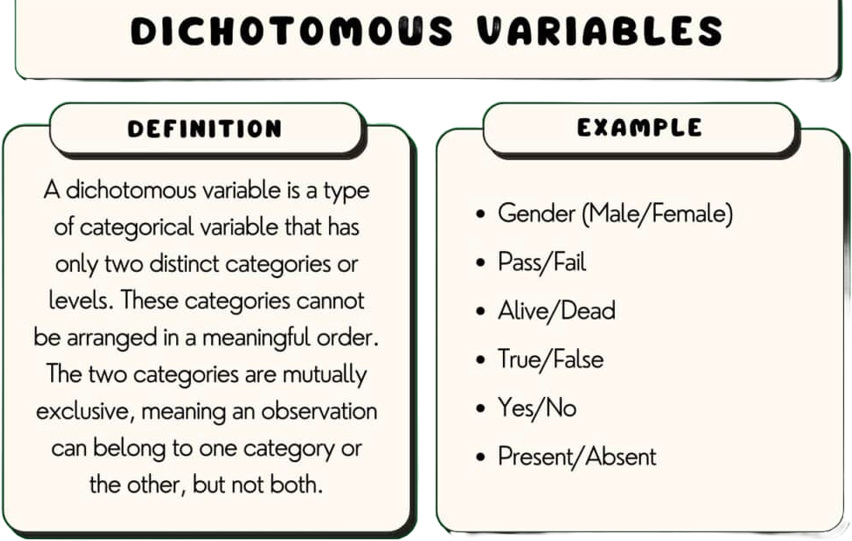
dichotomous

Slide 14
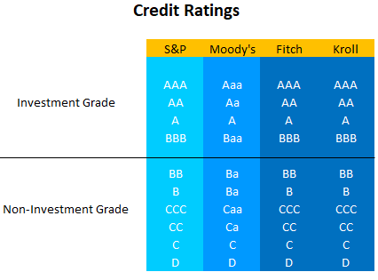
Ordered

Slide 15
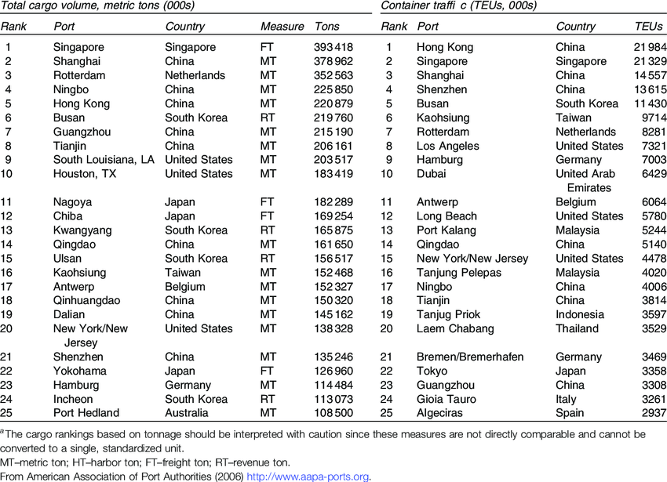
Port rankings

Slide 16
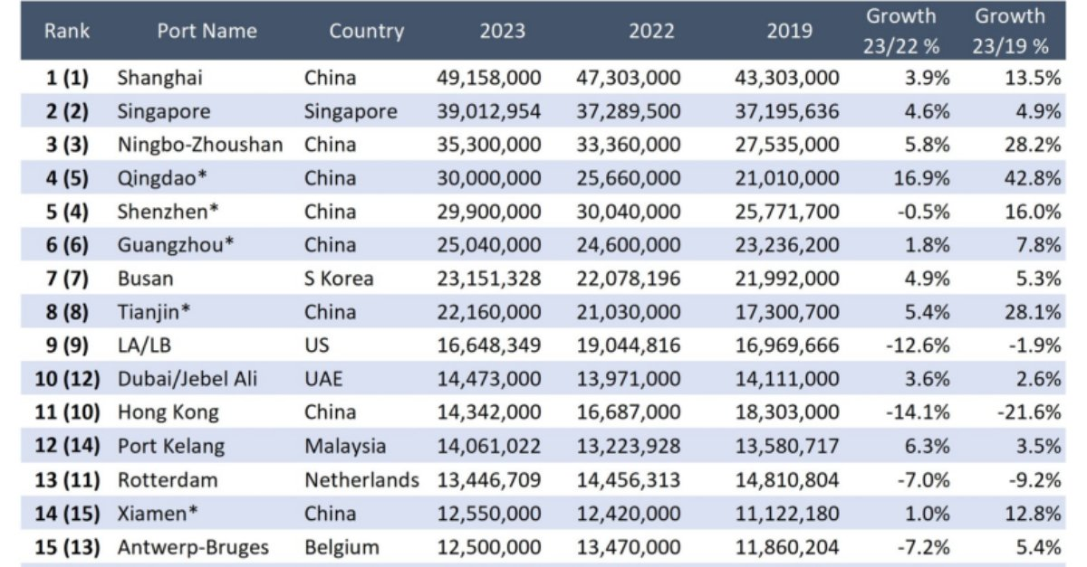

Slide 17
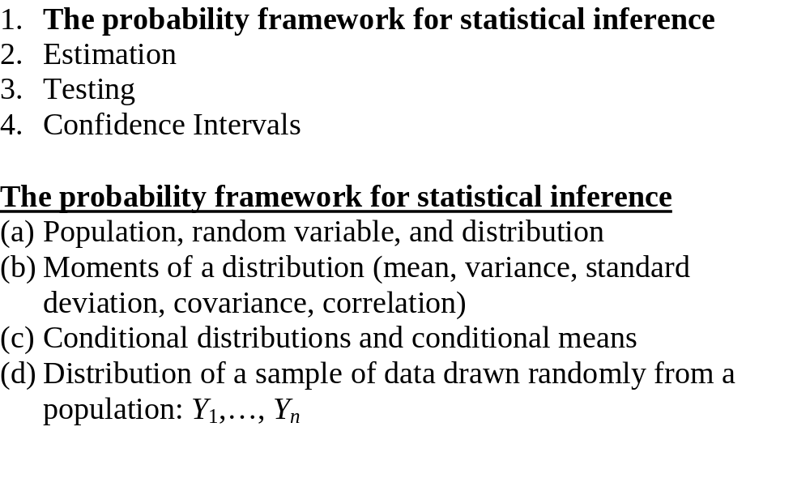
Review of Statistical Theory

Slide 18
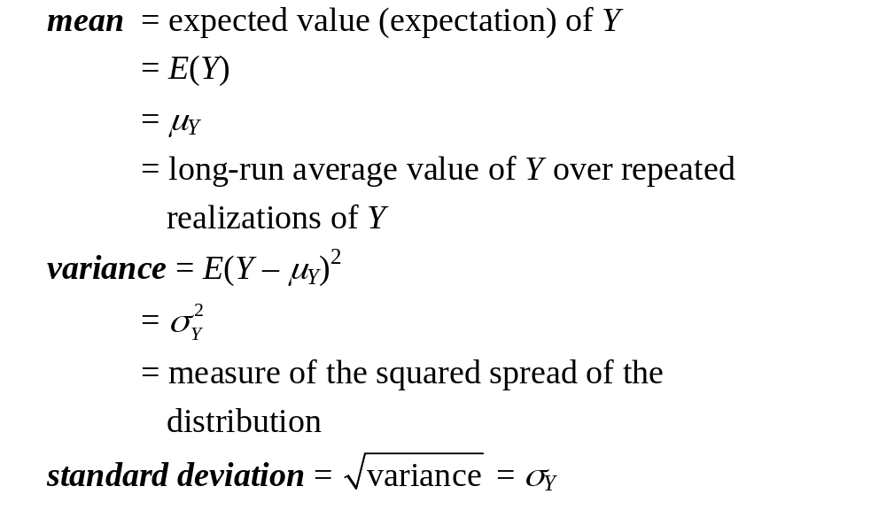
(b) Moments of a population distribution: mean, variance, standard deviation, covariance, correlation

Slide 19
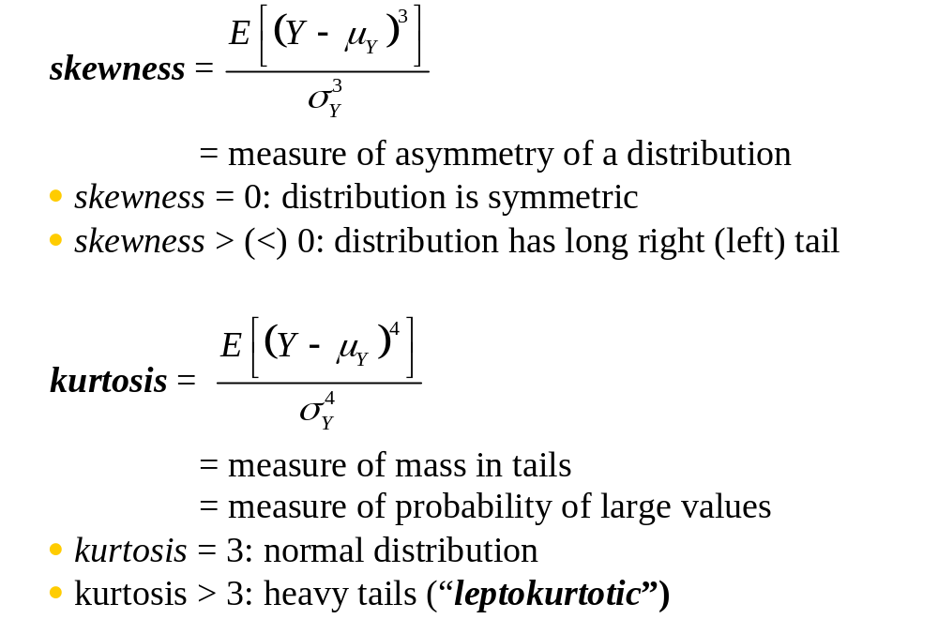
Moments, ctd.

Slide 20
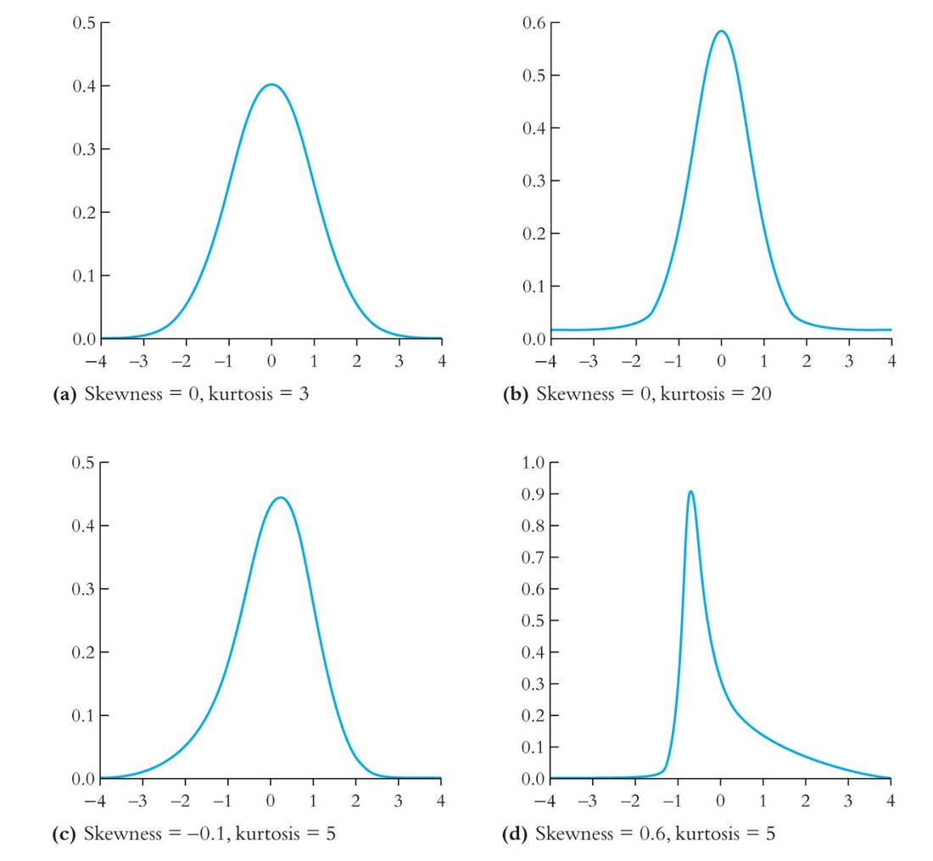

Slide 21
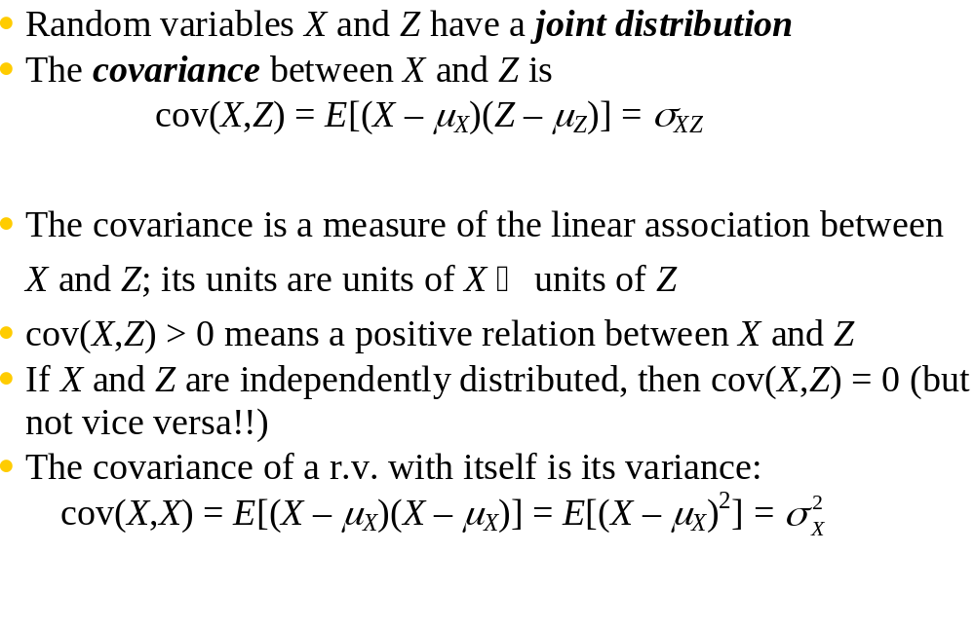
2 random variables: joint distributions and covariance

Slide 22
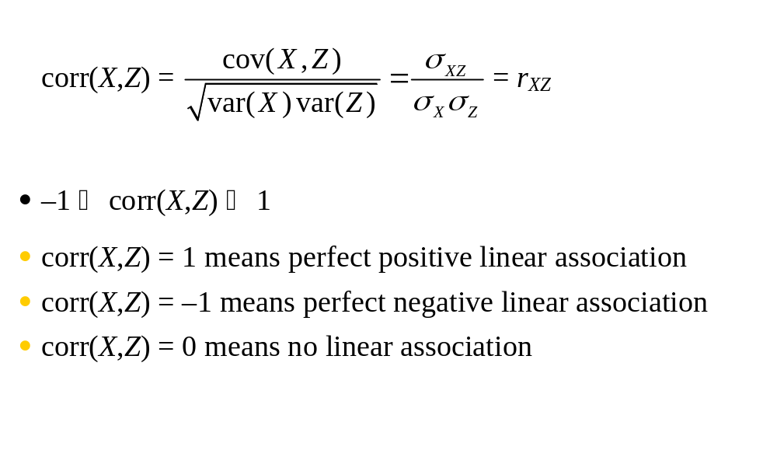
The correlation coefficient is defined in terms of the covariance:

Slide 23
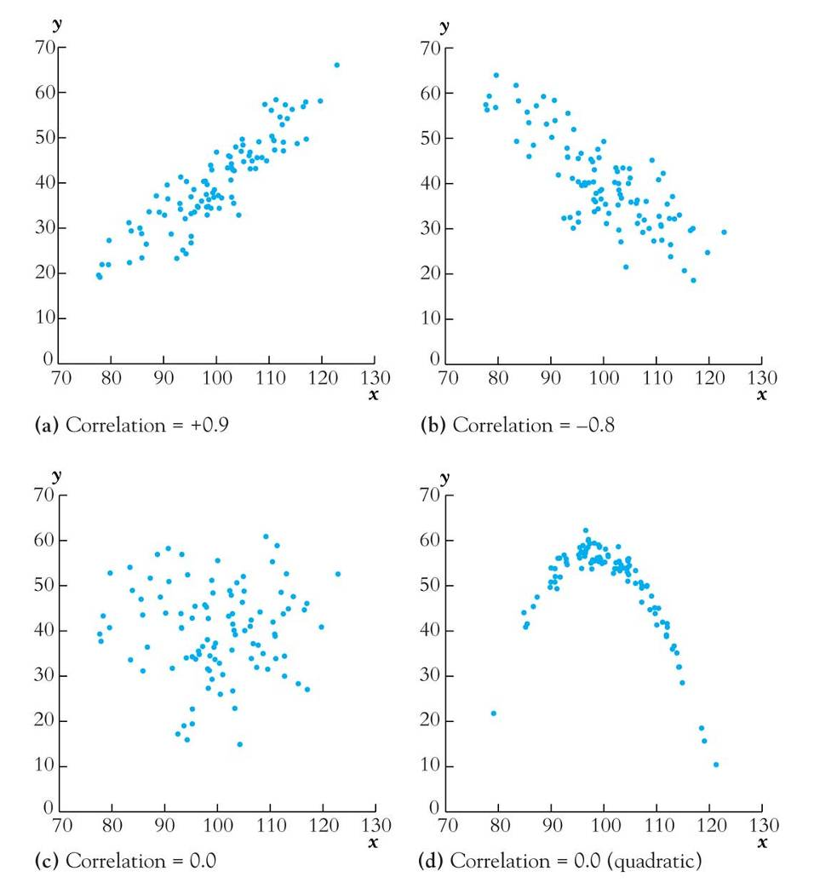
The correlation coefficient measures linear association

