Slide 1
Intro to Cointegration

Slide 2
Cointegration: an intuitive explanation based on economics 101

Slide 3
Consider the simplest economics model; demand & supply
There are 3 variables involved: quantity demanded (Qd), quantity supplied (Qs), price (P)
By the way, even in the simplest setup, there is no distinction between dependent and independent variables (they all affect and interact with each other), keep this at the back of your head****
What is equilibrium? A certain (unique) price that makes quantity demanded equal to the quantity supplied (Qs = Qd) or Qs – Qd =0
Note that there is a linear combination that relates to eqm (1, -1)

Slide 4
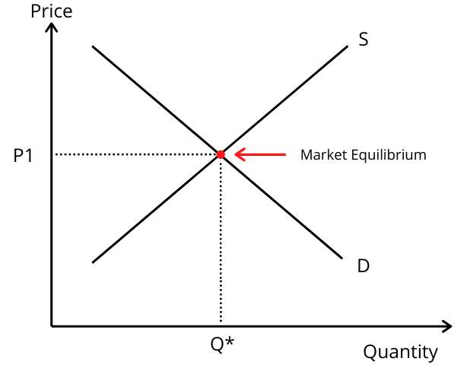

Slide 5
Graphically, the point of intersection between the demand and supply curves
What happens there? NOTHING, that’s why it is called equilibrium
Using physics jargon, the system is in equilibrium, all forces cancel each other out, and nothing changes.
Hence in eqm: ΔQs = ΔQd = ΔP = 0.

Slide 6
How does the system work if it is in disequilibrium?
Suppose the price is too high (relatively to the eqm price)
Then, we observe excess supply (demand is too low relatively to the supply)
The system in order to return to its equilibrium state, starts making some adjustments:
The price starts falling, and as this happens, quantity demanded starts increasing, while quantity supplied starts dropping
Mathematically, ΔQs < 0 , ΔQd > 0, ΔP <0
The exact opposite would happen if the price was too low

Slide 7
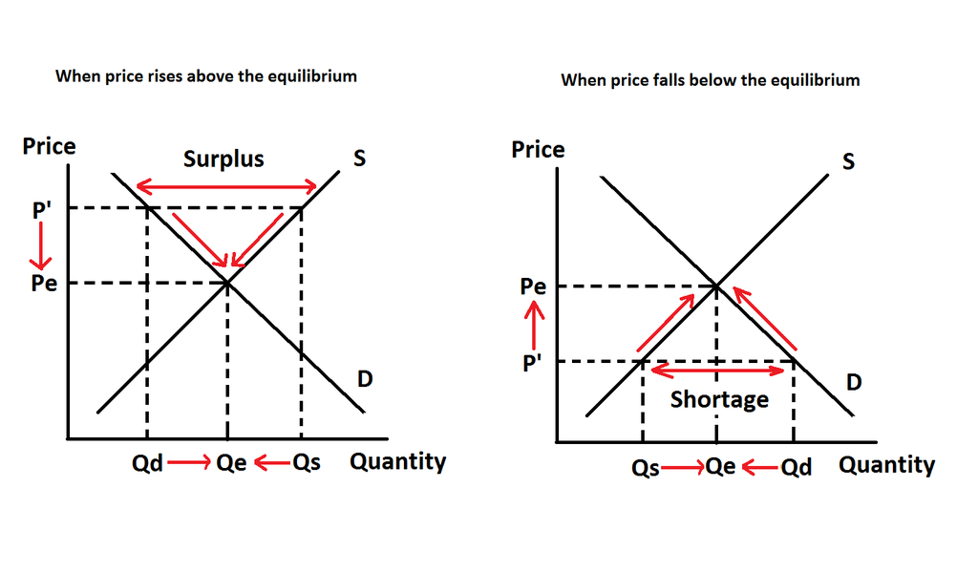

Slide 8
So, we observe that the system develops some dynamics, with the variables involved making an adjustment so as the system to reach the eqm
The eqm behaves as an attractor (if we are away from eqm, there are forces developed, which make an attempt to bring the system back to equilibrium)
So the system might be occasionally (in fact quite often) in disequilibrium, even for quite some time, but if the eqm is meaningful there are will an observed dynamic adjustment towards eqm

Slide 9
Cointegration: the econometrics of it and its implications
Assume two time series, each of which is I(1) **non-stationary
In principle, their linear combination will also be non-stationary
If however, there exists a linear combination that is stationary, then the series are cointegrated, and vice versa,
If two series are cointegrated, there exists a linear combination of them that is stationary
If the series are cointegrated, then there is a long run relationship between them (and vice versa)
Hence, their co-behaviour will be such that deviations from their long run relationship should be eliminated

Slide 10
Consider two time series, Yt and Xt
If both are stationary, I(0), then OLS is appropriate
If they have different orders of integration, then they cannot be related (since one has stable time properties and the other has properties that change overtime///hence to be related would be a contradiction in terms)
The interesting case is if both are I(1) ***that is each one of them is non-stationary

Slide 11
In principle any linear combination of non-stationary time series will also be non-stationary
So a model of the form Yt = α + β* Xt + u, which implies a linear combination of the two series (Yt - α - β* Xt ), will generate a non-stationary outcome
IF HOWEVER A LINEAR COMBINATION EXISTS THAT IS STATIONARY, THEN THE TWO SERIES ARE SAID TO BE COINTEGRATED

Slide 12
Note the following:
If two time series are NOT COINTEGRATED, then they can have a relationship only in the short run (in terms of their Δs)
If two time series ARE COINTEGRATED, then they are linked by a long run relationship (that is their levels are also related)

Slide 13
How can we test that?
Recall the original model Yt = α + β* Xt + u, and the linear combination of the two series (Yt - α - β* Xt ) which is equal to u
The initial testing procedure for cointegration was proposed by Engle and Granger, and is called Engle-Granger 2-step method

Slide 14
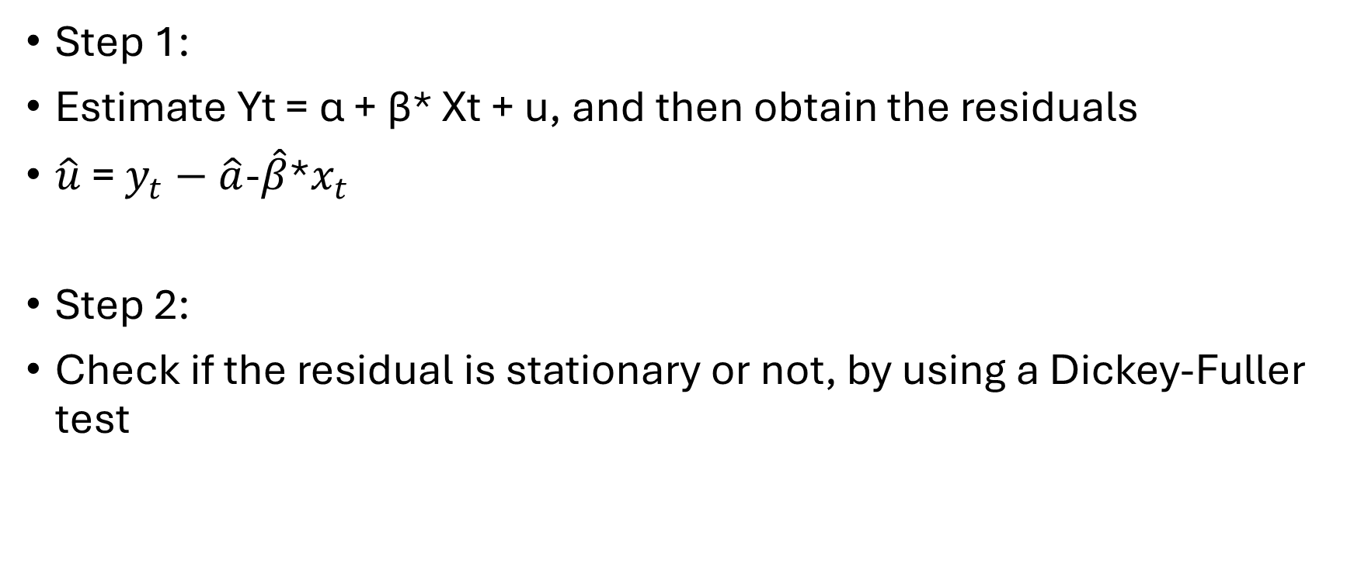
The Engle-Granger 2-step method
Step 1:
Estimate Yt = α + β* Xt + u, and then obtain the residuals
$\hat{u}$ = $y_{t}−\hat{a}$-$\hat{β}$*$x_{t}$
Step 2:
Check if the residual is stationary or not, by using a Dickey-Fuller test

Slide 15
From step 2, there are only two possible outcomes:
Outcome 1: The residuals are non-stationary, which implies that the linear combination from which they were generated was also non-stationary. Hence, Yt and Xt ARE NOT COINTEGRATED
Outcome 2: The residuals are stationary, which implies that the linear combination from which they were generated was also stationary. Hence, Yt and Xt ARE NOT COINTEGRATED

Slide 16
How to proceed with modelling depends on which outcome we encounter
Below I will provide a roadmap of how one should proceed

Slide 17
Y, X both non-stationary
Y and X
Not cointegrated
Estimate model in first differences:
ΔY = γ + δ*ΔX + ε
Y and X are cointegrated
Estimate
ΔY = γ + δ*ΔX + λ*(Yt-1 –α –β*Xt-1) +ε

Slide 18
(Yt-1 –α –β*Xt-1) is called Error Correction Mechanism (ECM) and captures the distance from the equilibrium to which the variable must respond to
λ is called Speed-of-Adjustment and captures the speed with which the dependent variable moves (since it is in Δ) in order to restore statistical equilibrium
In fact, 1 / abs(λ), measures how many periods it takes until the system goes back to equilibrium
For instance, if λ = 0.2, then 1 / 0.2 = 5
If your data in monthly (daily) frequency, then any deviation from equilibrium takes on average 5 months (days) to be eliminated

