Slide 1


Ασύρματα Δίκτυα και Κινητές Επικοινωνίες
Ενότητα # 5: Ασύρματα Τοπικά Δίκτυα (Wireless LANS - IEEE 802.11)
Διδάσκων: Βασίλειος Σύρης
Τμήμα: Πληροφορικής

Slide 2
IEEE 802.11 Wireless LANs
Architecture
PHY specifications – Spread Spectrum radios: FH & DS
MAC mechanisms: DCF and PCF
Components and identifiers
Synchronization, Power management, Roaming, Scanning
Security

Slide 3
IEEE 802.11 - WiFi
IEEE 802.11 working group formed 1990
802.11 used interchangeably with WiFi
  WiFi=Wireless Fidelity
  WiFi alliance: testing and certification of WLAN products
IEEE 802.11/WiFi most popular and pervasive Wireless LAN (WLAN) standard
Uses ISM (unlicensed) bands at 2.4 & 5 GHz

Slide 4
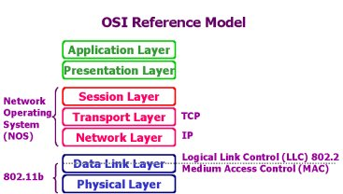
IEEE 802.11 and OSI model
Wireless

Slide 5
802.11 scope & modules
MAC and PHY specification for wireless connectivity for fixed, portable and moving stations in a local area
LLC
MAC
Sublayer
MAC Layer
Management
MAC
PLCP Sublayer
PHY Layer
Management
PHY
PMD Sublayer

Slide 6
IEEE 802.11 standards
802.11b
  2.4 GHz unlicensed spectrum
  up to 11 Mbps
802.11a
  5 GHz
  up to 54 Mbps
802.11g
  2.4, 5 GHz
  up to 54 Mbps
802.11n: MIMO (x4), multiple channels (40MHz), 64 QAM
  2.4, 5 GHz
  up to 450 Mbps (x3, 40MHz), 600 Mbps (x4, 40MHz)
802.11ac: MIMO (x8), multiple channels (160MHz), 256 QAM
  5 GHz
  Phase 1: up to 1.300 Mbps (x3, 80MHz) – 800 Mbps in practice
all use CSMA/CA for multiple access
all have base-station and ad-hoc network versions

Slide 7
Comparison of wireless standards
200
802.11n
54
802.11a,g
802.11a,g point-to-point
data
5-11
802.11b
802.16 (WiMAX)
4
UMTS/WCDMA-HSPDA, CDMA2000-1xEVDO
3G cellular
enhanced
Data rate (Mbps)
1
802.15
.384
UMTS/WCDMA, CDMA2000
3G
.056
IS-95, CDMA, GSM
2G
Indoor
10-30m
Outdoor
50-200m
Mid-range
outdoor
200m – 4 Km
Long-range
outdoor
5Km – 20 Km

Slide 8
WLAN usage
Single-hop networks
Home networks
Enterprise networks (offices, labs, etc.)
Outdoor areas (cities, parks, etc.)
Multi-hop networks
Ad-hoc network of small groups (e.g. aircrafts)
Balloon networks (SpaceData Inc.)
Mesh networks (e.g. routers on lamp-posts)

Slide 9
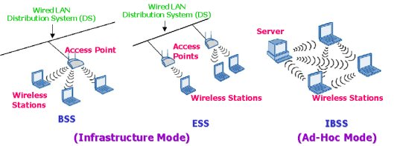
802.11 architecture – two modes

Slide 10
Wi-Fi P2P / Direct
Wi-Fi peer-to-peer: technology, technical specification
Wi-Fi direct: certification

Slide 11
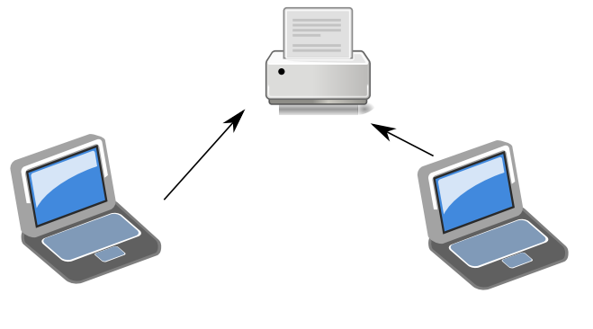
Wi-Fi Direct use cases

Slide 12
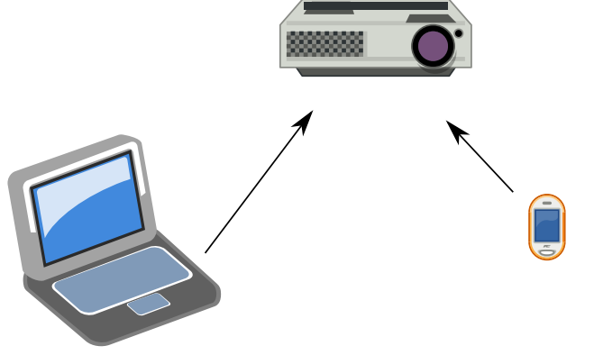
Wi-Fi Direct use cases

Slide 13
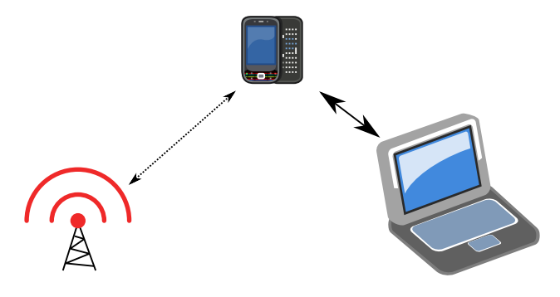
Wi-Fi Direct use cases

Slide 14
Infrastructure-based wireless network
AP
AP: Access Point
AP
wired network
AP
Infrastructure networks provide access to other networks
Communication typically takes place only between the wireless nodes and the access point (AP), but not directly between the wireless nodes
AP not only controls medium access, but also acts as bridge to other wireless or wired networks

Slide 15
Infrastructure-based wireless network (cont.)
Several wireless networks can form one logical network
  APs together with the wired/wireless network in between can connect several wireless networks to form larger network beyond actual radio coverage
Network connectivity functionality lies in APs, and wireless clients can remain quite simple
Different access schemes with or without collision
  Collisions may occur if medium access from wireless stations and AP is not coordinated.
  Collisions avoided If only AP controls medium access
    Useful for quality of service guarantees (e.g. minimum bandwidth)
    AP polls stations for uplink data transmission

Slide 16
Ad hoc wireless network
No need of a priori infrastructure
Nodes communicate directly with other nodes
  AP for medium access not necessary
  Complexity of each node higher: data forwarding

Slide 17
Ad hoc wireless network (cont)
Nodes within an ad-hoc network can communicate if
  they are within each other’s radio range
  other nodes can forward frames
IEEE 802.11 and HiperLAN2 are typically infrastructure-based networks, which additionally support ad-hoc networking
Bluetooth is a typical wireless ad-hoc network

Slide 18
IEEE 802.11 architecture and layers
fixed
station
mobile stationl
infrastructure
network
access point
application
application
TCP
TCP
IP
IP
LLC
LLC
LLC
802.11 MAC
802.11 MAC
802.3 MAC
802.3 MAC
802.11 PHY
802.11 PHY
802.3 PHY
802.3 PHY

Slide 19
Original 802.11 PHY specification
Direct-sequence spread spectrum
  Operating in 2.4 GHz ISM band
  Data rates: 1 and 2 Mbps
Frequency-hopping spread spectrum
  Operating in 2.4 GHz ISM band
  Data rates: 1 and 2 Mbps
Infrared
  Wavelength between 850 and 950 nm
  Data rates: 1 and 2 Mbps

Slide 20
802.11 PHY specifications
IEEE 802.11a
  5 GHz band, 20 MHz channel bandwidth
  Data rates: 6, 9 , 12, 18, 24, 36, 48, 54 Mbps
  Orthogonal frequency division multiplexing (OFDM)
  Subcarrier modulated using BPSK, QPSK, 16-QAM or 64-QAM
IEEE 802.11b
  2.4 GHz band, 20 MHz channel bandwidth
  Data rate: 5.5 and 11 Mbps
  Fall back to 1 and 2 Mbps to interoperate with 802.11
  DSSS, Complementary code keying (CCK) modulation scheme

Slide 21
802.11 PHY specifications
IEEE 802.11g
  Uses 2.4 GHz band, 20 MHz channel bandwidth
  Provides rates of 6, 9 , 12, 18, 24, 36, 48, 54 Mbps
  Similar to 802.11a, but operates in 2.4 GHz band
  Also backward compatible with 802.11b, legacy
IEEE 802.11n
  Uses 2.4GHz or 5GHz, 40 MHz channel bandwidth
  Data rates up to 540 Mbps, 50m
  Employs MIMO to achieve much higher data rates than previous 802.11 standards

Slide 22
802.11b PHY Technologies
Two kinds of radios based on
  “Spread Spectrum”
  “Diffused Infrared”
Spread Spectrum radios based on
  Frequency hopping (FH)
  Direct sequence (DS)
Radio works in 2.4GHz ISM band --- license-free by FCC (USA), ETSI (Europe), and MKK (Japan)
  1 Mb/s and 2Mb/s operation using FH
  1, 2, 5.5, and 11Mb/s operation using DSSS (FCC)

Slide 23
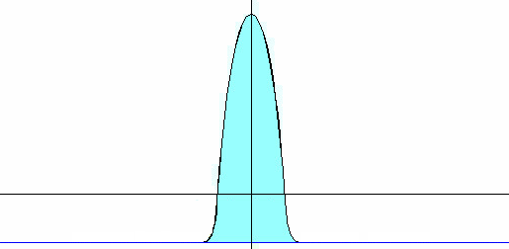

Why Spread Spectrum ?
C = B*log2(1+S/N) . . . [Shannon]
To achieve the same channel capacity C
  Large S/N, small B
  Small S/N, large B
  Increase S/N is inefficient due to the logarithmic relationship
power
power
signal
noise, interferences
signal
frequency
B
B
e.g. B = 30 KHz
e.g. B = 1.25 MHz

Slide 24
Spread Spectrum
Methods for spreading the bandwidth of the
transmitted signal over a frequency band (spectrum)
which is wider than the minimum bandwidth
required to transmit the signal.
Reduce effect of jamming
  Military scenarios
Reduce effect of other interferences
More “secure”
  Signal “merged” in noise and interference

Slide 25
Frequency Hopping SS (FHSS)
2.4GHz band divided into 75 1MHz subchannels
Sender and receiver agree on a hopping pattern (pseudo random series). 22 hopping patterns defined
Different hopping sequences enable co-existence of multiple BSSs
Robust against narrow-band interferences
One possible pattern
f
f
f
f
f
f
f
f
f
f
f

Slide 26
Direct Sequence SS
Direct sequence (DS): most prevalent
  Signal is spread by a wide bandwidth pseudorandom sequence (code sequence)
  Signals appear as wideband noise to unintended receivers
Not for intra-cell multiple access
  Nodes in the same cell use same code sequence

Slide 27
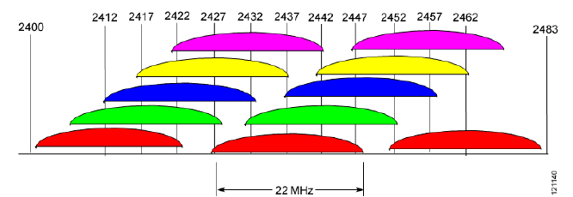
802.11b (2.4 GHz) channels
Available channels
  FCC (North America): 11 channels
  ETSI (EU): 13 channels
  Overall bandwidth: 22 MHz
  Center frequency separation only 5 MHz
non-overlapping: 25 MHz apart
  FCC: 1, 6, 11
  ETSI: 1,6,11 or 2,7,12 or 3,8,13
FCC:

Slide 28
PHY Sublayers
Physical layer convergence protocol (PLCP)
  Provides common interface for MAC
    Offers carrier sense status & CCA (Clear channel assessment)
    Performs channel synchronization / training
Physical medium dependent sublayer (PMD)
  Functions based on underlying channel quality and characteristics
    E.g., Takes care of the wireless encoding

Slide 29
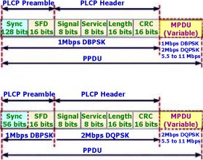
PLCP (802.11b)
long
preamble
192us
short
preamble
96us
(VoIP, video)

Slide 30
802.11 components
Stations (STA)
Access point (AP)
Basic service set (BSS)
Extended service set (ESS)
Distribution system (DS)

Slide 31
Basic Service Set (BSS)
Set of stations that communicate with each other
Independent BSS (IBSS)
  When all stations in a BSS are mobile and there is no connection to a wired network
  Typically short-lived with a small number of stations
  Ad-hoc in nature
  Stations communicate directly with one another
Infrastructure BSS (BSS)
  Includes an Access Point (AP)
  All mobiles communicate directly to AP
    AP provides connection to wired LAN and relay functionality

Slide 32
Extended Service Set (ESS)
Set of infrastructure BSS’s
  AP’s communicate with each other
  Forward traffic from one BSS to another
  Facilitate movement of stations from one BSS to another
Extends range of mobility beyond reach of a single BSS
ESS looks like a single virtual LAN and single subnet

Slide 33
Distribution System (DS)
Mechanism that allows APs to communicate with each other and wired infrastructure (if available)
Backbone of the WLAN
May contain both wired and wireless networks
Functionality in each AP that determines where received packet should be sent
  To another station within the same BSS
  To the DS of another AP (e.g., sent to another BSS)
  To the wired infrastructure for a destination not in the ESS
When DS of AP receives packet, it is sent to station in BSS

Slide 34
802.11 and fixed network
All mobile stations within ESS appear to outside networks as a single MAC-layer network where all stations are physically stationary
Provides level of indirection to hide station mobility
Allows existing network protocols (e.g., TCP/IP) to function properly within a WLAN where stations are mobile

Slide 35
802.11 identifiers
Service Set Identifier (SSID)
  “Network name”
  32 octets long
  One network (ESS or IBSS) has one SSID
Basic Service Set Identifier (BSSID)
  “cell identifier”
  6 octets long (MAC address format)
  One BSS has one SSID
  BSSID same as MAC address of the radio in Access-Point

Slide 36
802.11 frame
Bytes:
2
2
6
6
6
2
6
0-2312
4
Frame
Duration
Addr 1
Addr 2
Addr 3
Sequence
Addr 4
Frame
CRC
Control
ID
Control
Body
802.11 MAC Header
Bits: 2
2
4
1
1
1
1
1
1
1
1
Protocol
Type
SubType
To
From
More
Retry
Pwr
More
WEP
Rsvd
Version
DS
DS
Frag
Mgt
Data
Frame Control Field
MAC Header format differs per Type:
  Control Frames (several fields are omitted)
  Management Frames
  Data Frames

Slide 37
Addresses
Destination Address (DA): MAC address of the final destination to receive the frame
Source Address (SA): MAC address of the original source that initially created and transmitted the frame
Receiver Address (RA): MAC address of the next immediate STA on the wireless medium to receive the frame
Transmitter Address (TA): MAC address of the STA that transmitted the frame onto the wireless medium

Slide 38
Address fields
Bits: 2
2
4
1
1
1
1
1
1
1
1
Protocol
Type
SubType
To
From
More
Retry
Pwr
More
WEP
Rsvd
Version
DS
DS
Frag
Mgt
Data
Frame Control Field
To DS
From DS
Address 1
Address 2
Address 3
Address 4
0
0
DA
SA
BSSID
N/A
0
1
DA
BSSID
SA
N/A
1
0
BSSID
SA
DA
N/A
1
1
RA
TA
DA
SA
Addr. 1 = Receiver Address. All stations filter on this address
Addr. 2 = Transmitter Address (TA), Identifies transmitter to address the ACK frame to
Addr. 3 = Dependent on To and From DS bits
Addr. 4 = Only needed to identify the original source of WDS (Wireless Distribution System) frames

Slide 39
To/From DS bit
To DS bit is set – Frame is coming from a wireless station to the wired network
From DS bit is set – Frame is coming from the wired network, or possibly the AP itself and is destined for a wireless station
From DS and To DS are cleared – Frame is from an Ad-hoc network
From DS and To DS are set – Frame is from a WDS network and is destined for wired network. Example: wireless link between buildings

Slide 40
802.11 addressing
Internet
H1
R1
router
AP
R1 MAC addr H1 MAC addr
dest. address
source address
802.3 frame
AP MAC addr H1 MAC addr R1 MAC addr
address 1
address 2
address 3
802.11 frame

Slide 41
Frame types
Bits: 2
2
4
1
1
1
1
1
1
1
1
Protocol
Type
SubType
To
From
More
Retry
Pwr
More
WEP
Rsvd
Version
DS
DS
Frag
Mgt
Data
Frame Control Field
Type and subtype identify the function of the frame:
Type=00 Management Frame
  Beacon (Re)Association
  Probe (De)Authentication
  Power Management
Type=01 Control Frame
  RTS/CTS ACK
Type=10 Data Frame

Slide 42
802.11 MAC
  The basic services provided by the MAC layer are the mandatory asynchronous data service and an optional time-bounded service.
  IEEE 802.11 offers only the asynchronous data service in ad-hoc network mode
  Both service types can be offered using an infrastructure-based network together with the access point coordinating medium access.
  The asynchronous service supports broadcast and multicast packets, and packet exchange is based on a “best-effort” model
    no delay bounds can be given for transmission
    cannot guarantee a maximum access delay or minimum transmission bandwidth

Slide 43
802.11 MAC (cont)
  Three basic access mechanisms have been defined for IEEE 802.11
    CSMA/CA (mandatory)
    Optional method avoiding the hidden terminal problem
    A contention-free polling method for time-bounded service
      access point polls terminals according to a list
  The first two methods are also summarized as distributed coordination function (DCF)
  The third method is called point coordination function (PCF)
  DCF only offers asynchronous service, while PCF offers both asynchronous and time-bounded service, but needs an access point to control medium access and to avoid contention.

Slide 44
802.11 MAC (DCF)
CSMA/CA based
  Carrier Sense=Listen before you talk
  Uses exponential backoff
  Different from CSMA/CD (used in wireline MAC) – why ??
Robust for error and interference control
  More efficient to deal with errors at the MAC level than higher layer (such as TCP)
  MAC layer ACKnowledgment for unicast frames
  MAC level loss recovery through finite retransmissions
  No ACKs for broadcast frames
Physical carrier sense
  Sense medium for certain time to ensure channel free
  uses Clear Channel Assessment signal detection
Optional RTS/CTS offers Virtual Carrier Sensing
  RTS/CTS include transmission duration (Network Allocation Vector – NAV)
  Addresses hidden terminal problems

Slide 45
Wireless collision detection
typically wireless adapters have single radio that either transmits or receives at any time
collision detection in wireline networks based on signal strength
wireless channel attenuation
  transmitters might not hear each other (hidden terminal) – collision inferred by lost ACK
  destination might hear one transmitter (false collision

Slide 46
Inter-frame Spacing
IFS: minimum time channel must be sensed idle prior to transmission
  Short inter-frame spacing (SIFS)
    the shortest waiting time for medium access
    defined for short control messages (e.g., ACK of data packets)
  DCF inter-frame spacing (DIFS)
    the longest waiting time used for asynchronous data service within a contention period
    SIFS + two slot times
  PCF inter-frame spacing (PIFS)
    an access point polling other nodes only has to wait PIFS for medium access (for a time-bounded service)
    SIFS + one slot time
Different IFS values allow differential access to wireless channel
Delay values in slot time
  slot time=maximum time to detect a transmitting station (20 μsec in 802.11b

Slide 47
The mandatory access mechanism of IEEE 802.11 is based on carrier sense multiple access with collision avoidance (CSMA/CA).
  a random access scheme with carrier sense (with the help of the Clear Channel Assessment-CCA signal of the physical layer) and collision avoidance through random back-off.
The standard defines also two control frames:
  RTS: Request To Send
  CTS: Clear To Send

Slide 48
avoid collisions: 2⁺ nodes transmitting at same time
802.11: CSMA - sense before transmitting
  don’t collide with ongoing transmission by other node
802.11: no collision detection!
  difficult to receive (sense collisions) when transmitting due to weak received signals (fading)
  can’t sense all collisions in any case: hidden terminal, fading
  goal: avoid collisions: CSMA/C(ollision)A(voidance)
A
B
C
C
A’s signal
strength
C’s signal
strength
B
A
space

Slide 49
CSMA/CA
802.11 sender
1. if sense channel idle for DIFS then
  transmit entire frame (no CD)
2. if sense channel busy then
  start random backoff time
  timer counts down while channel idle
  transmit when timer expires
  if no ACK, increase random backoff interval, repeat 2
802.11 receiver
- if frame received OK
return ACK after SIFS (ACK needed due to hidden terminal problem)
sender
receiver
DIFS
data
SIFS
ACK

Slide 50
      receivers acknowledge after waiting for a duration of a Short Inter-Frame Space (SIFS), if the packet was received correctly
DIFS
data
sender
SIFS
ACK
receiver
DIFS
other
stations
data
t
waiting time
contention
      station has to wait for DIFS before sending data
    Unicast data transfer

Slide 51
Collision Avoidance
Collision avoidance mechanism: When transmitting a packet, choose a backoff interval in the range [0,cw]
      cw is contention window
Count down the backoff interval when medium is idle
When backoff interval reaches 0, transmit
0 cw

Slide 52
Collision Avoidance: Example
Timer decremented only in RED periods
B1 = 25
B1 = 5
wait
data
data
wait
data
B2 = 20
B2 = 15
B2 = 10
B1 and B2 are backoff intervals
at nodes 1 and 2
cw = 31

Slide 53
Collision Avoidance: Exponential Backoff
Initial value of CW is CWmin
For each collision, double the contention window CW
Maximum value of CW is CWmax
After successful transmission set contention window to CWmin

Slide 54
Hidden Node Problem
A and C want to communicate with B
Signal from A cannot reach C and vice-versa
Carrier sensing does not work!

Slide 55
Exposed Node Problem
B wants to send to A & C wants to send to D
C senses B’s transmission, hence doesn’t transmit
But, B->A and C->D both possible !
Carrier sensing does not work!

Slide 56
4-way handshake using RTS/CTS
Sender “reserves” channel prior to transmitting data frames
  First transmits small request-to-send (RTS) packets to BS using CSMA
  RTSs may still collide (but they’re short)
BS broadcasts clear-to-send CTS in response to RTS
CTS heard by all nodes
  sender transmits data frame
  other stations defer transmissions

Slide 57
      Other stations store medium reservations distributed via RTS and CTS
      acknowledgement via CTS after SIFS by receiver (if ready to receive)
    Sending unicast packets with RTS/CTS control frames
DIFS
RTS
data
sender
SIFS
SIFS
CTS
SIFS
ACK
receiver
NAV (RTS)
DIFS
data
other
stations
NAV (CTS)
defer access
t
contention
      station can send RTS with reservation parameter after waiting for DIFS (reservation determines amount of time the data packet needs the medium and the ACK related to it). Every node receiving this RTS now has to set its net allocation vector – it specifies the earliest point at which the node can try to access the medium again
      sender can now send data at once, acknowledgement via ACK

Slide 58
A
B
AP
RTS(B)
RTS(A)
reservation collision
RTS(A)
CTS(A)
CTS(A)
DATA (A)
defer
time
ACK(A)
ACK(A)

Slide 59
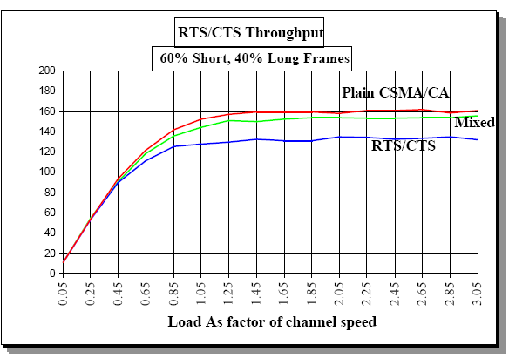
RTS/CTS overhead impact

Slide 60
802.11 Point Coordination Function (PCF)
AP polls stations
polls may include data
stations respond with data or ACKs
Only one AP should operate PCF periods in each channel
PCF periods alternate with DCF periods

Slide 61
DCF and PCF operation
B
PCF
DCF
B
PCF
DCF
Busy
NAV
NAV
NAV: Network Allocation Vector
PCF: Point Coordination Function
DCF: Distributed Coordination Function
B: Beacon Frame

Slide 62
802.11 MAC management
Synchronization
  Finding and staying with a WLAN
    Uses TSF timers and beacons
Power Management
  Sleeping without missing any messages
    Periodic sleep, frame buffering, traffic indication map
Association and Reassociation
  Joining a network
  Roaming, moving from one AP to another
  Scanning

Slide 63
Synchronization
Timing Synchronization Function (TSF)
  Enables synchronous waking/sleeping
  Enables switching from DCF to PCF
  Enables frequency hopping in FHSS PHY
    Transmitter and receiver has identical dwell interval at each center frequency
Achieving TSF
  All stations maintain a local timer.
  AP periodically broadcasts beacons containing timestamps, management info, roaming info, etc.
    Not necessary to hear every beacon
  Beacon synchronizes entire BSS
    Applicable in infrastructure mode ONLY
  Distributed TSF (for Independent BSS) more difficult

Slide 64
802.11 association and roaming
Questions
How does station find AP?
How does station associate with AP?
How does station roam to another AP?

Slide 65
802.11 channels and association
802.11b: 2.4GHz-2.485GHz spectrum divided into 11 channels at different frequencies
  AP admin chooses AP channel
  interference possible: channel can be same as that chosen by neighboring AP!
Stations association with an AP
  scans channels, listening for beacon frames containing AP’s name (SSID) and MAC address (BSSID)
  selects AP to associate with
    based on beacon signal strength
  may perform authentication
  will typically run DHCP to get IP address in AP’s subnet

Slide 66
Passive vs. active scanning
BBS 1
BBS 2
BBS 1
BBS 2
AP 1
AP 2
AP 1
1
AP 2
1
1
2
2
2
3
3
4
H1
H1
Passive Scanning:
beacon frames sent by APs
association Request frame sent by H1 to selected AP
association Response frame sent by selected AP to H1
Active Scanning:
Probe Request frame broadcasted from H1
Probes response frame sent from APs
Association Request frame sent from H1 to selected AP
Association Response frame sent from selected AP to H1

Slide 67
802.11 roaming
No or bad connection? Then perform:
Scanning
  scan the environment, i.e., listen into the medium for beacon signals or send probes into the medium and wait for an answer
Reassociation Request
  station sends a request to one or several AP(s)
Reassociation Response
  success: AP has answered, station can now participate
  failure: continue scanning
AP accepts Reassociation Request
  signal the new station to the distribution system
  the distribution system updates its data base (i.e., location information)
  typically, the distribution system now informs the old AP so it can release resources
Roaming support robustness/redundancy and mobility

Slide 68
802.11 roaming (cont)
L2 handover
  If handover from one AP to another belonging to the same subnet, then handover is completed at L2
L3 handover
  If new AP is in another domain, then the handover must be completed at L3, due to the assignment of an IP belonging to the new domain – hence routing to the new IP.
    Mobile IP deals with these issues – more later

Slide 69
H1 remains in same IP subnet: IP address can remain same
switch: which AP is associated with H1?
  self-learning: switch will see frame from H1 and “remember” which switch port can be used to reach H1
router
hub or
switch
BBS 1
AP 1
AP 2
H1
BBS 2

Slide 70
Reactive and proactive scanning
Reactive: scan when connection lost
Proactive: periodically scan for better AP
  higher performance but higher overhead
not standardized by 802.11
  vendor/implementation specific

Slide 71
802.11 rate adaptation
base station, mobile dynamically change transmission rate (physical layer modulation technique)
Key questions:
  what to measure
  when to change rate
  what rate to change to
10⁻¹
10⁻²
10⁻³
QAM256 (8 Mbps)
QAM16 (4 Mbps)
BER
10⁻⁴
BPSK (1 Mbps)
operating point
10⁻⁵
10⁻⁶
10⁻⁷
10
20
30
40
SNR(dB)
1. SNR decreases, BER increase as node moves away from base station
2. When BER becomes too high, switch to lower transmission rate but with lower BER

Slide 72
802.11 power management
Station-to-AP: “I am going to sleep until next beacon frame”
  AP knows not to transmit frames to this station
  Station wakes up before next beacon frame
Beacon frame: contains list of stations with packets waiting in AP buffer
  station stays awake as long as AP has frames to send it; otherwise sleeps again until next beacon frame
  if AP has packets for it, station polls AP
Broadcast packets can also be buffered

Slide 73
Battery powered devices require power efficiency
  LAN protocols assume idle nodes are always ON and thus ready to receive.
  Idle-receive state key source of power wastage
Devices need to power off during idle periods
  Yet maintain an active session – tradeoff power Vs throughput
Achieving power conservation
  Allow idle stations to go to sleep periodically
  APs buffer packets for sleeping stations
  AP announces which stations have frames buffered when all stations are awake – called Traffic Indication Map (TIM)
    TSF assures AP and Power Save stations are synchronized
    TSF timer keeps running when stations are sleeping

Slide 74
MAC management frames
Beacon
  Timestamp, Beacon Interval, Capabilities, ESSID, Supported Rates, parameters
  Traffic Indication Map
Probe
  ESSID, Capabilities, Supported Rates
Probe Response
  Timestamp, Beacon Interval, Capabilities, ESSID, Supported Rates, parameters
  same for Beacon except for TIM
Association Request
  Capability, Listen Interval, ESSID, Supported Rates
Association Response
  Capability, Status Code, Station ID, Supported Rates

Slide 75
MAC management frames (cont)
Reassociation Request
  Capability, Listen Interval, ESSID, Supported Rates, Current AP Address
Reassociation Response
  Capability, Status Code, Station ID, Supported Rates
Disassociation
  Reason code
Authentication
  Algorithm, Sequence, Status, Challenge Text
Deauthentication Reason

Slide 76
Fragmentation and reassembly
Allow burst of frame which are individually acknowledged
  smaller frames => smaller frame loss prob
Unicast only
Random backoff and retransmission in case of fragment loss
NAV duration in fragments and ACKs
When to fragment: frame size > fragmentation threshold
Implementation: same frame sequence number, increasing fragment number, MF (More Fragments) bit (=0 for last fragment)

Slide 77
Fragmentation
DIFS
Other
NAV(RTS)
NAV(Fragment0)
NAV(Fragment1)
PIFS
Back off Window
NAV(CTS)
NAV(ACK0)
NAV(ACK1)
SIFS
R
T
S
S
I
F
S
S
I
F
S
S
I
F
S
S
I
F
S
S
I
F
S
S
I
F
S
S
I
F
S
S
I
F
S
Transmitter
Fragment0
Fragment1
Fragment2
C
T
S
A
C
K
0
A
C
K
1
A
C
K
2
Receiver
NAV: Network Allocation Vector
RTS: Request To Send
CTS: Clear To Send
ACK: Acknowledgement
DIFS: Distributed IFS
PIFS: Point IFS
SIFS: Short IFS

Slide 78
802.11 security
Authentication: ensure station is allowed to associate to partiular AP
Privacy: prevent outsiders from eavesdropping
802.11: contains mechanisms to support both, but many aspects are vendor specific

Slide 79
WEP: Wired Equivalent Privacy
Provide security similar to wired 802 networks
Encryption over wireless hop (not end-to-end)
  only data payload
  based on RC4 stream cipher
  64-bit WEP (40 bit key), 128-bit WEP (26 hexadecimal – 106 bit key)

Slide 80

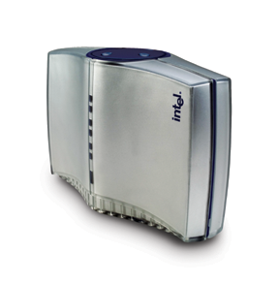
802.11i – Operational Components
Station
Access Point
Authentication Server
Security capabilities discovery
802.1X authentication
802.1X key management
RADIUS-based key distribution
Data protection

Slide 81
Actions of each phase
Discovery
  Determine promising parties with whom to communicate
  AP advertises network security capabilities to STAs
802.1X authentication
  Centralize network admission policy decisions at the AS
  STA determines whether it does indeed want to communicate
  Mutually authenticate STA and AS
  Generate Master Key as a side effect of authentication
  Use master key to generate session keys = authorization token

Slide 82
Actions of each phase (cont)
RADIUS-based key distribution
  AS moves (not copies) session key (PMK) to STA’s AP
802.1X key management
  Bind PMK to STA and AP
  Confirm both AP and STA possess PMK
  Generate fresh operational key (PTK)
  Prove each peer is live
  Synchronize PTK use

Slide 83
Data transfer
802.11i defines 2 protocols to protect data transfer
  TKIP – for legacy devices only
  CCMP – better security for new devices
Two protocols instead of one due to politics

Slide 84
Data transfer requirements
Never send or receive unprotected packets
Message origin authenticity — prevent forgeries
Sequence packets — detect replays
Avoid rekeying — 48 bit packet sequence number
Eliminate per-packet key – don’t misuse encryption
Protect source and destination addresses
Use one strong cryptographic primitive for both confidentiality and integrity
Interoperate with proposed quality of service (QoS) enhancements (IEEE 802.11 TGe)

Slide 85
Extended Distributed Channel Access (EDCA)
DIFS (AIFS in 802.11e)
CWmin
CWmax
Transmission Opportunity (TXOP)
Can also differentiate:
Persistence Factor (PF): CW increase after collision
Supported by EDCA

Slide 86
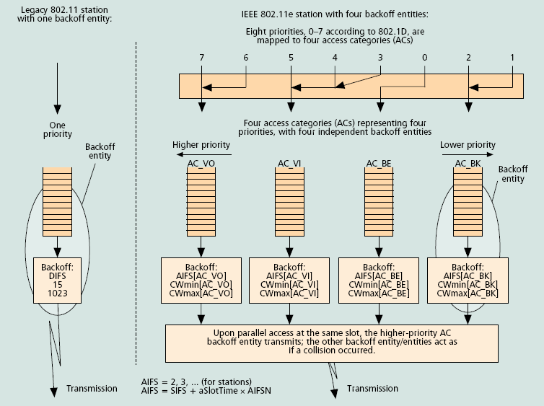
802.11e Access Categories

Slide 87
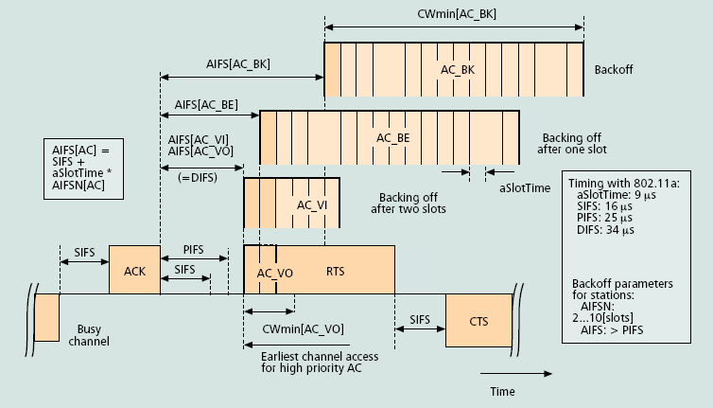
802.11e multiple backoff entities

Slide 88
Other 802.11 enhancements
802.11f: inter-AP communication
802.11h: dynamic frequency selection and power control
802.11i: enhanced security
802.11k: Radio measurements
802.11p
  WAVE: wireless access for vehicular environments
802.11r: reduction of handoff latency
802.11s
  Mesh networking

Slide 89
Τέλος Ενότητας # 5
Μάθημα: Ασύρματα Δίκτυα και Κινητές Επικοινωνίες
Ενότητα # 5: Ασύρματα Τοπικά Δίκτυα (Wireless LANS - IEEE 802.11)
Διδάσκων: Βασίλειος Σύρης
Τμήμα: Πληροφορικής

