Slide 1


Ασύρματα Δίκτυα και Κινητές Επικοινωνίες
Ενότητα # 3: Ασύρματο Κανάλι και Διάδοση Σημάτων
Διδάσκων: Βασίλειος Σύρης
Τμήμα: Πληροφορικής

Slide 2
What is wireless networking
Any form of communication that does not require the transmitter and receiver to be in physical contact
Simplex: one-way communication (e.g., radio, TV)
Half-duplex: two-way communication but not simultaneous (e.g., walkie-talkie, CB)
Full-duplex: two-way communication (e.g., cellular phones)

Slide 3
Basic communication system (single hop)
Transmitter performs encoding, modulation, and multiplexing
Receiver performs demodulation and demultiplexing
Transmitter
(Tx)
Channel
Receiver
(Rx)

Slide 4
Basic communication network (multiple hops)
Wired communication: channels independent (no interference)
Wireless: channels interfere
Same feature can be an advantage: broadcast
Channel
Channel
Tx/Rx
Tx/Rx
Channel
Node
Channel

Slide 5
Basic wireless terms
Frequency
Spectrum
Bandwidth
Capacity

Slide 6
Frequency
Frequency is the number of times that a wave's peak passes a fixed point in a specific period of time
Point A
1 Second
10 Cycles / 1 Second = 10 Hertz

Slide 7
Frequency (cont)
Frequency is measured in cycles per second, or Hertz (Hz)
Cellular phones, for example, produce radio waves with frequencies around 900 million Hz (900 MHz)
  1,000 Hz = 1 KiloHertz (kHz)
  1,000,000 Hz = 1 MegaHertz (MHz)
  1,000,000,000 Hz = 1 GigaHertz (GHz)

Slide 8
Spectrum
For our purposes, spectrum is the term that describes a set of radio waves that can be used to transmit information

Slide 9
Electromagnetic spectrum
Wireless communications: 100KHz-60GHz

Slide 10

Wireless Spectrum (1)
Broadcast TV
VHF: 54 to 88 MHz, 174 to 216 MHz
UHF: 470 to 806 MHz
30 MHz
300 MHz
3 GHz
30 GHz
FM Radio
88 to 108 MHz
Digital TV
54 to 88 MHz, 174 to 216 MHz, 470 to 806 MHz

Slide 11
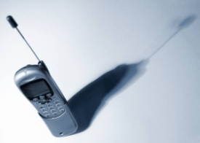
Wireless Spectrum (2)
3G Broadband Wireless
746-794 MHz, 1.7-1.85 GHz, 2.5-2.7 GHz
30 MHz
300 MHz
3 GHz
30 GHz
Cellular Phone
800-900 MHz
Personal Communication Service (PCS)
1.85-1.99 GHz

Slide 12


Wireless Spectrum (3)
Wireless LAN (IEEE 802.11b/g)
2.4 GHz
Wireless LAN (IEEE 802.11a)
5 GHz
30 MHz
300 MHz
3 GHz
30 GHz
Bluetooth
2.45 GHz
Local Multipoint Distribution Services (LMDS)
27.5-31.3 GHz

Slide 13
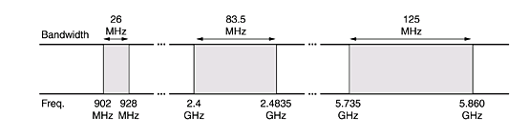
ISM Band (Industrial Scientific Medical)
Unlicensed
Used mainly by WLANs

Slide 14
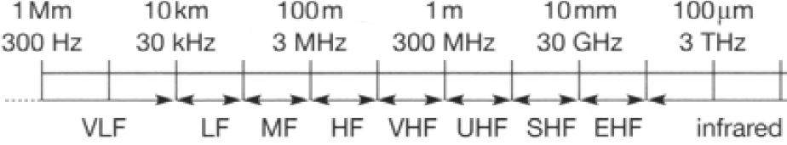
Basic properties
Moving from left to right
  higher bandwidth
  shorter range (higher attenuation, blocking)
  more power
  more sophisticated electronics

Slide 15
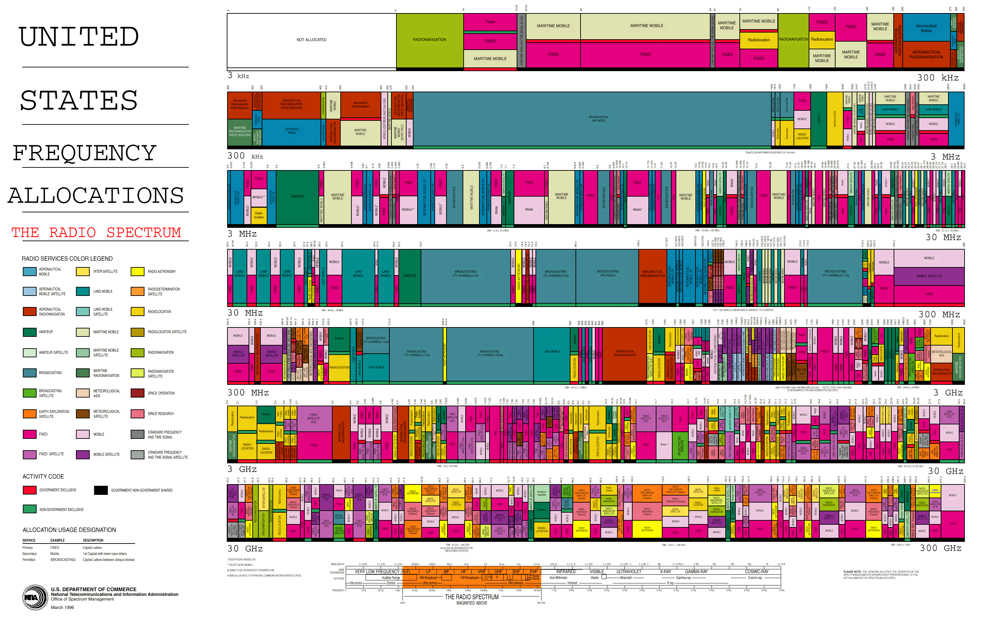
Radio Spectrum Allocation (USA)

Slide 16
Frequency vs. Bandwidth
Frequency is a specific location on the electromagnetic spectrum
Bandwidth is the range between two frequencies
  Bandwidth is measured in Hertz
  A cellular operator may transmit signals between 924-949 MHz, for a total bandwidth of 25 MHz

Slide 17
Bandwidth vs. Capacity
Bandwidth for a particular service is fixed, but the number of calls and the rate of data transmission is not (capacity)
The technology used determines the capacity of a particular bandwidth
Shannon capacity fundamental limit

Slide 18
Signal strength (or power)
The ability of an electromagnetic wave to persist as it radiates out from its transmitter
Signal strength, or power, is measured in Watts, or more conveniently expressed relative to milliWatts in decibels (dBm)

Slide 19
Signal propagation range
Transmission range
  communication possible
  low error rate
Detection range
  detection of the signal possible
  no communication possible
Interference range
  signal may not be detected
  signal adds to the background noise
sender
transmission
detection
distance
interference

Slide 20
Fading
Large-scale fading
Small-scale fading
Flat (frequency non-selective) fading

Slide 21
Fading (1)
With path loss and
shadow fading
Received
Signal
With path loss, shadow
fading, and Rayleigh fading
Power
(dB)
With path loss
log (distance)
path loss
slow fading (also called long term, shadowing)
fast fading (short term)

Slide 22
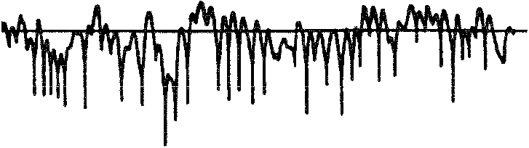
Fading (2)
Received
10
Signal
0
dB With Respect
Power
-10
to Average Value
(dB)
-20
0.5λ
-30
0
0.5
1
1.5
t, in seconds
0
10
20
30
x, in wavelength
fading due to multipath and mobility

Slide 23
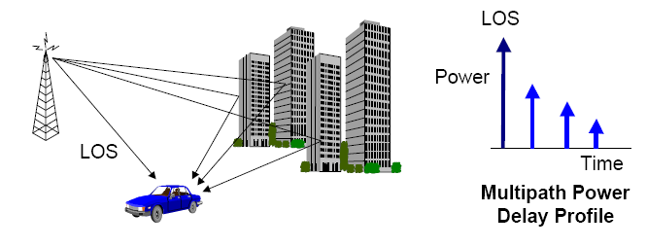
Multipath

Slide 24
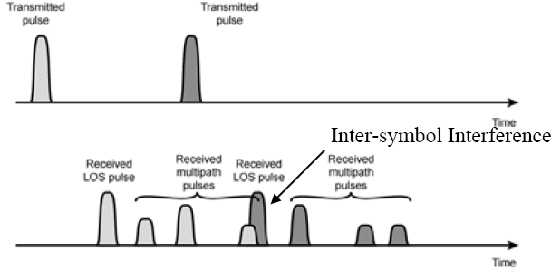
Multipath and delay spread
Delay spread: time between first and last version of signal
Multipath may add constructively or destructively => fast fading

Slide 25
Free space propagation model
Power of wireless transmission reduces with square of distance (due to surface area increase)
Reduction also depends on wavelength
  High wavelength/low frequency has less loss
  Small wavelength/high frequency has more loss

Slide 26
Fading (cont)
With path loss and
shadow fading
Received
Signal
With path loss, shadow
fading, and Rayleigh fading
Power
(dBm)
With path loss
log (distance)
path loss
slow fading (also called long term, shadowing)
fast fading (short term)

Slide 27
General propagation model
PL0 loss at reference distance d0
Path loss exponent a depends on environment
  Free space 2
  Urban area cellular 2.7 to 3.5
  Shadowed urban cell 3 to 5
  In building LOS 1.6 to 1.8
  Obstructed in building 4 to 6
  Obstructed in factories 2 to 3

Slide 28
dB and dBm
Decibel (dB): relative unit of measurement
Signal strength or power measured in dBm: power relative to 1mW
  1mW = 0dBm
  100mW=20dBm
  200mW=23dBm
  1000mW=30dBm

Slide 29
Path loss in dB
Path loss when power measured in Watt
Path loss when power measured in dBm
3dB loss = power halved (3dB ≈ 10log2)
easier to do addition/subtraction compared to multiplication/division

Slide 30
General propagation model (cont)
PL0 loss at reference distance d0
in dB
  path loss increases linear to log of distance

Slide 31
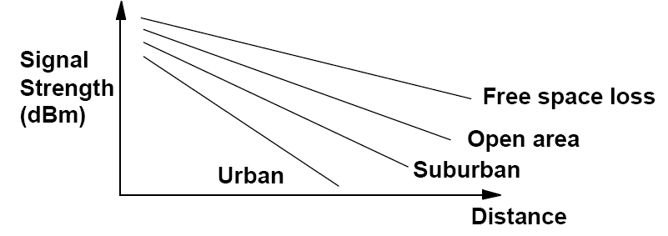
Path loss in different environments

Slide 32
Channel capacity
Transmission rate or Capacity
  In bits per second
  Rate at which data can be communicated
Bandwidth
  In cycles per second or Hertz (Hz)
  Constrained by transmitter and medium
Baud: symbols/second
  Baud ≠ Bits per second!

Slide 33
Nyquist Bandwidth
Noise-free channel
Limiting factor on transmission is channel bandwidth, and intersymbol interference
If bandwidth is B, highest signal rate is 2B
M different symbols encoded in log₂M bits
Multi-level signaling:
  C is the data rate
  B is the bandwidth
  M is the number of levels

Slide 34
Shannon’s Theorem
Noise creates errors
Each transmission channel corresponds to some maximum capacity C
Rate R<C can be transmitted with arbitrarily small bit error probability
  B is channel bandwidth in Hz
  S/N is signal to noise ratio at receiver

Slide 35
Shannon’s Theorem (cont.)
Gives theoretical maximum that can be achieved
Does not indicate how it can be achieved

Slide 36
Thermal noise
Thermal noise due to agitation of electrons
Present in all electronic devices and transmission media
Cannot be eliminated
Function of temperature

Slide 37
Thermal noise (cont.)
Amount of thermal noise found in a bandwidth of 1Hz in any device is:
    N0 = noise power density in watts per 1 Hz of bandwidth
    k = Boltzmann's constant = 1.3803 x 10⁻²³ J/K
    T = temperature, in kelvins (absolute temperature)
Noise is assumed to be independent of frequency
Thermal noise in bandwidth B Hertz

Slide 38
Example
Spectrum of a channel between 3 MHz and 4 MHz; SNR = 24 dB; what is the capacity? How many signaling levels are required?

Slide 39
Solution
SNR:
Shannon capacity:
Signaling levels required:

Slide 40
Eb/N0 and BER
Ratio of signal energy per bit to noise power density per Hertz
Bit Error Rate (BER) for digital data is a function of Eb/N0
  Given a value for Eb/N0 to achieve a desired error rate, parameters of this formula can be selected
  As bit rate Rb increases, transmitted signal power S must increase to maintain required Eb/N0

Slide 41
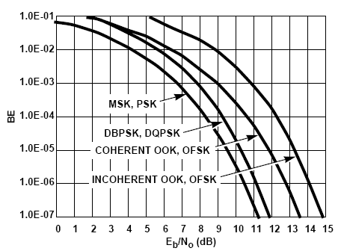
Eb/N0 and BER (cont.)
BER as function of Eb/N0 depends on modulation scheme

Slide 42
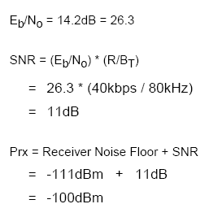
Receiver sensitivity
Receiver sensitivity (Prx): minimum signal strength to achieve given BER
Prx=ReceiverNoiseFloor+SNR

Slide 43
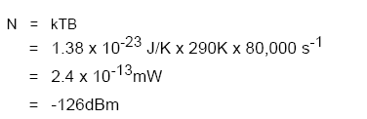

Noise floor
Thermal noise power (80KHz bandwidth):
Above is noise floor for ideal receiver
Practical receiver noise floor:

Slide 44
Link budget calculation
Link budget equation:
  P_{T}: power at transmitter in dBm
  CL_{T}: cable and connector losses at transmitter in dB
  G_{T}: transmitter antenna gain in dBi
  P_{L}: propagation loss in dB
  CL_{R}: cable and connector losses at receiver in dB
  G_{R}: receiver antenna gain in dBi
  Prx: receiver sensitivity in dBm
To achieve communication, Link Margin>Min Margin (=10-20 dB in practice)

Slide 45
Antenna radiation
Isotropic antenna (idealized) radiates power equally in all directions
Most practical antennas do not radiate power equally in all directions
  antenna’s radiation pattern shows energy it transmits/collects in each direction
Antenna gain measured in dBi
  power output in preferred direction compared to perfect isotropic antenna

Slide 46
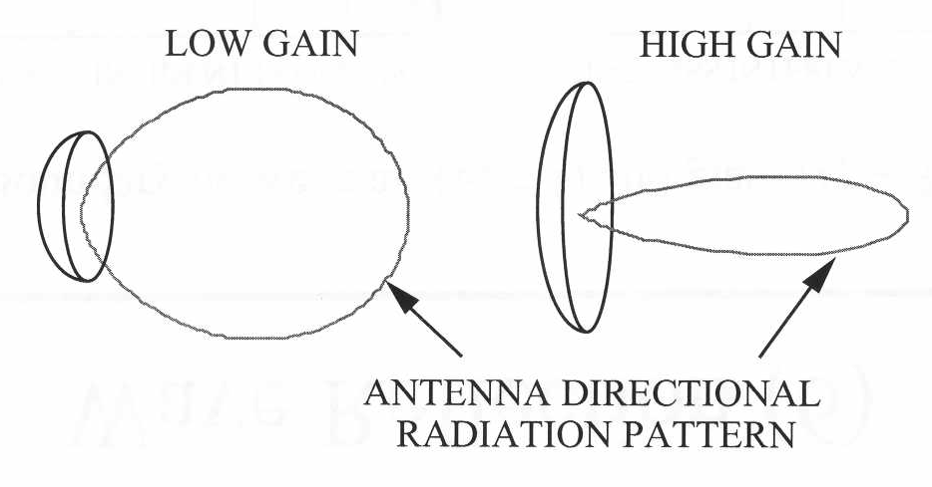
Antenna gain

Slide 47
Antenna types
Isotropic antenna (idealized)
  Radiates power equally in all directions
Omni-directional
Dipole antennas
Yagi
Parabolic or dish
Sector
Panel

Slide 48

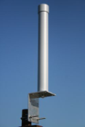
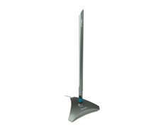

Omni-directional antennas
Indoor and outdoor
Typically 2-15 dBi

Slide 49
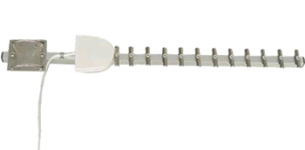
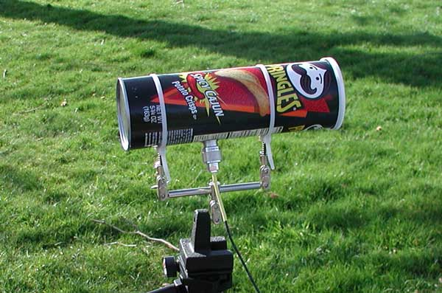
Yagi
referred to as Yagi – Uda
typically very directional
Cantenna: built from Pringles box!

Slide 50

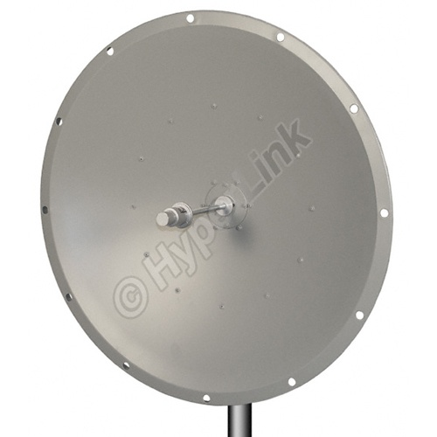
Parabolic
grid/wiretype or satellite dish (solid)

Slide 51
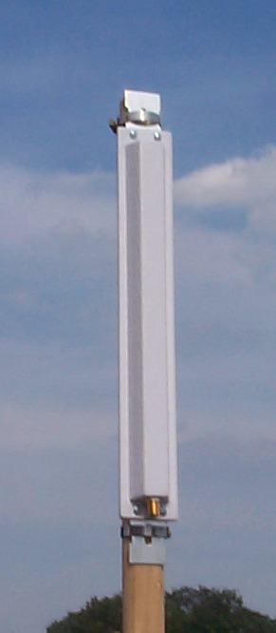
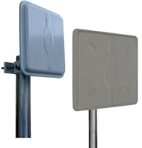
Sector and panel antennas
Patch: smaller version of panel antenna

Slide 52
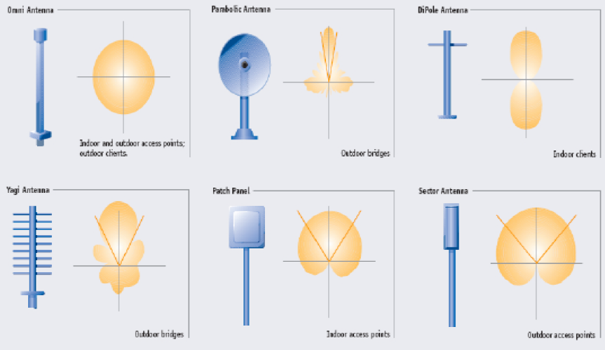
Antenna radiation patterns
Omni
Parabolic
Dipole
Yagi
Patch
Sector

Slide 53
EIRP
EIRP: Effective Isotropic Radiated Power
EIRP=Transmitter Power + Transmitter Gain – Cable Loss
European Radiocommunications Committee (ERC) sets max average EIRP (FCC in US)
max EIRP
  2.4GHz: max EIRP=100mW (20dBm)
    US: 36 dBm (9dBi omni), 48dBm (24dBi directional)
  5.150-5.350GHz (indoor use): 200mW (23dBm)
  5.470-5.725GHz: 1W (30dBm)
    US: 5.25-5.35: 30dBm, 5.725-5.825: 36dBm, higher for p2p

Slide 54
Τέλος Ενότητας # 3
Μάθημα: Ασύρματα Δίκτυα και Κινητές Επικοινωνίες
Ενότητα # 3: Ασύρματο Κανάλι και Διάδοση Σημάτων
Διδάσκων: Βασίλειος Σύρης
Τμήμα: Πληροφορικής

