Slide 1

Cryptographic solutions for geolocation privacy in mobile applications
George Stergiopoulos, Assistant Professor
University of the Aegean, Samos, Greece
2022

Slide 2


Who am I
Position
  Assistant Professor of IT/OT Systems Security
    University of the Aegean, Samos, Greece
  Security and Information Privacy
Research Interests
  Industrial Systems Security, Critical Infrastructure Protection and Risk Assessment.
  Network Security and Information privacy with cryptographic applications.
  Security in Software Engineering.

Slide 3

Location Based Services (LBS)
Google Maps
Dark Sky
Foursquare
Pokemon Go
Uber
Tinder
WhatsApp

Slide 4
LBS Pros and Cons
Pros ( = utility)
Near shops
Near offers
Travel information
Real-time weather forecasting
Physical disaster notifications
Call for help
Personalized location-based suggestions
Friends' locations
Dating and social
Marketing
Cons ( = privacy issues)
Route prediction
Social privacy
Ηabits
Religious, political, and sexual beliefs
Profiling
Behavioral targeting
Location disclosure to third-parties (e.g., for marketing)

Slide 5
Generalizing the LBS issue
Privacy-preserving computation
  A subfield of cryptography with the goal of creating methods for parties to jointly compute a function over their inputs while keeping those inputs private.
Private Set Intersection (PSI)
  PSI is a privacy-preserving computation cryptographic technique that allows two parties holding sets (e.g., location coordinates) to compare encrypted versions of these sets in order to compute the intersection. Neither party reveals anything to the other party except for the elements in the intersection.
Private Proximity Testing (PPT)
  Subset of PSI, PPT is a privacy-preserving computation cryptographic technique that allows users to know if they are within a threshold distance of each other at a given time without revealing information about their respective locations to anyone.
  In some protocols it is reduced to Private Equality Testing (PET) which allows two users to compare their private values for checking the equality (if a = b) without disclosing any information to each other.

Slide 6
2PC vs PSI ?
Secure two-party computation (2PC)
  Create a generic protocol that allows two parties to jointly compute an arbitrary function on their inputs without sharing the value of their inputs with the opposing party.
Public Set intersection
  One of numerous 2PC tasks
  Two parties hold two sets of strings X and Y, respectively. At the end of the
  protocol one (or both) party should learn the intersection of the two sets Z = X ∩ Y and nothing else about the input of the other party.
  Many real-world applications (COVID, mobile apps, supply chain etc.)

Slide 7




“Common Hobbies Dating”
Bob
Alice
Lord of the Rings (LOTR) Compatibility Protocol
WARNING!
Don’t Engage: LOTR Amazon series fan!
WARNING!
Don’t Engage: LOTR Book fan!

Slide 8
“Common Hobbies Dating”
Seriously?!
I adored Amazon’s interpretation of LOTR
FYI I agree with this person
Bob
Alice
Lord of the Rings (LOTR) Compatibility Protocol
WARNING!
Don’t Engage: LOTR Amazon series fan!
WARNING!
Don’t Engage: LOTR Book fan!

Slide 9
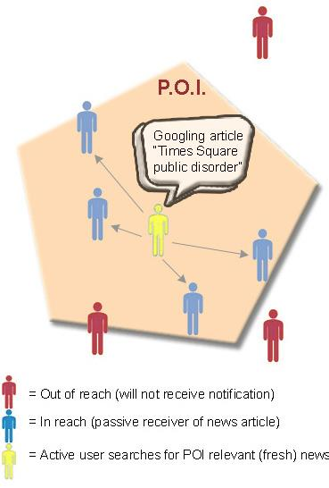
PSI vs PPT?
Private Proximity Testing
  Computes whether two parties are close to each other, without revealing their distances and positions to each other, or to any other external party.
  Usually via a thresholds.
  Potential issues with mobile adversary triangulating the other party’s exact position.

Slide 10
Location privacy via private proximity testing (PPT)
PPT architectures
PPT encryption
PPT different technology categories

Slide 11
PPT architectures
Trusted Third Party (TTP)
  A trusted third-party server that has access to the actual data coming from all users.
Non-Trusted Third Party (NTTP)
  One or more third-party servers that are considered not trusted.
Peer-to-Peer (P2P)
  Users exchange information in a peer-to-peer way to protect their data, without using a third-party server.
Local
  Does not require any communication with another party to protect data and process everything locally on the device.

Slide 12
PPT Basic technology stack
PPT
Public-key cryptography algorithms
Symmetric key cryptography algorithms
Garbled Circuits
Location tags
Homomorphic encryption algorithms (RSA, ElGamal, Paillier)
Elliptic-curve cryptography algorithms (ECC Diffie–Hellman (ECDH))
Lattice-based cryptography algorithms (NTRU encryption algorithm)
Block ciphers (AES)
WiFi tags
GSM tags
Location sketches
Environmental noise tags
Obfuscated boolean gate truth tables
Encoding / Encryption of a bool function

Slide 13
PPT crypto schemes
Symmetric key
The same key is used to encrypt and decrypt the message.
Fast
Used for large amounts of data
Less practical than asymmetric (?)
Mostly use AES
Hybrid key
Asymmetric to establish a secure connection (i.e., exchange the symmetric key)
Symmetric to communicate in a fast way
Examples: SSL, TLS, PGP
Asymmetric key
Two different keys to encrypt and decrypt the message.
Slower compared to symmetric
Used for small amounts of data
More utility than symmetric (?)
Examples: Diffie-Hellman, ECC, ElGamal and RSA

Slide 14
Metrics to compare PPT technologies
Privacy metrics
Utility metrics
Performance metrics

Slide 15

Location Privacy Metrics
Formal guarantee
  k-anonymity forlocation privacy: In given time window and area, there should be at least k users.
  In ∈-differential privacy (location privacy-protecting mechanisms) LPPMs attempt to protect the presence or absence of individual locations.
    Goal not to hide that a user in a dataset but to hide where he/she went.
Data distortion
  Compare privacy-related properties of mobility data before and after applying an LPPM on it.
  Using an LPPM is expected to hide sensitive information that was otherwise possible to obtain from actual mobility data.
  Examples include computing the entropy of protected data or evaluating whether POIs can still be retrieved.
Attack correctness
  Evaluate the impact of a location privacy attack that could be run by an adversary in order to gain knowledge about users.
  Three axes: Certainty, Accuracy and Correctness

Slide 16

Location Utility Metrics
Data distortion
  Compare utility-related properties of mobility before and after applying an LPPM on it.
  Examples of such metrics include evaluating the spatial and temporal imprecision and comparing the covered area.
Task distortion
  Compare the result of some practical tasks on the data before and after applying an LPPM. For instance, these metrics can be interested in data mining tasks or analytics queries.

Slide 17

Location Performance Metrics
Execution time
  A quantification of the time it takes for an LPPM to protect data. The execution time can be measured in different ways (e.g., seconds or CPU cycles).
Communication overhead
  Quantify the negative impact of applying an LPPM on the quantity of information that will be produced and exchanged through the network in online use cases.
  It has an impact on the execution time, but it can be measured separately.
Energy overhead
  Measure the battery consumption implied by using a given LPPM, when running it as an application on a mobile device.
  Scalability measures
    Responsiveness to high workload. For online LPPMs, scalability metrics are mostly related to the capability of handling a high volume of concurrent requests, while for offline LPPMs it concerns the ability to deal with datasets of large sizes.

Slide 18
Garbled Circuits

Slide 19
Garbled Circuits introduction [2]
Two parties, Ginny and Evan, want to figure out whether they should collaborate on a project.
Represent Ginny and Evan’s preferences using bits:
  Ginny’s bit g is 1 if she wants to work with Evan and 0 otherwise, and
  Similarly, Evan’s bit e is 1 if he wants to work with Ginny and 0 otherwise.
Goal: figure out the conjunction (AND, denoted ^) of their two bits g ^ e, without revealing anything else to one another.

Slide 20
Garbled Circuits introduction [2]
Goal can be realized using Yao’s Garbled Circuits.
  Garbling is a process by means of which the boolean gate truth table is obfuscated.
  Ginny, playing the role of a garbled circuit generator, or garbler, can generate a garbled AND gate and send it to Evan.
  Evan, playing the role of an evaluator, can then evaluate this garbled gate.
Ginny picks four random strings, or labels:
  WG0, WG1, WE0 and WE1.
    WG0 corresponds to the event that g = 0, and WG1 corresponds to the event that g = 1.
    Similarly, WE0 corresponds to the event that e = 0, and WΕ1 corresponds to the event that e = 1.

Slide 21
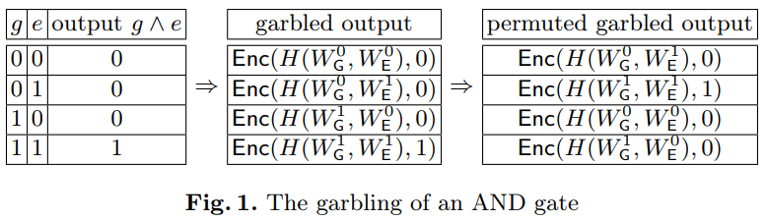
Garbled Circuits – Algorithm [2]
Ginny then uses every pair of labels corresponding to a possible scenario ((g = 0; e = 0); (g = 0; e = 1); (g = 1; e = 0) and (g = 1; e = 1)) to encrypt the output corresponding to that scenario, as shown in Figure 1.
  Two relevant labels put through key derivation function H to derive a symmetric encryption key, and that key is used to encrypt g ^ e.
  Garbled gate consists of the four resulting ciphertexts, in a random order (Figure 1).
Evan receives the garbled gate and needs to decrypt exactly one ciphertext corresponding to the real values g and e, encrypted with H(WGg; WEe).
To do this, he needs to receive the values WGg and WEe from Ginny.

Slide 22
Garbled Circuits - Algorithm [2]
Since Ginny knows g, she can send Evan WGg. The labels are all random, independent and identically distributed.
Getting WEe to Evan is harder.
  Ginny can’t send both WE0 and WE1 to Evan, because that will allow Evan to decrypt two ciphertexts in the garbled gate.
  Similarly, Evan can’t simply ask for the one he wants, because he doesn’t want Ginny to learn e.
So, Ginny and Evan use oblivious transfer, which allows Evan to learn only WEe without revealing e to Ginny.
  Evan needs to know when decryption succeeds, and when it doesn’t.
  Simply XOR-ing the key with the encrypted value will not work here.

Slide 23
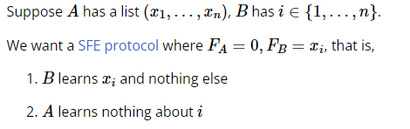
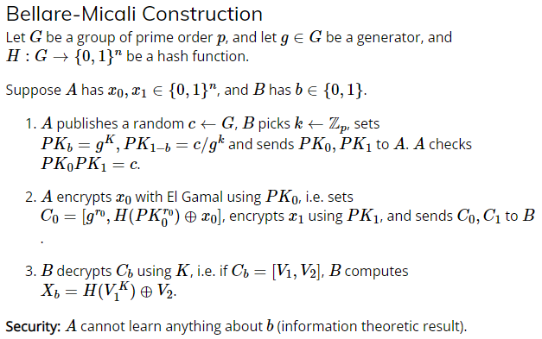
Oblivious Transfer [3]

Slide 24
Asymmetric public-key cryptography algorithms

Slide 25




ElGamal for PPT
Round 1 – Key generation and encryption
  When the system is first installed on the client it chooses a random x in Zp and computes h ← g^{x}
  Alice computes an ElGamal encryption of her location a encoded as hª
  Alice chooses a random r in ℤ_{p} and then computes C_{a} ← (g^{r}, h^{a+r}) and sends the ElGamal encryption ciphertext C_{a} to Bob.
Round 2 - Key generation and encryption
  Bob chooses a random non-zero s in ℤ_{p} and
  uses his own location b and the ciphertext Ca = (g₁, g₂) from Alice to construct his ciphertext of the message s . (a – b).
  Bob chooses a random t in ℤ_{p} and computes C_{b} ← (g₁^{s} g^{t}, g₂^{s} h^{(t-sb)}) and sends his ElGamal encryption ciphertext C_{b} to Alice.
Round 3 – Decryption
  Alice receives Bob’s ciphertext C_{b} = (u₁,u₂) = (g^{w}, h^{s(a-b)+w}) and uses her secret key x to decrypt C_{b}.
  She computes m ← (u₁ / u₂^{x}) = h^{(s(a-b)}.
    If m = 1 she concludes that a = b and
    if not, she concludes that a ≠ b.
  Note: In this case, Private Proximity Testing is reduced to Private Equality Testing.
C_{a} ← (g^{r}, h^{a+r})
C_{a}
Alice
Bob
C_{b} ← (g₁^{s} g^{t}, g₂⁸ h^{(t-sb)})
C_{b}
Alice
Bob
m ← (u₁ / u₂^{x}) = h^{(s(a-b)}
Alice
If m = 1, Alice learns that her location a is the same as Bob’s location b. If not, she learns that she is not in the same location and nothing else.

Slide 26
ElGamal
Choose between two plaintexts, m₀ and m₁, and receive encryption of either one. Semantically secure, if cannot guess with P != 1/2 whether given is an encryption of m₀ or m₁.
Asymmetric key encryption algorithm for public-key cryptography based on the Diffie–Hellman key exchange
ElGamal_{ECC}:
  Elliptic Curve Cryptography (ECC) used with ElGamal to create faster, smaller and more efficient cryptographic keys.
  Security-1
    depends on the properties of the underlying group G as well as any padding scheme used on the messages.
    If the computational Diffie–Hellman assumption (CDH) holds in the underlying cyclic group G, then the encryption function is secure.
  Security-2
    If the decisional Diffie–Hellman assumption (DDH) holds in G, then ElGamal achieves semantic security.
    Unconditionally malleable, and therefore is not secure under chosen ciphertext attack.
    To achieve chosen-ciphertext security, the scheme must be further modified.
  Efficiency
    ElGamal encryption is probabilistic.
    Encryption requires three or two exponentiations.
    Decryption requires two or one exponentiation.

Slide 27
Protocols based on ElGamal
Narayanan et al. 2011 (Location Privacy via Private Proximity Testing)
  A P2P protocol based on a mechanism of Lipmaa and the adaption for the asymmetric setting (ElGamal) with an efficiency improvement
  Secure against arbitrary collusion assuming the hardness of the standard Decision Diffie-Hellman problem.
  3 exponentiations for Alice and 2 for Bob.
Hallgren et al. 2015 (InnerCircle: A Parallelizable Decentralized Privacy-Preserving Location Proximity Protocol)
  A P2P protocol tested with Paillier encryption, ElGamal_{ℤ} and ElGamal_{ECC}
  Compared with protocols that use Garbled Circuits and homomorphic encryption (i.e., TASTY and FasterGC) and itself implemented with Paillier encryption, ElGamal_{ℤ} and ElGamal_{ECC} prove to be faster.
Figure: Hallgren et al. 2015 comparison

Slide 28
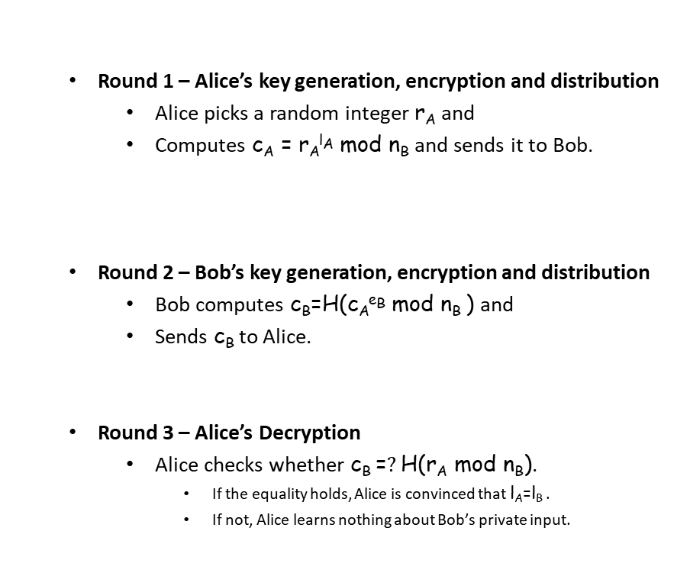

RSA – How it works for PPT
  Initialization
    Alice selects two prime numbers p_{A} and q_{A} which are kept private and publishes their factoring n_{A} (n_{A} = p_{A} . qA).
    At a given time period she is located at l_{A} and will set d_{A} ≡ l_{A} and will compute e_{A} : d_{A}·e_{A} = 1 mod ϕ(n_{A}).
    The same applies for Bob, which means that he selects two prime numbers p_{B} and q_{B} and publishes n_{B}.
    At a given time period he is located at l_{B} and will set d_{B} ≡ l_{B} and will compute e_{B} : d_{B}·e_{B} = 1 mod ϕ(n_{B}).
  Round 1 – Alice’s key generation, encryption and distribution
    Alice picks a random integer r_{A} and
    Computes c_{A} = r_{A}^{lA} mod n_{B} and sends it to Bob.
  Round 2 – Bob’s key generation, encryption and distribution
    Bob computes c_{B}=H(c_{A}^{eB} mod n_{B} ) and
    Sends c_{B} to Alice.
  Round 3 – Alice’s Decryption
    Alice checks whether c_{B} =$?$ H(r_{A} mod n_{B}).
      If the equality holds, Alice is convinced that l_{A}=l_{B} .
      If not, Alice learns nothing about Bob’s private input.
c_{A} = r_{A}^{lA} mod n_{B}
C_{a}
Alice
Bob
C_{b}
c_{B}=H(c_{A}^{eB} mod n_{B} )
Alice
Bob
c_{B} =$?$ H(r_{A} mod n_{B})
Alice

Slide 29
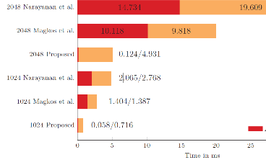
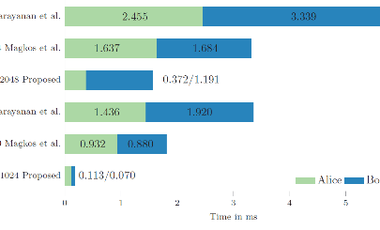
Protocols based on RSA
Kotzanikolaou et al. 2015 (Lightweight private proximity testing for geospatial social networks)
  A Non-Trusted Third Party (NTTP) protocol based on RSA
  It provides unconditional location privacy for Alice, the initiator of the protocol, while the privacy of Bob, the responder is guaranteed under the intractability of the factoring problem.
  One modular exponentiation for each user
  Outperforms some protocols with RSA 1024 and 2048-bit key settings
  Almost parity under certain conditions with elliptic curve cryptography in 224-bit key settings.

Slide 30
Use-Case:
Asymmetric cryptography with geotagging
“WoM”

Slide 31
“Word of Mouth” (WoM) PPT app
Near-complete protection of users’ location privacy for information distribution.
  e.g. A server cannot track the user's location and data.
  RSA encryption ensures user privacy.
The idea can be used in many applications that raise privacy concerns
  E.g. Targeted advertising without loss of privacy.

Slide 32
WoM attributes
Passively receive location-specific news as notifications in real-time.
Source of information are anonymous search queries on Google from other users.
  Not context-specific theme/site applications.
Only personalized news based on:
  Current location
  Points of interest (POIs)
  Special time frames.

Slide 33
WoM PPT protocol
Alice (the initiator of the protocol):
  Published n_{A} = p_{A} · q_{A} (where p_{A}, q_{A} are kept private)
  Currently uses the private key pair d_{A}(≡ l_{A}) and
    e_{A} computed by setting d_{A} ≡ l_{A} and then calculating e_{A} : d_{A} · e_{A} = 1 mod ϕ(n_{A}).
Similarily, Bob:
  Published n_{B} = p_{B} · q_{B} and
  Currently uses the private key pair d_{B}(≡ l_{B}) and e_{B}.
Input: Alice has private input l_{A} ∈ L and Bob has private input l_{B} ∈ L.
Output: Alice learns whether l_{A} = l_{B} and Bob learns nothing (asymmetry).
  If Alice chooses to reveal this to Bob, Bob will also learn whether l_{B} = l_{A}.

Slide 34
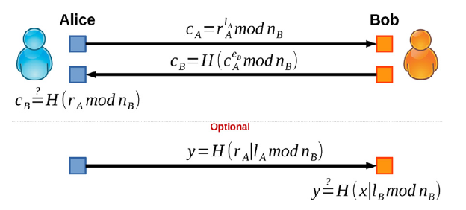
WoM PPT protocol
Alice picks random integer r_{A} of high entropy (say, 1024 bit), computes: c_{A} = r_{A}^{lA} mod n_{B} and sends it to Bob.
Bob computes x = c_{A}^{eB} mod n_{B} and c_{B} = H(x) and sends c_{B} to Alice.
Equality test for Alice: Alice checks whether c_{B}=?H(r_{A} mod n_{B})
  If equality holds, Alice is convinced that l_{A} = l_{B}.
  If not, Alice learns nothing about Bob’s private input.
l_{A} = l_{B}

Slide 35
WoM PPT protocol
l_{A}
\
l_{B}
If users are not in the same location, the protocol exports "no" (nothing more).
No location information is disseminated to the channel or server.

Slide 36
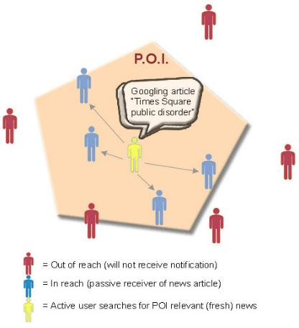
Use case: Incident at Times square
A mobile user installed WoM and authorized app to monitor Google search queries.
User reaches a metro station near Times Square and
hears police sirens along with what appears to be protesters yelling.
The user immediately Googles the query: “Times Square Public Disorder” and
clicks on a news article titled “Protesters against climate change at Times Square. Roads blocked”.
The WoM app privately distribute article to other WoM users in the broader Manhattan area
  relatively close to Times Square and
  have selected “Transportation” (matched using “roads blocked” keywords) and/or “Safety” (matched with “public disorder”) as topics of interest inside WoM’s preferences.

Slide 37
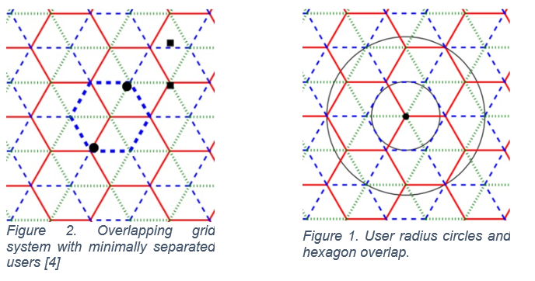
Reducing PPT testing to equality testing
Utilized approach first proposed by Stanford university [4].
There is a gap between the smaller outer edges of a hexagon (due to hexagons not being circular)
  Users can fall into different sub-triangles of a hexagon by moving only infinitesimal distances.
  e.g. borderline users that are relatively close but on different hexagons due to hexagon borders

Slide 38
Reducing PPT testing to equality testing
The region guaranteed not to be in her neighborhood is the complement of a bigger hexagon.
Stanford grid provides the simplest, working solution for eliminating borderline PPT failures.
  Three overlapping grids are required
  Two grids fail in cases when two people arbitrarily near this point but on opposite sides will not be detected as nearby).

Slide 39
References
[1] Kotzanikolaou, Panayiotis, et al. "Lightweight private proximity testing for geospatial social networks." Computer Communications 73 (2016): 263-270.
[2] Sophia Yakoubov, A Gentle Introduction to Yao’s Garbled Circuits, Boston University
[3] Shimon Even, Oded Goldreich, and Abraham Lempel. A randomized protocol for signing contracts. In David Chaum, Ronald L. Rivest, and Alan T. Sherman, editors, CRYPTO’82, pages 205–210. Plenum Press, New York, USA, 1982. (Page 4.).
[4] Narayanan, Arvind, et al. "Location Privacy via Private Proximity Testing." NDSS. Vol. 11. 2011.

