Slide 1


Advertising & Communication Management
IMC Branding Positioning & Consumer Engagement
Polyxeni (Jenny) Palla, PhD

Slide 2
Samsung
Samsung now produces Laptops, cell phones, flat-screen Tv’s
It is ranked 5th in the world in patents behind IBM, Canon, Micron Technology

Slide 3
Samsung Strategy
To reposition its current brand upward
The company’s most well known brand, Sanyo, produced copycat products- cheaper versions of Sony or Mitsubishi products.
Since 1997, the company has changed its image by producing more upscale, top-of-the line offerings.
It is pulling out of big discount chains like Kmart and Wal-mark which focus on price over quality
Moving to Best Buy, Circuit City, and other specialty stores.
While its brands are slightly lower priced than the very top names, the Samsung label is right there with them in quality

Slide 4
Samsung Strategy
The change in image has been supported by changes in advertising and promotion
A camping “DigitalAll: Everyone’s Invited” attempts to position products as exciting, cutting edge and reasonably priced.
The company’s 55 different advertising agencies were consolidated into one.
900$ million was spent on global IMC campaigns in 2002
70$ million of it in the US [including the cost of billboard in New York’s Times Square and a high-profile presence at the Olympic Games Salt Lake City]

Slide 5
Samsung Strategy
https://www.youtube.com/watch?v=CBjwAgu-F0g

Slide 6
Samsung Strategy
The current advertising campaign is designed
to raise awareness
To enhance brand image
The focus of the ads is surreal
Many featuring the snow women – a beautiful women who impacts an expensive and classy feeling to the viewer and hopefully, to the brand.
The ads appear on television, print, and on retail and outdoor billboards

Slide 7
Internet
Internet is a major part of the new IMC program
Sponsorships on 50 major websites such as
Fortune.com
Forbes.com
BusinessWeek.com
CNN.com
Samsung hopes to associate its brand with other well-known, and well-expected brands

Slide 8
Samsung Strategy
Samsung is the second most recognizable consumer electronics brand in the world
Strong player in China, Russia and Korea
Global brand

Slide 9

Samsung Strategy

Slide 10
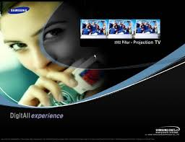

Slide 11
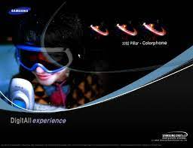
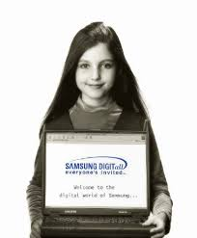
Samsung Strategy

Slide 12
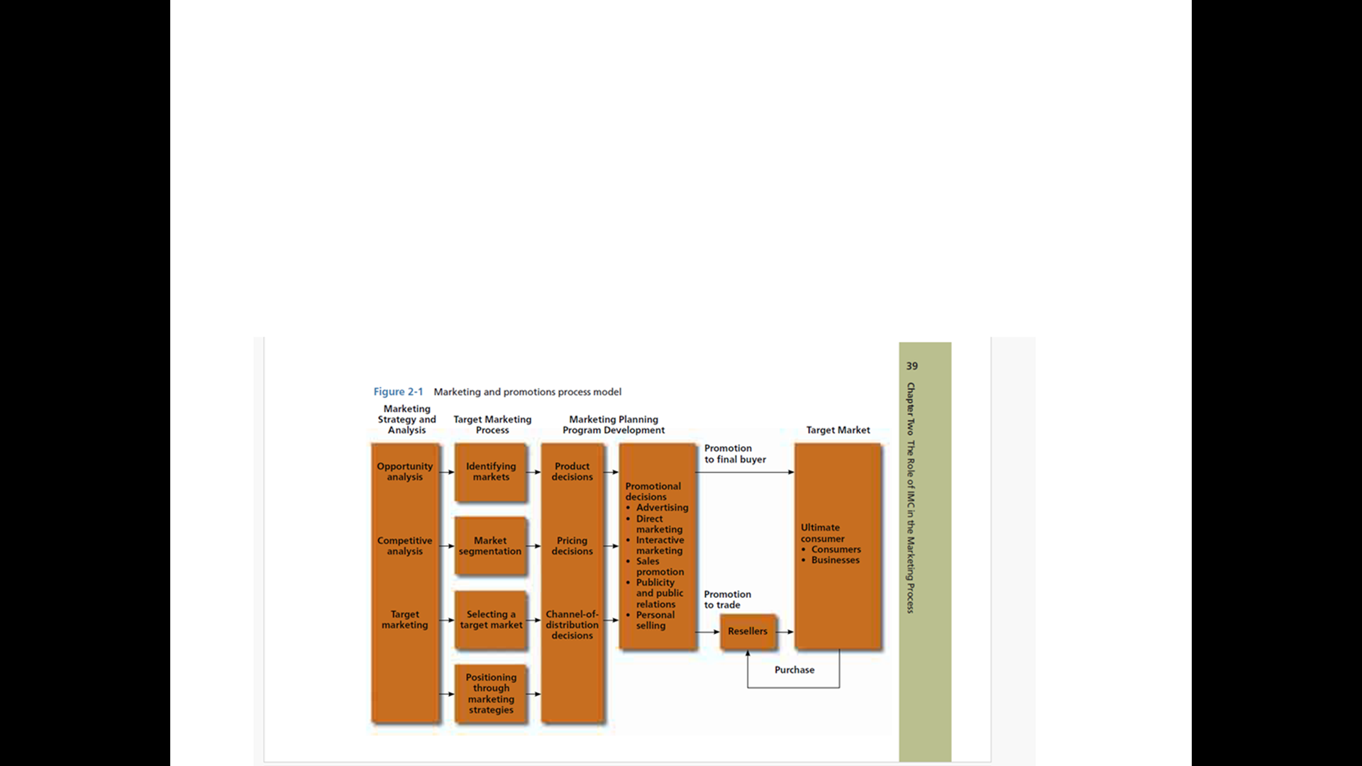
Marketing & Promotions Process Model
Belch & Belch pg 39

Slide 13
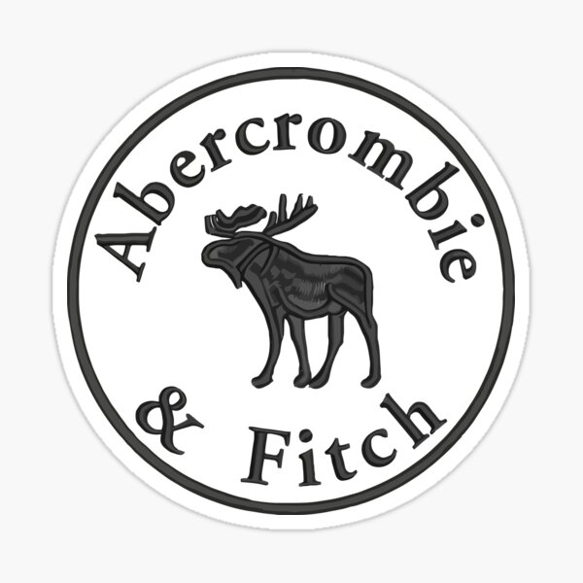
Marketing Strategy & Analysis
Strategic Marketing Plan
To guide allocation of its resources
Evolves from organization’s overall corporate strategy
Serves as a guide for specific marketing programs and policies

Slide 14
A Generic Strategic Approach
Strategy process model: A framework for approaching strategy development
According to McDonald (2003) Marketing Planning is defined as …
  the planned application of marketing resources to achieve marketing objectives… Marketing planning is simply a logical sequence and a series of activities leading to the setting of marketing objectives and the formulation of plans for achieving them

Slide 15
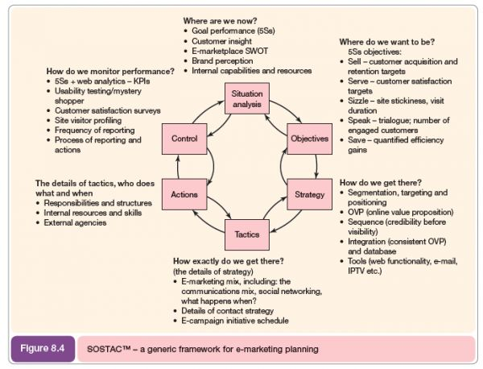
SOSTAC e-MARKETING PLAN
SOSTAC

Slide 16
Sostac – Situation Analysis
Situation Analysis means “where are we now”
  Planning activities involved at this stage include performing
  SWOT analysis,
  PEST analysis,
  Brand perceptions (how do consumers perceive our brand and how are competitors brand)
  consumer analysis,
  competitors
SOSTAC

Slide 17
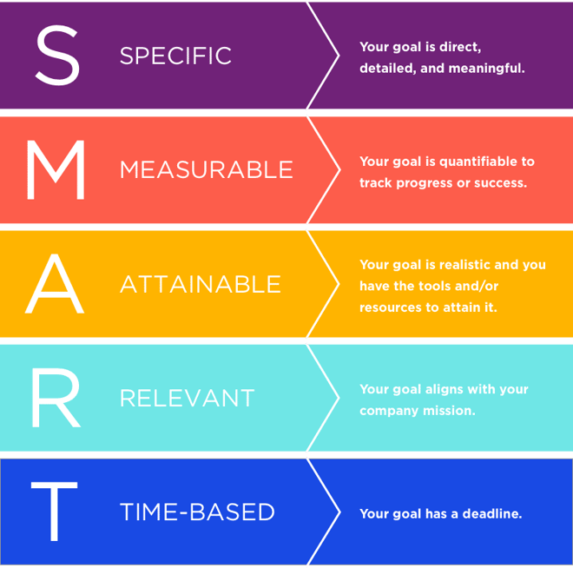
Sostac – Objectives
SOSTAC
Objectives means “where are we now?”
5 S’s objectives
[sell – serve – sizzle – speak -save]

Slide 18
Sostac – Strategy
Strategy means “how do we get there”?
Strategy means how o achieve objectives for the different decision points including
Segmentation, Targeting, Positioning
Value Proposition [VP] & Online Value Proposition [OVP]
Proposition development
Marketing Mix
SOSTAC

Slide 19
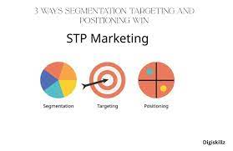
Sostac – Strategy - S-T-P
Segmentation means dividing the whole customer base into different subgroups based on their similar characteristics.
Targeting means deciding which subgroup the company should target to sell its products and services.
Positioning means placing a good image in the minds of customers about the product.
SOSTAC

Slide 20
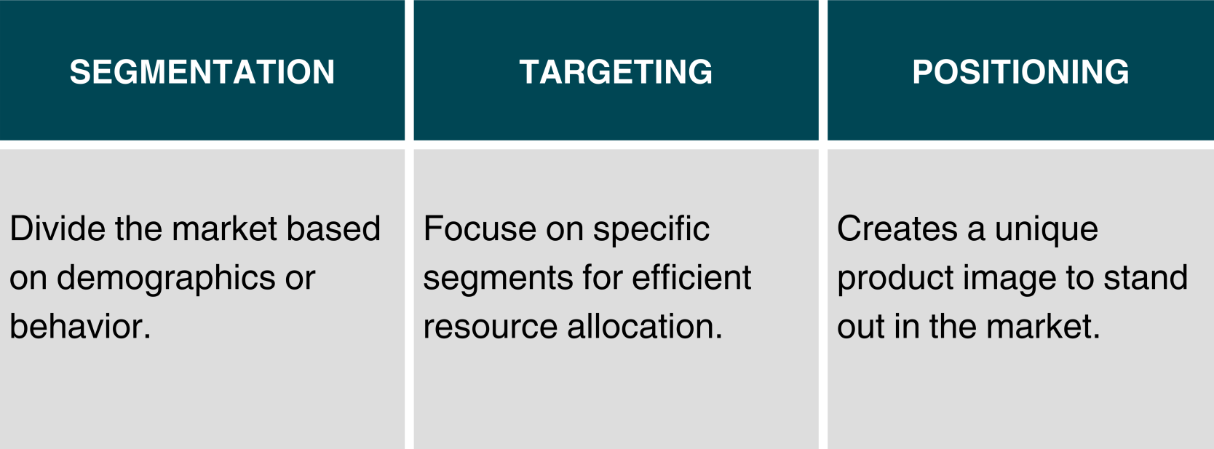
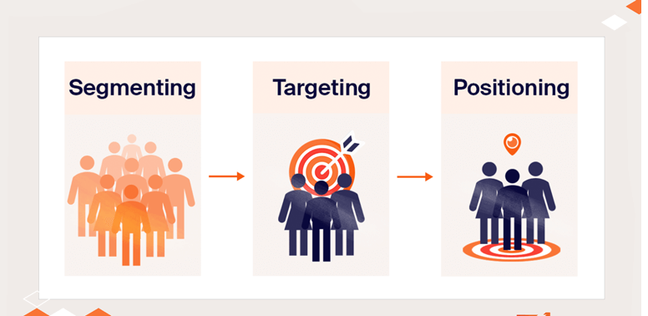
S-T-P
SOSTAC

Slide 21
Value Proposition
A value proposition is a clear statement that explains what benefits a product or service offers, how it solves customers’ problems or satisfies their needs, and what makes it different or better than competitors.
It answers the question:
“Why should customers choose you instead of someone else?”
SOSTAC

Slide 22
Online Value Proposition (OVP)
An online value proposition is the unique set of online benefits a brand provides to attract and retain customers on digital platforms.
It focuses on what makes the online experience (website, app, or digital service) valuable and different from competitors.
It answers the question:
“Why should customers engage with your brand online?”
SOSTAC

Slide 23
Tactics
The usage of tactical digital and non-digital communication tools. Specific details of the marketing mix, eCRM, experience and integration of communication tools
SOSTAC
Responsibilities & structures
Internal resources and skills
External agencies

Slide 24
Actions
Refers to actions plans, change management and project management skills
SOSTAC
Responsibilities & structures
Internal resources and skills
External agencies

Slide 25
Control
The use of management information including web analytics to assess whether strategic and tactical objectives are achieved and how improvements can be made to enhance results further
This stage enables at the objective setting for the following time period
SOSTAC

Slide 26
Strategic Approach in Advertising & IMC
Perspective strategy:
Strategic Analysis + Strategic Development + Strategy Implementation
Are linked together sequentially
Are interrelated and are developed together
Strategic Windows:
An emergent strategy approach is essential in a highly dynamic technology environment as this should enable organizations to respond to sudden environmental changes which can open strategic windows.
Strategic windows may occur through changes such as introduction of new technology eg AI.
Advertisers should take under consideration the danger in creating a responsive capability for technology in evaluating the significance of new approaches such as –privacy issues-which may degrade the overall customer experience

Slide 27

Example Strategy: VP -OVP

Slide 28
Starbucks Value Proposition
Starbucks’ value proposition centers on offering more than just coffee — it’s about delivering a premium coffee experience, personal connection, and a comfortable atmosphere that makes customers feel valued.
SOSTAC

Slide 29

Starbucks Value Proposition Statement
“To inspire and nurture the human spirit – one person, one cup, and one neighborhood at a time.”
Ad slogan “It starts with you”
Key Elements of Starbucks’ Value Proposition:
High-quality coffee and beverages made from ethically sourced ingredients.
Personalized customer experience (e.g., customized drinks, barista interaction).
Comfortable, community-focused spaces (“your third place” between home and work).
Strong brand identity associated with sophistication, relaxation, and social connection.
SOSTAC
https://www.youtube.com/watch?v=u3ybWiEUaUU

Slide 30
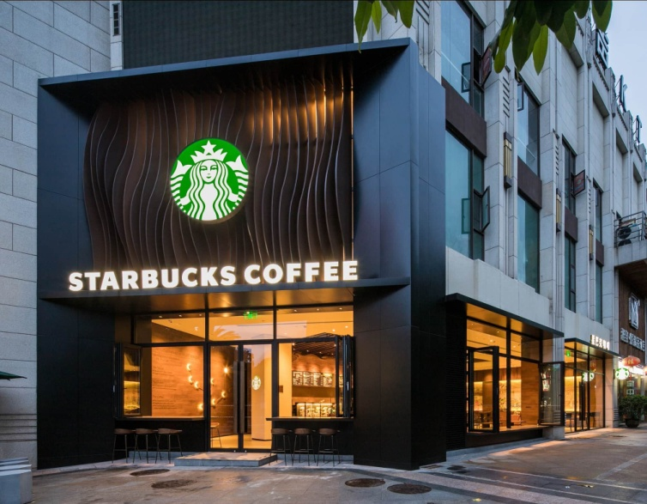
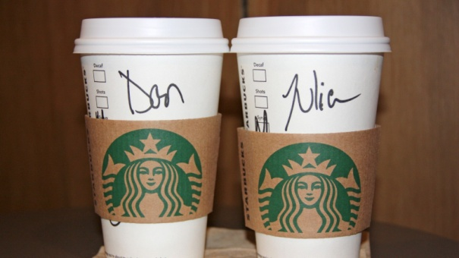
Starbucks Value Proposition Example
“When a customer walks into Starbucks, they’re not just buying a latte — they’re buying
a moment of comfort,
a sense of belonging, and
a consistent global experience
Slogan
“Every table has a story”
SOSTAC
https://www.youtube.com/watch?v=o-Ikkh5oxuo

Slide 31
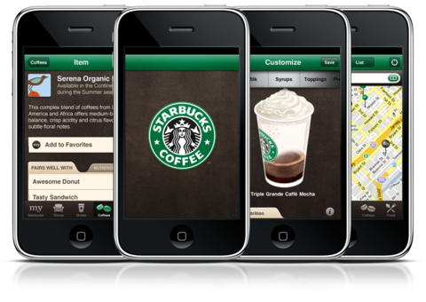
Starbucks On line Value Proposition
Starbucks’ online value proposition highlights the
digital convenience,
personalization, and
rewards
it offers customers through its online and mobile platforms.
SOSTAC

Slide 32
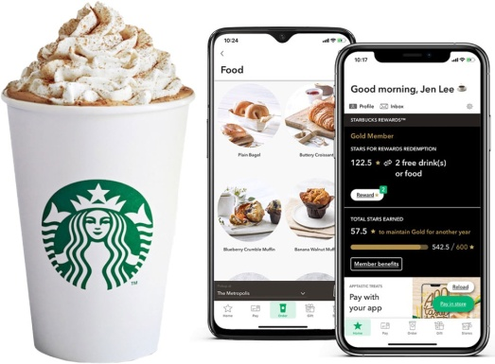
Starbucks On line Value Proposition Statement
“Order and pay ahead, earn rewards, and enjoy a personalized coffee experience anytime, anywhere.”
Starbucks Rewards App: Earn points (“Stars”), get free drinks, and access exclusive offers.
Mobile Ordering & Payment: Skip the line and pick up your order conveniently.
Personalized Recommendations: Tailored offers and product suggestions based on purchase history.
Digital Engagement: Interactive promotions, seasonal campaigns, and social media storytelling.
SOSTAC

Slide 33
Starbucks On line Value Proposition Statement- IMC
User friendly design
Engage loyalty program
Mobile pay and ordering
Integration with other platforms and services

Slide 34
Starbucks On line Value Proposition Statement- IMC
Instant Location Awareness
  A feature that leads to app successfulness is the location-based experience. The location-enabled mobile app improve speed and accuracy in drive-thru pickups. Less balking (people not ordering because of long wait times) and, as a result, more transactions.
“User Experience” Design Engineering (UX)
  For both drive-through and in-store ordering.
Customer Insights Via AI
  With a loyalty program-driven app comes lots and lots of customer data. Using AI and machine learning, Starbucks creates automated personalized incentives, pushes new products, and influences consumer habits.

Slide 35
Starbucks
Starbucks added personalization elements that allow app to recall your favourite order, suggest food items might pair well and suggest where you’d like to pick it up
Using the Geo-location feature, a user can see
The closet Starbucks location, the menu at each location, place an order and be ready upon arrival
Rewarding program
The innovative feature of the Starbucks app is giving the user a similar experience to visiting the store

Slide 36
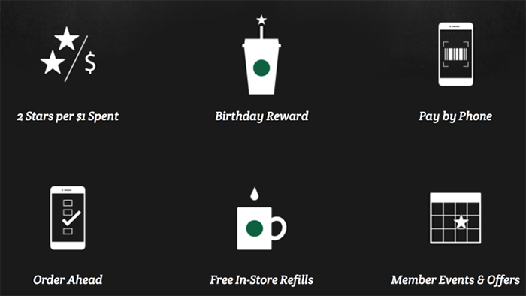
Starbucks Rewards online Loyalty Program
A prime example of how to get customer to utilize a mobile app

Slide 37
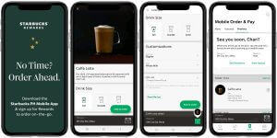
Starbucks’ Mobile App Makes Online Ordering and Paying Easy
Starbucks’ Mobile Order and Pay allows users to order and pay in the way that is most convenient for them — which encourages greater sales.
The mobile ordering system acts as a digital marketing tool,
Coupled with notifications from the app or email blasts, Starbucks creates interest in new menu items long before the customer arrives in the store.
Starbucks also enabled orders via Amazon’s Alexa, and the feature has also been integrated into Ford vehicles.
The coffee chain also expanded its My Starbucks barista, a feature integrated into the Starbucks app, which allows customers to order via voice command or messaging. The goal was to boost speed and convenience.
In-store payments through the app, Apple Pay, Google Pay,
For iOS users, the app integrates with the Apple Watch

Slide 38
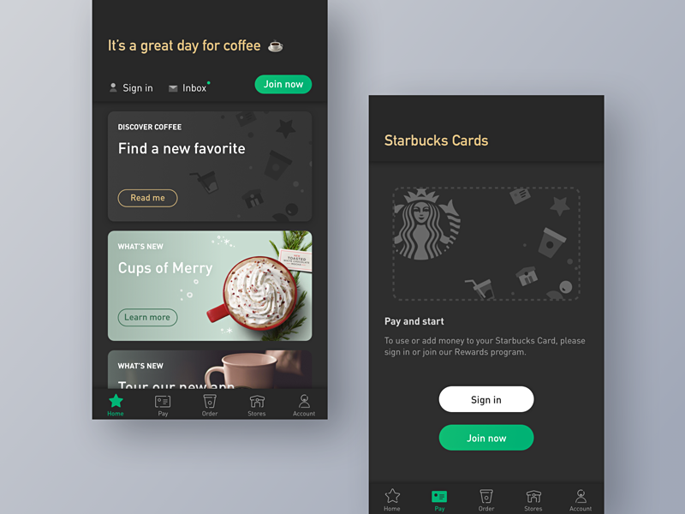
Starbucks On line Value Proposition- Example
A customer uses the Starbucks app to order their favorite drink, pays digitally, and earns rewards — all while being notified of a new pumpkin spice offer.
This creates
digital convenience + loyalty reinforcement.

Slide 39
Starbucks
Starbucks’ value proposition centers on offering more than just coffee —
it’s about delivering a
premium coffee experience,
personal connection &
comfortable atmosphere
that makes customers feel valued.
SOSTAC
vs
Starbucks’ online value proposition highlights the
digital convenience,
personalization, and
rewards
it offers customers through its online and mobile platforms.

Slide 40
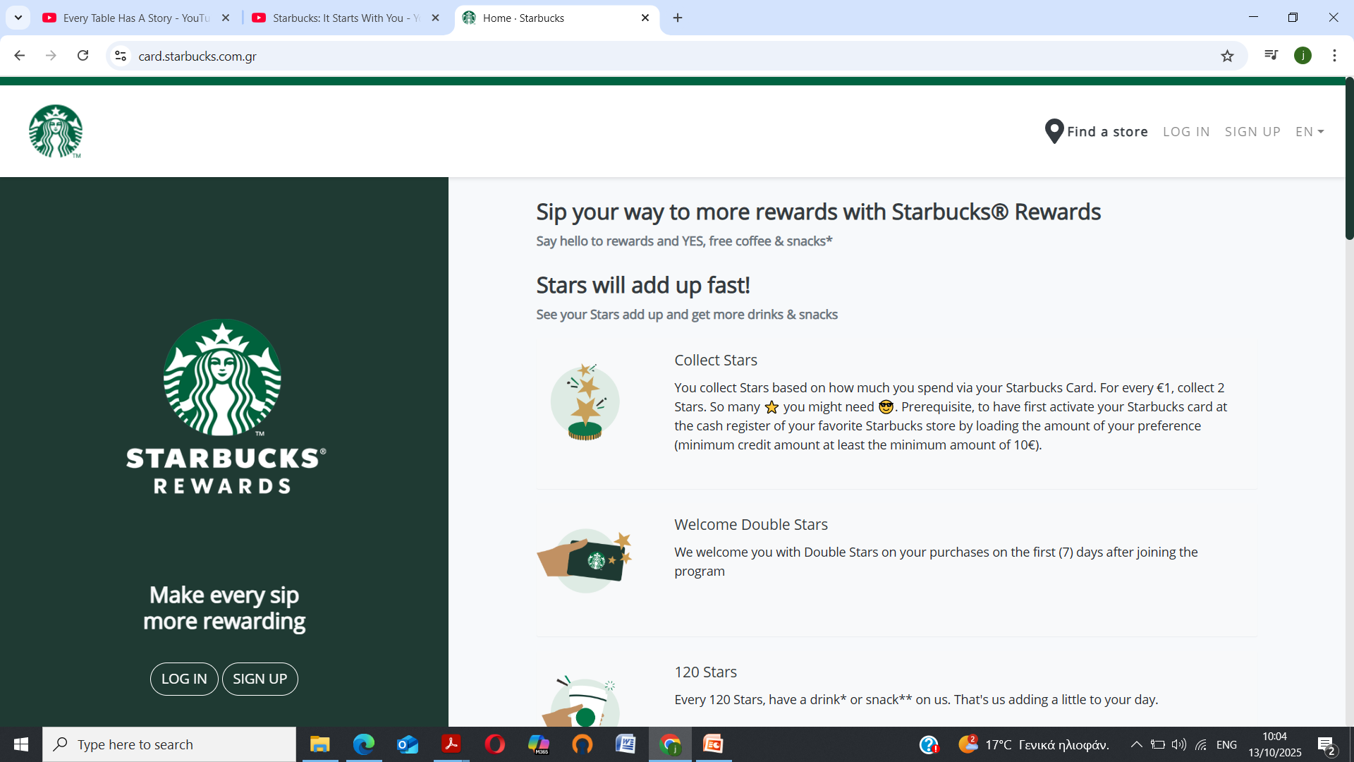
Website

Slide 41
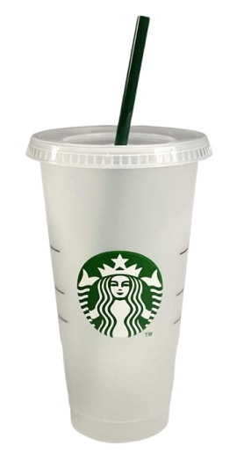
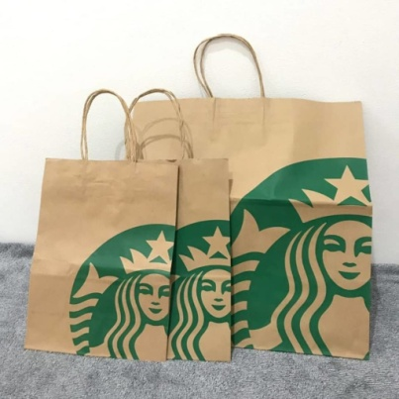
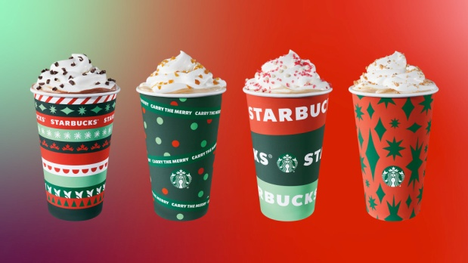

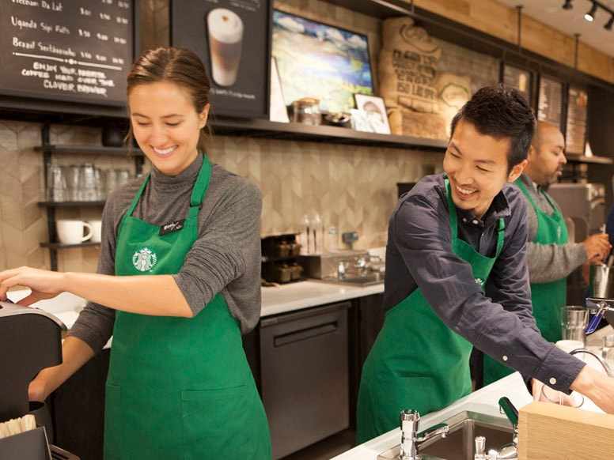
IMC

Slide 42

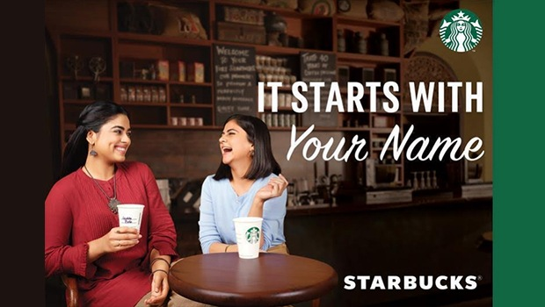

Slide 43
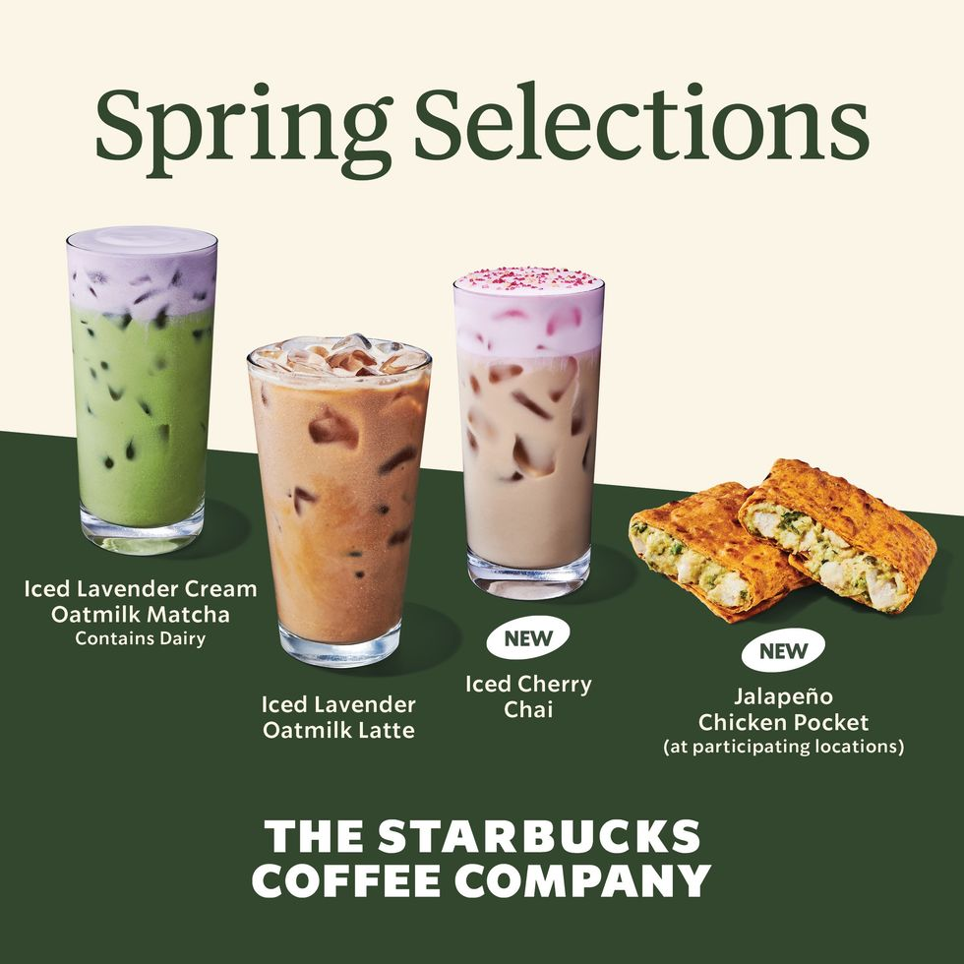

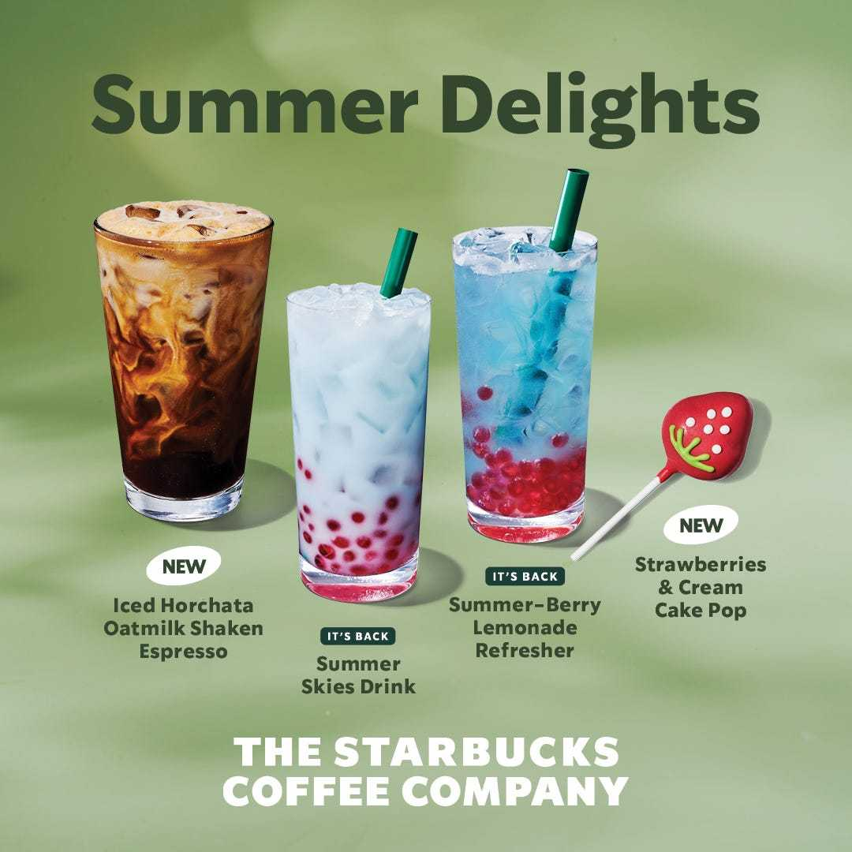

Slide 44
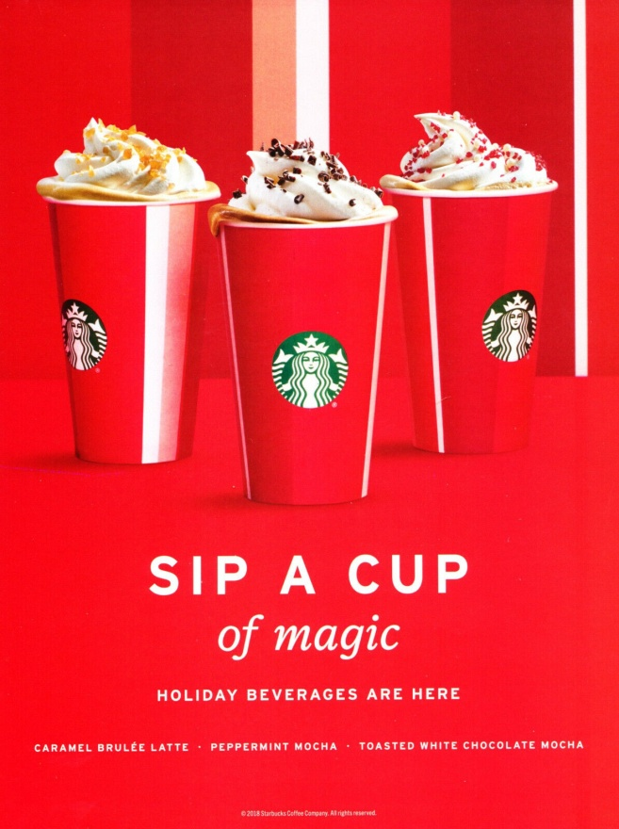
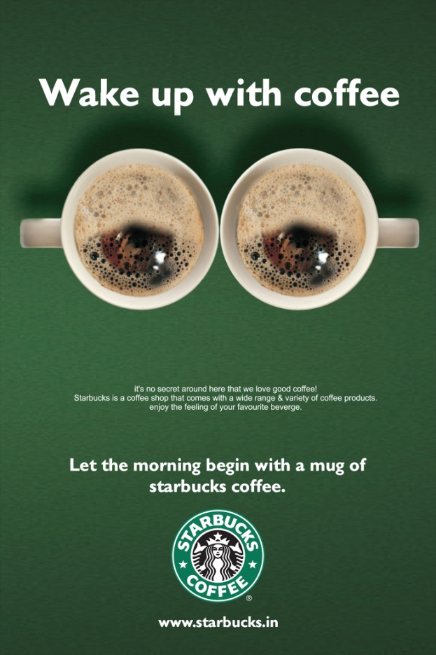
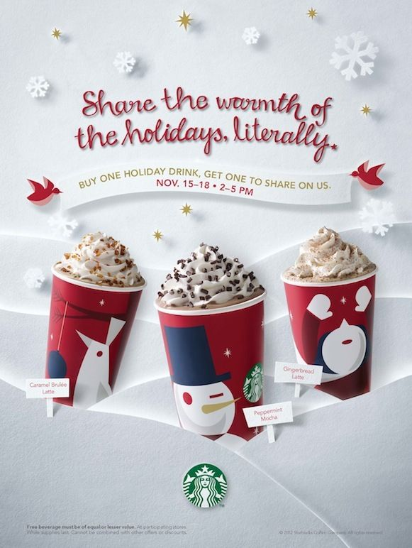

Slide 45
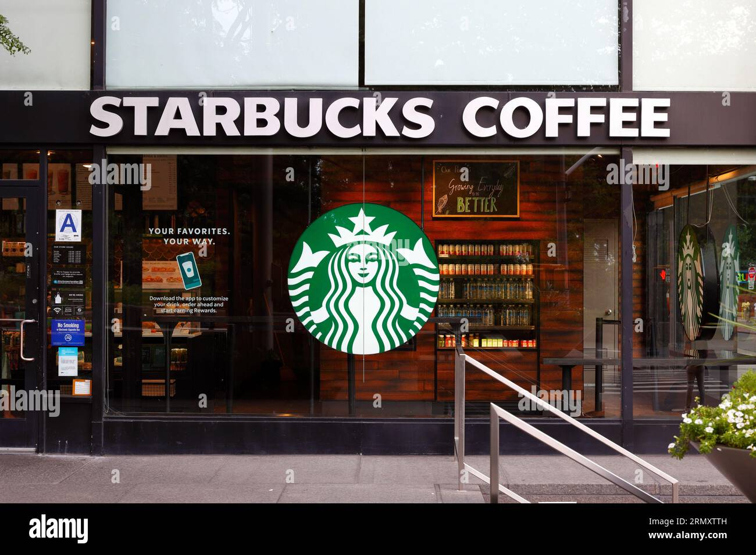
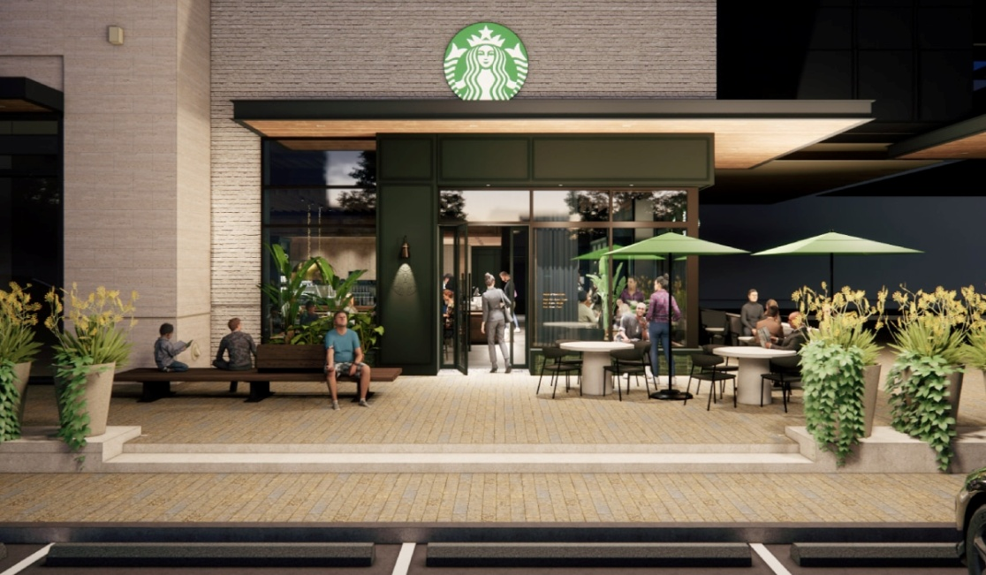
Giving guests a comfortable space between their home and workplace [the 3rd place]

Slide 46
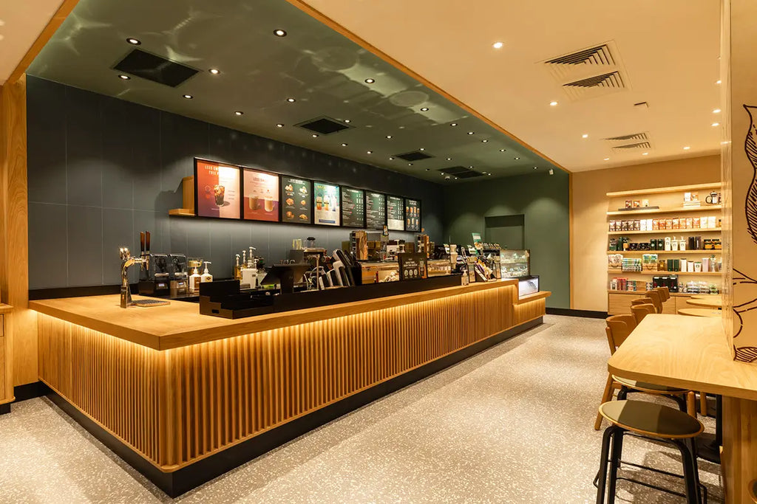
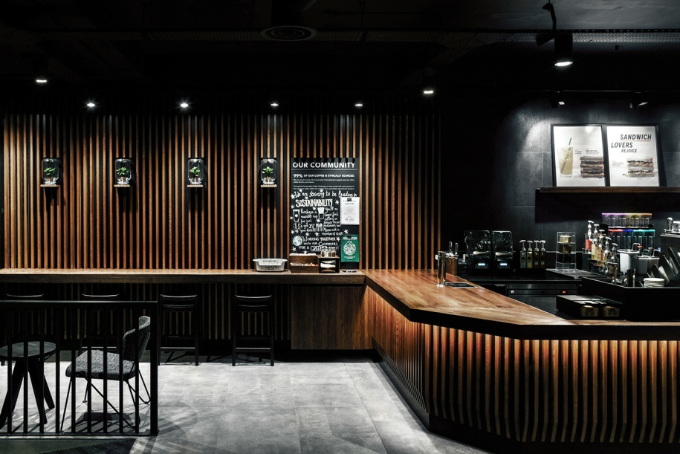
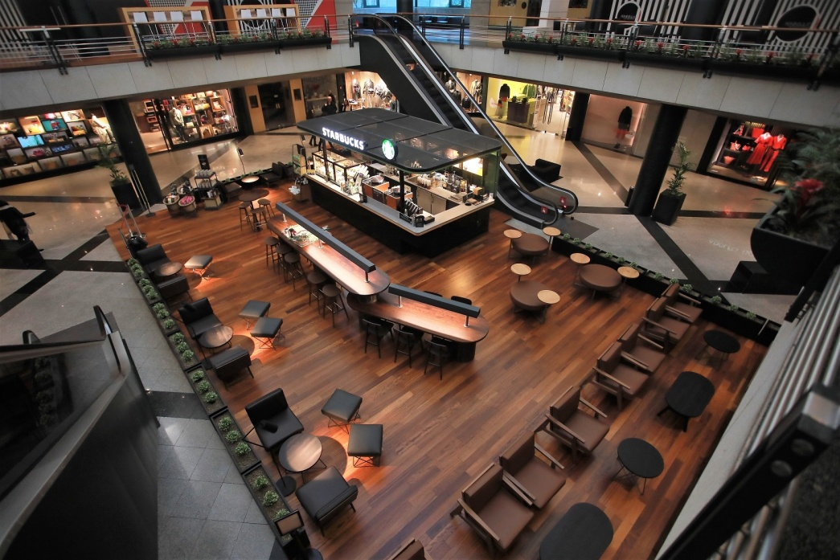

Slide 47
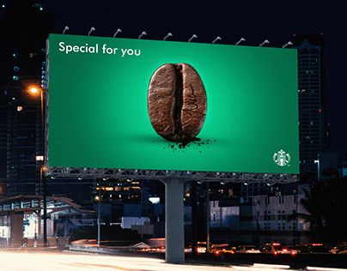
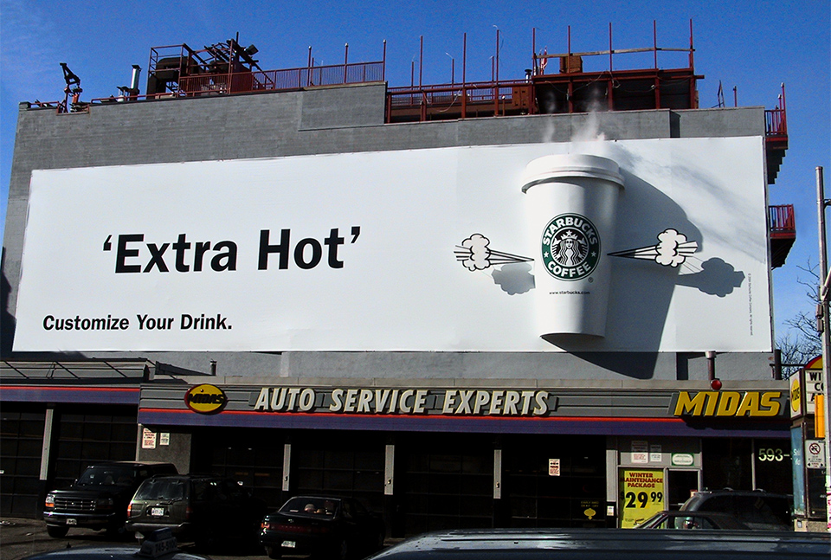
Starbucks Outdoor Ads

Slide 48
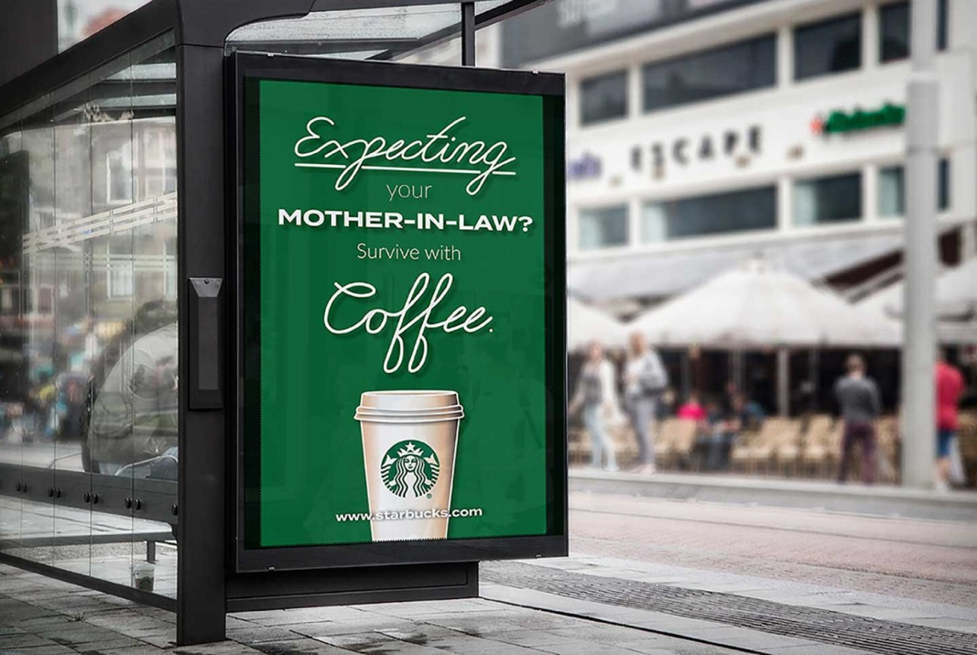
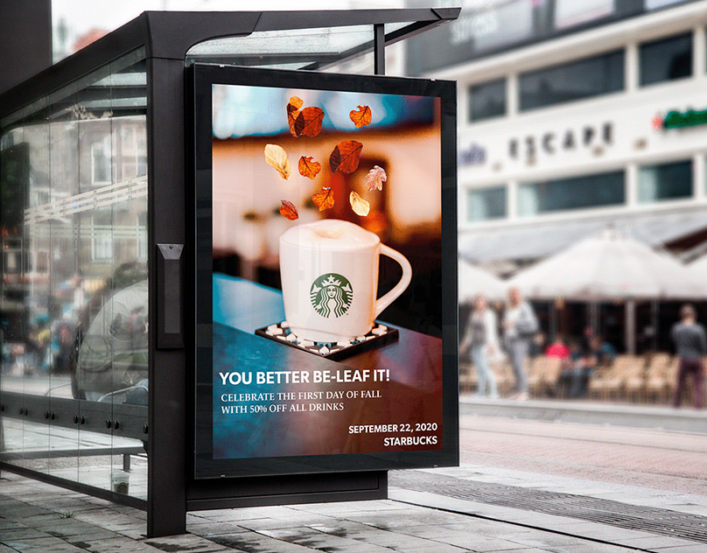

Slide 49
Marketing Strategy & Analysis
Strategic Marketing Plan
Opportunity Analysis
Competitive Analysis
Target Market Selection
Identifying Markets
Market Segmentation
Selecting A Target Market
Market Positioning

Slide 50
Marketing Strategy & Analysis
Strategic Marketing Plan
Opportunity Analysis
Competitive Analysis
Target Market Selection
Identifying Markets
Market Segmentation
Selecting A Target Market
Market Positioning

Slide 51
Marketing Strategy & Analysis
Opportunity Analysis
A careful analysis of the marketplace should lead to alternative market opportunities for
  existing product lines in current markets
  new products for current markets or
  new products for new markets
Market opportunities
Areas where there are favorable demand trends,
where the company believes customer needs and opportunities are not being satisfied, and where it can compete effectively.

Slide 52
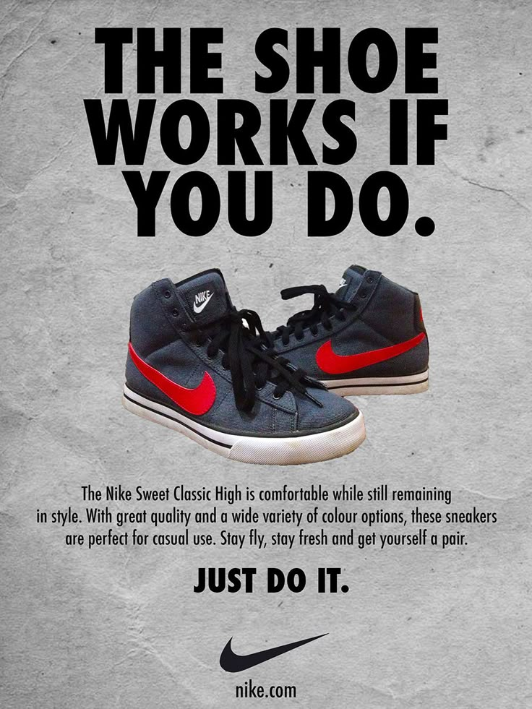
Market opportunities
For example, the number of people who exercise has increased in recent years, and the market for athletic footwear has reached over $13.5 billion.
Athletic-shoe companies such as Nike, Reebok, and others see the shoe market as an opportunity to broaden their customer base both domestically and internationally.
To capitalize on this growth, some companies spend millions of dollars on advertising alone. In 2001 New Balance spent “only” $13 million, Reebok spent $49 million and Nike spent over $155 million.
All told, athletic-footwear companies spent over $5.9 billion on advertising and celebrity endorsements in 2001.
Changes in lifestyles have seen changes in the market for trail, running, basketball, and “lifestyle” shoes such as slip-ons

Slide 53
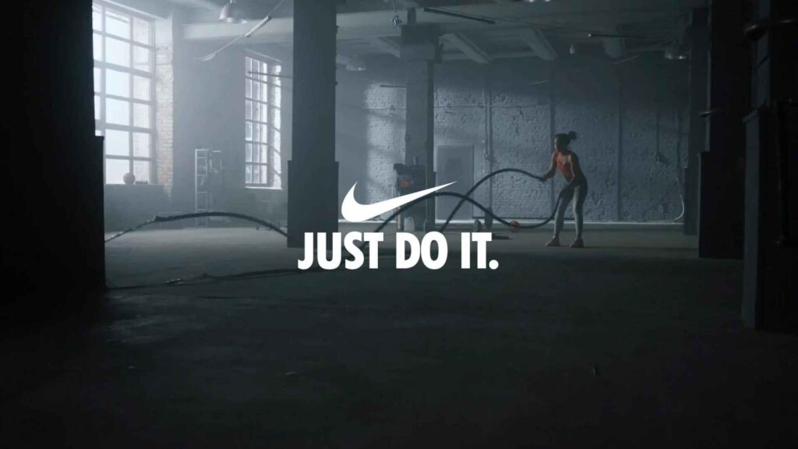
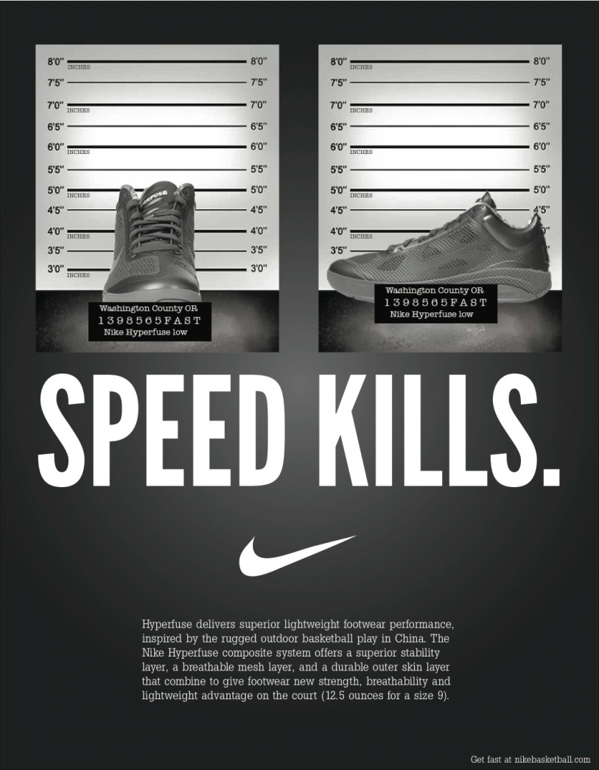
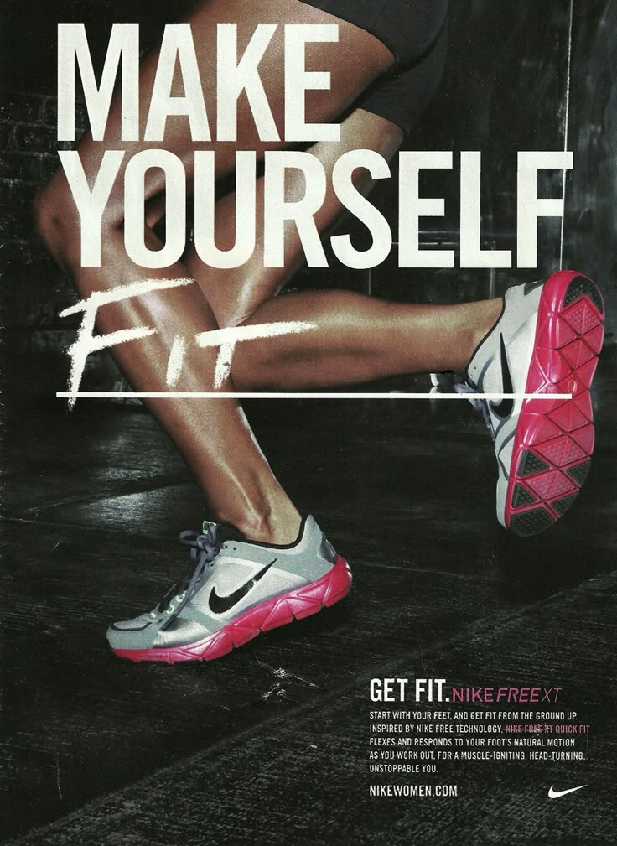
.,

Slide 54
Market Identification
A company usually identifies market opportunities by carefully examining the marketplace and noting demand trends and competition in various market segments.
A market can rarely be viewed as one large homogeneous group of customers; rather, it consists of many heterogeneous groups, or segments.
In recent years, many companies have recognized the importance of tailoring their marketing to meet the needs and demand trends of different market segments.
For example, different market segments in the personal computer (PC) industry include the home, education, science, and business markets.
These segments can be even further divided.
The business market consists of both small companies and large corporations; the education market can range from elementary schools to colleges and universities.
A company that is marketing its products in the auto industry must decide in which particular market segment or segments it wishes to compete.
This decision depends on the amount and nature of competition the brand will face in a particular market.

Slide 55
Marketing Strategy & Analysis
Strategic Marketing Plan
Opportunity Analysis
Competitive Analysis
Target Market Selection
Identifying Markets
Market Segmentation
Selecting A Target Market
Market Positioning

Slide 56
Competitive Analysis
In developing the firm’s marketing strategies and plans for its products and services, the manager must carefully analyze the competition to be faced in the marketplace.
This may range from direct brand competition (which can also include its own brands) to more indirect forms of competition, such as product substitutes

Slide 57
Competitive advantage
An important aspect of marketing strategy development is the search for a competitive advantage, something special a firm does or has that gives it an edge over competitors.
Ways to achieve a competitive advantage include
having quality products that command a premium price,
providing superior customer service,
having the lowest production costs and lower prices, or
dominating channels of distribution.
Competitive advantage can also be achieved through
advertising that creates and maintains product differentiation and brand equity, an example of which was the long-running advertising campaign for Michelin tires, which stressed security as well as performance.
For example, the strong brand images of Colgate toothpaste, Campbell’s soup,
Nike shoes, Kodak, and McDonald’s give them a competitive advantage in their respective markets

Slide 58
Marketing Strategy & Analysis
Strategic Marketing Plan
Opportunity Analysis
Competitive Analysis
Target Market Selection
Identifying Markets
Market Segmentation
Selecting A Target Market
Market Positioning

Slide 59
Target Market Selection
After evaluating the opportunities presented by various market segments, including a detailed competitive analysis, the company may select one, or more, as a target market.

Slide 60
Target Market Selection
Identifying Markets
When employing a target marketing strategy, the marketer identifies the specific needs of groups of people (or segments), selects one or more of these segments as a target, and develops marketing programs directed to each.
Target market identification isolates consumers with similar lifestyles, needs, and the like, and increases our knowledge of their specific requirements. The more marketers can establish this common ground with consumers, the more effective they will be in addressing these requirements in their communications programs and informing and/or persuading potential consumers that the product or service offering will meet their needs.

Slide 61
Marketing Strategy & Analysis
Strategic Marketing Plan
Opportunity Analysis
Competitive Analysis
Target Market Selection
Identifying Markets
Market Segmentation
Selecting A Target Market
Market Positioning

Slide 62
Market Segmentation
Market segmentation is “dividing up a market into distinct
groups that (1) have common needs and (2) will respond similarly to a marketing action.”
The segmentation process involves five distinct steps:
1. Finding ways to group consumers according to their needs.
2. Finding ways to group the marketing actions—usually the products offered—
available to the organization.
3. Developing a market-product grid to relate the market segments to the firm’s products
or actions.
4. Selecting the target segments toward which the firm directs its marketing actions.
5. Taking marketing actions to reach target segments.

Slide 63
Market Segmentation – Bases for Segmentation
Geographic Segmentation: markets are divided into different geographic units. These units may include nations, states, counties, or even neighborhoods.
Demographic Segmentation: variables such as age, sex, family size, education, income, and social class is called demographic segmentation.
Psychographic Segmentation :Dividing the market on the basis of personality and/or lifestyles is referred to as psychographic segmentation. While there is some disagreement as to whether personality is a useful basis for segmentation, lifestyle factors have been used effectively. Many consider lifestyle the most effective criterion for segmentation.

Slide 64
Psychographic segmentation has been increasingly accepted with the advent of the values and lifestyles (VALS) program. Although marketers employed lifestyle segmentation long before VALS
Developed by the Stanford Research Institute (SRI), VALS has become a very popular method for applying lifestyle segmentation. VALS 2 divides Americans into eight lifestyle segments that exhibit distinctive attitudes, behaviors, and decision-making patterns
education, income, health, energy level, self-confidence, and degree of consumerism

Slide 65
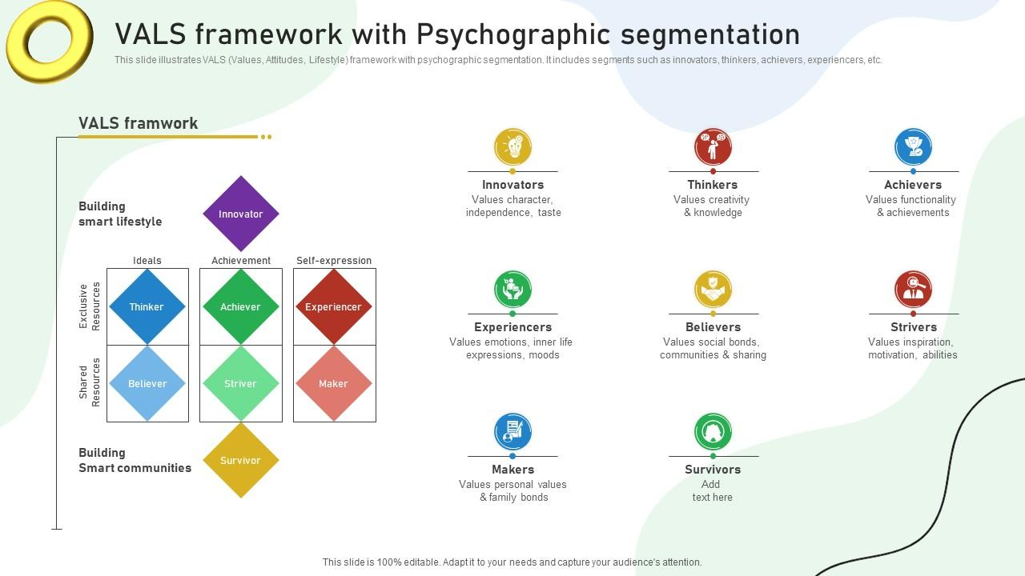

Slide 66
Behavioristic Segmentation
Dividing consumers into groups according to their usage, loyalties, or buying responses to a product is behavioristic segmentation.
A profile (demographic or psychographic) of the user is developed, which serves as the basis for promotional strategies designed to attract new users.
For example, teenagers share certain similarities in their consumption behaviors.

Slide 67
Benefit Segmentation In purchasing products, consumers are generally trying to satisfy specific needs and/or wants. They are looking for products that provide specific benefits to satisfy these needs. The grouping of consumers on the basis of attributes sought in a product is known as benefit segmentation and is widely used

Slide 68
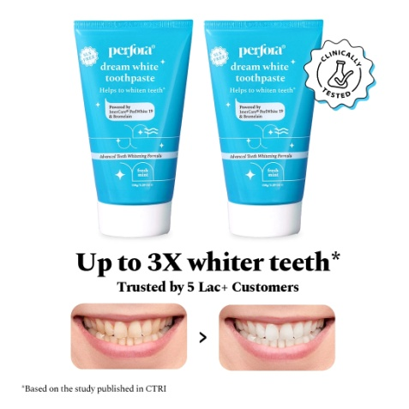
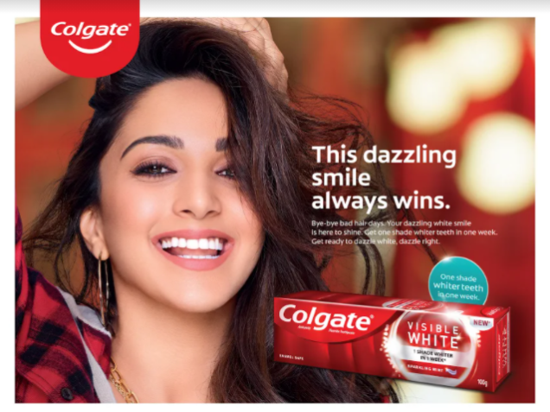
Benefit segmentation – example
Another example of benefit segmentation can be seen in the toothpaste market.
Some consumers want
a product with fluoride (Crest, Colgate);
others prefer one that freshens their breath (Close-Up, Aqua-Fresh).
offer tartar control (Crest) and
plaque reduction (Viadent). The Den-Mat Corp. introduced
Rembrandt whitening toothpaste for consumers who want whiter teeth,
and other brands followed with their own whitening attributes.

Slide 69
Marketing Strategy & Analysis
Strategic Marketing Plan
Opportunity Analysis
Competitive Analysis
Target Market Selection
Identifying Markets
Market Segmentation
Selecting A Target Market
Market Positioning

Slide 70
Marketing Strategy & Analysis
Strategic Marketing Plan
Opportunity Analysis
Competitive Analysis
Target Market Selection
Identifying Markets
Market Segmentation
Selecting A Target Market
Market Positioning

Slide 71
Selecting a Target Market
(1) determining how many segments to enter and
(2) determining which segments offer the most potential.

Slide 72
Selecting a Target Market
(1) determining how many segments to enter
Undifferentiated marketing involves ignoring segment differences and offering just one product or service to the entire market.
Differentiated marketing involves marketing in a number of segments, developing separate marketing strategies for each.
Concentrated marketing, is used when the firm selects one segment and attempts to capture a large share of this market.

Slide 73

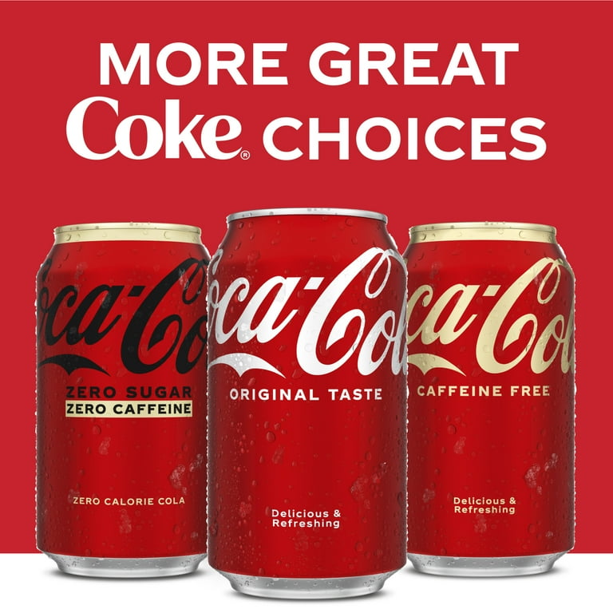
Selecting a Target Market
(2) determining which segments offer the most potential
The second step in selecting a market involves determining the most attractive segment.
The firm must examine the sales potential of the segment, the opportunities for growth, the competition, and its own ability to compete.
Then it must decide whether it can market to this group.
For example, Royal Crown (RC) Cola has often been quite successful in identifying new segment opportunities but because of limited resources has been less able to capitalize on them than Coke and Pepsi.
RC was the first to bring to market diet colas and caffeine-free colas, but it has not been able to establish itself as a market leader in either market.

Slide 74
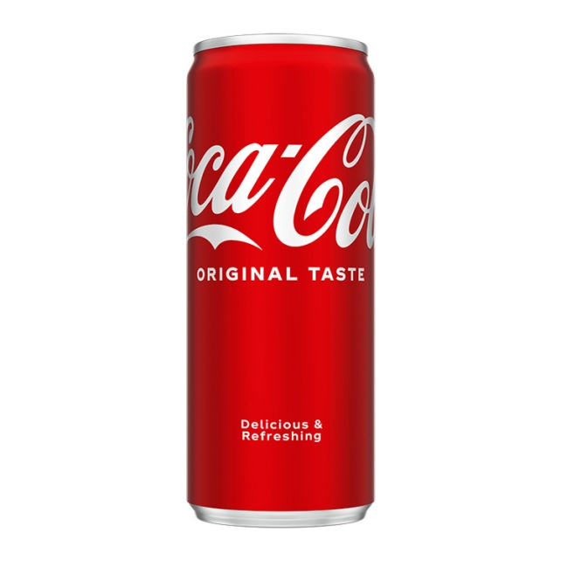
Undifferentiated marketing

Slide 75
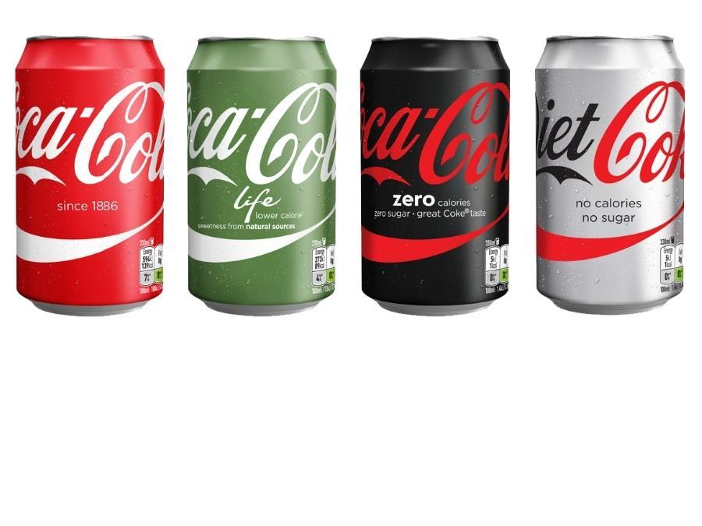
Differentiated marketing

Slide 76
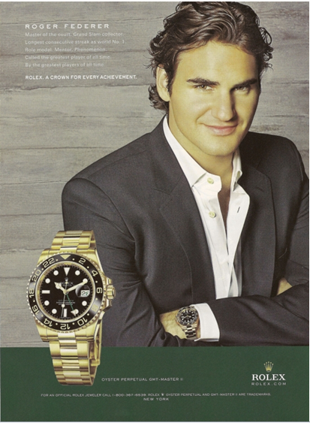
Concentrated marketing

Slide 77
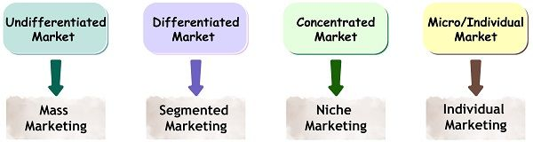
Selecting A Target Market

Slide 78
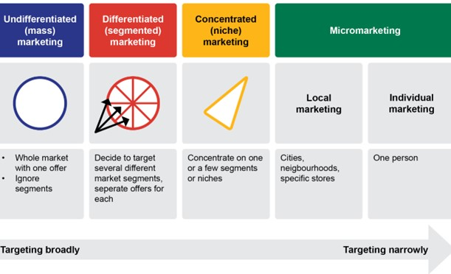
Selecting A Target Market

Slide 79
Marketing Strategy & Analysis
Strategic Marketing Plan
Opportunity Analysis
Competitive Analysis
Target Market Selection
Identifying Markets
Market Segmentation
Selecting A Target Market
Market Positioning

Slide 80
Market Positioning
Positioning has been defined as “the art and science of fitting the product or service to one or more segments of the broad market in such a way as to set it meaningfully apart from competition.”
As you can see, the position of the product, service, or even store is the image that comes to mind and the attributes consumers perceive as related to it.
This communication occurs through the message itself, which explains the benefits, as well as the media strategy employed to reach the target group.

Slide 81
Market Positioning
Take a few moments to think about how some products are positioned and how their positions are conveyed to you.
What comes to your mind when you hear their name?
What about their stores and their websites?
Think of their ads. Are their approaches different from their competitors? When and where are these ads shown?
Nike
Adidas
McDonalds
BMW
Apple

Slide 82
Market Positioning
The most important factor in establishing a brand in the marketplace.
Thus, positioning, relates to the image of the product and/or brand relative to competing products or brands. The position of the product or brand is the key factor in communicating the benefits it offers and differentiating it from the competition.

Slide 83
Developing a Positioning Strategy
1. What position, if any, do we already have in the prospect’s mind? (This information must come from the marketplace, not the managers’ perceptions.)
2. What position do we want to own?
3. What companies must be outgunned if we are to establish that position?
4. Do we have enough marketing money to occupy and hold the position?
5. Do we are strong enough to stick with one consistent positioning strategy?
6. Does our creative approach match our positioning strategy?

Slide 84
Positioning Strategies
Aaker and J. Gary Shansby discuss six such strategies: positioning by
product attributes,
price/quality,
use,
product class,
users,
and competitor.
positioning by cultural symbols [proposed by Aaker and Myers]

Slide 85
Positioning by Product Attributes and Benefits
A common approach to positioning is setting the brand apart from competitors on the basis of the specific characteristics or benefits offered.
Sometimes a product may be positioned on more than one product benefit.
Marketers attempt to identify salient attributes (those that are important to consumers and are the basis for making a purchase decision).
For example, when Apple first introduced its computers, the key benefit stressed was ease of use—an effective strategy, given the complexity of computers in the market at that time.

Slide 86

Positioning by Price/Quality
Price/quality characteristics to position their brands.
Employ ads that reflect the image of a high quality brand where cost, while not irrelevant, is considered secondary to the quality benefits derived from using the brand.
[Premium brands positioned at the high end employ this approach]

Slide 87

Positioning by Use or Application
is to associate it with a specific use or application.
Black & Decker Snakelight: an innovative solution to the problem of trying to hold a flashlight while working

Slide 88

Positioning by Product Class
Rather than positioning against a competitive brand,
Position against another product category

Slide 89

Positioning by Product User
Product associating it with a particular user

Slide 90


Positioning by Competitor
An effective positioning strategy for a product/brand may focus on specific competitors
https://www.youtube.com/watch?v=zMFuPbUQBPQ

Slide 91



Positioning by Cultural Symbols
cultural symbols are used to differentiate brands

Slide 92
The Role of Advertising & Promotion
Tools of promotion such as advertising, sales promotion, direct marketing, publicity/public relations, and personal selling are employed to inform consumers about their products, their prices, and places where the products are available.
All tools / promotional –mix variables must work together to achieve an integrated marketing communications program.
The development and implementation of an IMC program is based on a strong foundation that includes market analysis, target, marketing and positioning, and coordination of the various marketing-mix elements.

Slide 93
Bibliography
Belch, G. E., & Belch, M. A. (2021). Advertising and promotion: An integrated marketing communications perspective 6th. New York: McGraw-Hill.
Laudon K & Traver C. (2021). E-Commerce 2021-2022 Business, Technology and Society, 17th Global Edition

